Slide 1
Google Data Analytics Certificate Capstone Project
FitBit Wellness Device Usage Analysis
Bellabeat Leaf Chakra Device - Marketing Strategy Recommendations
Terence Lake
April 2022

Slide 2
Objective
Daily | Steps | Distance miles | Activity minutes | Calories
Minimum | - | - | - | -
Maximum | 36,019 | 28.0 | 552 | 4,900
Mean | 7,638 | 5.5 | 228 | 2,304
Median | 7,406 | 5.2 | 247 | 2,134
Analyze non-Bellabeat smart device usage for insights to drive Bellabeat Leaf Chakra marketing, growth strategy
Data Set
FitBit Fitness Tracker Data of 18 csv files from Kaggle public domain
33 Anonymous, Volunteer Users
31 Day Period: 4/12/16 – 5/12/16
Wellness Statistics
Activity Intensity
Calories Burned
Heart Rate
Sleep
Weight/BMI
Daily | Sleep minutes | Heart Rate bpm | Weight kg | BMI
Minimum | 58 | 36 | 52.6 | 21.5
Maximum | 796 | 203 | 133.5 | 47.5
Mean | 419 | 77 | 72.0 | 25.2
Median | 433 | 73 | 62.5 | 24.4

Slide 3
FitBit Device User Data Overview
Usage Insight #1
Not all FitBit Users monitor all health and wellness statistics
100% of participants in the study monitor Activity (and associated calories burned) but participation levels fall for other vital statistics
73% monitor Sleep
42% monitor Heart Rate
24% monitor Weight and BMI

Slide 4
FitBit Activity Comparison by Monitored Statistic
215
Usage Insight #2
Users who monitored their Heart Rate and BMI engaged in more daily activity than those who did not.
Those who monitored Sleep engaged in less daily activity than those who did not.
Stat Monitored % Change
Heart Rate vs Not + 13%
BMI vs Not + 19%
Sleep vs Not - 12%

Slide 5
FitBit Use Level
Usage Insight #3
Even though 100% of Users monitored Activity, the number of days those activities were monitored varied by User
Use Level by Number of Users
Full: 31 days 21
Hi: 29 - 30 days 5
Lo: 18 - 20 days 3
Med: 26 - 28 days 3
Very Lo: 4 days 1

Slide 6
FitBit Daily Average Activity Intensity by Use Level
Usage Insight #4
Although most Activity Intensity is Light regardless of Use Level, the higher Use Levels exercise more efficiently (less time overall, greater intensity)
Use Level | Hi Intensity %
Lo: 18 – 20 days | 10%
Med: 26 – 28 days | 11%
Full: 31 days | 15%
Hi: 29 – 30 days | 23%
Very Lo: 4 days | 2%

Slide 7
FitBit Total Minutes of Activity by Day of Week
Usage Insight #5
Users engaged in the least amount of Activity on Sunday
Moderately increased Activity on Monday (9%)
Dramatically increased Activity on Tuesday (30%) – the highest activity day
Gradually dropped Activity 5 to 6% for each of the next 3 days
Friday & Saturday Activity roughly equal with an 8% drop on Sunday

Slide 8
FitBit Use Over Time
Usage Insight #6
Although the Average Daily Steps across all FitBit Users does fluctuate from day to day, it is fairly, stable over time
The number of Users declined 36% over the period of observation from 33 to 21
Largest decline from 27 on Mon 5/9 to 21 on Tue 5/12

Slide 9
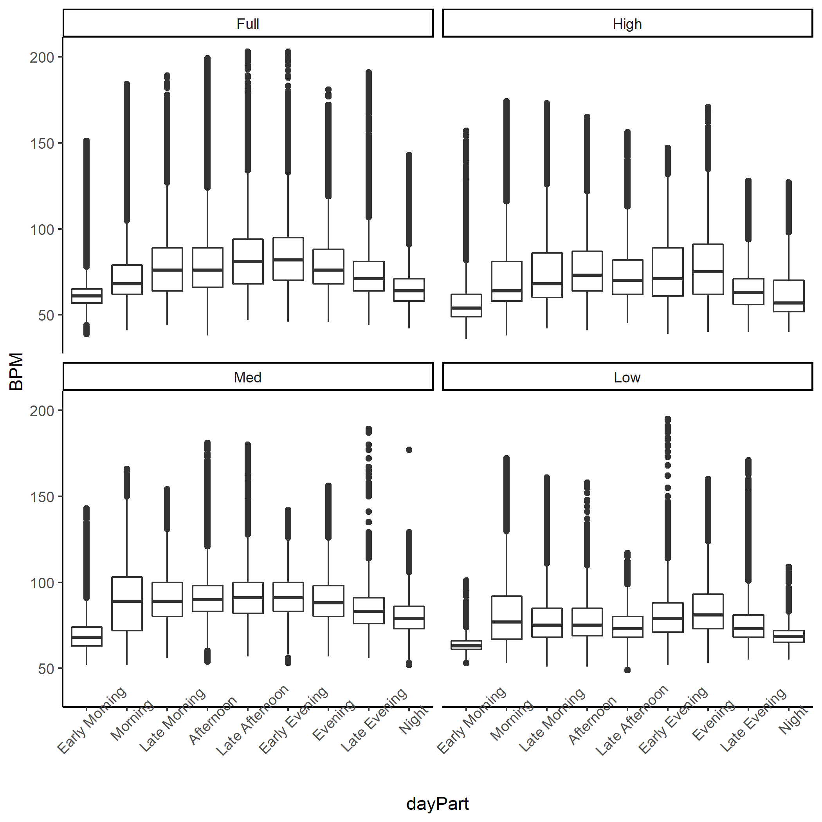
Heart Rate by Time of Day and Use Level
Usage Insight #7
The early evening (5p – 7p) and evening (7p – 9p) are the times of day where the has the heart rates are at their highest for FitBit Users on average.
Most FitBit Users engage in cardio exercise during the evening hours

Slide 10
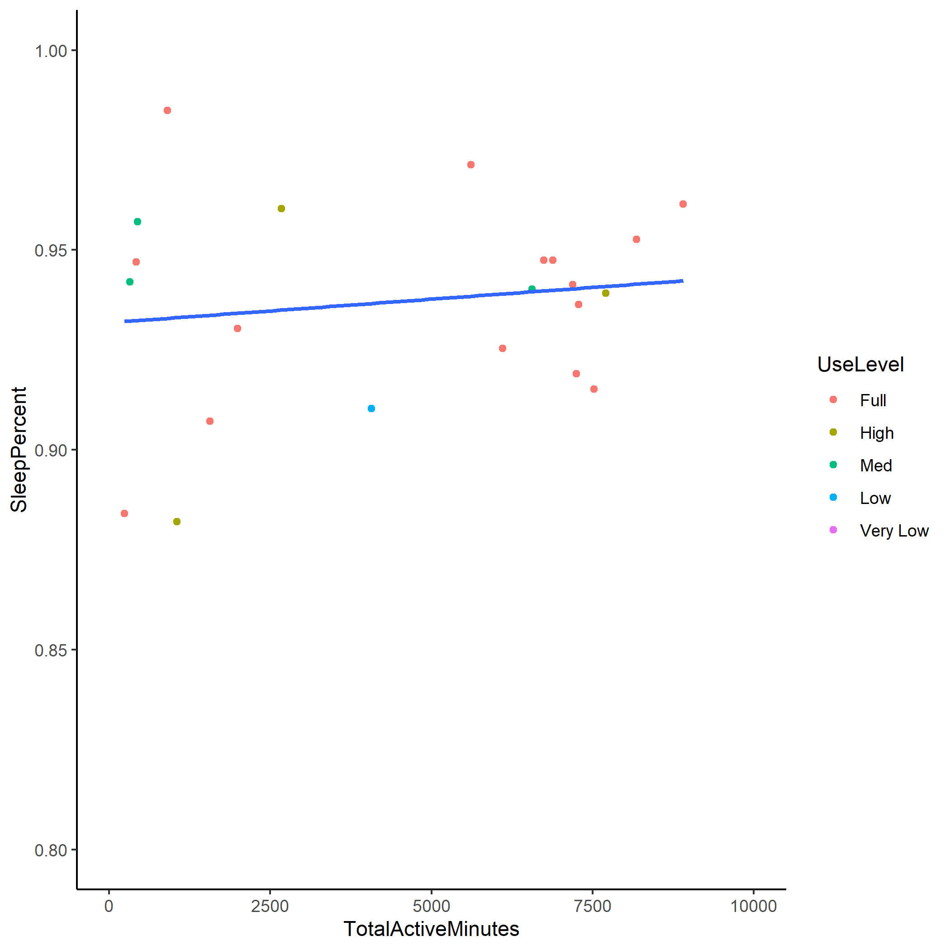
Quality of Sleep and Activity
Usage Insight #8
On average, the ratio of time asleep to time in bed (sleep quality) improves as minutes of activity increases
Note: There are 2 outliers removed from the data where the sleep percent is below 70%.

Slide 11
Bellabeat Leaf Chakra Marketing Strategy Recommendations
Emphasize unique wearability – comfort, style, flexibility
To maximize achievement of fitness goals, wear the Leaf Chakra at all times including sleep and capture all stats all the time
The more you wear, the more you know, the better you’ll do
Focus on quality of exercise not quantity – not just steps
Target busy women and how the Leaf Chakra can help increase exercise efficiency - timeliness, intensity improves BMI and sleep quality

Slide 12
Data Limitations and Caveats
Anonymity of the Users; lack of gender, age, purchase history, location or health status data, prevents in depth analytics regarding behavioral changes associated with Fit Bit use
The volunteer nature of study participation introduces data bias
The small sample size of 33 users, given the size of the Fit Bit community in 2016 of 23M (https://www.businessofapps.com/data/fitbit-statistics/) challenges its sufficiency to make statistically reliable inferences
The one month, time frame does not capture usage during different times of the year so seasonal effects can not be determined

Slide 13
Next Steps
Determine if a more in-depth analysis of non-Bellabeat wearable fitness device data is desired to improve insights and marketing approach
If expanded analysis is desired, address the data limitations noted in the previous slide for the study
Conduct a survey of Bellabeat users to determine product or marketing enhancements that would drive sales or market share growth

Slide 14
