Slide 1
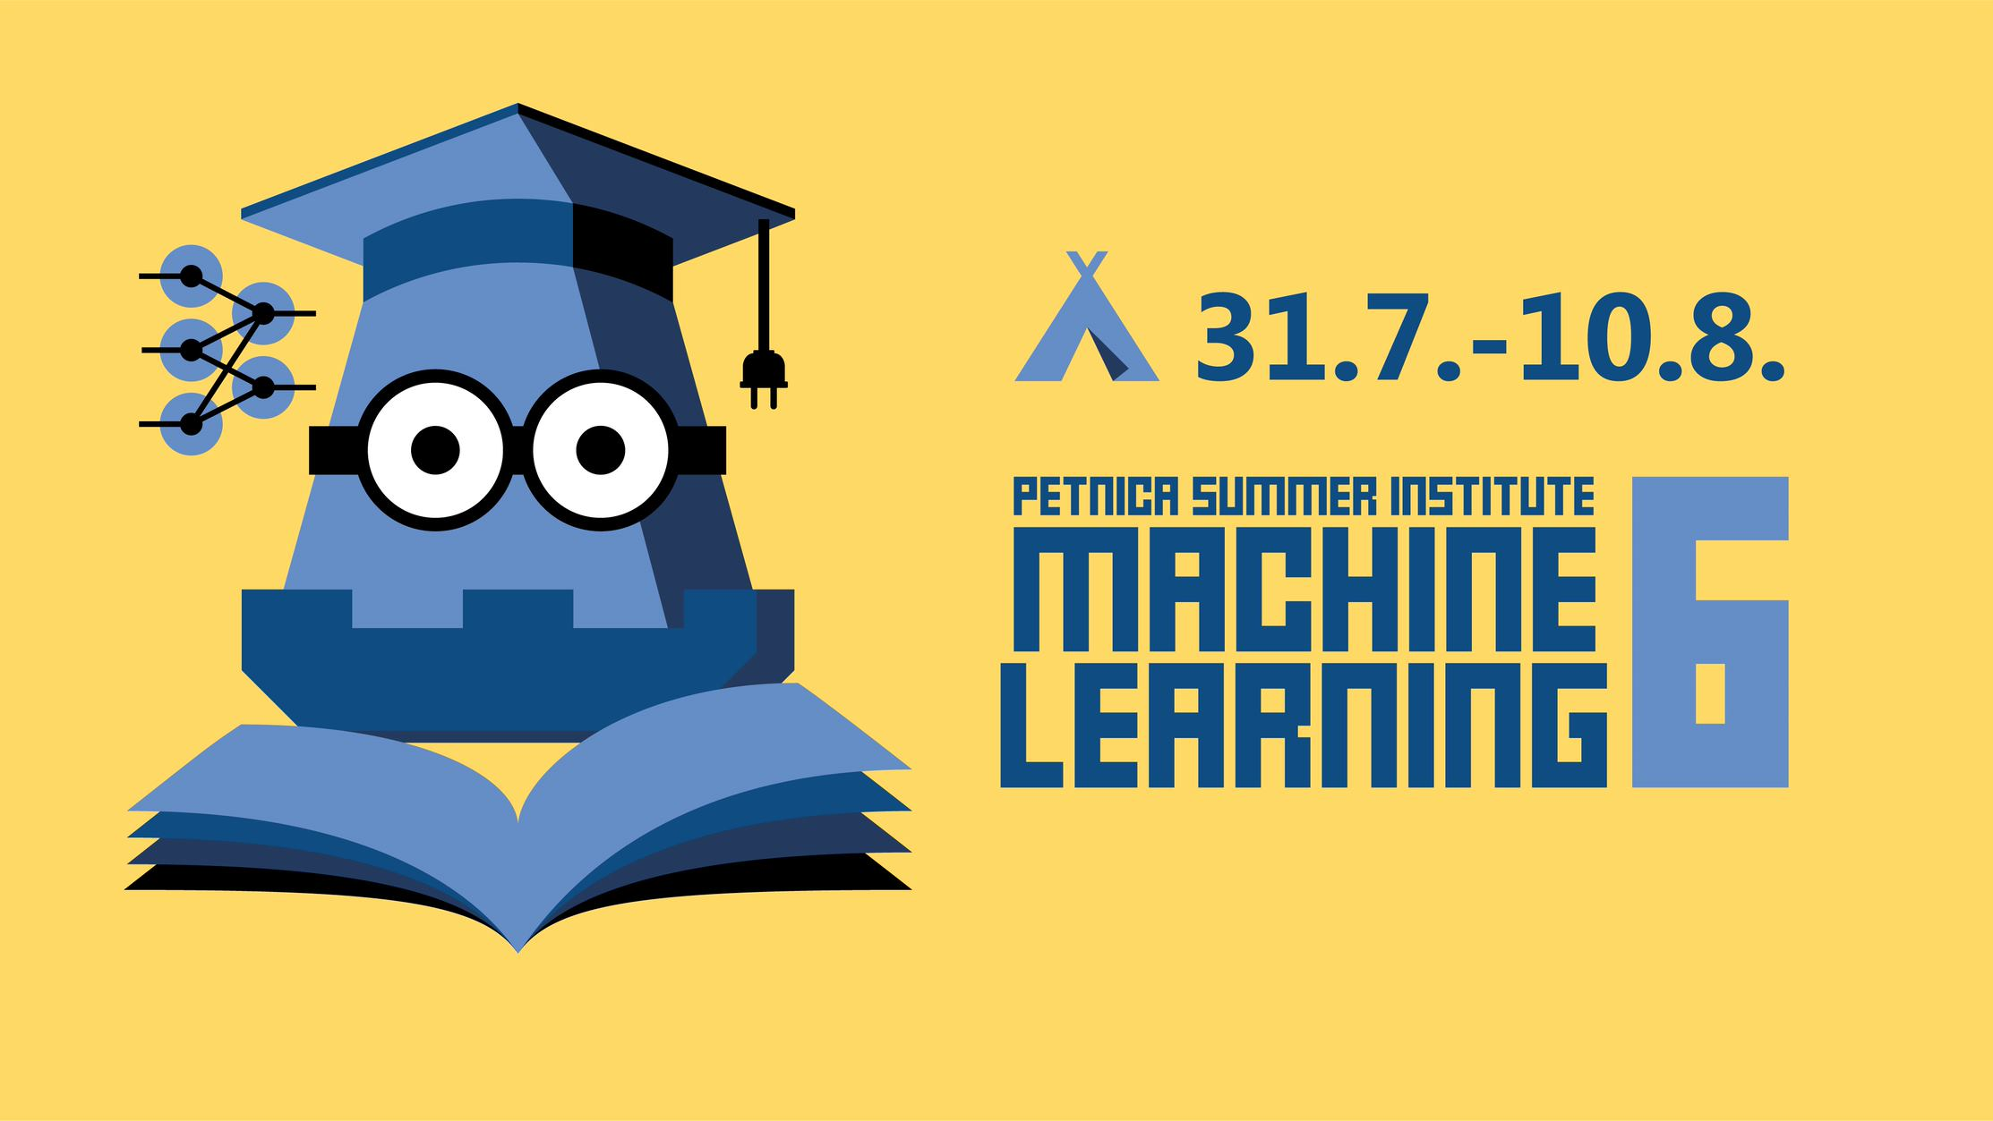

Slide 2
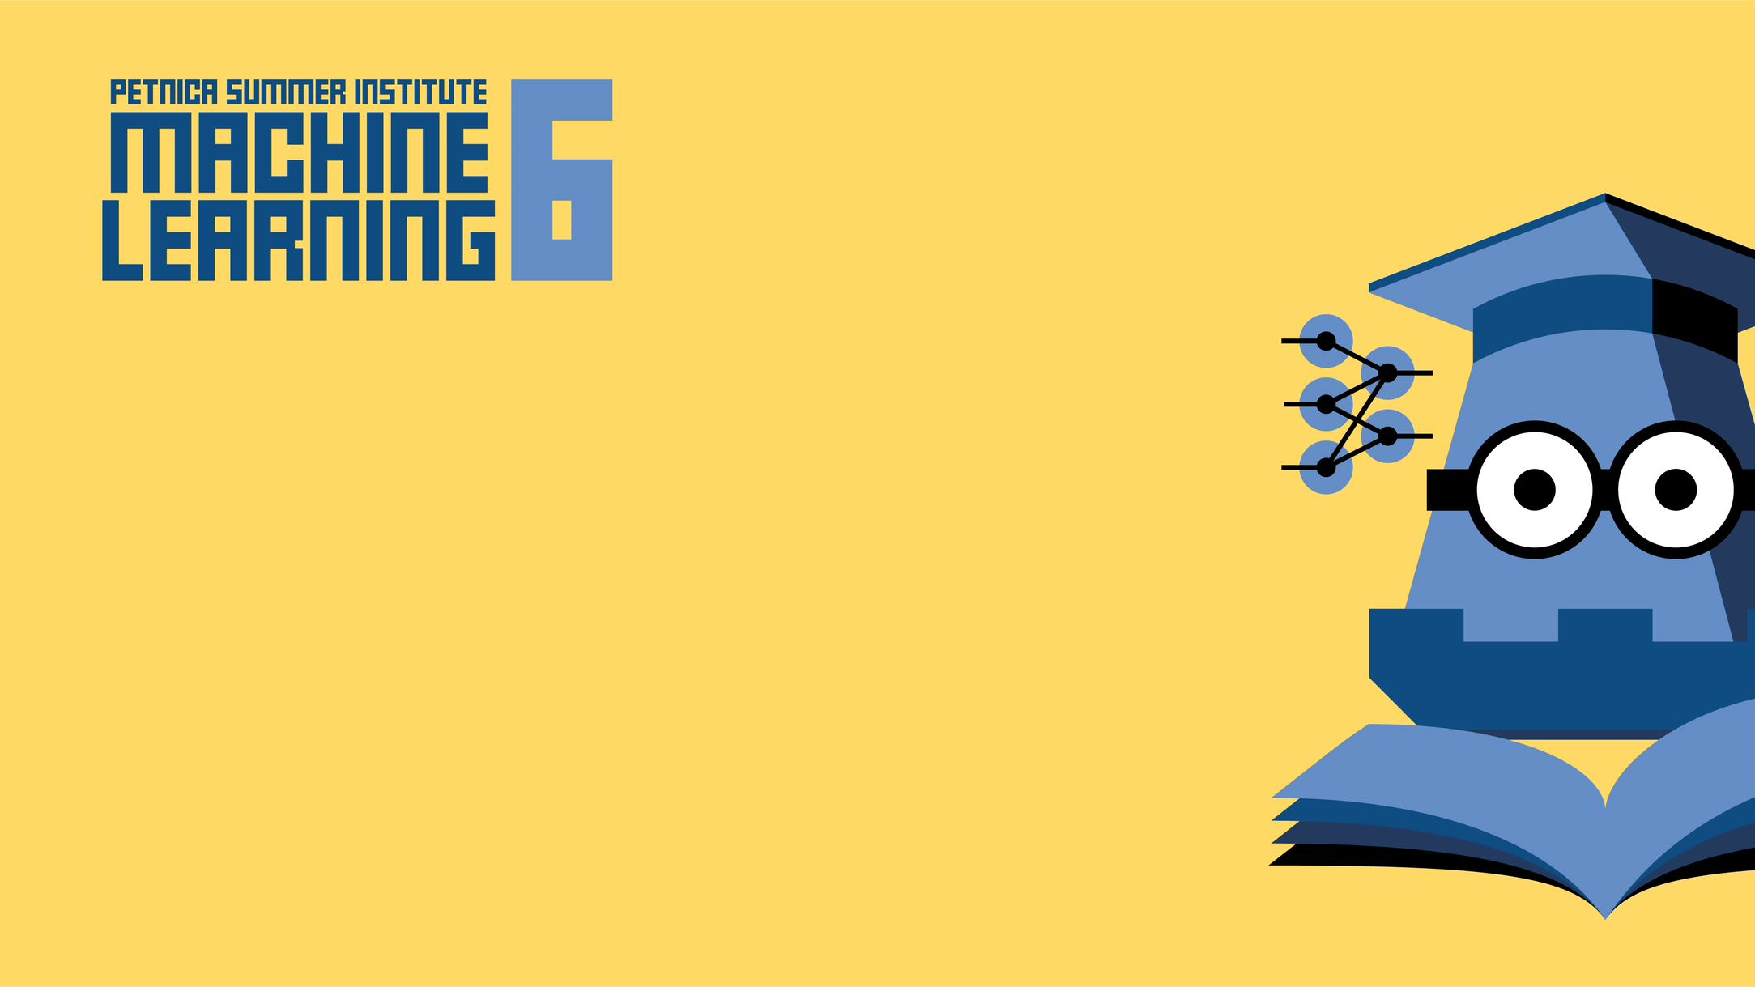
Hand Gesture Tetris
Hand gesture controlled tetris game
Veljko Maksimović
Tamara Lazarević

Slide 3

Motivation
The idea was to recognize hand movements taken from web camera stream to be used to controll other apps, in this case, Tetris game
Set of 5 hand movements was used:
Swipe Up – Rotate Tetris Piece
Swipe Down – Pull Tetris Piece Down
Swipe Left – Move Tetris Piece Left
Swipe Right – Move Tetris Piece Right
Thumbs Down - Swap Tetris Piece
Frames cut from the video stream are fed to the models and the output is used to move game pieces.

Slide 4
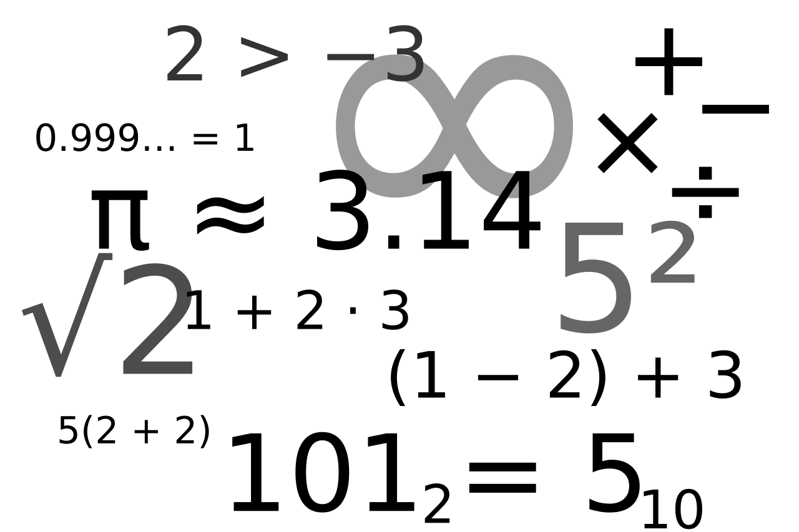
Implentation details and challenges
https://arxiv.org/abs/1901.10323
Architecture details
Models
Pipeline
Our implementation and training
Challenges
Big models
Confusing data
Tricky implementation

Slide 5



Demo and results
Evaluation
Detector
Classifier
Demo

Slide 6
Final words
What we learnt
Possible applications
Final thoughts

Slide 7


