Slide 1
Using semaphores to synchronize baboons across a buffer rope
Youjian Tang, Travis Tran and Tommy Le
CSE Department
University of South Florida
{tang24, travist, tle568} @usf.edu

Slide 2
Abstract
The objective of the lab with the sequence of baboons was to allow only 3 baboons to travel through a rope buffer.
To resolve the lab, we used multiple semaphores to synchronize the baboon order to account for the number of baboons inside buffer and to ensure one baboon could enter and exit the buffer at a time
The lab becomes successful when it display the access same order of FIFO from the input sequence. Additionally, the pauses and printing part of the sequence considered the requirements of the Lab

Slide 3
Introduction
There is an issue in which multiple threads would access the same resources at the same time. This creates a risk of data corruption or race condition.
Threads can be synchronized with semaphores so one thread can access critical section at a time. Semaphores run under a wait and signal so the thread waiting would only have access to critical section when semaphore returns 1.
The thread running critical section would signal (semaphore increment 1), allowing the wait thread to now have access to critical section. For this lab we used a variety of Semaphores.

Slide 4
Methodology​
typedef struct {
int capacity; // maximum capacity of baboons on rope
int travel_time; // time that baboons to travel through the rope
...
int left_count; // indiciate the current baboons travelling from the left
int right_count; // indiciate the current baboons travelling from the right
...
sem_t sem_left; // semaphore used to prevent baboons from the left entering the rope
sem_t sem_right; // semaphore used to prevent baboons from the right entering the rope
sem_t sem_counter; // semaphore used to limit the capacity of the baboons
sem_t sem_announce; // semaphore used to declare the direction of the rope
} ROPE;

Slide 5
Methodology
Count the number of Baboons to record in batch, break the count if it the total is 3, or if it encounters a Baboon moving in opposite direction
for (index ; index < rope->capacity + index; index++){
if (baboon_direction == baboons.direction[index] --> batch_count++;
else --> break;
}
Allocate memory for the thread arguments based on the # of baboons in batch(should be less than or equal to 3)
for (int index = 0; index < batch_count; index++){
threadArgs[index] = (ThreadArgs*)malloc(sizeof(ThreadArgs));
threadArgs[index]->rope = rope;
threadArgs[index]->direction = (DIRECTION)baboons.direction[baboon_index];
}

Slide 6
Methodology
...
// Create threads for each baboon in the batch
pthread_create(&threads[index], &attr, ROPE_cross, ...);
// Increment the actual baboon index
baboon_index++;
}
...
Create new thread for each baboon.
Run thread through ROPE_cross(): announce(), mount(), and dismount()
ROPE_cross() : have semaphore to ensure baboons only enter rope given the conditions.
void *ROPE_cross(void *args){ ROPE_announce(a->rope, a->direction);
ROPE_mount(a->rope, a->direction);
ROPE_dismount(a->rope, a->direction); return NULL;}

Slide 7
Methodology​
void ROPE_announce(ROPE *rope, DIRECTION direction){
// only one baboon can access the rope at one time
sem_wait(&rope->sem_announce);
// left side access the rope
if (direction == LEFT){
sem_wait(&rope->sem_left);
rope->left_count++;
if (rope->left_count == 1)
sem_wait(&rope->sem_right);
sem_post(&rope->sem_left);
}
// Else for right side access
// ...
sem_post(&rope->sem_announce);
/* Sem(announce) now available so other
baboons can access rope */
}
}
When the direction is "Left":
The Left-semaphore will wait() and signal(). and increment the count
If right has claimed the rope, then left will be waiting until the right batch crossing the rope. This also prevents other baboon announcing their direction, ensuring that it is the next baboon on the rope.
When there is at least one left baboon, the right-will wait(), making it inaccessible

Slide 8
Methodology
Rope Mount ()
Rope Dismount()
void ROPE_mount(ROPE *rope, DIRECTION direction){
sem_wait(&rope->sem_counter);
sleep(rope->travel_time);
printf("%c ", direction);
fflush(stdout);
sem_post(&rope->sem_counter);
}
"Counting" semaphore will mount baboons into buffer if there is space.
If semaphore becomes 0, no more baboons can access rope
void ROPE_dismount(ROPE *rope, DIRECTION direction){
if (direction == LEFT){
sem_wait(&rope->sem_left);
rope->left_count--;
if (rope->left_count == 0)
sem_post(&rope->sem_right);
sem_post(&rope->sem_left);
}
//...
}}
Access with "given direction" semaphore wait()/signal() ensuring that the count will decrement in an orderly way
Will release the "opposite direction" semaphore if count == 0 for the current direction, to enable both left and right baboons

Slide 9
Results: At most 3 and all in same direction
Baboon Directions: L, L, R, R, R, R, L, L, R, R
Next Element is Different Direction
Already has 3 baboons
Next Element is Different Direction
Print the sequence of baboons currently inside the buffer as sections.
Each section should be in same direction and never more than 3 baboons in each section
Otherwise: conditions not met.

Slide 10
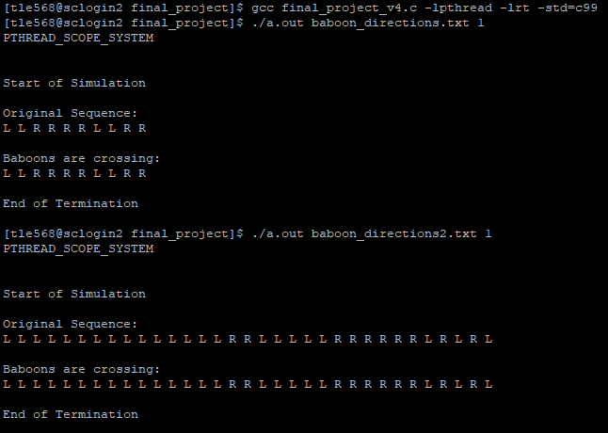
Results
Because we selected baboons in sequential order, the output should be the same as the input as the first baboons to enter, should also be the first to leave (FIFO).
A maximum of 3 baboons of the same direction will appear simultaneously after the travel time elapses.

Slide 11
Conclusion
Coordinating the baboons require four semaphores: one as a locking the direction for the current batch or turn, two to indicate left or right direction, and one to track the number of baboons on the rope.
The program iterates through a sequence to gather a batch of three or fewer baboons. Synchronization is achieved by threading through "Rope_Cross" functions, ensuring compliance with project conditions.
The output reflects the initial sequence, demonstrating FIFO, with each baboon section printed while adhering to project conditions.

