Slide 1

Perceptron Timeline
Team International Neural Intelligence:
Ming Hui Hsu
Tales Araujo Leonidas
Professor Patricia McManus
ITAI 2376: Deep Learning in Artificial Intelligence
January 24, 2024

Slide 2
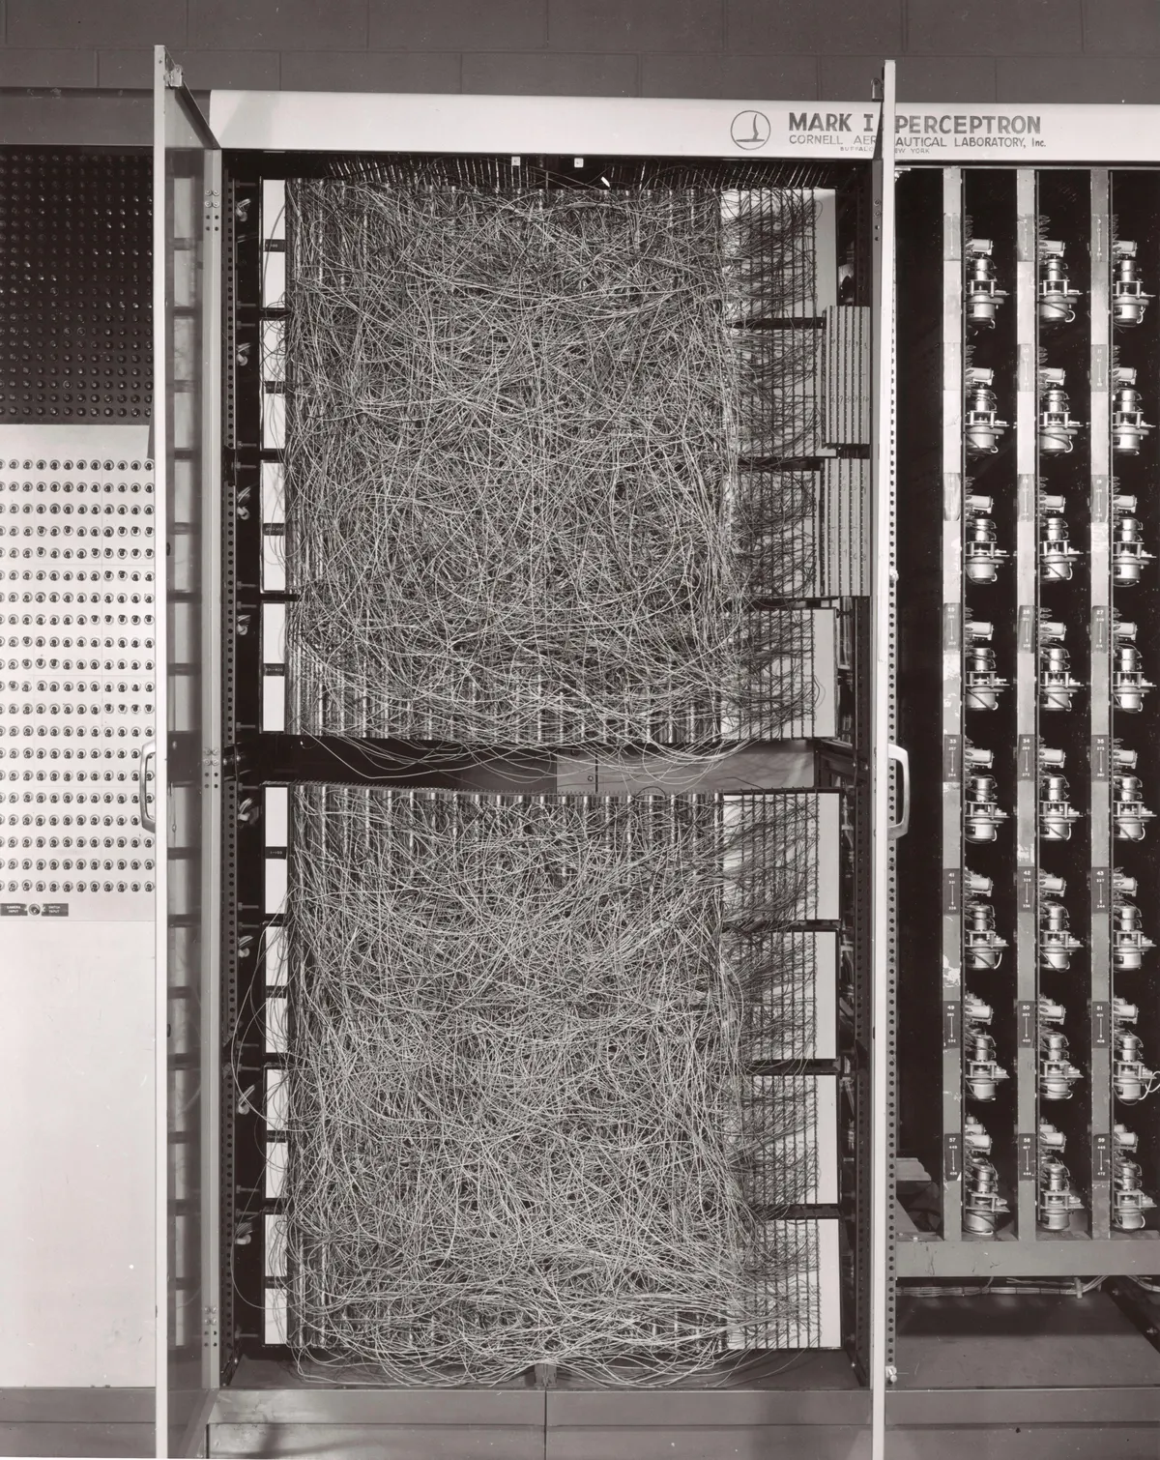
1943
Concept Introduction
1957
Perceptron Design
1958
First Perceptron Machine
Strickland, E. (2021, September 30)
An artificial neuron was proposed as a computational model of the “nerve net” in the brain.
"A Logical Calculus of Ideas Immanent in Nervous Activity” paper by Warren McCulloch and Walter Pitts.
Inspired by McCulloch and Pitts’ work, Frank Rosenblatt introduced the Perceptron algorithm. According to him, it mimicked the "neural structure of the brain and showed an ability to learn".
Mark I Perceptron was developed by Rosenblatt and his team at the Cornell Aeronautical Laboratory. It could recognize simple geometric shapes and image classification tasks.

Slide 3
1969
Perceptron Limitations
1986
Backpropagation Algorithm
Late 1970s
First AI Winter
Marvin Minsky and Seymour Papert proved in their book "Perceptrons" that "the Perceptron could only perform very basic tasks", showing that single-layer perceptrons had limitations in solving complex non-linear problems, leading to a decline in interest in neural networks.
Over-optimistic promises and limitations exposed in single-layer perceptrons led to a decline in funding and research interest in AI, specifically neural networks, which needed specially more computer power.
A method for training multilayer neural networks. Was rediscovered and reported by David Rumelhart, Geoffrey Hinton, and Ronald Williams in the paper "Learning representations by back-propagating errors".

Slide 4
1998
Convolutional Neural Networks (CNN)
Early 1990s
Second AI Winter
1998
Long short-term memory (LSTM)
Similar to the first AI Winter, it was influenced by unmet expectations and the inability of AI technologies to deliver on some of the ambitious promises made earlier. As a result, funding for AI research decreased, and a more skeptical view of the field emerged.
Yann LeCun defined the concept of Convolutional neural networks (CNN), which mimics the human visual cortex, in his paper "Object recognition with gradient-based learning" and applied neural networks on image recognition tasks.
Jurgen Schmidhuber and Sepp Hochreiter "introduced long short-term memory (LSTM), greatly improving the efficiency and
the practicality of recurrent neural networks (RNN)" (Kumar, A).

Slide 5
1998
Recurrent neural network (RNN)
2014s
Reinforcement Learning
2012
ImageNet Competition
John Hopfield popularized the first RNN, demonstrating its ability to iteractivelly store and retrieve information.
Enhanced by improved computer power, Geoffrey Hinton, Alex Krizhevsky, and Ilya Sutskever "highlighted the power of deep learning by showing significant results in the well-known ImageNet competition" (Kumar, A.).
Deep learning meets robot training. 2014 saw major breakthroughs in reinforcement learning, paving the way for smarter robots and machines.

Slide 6
References
Kumar, A. (2021, January 10). Historical Dates & Timeline for Deep Learning. Analytics Yogi. Retrieved January 23, 2024, from https://vitalflux.com/historical-dates-timeline-for-deep-learning/
Strickland, E. (2021, September 30). THE TURBULENT PAST AND UNCERTAIN FUTURE OF ARTIFICIAL INTELLIGENCE. IEEE Spectrum. Retrieved January 23, 2024, from https://spectrum.ieee.org/history-of-ai

