Slide 1




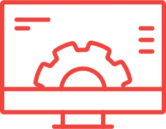

SAMPLE DEMONSTRATION PREPARATION AND DELIVERY
BEST PRACTICE
ANALYZE
DEFINE
BUILD
REHEARSE
EXECUTE
FOLLOW-UP
Existing Demos
Modifications to scenario or screens
New Demos
Storyboards and flow
Review with PM
Demo Source
Demo environment
Customer Needs
Pain points
Reasons for buying
Demo Approach
Existing demo inventory
Demo Data
Personas, demographics, financials, forms, correspondence, etc.
Demo Assets
Demo replay, walk-thru video, talk track, click instructions
Review with PM, iterate as necessary
Supporting Materials
Finalize agenda and timings, create PPT, confirm speakers, etc.
Individual Scenarios
Presenter and demo team (iterate)
Dry-Run
Full end-to-end dry-run with all participants
Orals Coach
Engage orals coach as needed
During Demo
Monitor time
Adjust agenda (as needed)
Capture questions and follow-up
Demo Assets
Archive in demo repository
Continuous Improvement
Compile “lessons learned”
Notes:
Speaker: Diane

