Slide 1
Problem Formulation
Natural Language Processing

Slide 2
Inhalt
Goal
Dataset overview
Dataset labels
Dataset annoations
Challenges

Slide 3
Goal
Category prediction
N-number of categories
Classification Models
Set optimization
Bias mitigation

Slide 4
Dataset overview
One Million Post Corpus
Austrian newspaper “Der Standard”
Dataset Language: German
Data from: 2015-06-01 to 2016-05-31
11.773 labeled and 1.000.000 unlabeled posts
annotated by professional forum moderators

Slide 5
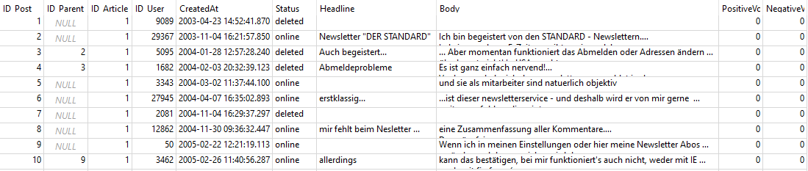
Dataset labels - Posts
Table: Posts

Slide 6
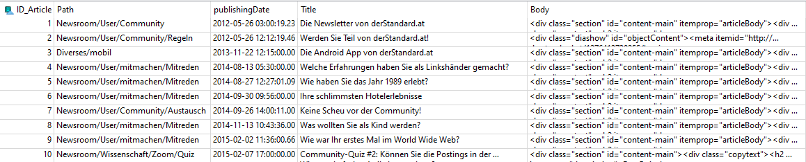
Dataset labels - Articles
Table: Articles

Slide 7
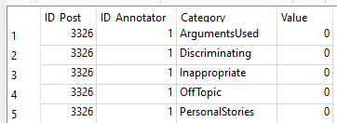
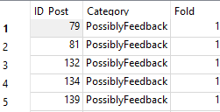
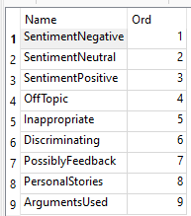
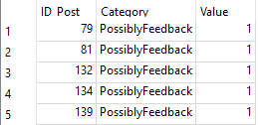
Dataset annotations
Table: Annotations
Table: CrossValSplit
Table: Categories
Table: Annotations_consolidated

Slide 8
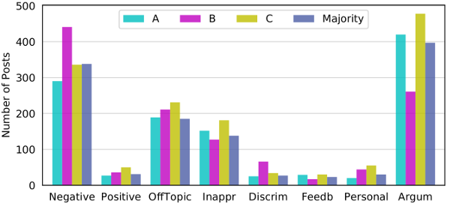
Challenges
Data Imbalance
Model optimization
Training-set optimization

Slide 9
Le Fin

