Slide 1
One Million Corpus Posts

Slide 2
Dataset overview
One Million Post Corpus
Austrian newspaper “Der Standard”
Dataset Language: German
Data from: 2015-2016, around June each year
11.773 labeled and 1.000.000 unlabeled posts
annotated by professional forum moderators

Slide 3
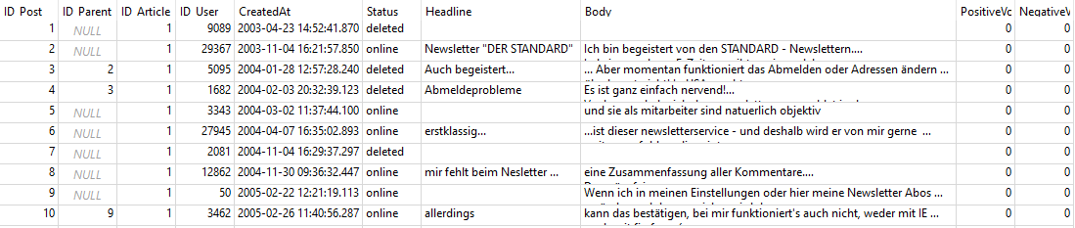
Dataset labels - Posts
Table: Posts

Slide 4
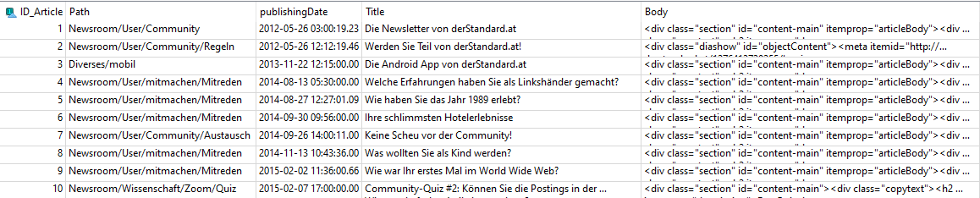
Dataset labels - Articles
Table: Articles

Slide 5
Structure: Posts and Articles
Structure of posts:
No HTML-Tags or more complicated structure, though maybe links and E-Mails.
Possible posts (= user comments) pecularities
Typos
Auto-correct fails
Creative ways of putting emphasis, e.g. Capslock or repeated vocals
Sidestepping Curse word filters by replacing letters, for example by stars.
smileys (no exotic non-ASCII symbols)
Structure of Articles:
HTML structure

Slide 6
Possible labels of posts
ArgumentsUsed
Discriminating
Inappropriate
OffTopic
PersonalStories
PossiblyFeedback
SentimentNegative
SentimentNeutral
SentimentPositive

Slide 7
Labels possibly imbalanced:
ArgumentsUsed (≈ 2600 to ≈ 1000)
Discriminating (≈ 3000 to ≈ 300)
SentimentPositive (≈ 3600 to ≈ 40)

Slide 8
Labels
3600 posts: All 9 labels set.
Most posts: Only a subset of labels is set (≈ 10,000 posts)
In total: ≈ 40,000 labels assigned
1 million remaining posts are unlabeled.

Slide 9
Meta-Labels
Posts can have:
Positive-/Negative votes
Status: Deleted or not

Slide 10
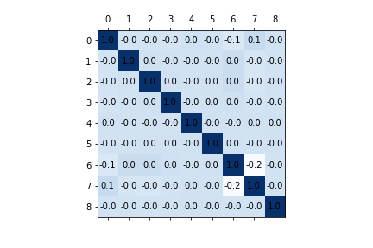
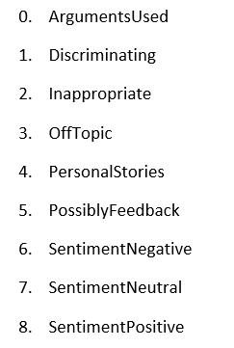
Correlations between Labels

Slide 11
Classifiers

Slide 12
Used Features
Dense Features:
Spacy Word-to-Vector-Embeddings
Sparse Features:
TF-IDF-Embeddings

Slide 13
Trained classifiers
SVC with different kernels
Boosted Decision Trees
Feed-Forward Neural Network
k-Nearest Neighbor
Naive Gaussian Bayes
Logistic Regression

Slide 14
[Switch to PDF]

Slide 15
Results
Difficult and simple labels
Difficult:
Discriminating (F-Score: 0.26)
Inappropriate (F-Score: 0.25)
Offtopic (F-Score: 0.35)
Simple:
PersonalStories (F-Score: 0.72)

