Slide 1
Parse User Log from Texas Holdem Server
Tony Chu
2018-08-01

Slide 2
How the original logs look like
Same format of files (compressed in in ZIP), each ZIP per day, from 2 different servers
Some ZIPs contain multiple sub-ZIPs
JSON data after “>>> event type >>>”
Event types are:
SHOW_ACTION
ROUND_END
GAME_OVER

Slide 3
How to parse
Discard “noise” lines
Keep only SHOW_ACTION & GAME_OVER events
For each SHOW_ACTION event, find its current player who is on the same table and in the “winners” list of the GAME_OVER event; if found, keep the time/data in DB; otherwise discard

Slide 4
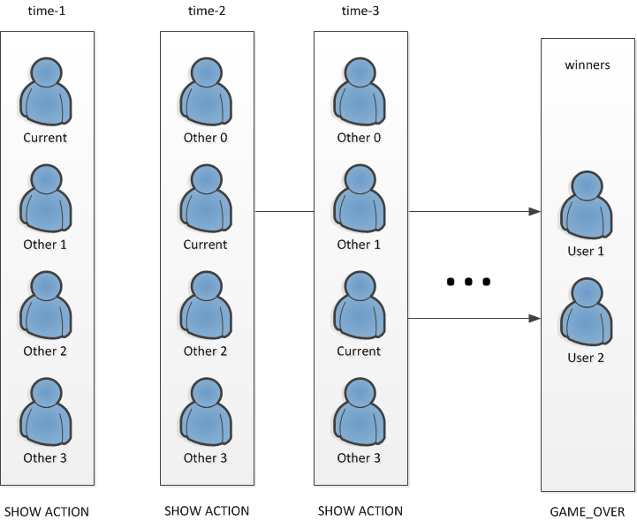
How to parse (cont)

Slide 5
Digested DB data

Slide 6
Merge [DIGESTED] & save to CSV
Group by cards+boards+action => average rank
For the same cards+boards+action, keep the row with highest average rank
Sort by LEN(board) and then by cards,boards, for the sake of readability

Slide 7
Save to CSV (cont)

Slide 8
Performance improved
Process the total logs from past 3 weeks: 23 minutes
By using the DB, we can accumulatively process only the log(s) of the day, which totally takes only 2~3 minutes (manually unzipping files)

Slide 9
Use the data in Python
Given the cards/board, determine the best action (from past history):
def get_parsed_decision(cards, board):
k = cards + ';' + board
return decision_from_parsed[k] if k in decision_from_parsed else None
cards=‘2C,2D’, board=‘2H,3S,6S’ => ‘bet’

