Slide 1
TM500 Training for Customer X
Presented by: Alex Blackwood
Principal Field Application Engineer
July 2015

Slide 2
D500 Traffic Generator / Analyser
Notes:
1/12/2016
Proprietary
1

Slide 3
Confusion about the DiversifEye
You will see names like DiversifEye, D500, D1000, and Shenick
DiversifEye is the actual product name for the device that is used to generate data traffic in the E500
DiversifEye is the software that you use to interact with the D500
Shenick is the name of our former partner company that produces the DiversifEye
Shenick is now Aeroflex!! ☺
Aeroflex is now Cobham!! ☺ ☺

Slide 4
Flavors of DiversifEye
The DiversifEye comes in two hardware configurations. In one configuration there are two boxes and in the other there is one box
In the two box configuration
One box is a network Edge box; it connects to UEs
One box is a network Core box; it connects to the ePC
This configuration supports 6 simultaneous users
In the one box configuration the Edge and the Core are in one box
This configuration supports 3 simultaneous users

Slide 5
What is the DiversifEye?
It is a Real Data Traffic Generator
What does it do?
When integrated with the E500 it provides multiple data services running in parallel for thousands of UEs in a multi-cell environment
Simulates applications such as HTTP, FTP, VoIP, VoLTE, Video
Client & Server simulation
Enables
End to end network testing
Quality of experience measurements
Application level measurements per flow
e.g. latency, jittering etc
Supports 6 users:
One TM500 per user, One shared DiversifEye
It can also be used with standalone EMUE or MUE

Slide 6
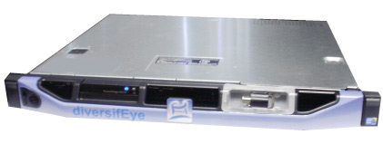



DiversifEye in the System
DiversifEye Edge/Core
UL traffic gen
& DL analysis
DL traffic gen
& UL analysis
EPC
TM500

Slide 7
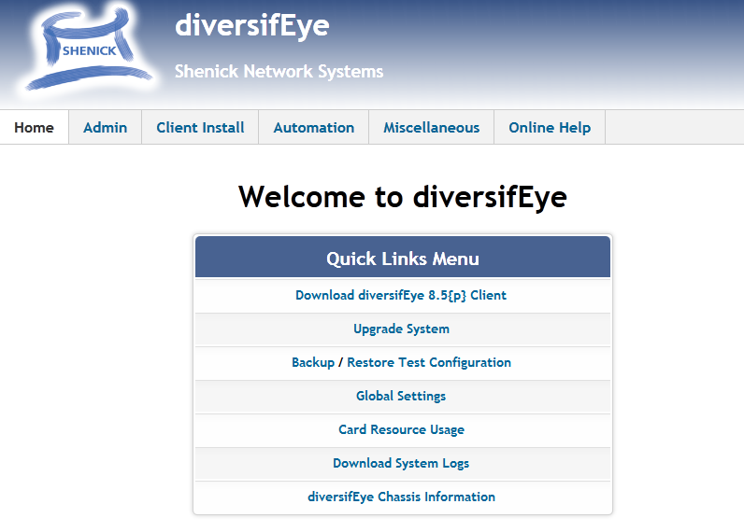
6
Default Management IP Address
192.168.10.200 Edge Static IP
Connect via Standard Web Browser
PROPRIETARY & CONFIDENTIAL
Notes:
Add real people testing

Slide 8
7
Download GUI Client
In a standard Web Browser type D500 Edge IP Address
Click on “Download diversifEye X.y Client”
Installers Provided: -
Windows (XP and 7)
MAC OSX (Snow Leopard and Lion)
Linux (Fedora/Centos/Redhat and UBUNTU)
Solaris
PROPRIETARY & CONFIDENTIAL
Notes:
Add real people testing

Slide 9
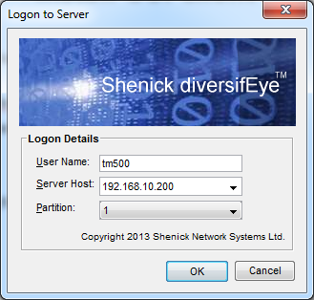
8
Install GUI Client
For Installation Instructions client “Client Install” on Web Admin view
After Installing GUI Client load the GUI Client login dialogue
Username: ‘tm500’
Server Host: 192.168.10.200
Partition: 1
PROPRIETARY & CONFIDENTIAL
Notes:
Add real people testing

Slide 10
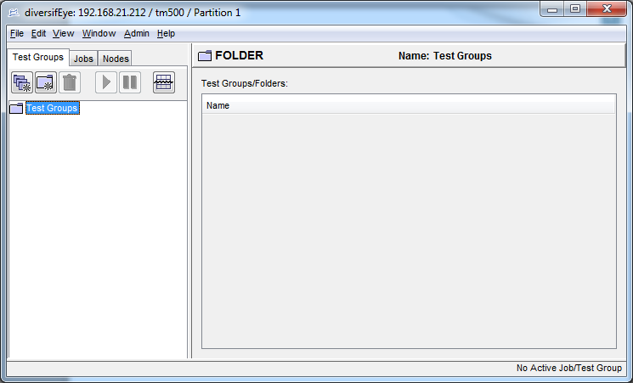
9
Java GUI Client View
Click on ‘Nodes’ tab to check Status of Test Agent Cards
PROPRIETARY & CONFIDENTIAL
Notes:
Add real people testing

Slide 11
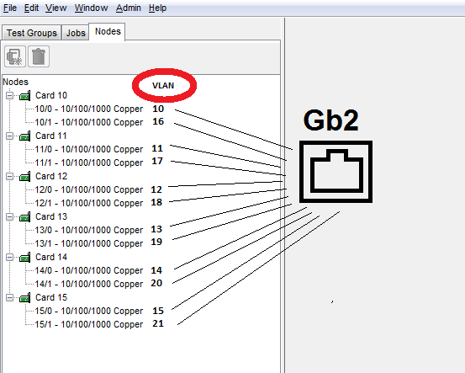
10
D500 Edge Standalone – Test Agent View
PROPRIETARY & CONFIDENTIAL
Notes:
Add real people testing

Slide 12
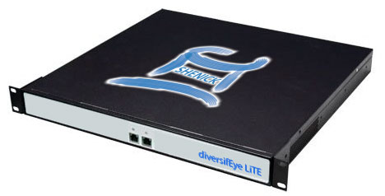
11
D500 Standalone Interface Specifications
Flow Processor | VLAN Tag | Partition (User)
10/0 | 10 | 1
11/0 | 11 | 2
12/0 | 12 | 3
10/1 | 16 | 1
11/1 | 17 | 2
12/1 | 18 | 3
Accommodates 1-3 Users
Client or Server Emulation
Physical Ports
GB1: Management Interface
GB2: Test Traffic Port
PROPRIETARY & CONFIDENTIAL
Notes:
Add real people testing

Slide 13
12
D500 Edge Logical Test Port/Partitions
Flow Processor | VLAN Tag | Partition (User)
10/1 | 16 | 1
11/1 | 17 | 2
12/1 | 18 | 3
username
User1
P1 10/0 tm500
User2
P2 11/0 tm500
PROPRIETARY & CONFIDENTIAL
Notes:
Add real people testing

Slide 14
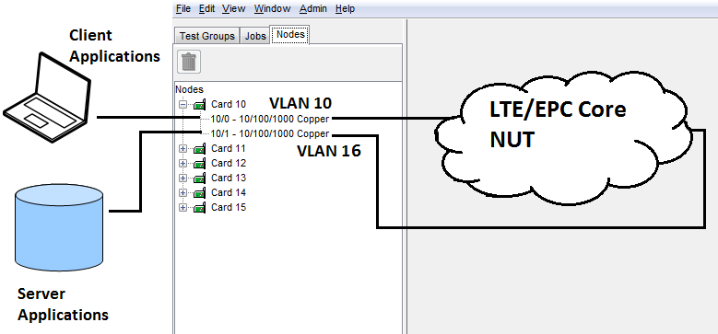
13
D500 Edge Standalone Logical Connectivity
Typical Logical Port Assignment for Edge Standalone
1 GUI Client per D500 partition – controlling 2 different VLANs
PROPRIETARY & CONFIDENTIAL
Notes:
Add real people testing

Slide 15
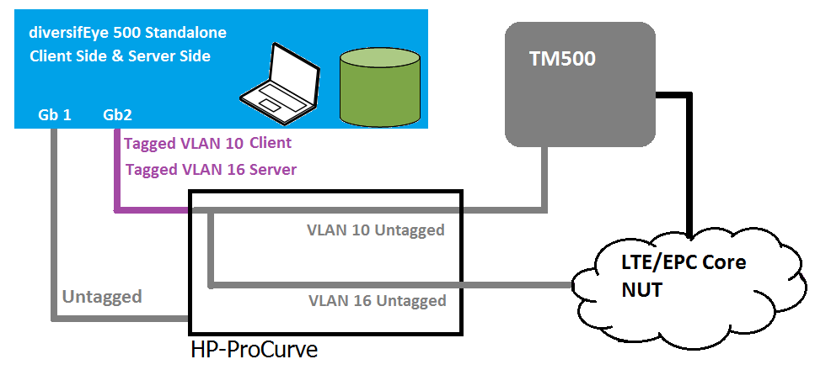
14
D500 Edge Standalone in Ex-MUE Solution
Typical Benchtop Setup
PROPRIETARY & CONFIDENTIAL
Notes:
Add real people testing

Slide 16
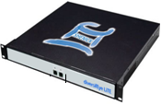
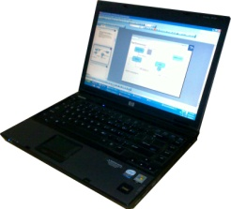
HP Switch VLAN configuration
Management
Data
1
10
11
12
16
17
18
M
Each D500 is internally divided with 6 partitions with different VLAN tagging. We can access different partitions using different VLAN tag from a single data port.
VLAN tags from10-12 is for Edge and 16-18 is for Core.

Slide 17
DiversifEye Control
The DiversifEye can be controlled in multiple ways
Via the DiversifEye GUI software
Via a Command Line Interface (CLI)
Via E500 embedded software running in MTS/ NAS mode
The most convenient method is to use the DiversifEye with EMUE or E500 running in MTS/NAS mode
The CLI can be used for automated control, especially when using MUE
The EMUE/E500 embedded software actually uses the CLI to control the DiversifEye when running in MTS/NAS mode

Slide 18
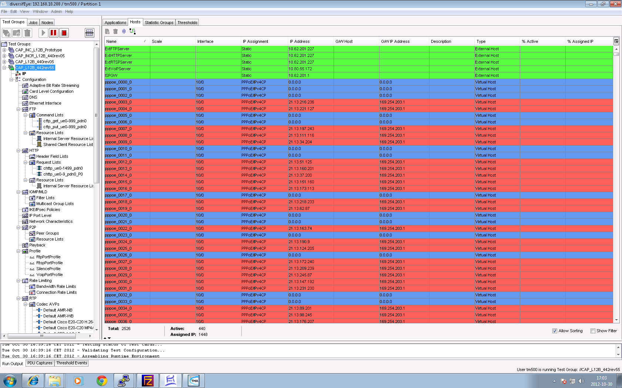
DiversifEye DiversifEye GUI Control
Controling the DiversifEye via the DiversifEye GUI
The DiversifEye GUI is a Java based GUI

Slide 19
DiversifEye CLI Control
The CLI interface is a Telnet or SSH based interface.
Username is “cli”, password is “diversifEye”
The CLI is best used in an automation script
The user can load/list/select/start/stop test groups
Get statistics , display threshold events
From the command line you can get help
To see all available commands and description log in and give the command cli help

Slide 20
DiversifEye Usage
There are two steps to using the DiversifEye
Step 1: Provisioning
Sets up test cases for use later
Builds XML files that are used by the DiversifEye during normal operation
Step 2: Data Traffic Generation
Uses the provisioned XML files to generate data traffic for UEs
Controlled via the CLI by either
The Diversify GUI
The EMUE/E500 embedded software
Automation scripts

Slide 21
DiversifEye Provisioning
Each EMUE/E500 release comes with templates and scripts to help provision the DiversifEye.
These files are installed into the Program Files directory
Aeroflex/TM500/<Release>/diversifEye
There are two files that will need editing
live.bat
TM500.xml

Slide 22
DiversifEye Provisioning – Live.bat
Live.bat is a windows batch file that helps automate the provisioning. It sets up some variables, then calls a Python script Shenick.py.
Modify the following in Live.bat as needed
set aflx_ip_addr=192.168.10.200
set aflx_group_name=TM500LteTestPfc
set aflx_part=1

Slide 23
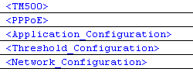
DiversifEye Provisioning – TM500.xml
TM500.xml is the file that you modify to create your test cases
This file has the following primary blocks in it

Slide 24
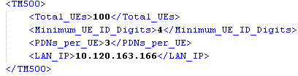
DiversifEye Provisioning – TM500 Block
TM500 block includes below parameters.
Total_UEs : No of UEs need to be configured in the script
Minimum_UE_ID_Digits : This is the no of digits need to represent UE id in “Host name” or “application name” in test group. It should be same as in command DECONFIGRDASTARTTESTCASE.
PDNs_per_UE : No of PDN we need to configure per UE
LAN_IP : This is the IP address of AC DTE port usually Tsec1

Slide 25
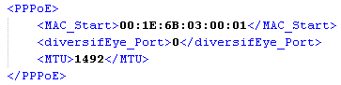
DiversifEye Provisioning – PPPoE Block
PPPoE block includes below parameters
MAC_Start : arbitrary start MAC address for all PPPoE hosts
diversifEye_Port : 0 is for client and 1 is for server. As we are setting up PPPoE for client the default value is 0.
MTU : Here we can define MTU size.

Slide 26
Application Configuration Block
Application_Configuration block includes below parameters.
Server Application : In this block we can set different parameters required for setting up, FTP server, Web server (HTTP server), SIP Server and RTSP server. There are different server blocks for each server.
Client Profiles : Here we have to configure client application (FTP, HTTP client etc ) configuration details. All the client application are defined inside the client profiles block.

Slide 27
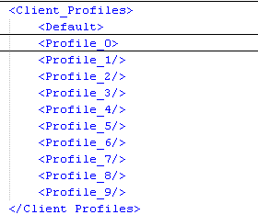
DiversifEye Provisioning – Client Configuration
Further client application has two parts. One is default configuration and 0-n profiles configuration.
Default : This is the default application configuration which is associated with a particular client Host. There is one to one mapping between each default application and a host.
Profile_n : There can be multiple additional applications can be associated with a particular Host profile configuration.
NOTE: There can be one default and multiple profiles associated with one Host.

Slide 28
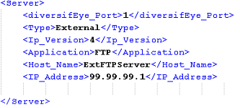
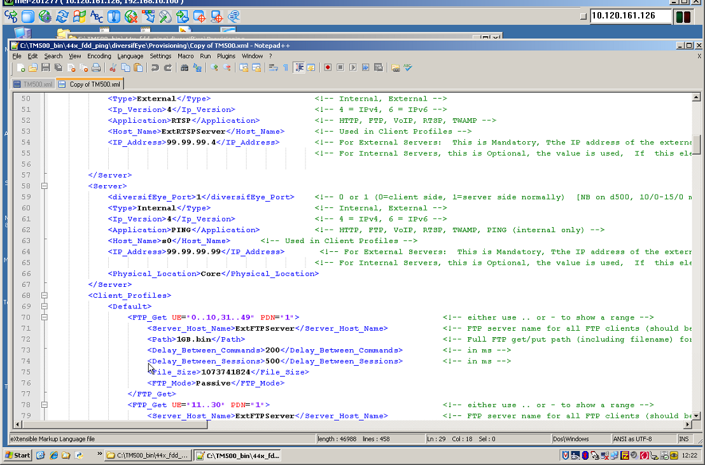
DiversifEye Provisioning – FTP Configuration
Server Configuration
Client configuration

Slide 29
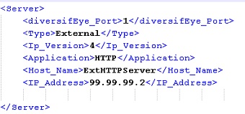
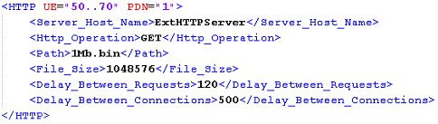
DiversifEye Provisioning – HTTP Configuration
Server Configuration
Client configuration

Slide 30
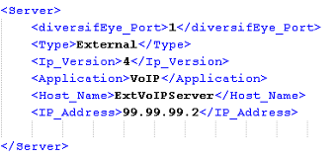
DiversifEye Provisioning – VOIP Configuration
Server Configuration

Slide 31
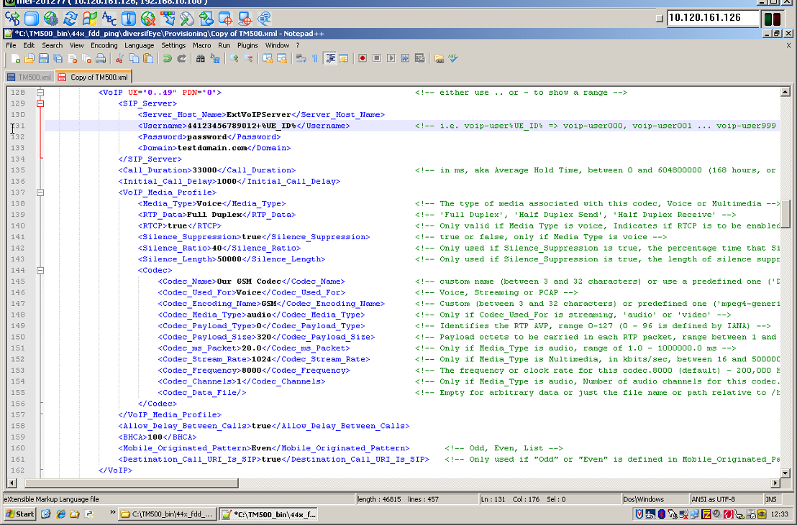
DiversifEye Provisioning – VOIP Configuration
Client Configuration

Slide 32
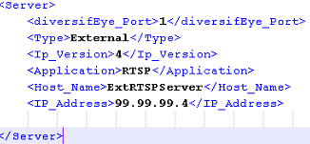
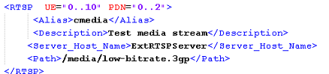
DiversifEye Provisioning – RTSP Configuration
Server Configuration
Client configuration

Slide 33
DiversifEye Edge Usage
The DiversifEye Edge Connects to the Access Concentrator
Each Virtual UE in the system creates PPPoE sessions for each assigned IP address and/or PDN
DiversifEye Edge Clients create PPPoE sessions with the Virtual UEs
The E500 embedded software then starts and stops data sessions based scripts

Slide 34
DiversifEye Core Usage
The DiversifEye Core Connects to the RAN SGi Interface
The DiversifEye Edge controls creation of servers on the DiversifEye Core
The E500 embedded software then starts and stops data sessions based scripts

Slide 35
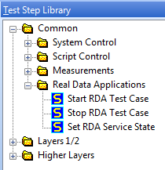
Scripting with the Ext-MUE gui
Operating Data Applications with RDA
RDA applications can also be controlled via TMA scripting. Useful when unmanned automation is needed. It also simplifies the need to control diversifEye separately.
Three main commands, normally used in the following order:
Start RDA Test Case – Configures the partition used, Test group, IP address etc…
Set RDA Service State – Configures the service state for applications such as ftp_put, ftp_get, UDP uplink / downlink etc…
Stop RDA Test Case – Stop all the applications and services for the partition used.

Slide 36
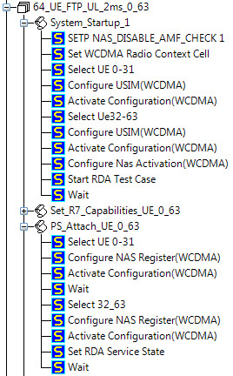
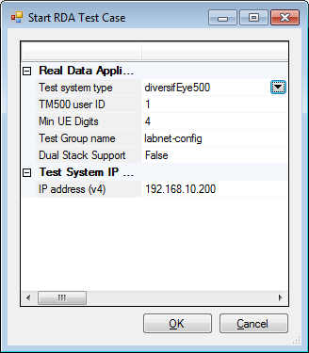
Scripting
Operating Data Applications with RDA
Example use of Start RDA Test Case
Note: Start RDA Test Case will stop any existing diversifEye test group before starting current test group

Slide 37
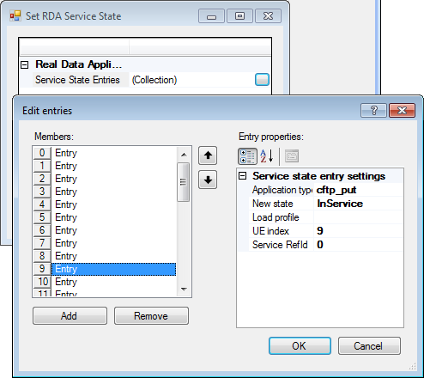
Scripting
Operating Data Applications with RDA
Example use of Set RDA Service State

