Slide 1
Image Segmentation
Longin Jan Latecki
CIS 601

Slide 2
Image Segmentation
Segmentation divides an image into its constituent regions or objects.
Segmentation of non trivial images is one of the difficult task in image processing. Still under research.
Segmentation accuracy determines the eventual success or failure of computerized analysis procedure.

Slide 3
Segmentation Algorithms
Segmentation algorithms are based on one of two basic properties of intensity values discontinuity and similarity.
First category is to partition an image based on abrupt changes in intensity, such as edges in an image.
Second category are based on partitioning an image into regions that are similar according to a predefined criteria. Histogram thresholding approach falls under this category.

Slide 4
Domain spaces
  spatial domain (row-column (rc) space)
  histogram spaces
  color space
  other complex feature space

Slide 5
Histograms
Histogram are constructed by splitting the range of the data into equal-sized bins (called classes). Then for each bin, the number of points from the data set that fall into each bin are counted.
Vertical axis: Frequency (i.e., pixel counts for each bin)
Horizontal axis: Response variable
In image histograms the pixels form the horizontal axis

Slide 6
Thresholding - Foundation
Suppose that the gray-level histogram corresponds to an image f(x,y) composed of dark objects on the light background, in such a way that object and background pixels have gray levels grouped into two dominant modes. One obvious way to extract the objects from the background is to select a threshold ‘T’ that separates these modes.
Then any point (x,y) for which f(x,y) < T is called an object point, otherwise, the point is called a background point.

Slide 7
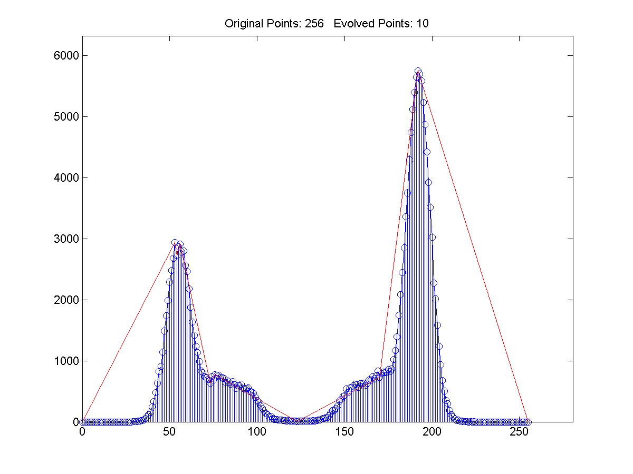
Example

Slide 8
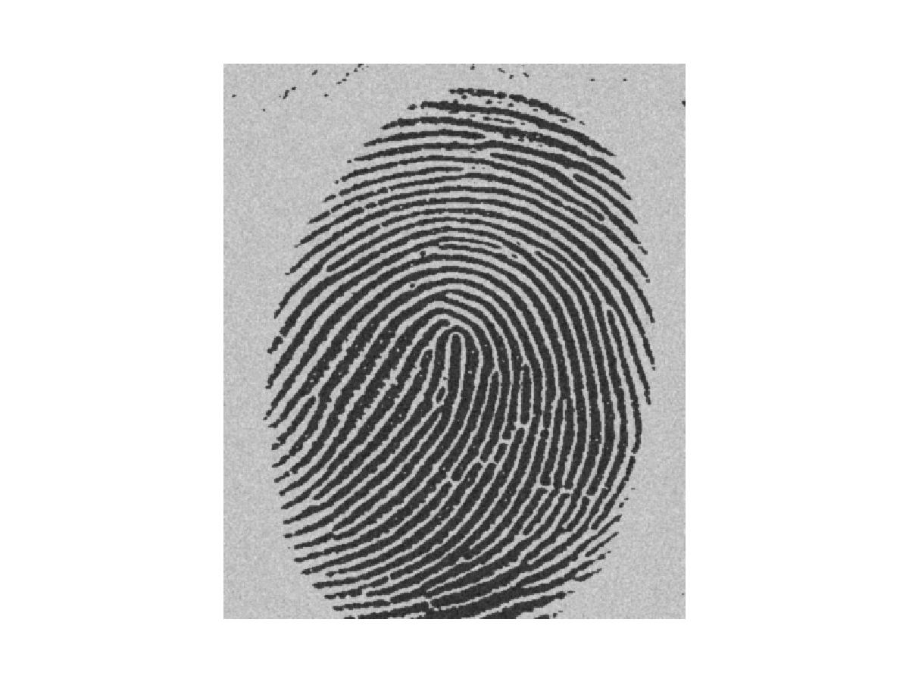
Gray Scale Image - bimodal
Image of a Finger Print with light background

Slide 9
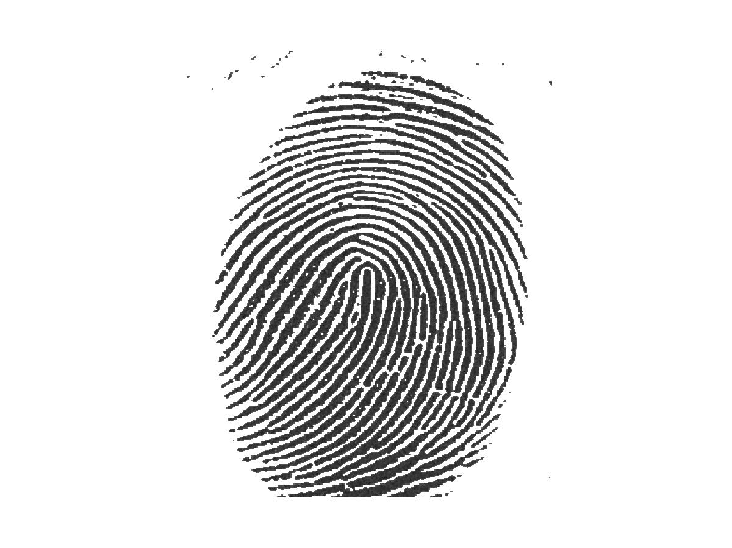
Segmented Image
Image after Segmentation

Slide 10
In Matlab histograms for images can be constructed using the imhist command.
I = imread('pout.tif');
figure, imhist(I) %look at the hist to get a threshold, e.g., 110
BW=roicolor(I, 110, 255); % makes a binary image
figure, imshow(BW) % all pixels in (110, 255) will be 1 and white
% the rest is 0 which is black
roicolor returns a region of interest selected as those pixels in I that match the values in the gray level interval.
BW is a binary image with 1's where the values of I match the values of the interval.

Slide 11
Bimodal Histogram
If two dominant modes characterize the image histogram, it is called a bimodal histogram. Only one threshold is enough for partitioning the image.
If for example an image is composed of two types of dark objects on a light background, three or more dominant modes characterize the image histogram.

Slide 12
Multimodal Histogram
In such a case the histogram has to be partitioned by multiple thresholds.
Multilevel thresholding classifies a point (x,y) as belonging to one object class
if T1 < (x,y) <= T2,
to the other object class
if f(x,y) > T2
and to the background
if f(x,y) <= T1.

Slide 13
Thresholding Bimodal Histogram
Basic Global Thresholding:
1)Select an initial estimate for T
2)Segment the image using T. This will produce two groups of pixels. G1 consisting of all pixels with gray level values >T and G2 consisting of pixels with values <=T.
3)Compute the average gray level values mean1 and mean2 for the pixels in regions G1 and G2.
4)Compute a new threshold value
T=(1/2)(mean1 +mean2)
5)Repeat steps 2 through 4 until difference in T in successive iterations is smaller than a predefined parameter T0.
Basic Adaptive Thresholding: Images having uneven illumination makes it difficult to segment using histogram, this approach is to divide the original image into sub images and use the above said thresholding process to each of the sub images.

Slide 14
Thresholding multimodal histograms
A method based on
Discrete Curve Evolution
to find thresholds in the histogram.
The histogram is treated as a polyline
and is simplified until a few vertices remain.
Thresholds are determined by vertices that are local minima.

Slide 15
Discrete Curve Evolution (DCE)
It yields a sequence: P=P⁰, ..., P^{m}
P^{i+1} is obtained from P^{i} by deleting the vertices of P^{i} that have minimal relevance measure
K(v, P^{i}) = |d(u,v)+d(v,w)-d(u,w)|
v
v
>
w
w
u
u

Slide 16
Example

Slide 17
Thresholding – Colour Images
In colour images each pixel is characterized by three RGB values.
Here we construct a 3D histogram, and the basic procedure is analogous to the method used for one variable.
Histograms plotted for each of the colour values and threshold points are found.

Slide 18
Displaying objects in the Segmented Image
The objects can be distinguished by assigning a arbitrary pixel value or average pixel value to the regions separated by thresholds.

Slide 19
Experiments by Venugual Rajagupal
Type of images used:
1) Two Gray scale image having bimodal histogram structure.
2) Gray scale image having multi-modal histogram structure.
3) Colour image having bimodal histogram structure.

Slide 20
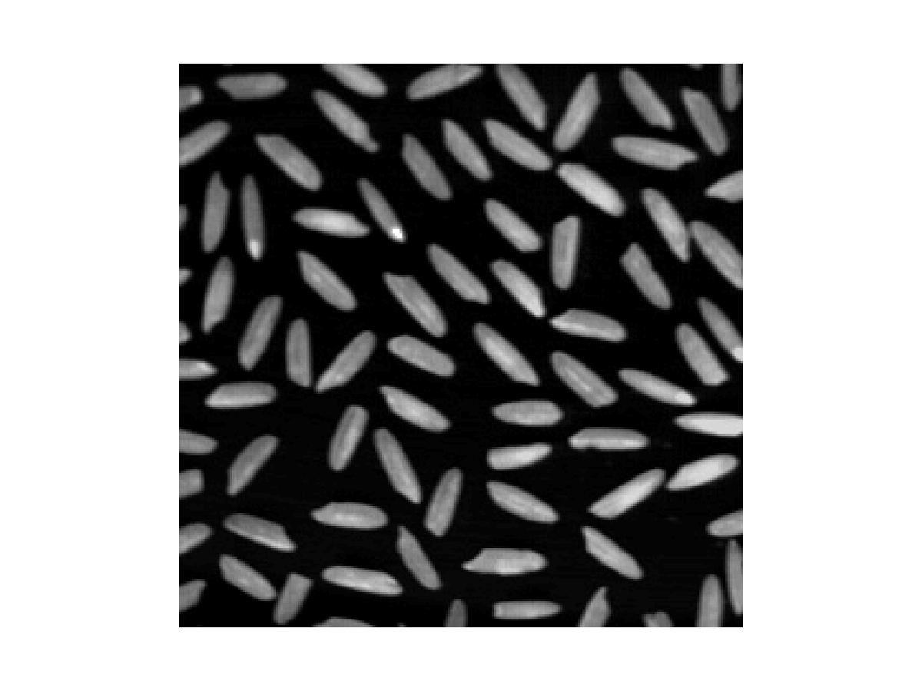
Gray Scale Image - bimodal
Image of rice with black background

Slide 21
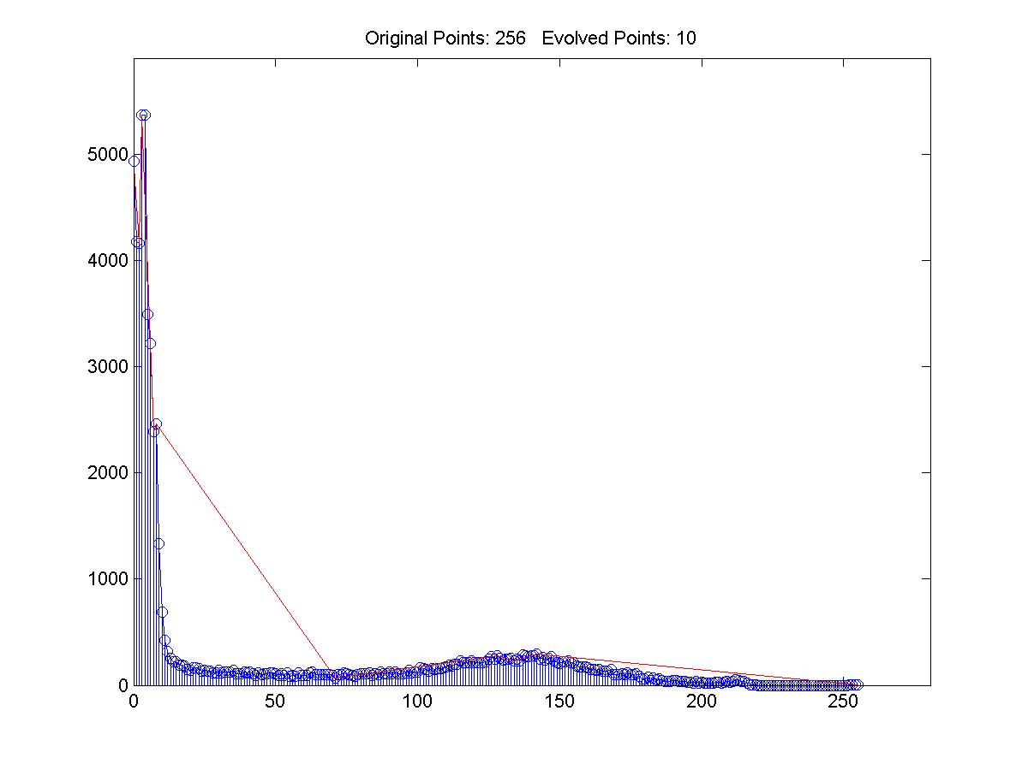
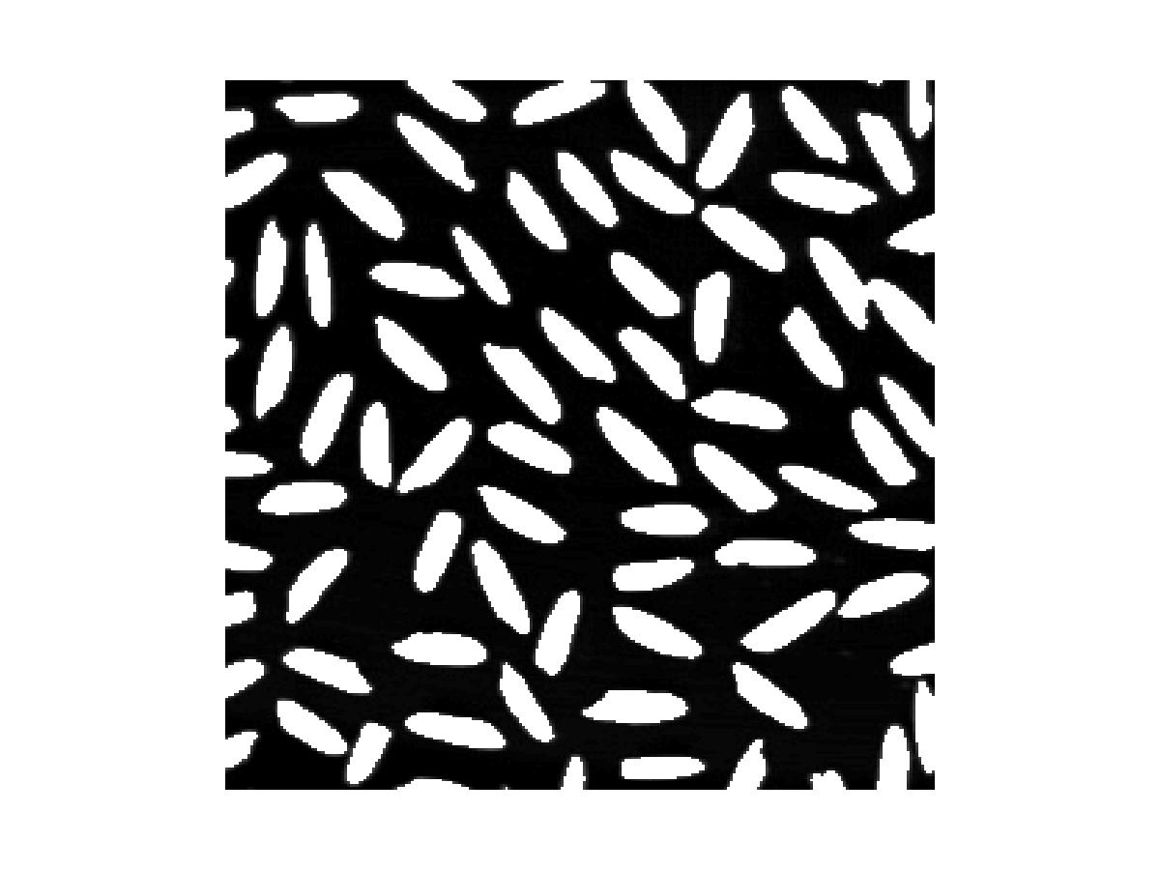
Segmented Image
Image histogram of rice
Image after segmentation

Slide 22
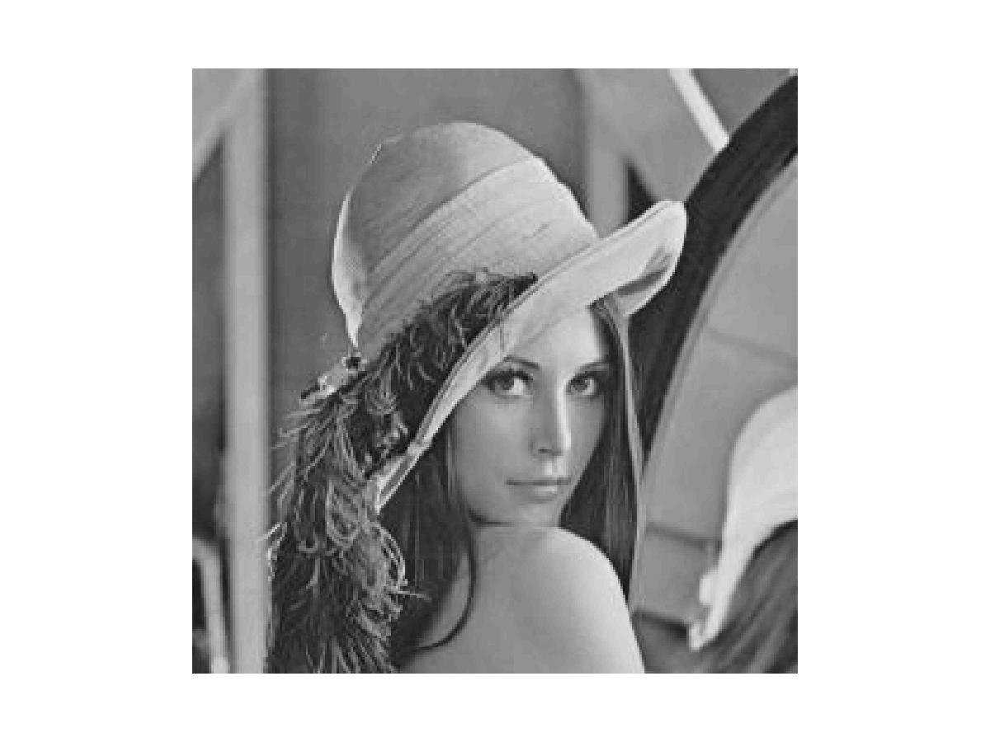
Gray Scale Image - Multimodal
Original Image of lena

Slide 23
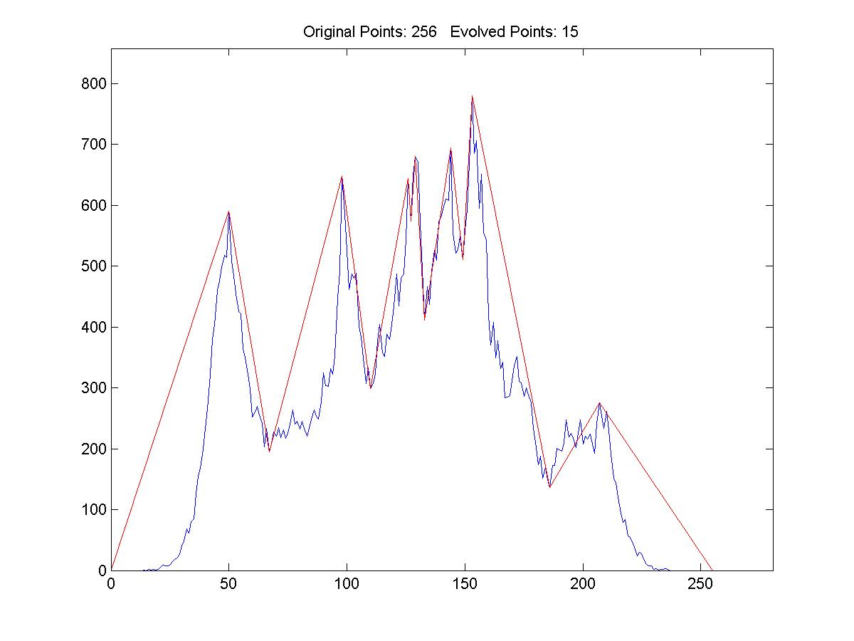
Multimodal Histogram
Histogram of lena

Slide 24
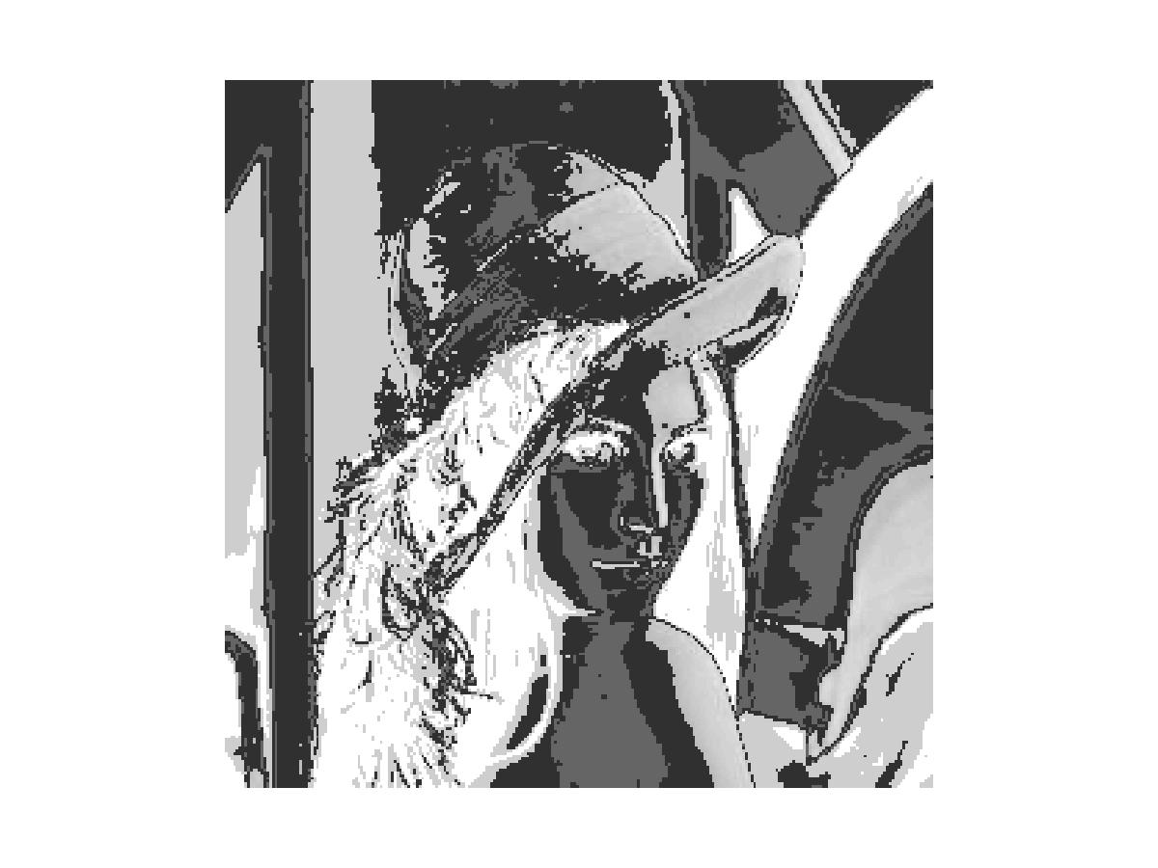
Segmented Image
Image after segmentation – we get a outline of her face, hat, shadow etc

Slide 25
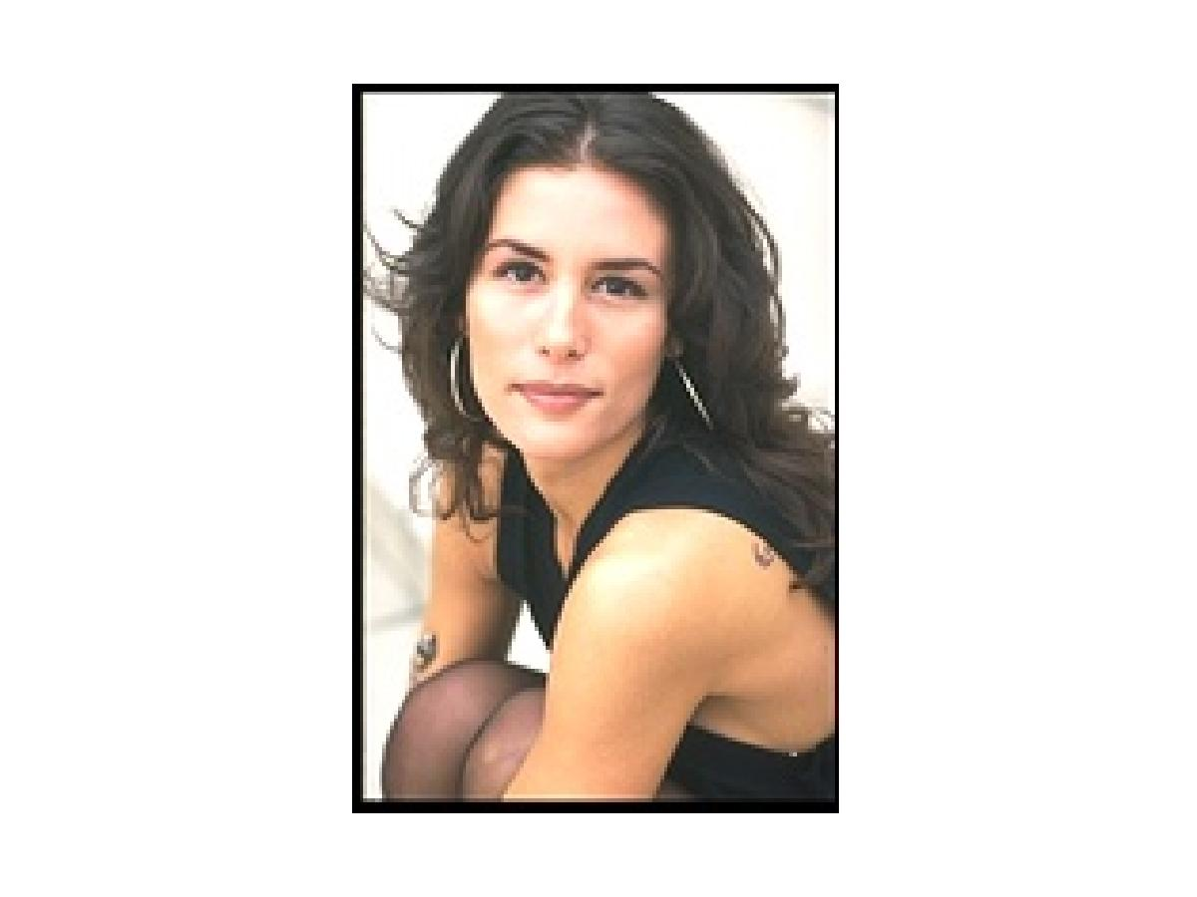
Colour Image - bimodal
Colour Image having a bimodal histogram

Slide 26
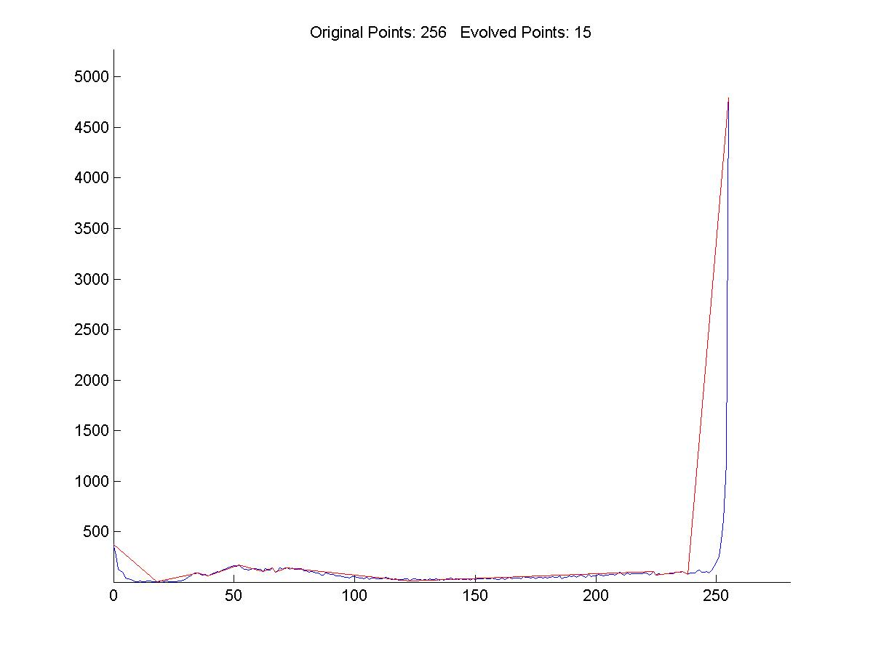
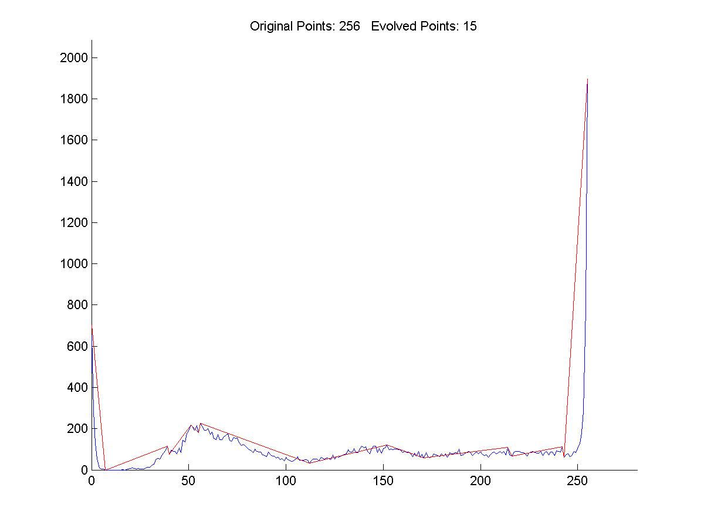
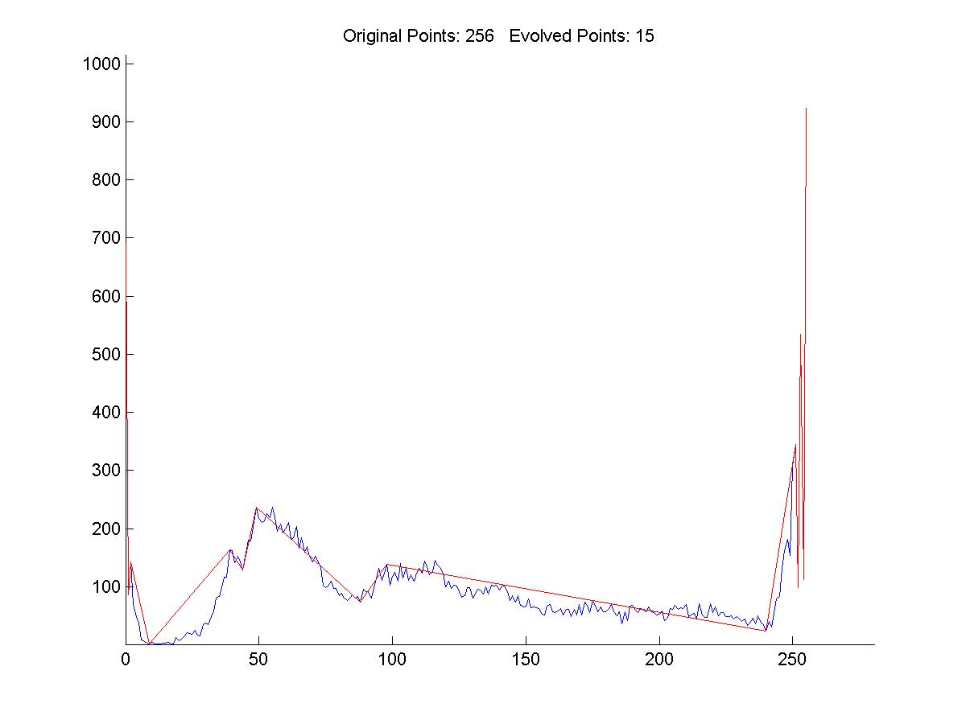
Histogram
Histograms for the three colour spaces

Slide 27
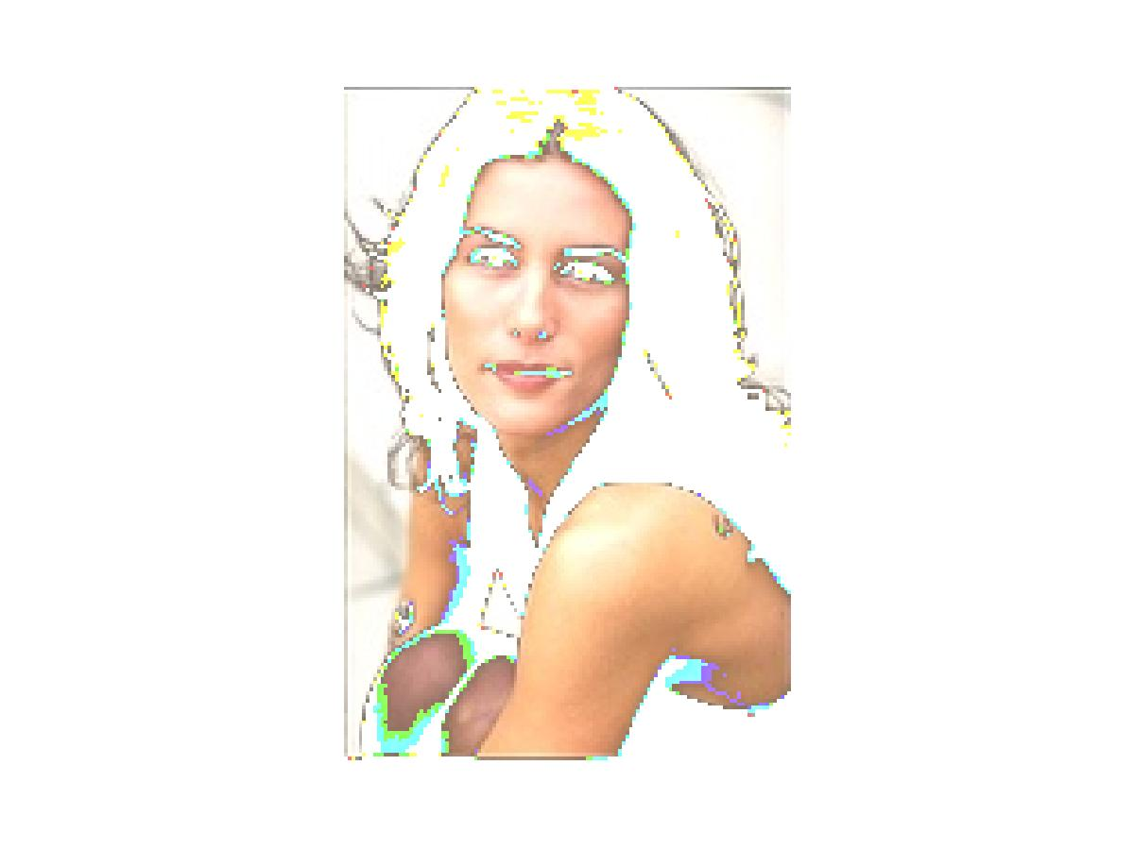
Segmented Image
Segmented image – giving us the outline of her face, hand etc

Slide 28
Clustering in Color Space
Each image point is mapped to a point in a color space, e.g.:
Color(i, j) = (R (i, j), G(i, j), B(i, j))
The points in the color space are grouped to clusters.
The clusters are then mapped back to regions in the image.

Slide 29
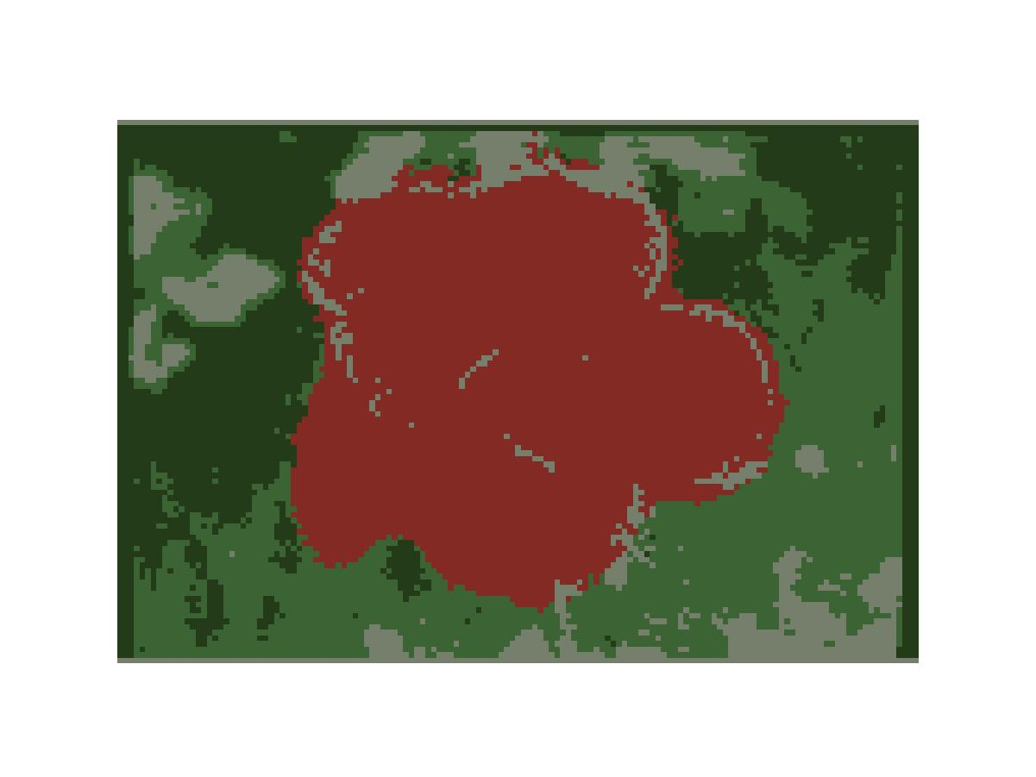
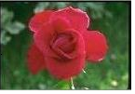
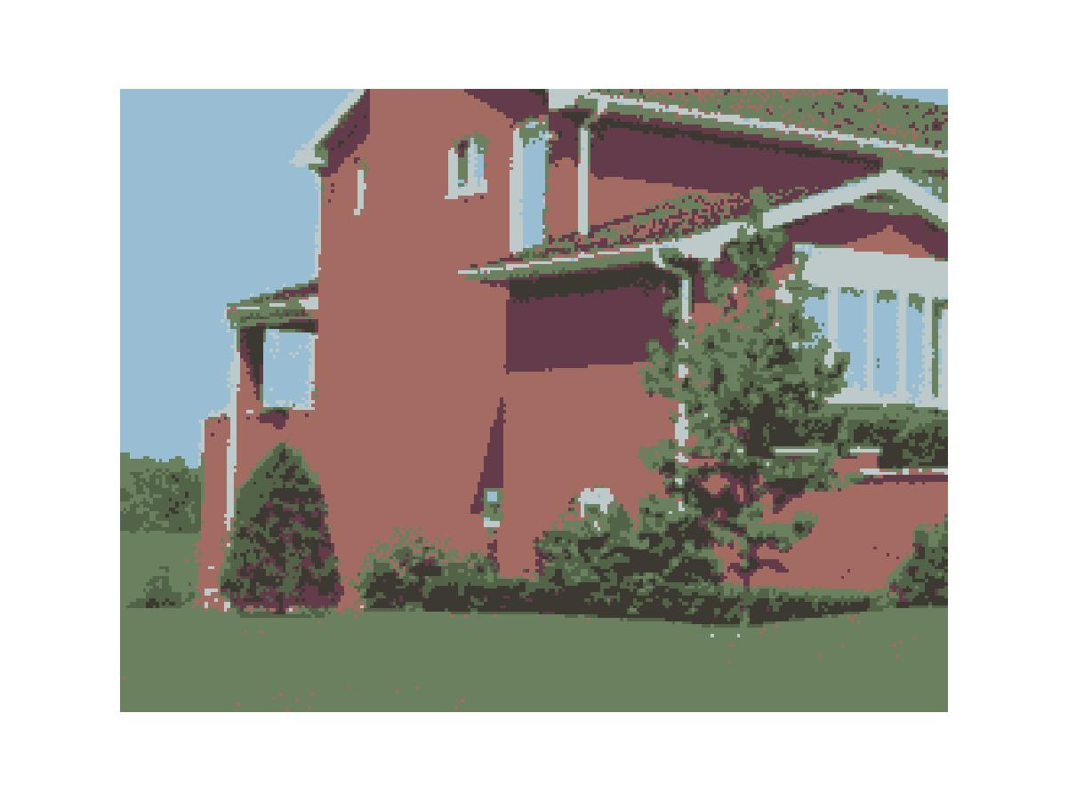
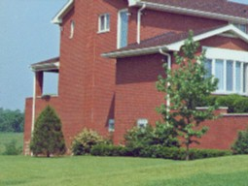
Resluts 1
Original pictures segmented pictures
Mnp: 30, percent 0.05, cluster number 4
Mnp : 20, percent 0.05, cluster number 7

Slide 30
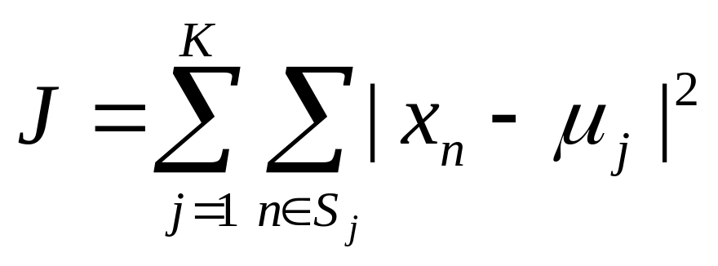
k-means Clustering
An algorithm for partitioning (or clustering) N data points into K disjoint subsets Sj containing Nj data points so as to minimize the sum-of-squares criterion
where x_{n} is a vector representing the nth data point and μ_{j} is the geometric centroid of the data points in S_{j}

Slide 31
The algorithm consists of a simple re-estimation procedure:
First, K centroid points are selected μ_{j}, e.g., at random.
Second, each data points is assigned to
the cluster Sj of the closest centroid μ_{j}.
Third, the centroid μ_{j} is recomputed for each cluster set.
The steps two and three are alternated until a stopping criterion is met,
i.e., when there is no further change in the assignment of the data points.
In general, the algorithm does not achieve a global minimum of J over the assignments. In fact, since the algorithm uses discrete assignment rather than a set of continuous parameters, the "minimum" it reaches cannot even be properly called a local minimum. Despite these limitations, the algorithm is used frequently as a result of its ease of implementation.
Homework:
Implement in Matlab and test on some example images the clustering in the color space. You can use k-means or some other clustering algorithm.

Slide 32
Matlab example
Matlab programs are in
www.cis.temple.edu/~latecki/CIS601-03/Lectures/Matlab/Clustering/
data=load('irises1.dat'); % loads a classic data set of Irises
[distance,cluster,tse] = kmeans1(data,3); %starts k-means clustering
showcluster(cluster,'irises1.dat'); % shows clusters in 3D projection obtained by PCA
[output_matrix] = test_tableform('ireses_gt.txt',cluster,3);
%if the ground truth is know, this function compares the clustering result to it

Slide 33
Conclusion
After segmenting the image, the contours of objects can be extracted using edge detection and/or border following techniques.
Image segmentation techniques are extensively used in Similarity Searches, e.g.:
http://elib.cs.berkeley.edu/photos/blobworld/

