Slide 1
Project-01-Preperation

Slide 2
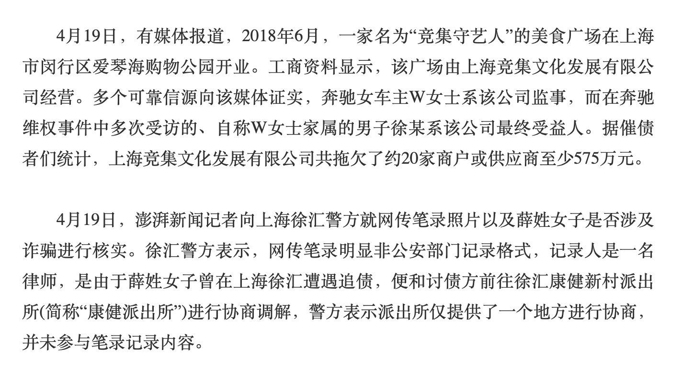
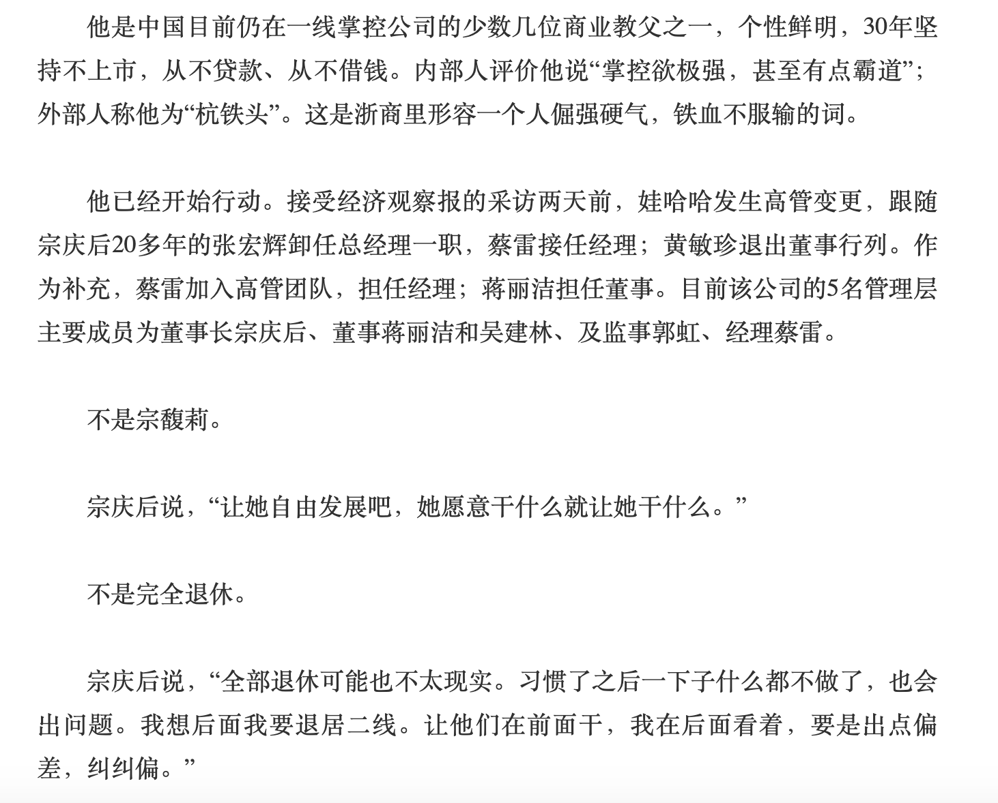
Our Target

Slide 3
1. How to use SQL
https://www.w3schools.com/sql/sql_intro.asp
2. Download DataGrip or MySQL Workbench
https://www.jetbrains.com/datagrip/
3. Learn to use Git
https://product.hubspot.com/blog/git-and-github-tutorial-for-beginners
4. Using Word-Embedding, BFS, Dependency Parsing, NER
We will learn these in course
5. Python Backend Development
https://bottlepy.org/
6. Simple HTML Build (HTML, CSS)
https://getbootstrap.com/

