Slide 1
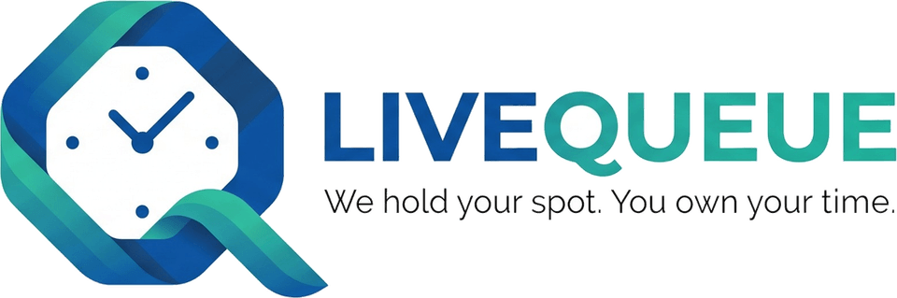
LiveQueue
A Real-Time Digital Queue Management Platform
Join from a QR code, wait anywhere, get called the moment it is your turn — with server-authoritative dispatch across many counters.
In production · Android v1.0.6
Presenter: [Your name] · Supervisor: [Name] · [Department, University] · [Date]
Notes:
Introduce LiveQueue in one sentence: a live digital queue for organizations — visitors join from a QR code on Android or iPhone, staff serve from counters in a web dashboard, and everyone sees updates in real time. It is deployed and in production, with Android release v1.0.6 published. Replace the bracketed presenter placeholders before presenting.

Slide 2
Queues are still physical and uncertain
1
Visitors
2
Counter staff
3
Administrators
Stand in a crowd for an unknown time
No live update, easy to miss a call
Multi-step visits restart the wait
Who is next? Who was here first?
Several counters, several services
Hand-offs between counters are informal
No visibility of load or idle counters
No record of who served whom
Hard to run several desks or teams
Multi-service visits (e.g. an enquiry, then a payment) make every one of these worse.
Notes:
Frame the problem from three viewpoints: visitors don't know how long they will wait and have to stand in a crowd; staff juggle several counters and services without a shared view; administrators can't see or audit what happened. Multi-service visits — e.g. an enquiry followed by a payment — make every one of these worse.

Slide 3
One live queue, shared by every device
Organizations & roles
Queues & counters
QR entry
Ordered journeys
Head, Manager, Admin workspaces, Executives
Many counters per queue · Open / Paused / Off
One organization QR → choose a queue
Several services in a chosen order · referrals
Live updates
Notifications
Governance & audit
Floating Counter Console
Socket.io: position, ETA, called, done
Android FCM · iPhone Web Push · email
Admin replacement · Head succession · immutable history
Always-visible serving controls (live)
Clients: Flutter Android app · React staff dashboard · iPhone/iPad Safari portal (PWA)
Notes:
Everything on this slide is implemented and in production, including the Floating Counter Console, which went live on 9 October 2026. The key idea: one backend owns the queue, and three kinds of client — Android, iPhone browser and the staff dashboard — stay in sync through realtime events.

Slide 4
Four roles: governance and operations
GOVERNANCE
Product rules (enforced in the database)
One Head per organization
One live queue per Admin
A live queue always keeps its Admin
Executives belong to one workspace
Permissions derive from role only
Organization Head
Whole organization · exactly one
Organization Manager
Org-wide reports & audit · no serving
OPERATIONS — isolated Admin workspaces
Admin A
Owns ≤ 1 live queue
Admin B
Owns ≤ 1 live queue
Executive
Executive
Executive
Executive
Queue: Student Services
Queue: Library Desk
✕ no cross-workspace access
Notes:
Explain the split. The Organization Head and Manager govern the whole organization; neither serves people. Each Admin owns an isolated workspace with at most one live queue — that is a product rule enforced by a unique index in the database. Executives belong to exactly one Admin and serve from a counter. Workspace isolation means an Admin never sees another Admin's queue, history, audit or reports.

Slide 5
System architecture
HTTPS + WebSocket
Android app
Flutter · visitors
Render · one web service
Firebase Cloud Messaging
Android push
Express REST API
Node.js · TypeScript · Zod
iPhone/iPad portal
Safari PWA · visitors
Socket.io server
org / workspace / token rooms
Web Push
iPhone/iPad Safari (Home Screen PWA)
VAPID-based notifications
Staff dashboard
React + Vite
Authorization + business rules
dispatch · journeys · governance
Resend
Transactional email
Floating Counter Console
Document PiP · fallback dock
Schedulers (node-cron)
GitHub
Source · Actions CI · signed APK releases
Cloudflare Pages
Static dashboard + portal
Neon PostgreSQL
via Prisma · constraints & triggers
assets
Notes:
Walk left to right. Three clients. One backend process on Render runs the REST API, the Socket.io server and two schedulers. PostgreSQL on Neon is the single source of truth via Prisma. Static dashboard and portal are served by Cloudflare Pages — note that API traffic goes straight to Render, not through Cloudflare. Notifications fan out to FCM for the Android app, Web Push for iPhone/iPad visitors who added the Safari portal to their Home Screen, and Resend for email. The Floating Counter Console is a fourth staff surface, live in production: it shares the dashboard's session, data cache and Socket.io connection.

Slide 6
REST for truth, Socket.io for change
REST — every read and write
Client
authenticate
(JWT + DB reload)
validate
(Zod)
service layer
authorize · transaction
PostgreSQL
Socket.io — "something changed"
Committed change
emit to rooms
org · workspace · token
dashboard: batched invalidate
visitors: apply payload
dashboard refetches once
per burst over REST
On reconnect: re-join rooms and refetch everything — a missed event is never assumed to be replayed. Rooms: organization (Head/Manager), workspace (Admin/Executives), token (one visitor), public queue (no personal data).
Notes:
Two lanes. Top: every read and write is a REST request that is authenticated, validated, authorized and usually wrapped in a transaction. Bottom: Socket.io tells clients that something changed. The staff dashboard batches the resulting refetches, so a burst of events costs one reload per view; the Android app and the iPhone/iPad portal apply the event payload directly, which the server builds with the same function as the REST read. Events are never replayed, so after a reconnect every client rejoins its rooms and re-reads the server's state.

Slide 7
Token lifecycle: one server-side state machine
Serve next
Start (± code)
Complete
WAITING
CALLED
IN_PROGRESS
COMPLETED
visitor cancels
(before service)
staff skip — reason required
CANCELLED
SKIPPED
Journey step done, more to go → back to WAITING for the next step, keeping the original arrival position.
Serve next and Start are atomic compare-and-swap updates; the server rejects any transition the machine does not allow.
Notes:
This is the real state machine from tokenStateMachine.ts. Visitors can cancel only before service starts. Staff must give a reason to skip. On an ordered journey, completing a step that is not the last returns the token to WAITING for its next step — keeping the original arrival position. Clients only render the state; they never decide transitions.

Slide 8
Ordered journeys and referrals
Step 1
Admissions enquiry
Step 2
Fee payment
Step 3
Document collection
current step
Desk 2 handles Payment → served there
Ordered, 1–20 steps
Repeat rules
Locked at creation
Chosen by the visitor from the recommended order
A service may repeat (limit 1–10), never twice in a row
Any change is refused: 409 JOURNEY_LOCKED
Counter eligibility
Referral
Fallback
A counter serves only the services it handles
Next step goes to a chosen open counter — no interruption
Target closes → priority kept at another eligible counter
Notes:
A visitor builds their own ordered journey from the queue's services, starting from the Admin's recommended order. Rules: 1 to 20 steps, a service may repeat but never twice in a row and not beyond its limit. Once the token exists the order is locked. Each step is served by a counter that handles that service. A referral sends the next step to a specific open counter, ahead of normal order but never interrupting anyone; if that counter closes, the referral keeps its priority at another counter that handles the step.

Slide 9
Many counters, one server-side dispatcher
Counter states
Serve next — decided on the server
Open
ACTIVE · operator required
Client sends only the queue id
No person, counter or staff id is accepted
1
Paused
ON_BREAK · operator retained
2
Lock the caller's own counter
SELECT … FOR UPDATE inside a transaction
3
Pick: referrals first, then earliest arrival
Whose current step this counter handles
Off
OFFLINE · unassigned
4
Compare-and-swap WAITING → CALLED
A concurrent claim matches nothing and moves on
Assign operator to Off → Paused (never straight to Open). Off is refused while someone is called or in service there.
5
Commit, then broadcast
Every device converges on the same truth
Notes:
Left: the counter lifecycle. Open requires an operator, Paused keeps the operator, Off releases them. Assigning someone to an Off counter makes it Paused, never Open. Right: the most important design decision — the server decides who is next. Serve next sends only the queue id; the backend picks the earliest eligible person for the caller's own counter inside a transaction that locks the counter and compare-and-swaps the token, so two counters can never claim the same person and every device sees the same order.

Slide 10
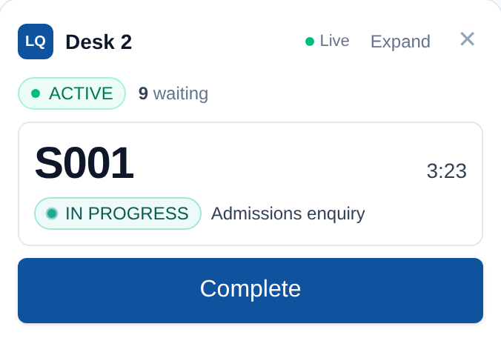
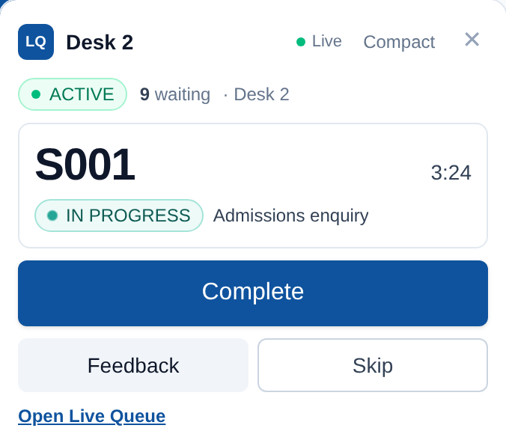
Floating Counter Console
Compact
Expanded
Document Picture-in-Picture: a small always-on-top window (Chromium desktop browsers)
Same APIs, same Socket.io connection — no second dispatch engine
Shows token, service, state, waiting count, server-timed timer
Actions held while reconnecting; access loss closes it
Token number and service only — no personal data
Fallback: in-page dock that says it cannot stay on top
Real screenshots, fictional demo data.
Ready for review · not deployed
Notes:
Newest feature — implemented, tested and ready for review on its own branch, not yet deployed. It uses the browser's Document Picture-in-Picture API to keep a tiny console on top of other windows. It is a React portal from the dashboard's own app, so it shares the same session, cache and single Socket.io connection — there is no second dispatcher. Every button calls the same endpoints as the main page. Browsers without the API get an in-page dock that says honestly it cannot stay on top.

Slide 11
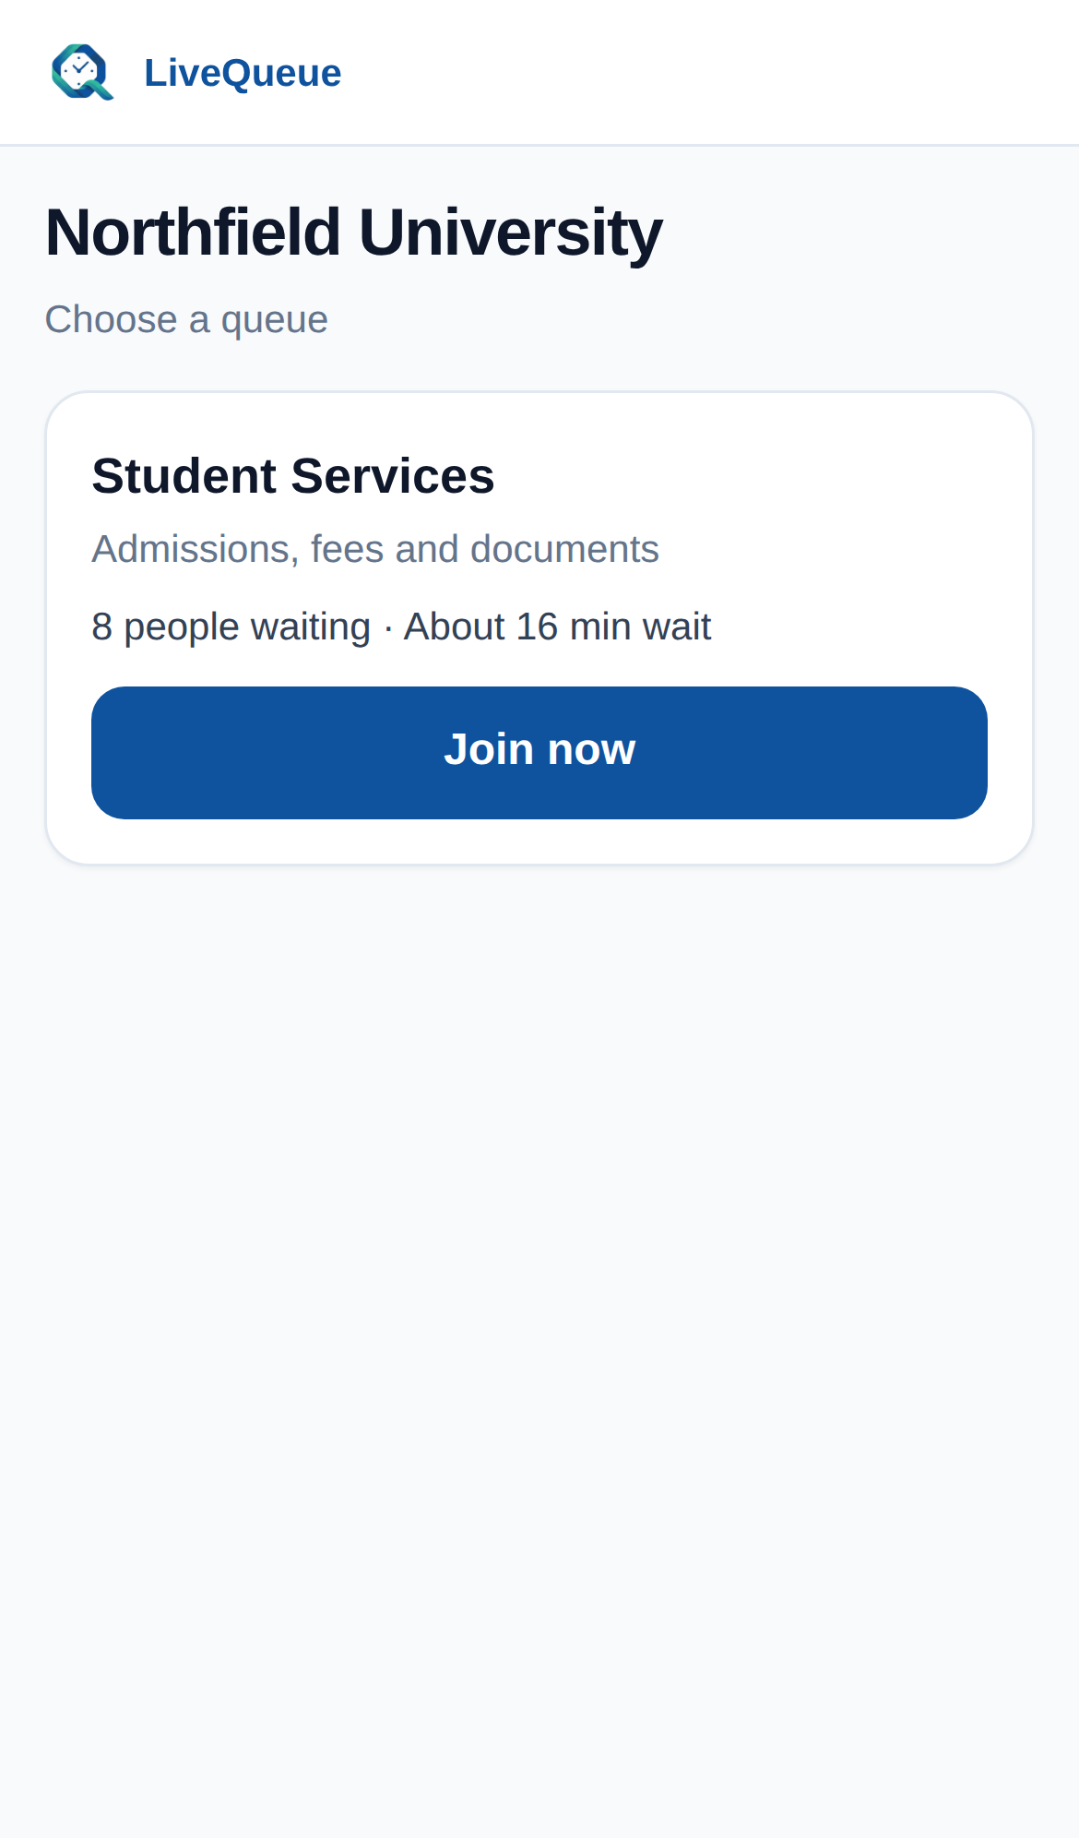
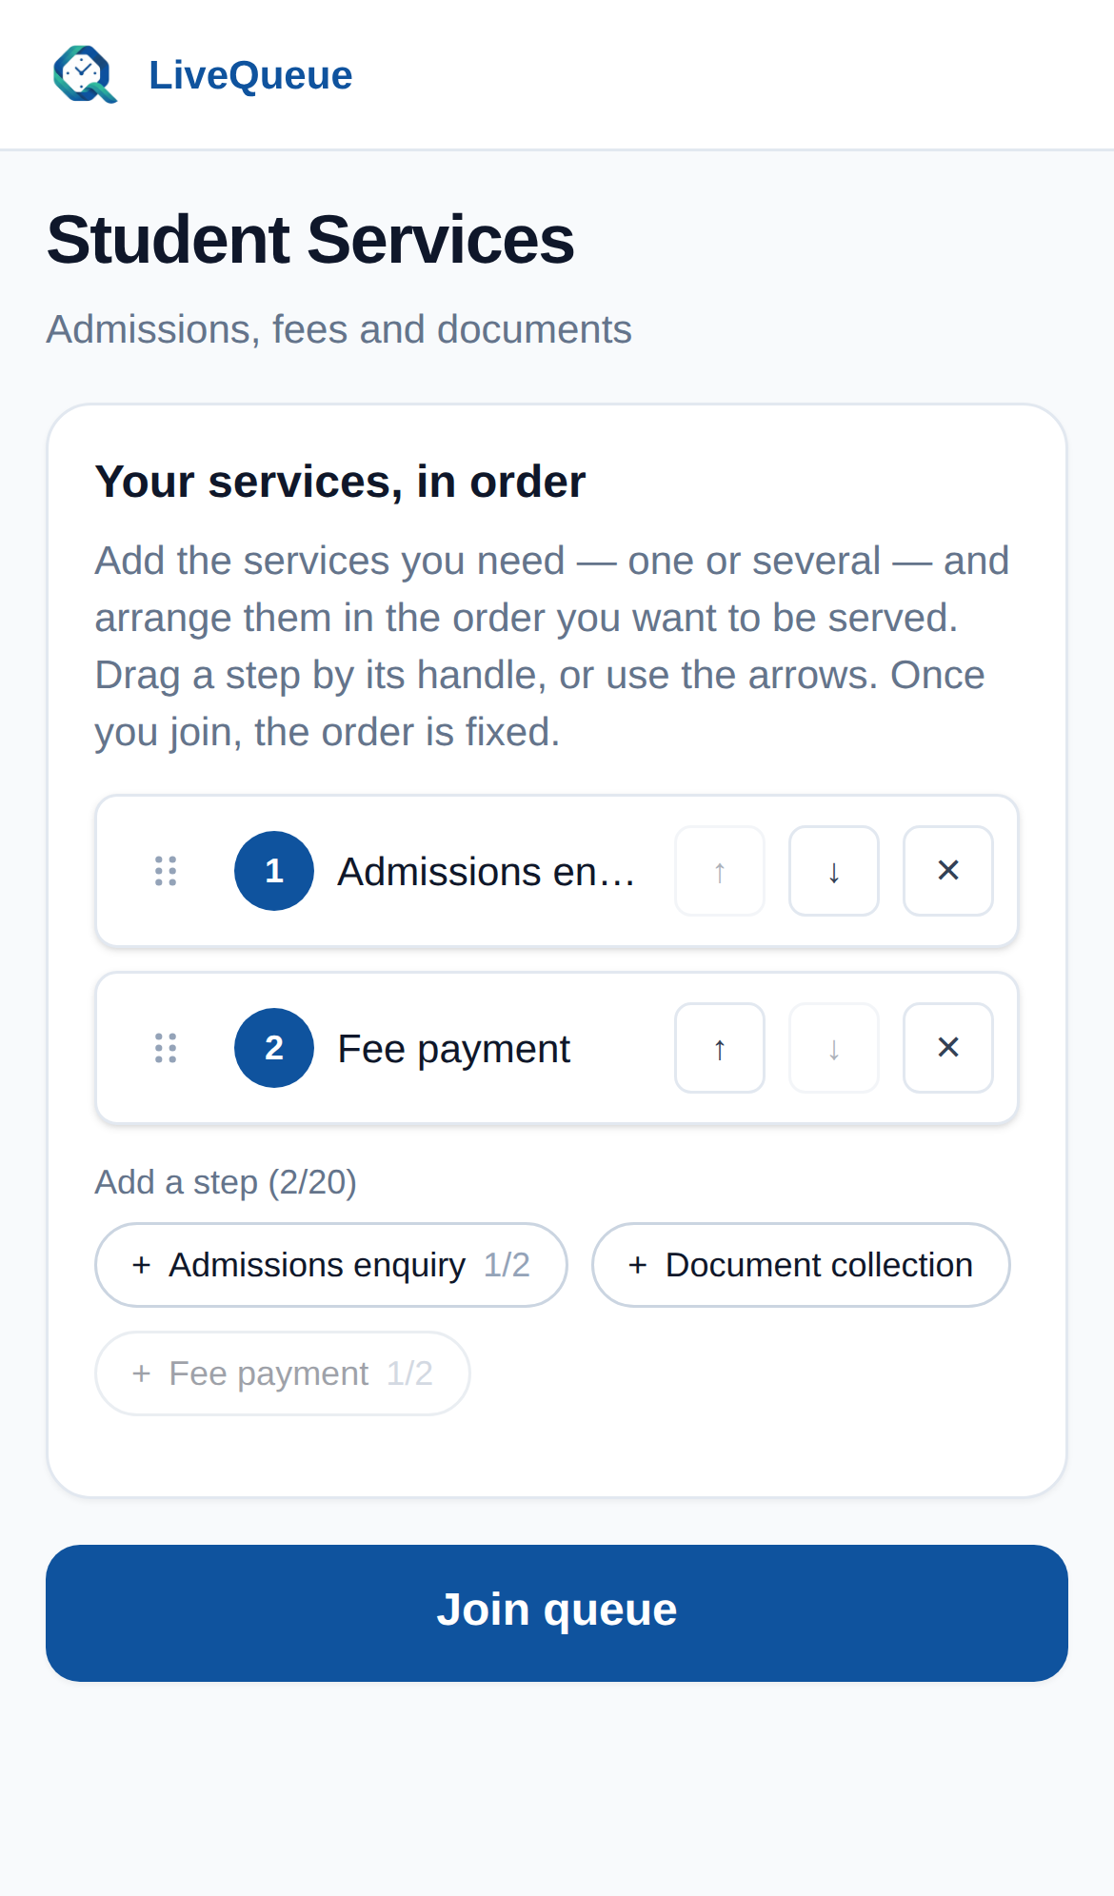
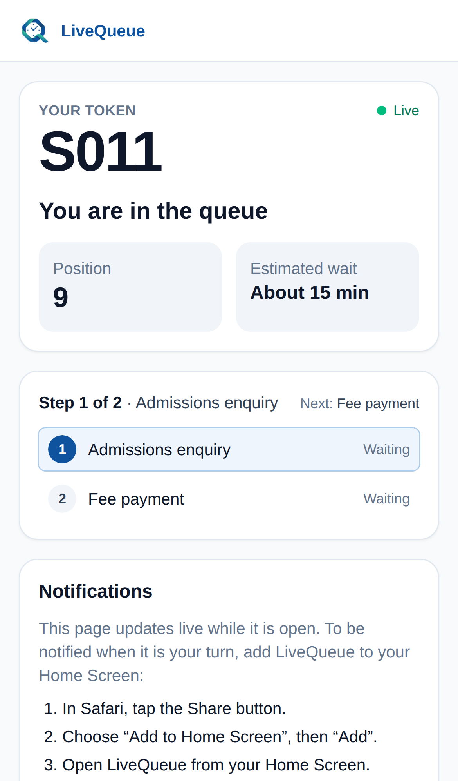
Visitor experience: QR → services → token
Android (Flutter)
Same flow in the app; push via Firebase Cloud Messaging.
iPhone / iPad
Safari portal; notifications need iOS 16.4+, Home Screen install and permission.
Physical iPhone push: pending
Physical Android QA: pending
1 · Scan organization QR
2 · Choose services in order
3 · Live token, position, ETA
Screens: fictional demo data.
Notes:
These are real screens from the iPhone/iPad portal, with a fictional demo organization. One organization QR opens the list of queues; the visitor builds an ordered journey; the tracking page shows position, ETA and step progress live. On Android the Flutter app does the same with FCM notifications. Physical device checks are still pending and labelled as such.

Slide 12
Notification architecture
Socket.io
Open app / portal / dashboard
live, instant
Queue event
called · close to turn · completed
Backend
events + reminder scheduler (every minute)
FCM
Android app
free · Google
Web Push (VAPID)
iPhone/iPad Safari PWA
free · Apple push service
Best-effort delivery. Push depends on device settings, OS rules and vendor services. LiveQueue never assumes a notification arrived — the live screen and the server state stay authoritative.
Resend email
Accounts, invitations, succession
free: 100/day
Notes:
A queue event in the backend drives up to four channels. Socket.io updates any open screen instantly. Android devices get Firebase Cloud Messaging; iPhone home-screen web apps get standards Web Push through Apple's push service, signed with our VAPID key. A scheduler checks every minute for people whose turn is close and sends reminders. Email through Resend is for accounts and governance, plus visitor codes only on queues configured that way. Stress that delivery is best-effort — no channel is guaranteed.

Slide 13
Governance and succession
✓
Admin replacement
✓
Live queue keeps its Admin
Queue + every Executive move atomically; counters, tokens and history untouched
Database trigger; refused with a guided replacement flow
✓
Head succession
✓
Tenure history
Password + emailed code → single-use 72-hour link → explicit acceptance
Who led the organization, when, and why — visible by role
✓
Transactional audit
✓
Immutable history
Change and audit row commit together, with actor snapshots
Triggers block edits and deletes; deleting an org leaves a minimal receipt
Notes:
This makes LiveQueue usable by a real organization with staff turnover. A live queue can never lose its Admin: changing or removing that Admin requires choosing a replacement, and the queue and all Executives move in one transaction. The Head can hand the organization to a successor, verified with their password, an emailed code and a single-use 72-hour link. Every governance change and its audit record are written in the same transaction, and database triggers make history append-only.

Slide 14
Security: implemented vs known gaps
Implemented
Known gaps
bcrypt passwords · 15-min JWT · rotated, hashed refresh tokens
User + organization reloaded from the DB on every request
Tenant & workspace scoping on every query (404, never leak)
Backend authorization on every mutation, whatever the UI shows
Instant revocation: tokens + live sockets dropped
Single-use, hashed, expiring invitation and handover links
Transactional, immutable audit with actor snapshots
Rate limits per real client (CF-Connecting-IP; spoof-resistant)
Rate limits are in-memory, per process
People behind one NAT (campus Wi-Fi, carrier) share a limit
No external penetration test or WAF
No centralized security monitoring or alerting
Notes:
Left column: controls that exist in code and are covered by tests. Right column: honest limitations. Worth mentioning: preparing this analysis we found every visitor shared one rate-limit bucket behind Render's proxy. That is fixed and live: limits now key on the real client address from Cloudflare's CF-Connecting-IP, with Express trust proxy deliberately left off so forged X-Forwarded-For headers are ignored. Verified in production from two machines on 9 October 2026.

Slide 15
Database design (simplified)
Organization
tenant root
Queue
≤1 live per Admin
Token
number unique per queue
Enforced in PostgreSQL
One Head per org
One live queue per Admin
Live queue needs an Admin
One open succession
Unique token number per queue
History append-only (triggers)
Staff (Associate)
role · workspace
Counter
Open / Paused / Off
Journey step
ordered · referral
AuditLog
append-only
CounterService
routing (N–M)
Device
visitor identity · 1–N tokens
Governance
tenures · successions
QueueService
duration · repeat limit
Notes:
Only the core entities are shown. An Organization has Associates (the staff table), queues and audit history. A queue has services and counters; counters and services are many-to-many, which is how routing works. A token belongs to a queue and has ordered journey steps. Governance tables keep tenures, successions and workspace transfers. Point out the constraints at the bottom — these are what keep the rules true under concurrency.

Slide 16
Deployment and release pipeline
Cloudflare Pages
dashboard + portal (static)
Render · 1 instance
API + Socket.io + cron
Neon
PostgreSQL
FCM · Push · Resend
Single instance by design: Socket.io has no cross-instance adapter yet.
Release process (used for v1.0.6)
Feature branch + tests
Merge to master
Render: prisma migrate deploy, then start
Production smoke checks
Signed APK dry run + verification
Publish GitHub Release
APK verification on every release: exactly one signer · certificate pinned to 70:08:D3:…:0A:93 · package com.livequeue.mobile_app · version 1.0.6 (build 7) · not debuggable · production API compiled in. Signing keys live only in GitHub secrets — never in the repository.
Notes:
Production topology on top: Cloudflare Pages for static files, one Render web service for the API and Socket.io, Neon for PostgreSQL. The backend deliberately runs a single instance because Socket.io has no cross-instance adapter yet. Bottom: the real release process used for v1.0.6 — feature branch and tests, merge to master, Render applies Prisma migrations before the new code starts, smoke checks, then a signed Android dry run that verifies the signer certificate, package, version and production API before publishing.

Slide 17
Testing and current production status
1,234
640
479
Pending / not yet done
Real iPhone Web Push delivery — pending physical iPhone test
Physical Android device QA — pending
Formal load testing — not done
Console always-on-top on a real desktop OS — not verified headlessly
Post-deploy DB counts recorded manually by the owner (read-only SQL)
backend tests
dashboard tests
Flutter tests
All passing on production master (9 Oct 2026). Typecheck, lint and production builds clean.
Verified automatically
Backend live: health, Socket.io handshake, Web Push config
Both governance migrations applied; new routes respond
Dashboard + portal render (headless Chromium checks)
Android v1.0.6 published, Latest; APK independently verified
Console + performance fixes live; per-client rate limits verified
Notes:
Separate what was verified automatically from what still needs a physical device. Test counts are for production master after the 9 October rollout. Emphasize: these are correctness tests; they are not load tests, and we have not run a formal load test.

Slide 18
Capacity, cost and scaling
Answering “How big can it run for free?” — with every number labelled
Notes:
Transition. Everything that follows is labelled: PROVIDER LIMIT from official pages checked on 8 October 2026, HARD LIMIT from our code, MEASURED locally on a development machine, or ESTIMATE. Nothing here is a load-test result.

Slide 19
What is actually free today?
Service | Plan | Key free limits (PROVIDER LIMIT)
Render (API + Socket.io) | Free web · Hobby | 0.1 CPU · 512 MB · 1 instance · sleeps after 15 min (≈1 min wake) · 5 GB outbound/month
Neon (PostgreSQL) | Free | 100 CU-h/month (≈400 h at 0.25 CU) · 1 GB storage · 5 GB egress · sleeps after 5 min
Cloudflare Pages | Free | 500 builds/month · no published static bandwidth cap
Firebase Cloud Messaging | No-cost | 600k messages/min per project
Web Push (VAPID) | No fee | iPhone/iPad Safari Home Screen PWA via Apple's push service; iOS/iPadOS 16.4+ and user permission
Resend | Free | 100 emails/day · 3,000/month
GitHub | Free (public repo) | Standard Actions runners free for public repos
Domain (tdastudbook.au): separate registration/renewal cost — not verified. Quotas checked on: 2026-10-08 · production state: 2026-10-09
Registered ≠ daily active ≠ waiting now ≠ open sockets ≠ requests/second. Infrastructure is sized by concurrency and event rate, not by accounts.
Notes:
Two points. First, the infrastructure costs nothing today, but the domain may have a separate registration cost that we have not verified. Second, capacity is about concurrency and traffic, not registered accounts: 100,000 accounts are just rows; what matters is how many sockets are open, how many queue events per second, and how long the queues are.

Slide 20
Capacity: one queue
 | People waiting in one queue
Application limit | None (HARD LIMIT: 32-bit token number)
Comfortable | ~300 – 500 on free CPU (ESTIMATE)
Caution | > 500, or many open staff tabs (ESTIMATE)
Before the fixes | ≤ ~50 (ESTIMATE)
Load-tested | NOT LOAD-TEST VALIDATED
Counters per queue: no limit; comfortable 1–10, caution 10–25 (ESTIMATE).
ETA recompute per event (local): 16 ms · 103 ms · 454 ms
1 Serve next, 200 waiting: ~400 → 4 dashboard requests · 0 visitor re-reads (MEASURED, local)
Notes:
There is no software limit on people waiting. The cost of each queue event grows with the queue length, because the server recomputes everyone's ETA and sends each waiting person an update. The chart shows bytes one staff dashboard receives per serve cycle, measured locally. We found, in a real browser, that one Serve next with 200 waiting caused hundreds of dashboard requests, and that every iPhone visitor re-read their ticket on every event. Both are fixed and live: one Serve next now costs 2 to 4 dashboard requests and zero visitor re-reads at 50, 200 or 500 waiting. Hence: comfortable up to about 300 to 500 waiting per queue on the free server, Android and iPhone alike — an estimate, not a load test.

Slide 21
Capacity at every level
Level | Application rule (HARD LIMIT) | Comfortable (ESTIMATE) | Upgrade trigger
One counter | One operator · one person at a time | ~12 visits/hour (5-min service) | —
One queue | No waiting limit | ~300–500 waiting · 1–10 counters | > 500 waiting · > 25 counters
One organization | 1 live queue per Admin; no Admin limit | 1–2 queues · ~200 visits/day | ≥ 5 busy queues
Whole platform | No organization limit | ≈ 25,000 visits/month · ~5 small organizations | Neon free quotas exhausted
Assumptions: 4 queue events per visit, ~10 waiting, 2 staff tabs per queue, 8 h/day, 22 days/month. NOT LOAD-TEST VALIDATED.
Notes:
Read top to bottom. Every row distinguishes the application rule from the infrastructure estimate. One Admin, one live queue is a product rule, not a hosting limit. No limit on organizations does not mean infinite organizations. The platform row is the one faculty will ask about: about twenty-five thousand visits a month on the free tiers, from formulas in the capacity document. SHORT ANSWER if asked: LiveQueue runs entirely on free tiers. There is no software limit on people per queue, queues per organization, or organizations. With the software fixes now live, we estimate the free deployment is comfortable for about five small organizations with similar business hours — about twenty-five thousand visits a month — and about 300 to 500 people waiting per queue. The first likely limit is Neon's free quotas: 5 GB of data transfer and 100 compute-hours a month. The first paid step is Neon Launch, roughly 10 to 20 dollars a month, then Render Starter at 7 dollars to remove cold starts. These are engineering estimates, not load-test results.

Slide 22
Current bottlenecks, in order
✓
Fixed and live (9 Oct 2026)
Dashboard refetch storm · iPhone portal re-reads · shared rate-limit bucket
1
Neon free quotas: 5 GB transfer + 100 CU-h/month
First likely limit; the reminder job keeps the DB awake while the backend is
2
Render Free: 0.1 CPU, ~1-minute cold start
Per-event ETA work grows with queue length
3
Render outbound: 5 GB/month
Socket updates grow with waiting × open staff tabs
4
Resend: 100 emails/day
Only if queues verify every visitor by email
—
Not limiting now: Cloudflare Pages, FCM, Web Push, GitHub Actions
Free or no published cap at this scale
ESTIMATE from measured payloads + published quotas. Quotas checked on: 2026-10-08 · production state: 2026-10-09
Notes:
Three software bottlenecks we found are fixed and live since 9 October: the dashboard refetch storm, the iPhone portal's per-visitor re-reads, and the shared rate-limit bucket. What remains is infrastructure. Number one is Neon's free quotas: 5 GB of data transfer and 100 compute-hours a month — the reminder job queries every minute, so the database stays awake whenever the backend is. Then Render Free's small CPU and one-minute cold start, then Render's 5 GB outbound for long queues watched by many staff tabs, then Resend's 100 emails a day, but only for queues that email every visitor.

Slide 23
When do we need to pay?
When this happens | Service | Upgrade to | Why | Approx. cost
Refetch storm / shared limits | Code | Done — live 9 Oct 2026 | Batched refetch · per-client limits | $0
Neon egress or hours run out | Neon | Launch (usage-based) | 500 GB egress, no hour cap | ≈ $11–20/mo*
Cold starts / CPU busy | Render | Starter 0.5 CPU | Always on, 5× CPU | $7/mo†
Outbound > 5 GB | Render workspace | Payment method or Pro | Avoid suspension; 25 GB | $0.15/GB or $25/mo
Sustained load | Render | Standard 1 CPU · 2 GB | More compute, 1 instance | $25/mo†
> 100 emails/day | Resend | Pro | 50k/month, no daily cap | $20/mo
Need > 1 instance | Render + Redis | Replicas + Socket.io adapter | Events reach every instance | Size after load test
* 0.25 CU × 400–730 h × $0.106/CU-h. † Render pricing page is dynamic; figures corroborated by third-party listings — confirm in dashboard. Quotas checked on: 2026-10-08 · production state: 2026-10-09
Notes:
The free software fixes are done and live, and bought roughly five times more headroom. The first paid step is Neon Launch — pay-as-you-go, about 10 to 20 dollars a month for one small always-busy compute, with 500 GB of egress included. Then Render Starter at 7 dollars for an always-on backend with five times the CPU. Resend Pro only if queues email every visitor. Render prices come from the pricing page as reported by third parties because the official page loads dynamically — confirm in the dashboard.

Slide 24
From one backend to distributed realtime
TODAY
FUTURE (not implemented)
Clients
app · portal · dashboard
Load balancer
sticky sessions / WebSocket-only
Backend 1
Backend 2
One backend
REST + Socket.io + cron
Redis
Socket.io adapter · rate limits
PostgreSQL (Neon)
PostgreSQL
Adding instances alone breaks realtime: events stay on the instance that emitted them.
Notes:
Today one process holds every socket, so any event it emits reaches everyone. If you simply add a second Render instance, a visitor connected to instance two will not hear an event emitted by instance one. The fix is the Socket.io Redis adapter, which relays events between instances, plus moving rate-limit counters into Redis and handling sticky sessions or WebSocket-only transport. This is future architecture, not implemented.

Slide 25
Cost & capacity roadmap
Stage 0
Stage 1
Stage 2
Stage 3
Stage 4
Before fixes
Today: software fixes live
First paid
Growing multi-org
High concurrency
$0
$0
≈ $18–27/mo
≈ $70–110/mo
Size after load test
All free tiers · 1 instance
Batched refetch · portal payloads · per-client limits
Neon Launch · Render Starter
Render Standard · Pro workspace · Resend Pro (if needed)
Replicas · Redis · Socket.io adapter · metrics
≈ 4k visits/mo
≈ 25k visits/mo
Always-on; no Neon hour cap
More CPU + 25 GB outbound
Horizontal realtime
ESTIMATES, not load-test validated. Fixed vs usage-based: Render plans fixed; Neon Launch usage-based. Domain cost separate. Quotas checked on: 2026-10-08 · production state: 2026-10-09
Notes:
Stage 0 was the free deployment before the fixes. Stage 1, software only and still free, is done and live since 9 October 2026 — that is where LiveQueue is today. Stage 2 is the first paid step at roughly 18 to 27 dollars a month. Stage 3 for a growing multi-organization platform. Stage 4 changes the architecture and should only be priced after a load test tells us how big it needs to be. All figures are estimates with pricing checked today.

Slide 26
Known limitations and future development
Limitations today
Future (not implemented)
Single backend instance; no Socket.io adapter
Free-tier cold start (~1 minute after 15 idle minutes)
Per-person socket fan-out (grows with waiting × staff tabs)
In-memory rate limits; a shared NAT shares one limit
No formal load test; no central metrics/alerts
Physical iPhone push and Android QA pending
Queue-level realtime updates instead of one per person
Redis + Socket.io adapter + horizontal replicas
Observability: metrics, central logs, alerts
Analytics and predictive wait times
Kiosk mode and institutional integrations
Optional desktop (Tauri/Electron) counter companion
Notes:
Be candid: each limitation on the left is true today. The right column is clearly future work — none of it is implemented. If asked about the desktop console: browser Picture-in-Picture already gives an always-on-top window with no install; a Tauri or Electron companion is an option only if that proves insufficient.

Slide 27
Live demo plan (≈ 5 minutes)
1
Log in as Head: dashboard, queue, counters, services
5
Start → Complete step → person returns for step 2
2
Visitor scans the organization QR on a phone
6
Referral to another counter (if time allows)
3
Build a 2-step journey; get a token
7
Open the Floating Counter Console (local build)
4
Executive presses Serve next — phone updates live
8
Show Associates, audit log and service history
Fallback: wake Render 5 minutes early · keep a local build ready · use the screenshots in this deck if a provider is down.
Notes:
Keep the demo short and in this order. Use a demo organization, never real data. If the backend is asleep, open the dashboard five minutes early to wake it — the cold start is about a minute. If the internet or a provider is down, use the fallback: run locally, or show the recorded screenshots in this deck.

Slide 28
Conclusion
Real problem
Physical, uncertain queues → live, multi-counter, multi-service
Engineering
Server-authoritative dispatch · transactions · DB-enforced rules
Realtime
Socket.io across Android, iPhone and the dashboard
Trust
Instant revocation · immutable audit · governance & succession
Honest scale
Free today; first limit is egress (fixable); clear upgrade path
Questions?
Notes:
Summarize in one breath: a real problem, solved with a production system — server-authoritative dispatch, realtime sync across three clients, strong governance and security, and an honest, measured scaling path. Then invite questions; the faculty Q&A document has prepared answers.

