Slide 1
Hamilontian MCMC in TMB (and ADMB)
Cole Monnahan
2/2016
Workshop

Slide 2
Bayesian Integration
A posterior is a distribution of parameters
We integrate to make inference. If it’s easy, we do it analytically:
If not, we can do it numerically, e.g,.:
> mean(rnorm(1e3,0,1)<0) [1] 0.488
> mean(rnorm(1e6,0,1)<0) [1] 0.499608
But how to generate random posterior samples? Enter MCMC!
MCMC is r<your posterior>()

Slide 3
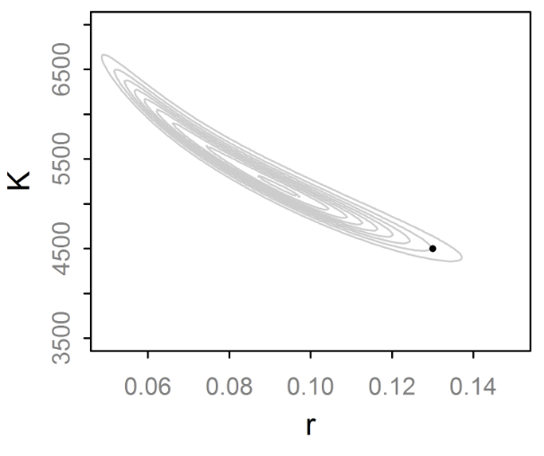
Difficult surfaces to fit
Efficient MCMC needs to move about space easily
This shape is problematic for Gibbs and RWM:
May take many steps to get to other end

Slide 4
Beyond RWM and Gibbs
RWM pros/cons:
Easy to implement and works well for many problems w/o conjugacy.
Must be tuned, can be very sensitive to this
Gibbs pros/cons:
No tuning needed, if full conditionals are possible
Easy to implement (JAGS, BUGS, etc.)
As the dimensionality and complexity increases, these algorithms can struggle.
Thought: We could use gradients to quickly move between areas regardless of dimensionality

Slide 5
Hamiltonian Dynamics
Imagine a puck moving on a frictionless surface
It has position θ with a potential energy U(θ)
And momentum r, with kinetic energy K(r).
The Hamiltonian [H(θ,r)] describes the behavior of the system over time. For MCMC:H=U(θ)+K(r)
Trivial to calculate
Derivative of log-posterior

Slide 6
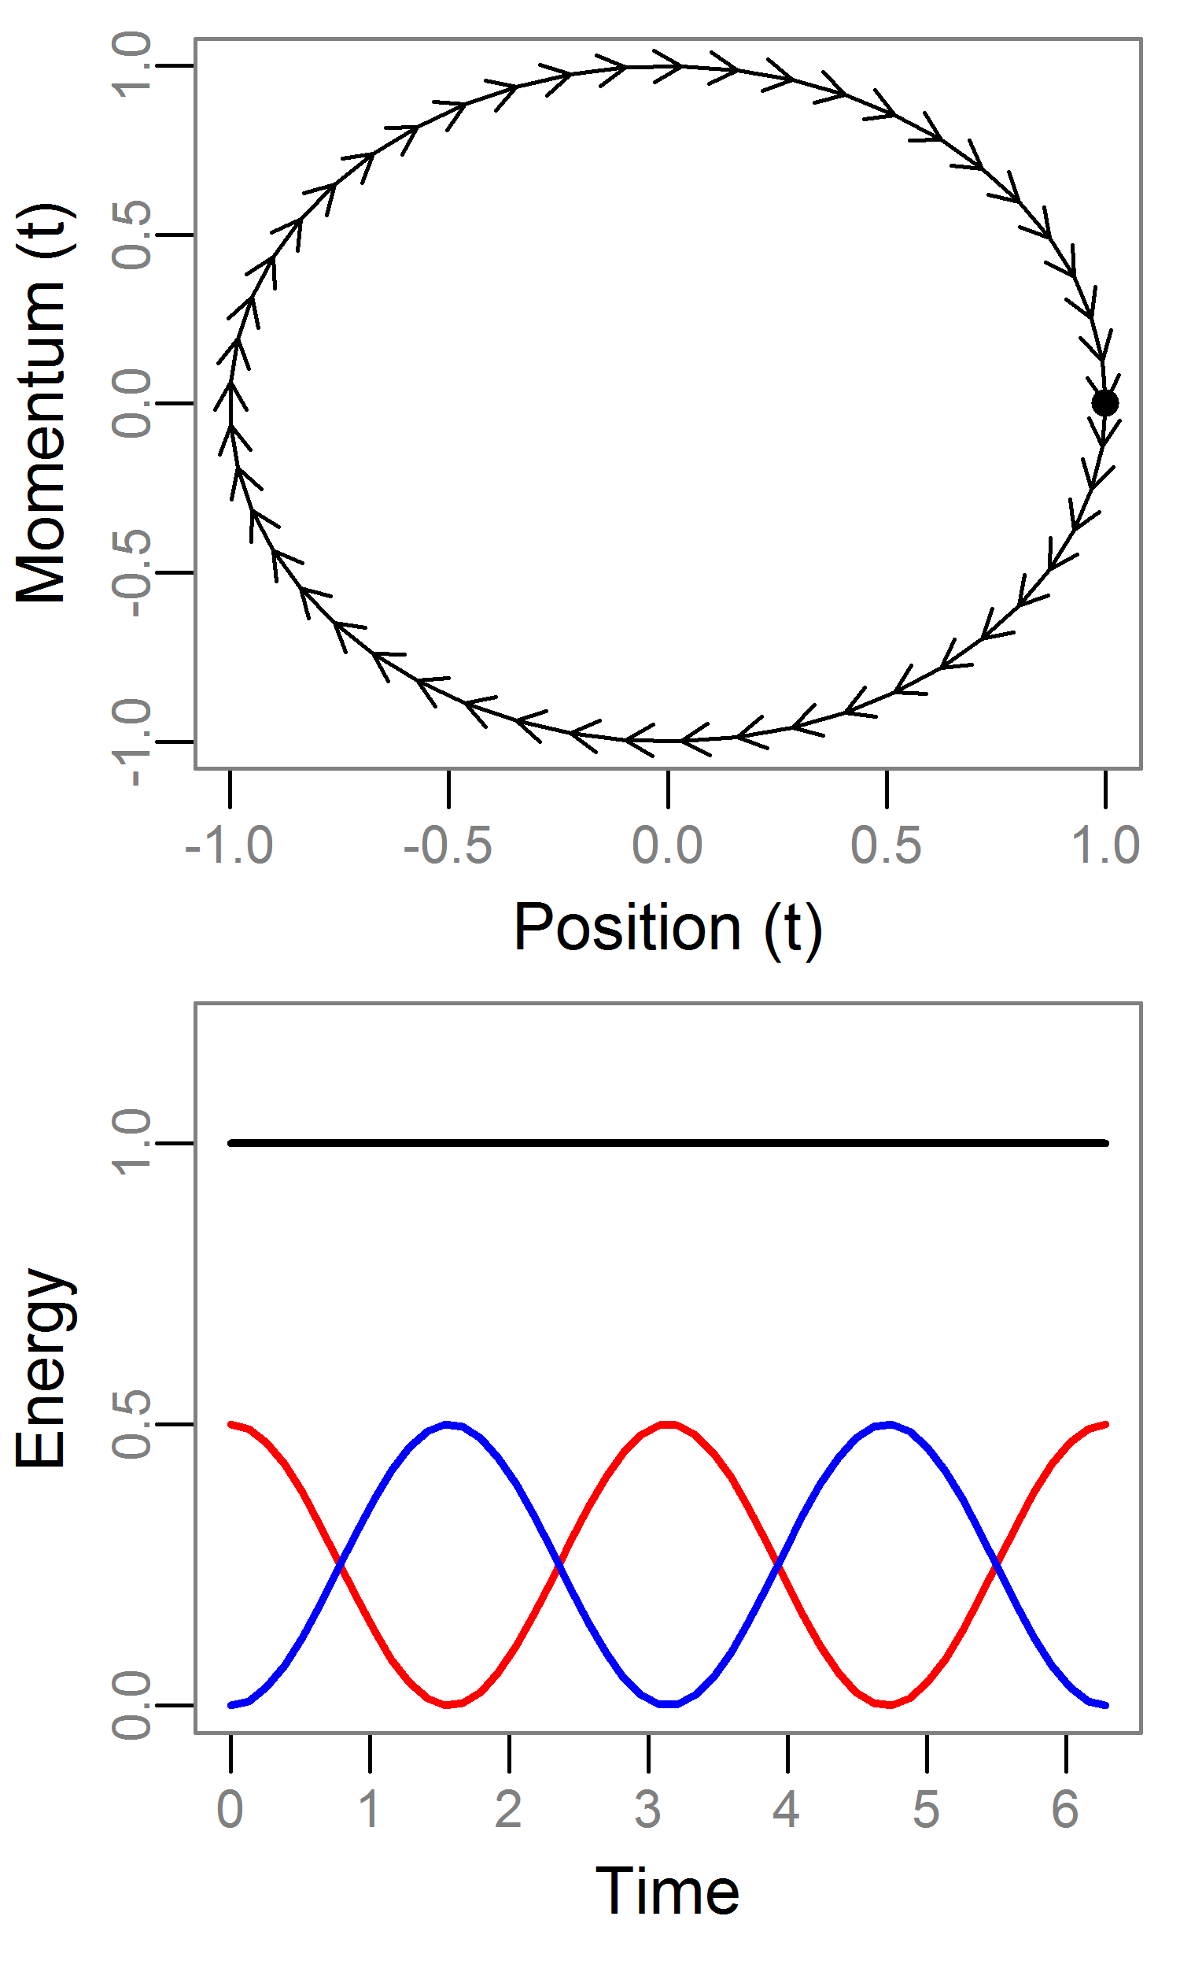
Hamiltonian Dynamics: Example
See Neal (2010) for good review
For MCMC we set U=log posterior and K=log N(0,Σ)
Take a 1d example where:
U=θ²/2 [θ~N(0,1)]
K=r²/2 [r~N(0,1)]
We can solve these equations analytically
Note:
H is constant over time
Each r is a different contours
Most systems are not solvable
H
U
K

Slide 7
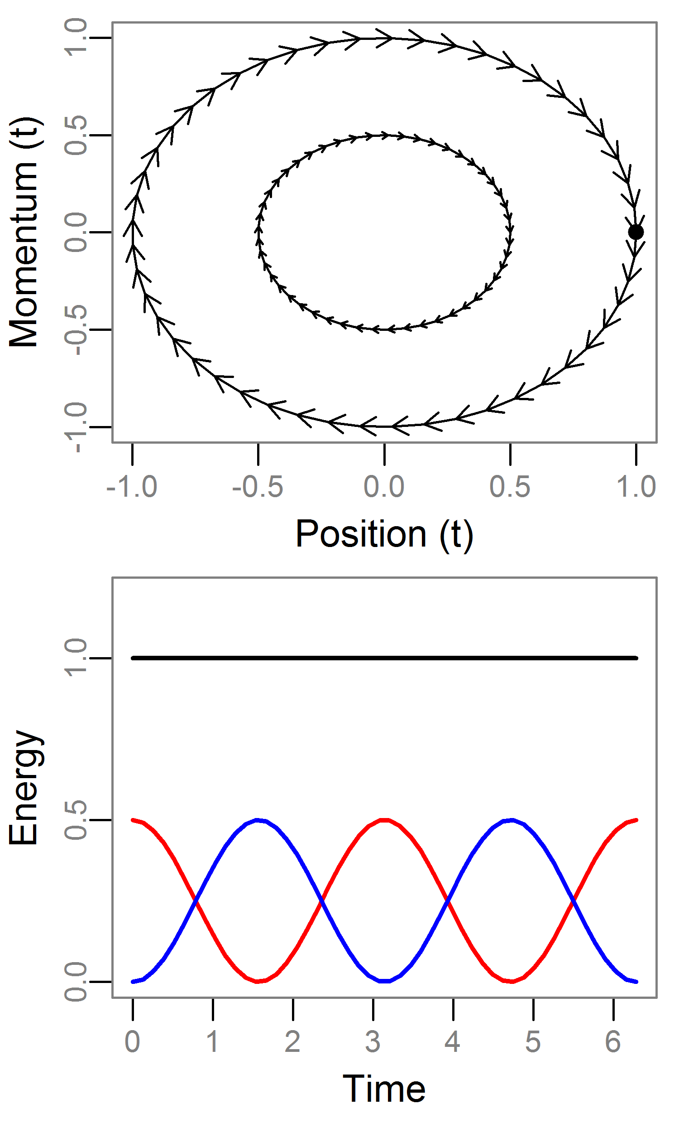
Hamiltonian Dynamics: Example
See Neal (2010) for good review
For MCMC we set U=log posterior and K=log N(0,Σ)
Take a 1d example where:
U=θ²/2 [θ~N(0,1)]
K=r²/2 [r~N(0,1)]
We can solve these equations analytically
Note:
H is constant over time
Each r is a different contours
Most systems are not solvable
H
U
K

Slide 8
Hamiltonian Monte Carlo
Draw r~MVN(0,Σ) (Σ ¹ is unit diagonal)
Project forward² L discrete steps of size ɛ.
The final value of trajectory is our proposed value (q!!).
Note:
H varies due to discretization, so use RWM step:
This generates joint samples (θ,r), so we discard (ignore) the r samples.
¹ This is known as the “mass matrix”
² Using the Leapfrog integrator which is more stable/robust than Euler’s method

Slide 9
Hamiltonian Monte Carlo
Q: Why do we need to utilize a Hamiltonian system?
A: Detailed balance!
HMC has several mathematical properties advantageous for MCMC:
Reversible + Volume preserving.
Informally: the q cancels out. Impossible to calculate otherwise.
Crucially, these hold under discretization
Bottom line: The chain gives us samples from the posterior

Slide 10
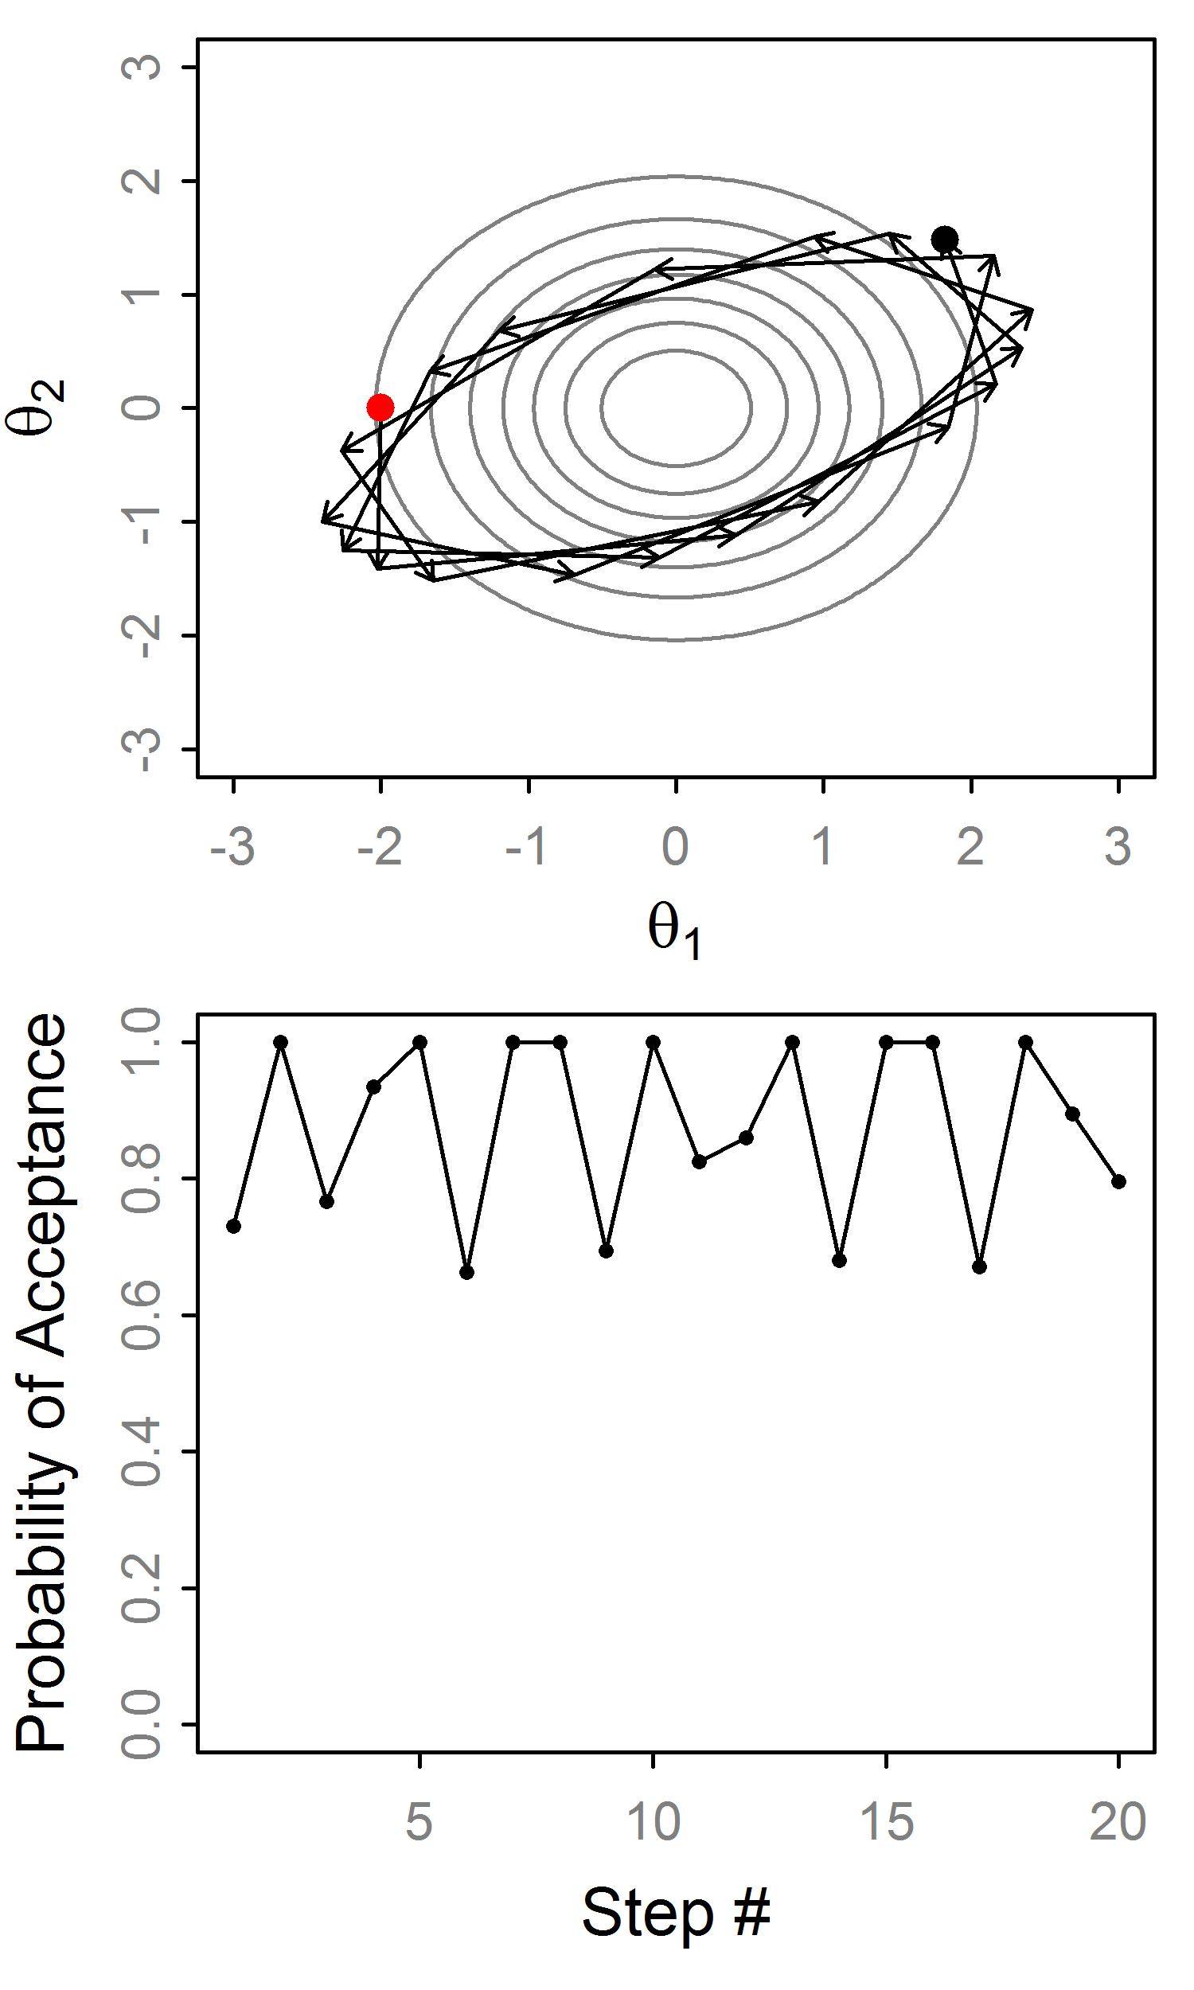
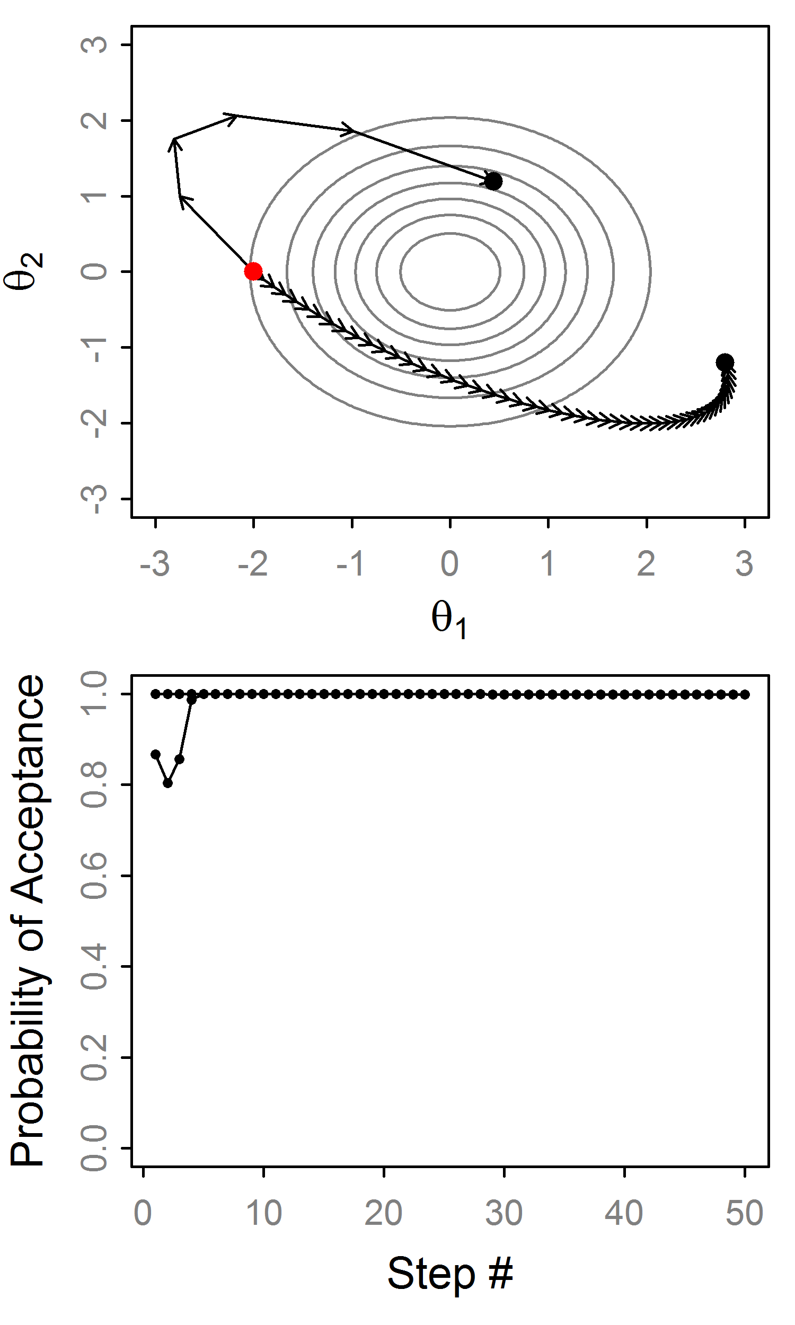
HMC: Example trajectories
Very stable!
Big ɛ, small L
Small ɛ, big L
Big ɛ leads to variation in H
Errors don’t accumulate

Slide 11
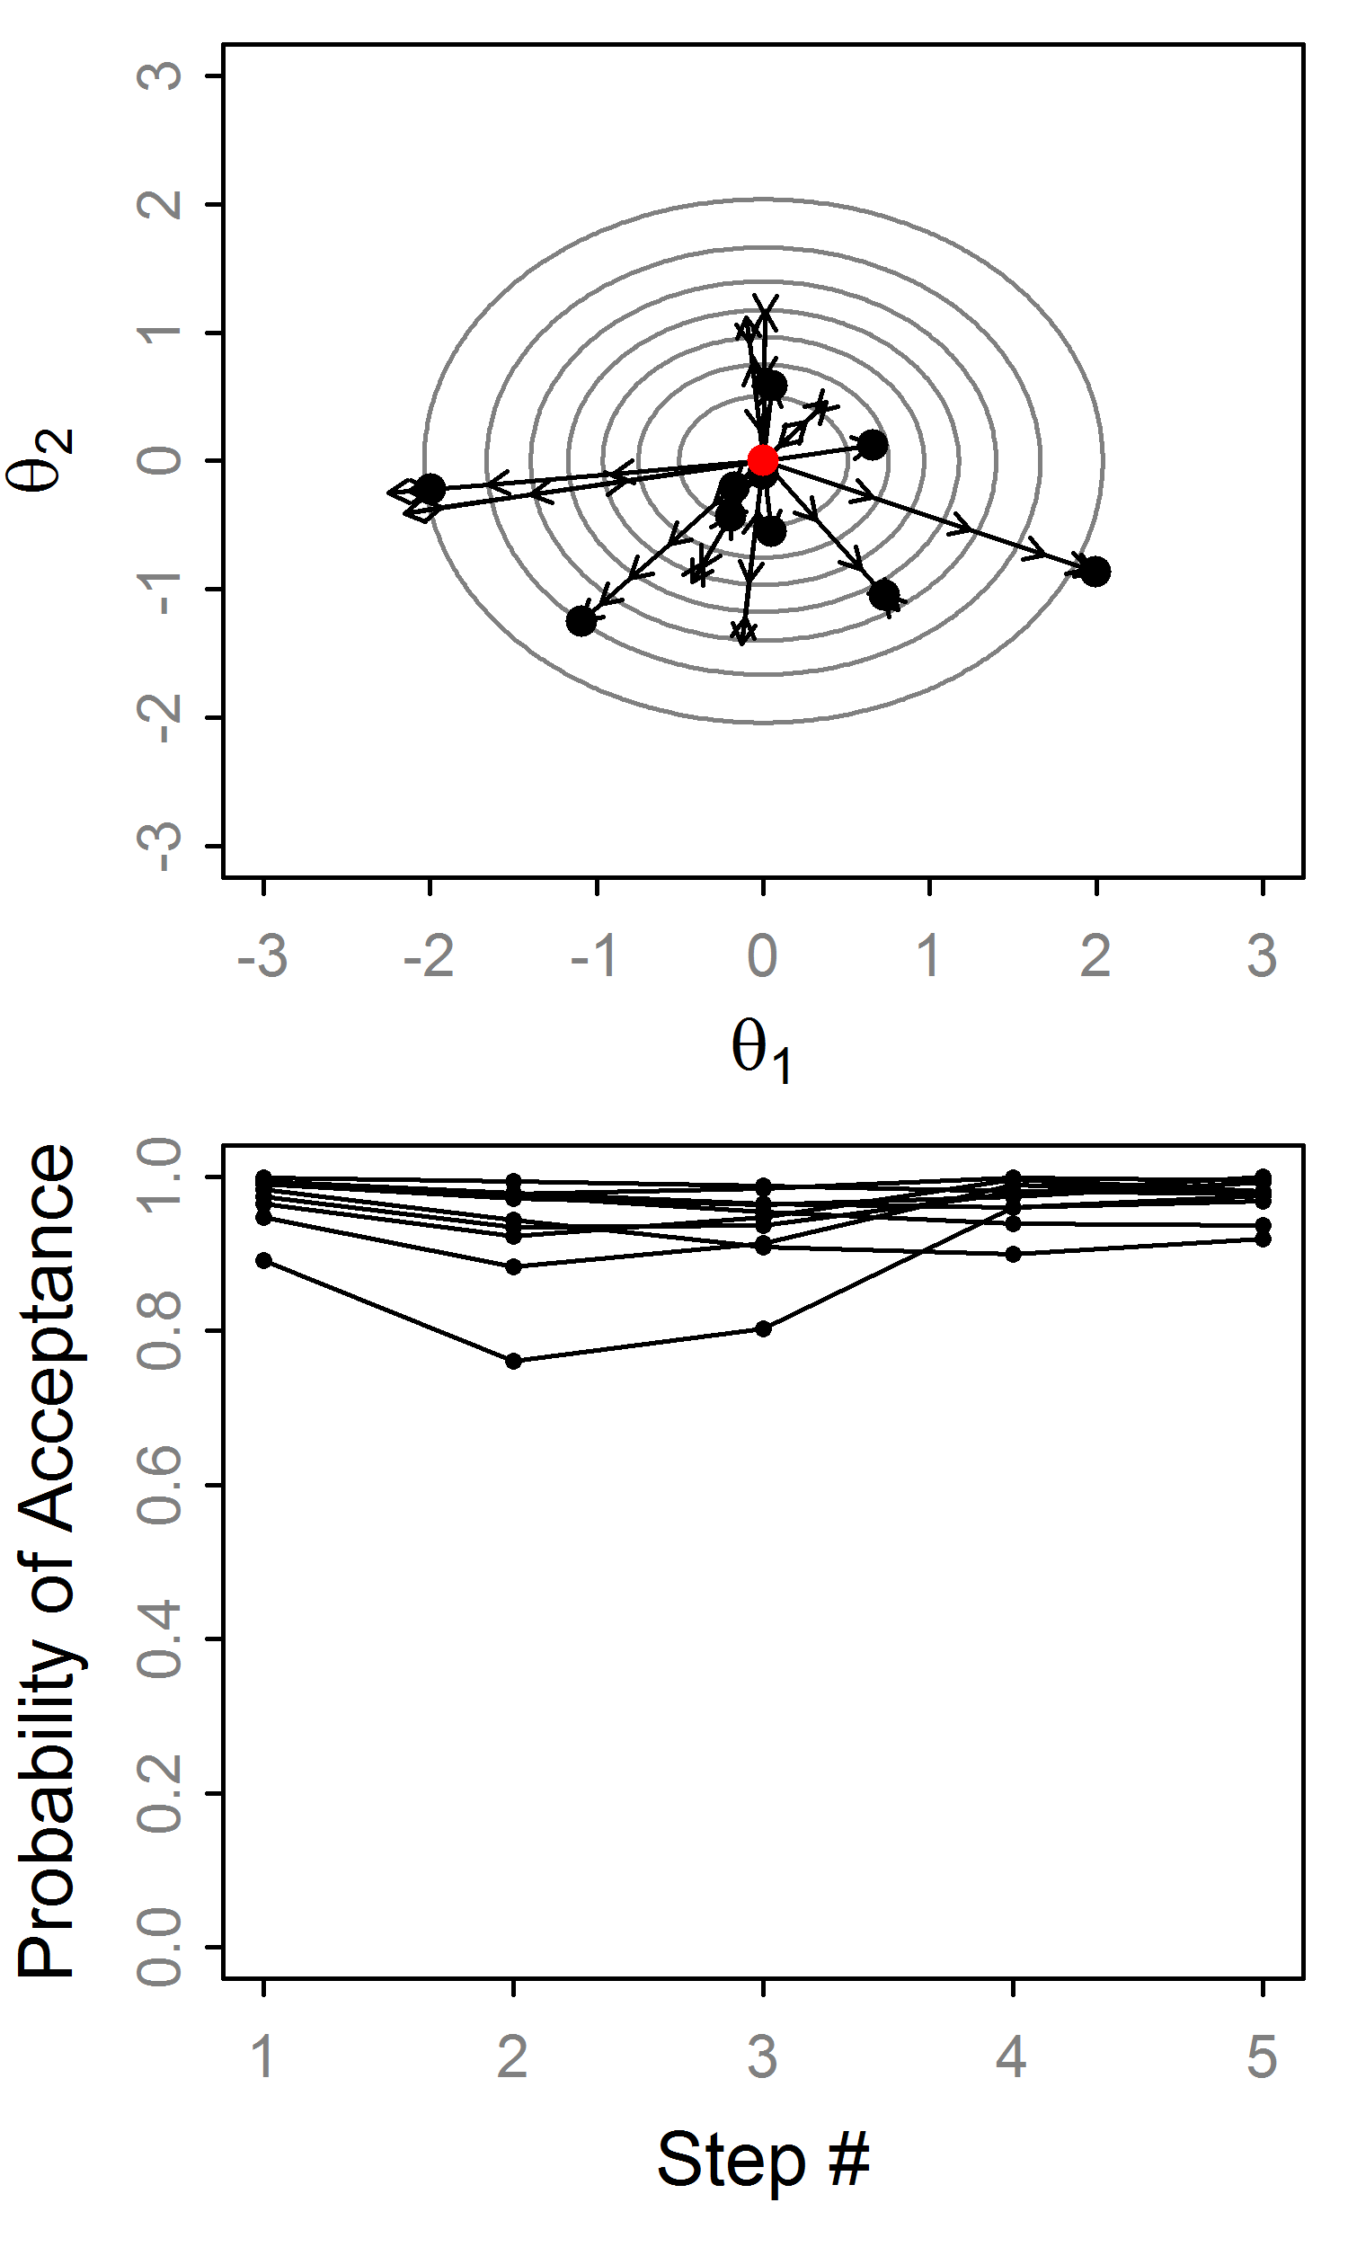
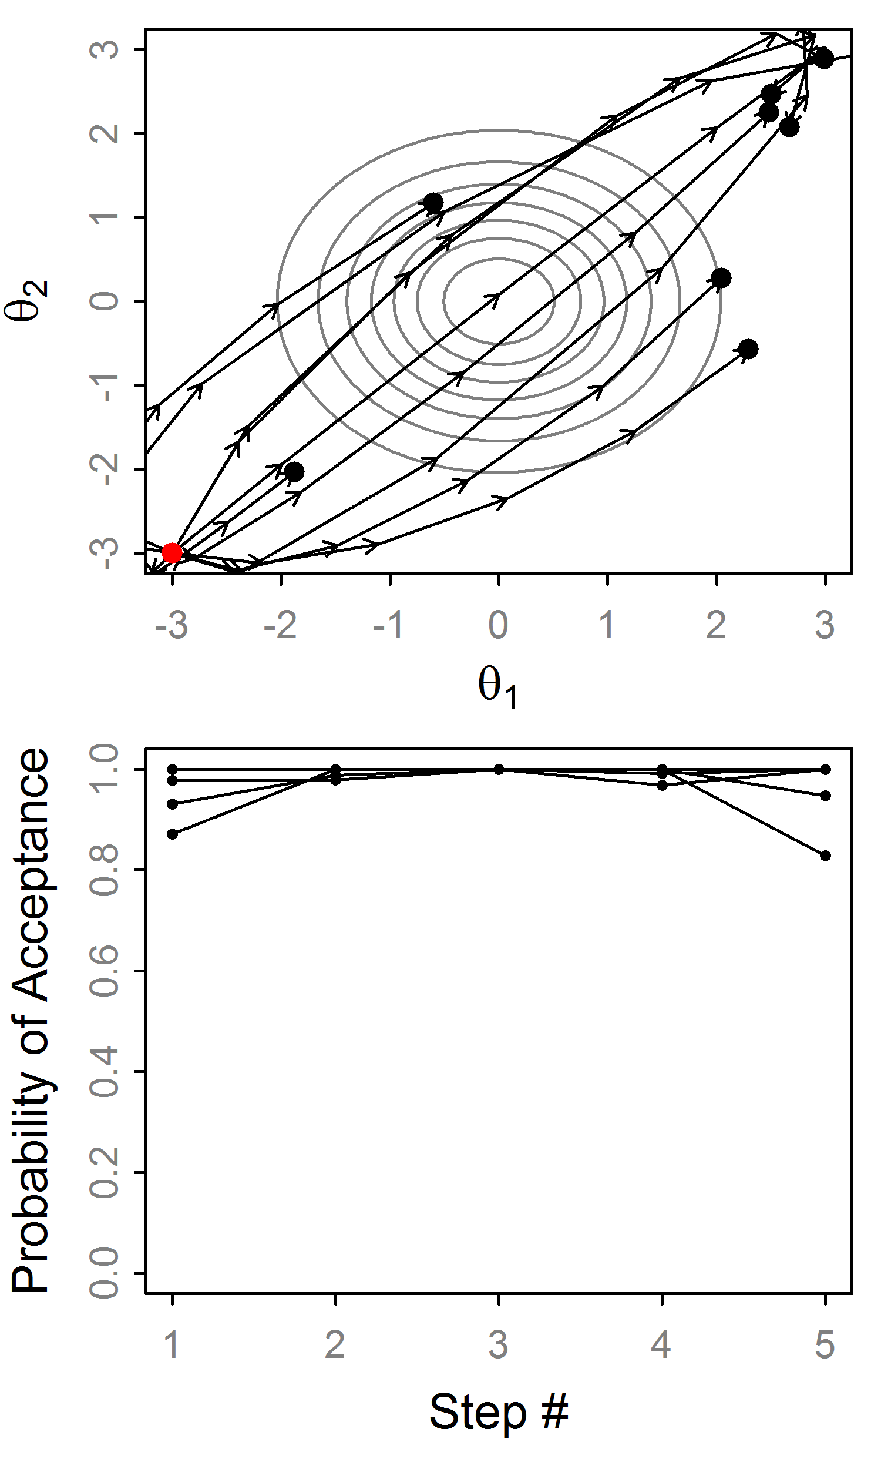
Effect of random momentum
Random momentum and ɛ
w/o random ɛ we’d alternate here!!!

Slide 12
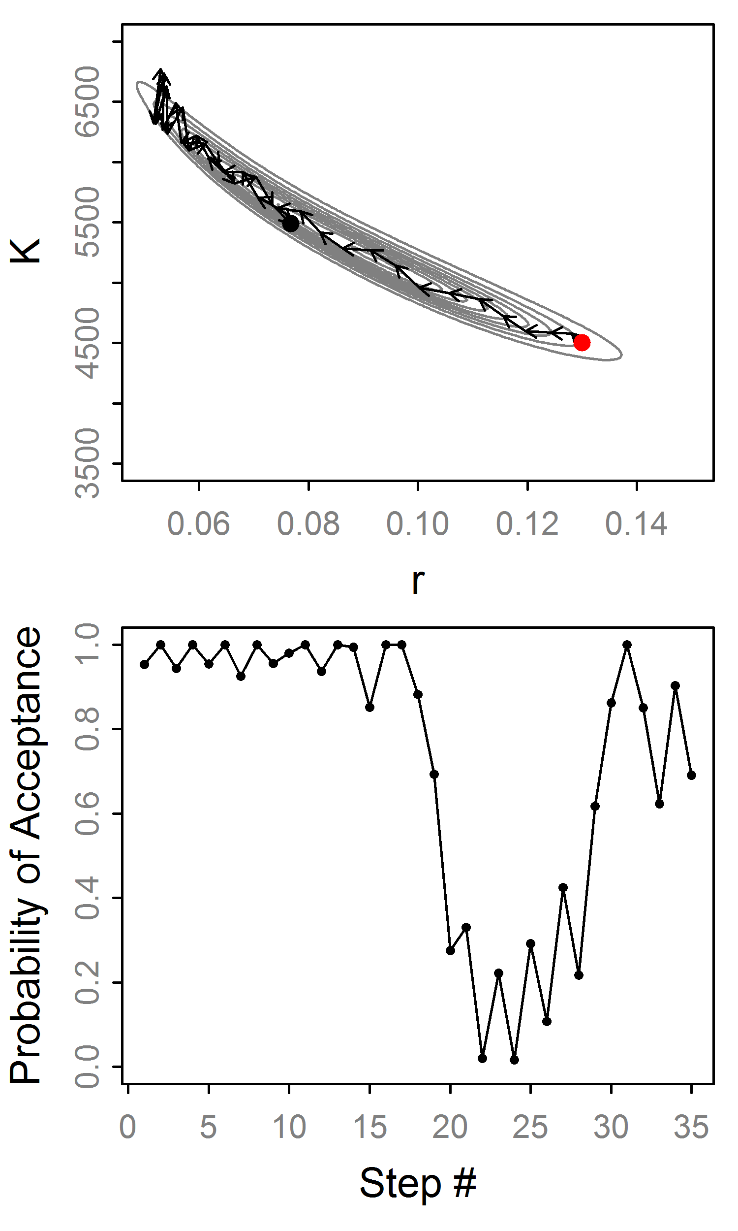
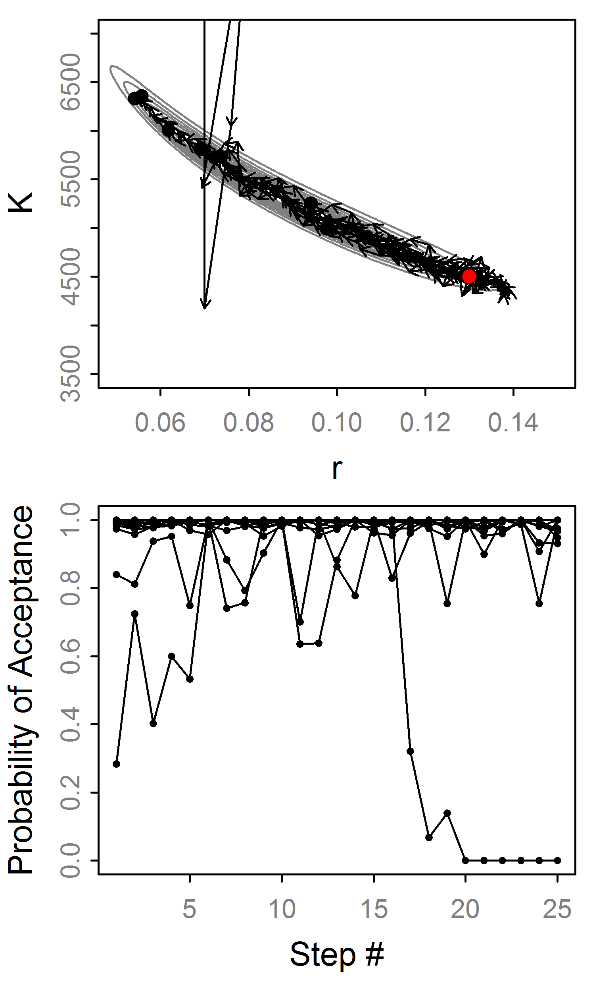
HMC: Example trajectories
“Divergent”
“Divergent”

Slide 13
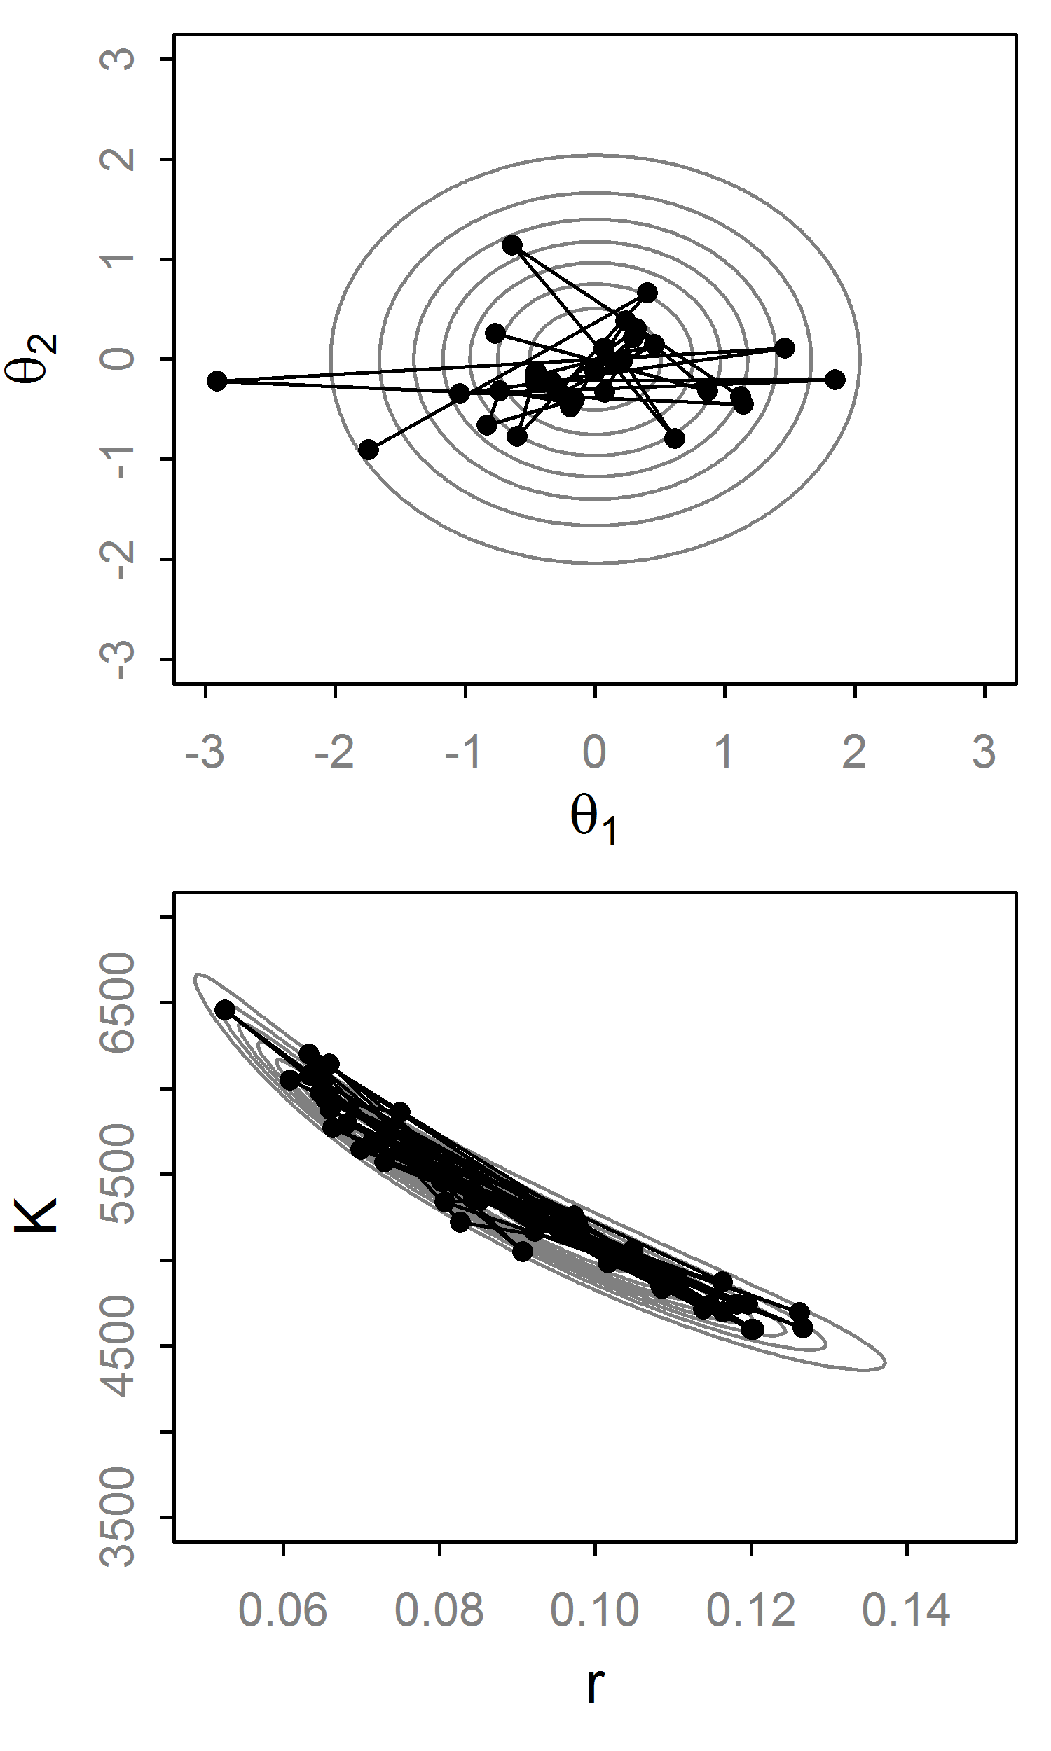
Hamiltonian Monte Carlo
HMC eliminates inefficient random walk behavior
Fancy way to propose values
Often produces nearly independent samples (for large L)
Has high computational cost (L ≈ to thinning)

Slide 14
Implementation Hurdles of HMC
Introduced by Duane et al. (1987)… why uncommon?
Some in the physics/stats literature¹, but it “seems to be under-appreciated by statisticians” (Neal, 2010).
Mainly for two reasons:
Hard to calculate derivatives of log posteriors
Efficiency is notoriously sensitive to the tuning parameters: (L, ɛ, Σ)
¹ e.g., Neal (1996), Ishwaran (1999) and Schmidt (2009)

Slide 15
Solution #1: Automatic Differentiation
AD is a numerical technique to get precise derivative of any continuous function.
The computer applies the chain rule successively
It is as precise as analytical derivatives up to computer precision.
Available widely, e.g., ADMB, TMB, Stan
Posterior must be continuously differentiable

Slide 16
Solution #2: No-U-Turn Sampler
Extends HMC to avoid specifying L and ɛ.
ɛ is adapted with ‘dual averaging’. Works for HMC too. Skipping this...
L is set automatically with a sophisticated algorithm that detects a “U-turn” in the trajectory and stops.
Thus L varies at each iteration, avoiding wasteful steps.
Hoffman and Gelman (2014)

Slide 17
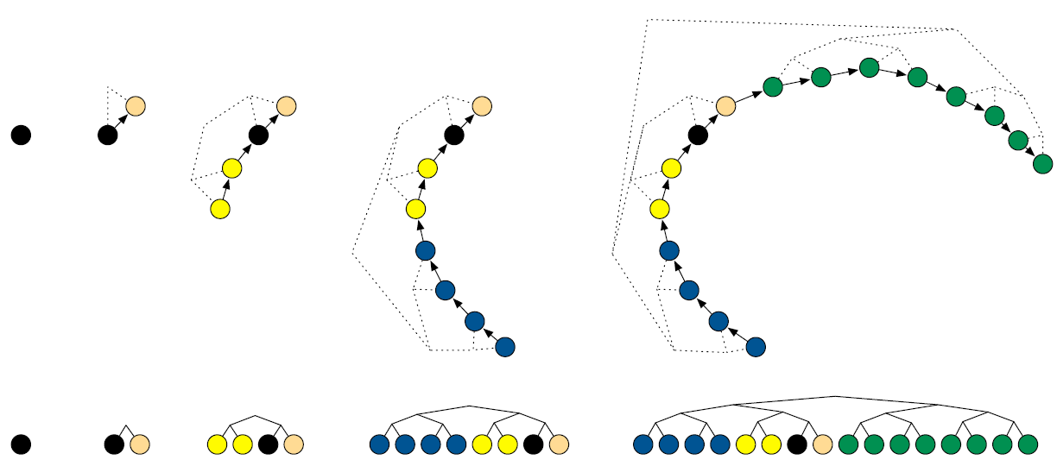
No-U-Turn Trajectory
for j in 0:max_depth
Pick random direction (left or right)
Recursively build tree of size 2^{j}
If U-turn occur in subtree or divergence
break, excluding subtree
Balanced Binary Tree
Fig 1, Hoffman and Gelman (2011)

Slide 18
Sampling from Trajectory
Let B be set of states (θ,r) in trajectory.
Generate a slice variable
Set C is states in B where
Uniformly select from C to get θ_{t+1}
Why so complicated? Detailed balance!
Note: There is no Metropolis step, this is technically Gibbs sampling [p(θ,r,u,B,C|ɛ]

Slide 19
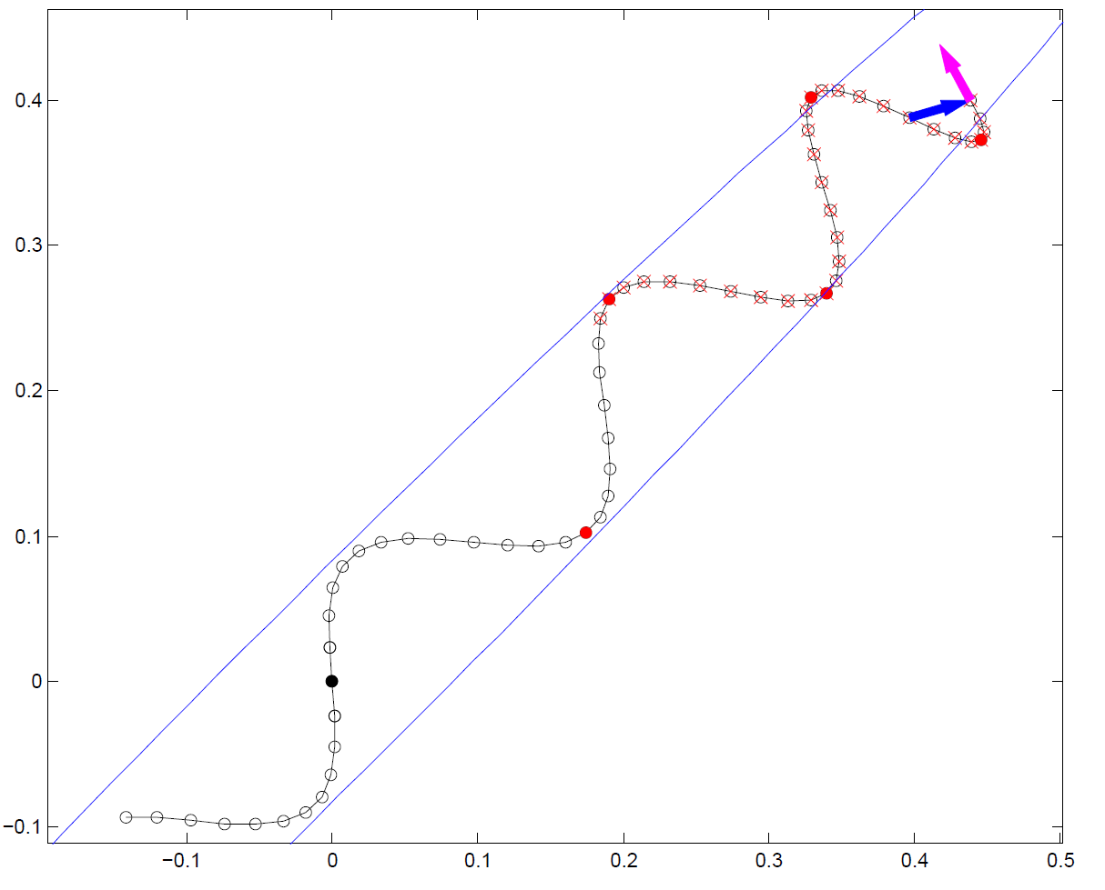
No-U-Turn Example
Exclude this subtree
U-Turn!!
Exclude due to slice variable
Fig 2, Hoffman and Gelman (2014)

Slide 20
Tuning the No-U-Turn Sampler
Eliminates the need to specify ɛ or L: ɛ is tuned during the warmup phase, L dynamically.
But, introduces new tuning parameters:
max_depth: Maximum tree depth.
Delta=0.6: The target acceptance rate.
γ=0.05, κ=0.75, t₀=10: For dual averaging
However, this seems to work smoothly without intervention (good for general use)

Slide 21
Software implementation
 | ADMB | TMB | Stan
Static HMC | ✓ | ✓ | ✓
NUTS | X | ✓ | ✓
Dual averaging | X | ✓ | ✓
Step size: ɛ | hyeps | eps | stepsize
# of steps: L | hynstep | L | int_time¹
Delta | NA | delta | adapt_delta
Max tree depth | NA | max_doubling | max_treedepth
jitter | Hard-coded on L | Hard-coded on ɛ | stepsize_jitter
Mass matrix | Estimated covariance | Arbitrary matrix | Unit diagonal, adapted diagonal, or adapted “dense”
Stan is state-of-the art for HMC. TMB and ADMB are very far behind
https://github.com/kaskr/adcomp/blob/master/TMB/R/mcmc.R
¹ Technically integrated time (=eps*L)

Slide 22
State of HMC in TMB
Beta versions of RWM, HMC and NUTS
Mass matrix argument (covar), but no adaptation (like Stan).
Bounding must be done internally (disadvantage)
Next version will have box constraints (help wanted!)
Can do LA at each iteration, or not, for RE models
Poor handling of NaN’s (fn and gr)

Slide 23
State of HMC in TMB
Individual samplers can be used w/ analytical gradients too
Burn in (warmup) and thinning must be done externally for now
Diagnostic=TRUE will return diagnostic info, particularly useful for NUTS
Try it out and let me know if you want to help contribute!
https://github.com/kaskr/adcomp/blob/master/TMB/R/mcmc.R

Slide 24
Bottom line
Use Stan if only care about MCMC
If using TMB, start with NUTS and adaptive step size
Should work well for fixed and mixed models, the latter being helped by ‘non-centering’ your RE¹
covar option can help a lot, but has computational overhead and not as thoroughly tested
You must specify priors explicitly!!
Beware of implicit improper uniform priors
NUTS did not save the world, you still need to be a proactive user:
Multiple starting values, Check convergence statistics, Use common sense, Reparameterize where possible, etc.
¹ Betancourt and Girolami 2015: Hamiltonian Monte Carlo for hierarchical models

