Slide 1
Introduction to template model builder, an improved tool for maximum likelihood and mixed-effects models in R
James Thorson

Slide 2
Outline
Likelihood statistics
Automatic differentiation
TMB examples

Slide 3
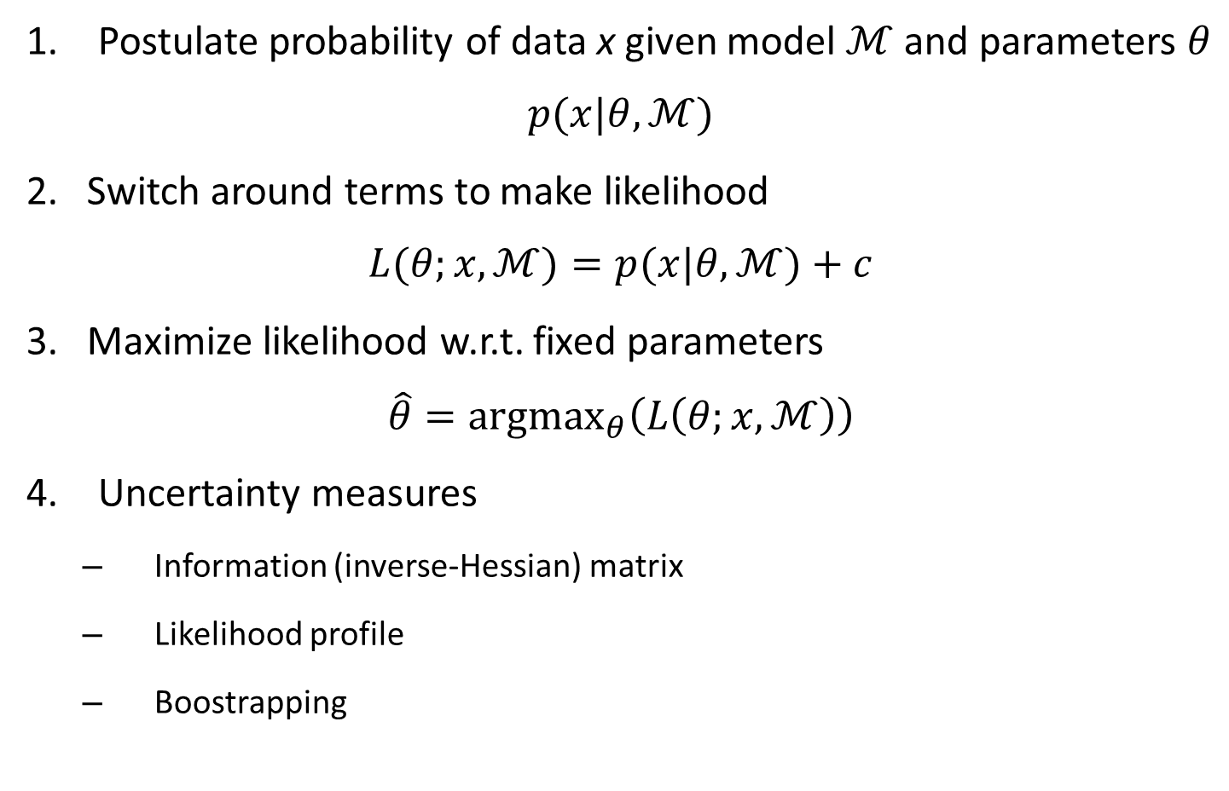
Likelihood statistics
Postulate probability of data x given model $ℳ$and parameters $θ$
$$p{(x|θ,ℳ})$$
2. Switch around terms to make likelihood
$$L{(θ;x,ℳ)}=p{(x|θ,ℳ})+c$$
3. Maximize likelihood w.r.t. fixed parameters
$$\hat{θ}={argmax}_{θ}\left(L\left(θ;x,ℳ\right)\right)$$
Uncertainty measures
Information (inverse-Hessian) matrix
Likelihood profile
Boostrapping

Slide 4
Likelihood statistics
Sometimes (almost always!) parameters have a hierarchy
Hierarchical modelling – Formulating a model where parameters are estimated to arise from a process governed by other parameters
Parameters arising from hierarchy are no longer “fixed”!
Unclear how to write the probability of the data

Slide 5
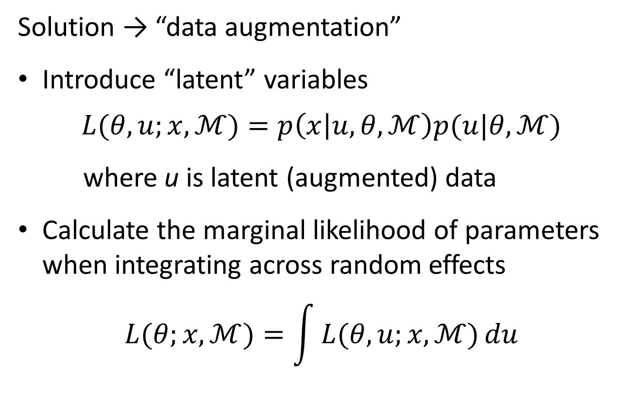
Likelihood statistics
Solution → “data augmentation”
Introduce “latent” variables
$$L{(θ,u;x,ℳ)}=p\left(x | u,θ,ℳ\right)p(u|θ,ℳ)$$
where u is latent (augmented) data
Calculate the marginal likelihood of parameters when integrating across random effects
$$L{(θ;x,ℳ})=\int{L{(θ,u;x,ℳ)}du}$$

Slide 6
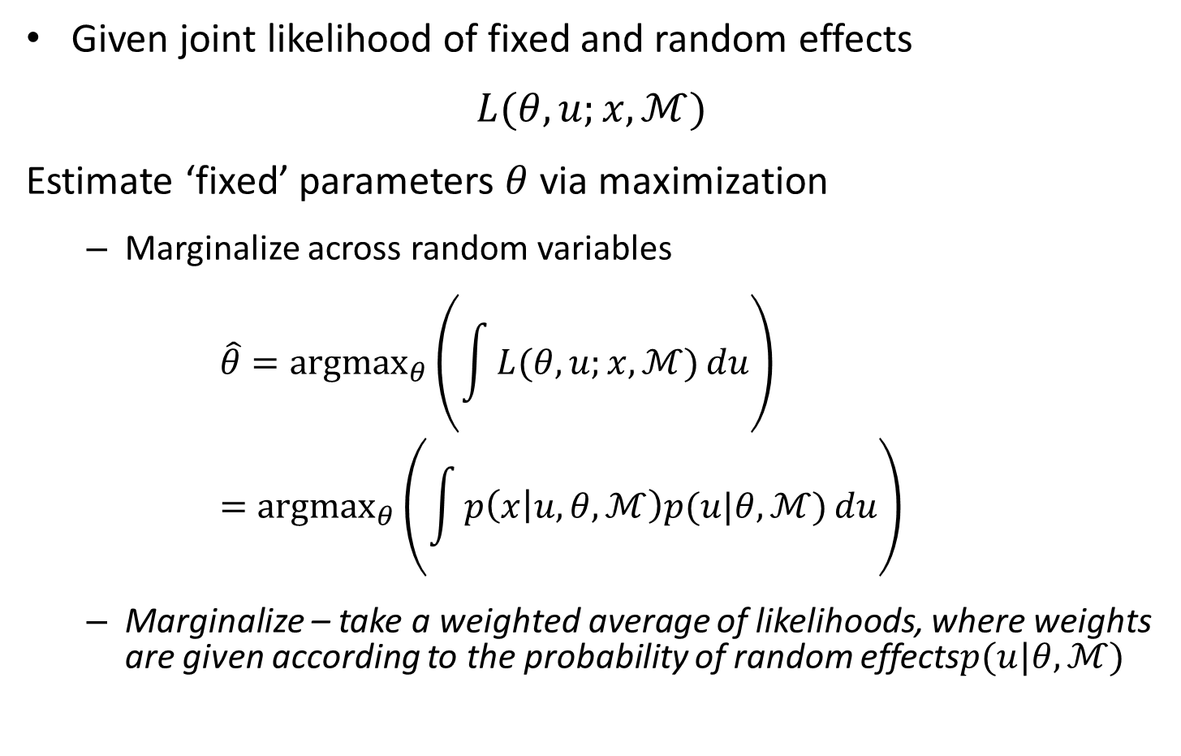
Likelihood statistics
Given joint likelihood of fixed and random effects
$$L{(θ,u;x,ℳ)}$$
Estimate ‘fixed’ parameters $θ$ via maximization
Marginalize across random variables
$$\hat{θ}={argmax}_{θ}\left(\int{L{(θ,u;x,ℳ)}du}\right)={argmax}_{θ}\left(\int{p\left(x | u,θ,ℳ\right)p(u|θ,ℳ)du}\right)$$
Marginalize – take a weighted average of likelihoods, where weights are given according to the probability of random effects$p(u|θ,ℳ)$

Slide 7
Likelihood statistics
Why would you make a hierarchy of parameters
Stein’s paradox and shrinkage – Pooling parameters towards a mean will be more accurate on average
10 batting average + 1 proportions US car sales (Efron and Morris 1977)
Biological intuition – Formulate models based on knowledge of constituent parts (Burnham and Anderson 2008)
Variance partitioning – Separate different sources of variability (e.g., measurement errors!)

Slide 8
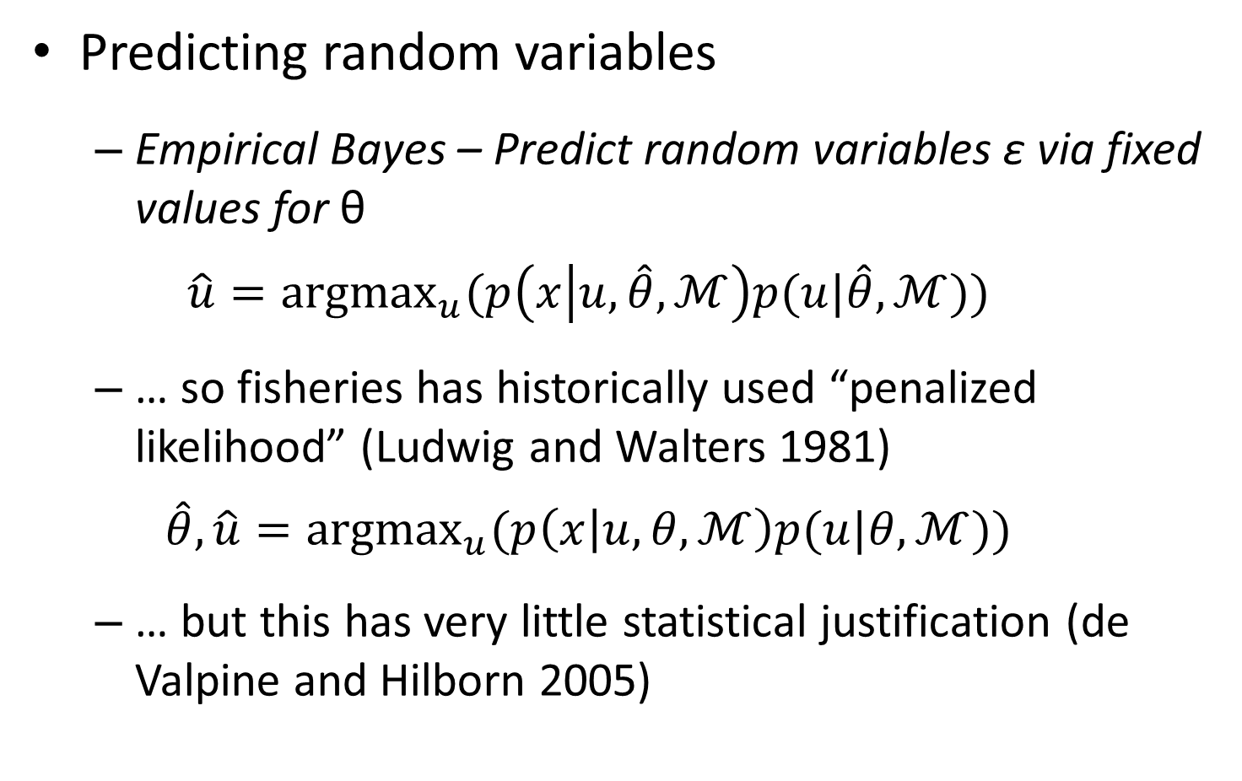
Likelihood statistics
Predicting random variables
Empirical Bayes – Predict random variables ε via fixed values for θ
$$\hat{u}={argmax}_{u}(p\left(x | u,\hat{θ},ℳ\right)p(u|\hat{θ},ℳ))$$
… so fisheries has historically used “penalized likelihood” (Ludwig and Walters 1981)
$$\hat{θ},\hat{u}={argmax}_{u}(p\left(x | u,θ,ℳ\right)p(u|θ,ℳ))$$
… but this has very little statistical justification (de Valpine and Hilborn 2005)

Slide 9
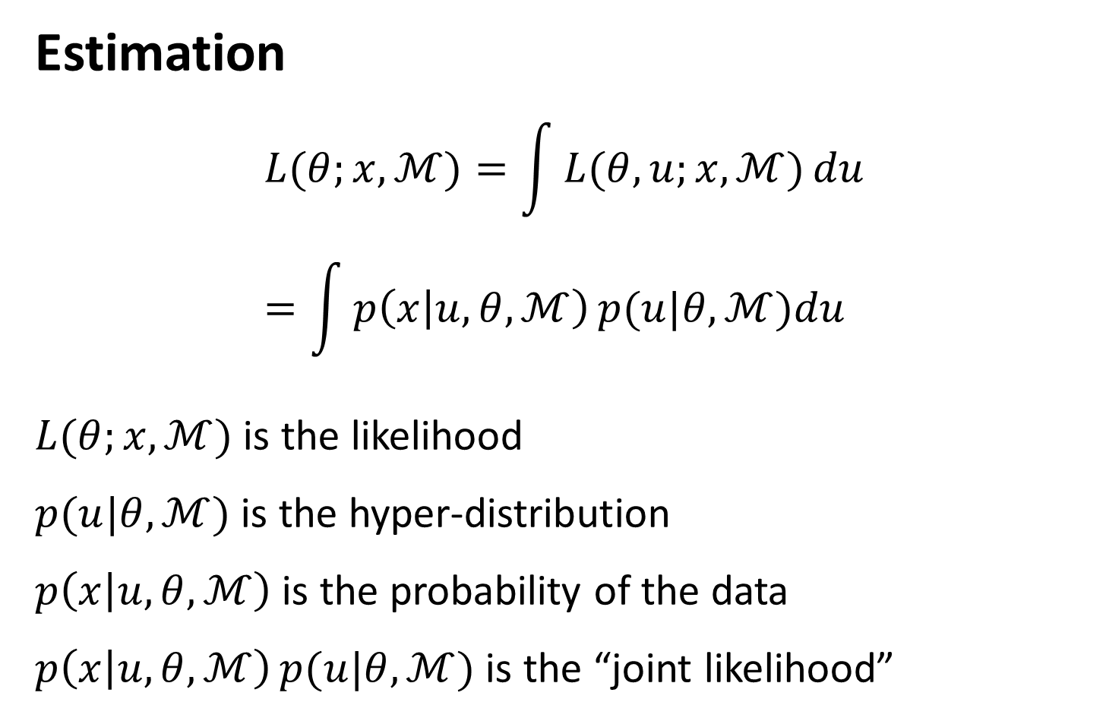
Likelihood statistics
Estimation
$$L{(θ;x,ℳ})=\int{L{(θ,u;x,ℳ)}du}=\int{p\left(x | u,θ,ℳ\right)p(u|θ,ℳ)du}$$
$L{(θ;x,ℳ})$ is the likelihood
$p(u|θ,ℳ)$ is the hyper-distribution
$p\left(x | u,θ,ℳ\right)$ is the probability of the data
$p\left(x | u,θ,ℳ\right)p(u|θ,ℳ)$ is the “joint likelihood”

Slide 10
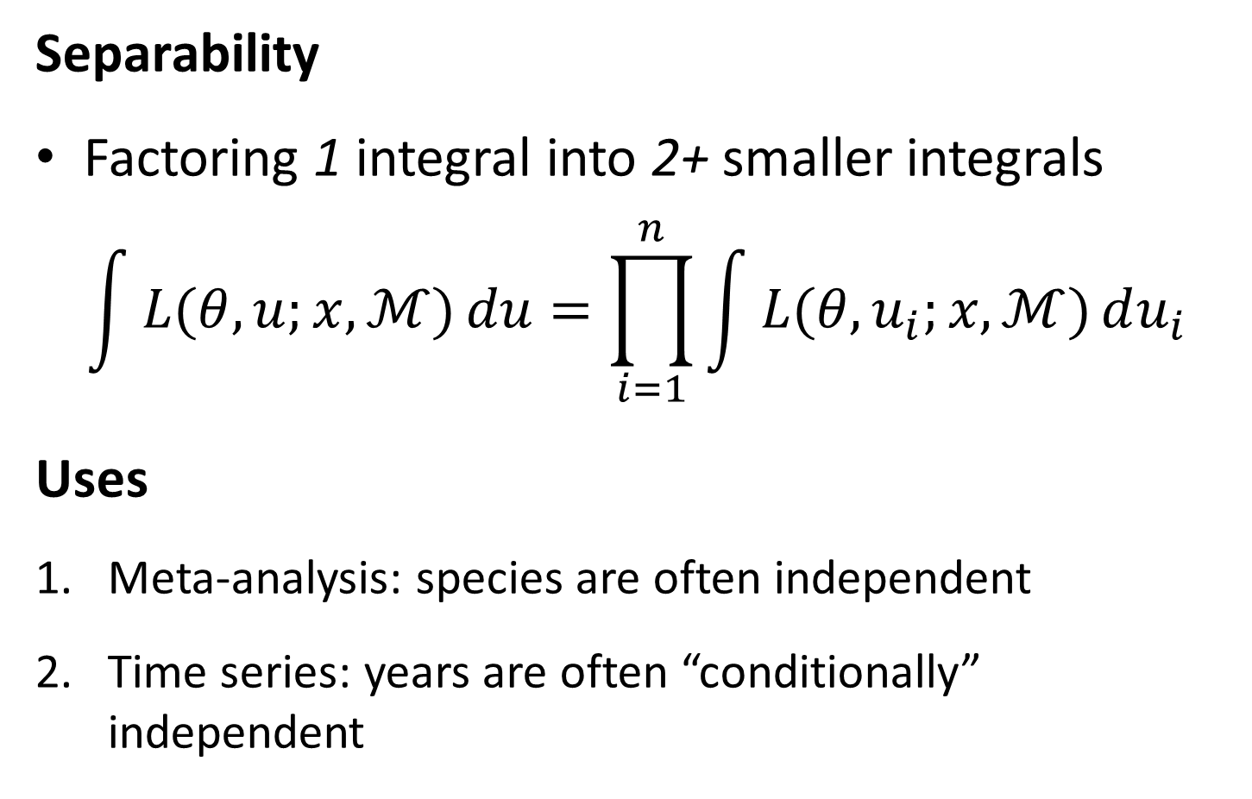
Likelihood statistics
Separability
Factoring 1 integral into 2+ smaller integrals
$$\int{L{(θ,u;x,ℳ)}du}=\prod_{i=1}^{n}{\int{L{(θ,u_{i};x,ℳ)}du_{i}}}$$
Uses
Meta-analysis: species are often independent
Time series: years are often “conditionally” independent

Slide 11
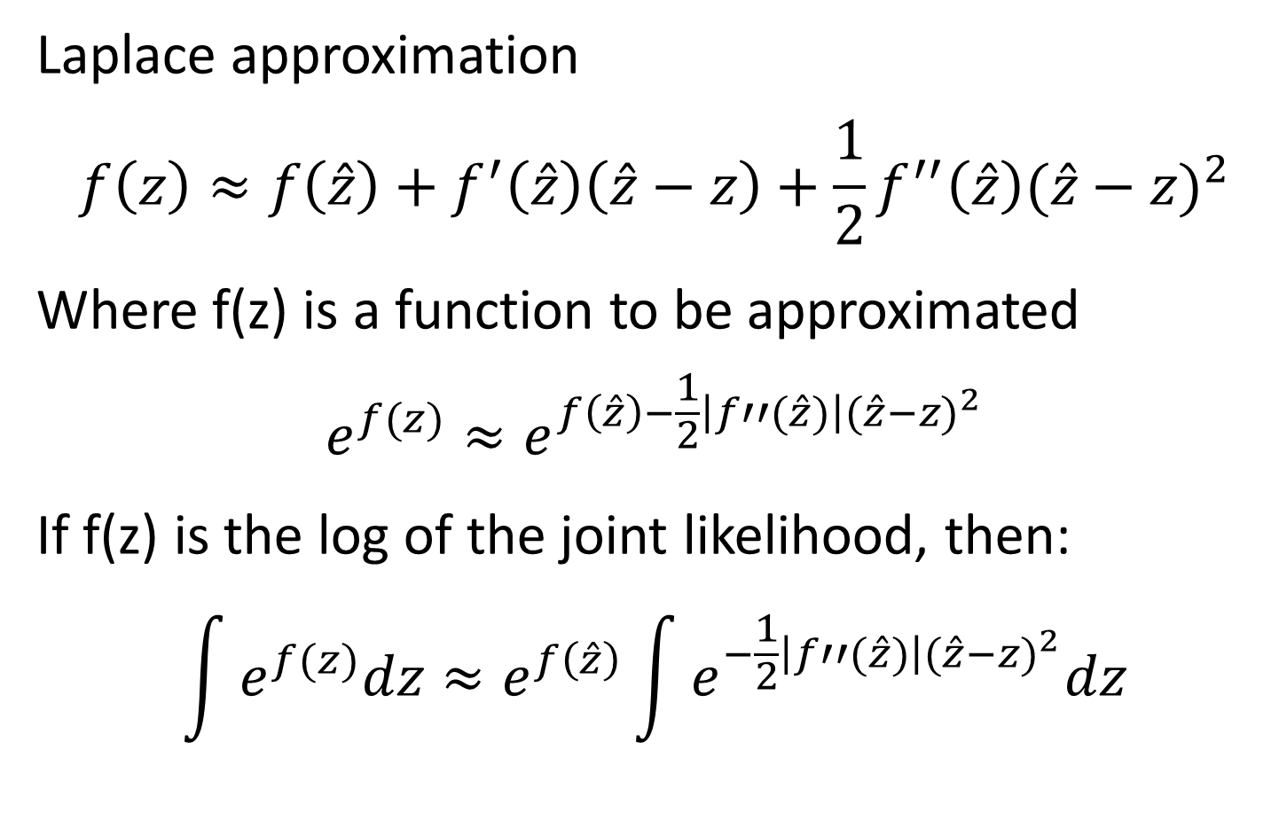
Likelihood statistics
Laplace approximation
$$f\left(z\right)≈f\left(\hat{z}\right)+f^{′}\left(\hat{z}\right)\left(\hat{z}−z\right)+\frac{1}{2}f^{′′}\left(\hat{z}\right){(\hat{z}−z)}^{2}$$
Where f(z) is a function to be approximated
$$e^{f(z)}≈e^{f\left(\hat{z}\right)−\frac{1}{2}\left|f′′(\hat{z})\right|{(\hat{z}−z)}^{2}}$$
If f(z) is the log of the joint likelihood, then:
$$\int{e^{f(z)}dz}≈e^{f\left(\hat{z}\right)}\int{e^{−\frac{1}{2}\left|f′′(\hat{z})\right|{(\hat{z}−z)}^{2}}dz}$$

Slide 12

Likelihood statistics
Chi-squared example
$$\operatorname{Pr}\left(x\right)=\frac{x^{\frac{k}{2}−1}e^{\frac{−x}{2}}}{c}$$
Taking derivatives:
$$l\left(x\right)∝\left(\frac{k}{2}−1\right)\log\left(x\right)−\frac{x}{2}$$
$$l^{′}\left(x\right)∝\left(\frac{k}{2}−1\right)x^{−1}−\frac{1}{2}$$
$$l^{′′}\left(x\right)∝−\left(\frac{k}{2}−1\right)x^{−2}$$
Solving for mode and Hessian:
$$l^{′}(x)=0→\hat{x}=k−2$$
$$l^{′′}\left(\hat{x}\right)=−\left(\frac{1}{2\left(k−2\right)}\right)$$
Hence:
$$p(x)∝Normal(k−2, 2\left(k−2\right))$$

Slide 13
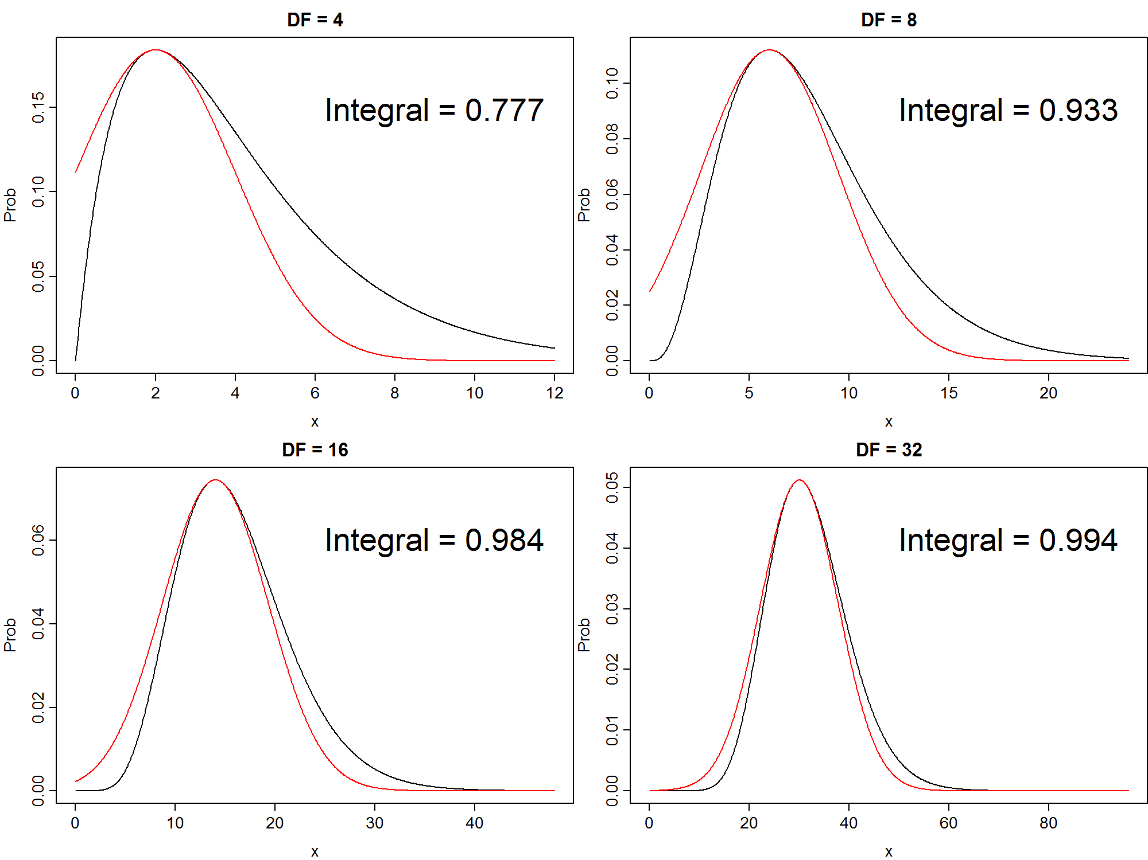

Slide 14
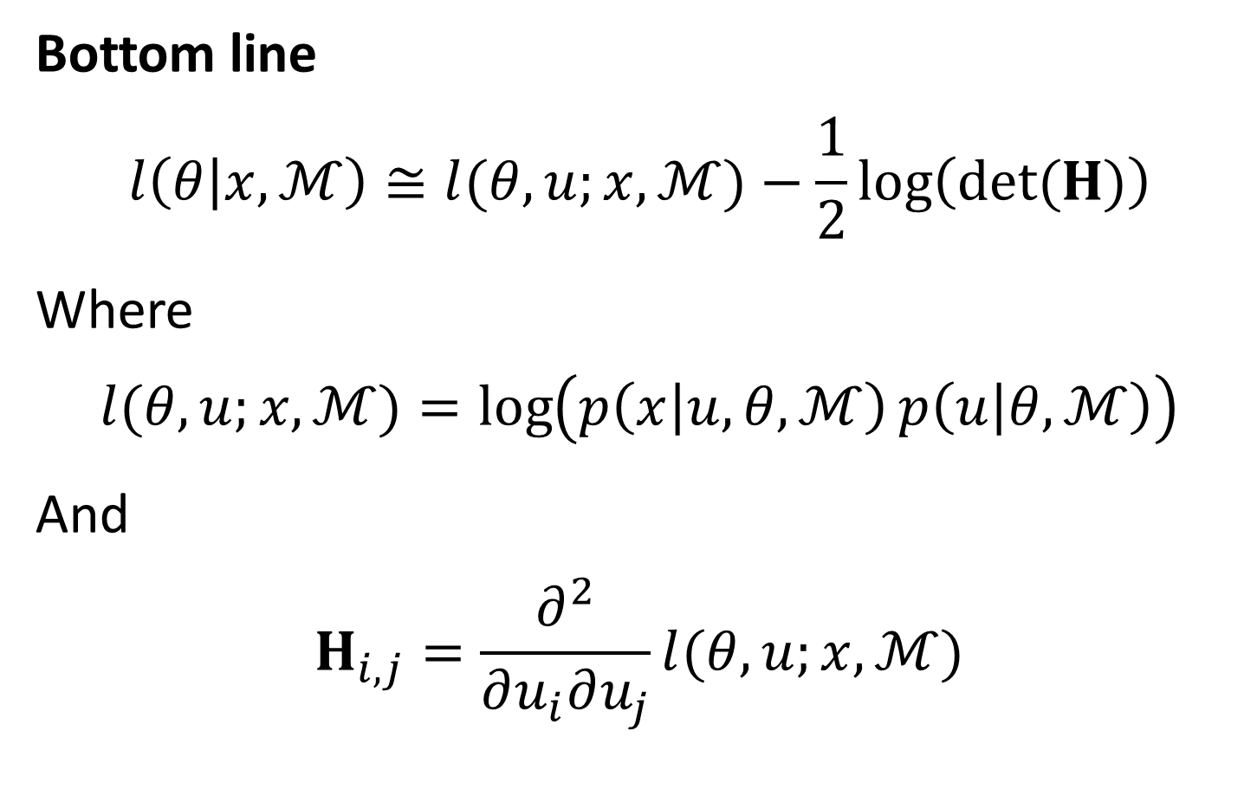
Likelihood statistics
Bottom line
$$l\left(θ | x,ℳ\right)≅l{(θ,u;x,ℳ)}−\frac{1}{2}\log\left(det⁡(H)\right)$$
Where
$$l{(θ,u;x,ℳ)}=\log\left(p\left(x | u,θ,ℳ\right)p\left(u | θ,ℳ\right)\right)$$
And
$$H_{i,j}=\frac{∂^{2}}{∂u_{i}∂u_{j}}l{(θ,u;x,ℳ)}$$

Slide 15
Likelihood statistics
Examples of hierarchical models from ecology
Avoiding pseudo-replication
Split-plot designs
Tag-resighting
Tag histories are “random” and marginalized across
State-space
R. Millar, deValpine, etc…
Meta-analyses
Myers demonstrations in the late 1990s

Slide 16
Outline
Likelihood statistics
Automatic differentiation and TMB
TMB examples
.

Slide 17
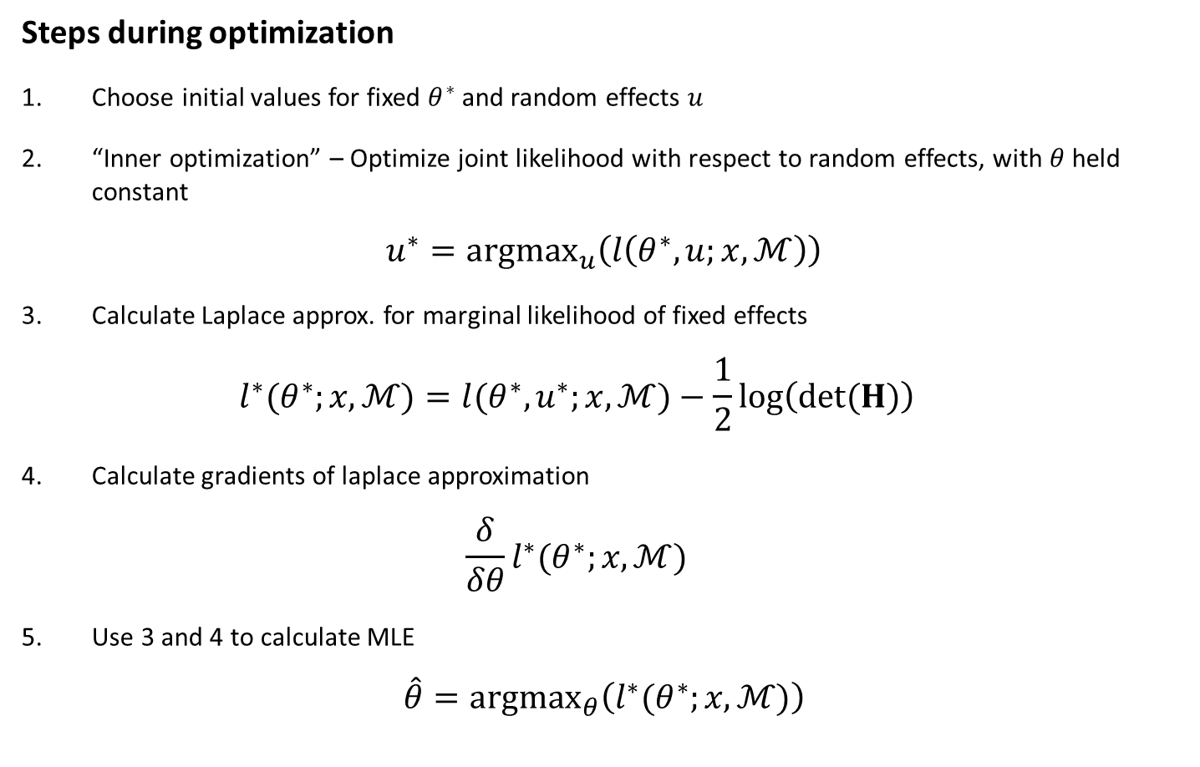
TMB
Steps during optimization
Choose initial values for fixed $θ^{∗}$ and random effects $u$
“Inner optimization” – Optimize joint likelihood with respect to random effects, with $θ$ held constant
$$u^{∗}={argmax}_{u}\left(l\left(θ^{∗},u;x,ℳ\right)\right)$$
Calculate Laplace approx. for marginal likelihood of fixed effects
$$l^{∗}(θ^{∗};x,ℳ)=l{(θ^{∗},u^{∗};x,ℳ)}−\frac{1}{2}\log\left(det⁡(H)\right)$$
Calculate gradients of laplace approximation
$$\frac{δ}{δθ}l^{∗}(θ^{∗};x,ℳ)$$
Use 3 and 4 to calculate MLE
$$\hat{θ}={argmax}_{θ}\left(l^{∗}(θ^{∗};x,ℳ)\right)$$

Slide 18
Outline
Likelihood statistics
Automatic differentiation and TMB
TMB examples

Slide 19
TMB examples
[See example – linear mixed model]
SEE:
https://github.com/James-Thorson/mixed-effects

Slide 20
TMB examples
[See example – state-space model]
SEE:
https://github.com/James-Thorson/mixed-effects/tree/master/state-space_Ricker_with_chaotic_dynamics

