Slide 1
Simple Random Walk in TMB

Slide 2
Premise
You are given a time series of population observations
Can you estimate the population and separate the process and observation errors assuming the population follows a random walk?

Slide 3
Data Generator
n.obs <- 35
true.process.error <- 0.2
true.obs.error <- 0.4
true.population <- rep(0,n.obs)
true.population[1] <- rnorm(1,0,true.process.error)
for (i in 2:n.obs){
true.population[i] <- true.population[i-1] + rnorm(1,0,true.process.error)
}
observed <- round(true.population + rnorm(n.obs,0,true.obs.error), 6)
true.population follows a random walk determined by true.process.error
observed depends on true.population and true.obs.error

Slide 4
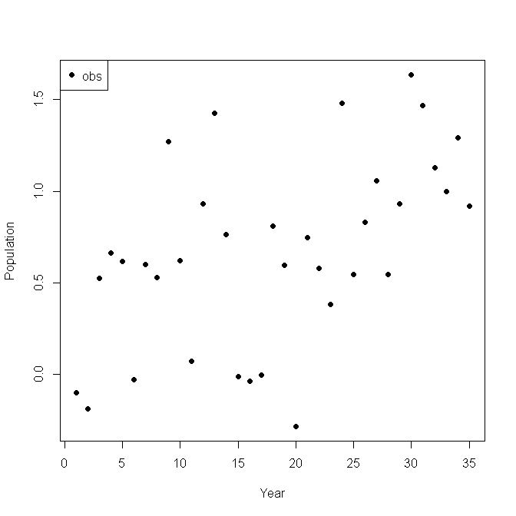
observed.dat
This is what you are given

Slide 5
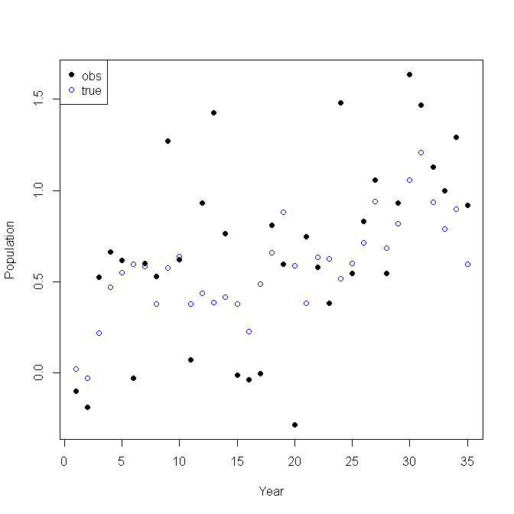
Want to estimate the blue circles
The blue circles are what you really want

Slide 6
simple_rand_walk.cpp
#include <TMB.hpp>
template<class Type>
Type objective_function<Type>::operator() ()
{
DATA_VECTOR(observed);
PARAMETER_VECTOR(population);
PARAMETER(log_process_error);
PARAMETER(log_obs_error);
Type process_error=exp(log_process_error);
Type obs_error=exp(log_obs_error);
int n_obs = observed.size(); // number of observations
Type nll=0; // negative log likelihood
// likelihood for state transitions
for(int y=1; y<n_obs; y++){
Type m=population[y-1];
nll -= dnorm(population(y), m, process_error, true);
}
// likelihood for observations
for(int y=0; y<n_obs; y++){
nll -= dnorm(observed(y), population(y), obs_error, true);
}
ADREPORT(process_error);
ADREPORT(obs_error);
return nll;
}
Error terms on log scale to ensure they are positive
m is used for the random walk
Note the loops end at n_obs-1

Slide 7
Estimate the model
# set up data and parameters
dat <- list(
observed=observed
)
parameters <- list(
population=rep(0,n.obs),
log_process_error=0,
log_obs_error=0
)
# now estimate population, process error, and observation error
obj <- MakeADFun(dat,parameters,DLL="simple_rand_walk", random=c("population"), silent=TRUE)
opt <- nlminb(obj$par, obj$fn, obj$gr, control=list(iter.max=1000,eval.max=1000))
rep <- sdreport(obj)
srep <- summary(sdreport(obj))
print(srep)
Declare population as random effect

Slide 8
A little housekeeping
I’m sure this can be done much more elegantly
# get results in a format for plots
est.pop <- srep[rownames(srep) == "population",]
est.process.error <- as.vector(round(srep[rownames(srep) == "process_error",],3))
est.obs.error <- as.vector(round(srep[rownames(srep) == "obs_error",],3))
ep <- est.pop[,1]
hi <- est.pop[,1]+2*est.pop[,2]
lo <- est.pop[,1]-2*est.pop[,2]
my.range <- range(c(observed,hi,lo))
Rounding for plots

Slide 9
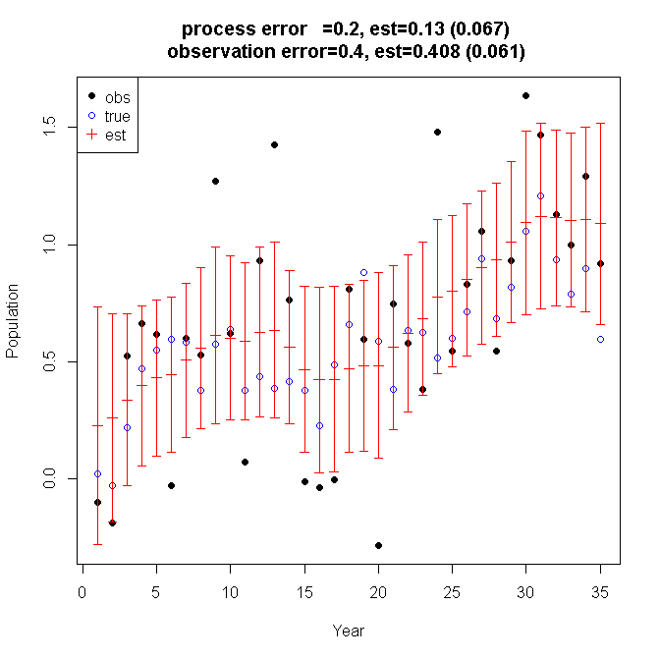
Did a good job separating the two types of error (in this case)
Last true point not well estimated
(in this case) but 33 of the 35 years have true value within CI

Slide 10
Exercise
Generate data
Try different values for the two errors
Fit model
Lather, rinse, repeat
How can model fail?
What leads to model failure?
What happens if population is not random?

Slide 11
Advanced Questions
How are one step ahead residuals computed?
What happens when assumed and true distribution types differ?
Can outliers be detected?
How is an outlier defined?
How far into future can this model predict?
Does this model exhibit a retrospective pattern?
What happens when there is a year missing?
How estimate a value for the first year?

Slide 12
All observation error

Slide 13
All process error

