Slide 1
Advantages of gradient-based MCMC algorithms for difficult-to-fit Bayesian models in fisheries and ecology
Cole Monnahan
12/4/2015
SAFS Quant. Seminar

Slide 2
Introduction
Bayesian inference is increasingly common in fisheries in ecology
There is a need for efficient algorithms for:
complex models and cross validation of simple models (Hooten and Hobbs 2014)
Common software (JAGS etc.) can be too slow
A new class of algorithms is gaining traction in the statistical community (Stan)

Slide 3
Plan of attack
Bayesian intro and background
Gibbs and Metropolis overview
Intro to Hamiltonian dynamics
Hamiltonian Monte Carlo & No-U-Turn
Develop intuition for these MCMC algorithms
Review software options
Performance and concluding thoughts
Goal: Understand algorithms enough to diagnose and interpret MCMC output

Slide 4
Bayesian Integration
A posterior is a distribution of parameters
We integrate to make inference. If it’s easy, we do it analytically:
If not, we can do it numerically, e.g,.:
> mean(rnorm(1e3,0,1)<0) [1] 0.488
> mean(rnorm(1e6,0,1)<0) [1] 0.499608
But how to generate random posterior samples? Enter MCMC!
MCMC is r<your posterior>()

Slide 5
Markov chain Monte Carlo
Markov chains’ next state only depends on the current state
If one is run to ∞, the states will form an ‘equilibrium’ distribution¹
A MCMC is a chain designed such that the equilibrium distribution = posterior of interest
Efficiency is producing independent samples fast. Must be able to easily move between regions.
¹ Under certain conditions. Informally calling this “detailed balance”

Slide 6
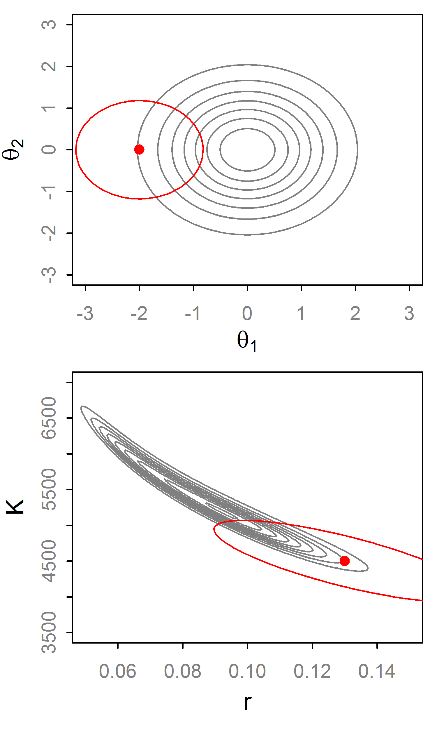
Random Walk Metropolis (RWM)
Propose θ* with distribution q~N(θ_{t}, Σ).
Then set:
If q is symmetric this cancels out
q affects efficiency of RWM so it needs to be ‘tuned’

Slide 7
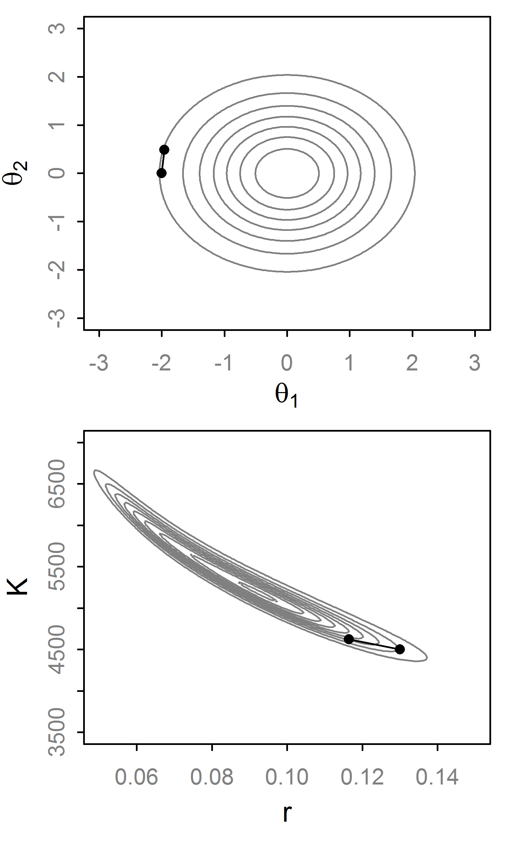
Random Walk Metropolis (RWM)
Propose θ* with distribution q~N(θ_{t}, Σ).
Then set:
If q is symmetric this cancels out
q affects efficiency of RWM so it needs to be ‘tuned’

Slide 8
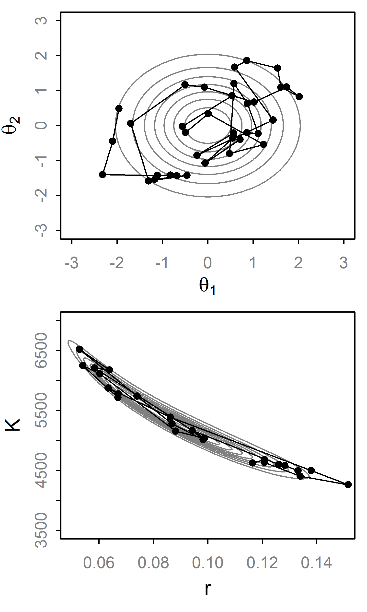
Random Walk Metropolis (RWM)
Propose θ* with distribution q~N(θ_{t}, Σ).
Then set:
If q is symmetric this cancels out
q affects efficiency of RWM so it needs to be ‘tuned’

Slide 9
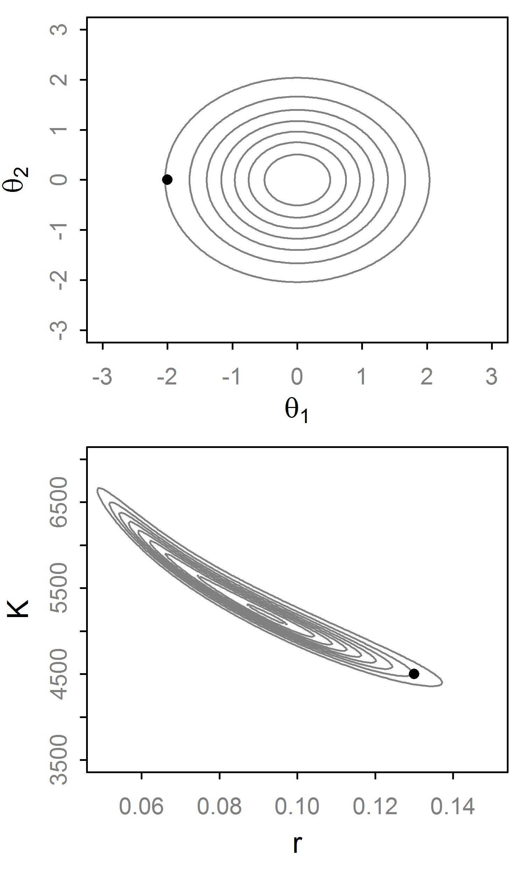
Gibbs Sampler
Condition on all but first variable, find conjugate form
Generate a value from this “full conditional” distribution.
Repeat for all variables. That is a single step.
If not conjugate, do Metropolis-within-Gibbs
No tuning necessary, but poor efficiency for correlated parameters

Slide 10
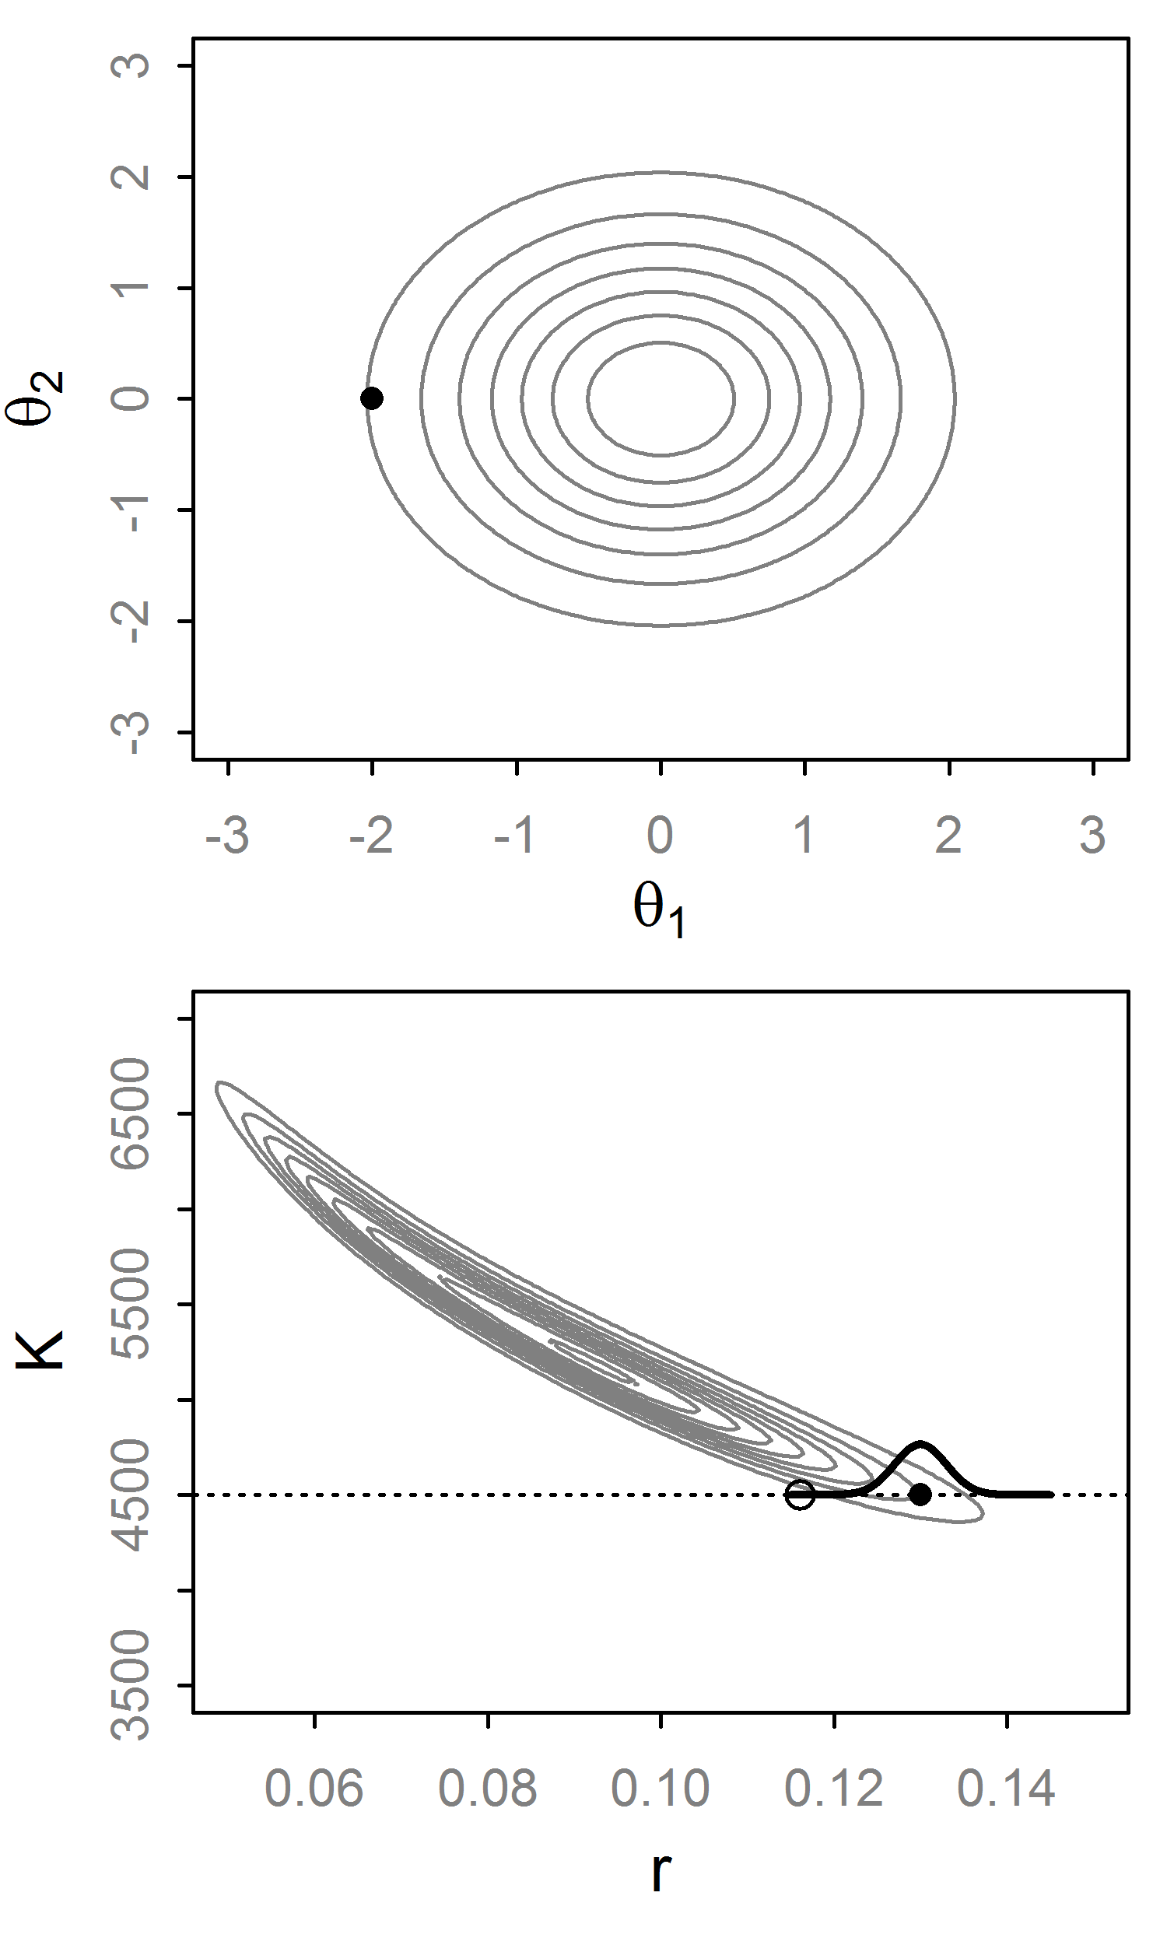
Gibbs Sampler
Condition on all but first variable, find conjugate form
Generate a value from this “full conditional” distribution.
Repeat for all variables. That is a single step.
If not conjugate, do Metropolis-within-Gibbs
No tuning necessary, but poor efficiency for correlated parameters

Slide 11
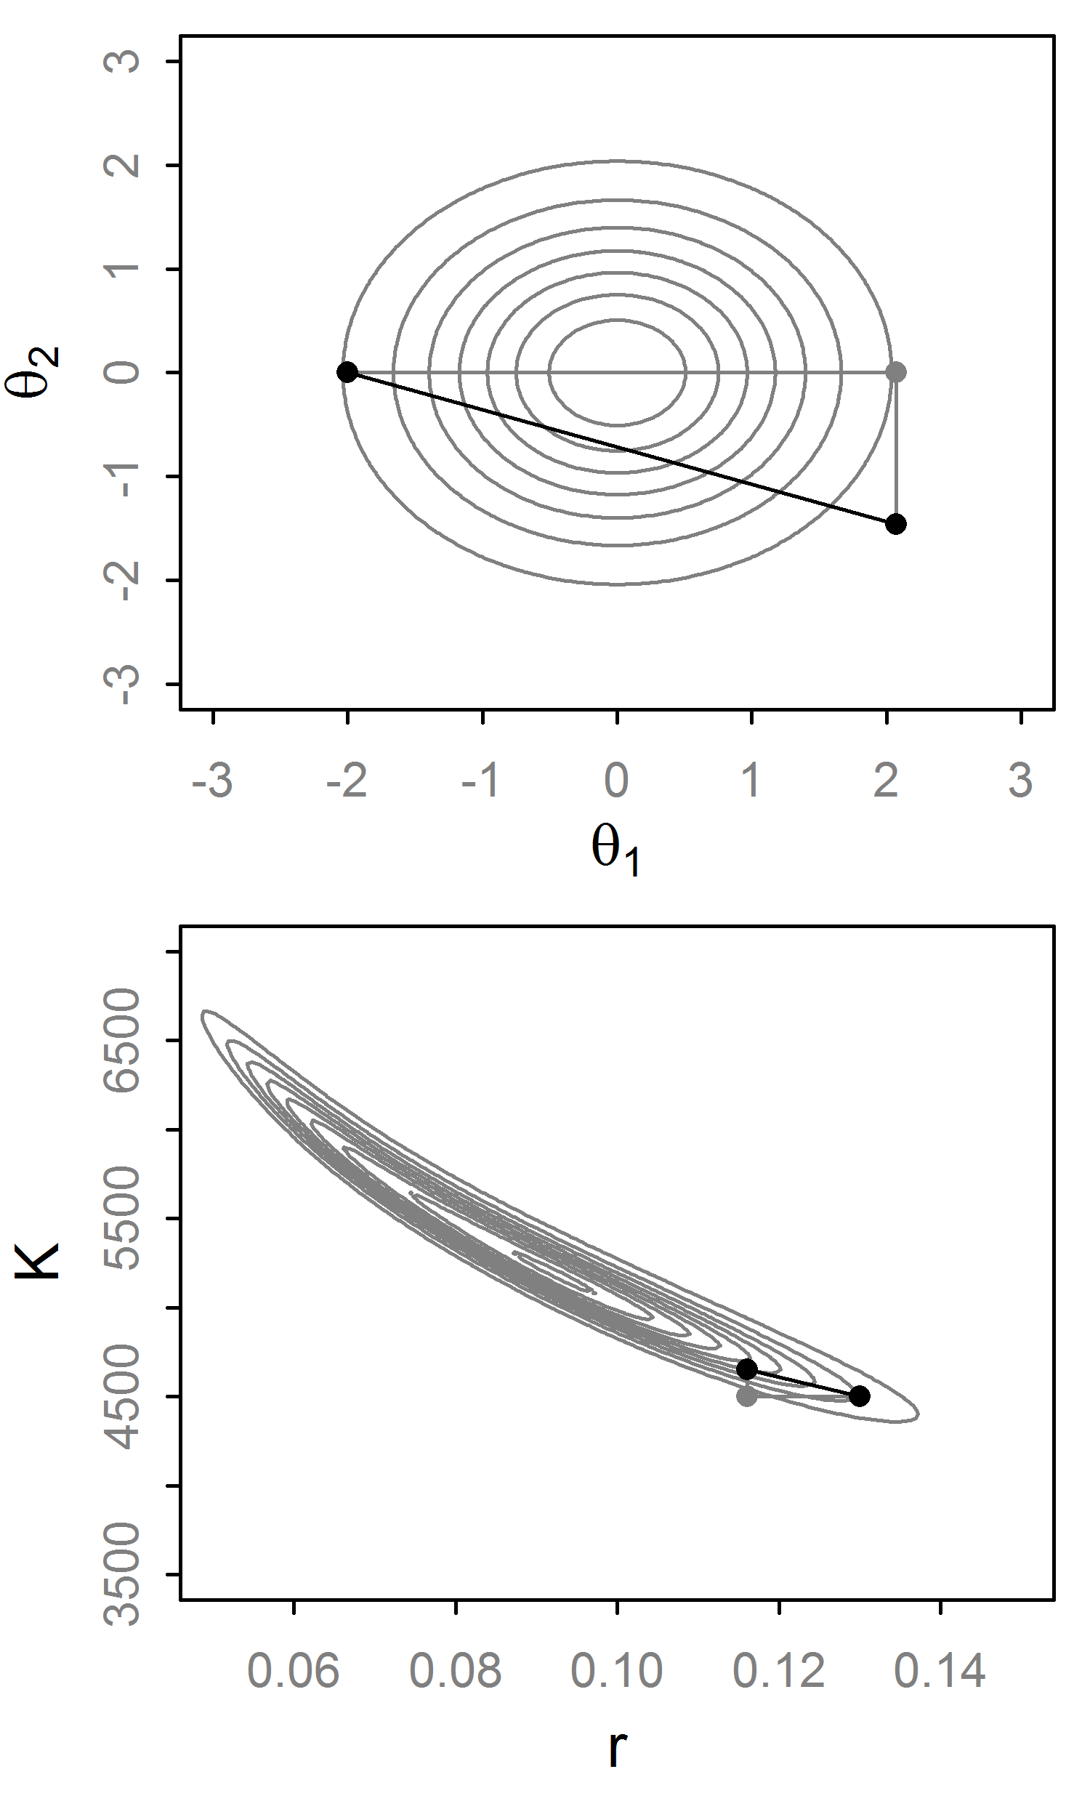
Gibbs Sampler
Condition on all but first variable, find conjugate form
Generate a value from this “full conditional” distribution.
Repeat for all variables. That is a single step.
If not conjugate, do Metropolis-within-Gibbs
No tuning necessary, but poor efficiency for correlated parameters

Slide 12
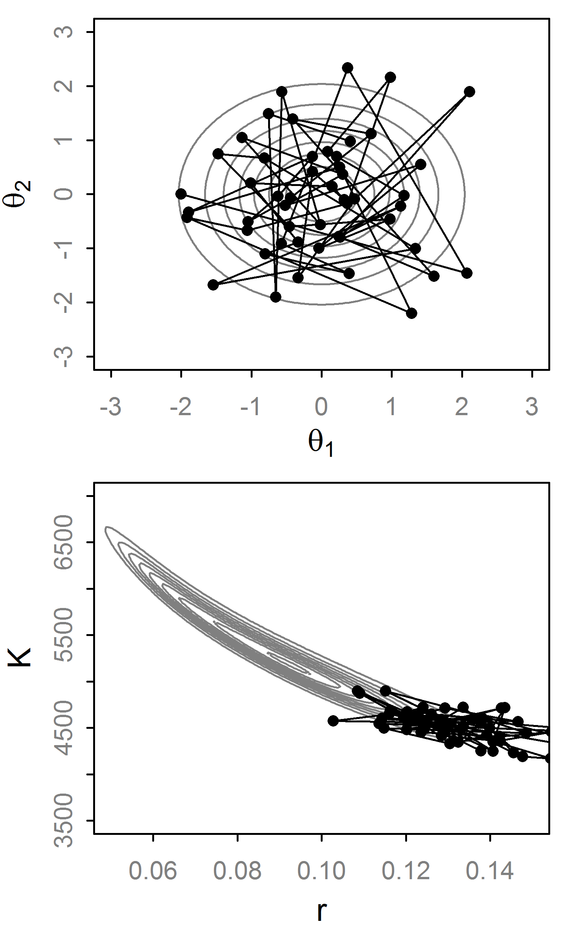
Gibbs Sampler
Condition on all but first variable, find conjugate form
Generate a value from this “full conditional” distribution.
Repeat for all variables. That is a single step.
If not conjugate, do Metropolis-within-Gibbs
No tuning necessary, but poor efficiency for correlated parameters

Slide 13
Beyond RWM and Gibbs
RWM pros/cons:
Easy to implement and works well for many problems w/o conjugacy.
Must be tuned, can be very sensitive to this
Gibbs pros/cons:
No tuning needed, if full conditionals are possible
Easy to implement (JAGS, BUGS, etc.)
As the dimensionality and complexity increases, these algorithms can struggle.
Thought: We could use the gradient to quickly move between areas regardless of dimensionality

Slide 14
Hamiltonian Dynamics
Imagine a puck moving on a frictionless surface
It has position θ with a potential energy U(θ)
And momentum r, with kinetic energy K(r).
The Hamiltonian [H(θ,r)] describes the behavior of the system over time. For MCMC:H=U(θ)+K(r)
Trivial to calculate
Derivative of log-posterior

Slide 15
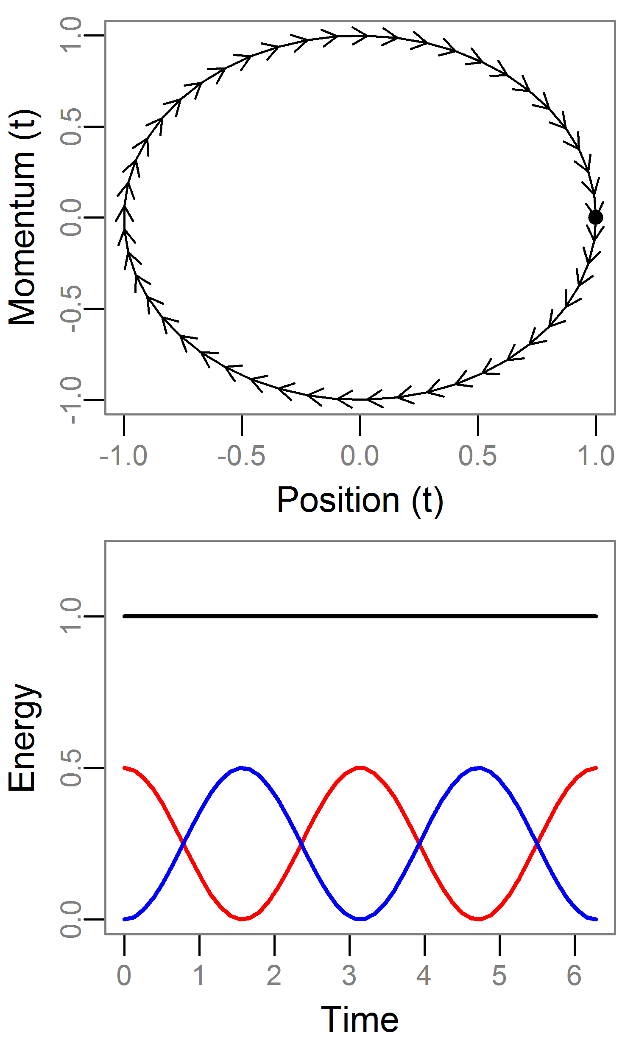
Hamiltonian Dynamics: Example
See Neal (2010) for good review
For MCMC we set U=log posterior and K=log N(0,Σ)
Take a 1d example where:
U=θ²/2 [θ~N(0,1)]
K=r²/2 [r~N(0,1)]
We can solve these equations analytically
Note:
H is constant over time
Each r is a different contours
Most systems are not solvable
H
U
K

Slide 16
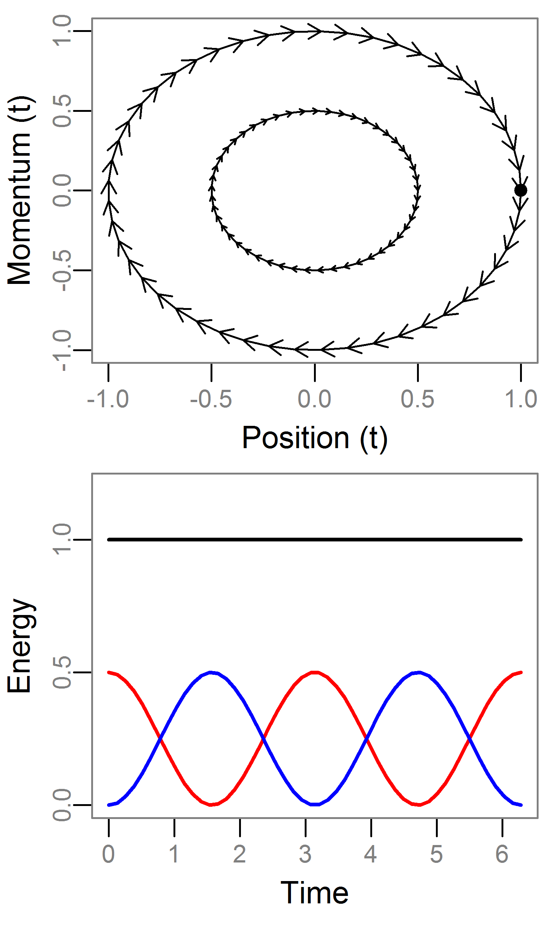
Hamiltonian Dynamics: Example
See Neal (2010) for good review
For MCMC we set U=log posterior and K=log N(0,Σ)
Take a 1d example where:
U=θ²/2 [θ~N(0,1)]
K=r²/2 [r~N(0,1)]
We can solve these equations analytically
Note:
H is constant over time
Each r is a different contours
Most systems are not solvable
H
U
K

Slide 17
Hamiltonian Monte Carlo
Draw r~MVN(0,Σ) (Σ ¹ is unit diagonal)
Project forward² L discrete steps of size ɛ.
The final value of trajectory is our proposed value (q!!).
Note:
H varies due to discretization, so use RWM step:
This generates joint samples (θ,r), so we discard (ignore) the r samples.
¹ This is known as the “mass matrix”
² Using the Leapfrog integrator which is more stable/robust than Euler’s method

Slide 18
Hamiltonian Monte Carlo
Q: Why do we need to utilize a Hamiltonian system?
A: Detailed balance!
HMC has several mathematical properties advantageous for MCMC:
Reversible + Volume preserving.
Informally: the q cancels out. Impossible to calculate otherwise.
Crucially, these hold under discretization
Bottom line: The chain gives us samples from the posterior

Slide 19
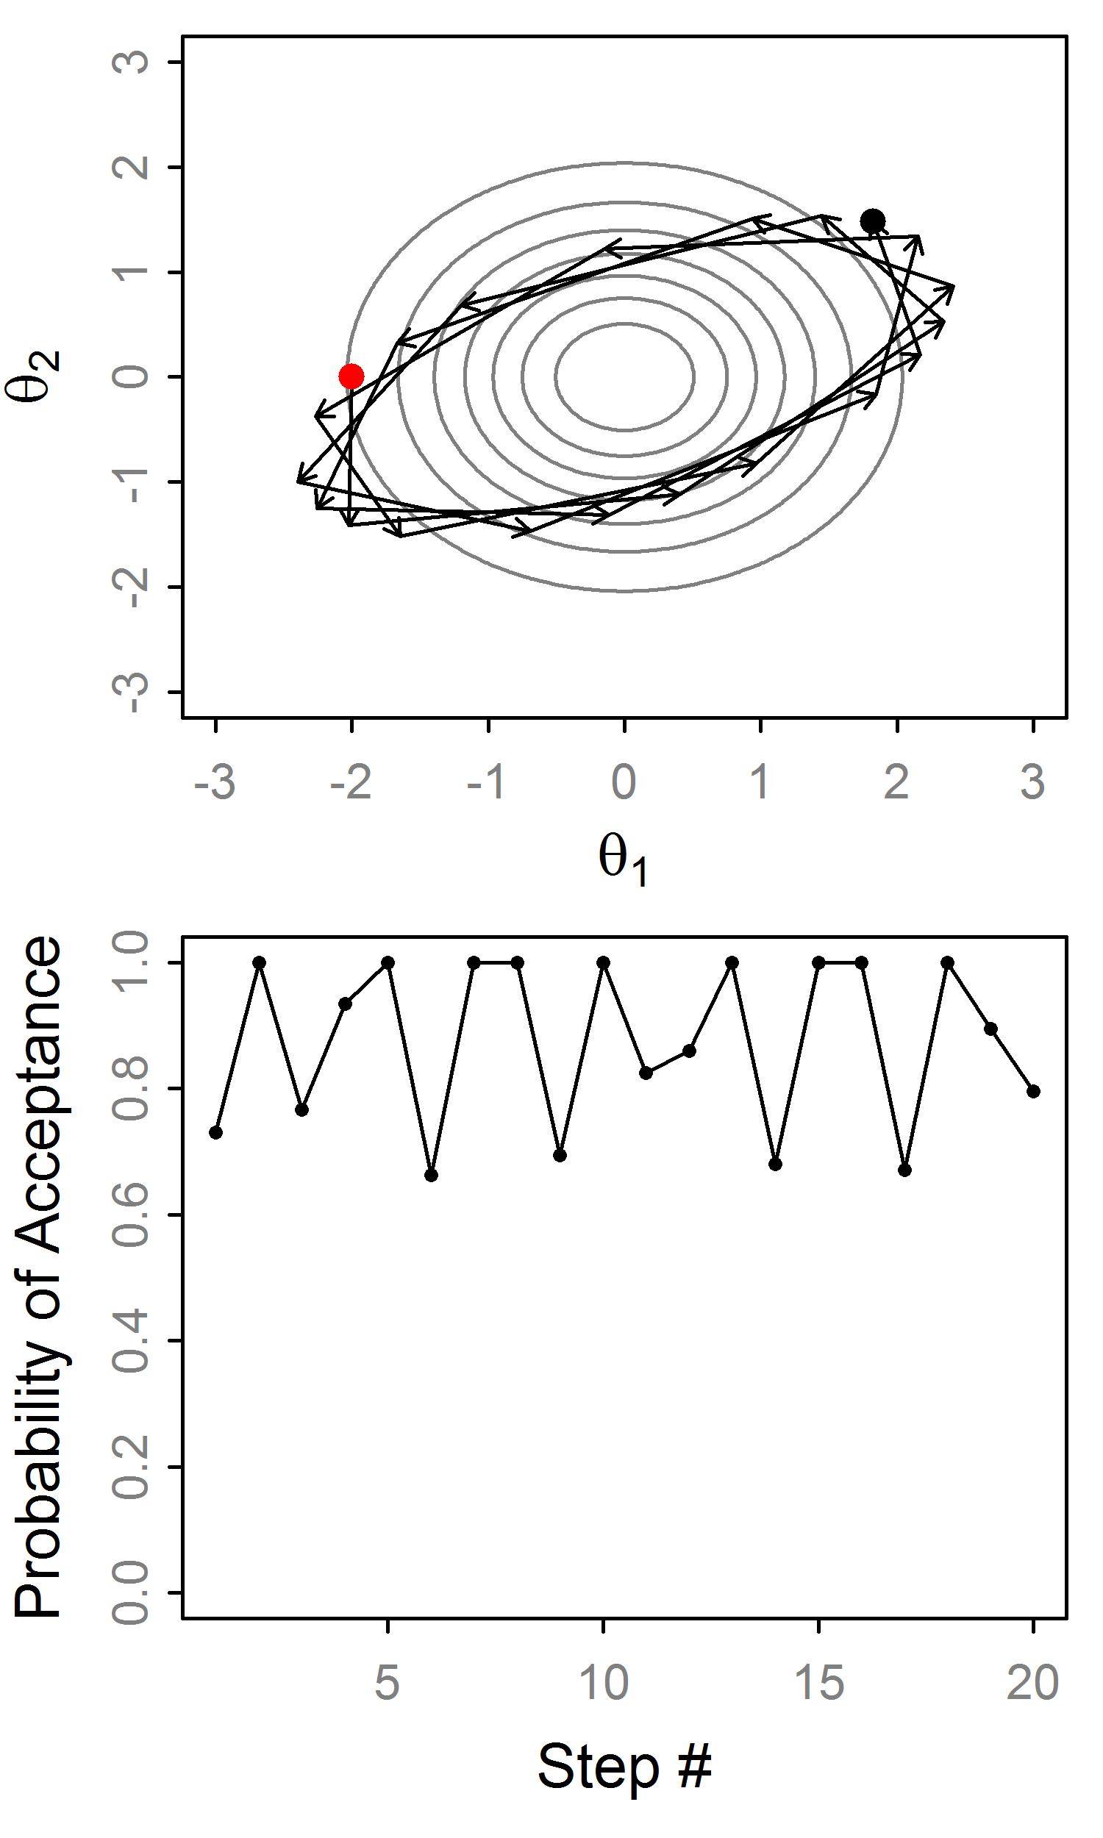
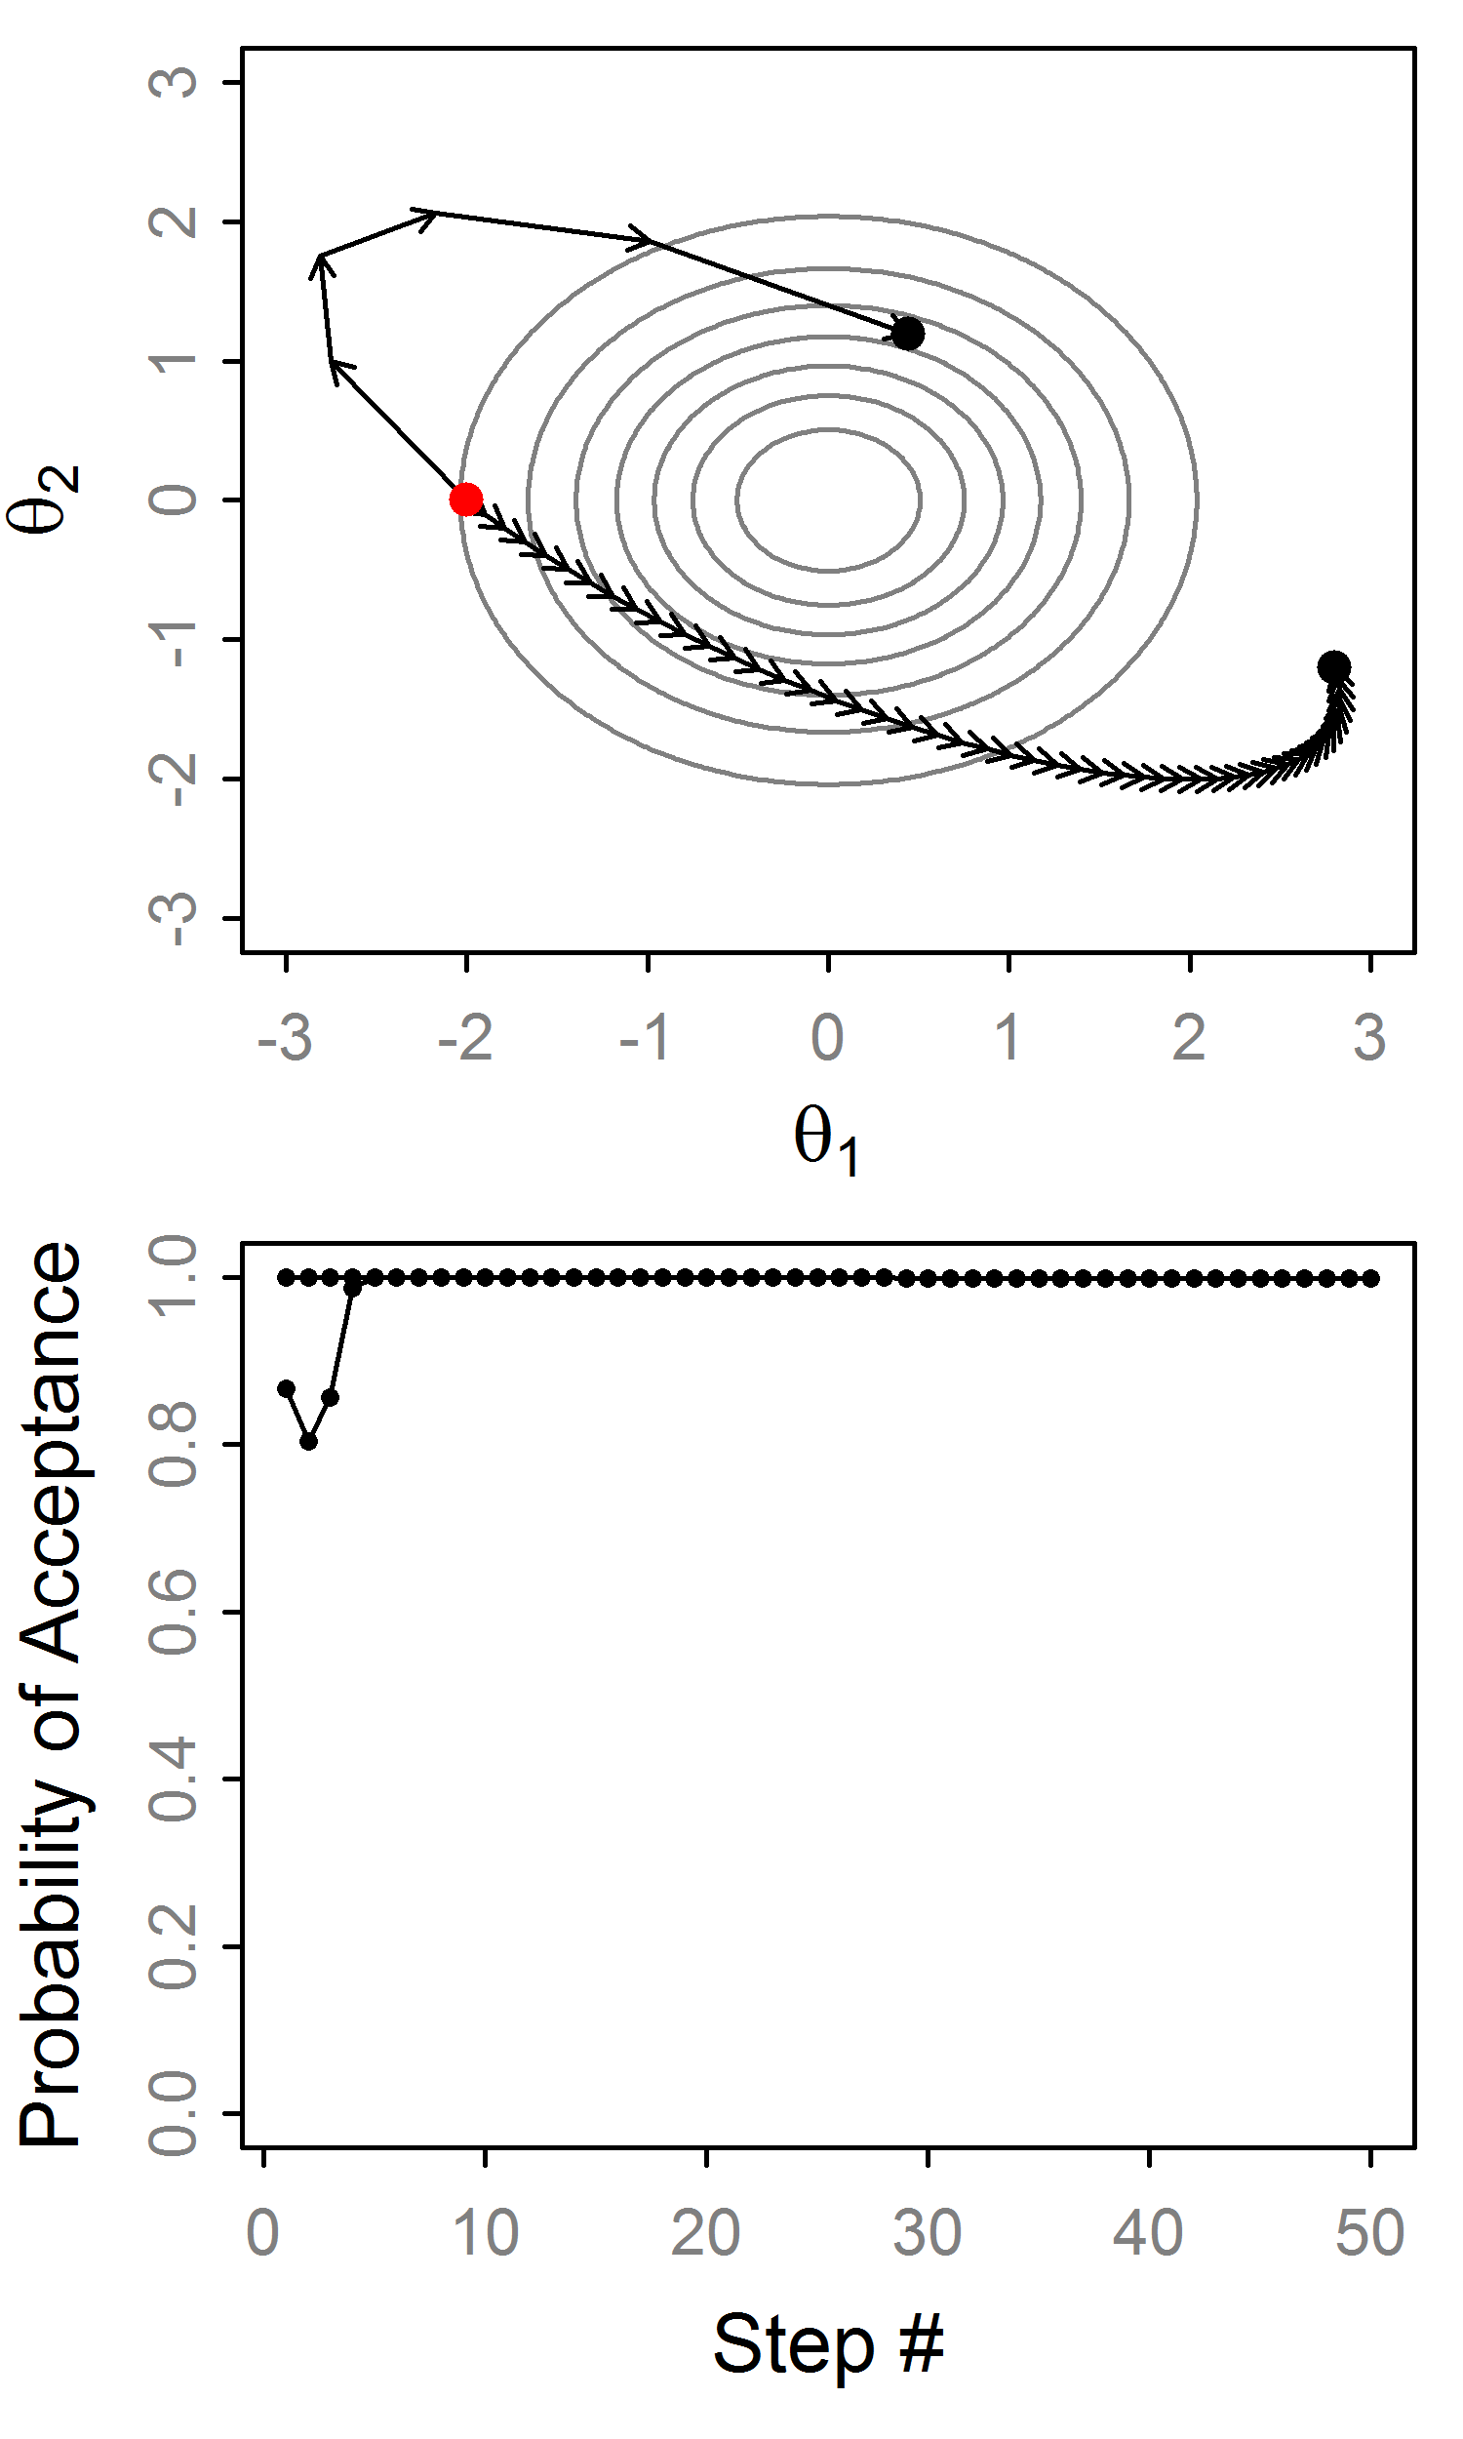
HMC: Example trajectories
Very stable!
Big ɛ, small L
Small ɛ, big L
Big ɛ leads to variation in H
Errors don’t accumulate

Slide 20
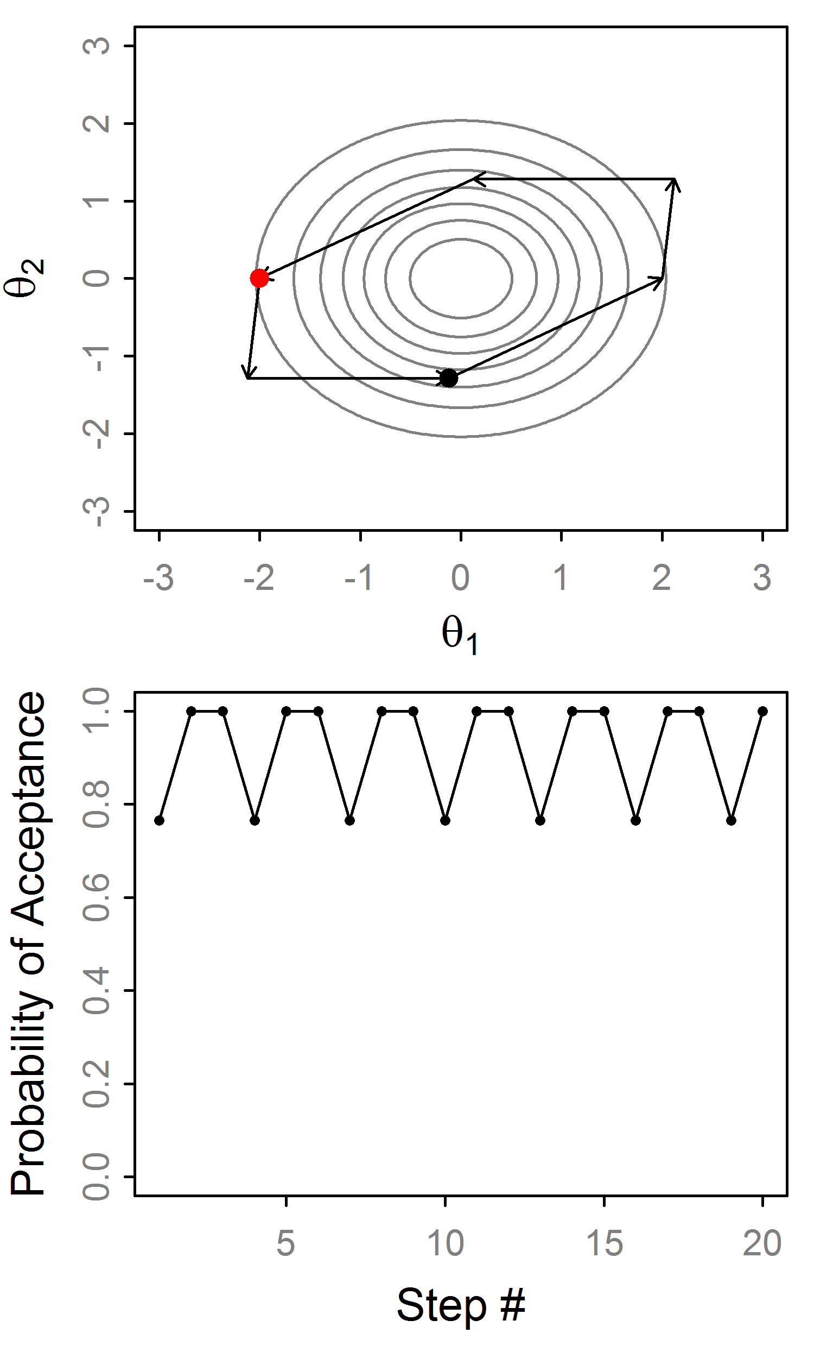
HMC: Example trajectories
What’s happening here?
The trajectory is cycling exactly w/ period 6.
This is really bad for MCMC.
Leads to slow mixing in practice¹.
Solution: randomize L or ɛ
What happens over time?
Exact cycles!
¹ Exact periods are unlikely in real problems

Slide 21
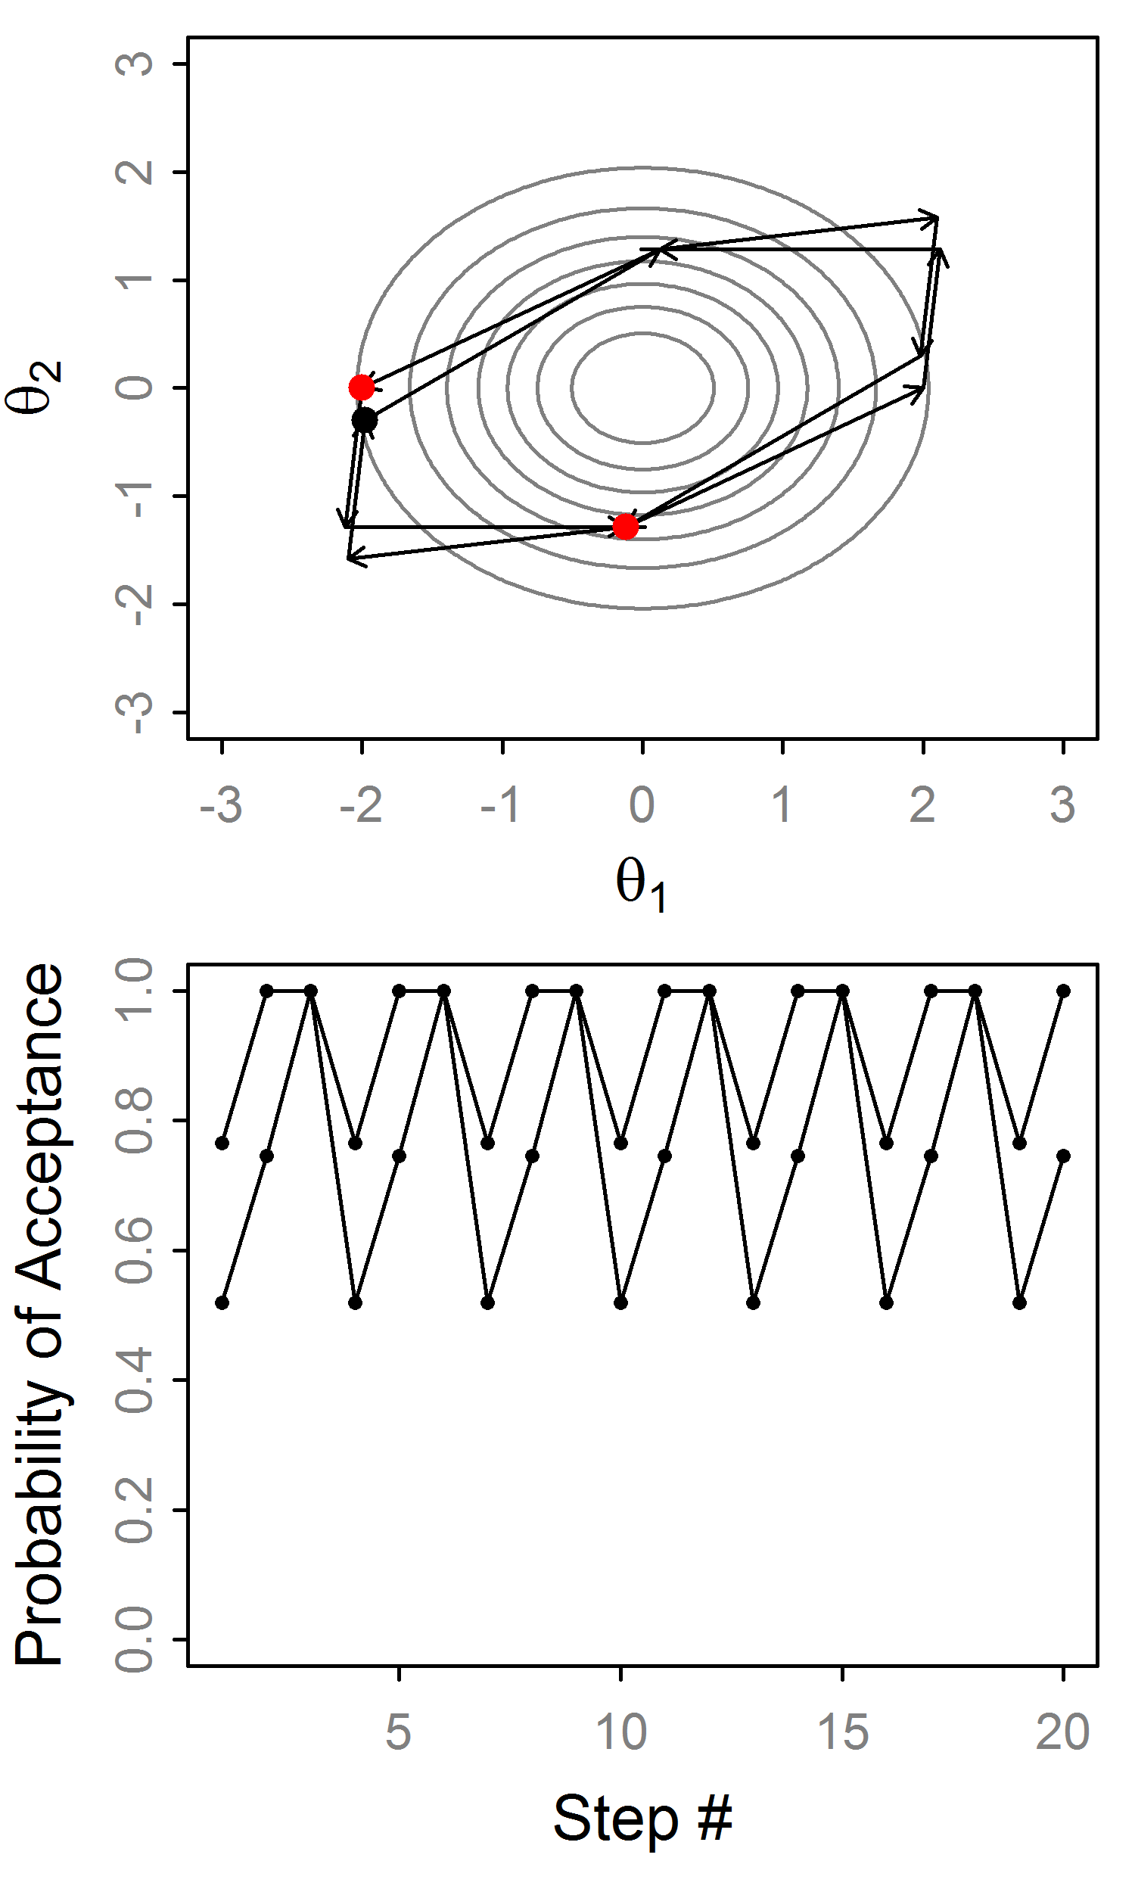
HMC: Example trajectories
What’s happening here?
The trajectory is cycling exactly w/ period 6.
This is really bad for MCMC.
Leads to slow mixing in practice¹.
Solution: randomize L or ɛ
What happens over time?
¹ Exact periods are unlikely in real problems

Slide 22
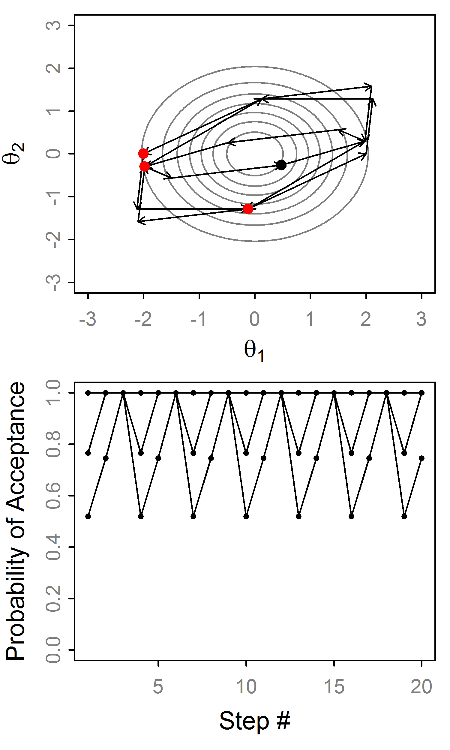
HMC: Example trajectories
What’s happening here?
The trajectory is cycling exactly w/ period 6.
This is really bad for MCMC.
Leads to slow mixing in practice¹.
Solution: randomize L or ɛ
What happens over time?
¹ Exact periods are unlikely in real problems

Slide 23
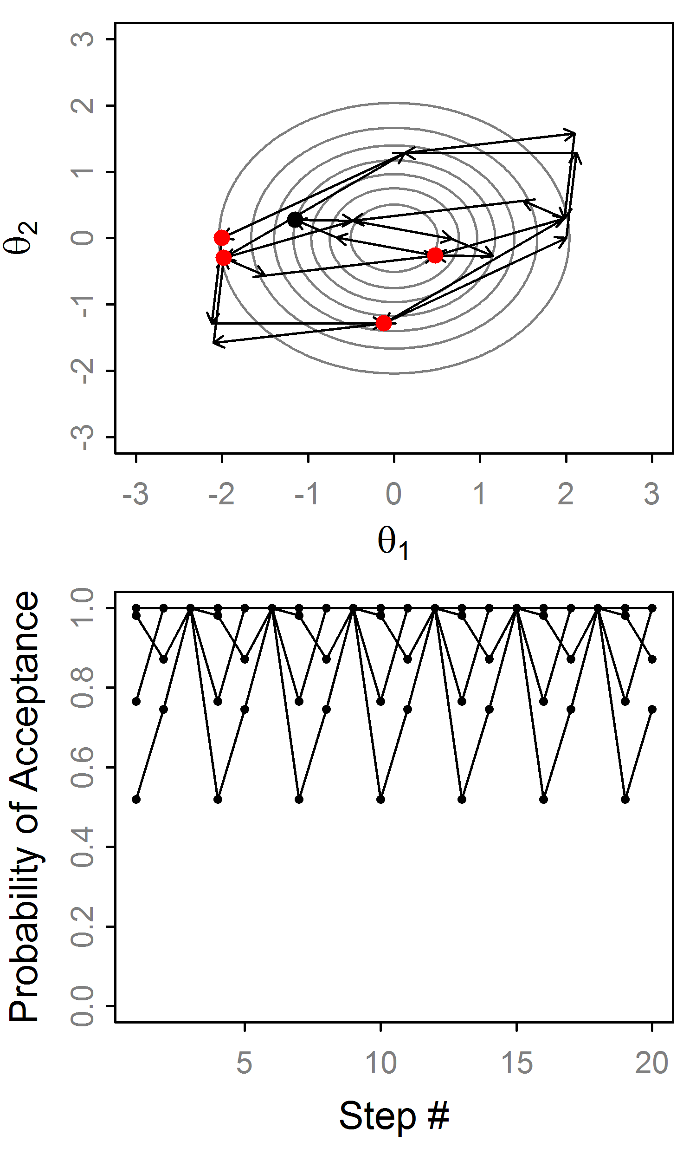
HMC: Example trajectories
What’s happening here?
The trajectory is cycling exactly w/ period 6.
This is really bad for MCMC.
Leads to slow mixing in practice¹.
Solution: randomize L or ɛ
What happens over time?
¹ Exact periods are unlikely in real problems

Slide 24
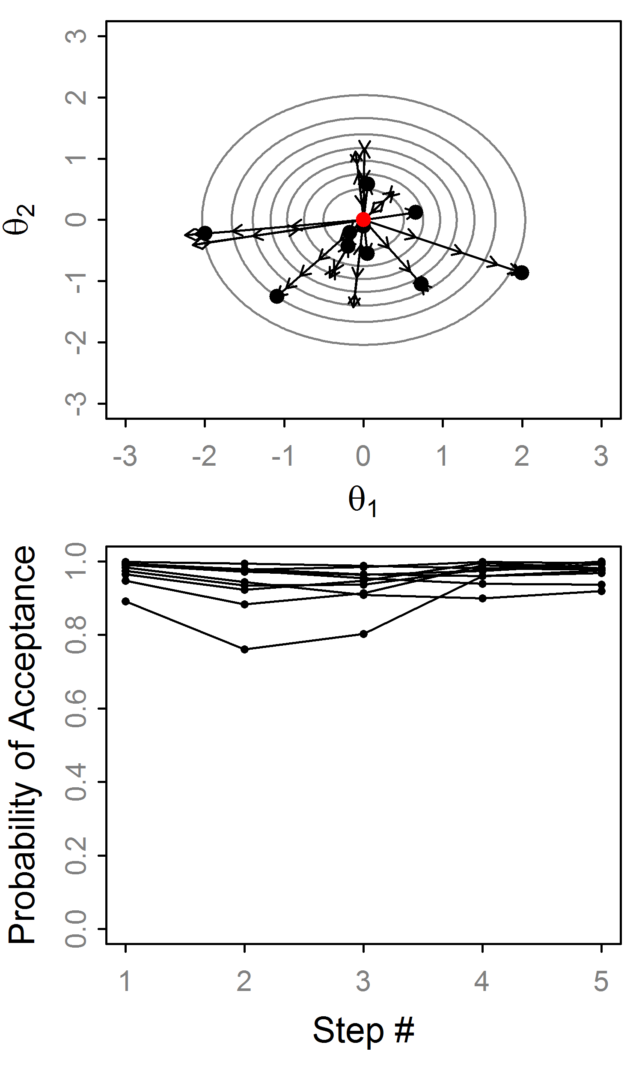
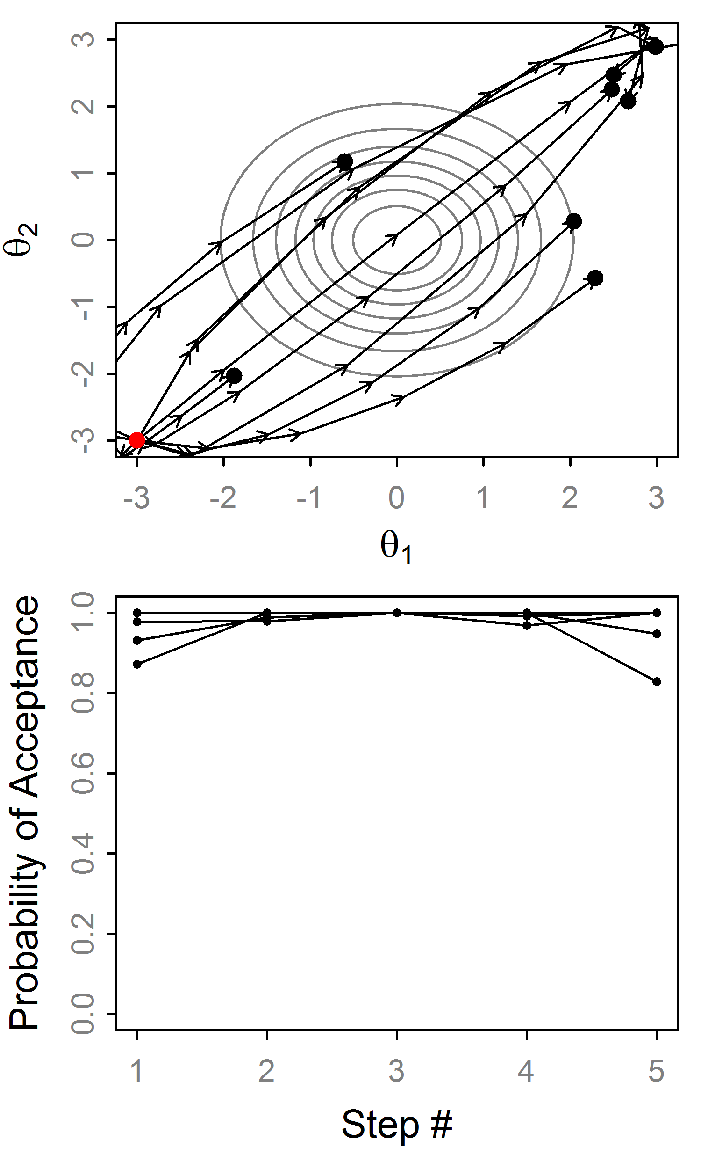
Effect of random momentum
Random momentum and ɛ
w/o random ɛ we’d alternate here!!!

Slide 25
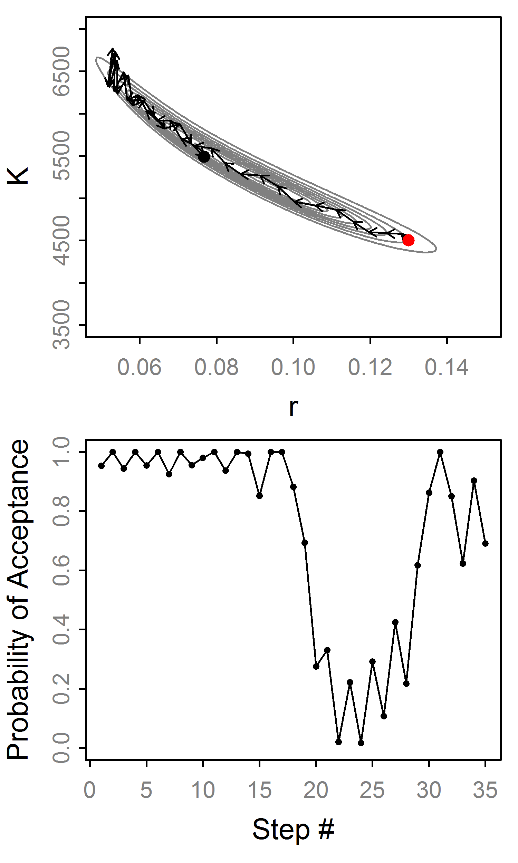
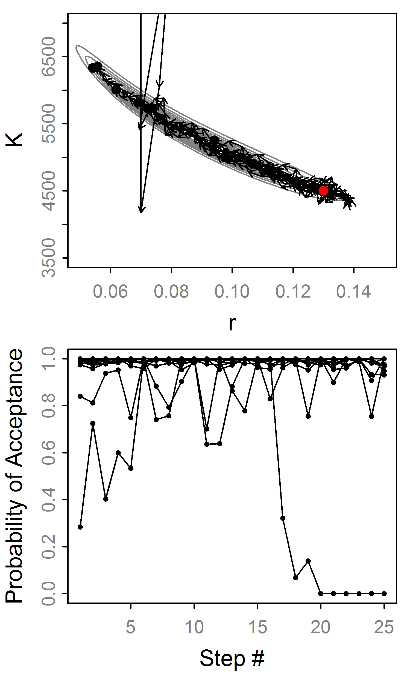
HMC: Example trajectories
“Divergent”
“Divergent”

Slide 26
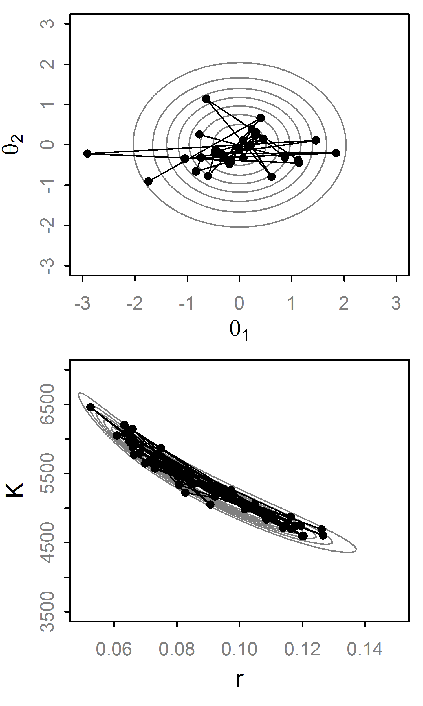
Hamiltonian Monte Carlo
HMC eliminates inefficient random walk behavior
Fancy way to propose values
Often produces nearly independent samples (for large L)
Has high computational cost (L ≈ to thinning)

Slide 27
Implementation Hurdles of HMC
Introduced by Duane et al. (1987)… why uncommon?
Some in the physics/stats literature¹, but it “seems to be under-appreciated by statisticians” (Neal, 2010).
Mainly for two reasons:
Hard to calculate derivatives of log posteriors
Efficiency is notoriously sensitive to the tuning parameters: (L, ɛ, Σ)
¹ e.g., Neal (1996), Ishwaran (1999) and Schmidt (2009)

Slide 28
Solution #1: Automatic Differentiation
AD is a numerical technique to get precise derivative of any continuous function.
The computer applies the chain rule successively
It is as precise as analytical derivatives up to computer precision.
Available widely, e.g., ADMB, TMB, Stan
Posterior must be continuously differentiable

Slide 29
Solution #2: No-U-Turn Sampler
Extends HMC to avoid specifying L and ɛ.
ɛ is adapted with ‘dual averaging’. Works for HMC too. Skipping this...
L is set automatically with a sophisticated algorithm that detects a “U-turn” in the trajectory and stops.
Thus L varies at each iteration, avoiding wasteful steps.
Hoffman and Gelman (2011)

Slide 30
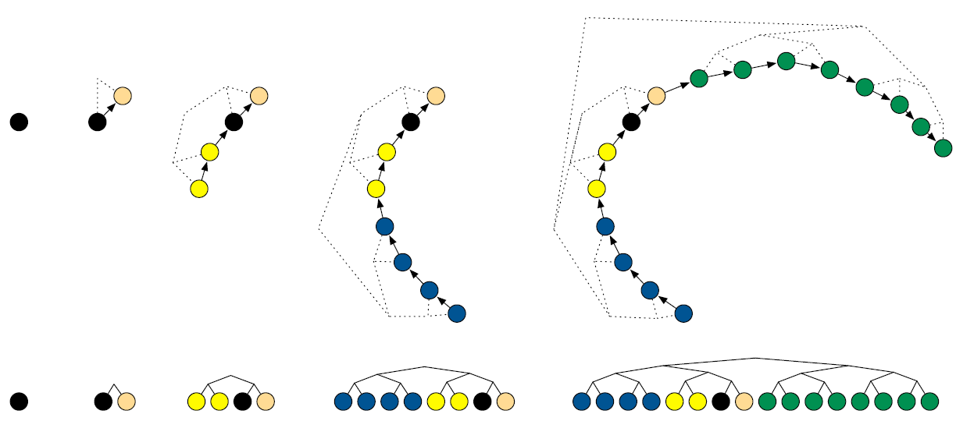
No-U-Turn Trajectory
for j in 0:max_depth
Pick random direction (left or right)
Recursively build tree of size 2^{j}
If U-turn occur in subtree or divergence
break, excluding subtree
Balanced Binary Tree
Fig 1, Hoffman and Gelman (2011)

Slide 31
Sampling from Trajectory
Let B be set of states (θ,r) in trajectory.
Generate a slice variable
Set C is states in B where
Uniformly select from C to get θ_{t+1}
Why so complicated? Detailed balance!
Note: There is no Metropolis step, this is technically Gibbs sampling [p(θ,r,u,B,C|ɛ]

Slide 32
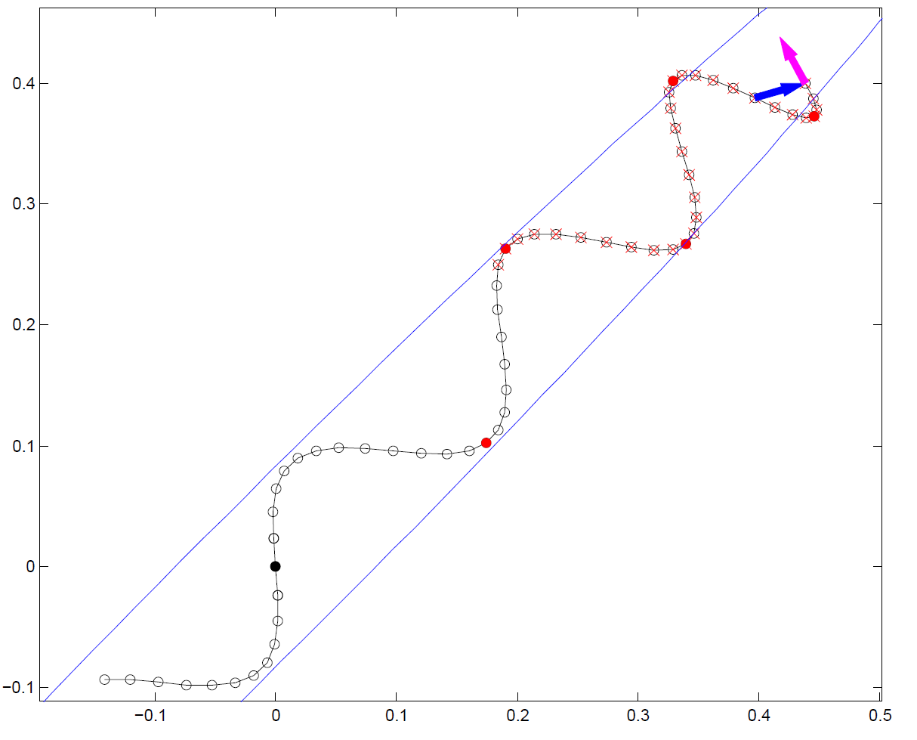
No-U-Turn Example
Exclude this subtree
U-Turn!!
Exclude due to slice variable
Fig 2, Hoffman and Gelman (2011)

Slide 33
Tuning the No-U-Turn Sampler
Eliminates the need to specify ɛ or L: ɛ is tuned during the warmup phase, L dynamically.
But, introduces new tuning parameters:
max_depth: Maximum tree depth.
Delta=0.6: The target acceptance rate.
γ=0.05, κ=0.75, t₀=10: For dual averaging
However, this seems to work smoothly without intervention (good for general use)

Slide 34
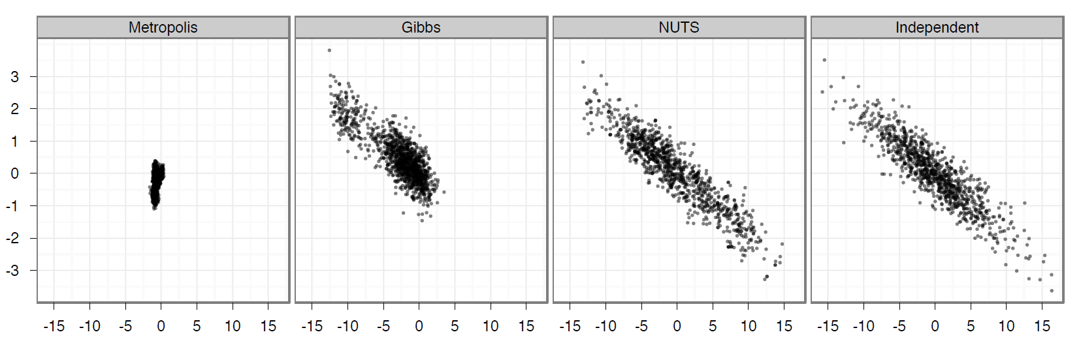
Performance Comparison
250 dimension MVN.
1M RWM and Gibbs samples thinned to 1000
1000 NUTS samples
Fig 7, Hoffman and Gelman (2011)

Slide 35
Software implementation
 | ADMB | TMB | Stan
HMC | ✓ | ✓ | ✓
NUTS | X | ✓ | ✓
Dual averaging | X | ✓ | ✓
Step size: ɛ | hyeps | eps | stepsize
# of steps: L | hynstep | L | int_time
Delta | NA | delta | adapt_delta
Max tree depth | NA | max_doubling | max_treedepth
jitter | Hard-coded on L | Hard-coded on ɛ | stepsize_jitter
Mass matrix | Estimated covariance | Arbitrary matrix | Unit diagonal, adapted diagonal, or adapted “dense”
NUTS is the default algorithm for Stan, which has a rich set of adaptive procedures and built-in diagnostic tools. See https://jgabry.shinyapps.io/ShinyStan2Preview
HMC/NUTS are implemented in TMB in R, and much easier to follow than the C++ used by Stan or ADMB. https://github.com/kaskr/adcomp/blob/master/TMB/R/mcmc.R

Slide 36
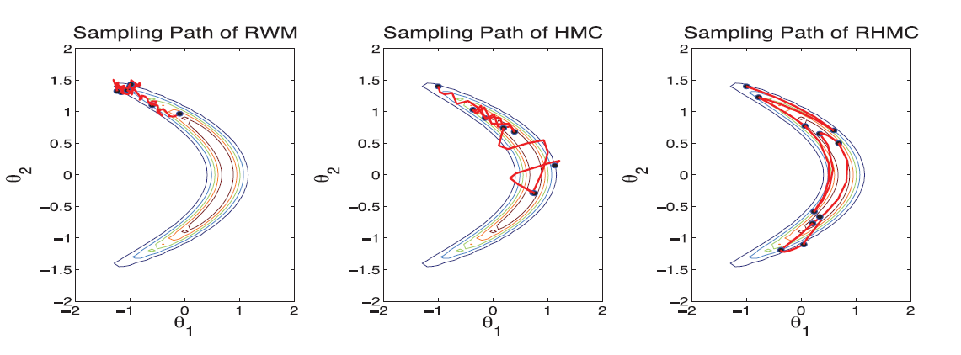
Beyond HMC
Riemann Manifold HMC (Girolami & Calderhead, 2011)
Uses Riemann geometry to adapt the mass matrix at each step (use Hessian instead of first derivs)
Lagrangian HMC (Lan et al., 2014)
Extend RMHMC by replacing Hamiltonian dynamics with Lagrangian dynamics (velocity instead of momentum)
Improved adaptation schemes (Wang et al., 2013)
Not available (yet) in generic software.
Bottom line: HMC is evolving quickly into significantly more sophisticated algorithms…. This is likely the future of MCMC

Slide 37
Concluding thoughts
These algorithms are extremely sophisticated
However, a basic understanding helps interpret and diagnose output
Stan is replacing JAGS as a generic platform
TMB is replacing ADMB as flexible platform
I found that Stan inconsistently outperforms JAGS, and is more finicky in general.
Advice: JAGS is good starting place. Switch to Stan and gradient-based MCMC if needed.

Slide 38
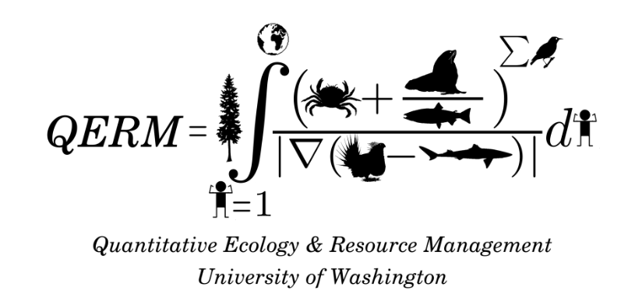

Acknowledgements
Jim Thorson
Advice and guidance
Kasper Christensen, Hans Skaug
Advice and help integrating with TMB
Thanks… Questions?

