Slide 1
srw_sim

Slide 2
What was done
Use swr.cpp to estimate process and observation error for 35 year time series
Both process and observation error could be 0.1, 0.3, or 0.5 (3X3 factorial)
100 datasets created for each combination
Examined:
How many times error CIs contained true values
How many times error estimates < 0.001 (failed)

Slide 3
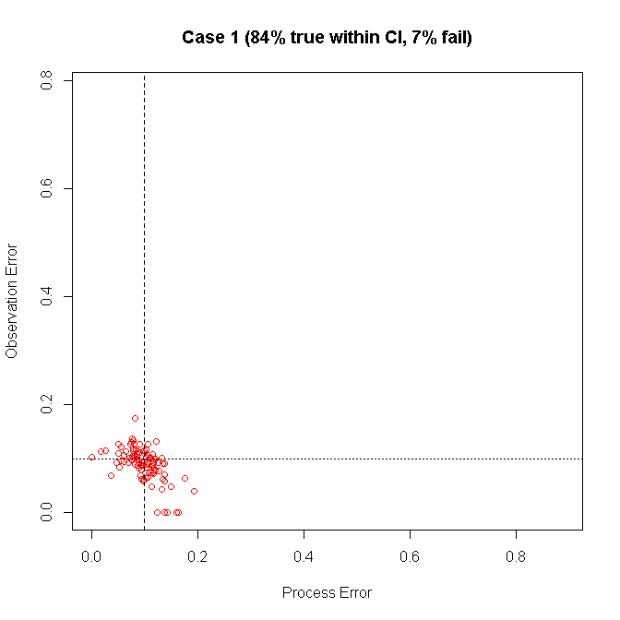
Both errors need to have true within CI, but either error can fail
Horizontal and vertical dashed lines show true values
Failed estimates
Error < 0.001

Slide 4
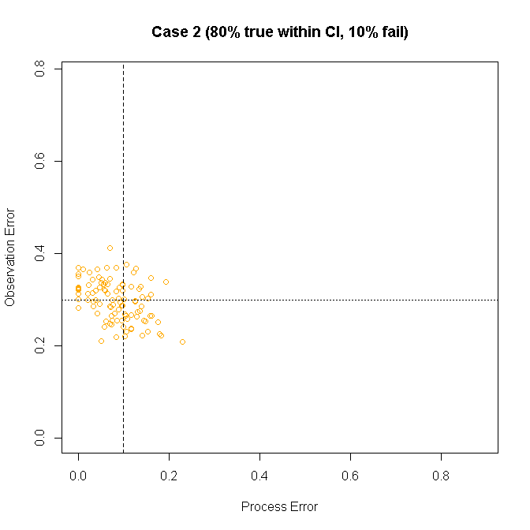

Slide 5
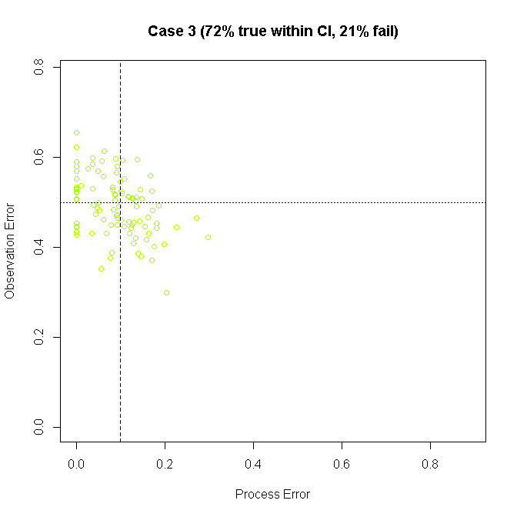

Slide 6
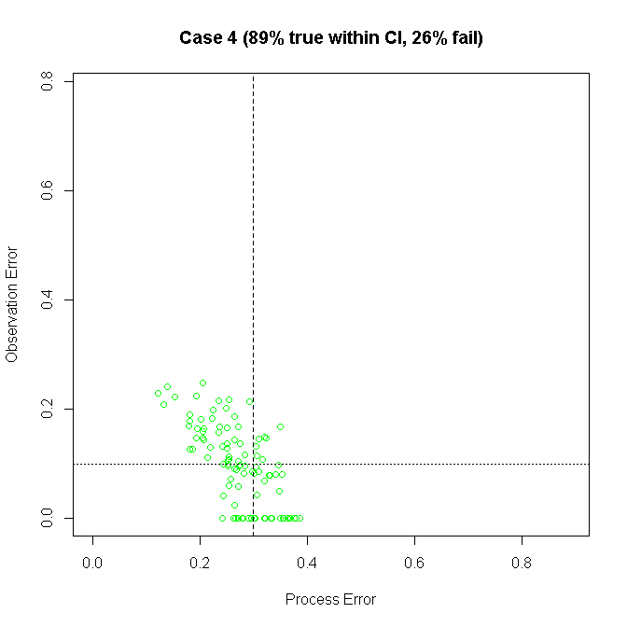

Slide 7
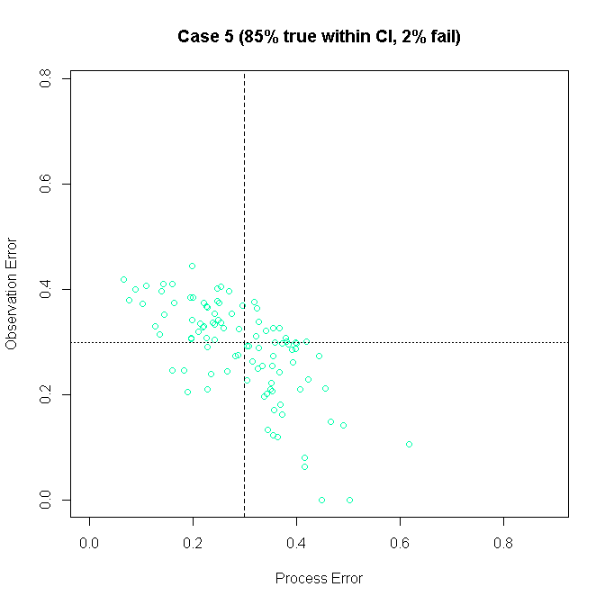

Slide 8
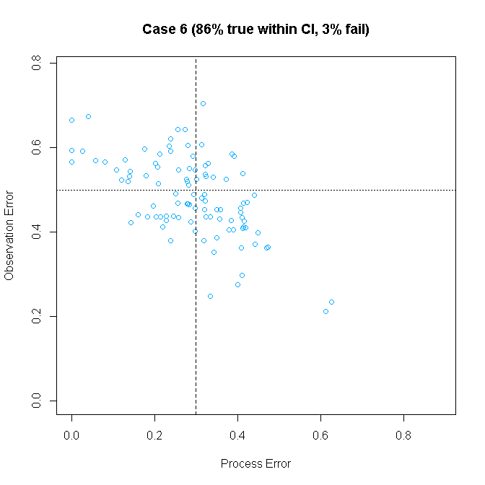

Slide 9
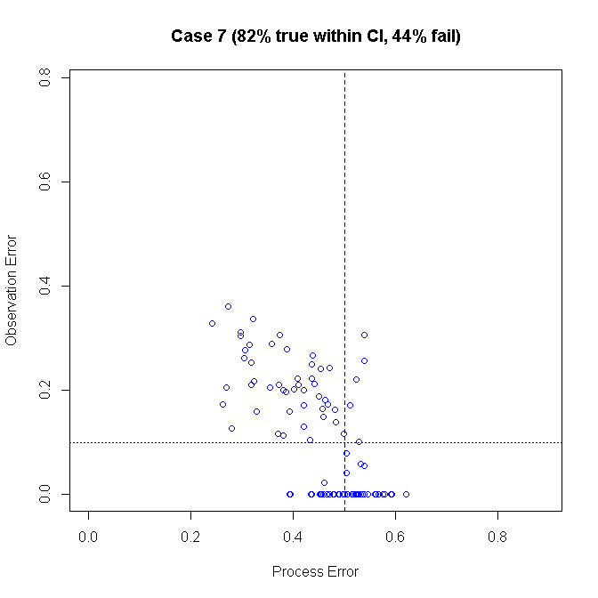

Slide 10
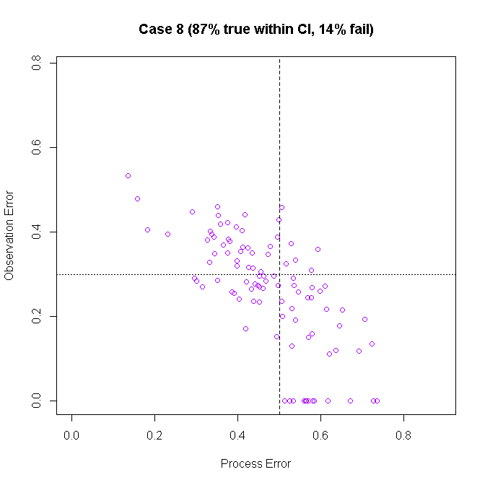

Slide 11
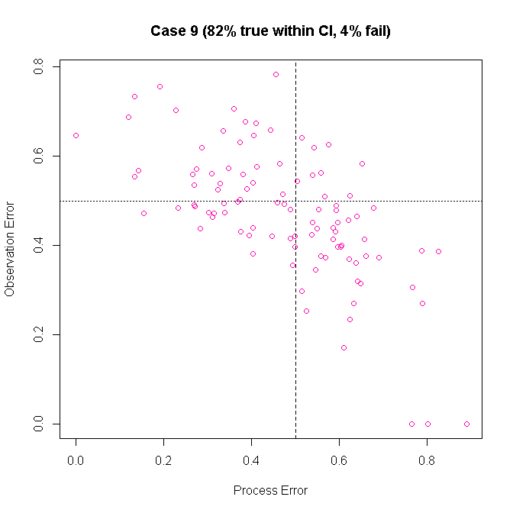

Slide 12
Summary
More likely to fail when process and observation errors not equal
Process error more likely to go to zero
Generally good ability to estimate both error types (within CI)
but even some fails are within due to large CI

