Slide 1
Turbulence Modeling Benchmarks Survey
RANS Turbulence Modeling Discussion Group led by
Brian R. Smith
LM Fellow
Lockheed Martin Aeronautics Company
P. G. Huang
Department of Mechanical and Materials Engineering
Wright State University
Dayton, OH

Slide 2
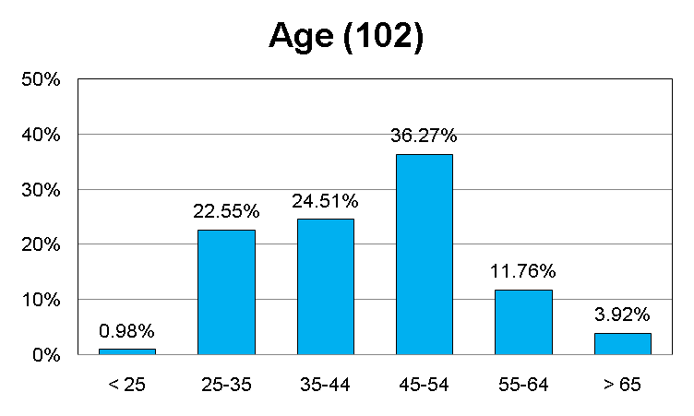
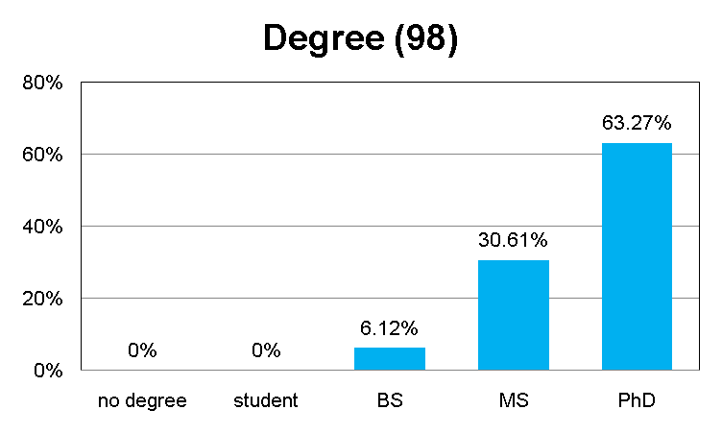
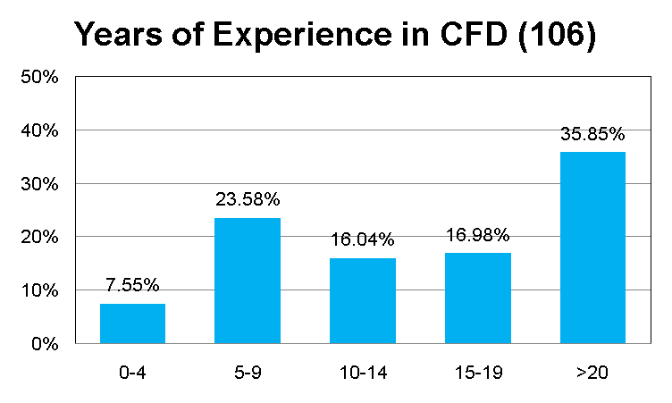
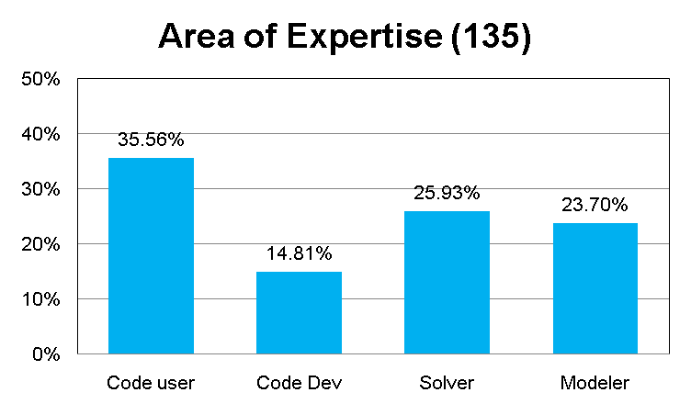
Profiles

Slide 3
Profiles
We have a total of 108 replies.
Most are in aerospace-related Industry.
Most of them have PhD degree and > 93% have at least a MS degree.
Average age is around 45 years.
1/3 have more than 20 years experience in CFD while the age ranges are quite wide spread.
Areas of expertise are also widely distributed among code users, code developers, solver developers and turbulence modelers.

Slide 4
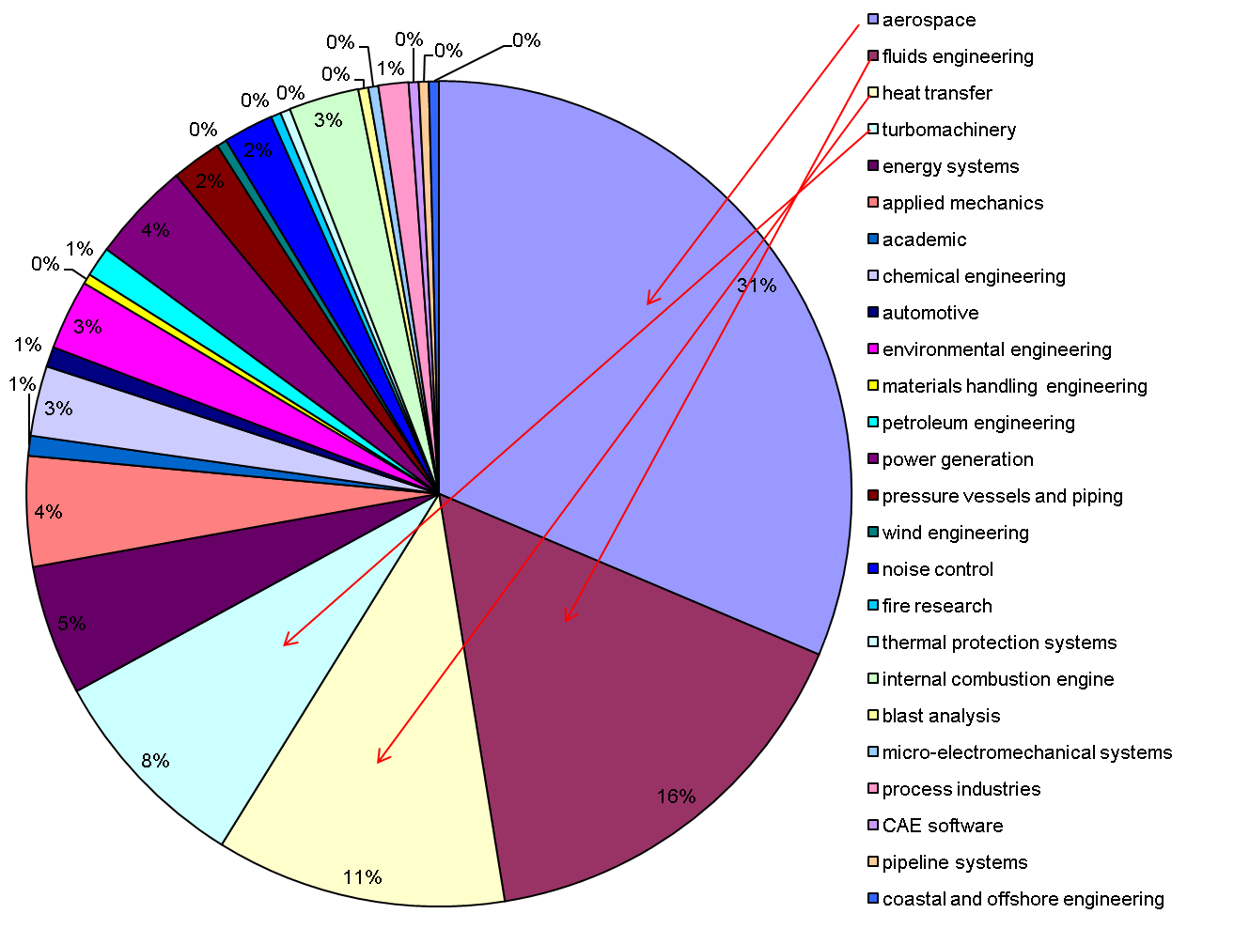

Slide 5
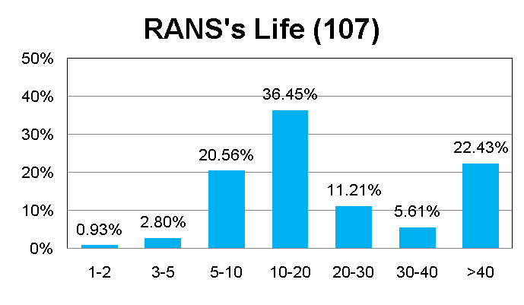
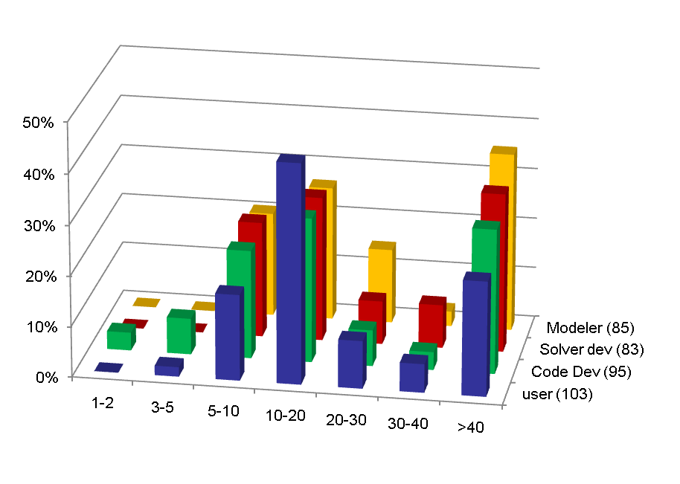
RANS

Slide 6
RANS’s life
21% believe it will ends in 5-10 years.
Majority (36%) believe 10-20 years.
22% believe it will not come during their life time.
Modelers > Solver > Code Dev > User

Slide 7
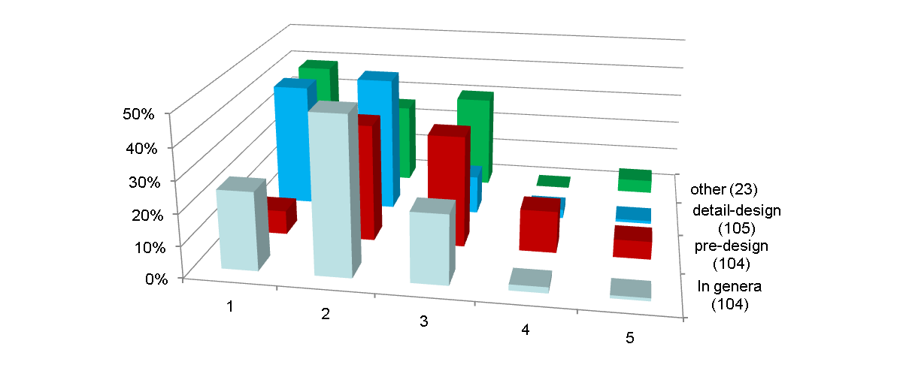
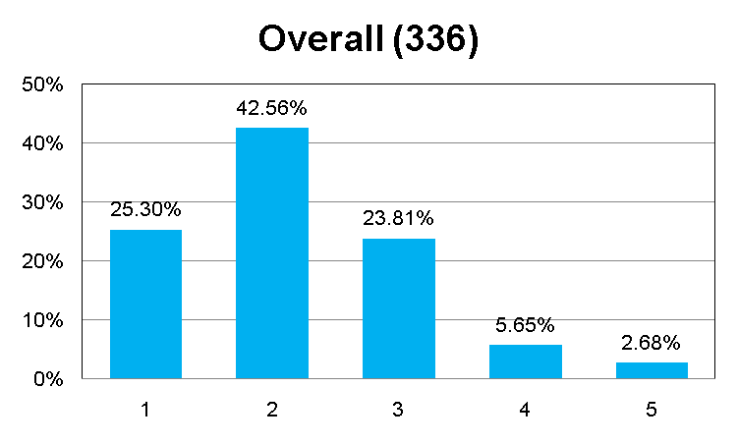
How critical is the accuracy of RANS to the success of CFD designs?
Extremely not very
Extremely not very

Slide 8
How critical is the accuracy of RANS to the success of CFD designs?
Majority believe it is very critical.
Most critical area is in detailed designs.
A small fraction believe that it is not that useful in pre-design stages.

Slide 9
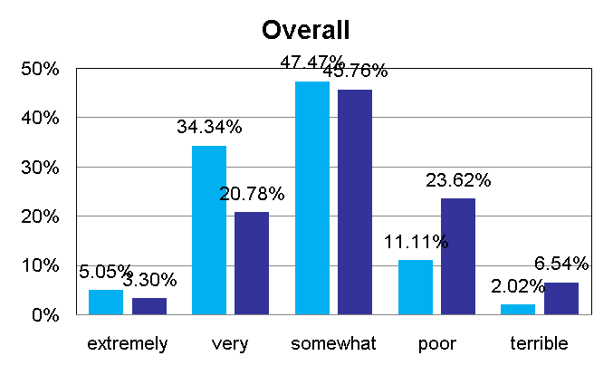
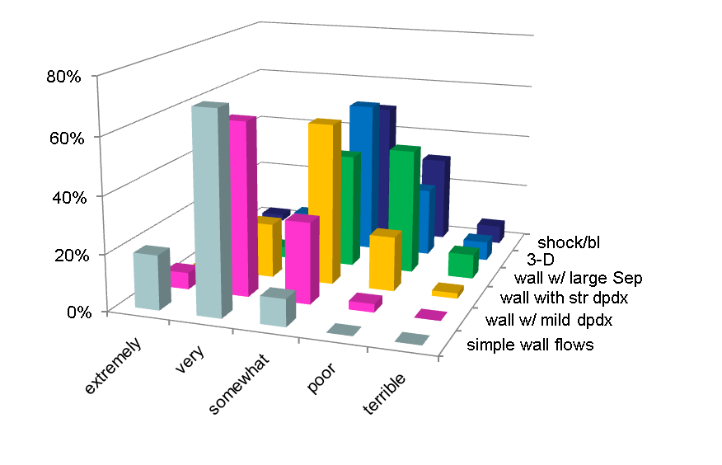
Are today’s RANS sufficiently accurate?

Slide 10
Are today’s RANS sufficiently accurate?
Most are not unhappy about RANS.
Most have confidence for simple flows while are less so for complex flows.

Slide 11
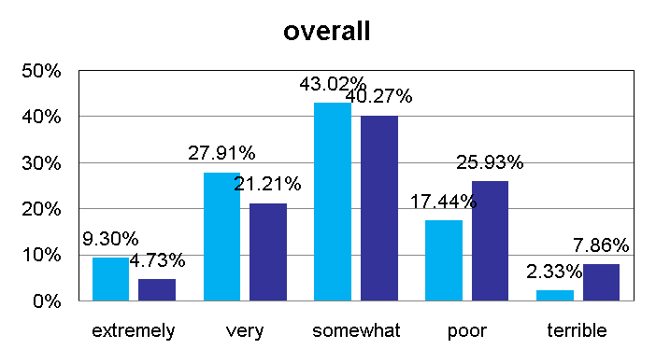
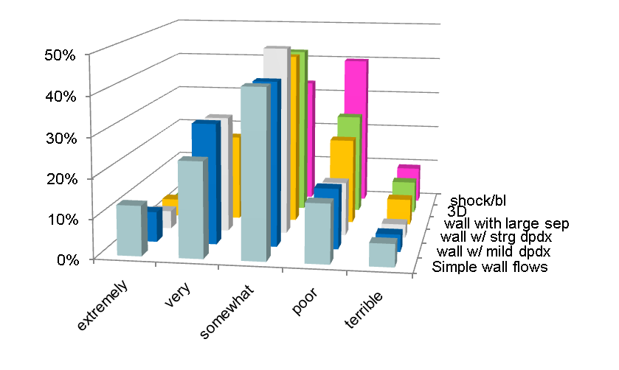
Have RANS models been improved in the past 10 years?

Slide 12
Have RANS models been improved in the past 10 years?
Most believe between very and somewhat.
But more so in simple flows than in complex flows.

Slide 13
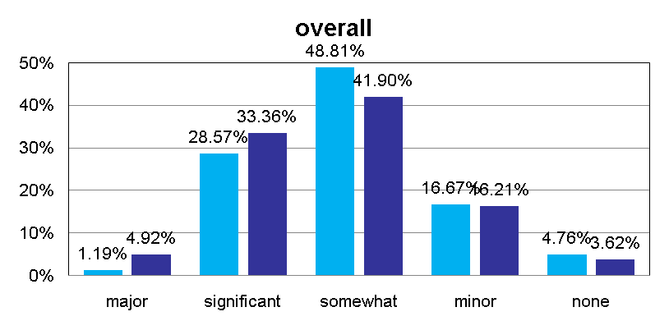
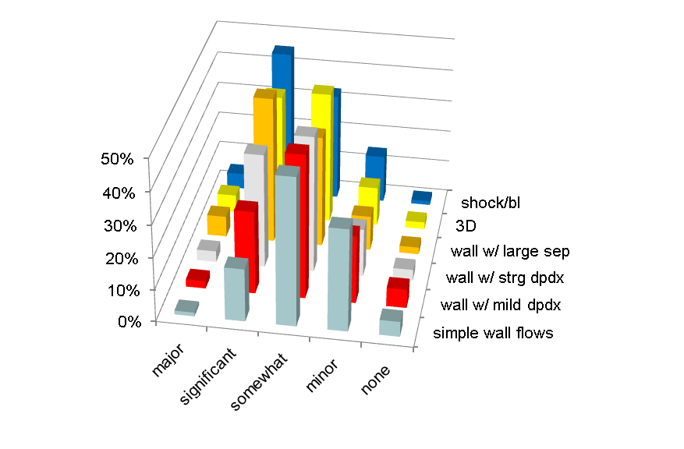
Can RANS models be improved in the next 10 years?

Slide 14
Can RANS models be improved in the next 10 years?
Most believe the same scale of successes they have observed for the simple flows in the past 10 years will apply to the complex flows in the next 10 years.

Slide 15
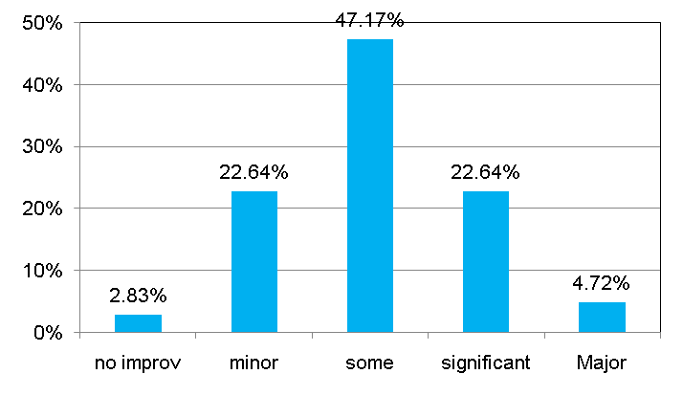
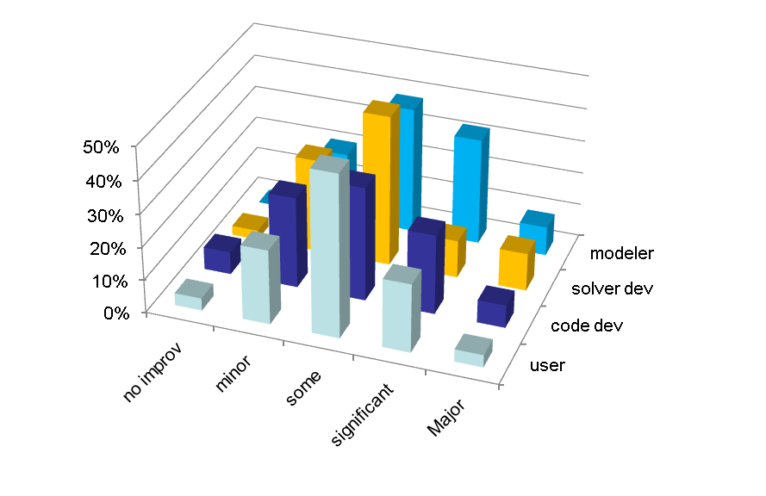
Can the accuracy of RANS be improved for a broad range of applications?

Slide 16
Can the accuracy of RANS be improved for a broad range of applications?
Most are neutral to this question.
However, the modelers are more hopeful than the rest groups.

Slide 17
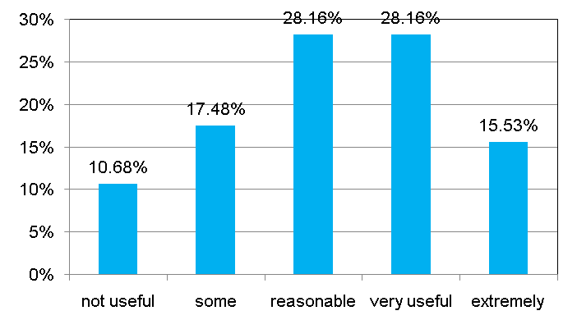
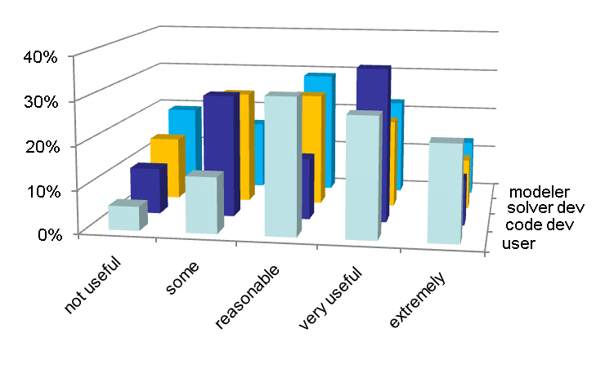
Are wall functions useful today and in the next 5-15 years?

Slide 18
Are wall functions useful today and in the next 5-15 years?
Majority will continue to use wall functions.
Modelers tend to move away from using wall functions.

Slide 19
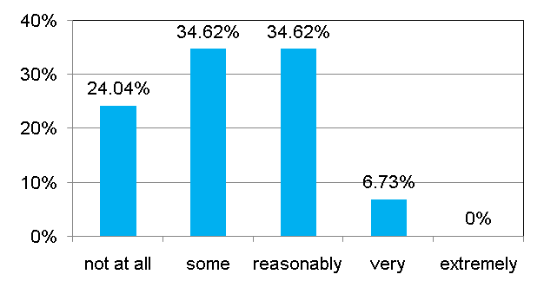
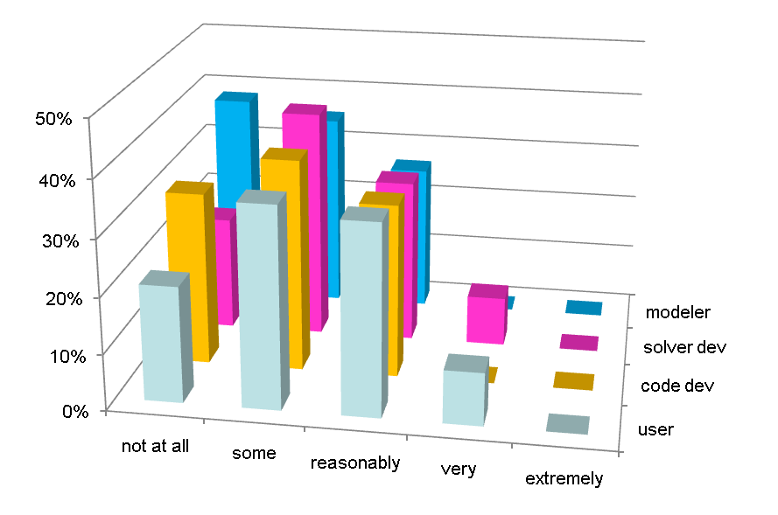
How confident are you on the turbulence model implementation in commercial and government codes?

Slide 20
How confident are you on the turbulence model implementation in commercial and government codes?
Most do not have confidence.
Among them, a majority of non-believers are code developers and modelers!

Slide 21
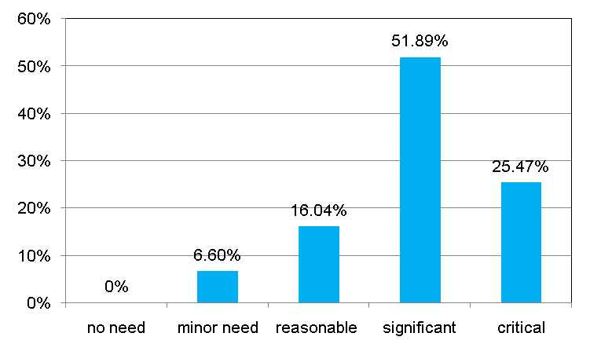
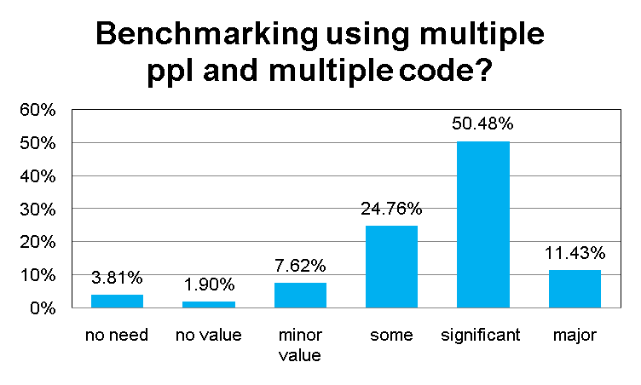
Do we need to improve documentation and expand benchmarking of turbulence models?

Slide 22
Do we need to improve documentation and expand benchmarking of turbulence models?
Most believe it is very important.
Most also believe benchmarking using different people with different codes is significantly important.

Slide 23
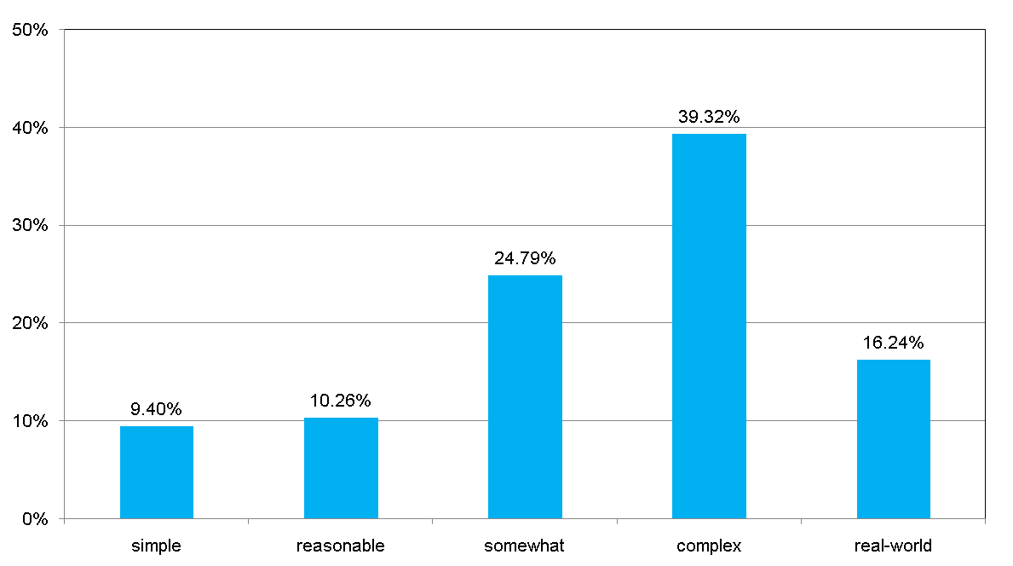
What types of flow cases should be the emphasis of a benchmark effort?

Slide 24
What types of flow cases should be the emphasis of a benchmark effort?
Most believe there is a need to shift the emphasis from simple to complex flows.

