Slide 1
Overview of Turbulence Model Benchmarking Discussion Group Activities and Internal Survey
Lockheed Martin Aeronautics Company
Oral Presentation
© 2009 Lockheed Martin Corporation
19th AIAA Computational Fluid Dynamics Conference
San Antonio, Texas
22-25 June, 2009
Brian R. Smith
LM Fellow
Lockheed Martin Aeronautics Company

Slide 2
Outline for Talk
Motivation for Turbulence Modeling Benchmarking Discussion Group
Group Objectives - Members
TMBDG - Activity Overview
  Internal Survey
  Industry Questionnaire
  Model Documentation
  Model Benchmarking
Internal Survey – Questions and Results

Slide 3
Motivation for Formation of TMB-DG
Group members have an interest in Reynolds Averaged Navier-Stokes (RANS) turbulence modeling
General observations of discussion group membership
  There is and will continue for many years to be a need for RANS models
  Recent developments and improvements in turbulence modeling accuracy have been limited.
  Aerospace and other industries are relying more and more on CFD for development
    Demand for higher accuracy simulations
    Increased computational resources reduce numerical errors,
    Turbulence modeling errors will become a larger part of total error
  Many models have been poorly documented
  It is difficult to assess and compare new turbulence models
    Difficult to separate turbulence model performance from numerical issues in typical comparison papers
    Variety of test cases make head to head comparison of models difficult

Slide 4
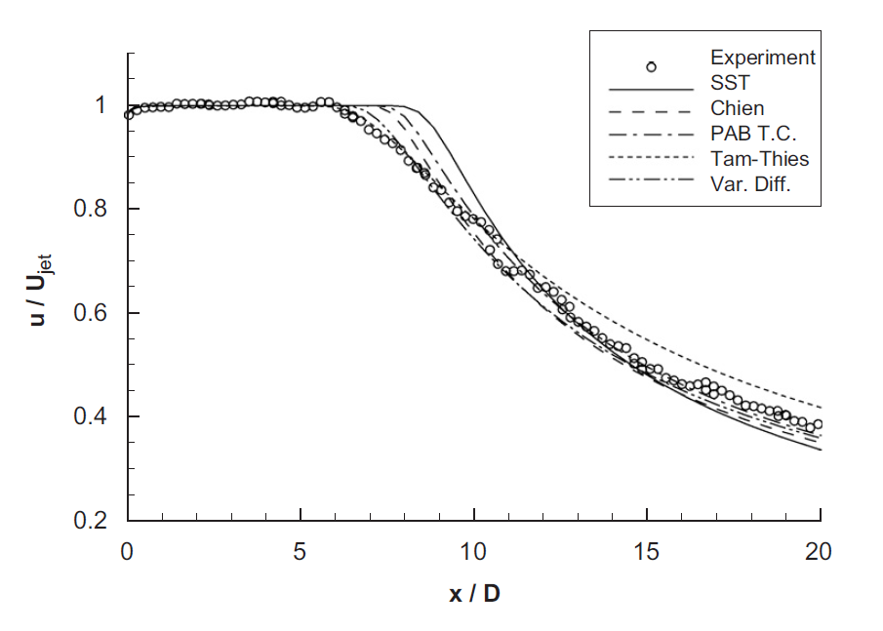
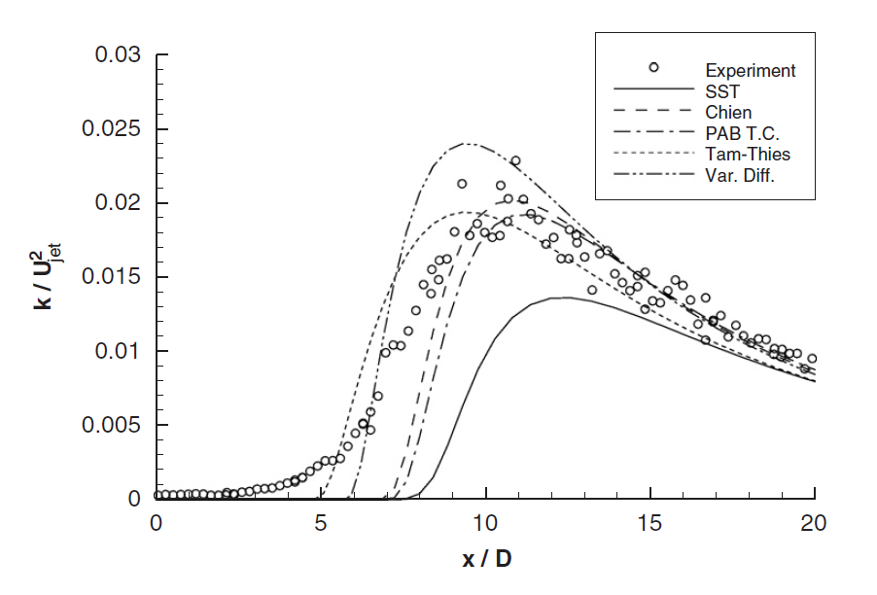
Turbulence Models Can Show Significant Variation Even For Simple Flows
Example of a consistent comparison in a single code with same computational mesh
Five turbulence models give different predictions for incompressible round jet
  Fair agreement for centerline velocity decay
  Poor agreement for turbulent kinetic energy
Centerline Velocity for Incompressible Jet
Turbulent Kinetic Energy on Jet Centerline
From Georgiadis, Yoder and Engblom
AIAA Journal, December 2006

Slide 5
Members of Turbulence Model Benchmarking Discussion Group
We have a balanced group with Government, University and Industrial participation
Members include model developers, CFD experts in model implementation, and researchers with experience in model evaluation
Co-chairmen
  Brian Smith – Lockheed Martin Aeronautics Company
  Christopher Rumsey – NASA Langley Research Center
Active Members
  Nick Georgiadis – NASA Glenn Research Center
  Hassan Hassan – North Carolina State University
  George Huang – Wright State University
  Won-Wook Kim – Pratt & Whitney
  Philippe Spalart – Boeing
  Bora Suzen – North Dakota State University
  Dennis Yoder – NASA Glenn Research Center
Membership is open to any interested researcher

Slide 6
Group Objectives
To develop a repository for turbulence model documentation
  Have model authors clearly document model formulations
  Have a rating system associated with models that describes the maturity of the model
To include benchmark test cases in the repository
  Help people implementing a model to make sure they have model implemented correctly
  Allow CFD users to have a basis of comparison of relative predictions of different turbulence models for different turbulent flows.

Slide 7
Turbulence Model Benchmarking Discussion Group Activities
Internal survey
  Members of the DG responded to a series of questions about RANS turbulence modeling
  Responses helped provide direction for group activities
  Survey results to be reviewed in this presentation
Industry survey
  Developed a multiple choice version of survey
  Distributed to AIAA TCs, other technical organizations
  Over 100 responses
  Survey should help to ensure that group activities are relevant to CFD community
Model documentation and rating
  Developed a rating criteria for model maturity
  Example documentation available on website
Benchmarking
  Group has begun discussing potential benchmarking cases
  Group members have individually prioritized the test cases, working toward a consensus
  Website showing documentation and benchmark examples created

Slide 8
Internal Survey Questions
(1) Given the developments of LES and DNS methods, how long will RANS turbulence models be in wide use, either alone, or in combination with a hybrid RANS/LES method for aerospace development and design?
(2) How critical is the accuracy of RANS turbulence models to the successful application of CFD in aerospace research, development and design?
(3) Are RANS turbulence models today sufficiently accurate?
(4) Recognizing that there are different types of wall functions with different degrees of accuracy, are wall functions a useful complement to a RANS turbulence model today? Do you feel they will continue to be useful 5-15 years in the future?
(5) Do you believe that it is possible to significantly improve the accuracy of turbulence models for use in a predictive way so that the model is essentially either universally applicable, or is applicable over relatively broad range of applications (classes such as incompressible flows, compressible flows, or attached flows with small separation bubbles), or is RANS turbulence modeling at a level of maturity where further improvement is difficult to achieve and has minimal impact?

Slide 9
Internal Survey Questions (concluded)
(6) Do you believe that there has been significant improvement in the accuracy of RANS turbulence models typically applied in industry in the past 10 years?
(7) Do you have confidence that when a specific turbulence model is implemented in multiple commercial or readily available government codes that consistent results will be obtained?
(8) Do you feel there is a need for improved documentation and expanded benchmarking of turbulence models?
(9) If you believe there is a need for expanded benchmarking of turbulence models, is there a value in allowing multiple model developers to benchmark models using different CFD flow solvers, or does this effort have to be performed by a limited group of qualified experts to be useful?
(10) What types of flow cases should be the emphasis of a benchmarking effort – simple turbulent flows, or complex flows?
(11) What types of flows present a great challenge to RANS turbulence modeling yet you believe should be possible to predict, but are unable to predict with accuracy today?

Slide 10
Question #1 – How Long Will RANS Turbulence Models be in Wide Use
  DG believed that RANS models would be in wide use for between 20 and 50 years
  RANS models would be a critical part of hybrid schemes during this period
  RANS models would complement LES methods, being used heavily for design and optimization, places where LES methods are too expensive for quick-turnaround design

Slide 11
Question #2 – How Critical is Turbulence Modeling Accuracy to Application of CFD
Scored on a scale with 1 being “not very” and 5 being “extremely”
  All gave a score between 3 and 5
  Most respondents felt the importance of accuracy was case and application dependent
  Accuracy is less critical in some cases because:
    Currently we do not have grid converged solutions for many complex applications
    Currently, when CFD is used to determine trends and increments, absolute accuracy is not required
  Respondents generally felt that turbulence model accuracy would become more important in the future as grid converged solutions become more common.

Slide 12
Question #3 – Are RANS Turbulence Models Sufficiently Accurate?
Scored on a scale with 1 being “sufficiently accurate” and 5 being “not nearly accurate enough”
  For attached flows, DG believe RANS models are adequate, giving them a score between 2 and 3.
  For separated flows, DG believes RANS models are not sufficiently accurate, giving scores of 4 to 5
  For many flow phenomena, current RANS models are judged inaccurate
    High Mach flows
    High curvature
    Mixing, scalar transport
    Reattachment and recovery region

Slide 13
Question #4 – Are Wall Functions a Useful Complement to Turbulence Models?
  Can be very useful in regions of a computation where user wants to account for viscous effects, but flow is relatively benign – for example, test section walls.
  Wall functions help to ensure reasonable results for users who do not carefully control near wall spacing
  Some members felt that their use should be minimized – they introduce needless simplifications and inaccuracy
  The utility of wall functions is linked to the inaccuracy of near wall region modeling in many turbulence models
  Wall function accuracy depends on:
    Are streamwise pressure gradients accounted for
    How do they behave in separated flows

Slide 14
Question #5 – Is it Possible to Significantly Improve Accuracy of Turbulence Models?
  It is unlikely that there will be major progress toward a simple, universally accurate model applicable to a wide range of flow conditions
  We are in a “law of diminishing returns” environment, but significant improvements are possible.
  Improvements for many flows, for example, flows with small separation bubbles and reattachment regions should be possible.
  Phenomena specific improvements could be incorporated in a general modeling scheme through zonal modeling or automated parameter adjustment.

Slide 15
Question #6 – Has There Been Significant Improvement in Turbulence Modeling in Past 10 Years?
  DG believes there has been minimal improvement over the past 10 years
  Last major improvements:
    SST model
    EASM maturation
  The DG believes that there has been minimal attention paid to the dissipation, length scale equation, and this is one area where research could pay dividends.

Slide 16
Question #7 - Do you Confidence That Turbulence Models are Implemented Properly in Commercial and Government Codes?
  Most members of DG do not have confidence that models are implemented correctly or consistently
    CFD developers may put caps or tweaks to improve robustness, but change results
    Coding errors
    Model is not completely or consistently documented, so multiple versions in existence, or implementations without consultation or involvement of model developer are incomplete.

Slide 17
Question #8 – Is There a Need for Improved Documentation and Benchmarking of Turbulence Models?
  Universal agreement among DG that there is a need for improved documentation of turbulence models
    A few heavily used models are well documented
    Many models that show promising results in limited set of cases are poorly documented
    Often there is confusion due to multiple versions of a model.
  Recognition among members that it would be valuable to have documentation and benchmarking associated and on line.

Slide 18
Question #9 – How Should Benchmarking be Conducted – by Developers or Outsiders?
  DG has not reached a clear consensus on this question
  Most agree that having an independent researcher implement and benchmark models is ideal
  Most also believe that this is impractical
  The model rating system developed by the DG helps to address this issue
    For lower level ratings, developer can benchmark model
    To achieve higher level ratings, model is implemented in multiple codes and tested by someone independent of developer

Slide 19
Question #10 – What Types of Flows Should be Emphasis of Benchmarking Effort?
  This is another issue that the DG has not reached a consensus on
  We agree that relatively simple test cases are far more practical
    Simple cases simplify work for developers
    Enable check to make sure model is implemented correctly
    Allow specific flow phenomena to be isolated and performance for these to be understood
  User community is typically interested in specific, often complex flows
    Range of possible flow configurations is daunting for benchmarking effort
    Grid convergence becomes an issue
    Difficult to get numerous models run on many complex cases
  Possible resolution – model developers, once they have documented and benchmarked models on would be encouraged to advertise model predictions of complex flows on web site.

Slide 20
Question #11 – What Types of Flows Do You Think RANS Models Should be Able to Predict Well, But Don’t?
The DG generated an extensive list of flows that could be modeled/predicted better with RANS models
  Reattachment and recovery regions
  Multi-element airfoils
  3-D attached boundary layers
  Tip/edge vortices
  Round jet / plane jet anomaly
  High compressibility
  Scalar transport
  Compressible planar mixing layers
  Transitional flow regions
  Contained separated flows

Slide 21
Summary of DG Survey
The members of the DG believe:
  RANS models will continue to be an important part of aerospace analysis tools for many years
  Progress and improvements over past 10 years have been limited
  There are areas where significant improvements are possible
  Model documentation and benchmarking are critical parts of the development process – we need to know where we are in order to know where we need to go.

Slide 22
What do you think?
Our DG has been in existence one year
We are hoping to have an impact on research community
We have solicited input through industry survey – results to be presented in next talk
We are hoping to get additional input in our panel discussion in this session

