Slide 1
Turbulence Modeling Benchmarking - Preliminary Plans
Christopher L. Rumsey
NASA Langley Research Center
Hampton, VA
Session 67-CFD-15
19th AIAA CFD Conference, June 22-25 2009, San Antonio, TX

Slide 2
Outline
Introduction
Current Components and Focus
  Turbulence model documentation/description
  Verification cases and grids
  Validation database archive
  Collection of turbulent manufactured solutions
Future Expansion
  Model “readiness level” rating system
  Suite of basic validation cases

Slide 3
Introduction
Need for improved turbulence modeling “usage” practices in the CFD community
  inconsistencies in model formulation or implementation in different codes make it difficult to draw firm conclusions from multi-code CFD studies
  naming conventions and processes to insure model implementation consistency
Also want to avoid difficulties & inconsistencies that can occur when attempting to implement models from papers/reports

Slide 4
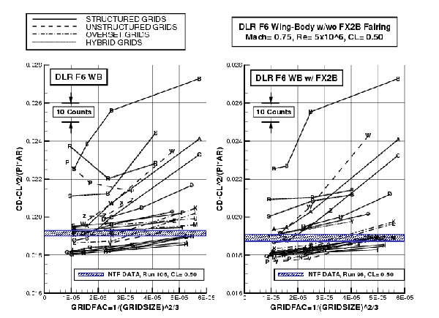
What we want to avoid
Example from Drag Prediction Workshop
from Vassberg et al, AIAA Paper 2008-6918, August 2008

Slide 5
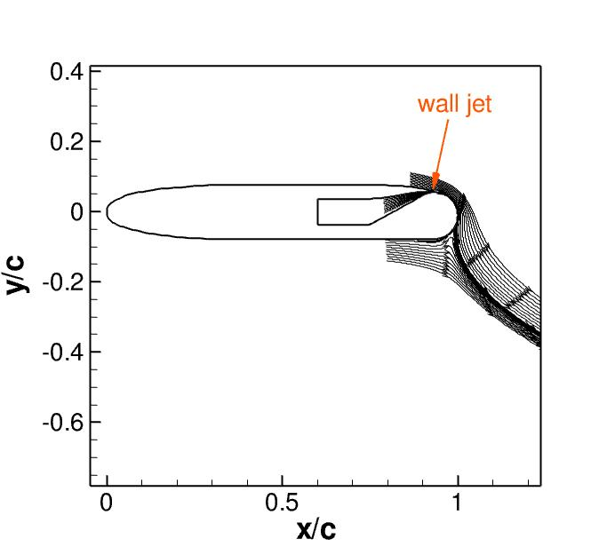
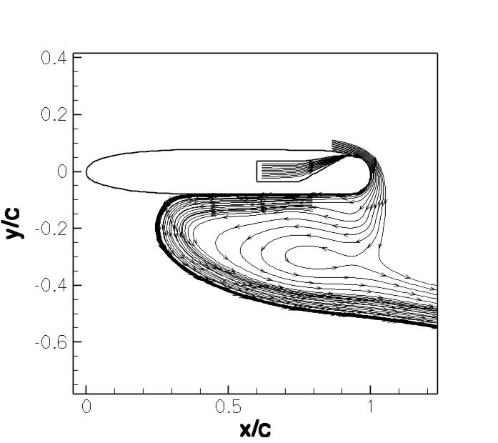
What we want to avoid
“Same” turbulence model - different results!
Sensitive cases can depend in part on model implementation differences
(see, e.g.: 2004 NASA/ONR Circulation Control Workshop)

Slide 6
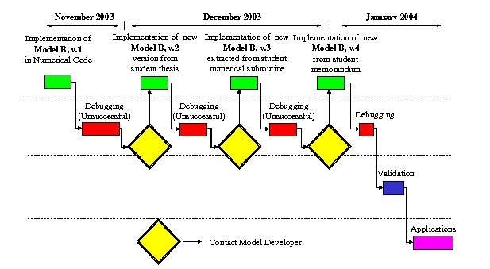
What we want to avoid
Record of attempted implementation of someone else’s turbulence model
from Viti et al, Computers & Fluids 36 (2007) 1373-1383

Slide 7
Introduction
Turbulence model benchmarking working group established
  under Fluid Dynamics Technical Committee
  current active members:
    Brian Smith (LMCO)
    Chris Rumsey, Dennis Yoder, Nick Georgiadis (NASA)
    Bora Suzen (NDSU)
    George Huang (Wright State)
    Hassan Hassan (NCSU)
    Philippe Spalart (Boeing)
    Won-Wook Kim (P&W)
NASA website established
  http://turbmodels.larc.nasa.gov
  a resource for finding and verifying turbulence models
  this type of effort was also called for at a major turbulence modeling workshop held in 2001 (NASA/CR-2001-210841)

Slide 8
Primary purpose of website
Provide a central location where widely-used Reynolds-averaged Navier-Stokes (RANS) turbulence models are described and selected results given
Provide simple test cases and grids, along with sample results (including grid convergence studies) from one or more previously-verified codes
List accepted versions of the turbulence models as well as published variants
  Establish naming conventions in order to help avoid confusion when comparing results from different codes

Slide 9
Turbulence model descriptions
Currently two models are described on the website
  Spalart-Allmaras (SA) 1-equation model
  Menter shear-stress-transport (SST) 2-equation model
Equations & recommended BCs are given
Known variants are listed
  SA, SA-Ia, SA-noft2, SA-RC, SA-Catris, SA-Edwards, SA-fv3, SA-salsa
  SST, SST-V, SST-2003, SST-sust, SST-Vsust
  Many of these are minor variants, but we seek to establish naming conventions to avoid future ambiguity
  Example: SA-fv3 is an “unofficial” version used in several major codes, but not recommended by its creator because of “an odd effect on transition at low Re” (AIAA-2000-2306)
More models will be added in the future

Slide 10
Verification cases and grids
How to achieve consistency in turbulence model implementation?
  Decided to create series of “verification cases”
  Show how 2 or more independent codes with the same turbulence model go to the same result as grid is refined
  Provide grids for others to use
  Provide solutions for others to compare against
  Simple, analytically-defined geometries, no separation, easy to converge
Current verification cases:
  2D zero pressure gradient (ZPG) flat plate
  2D planar shear
  2D bump in channel
  3D bump in channel

Slide 11
CFD codes
Currently employing 2 NASA CFD codes
  CFL3D
    structured
    cell-centered
    full N-S capability
    Roe flux-difference splitting (FDS) upwind-biased
    http://cfl3d.larc.nasa.gov
  FUN3D
    unstructured
    node-centered
    full N-S
    Roe FDS upwind-biased
    http://fun3d.larc.nasa.gov

Slide 12
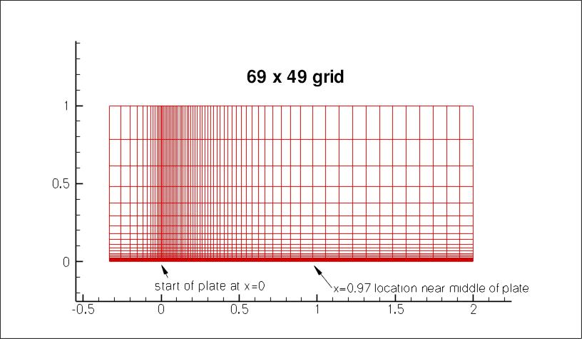
2D flat plate
Sequence of 5 grids of the same family
  545x385 (finest), 35x25 (coarsest)
  Provided as both structured as well as unstructured (quads or triangles)

Slide 13
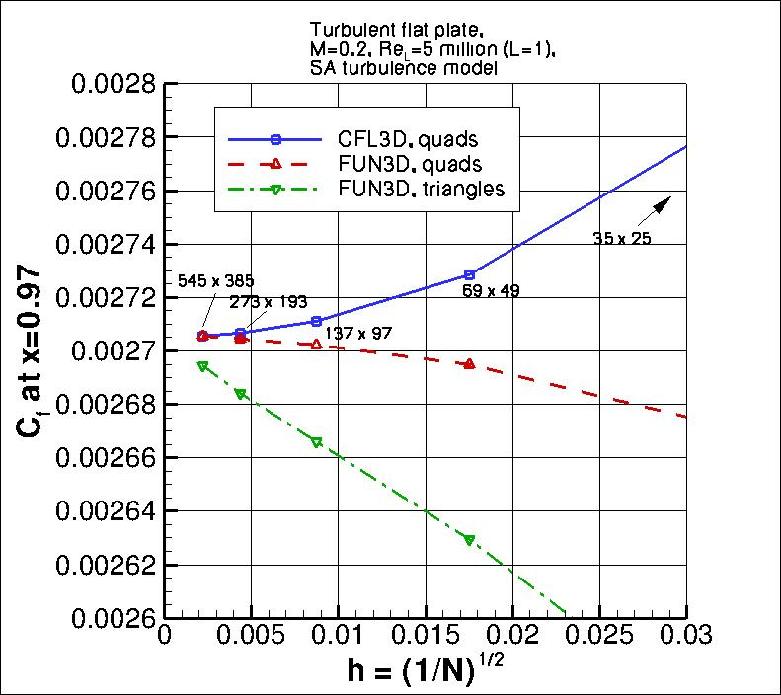
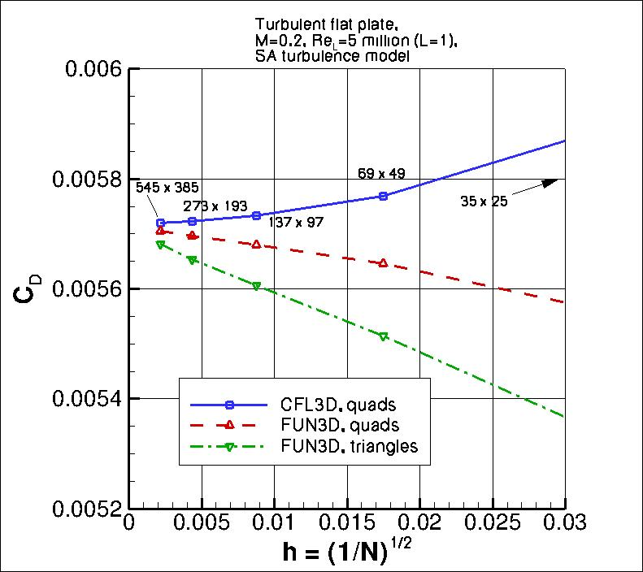
2D flat plate, SA model
Results converge as grid is refined

Slide 14
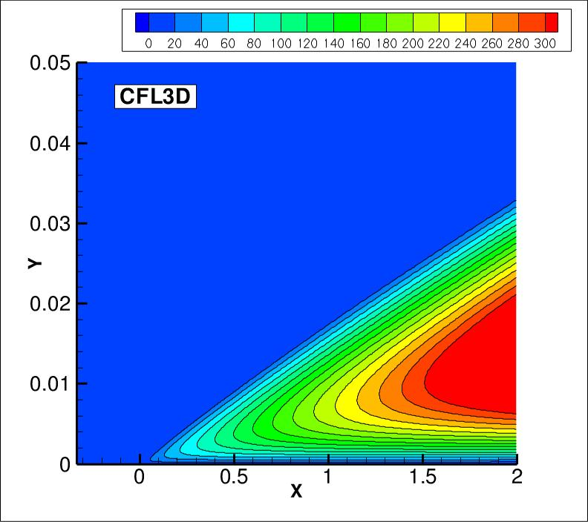
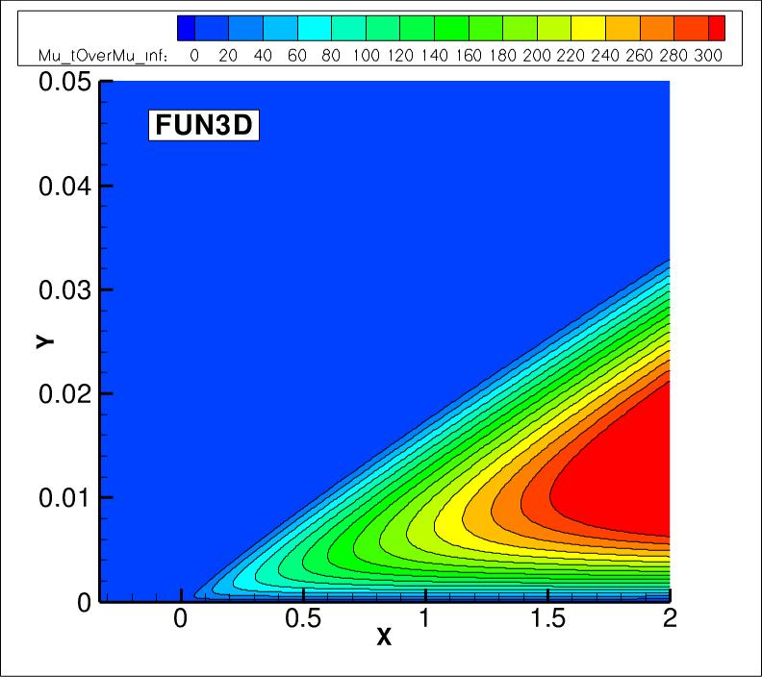
2D flat plate, SA model
Eddy viscosity essentially identical for 2 codes as grid refined

Slide 15
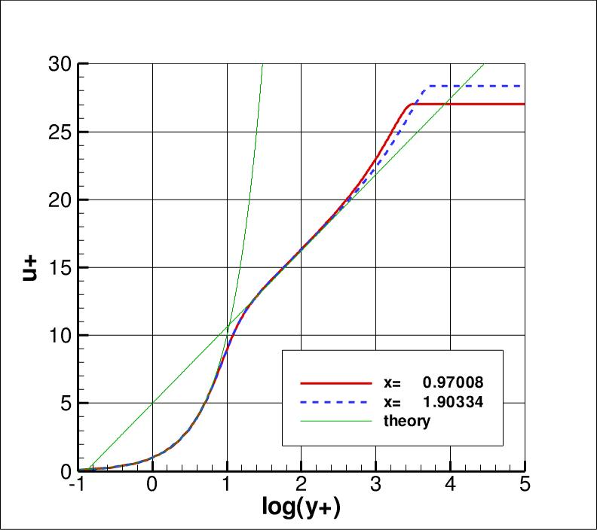
2D flat plate, SA model
Results agree with theory

Slide 16
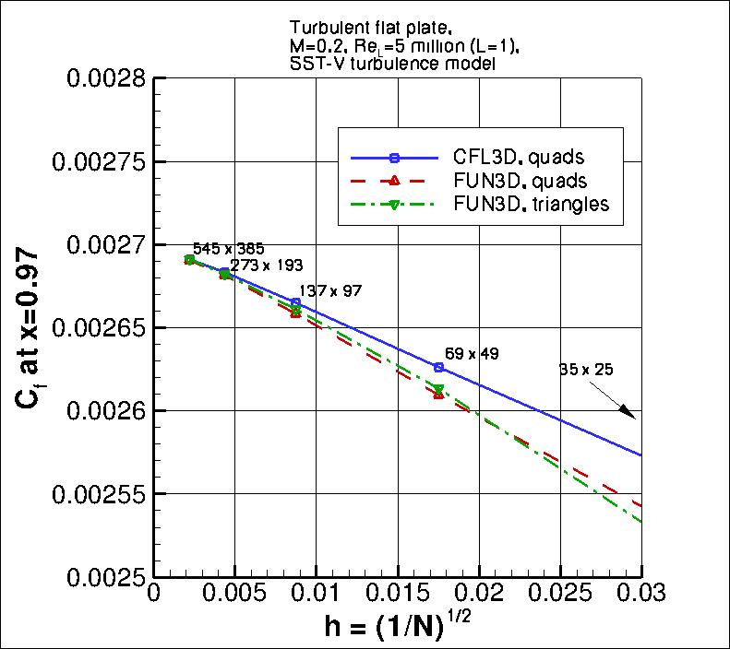
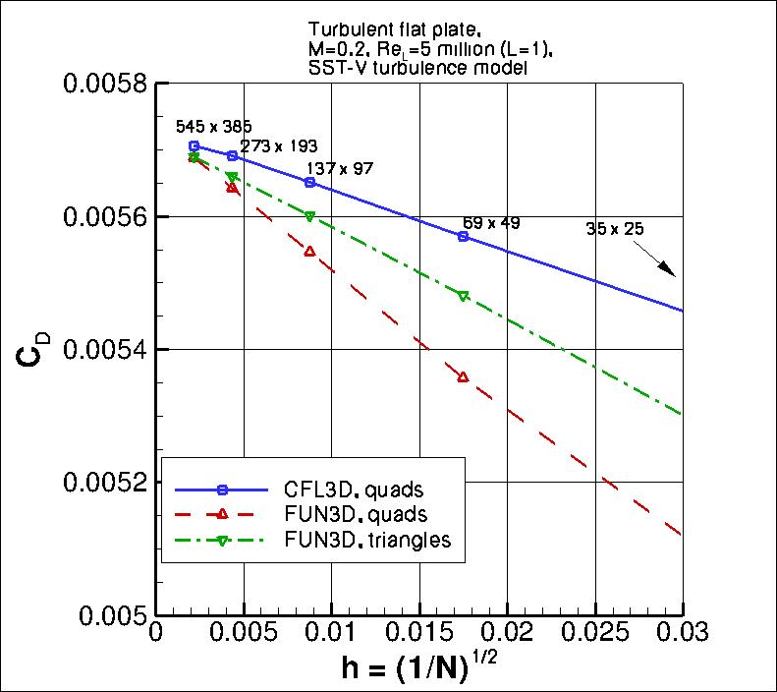
2D flat plate, SST-V model
Results converge as grid is refined

Slide 17
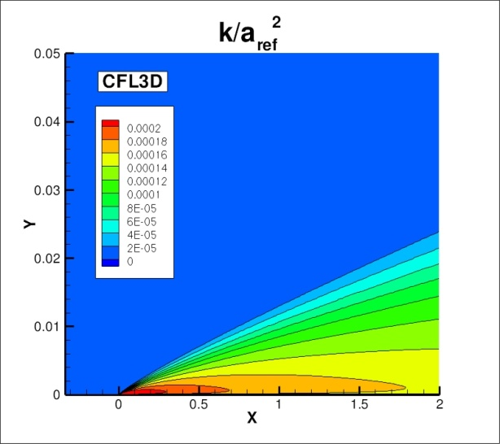

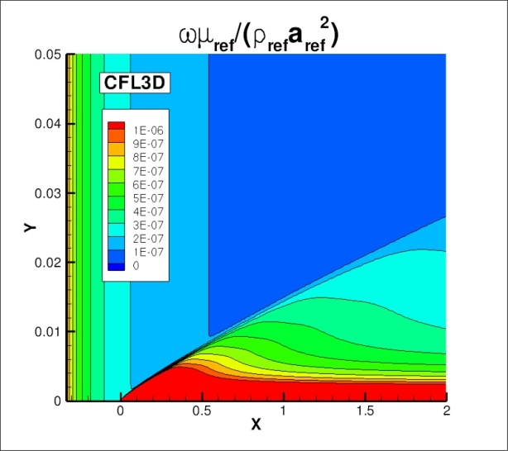

2D flat plate, SST-V model
Eddy viscosity and both turbulence quantities (k and omega) essentially identical for 2 codes as grid refined

Slide 18
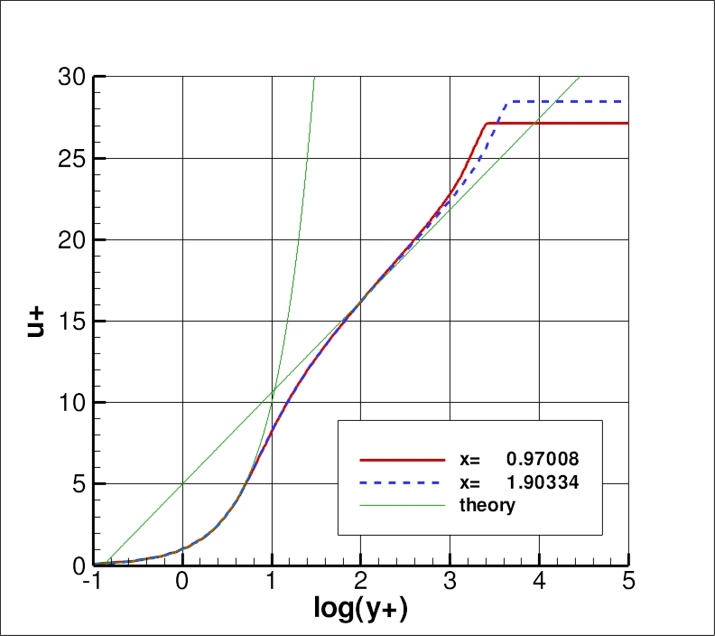
2D flat plate, SST-V model
Results agree with theory

Slide 19
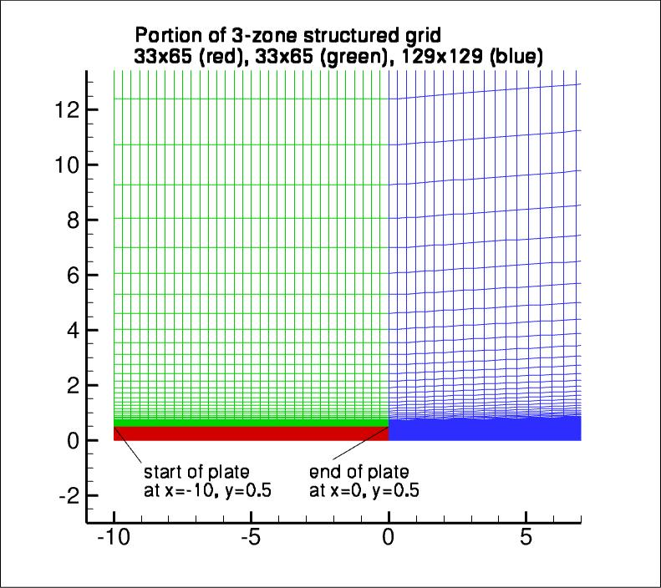
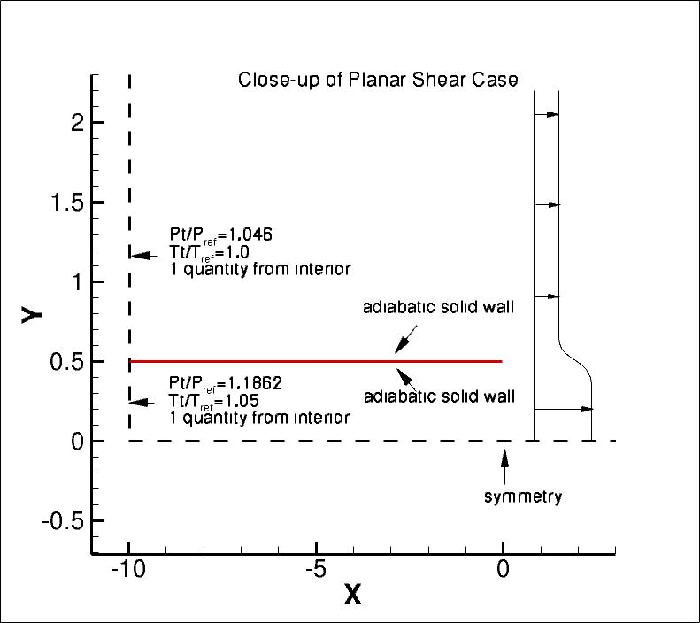
2D planar shear
Sequence of 5 grids of the same family
  327,680 cells (finest), 1280 cells (coarsest)
  Provided as both structured as well as unstructured (quads)

Slide 20
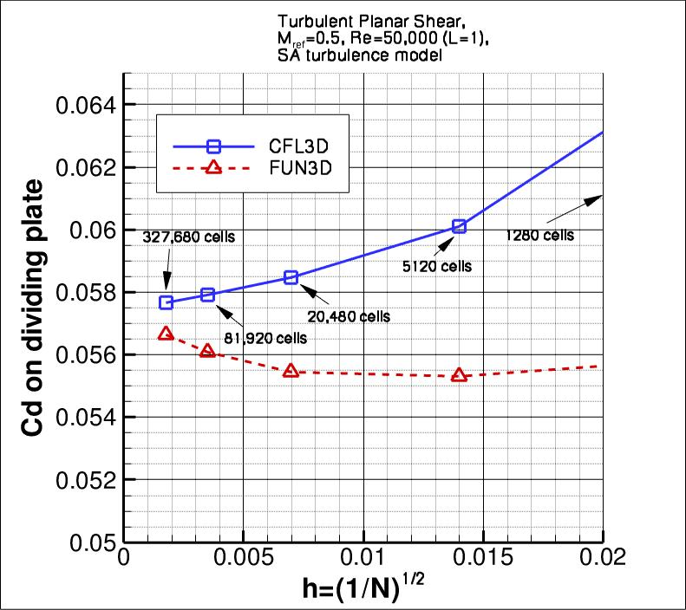
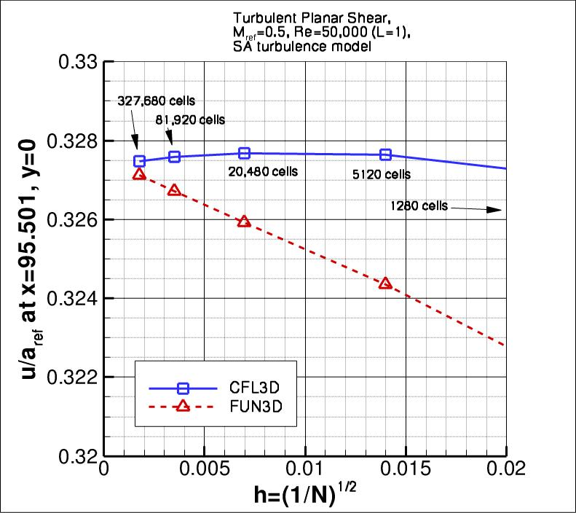
2D planar shear, SA model
Results converge as grid is refined

Slide 21
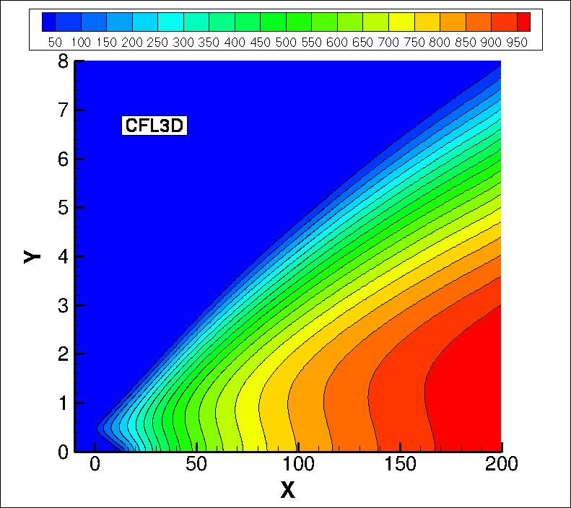
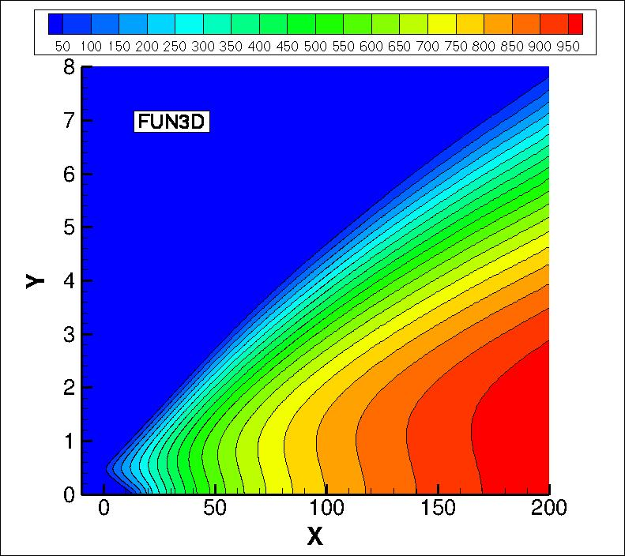
2D planar shear, SA model
Eddy viscosity essentially identical for 2 codes as grid refined

Slide 22
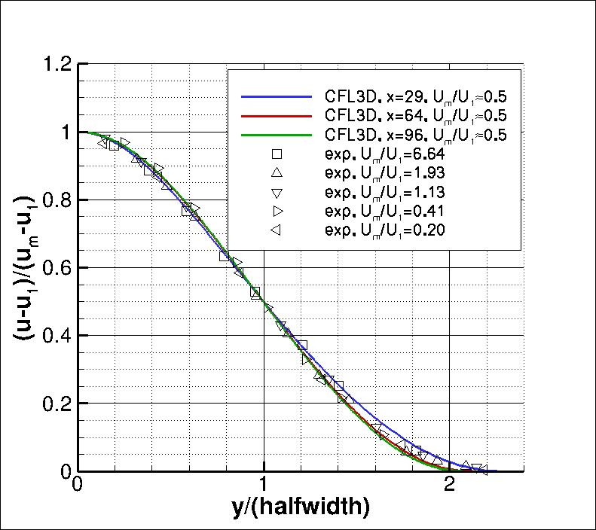
2D planar shear, SA model
Results become self-similar; agree with experiment

Slide 23
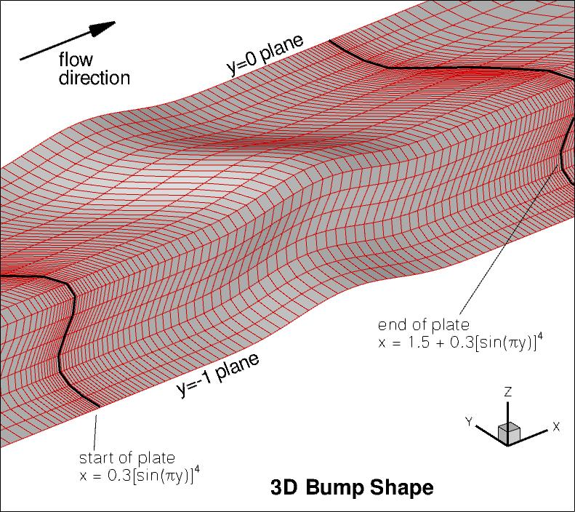
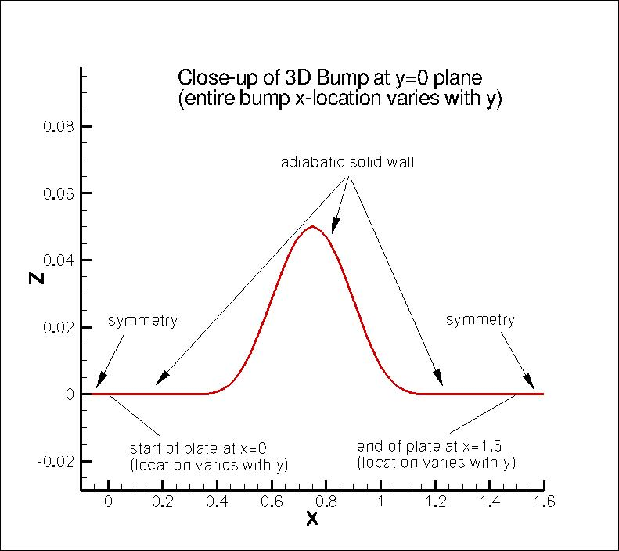
3D bump-in-channel
Sequence of 5 grids of the same family
  65x705x321 (finest), 5x45x21 cells (coarsest)
  Provided as both structured as well as unstructured (hexes or tets)

Slide 24
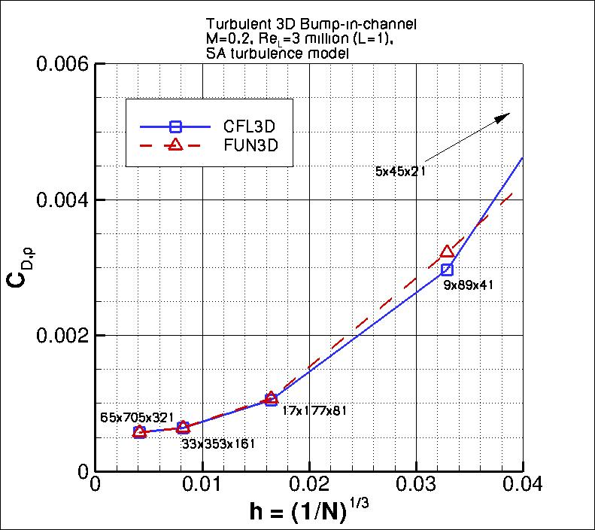
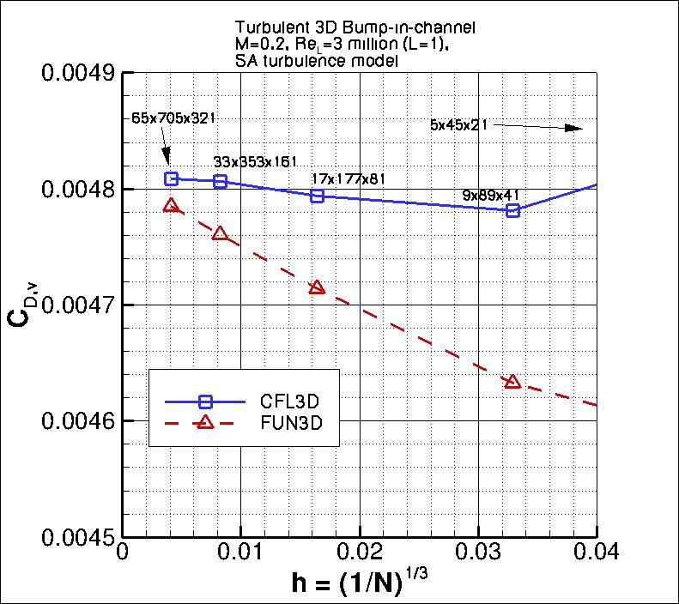
3D bump, SA model
Results converge as grid is refined

Slide 25
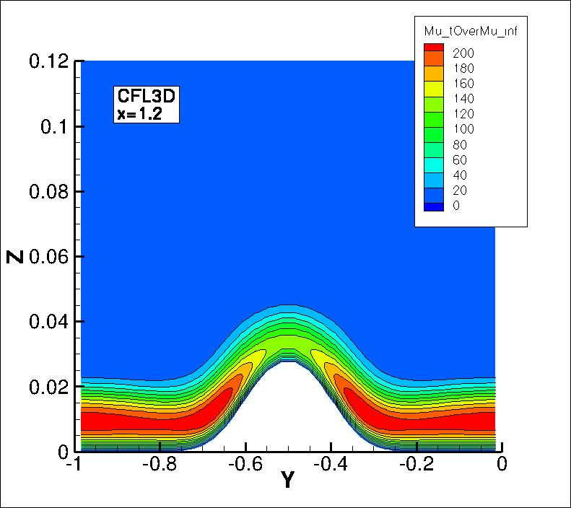
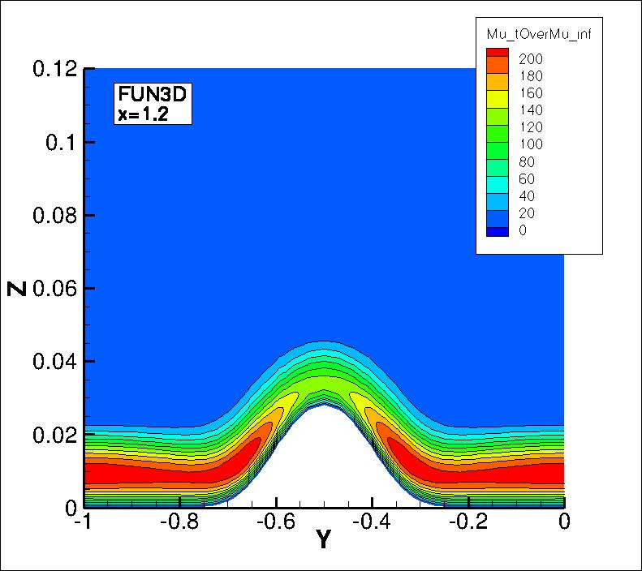
3D bump, SA model
Eddy viscosity essentially identical for 2 codes as grid refined

Slide 26
Validation database archive
Turbulent flow experimental and simulation databases are included from Bradshaw, P., Launder, B. E., and Lumley, J. L., “Collaborative Testing of Turbulence Models,” Journal of Fluids Engineering, Vol. 118, June 1996, pp. 243-247.
  Incompressible Flow Cases from 1980-81 Data Library
  Compressible Flow Cases from 1980-81 Data Library
  More recent databases (courtesy P. Bradshaw) also included

Slide 27
Collection of turbulent manufactured solutions
From “Workshop on CFD Uncertainty Analysis” series (three held to date)
  Manufactured Fortran function files, courtesy Luis Eca, IST (Lisbon)
    Spalart-Allmaras (SA-noft2), Menter one-equation, Menter BSL, standard k-epsilon, Chien k-epsilon, TNT k-omega
In method of manufactured solution (MMS), analytical source terms are added to Navier-Stokes equations
  i.e., you know precisely what the error is because you know the exact answer
  solution should approach exact solution with design-order accuracy as grid is refined

Slide 28
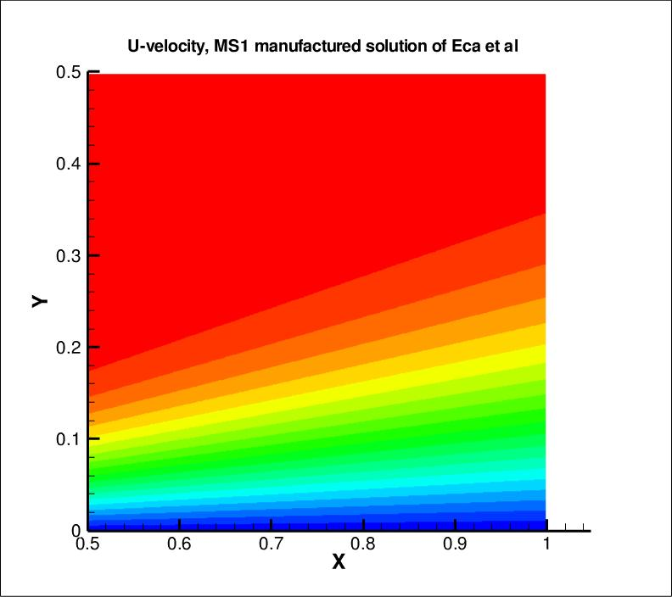
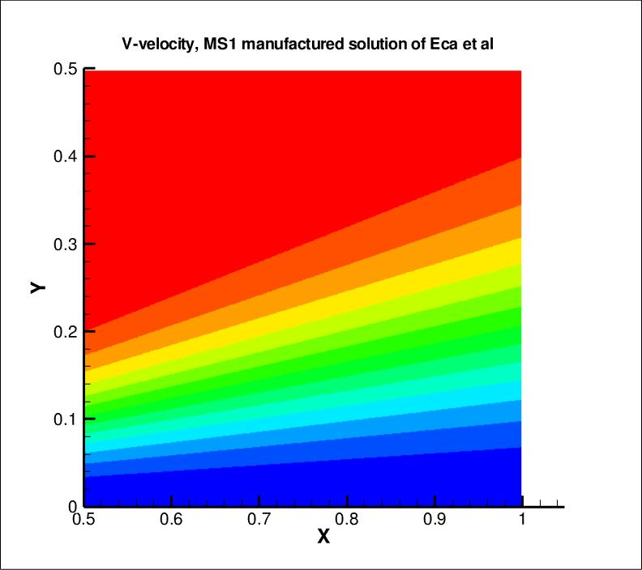
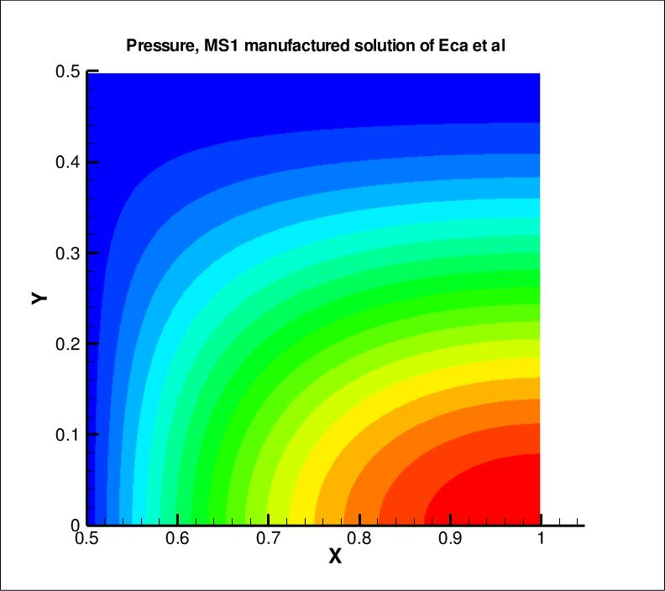
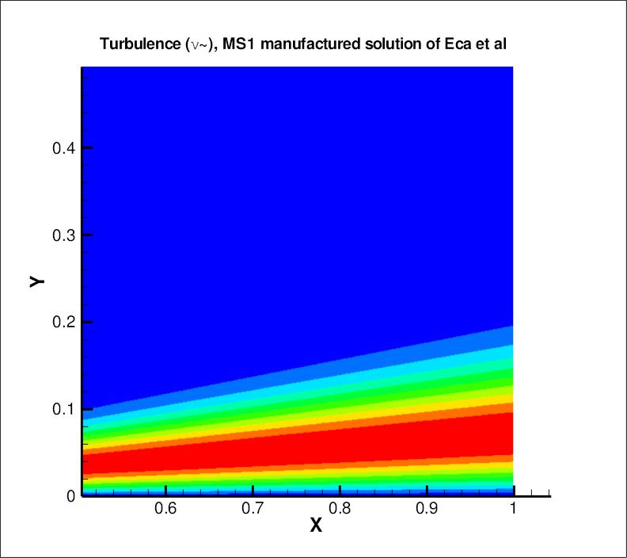
Exact Solution from workshop

Slide 29
Future expansion
Model “readiness level” rating system (proposed)
  Level 0: Well-Defined Model
  Level 1: Single-Code/Single-User Verification
  Level 2: Multiple-Code/Single-User Verification
  Level 3: Multiple-Code/Multiple-User Verification
 | Level 0 | Level 1 | Level 2 | Level 3
Sponsor
Completely described and referenceable
In at least 1 CFD code
Run on flat plate with grid study & results available
In 2 or more codes - results agree as grids refined
Run on 2 or more verification cases & results available
At least one code from outside home organization
Independently verified (committee or other designee)

Slide 30
Future expansion
Suite of basic validation cases
  Would be helpful for people to choose a model to implement, based on its ability to perform well for particular applications
Current plan:
  Choose small suite of 5 or so representative simple cases
  Some possibilities:
    flat plate (law-of-the-wall theory, direct simulations, etc.)
    axisymmetric bump (Bachalo & Johnson)
    backward-facing step (Driver & Seegmiller)
    separated NACA 4412 airfoil (Coles & Wadcock)
    free shear layer / mixing layer (various experiments)
    airfoil wake flow (Nakayama)
  Show how Level 2-3 models perform for these; provide references or point to results for additional cases

Slide 31
Conclusions
There is a need to establish consistency in turbulence modeling
  Across multiple codes in the CFD community
  Through verification/validation studies
Website http://turbmodels.larc.nasa.gov established
  Currently addresses verification & consistency
    Documents model versions & establish naming conventions
    Uses verified codes for several cases, including full grid convergence studies
    Provides grids and solutions for easy reference
  In future, also to address validation
    Easily-accessible one-stop location that will document performance of various models for a suite of representative cases

