Slide 1
Experimentalist’s Notes for Case 3
The following notes are intended to serve as auxiliary information for people interested in this experimental test case. These are not officially publishable or referenceable as yet; they are intended for information only. All definitions are consistent with the information published on the website.
There are 7 figures. All but figure 7 have five parts (a-e) and they are all arranged the same way, namely (a) Cp on the entire model and splitter plates; (b) Cp zoomed in on the bubble; (c) “leading-edge” (LE) spanwise Cp (at x/c=0.19); (d) “trailing-edge” (TE) spanwise Cp (at x/c=0.86); and (e) C’p (rms) in the bubble region. Figure 7 shows tunnel ceiling pressures.
BASELINE DATA
Figure 1 shows that there is no significant Reynolds number effect for Re≥557,400 on this model. Also the extent of the bubble is similar to that of Seifert & Pack (S&P) at much higher Re. (The reference pressure of S&P was adjusted by 0.266% in order to match their inflow Cp with the present data). The suction peak upstream of the slot is somewhat higher that that of S&P. The most likely reason for this is blockage: the ratio of model height to tunnel height are different - h/H=8% (S&P) and 13% (present setup). It is not clear why the C’p differ quantitatively with the S&P data.
Figure 2 shows a comparison between the open slot (sealed internally at the bottom of the manifold) and the slot taped over externally. The static and dynamic pressures are virtually insensitive to the presence of the slot.

Slide 2
CONTROL DATA
Figure 3 shows control from the two-dimensional slot via steady suction for increasing suction rates. Suction rates are often expressed as a mass flux coefficient (Cm). S&P used Cµ, to allow direct comparison with oscillatory cases. Both are shown in figure 3. Note that the Cp scatter appears to increase in the vicinity of the bubble when suction is applied (e.g. figure 3b). This is because the dynamic pressure taps are mounted off the centerline and as suction is applied, the flow becomes slightly 3-D (see figure 3d – lines as a visual aid). There is also a slight asymmetry in the spanwise pressures, which is most probably due to the slightly non-uniform slot width, which varies from about 0.029 inches to 0.031 inches from one side to the other (see the QA geometry data). Note that the bubble is not fully eliminated by the suction due to suction pump limitations. However, low Re runs were performed at higher Cµ (or Cm), to eliminate the bubble (see figure 6 and discussion below). The C’p data shows a high peak at separation and another lower and flatter peak around reattachment.
Figure 4 shows the test condition (target Cµ=0.242%) at different Reynolds numbers (the CFD test is at Re=929,000, M=0.1). There is a Reynolds number effect that can be seen in figure 4b. Note also that the geometry of the slot is somewhat different than that of S&P. For example, the present width is about 12% smaller than theirs, when referenced to chord. Figure 5 has a similar format to figure 4, but at higher Cµ~0.456%, and shows similar trends to those at lower Cµ.
In figure 6, low Re was used to obtain high Cµs and thus the bubble could be eliminated at Cµ~2.6%.
Figure 7 shows the ceiling Cps for a variety of conditions. Note that these are approximate dimensions. There are no pressure taps above the model due to the optical glass access there.
David Greenblatt
NASA LaRC
MS 170
Hampton, VA 23681
(757) 864-8394

Slide 3
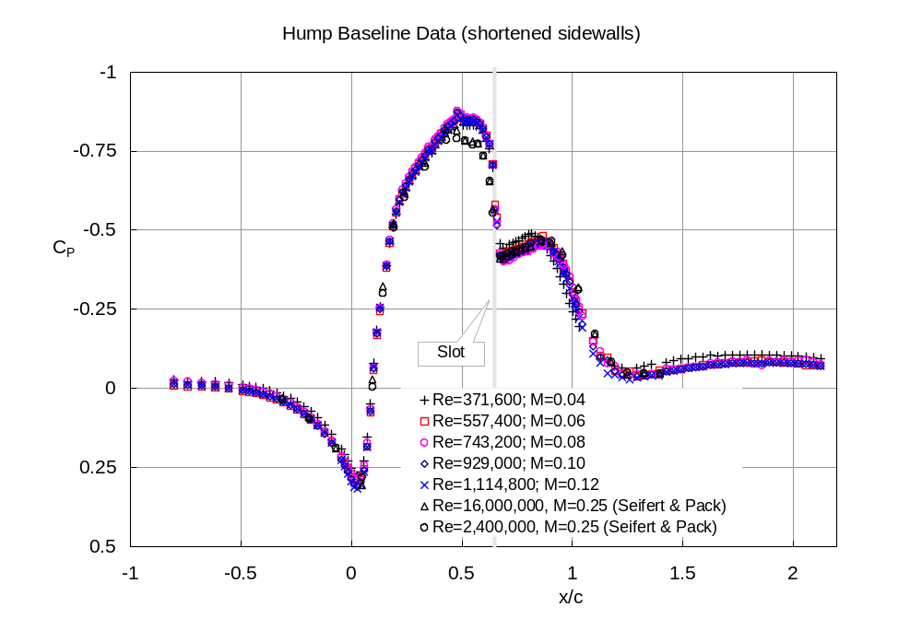
1a

Slide 4
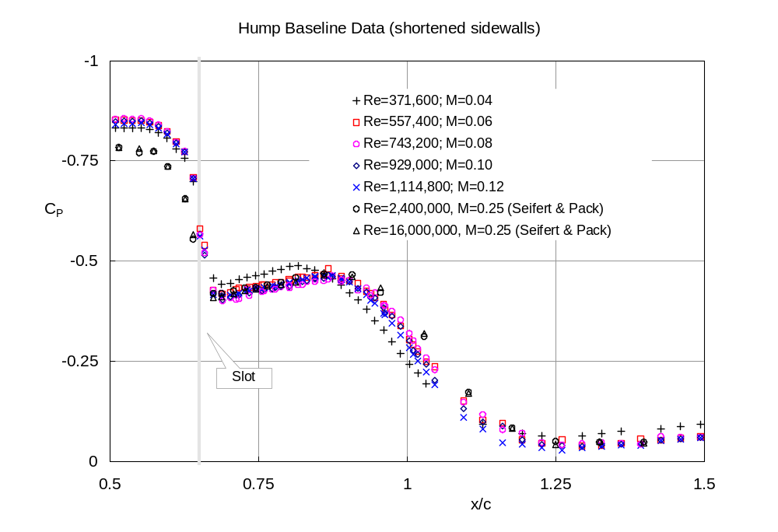
1b

Slide 5
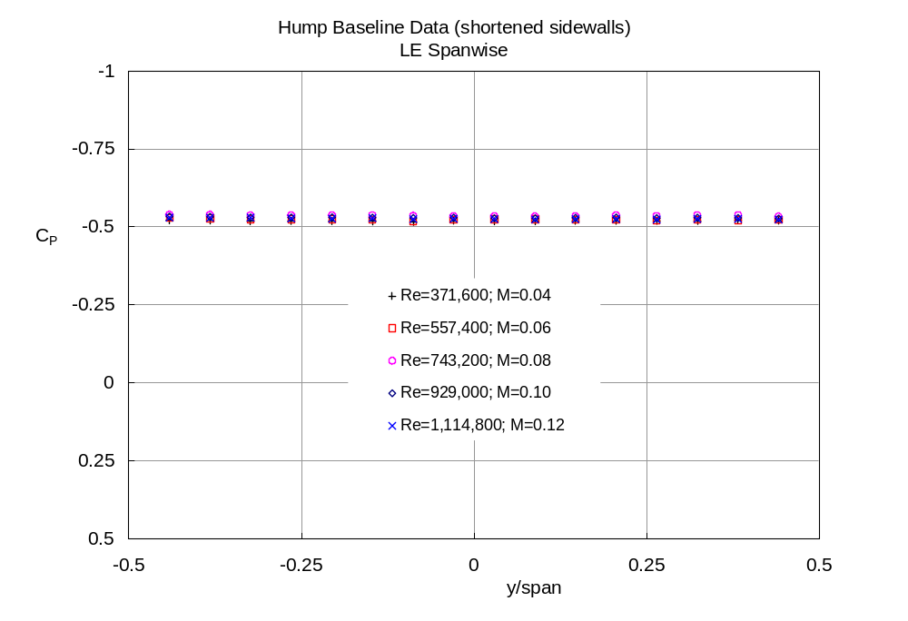
1c

Slide 6
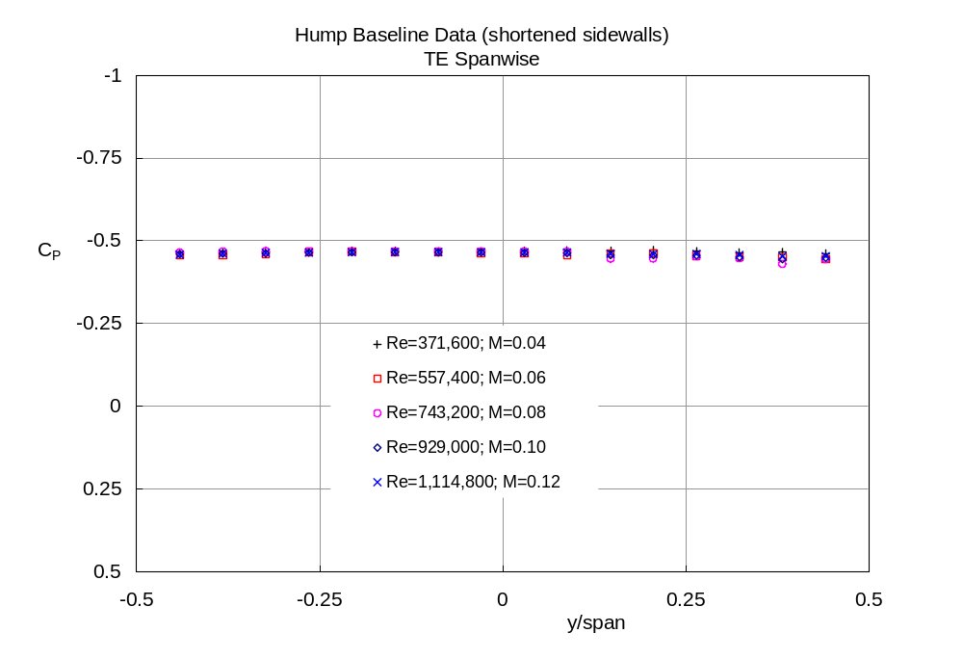
1d

Slide 7
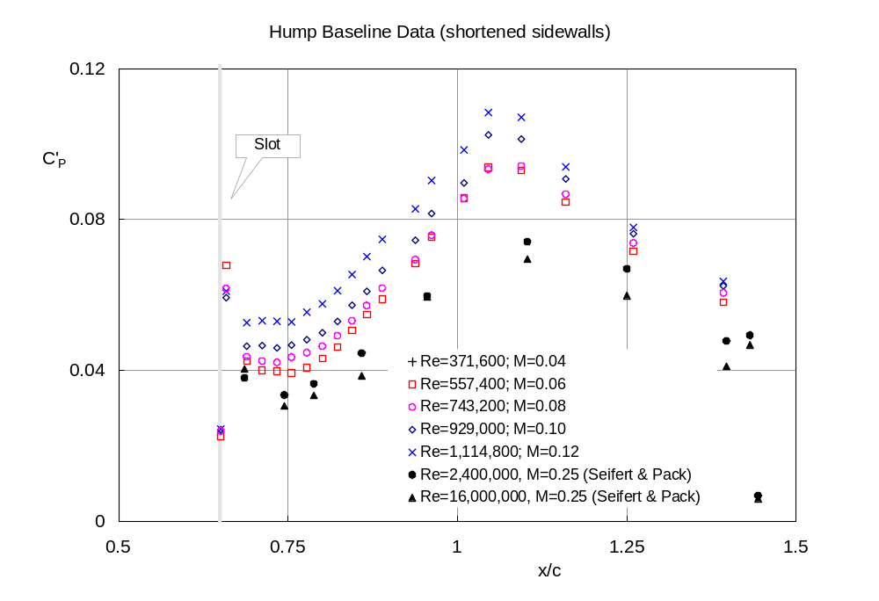
1e

Slide 8
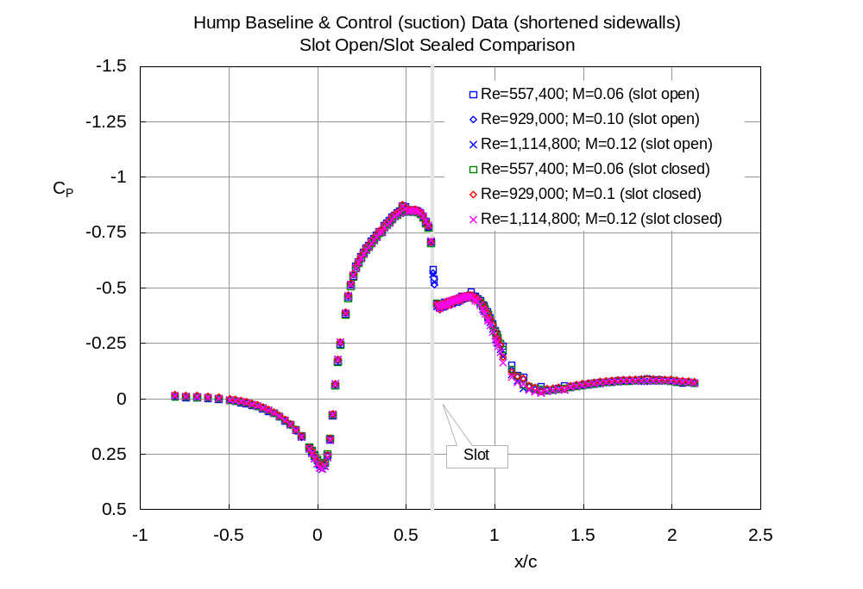
2a

Slide 9
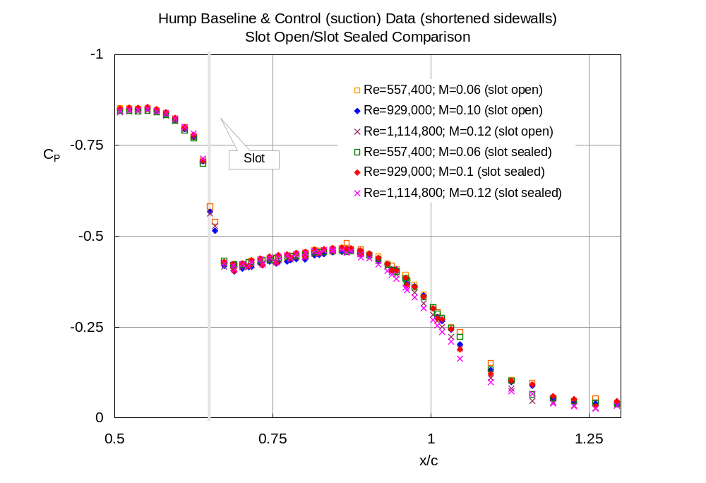
2b

Slide 10
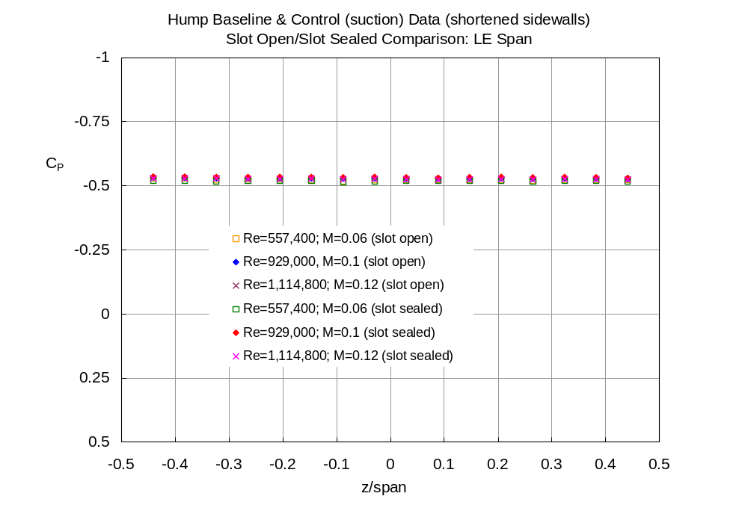
2c

Slide 11
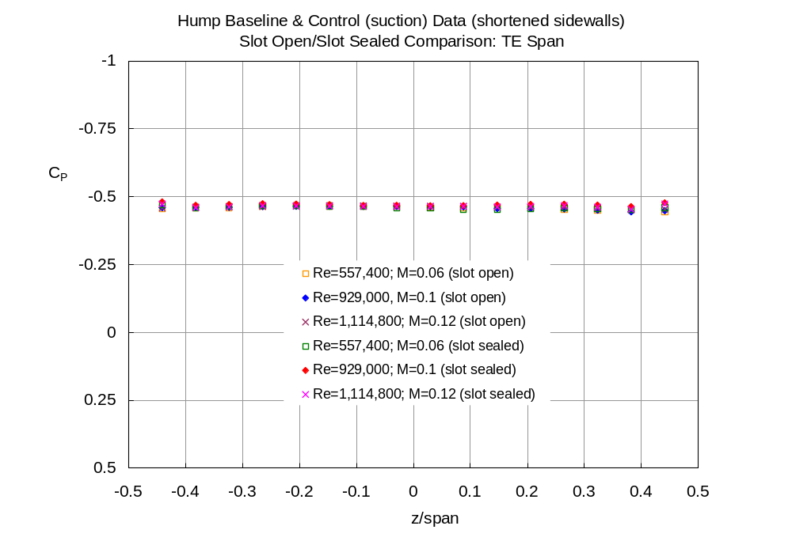
2d

Slide 12
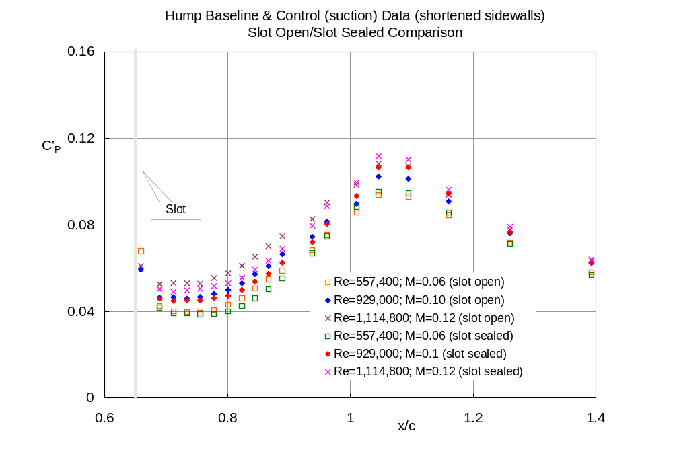
2e

Slide 13
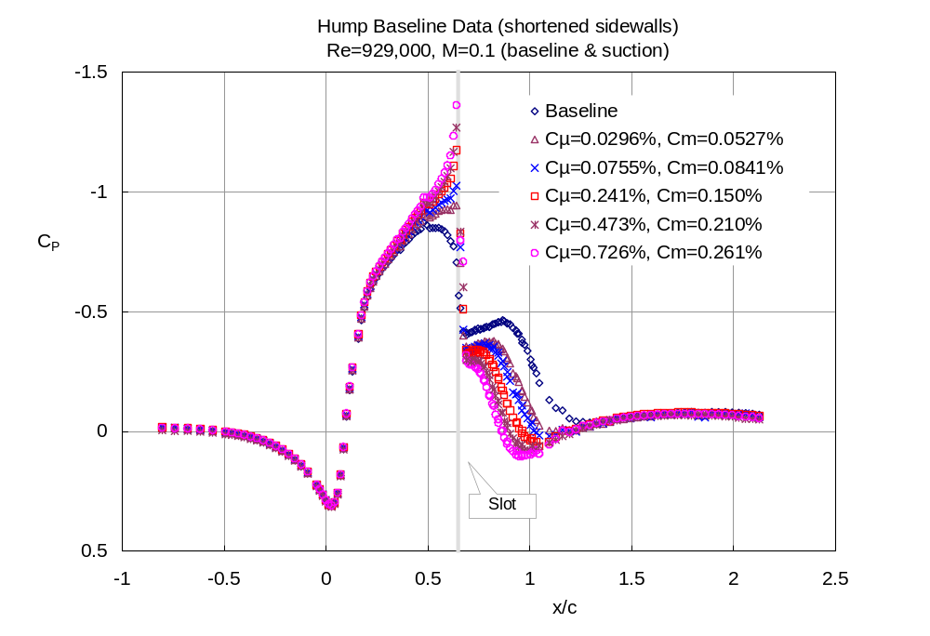
3a

Slide 14
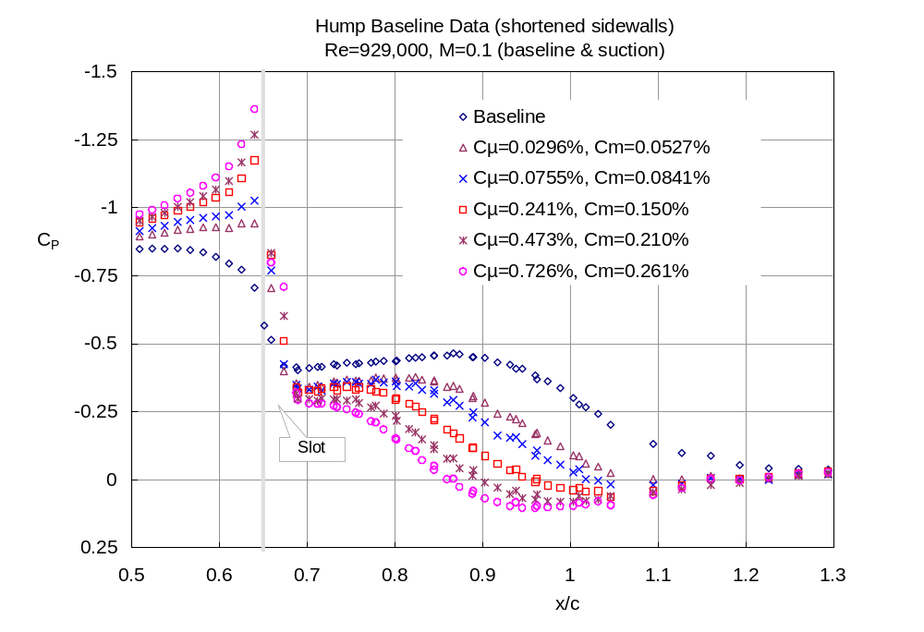
3b

Slide 15
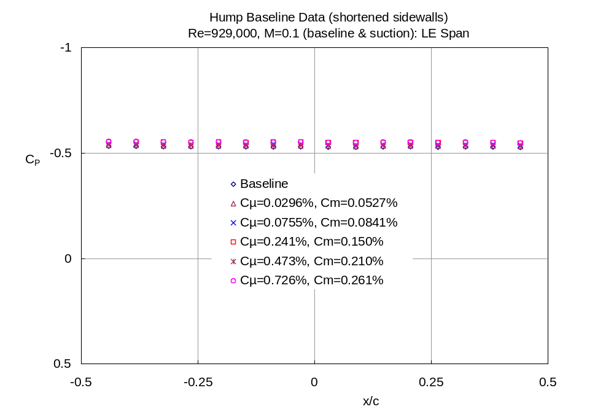
3c

Slide 16
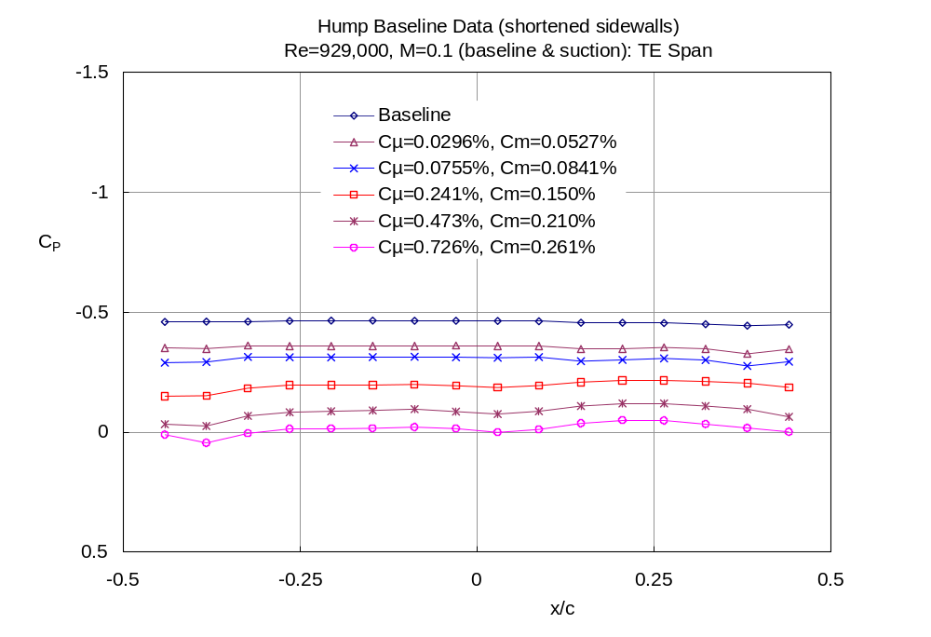
3d

Slide 17
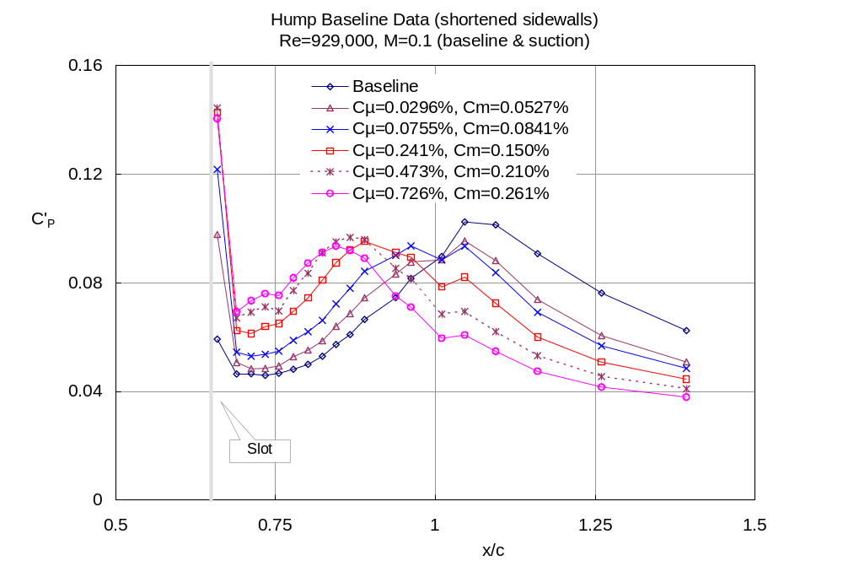
3e

Slide 18
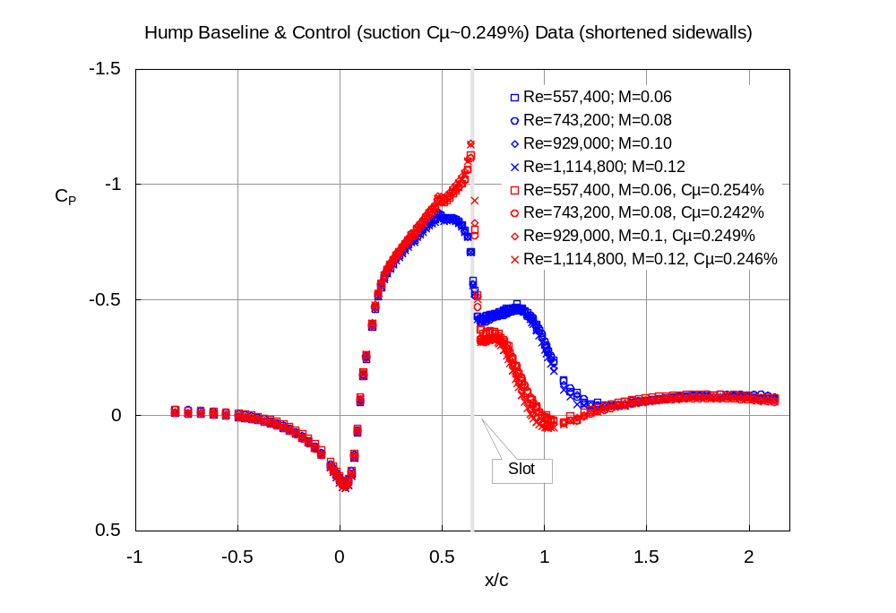
4a

Slide 19
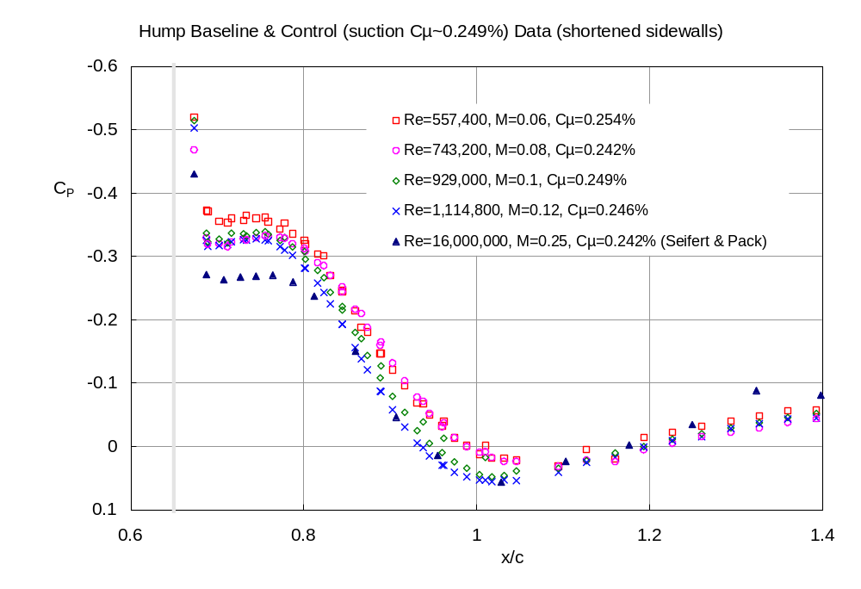
4b

Slide 20
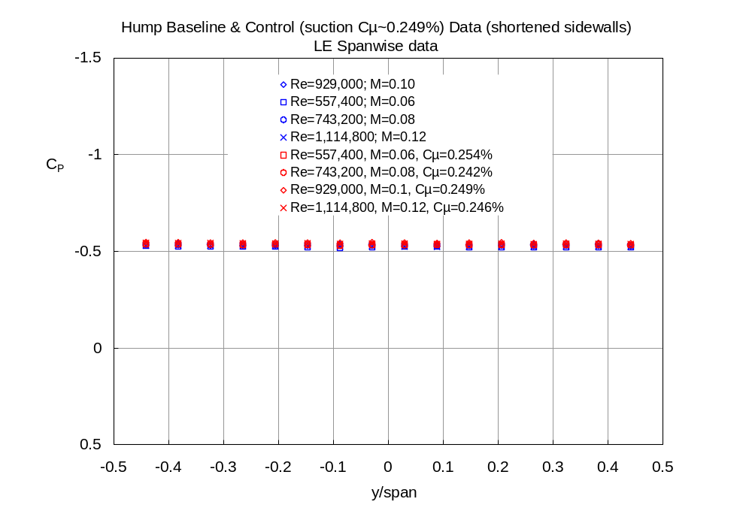
4c

Slide 21
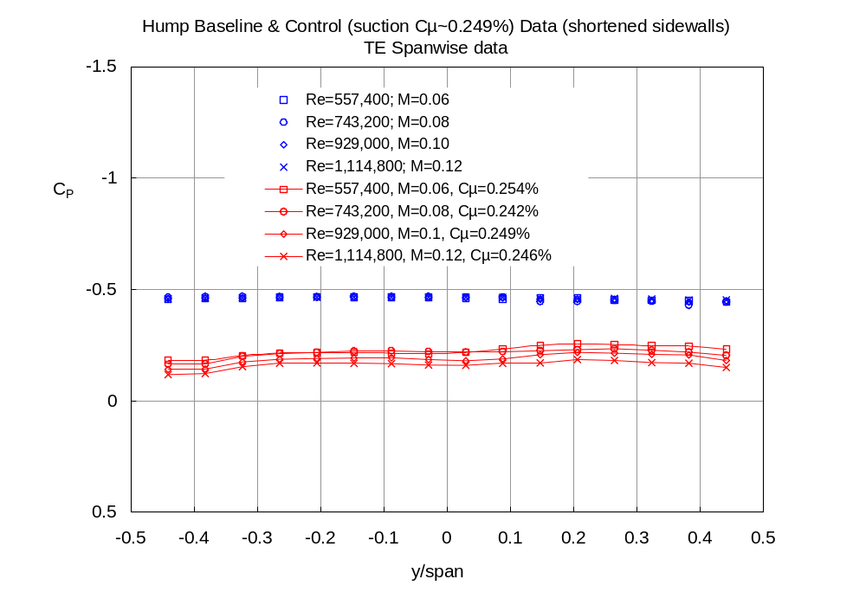
4d

Slide 22
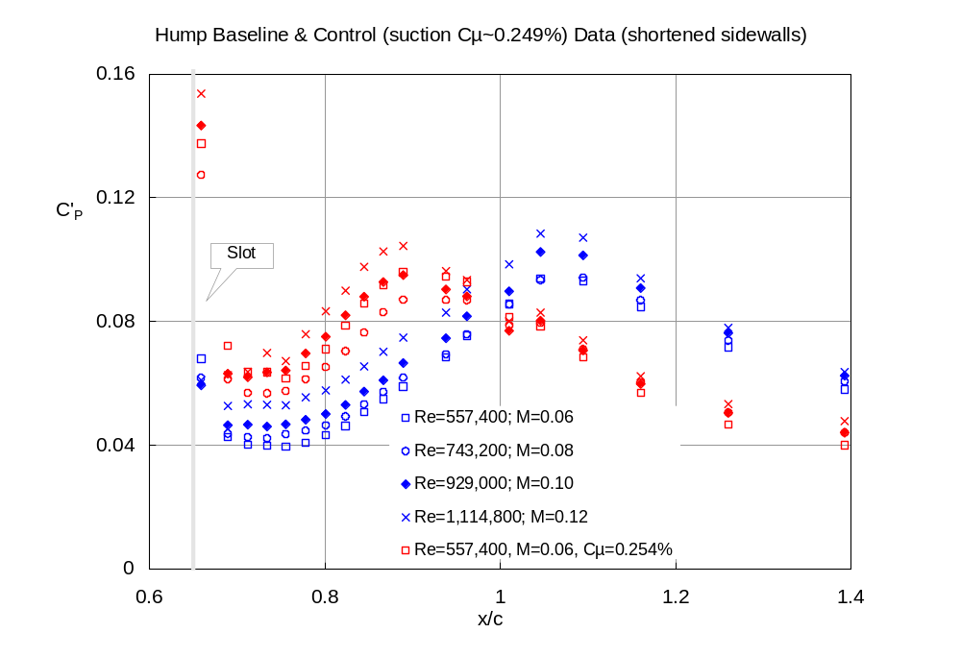
4e

Slide 23
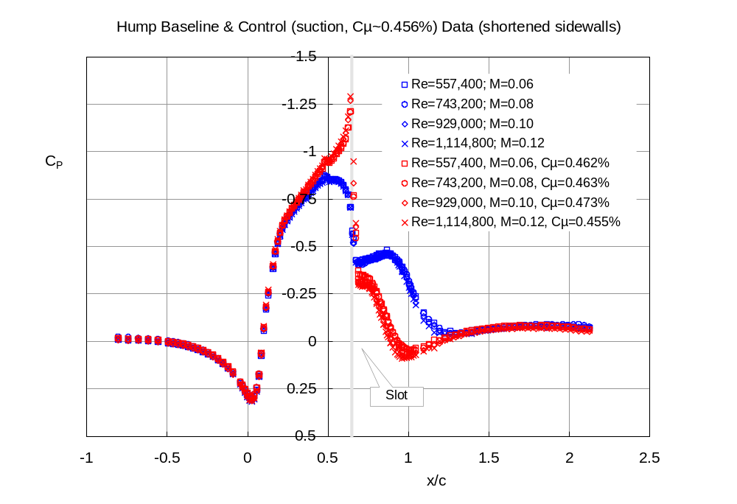
5a

Slide 24
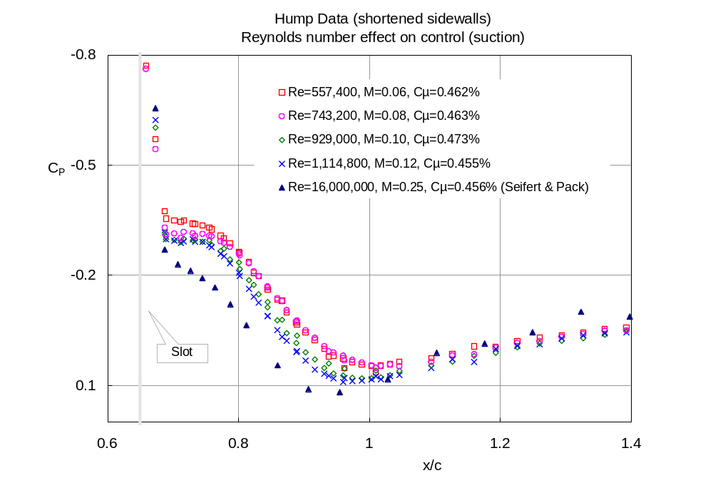
5b

Slide 25
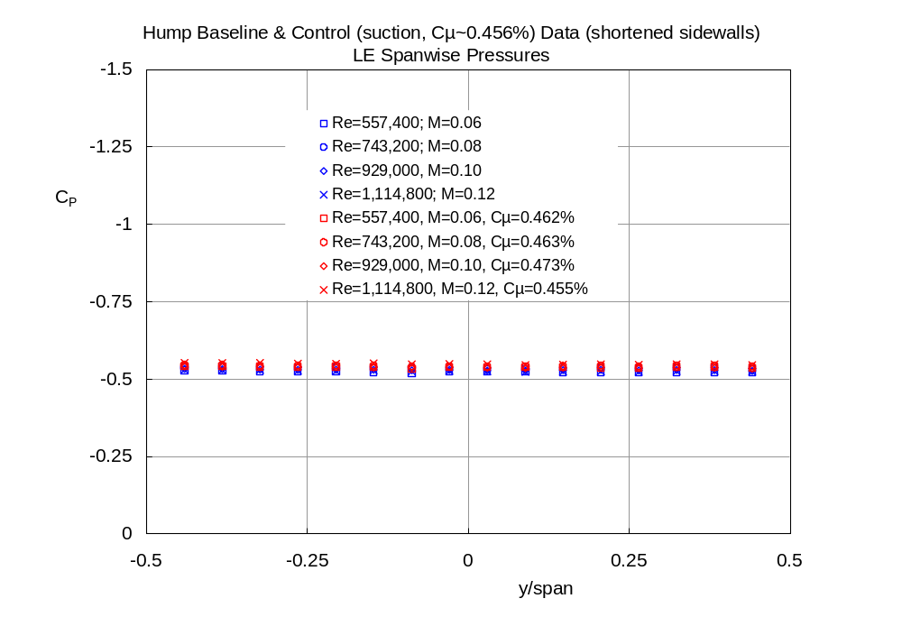
5c

Slide 26
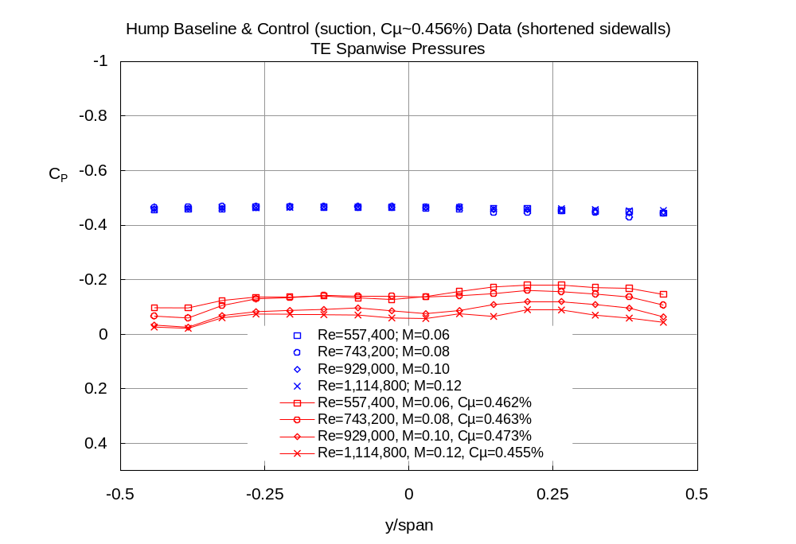
5d

Slide 27
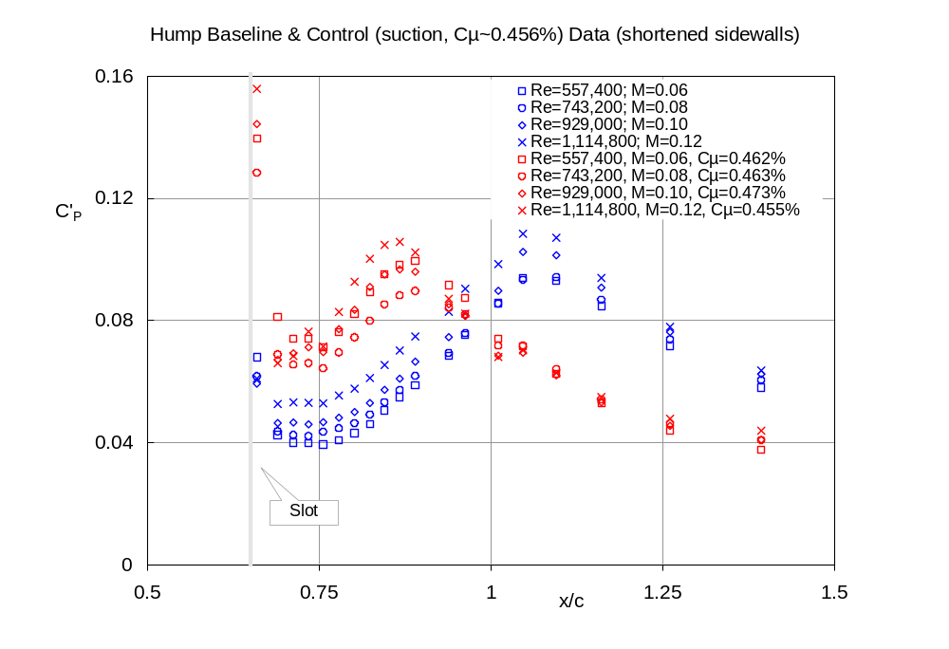
5e

Slide 28
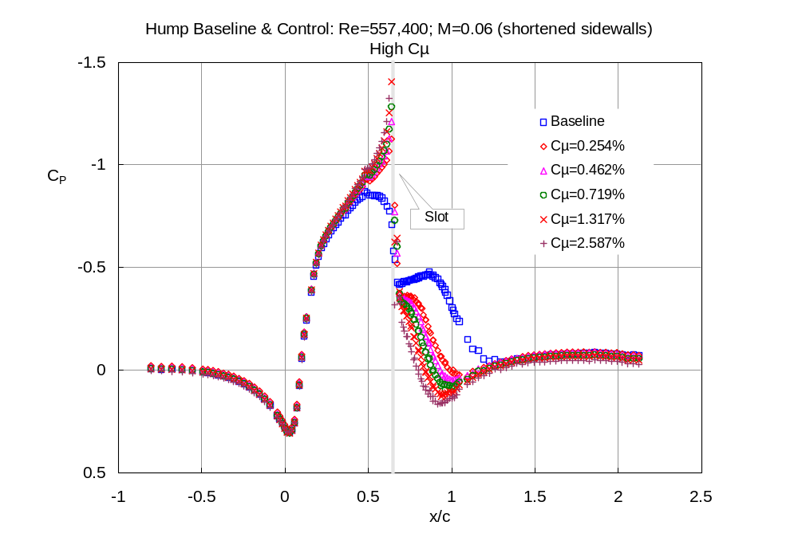
6a

Slide 29
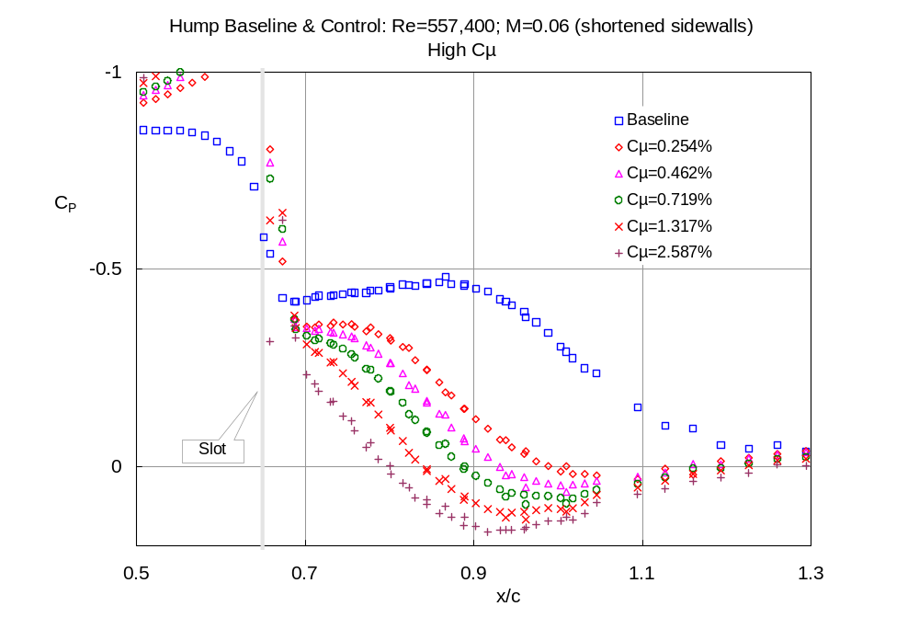
6b

Slide 30
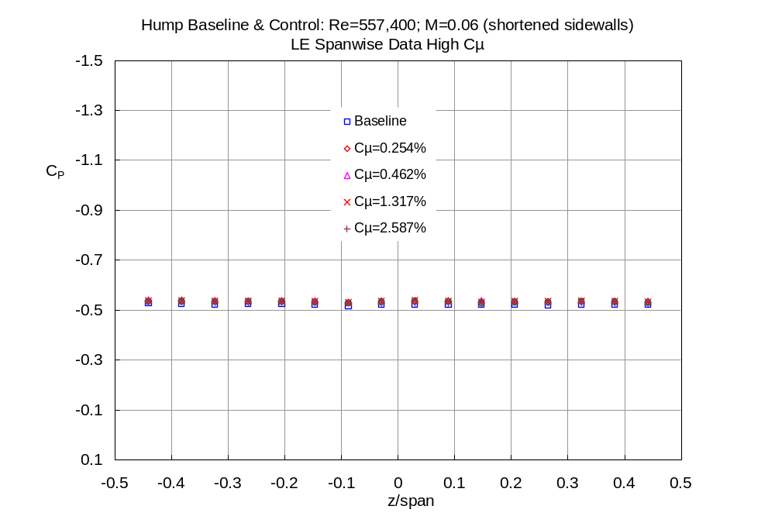
6c

Slide 31
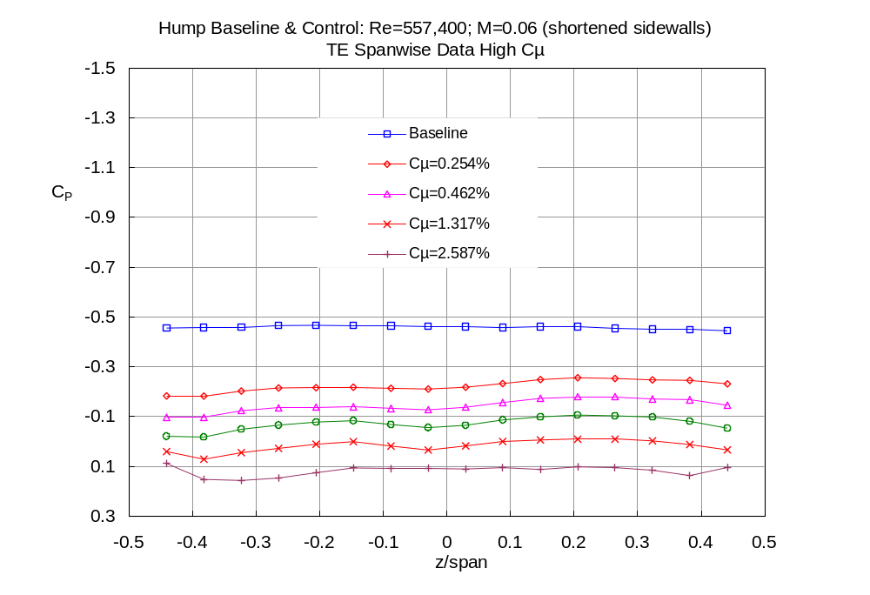
6d

Slide 32
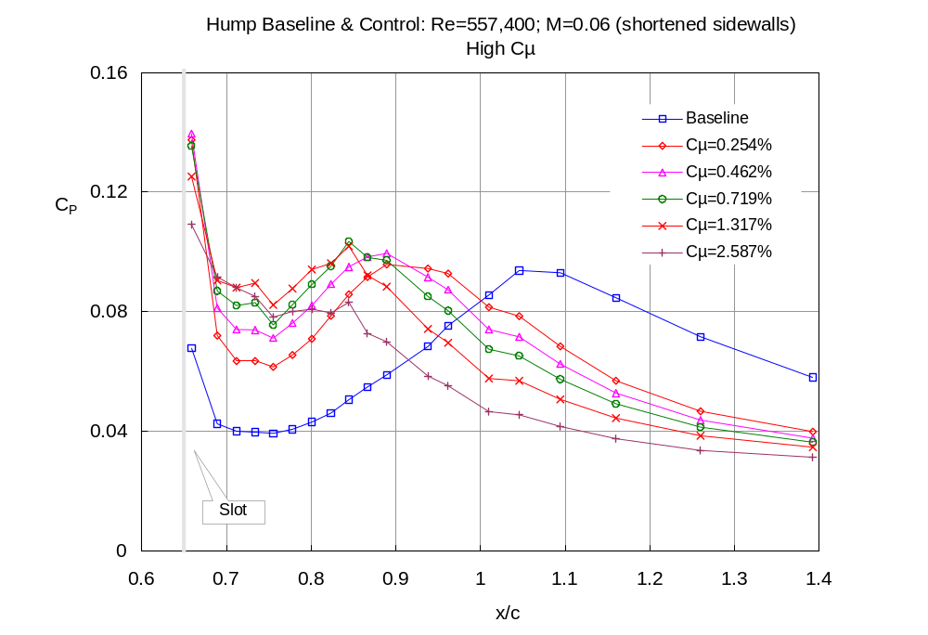
6e

Slide 33
