Slide 1
Successes and Challenges for Flow Control Simulations (Invited)
Christopher L. Rumsey
NASA Langley Research Center
Hampton, VA
AIAA 2008-4311
4th AIAA Flow Control Conference, Seattle, WA

Slide 2
Outline
Introduction
Perspectives on 3 workshop cases
  Synthetic Jet into Quiescent Air
  Synthetic Jet in a Crossflow
  Flow over a Hump Model
For each, summary given and remaining challenges identified

Slide 3
Introduction
Synthetic jets have many practical applications
  Jet vectoring, separation control, enhanced mixing, skin friction reduction, virtual aeroshaping
How accurate is CFD for predicting these types of unsteady flows?
CFDVAL2004 workshop was held in March 2004 and addressed this question
  (http://cfdval2004.larc.nasa.gov)
  Special issue of AIAA Journal (Vol 44, No 2, 2006) had summary paper and 6 CFD papers
  Many other papers have appeared as well (both AIAA conference papers as well as in journals)
Purpose of this paper: Summarize progress and answer the questions
  Has CFD gotten better at computing these types of flows?
  Are more advanced methodologies being applied?
  What challenges remain?

Slide 4
Introduction, cont’d
CFDVAL2004 workshop
  Case 1: Synthetic jet into quiescent air
  Case 2: Synthetic jet in a crossflow
  Case 3: Flow over a Hump model
    Three conditions: no-flow-control, steady suction, oscillatory control
    In ERCOFTAC database (Classic Collection), Case C.83
Overall summary from AIAA Journal, Vol 44 No 2, 2006
  CFD only able to qualitatively predict synthetic jet flow physics
  In part due to uncertainty in how to model the BCs
  Need identified: building-block experiments to focus on obtaining extremely detailed data at and near slot/orifice exits
A plug for workshops of this type:
  Many people computing same problems
  Improves synergy between CFDers and experimentalists
  Easier to discern trends & deficiencies
  “Outliers” easier to recognize

Slide 5
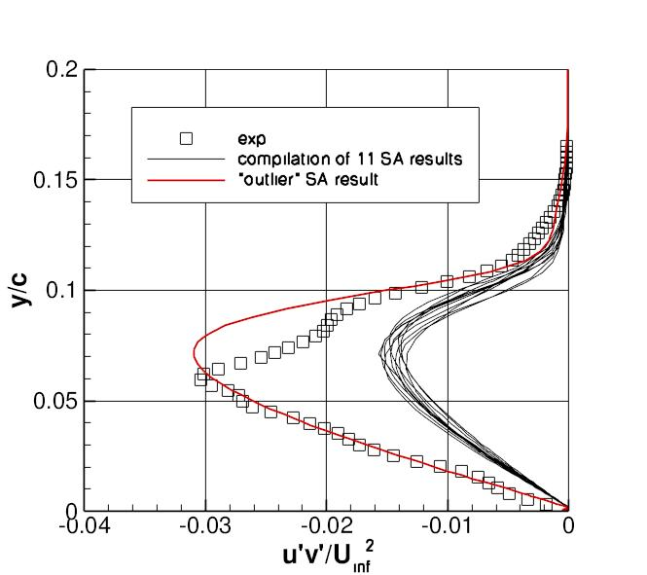
Turbulent shear stresses from CFDVAL2004 workshop, Case 3, separated region, SA model

Slide 6
Description of methodologies
Reduced-order or low-order
  Simplifications to RANS/URANS
  E.g., lumped element models, quasi-one-D models, proper orthogonal decomposition (POD) models
  Less expensive than RANS/URANS
  Useful to find viable design from among hundreds of possibilities

Slide 7
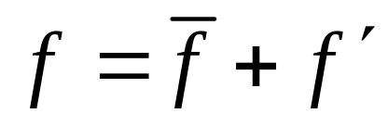


Description of methodologies
RANS/URANS
  Both solve Reynolds-averaged equations (RANS is steady-state, URANS is time-accurate)
(incompressible)
- Then equations written in terms of (long-time-average or phase-average)
- End up with unclosed term(s), turbulent stress:
- Modeled with turbulence model (e.g., 1-eqn, 2-eqn, EASM, RSM): models the MEAN EFFECTS of turbulent fluctuations
- RANS/URANS assumed to be valid if time scale of turbulent fluctuations << physical time step << important global unsteady time scales in the flow

Slide 8

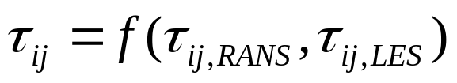
Description of methodologies
LES & blended RANS/LES
  Derived by applying low-pass filter to N-S eqns
  Idea is to resolve larger turbulent eddies, model smaller ones
  Resulting filtered eqns are functionally identical to RANS equations: again unclosed terms must be modeled
  LES subgrid-scale (SGS) models are different from RANS turbulence models in that they include filter (typically dependent on local grid size)
  Blended RANS/LES works by blending the SGS model and turbulence model
    Sometimes problems in blending region (e.g., if in log-layer)

Slide 9
Description of methodologies
LES & blended RANS/LES, cont’d
  LES is difficult to analyze - easily complicated by numerics
  Excessive numerical dissipation affects ability to resolve features
  Numerical dissipation can behave like SGS model
  This fact taken advantage of in implicit LES (ILES)
    No SGS model used
    Inherent numerical dissipation provides filtering needed at smallest scales
    Theoretically justified in MILES (specific numerical methods employed)

Slide 10
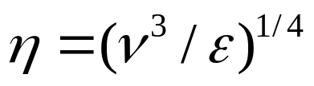
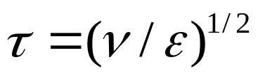
Description of methodologies
DNS
  Direct simulation of N-S equations
  By implication & standard definition: requires that all spatial and temporal scales are resolved down to Kolmogorov scales
    Impossible at high Re on today’s computers
  More common: “coarse-grid” DNS - finest scales not resolved
  What is the difference between ILES and “coarse-grid” DNS?
    Equations identical
    No SGS model - numerical dissipation “models” the effects of smallest eddies & prevents artificial build-up of energy at smallest scales
    Numerics can be similar

Slide 11
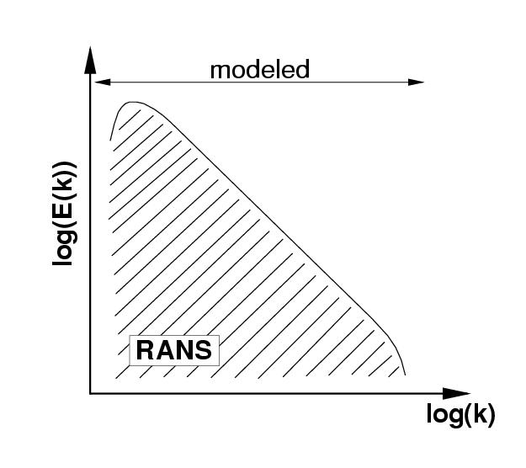
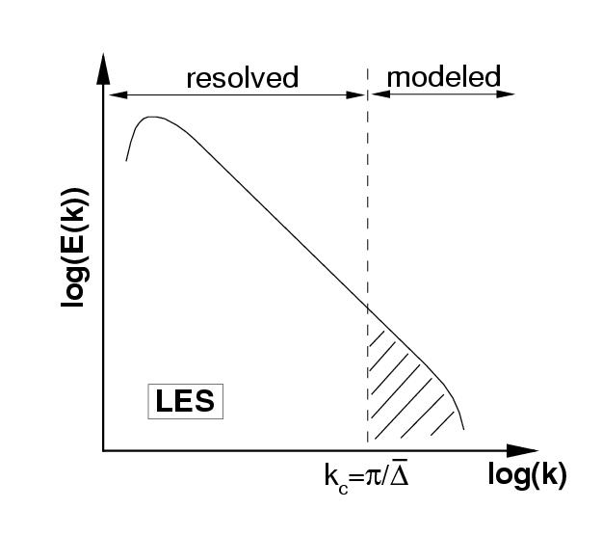
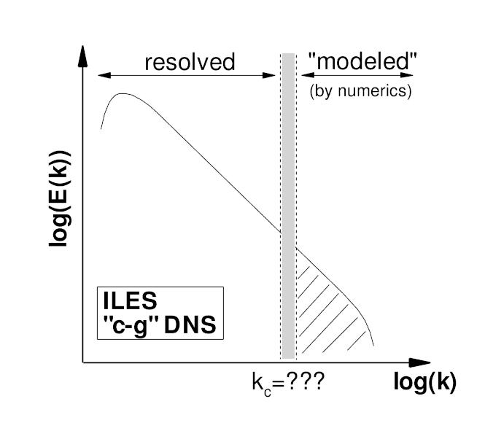
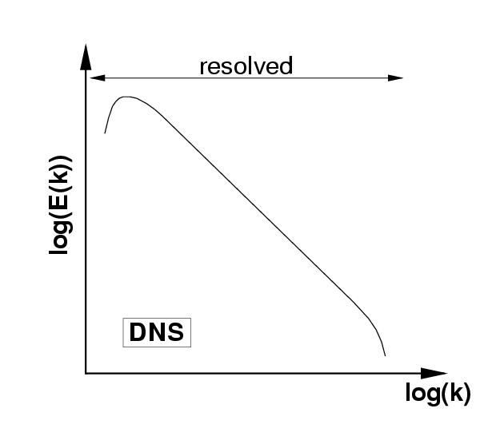
Representation of different methods in Fourier space

Slide 12
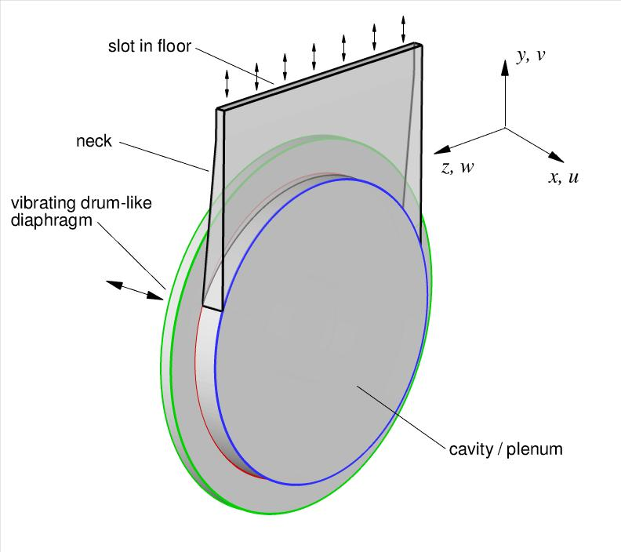
Case 1:
Synthetic jet into quiescent air

Slide 13
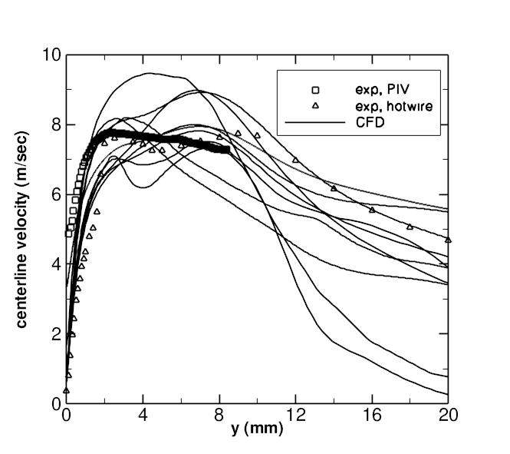
Time-averaged centerline velocity from original CFDVAL2004 workshop
(PIV = Particle Image Velocimetry)

Slide 14
Analysis
Workshop CFD results “all over the map”
  Turb models and slot BCs had big impact
Experiment PIV & hotwire different near slot in original experiment
  New experiment (post-workshop) - at slightly different conditions
  New experiment PIV & Laser Doppler Velocimetry (LDV) agreed well
  Hotwire not accurate near slot

Slide 15
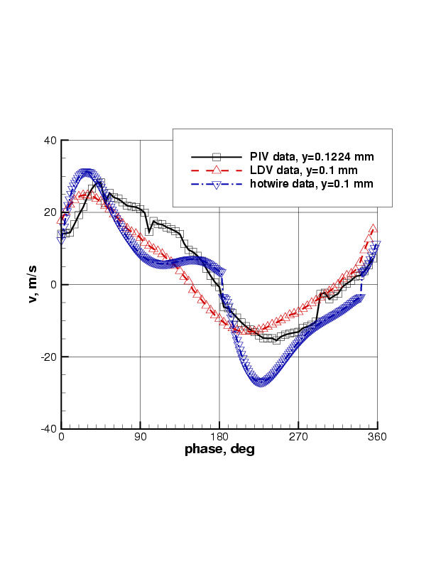
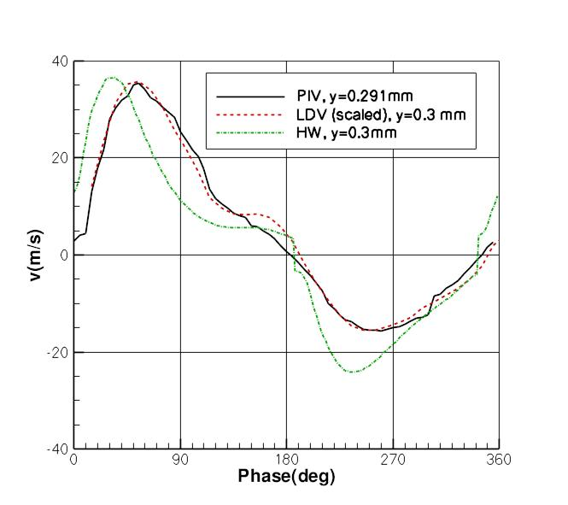
Velocity measured near slot exit
Original data
Newer data

Slide 16
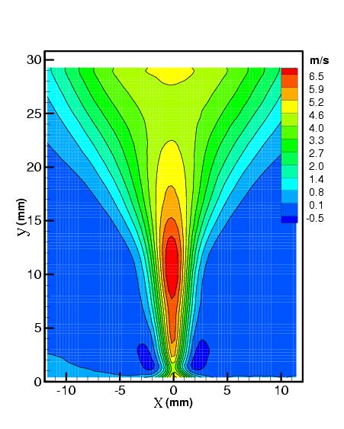
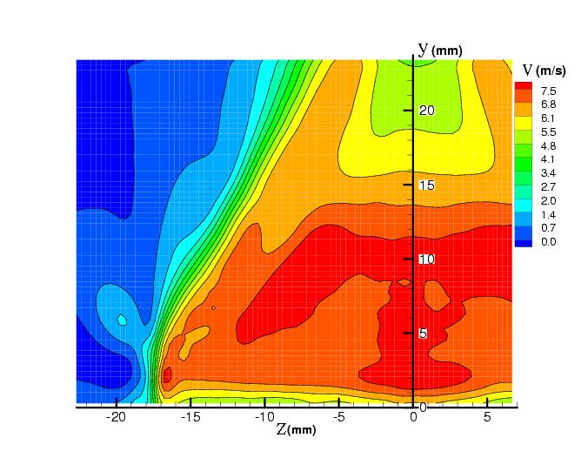
New experiment
- Slot end effects:
-intrude toward center, cause axis-switching phenomenon (vortex structures deform & orient long axis perpendicular to initial orientation)
-“2-D” approximation likely poor above 8h or so

Slide 17
Published results for case 1
Yamaleev & Carpenter - low-order (1-D Euler) method for internal cavity coupled to laminar flow N-S in field
Vatsa & Turkel - URANS with FFT curve fitting of internal slot BC to match flow at exit
Zhang & Wang - URANS with similar FFT internal BC
Park et al - URANS with internal BC curve fit to data
Carpy & Manceau - URANS with no cavity; exp data at exit used for BC
Xia & Qin - DES with predictive moving wall internal BC
Cui & Agarwal - DES & SST-LES; simple sinusoidal internal BC to try to match PIV & hotwire
Kotapati et al - N-S; simple sinusoidal internal BC to try to match PIV

Slide 18
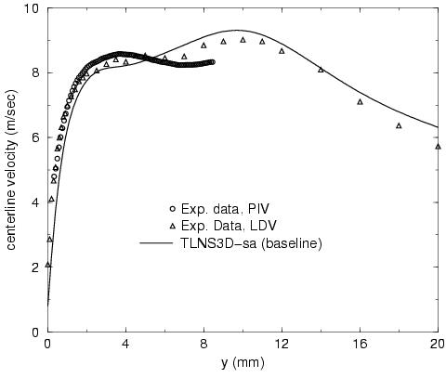
Subsequent CFD improvements example from Vatsa & Turkel
- Key: better matching experimental conditions at exit (FFT used to help match temporal variations)

Slide 19
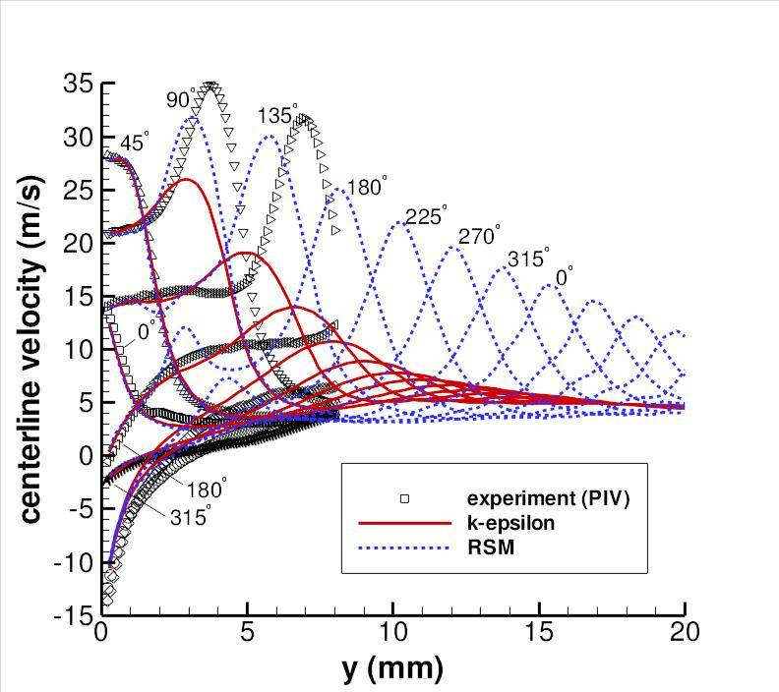
Subsequent CFD improvements example from Carpy & Manceau
- Used PIV experimental conditions at exit
RSM much better than k-epsilon model
time lag between strain & anisotropy tensors (yielding negative production) cannot be captured by E.V. models

Slide 20
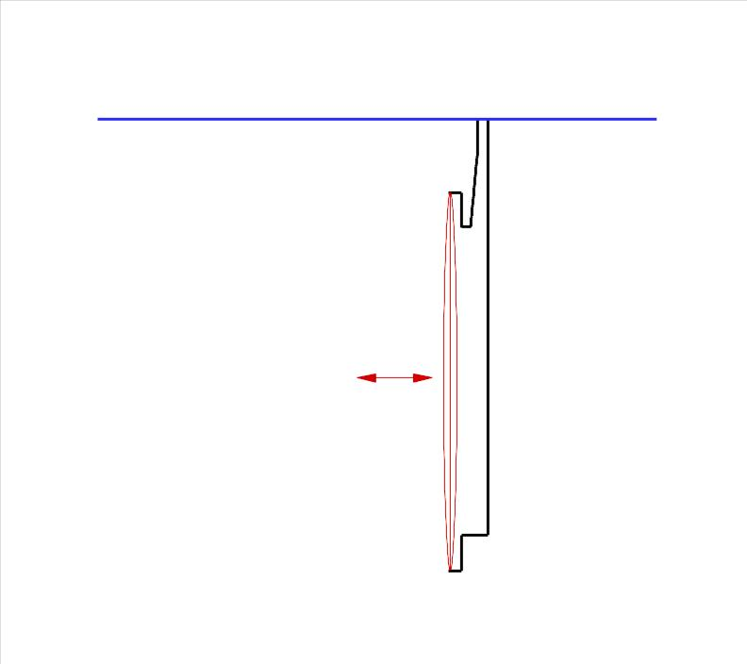
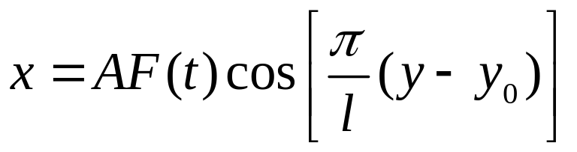
Subsequent CFD improvements
Xia & Qin
- Drum-like motion simulated with moving grid on 2-D section shape (predictive)
- 3-D DES computations with periodic BCs

Slide 21
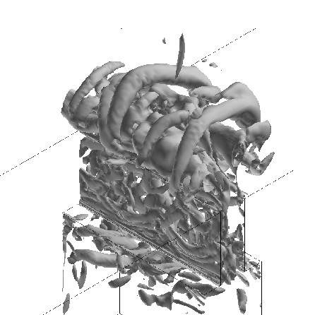
Subsequent CFD improvements example from Kotapati et al
- Full simulation of turbulent structures in near-field (periodic BCs)

Slide 22
Summary - case 1
What’s new
  Recognition of importance of end effects
  Development/recognition of techniques to better match BCs at exit
  Internal cavity shape itself not a major factor
    But you need exp data at exit to match
    Predictive modeling of membrane motion used 2-D version of actual cavity shape
  DES and N-S simulations (as well as URANS) have been successful in the near-field

Slide 23
Summary - case 1
Remaining challenges
  Unclear whether URANS is adequate & which models are best
    SA & SST appear reasonable, but Carpy & Manceau suggest linear models miss key physics
    When is simulation (e.g., DES, N-S) necessary?
  Capturing 3-D end effects (and physics further into the field) possible?
  How well will a predictive moving-grid BC for 3-D diaphragm shape work?

Slide 24
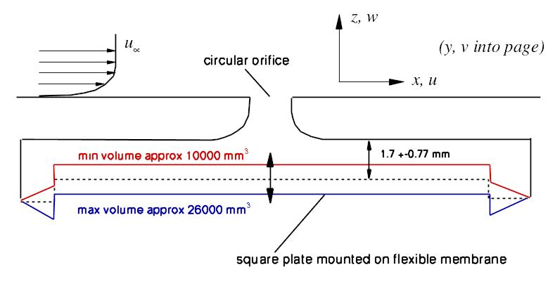
Case 2:
Synthetic jet in a crossflow

Slide 25
Published results for case 2
Iaccarino et al - URANS (v2f and k-eps models) without & with plenum
Biedron et al - URANS (SA model) with plenum
Rumsey et al - URANS (SA, SST, EASM models) with plenum
Cui & Agarwal - DES and URANS (SST model) with plenum
Xia & Qin - DES with moving-wall BC in plenum
Dandois et al - LES (mixed scale model) and URANS (SST model) with plenum

Slide 26
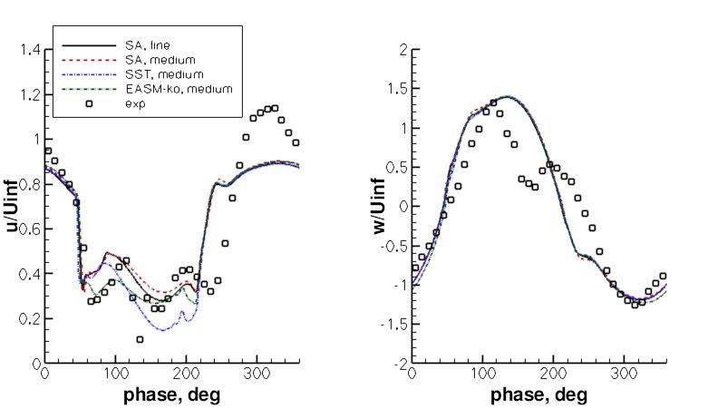
Sample CFD results over orifice using simple periodic BCs in plenum (Rumsey)
Dip likely caused by large
cross-flow component in exp,
not modeled in CFD

Slide 27
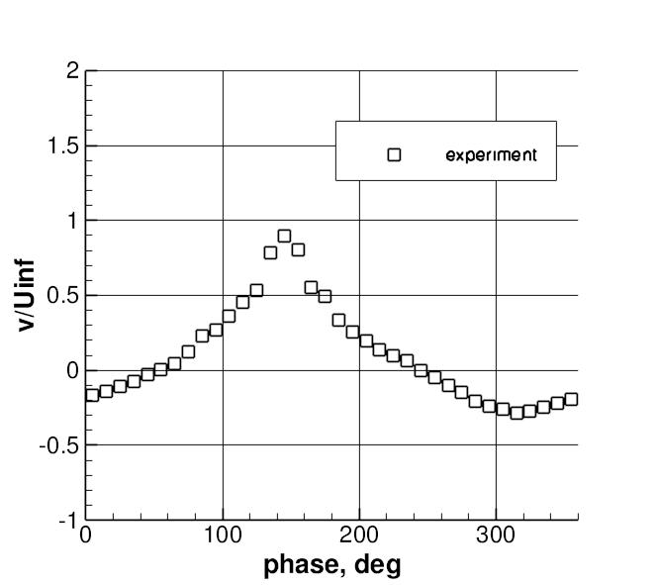
Unexplained asymmetry in exp above center of orifice

Slide 28
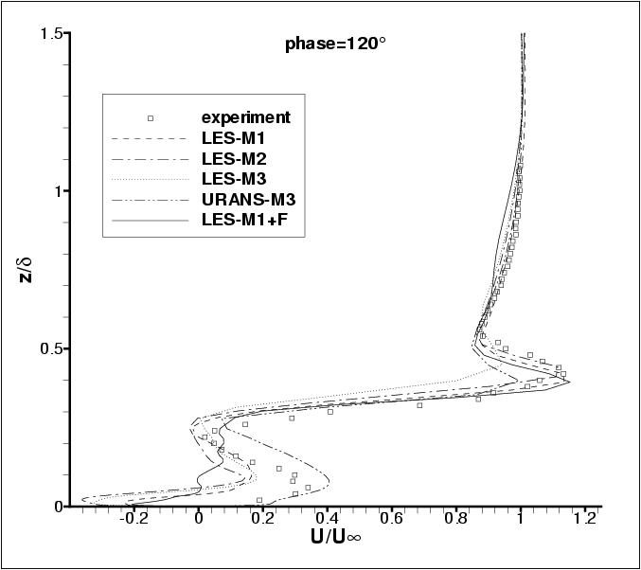

Sample CFD results u-velocity 1D downstream (Dandois et al)

Slide 29
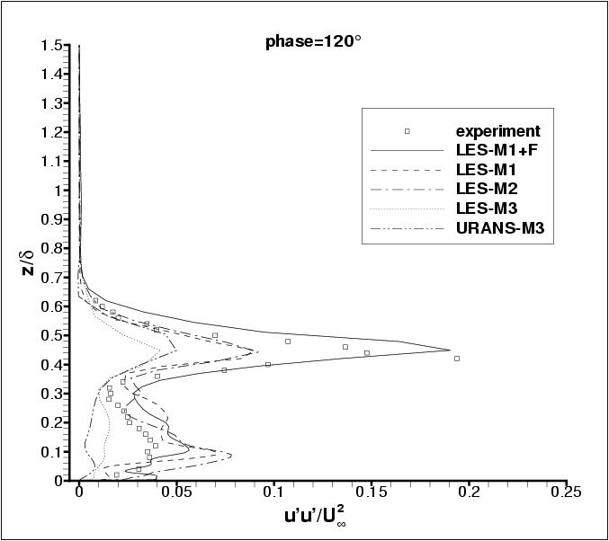
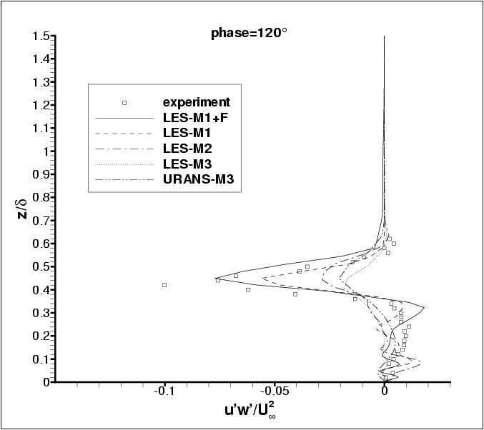
Sample CFD results turbulent normal and shear stresses 1D downstream (Dandois et al)

Slide 30
Summary - case 2
What’s new
  LES (with appropriate upstream inflow BCs) better than URANS at predicting turbulent quantities
    Earlier: recognition at CFDVAL2004 workshop that URANS & LES could both predict mean flow quantities reasonably well
  Including orifice important for capturing complex flowfield in its immediate vicinity
    Simple top-hat wall BCs miss physics
  Dandois demonstrated potential effects of large periodic cross-flow velocity component in experiment
  Xia & Qin used moving wall BC in plenum
    Results appeared to be similar to usual simple periodic transpiration BC

Slide 31
Summary - case 2
Remaining challenges
  Can a predictive (moving wall) BC in plenum be used to achieve closer agreement with velocities at orifice exit?
  In light of unexplained large v-velocity component in workshop experiment, revisit experiment or establish new benchmark dataset

Slide 32
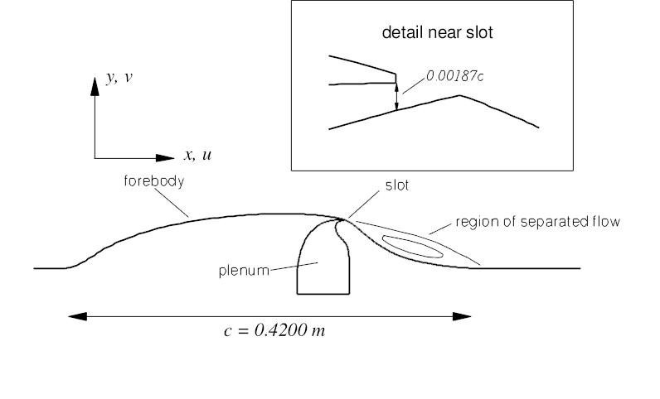
Case 3:
Flow over a hump model
- Based on earlier experiment by Seifert & Pack (AIAA J, Vol. 40, No. 7, 2002, pp. 1363-1372)
- This case also used in subsequent 11th & 12th ERCOFTAC/IAHR Workshops on Refined Turbulence Modelling

Slide 33
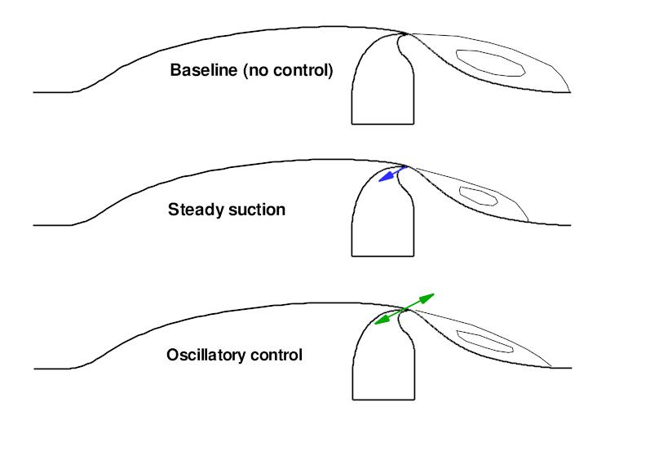
Hump model – 3 conditions

Slide 34
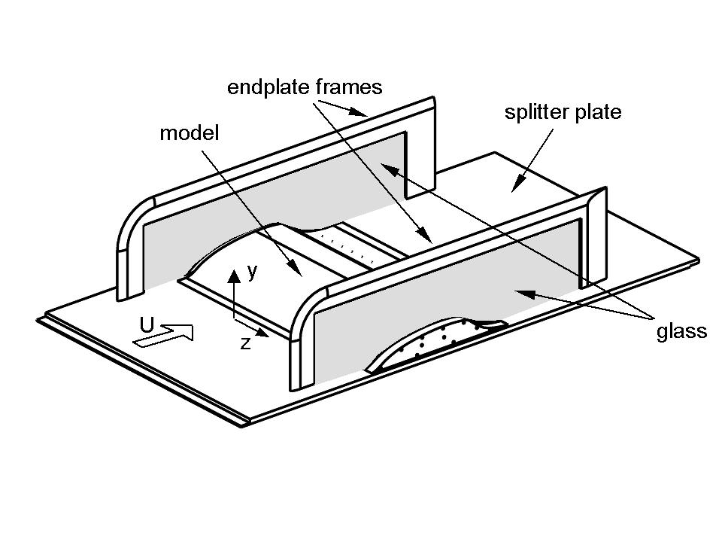
Hump configuration
Blockage effects due to endplates must be accounted for in CFD
(affects surface Cp)

Slide 35
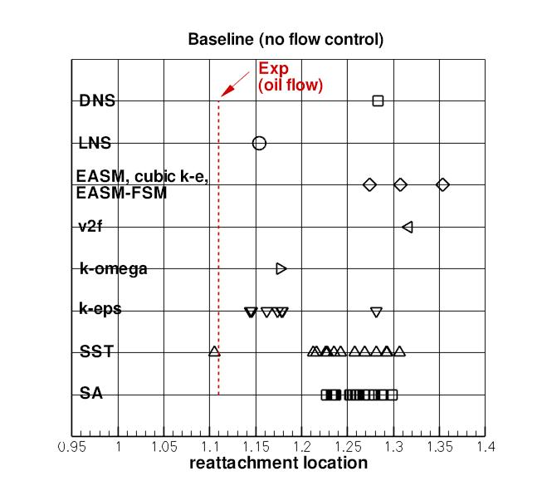
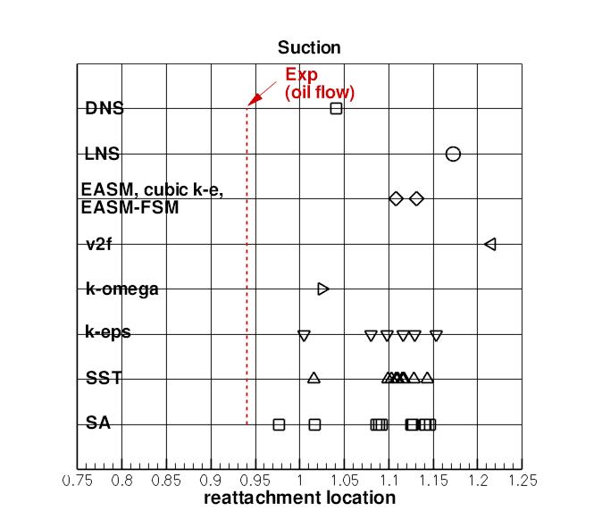
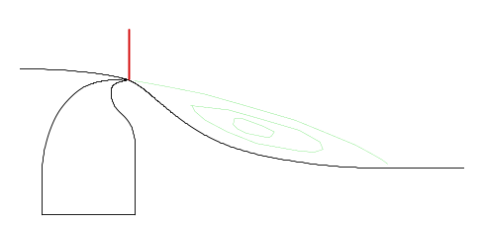
Results from workshop reattachment location

Slide 36
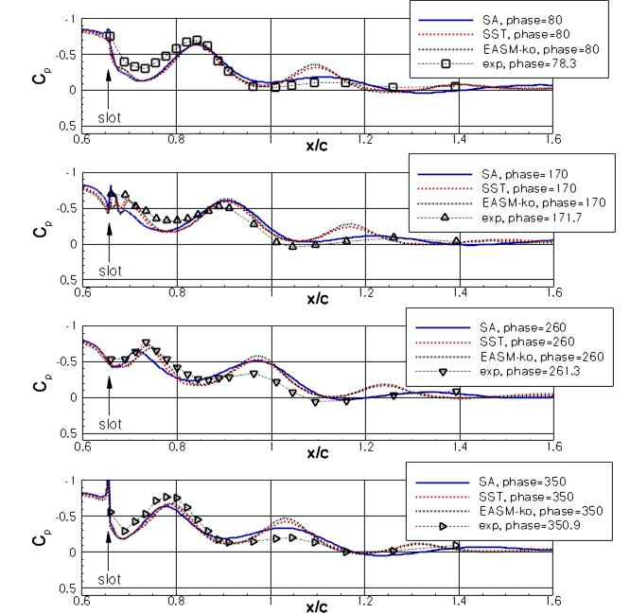
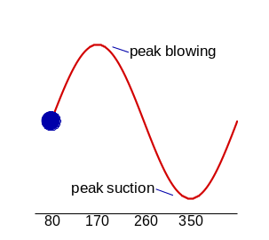
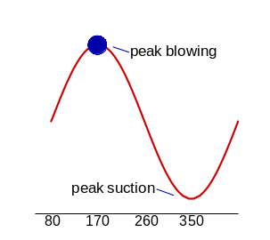
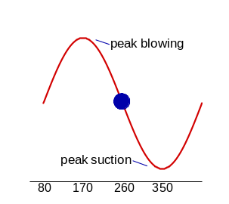
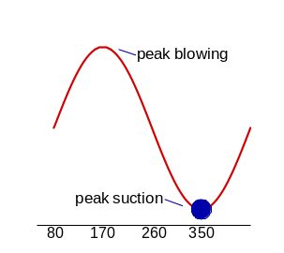
Phase-averaged Cp

Slide 37
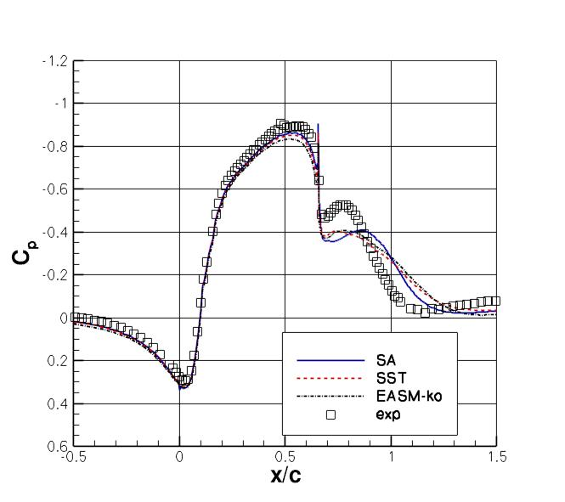
Long-time-average Cp oscillatory case

Slide 38
RANS/URANS problem identified
Eddy viscosity underpredicted in separated shear layer region
  Too little mixing
  Too late a reattachment downstream
  Occurs for baseline, steady suction, or oscillatory control
  Similar problem seen in a separate 2-D hill workshop case
Hump case has been computed by no less than 16 different groups

Slide 39
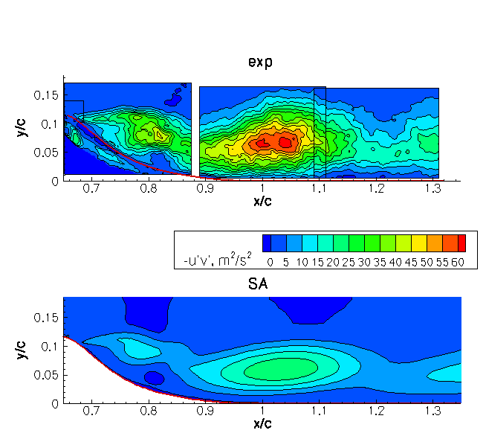
Movie (turbulent shear stress) example RANS (SA compared with experiment)

Slide 40
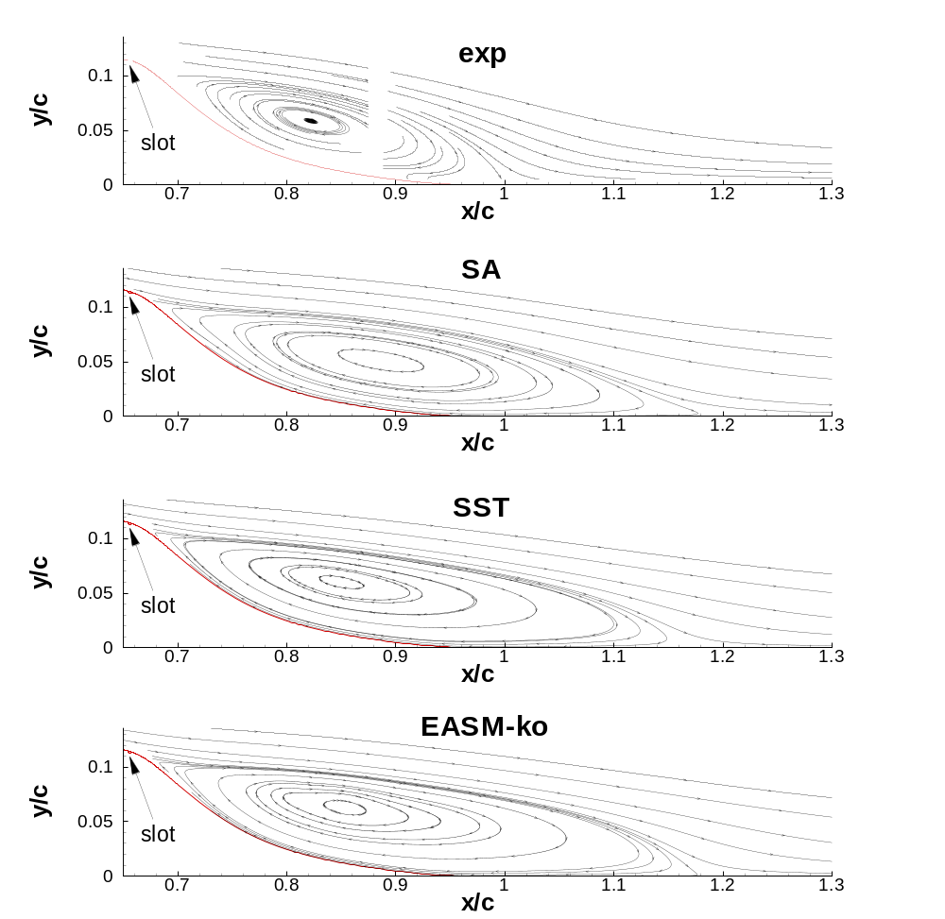
Long-time-average streamlines example RANS

Slide 41
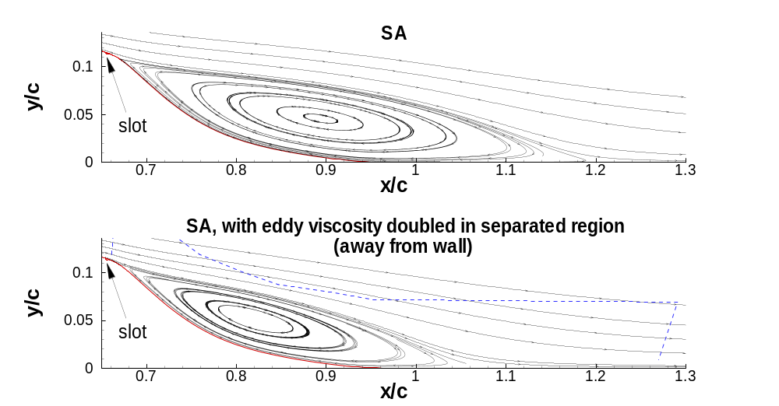
Numerical experiment effect of arbitrarily doubling eddy viscosity in separated region, SA

Slide 42
RANS/URANS results for case 3
Iaccarino et al
Capizzano et al - used Neumann surface BCs
Cui & Agarwal
Balakumar - employed higher order WENO
Morgan et al - employed higher order compact scheme
Bettini & Cravero - commercial package
He et al - commercial package; looked at plasma control
  k-epsilon attached earlier
  but because it separated later, not due to better physics!
Madugundi et al - commercial package
Rumsey et al - included parametric studies at other conditions from the experiment

Slide 43
Blended RANS-LES, LES, & DNS
Israel et al - EASM combined with FSM
Hiller & Seitz - SAS model
Krishnan et al - DES
  Also RANS with many variants, including 3-D with endplates
  Helped discover blockage issues
Biswas - LES (dynamic model with KE eqn)
Saric et al - LES (Smagorinsky - const C_{s}), DES, and RANS
Morgan et al - ILES
You et al - LES (dynamic Smagorinsky)
Franck & Colonius - LES (both types Smag) & ILES
Postl & Fasel - “coarse-grid” DNS

Slide 44
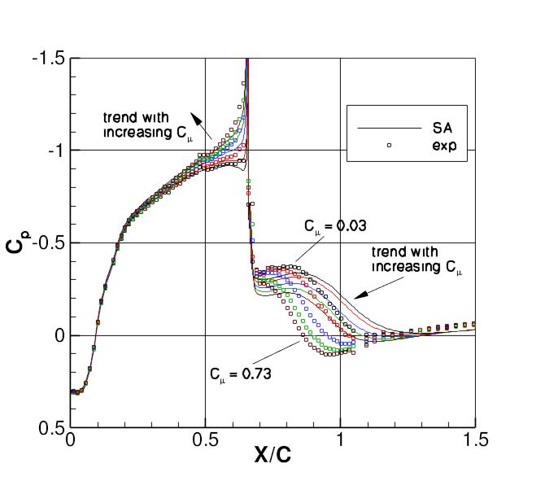
RANS parametric study steady suction, from Rumsey & Greenblatt
- RANS consistently overpredicted bubble length, as increased suction lessened its size

Slide 45
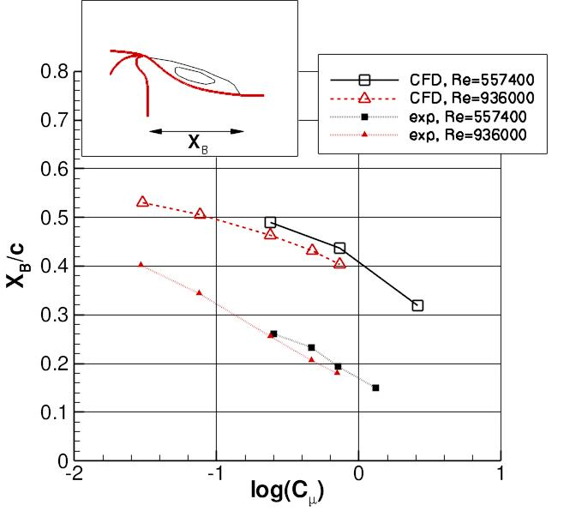
RANS parametric study steady suction, from Rumsey & Greenblatt

Slide 46
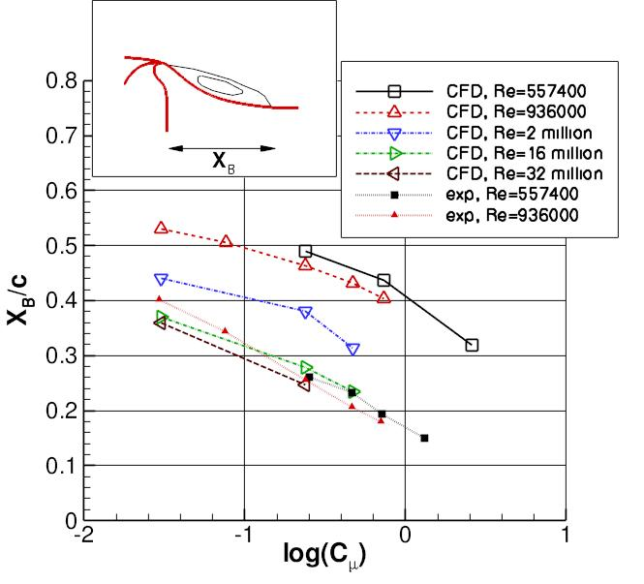
RANS parametric study steady suction, from Rumsey & Greenblatt

Slide 47
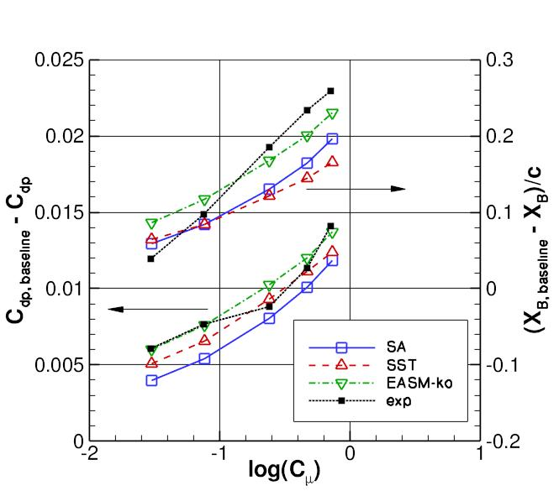
RANS parametric study steady suction, from Rumsey & Greenblatt
- RANS did fair job predicting suction trends (bubble-length slope low)
- URANS Results for oscillatory control not as favorable

Slide 48
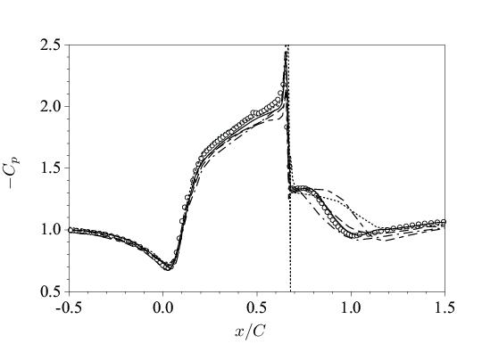
Subsequent CFD improvements steady suction case, figure from You et al
URANS
DES
LES (3 sets)

Slide 49
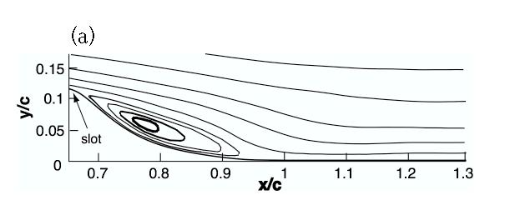
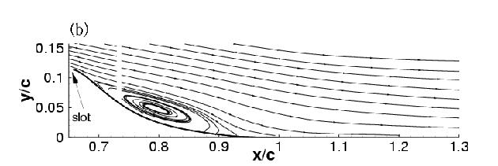
Subsequent CFD improvements
LES example from You et al
LES
experiment

Slide 50
Results from workshop

Slide 51
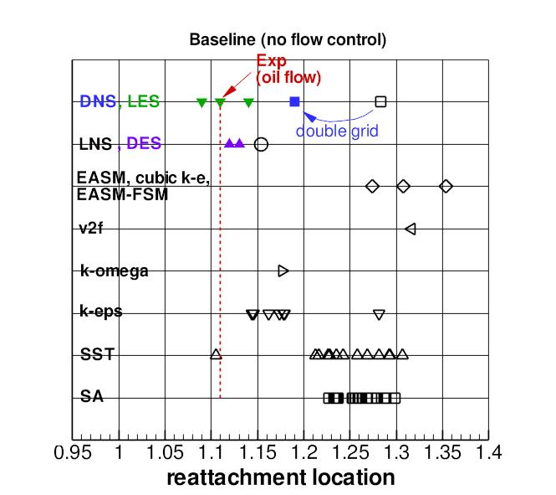
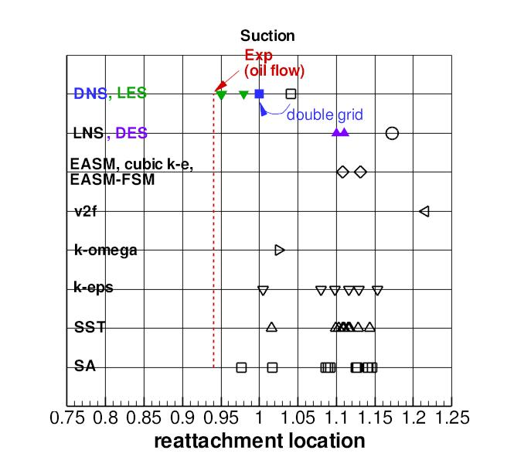
Results from workshop
+some newer results

Slide 52
Summary - case 3
What’s new
  RANS/URANS
    Trends for steady suction can be obtained in fair agreement with experimental trends (oscillatory control not so good)
    Can get right answer (bubble length) for wrong reason with k-epsilon, for example
    Computing with or without plenum not a big factor when looking at global flow field properties
  DES
    Shown to work well for baseline case
    Generally no benefit for smaller bubbles (issues related to RANS-LES interface location and insufficient eddy content)
  LES & coarse-grid DNS
    Can yield very good results

Slide 53
Summary - case 3
Remaining challenges
  Is there bubble size small enough for which RANS/URANS predicts physics & reattachment well?
  Improve blended RANS-LES methods like DES to work more consistently, especially for cases with small separations
  How well can LES predict trends due to jet strength, Re, frequency, etc?
  Can LES-type simulations be used to help improve RANS/URANS models for this class of flows?

Slide 54
Conclusions
CFD increasingly called upon to predict synthetic-jet flows
Need to establish confidence in CFD
  Through verification/validation studies and records of documented successes & failures
Workshops such as CFDVAL2004 are an important part of this documentation

Slide 55
Important to “follow through” and address challenges that remain
- additional follow-up flow control CFD workshops would be useful

Slide 56
End

Slide 57
Backup slides

Slide 58

Hump configuration
Two 2-D grids employed: fine=210,000 points, medium=53,000 points

Slide 59

2-D oscillatory control achieved by use of rigid piston spanning the model, driven by series of voice coil actuators

Slide 60


Phase-averaged profiles at x/c=0.66

Slide 61



Phase-averaged profiles at x/c=0.8

Slide 62



Phase-averaged profiles at x/c=1.0

