Slide 1
Summary of the CFDVAL2004 Workshop and Follow-on Results
Christopher L. Rumsey
NASA Langley Research Center
Hampton, VA
8/17/2005
Notes:
Title slide

Slide 2
Summary
This talk is in 2 parts:
  1st part is summary of the CFDVAL workshop, March 2004, which examined 3 flow-control validation cases (See AIAA Paper 2004-2217 and http://cfdval2004.larc.nasa.gov)
  2nd part is summary of the 11th ERCOFTAC/ IAHR turbulence modeling workshop continuation of Case 3, April 2005 (hump model) and comparison with CFDVAL
Notes:
Summary of overall presentation

Slide 3
Introduction
CFDVAL2004 3-day workshop held March 2004 in Williamsburg, VA
3 cases (experiments performed at NASA LaRC)
  Increasing geometric/physical complexity
  Measured using multiple instrumentation systems
  Designed for CFD validation, not highest performance
75 participants at the workshop
7 countries (62 U.S., 4 France, 3 Italy, 2 Germany, 2 Japan, 1 U.K., 1 Switzerland)
Representation from universities, companies, and public sector research laboratories
Notes:
Introduction for CFDVAL

Slide 4
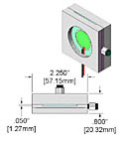
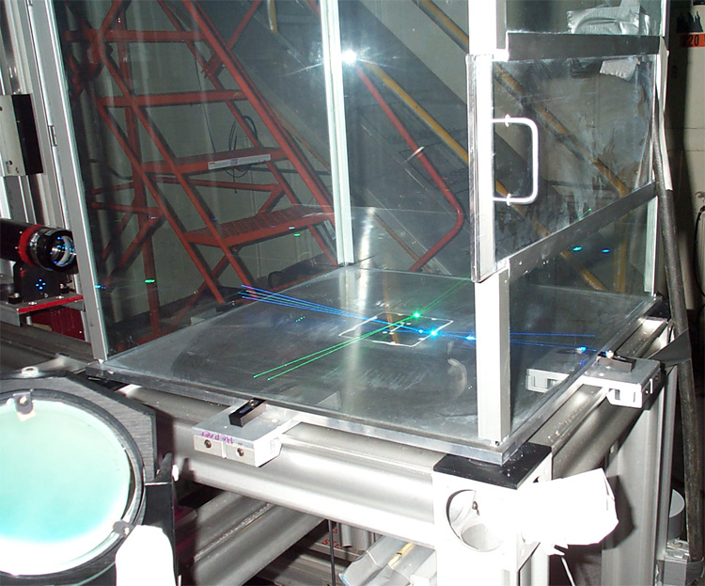
Case 1
Synthetic jet in quiescent air
8 contributors
25 separate cases
Notes:
Case 1 overview slide

Slide 5
Case 1 Details
Synthetic jet flow in and out of slot (1.27mm wide by 35.56mm long)
Driven by side-mounted circular piezo-electric diaphragm inside cavity
  444.7 Hz
  Max velocity out of slot approx 25-30 m/s
Flow issues into enclosed box 0.61m per side
Notes:
Case 1 details

Slide 6
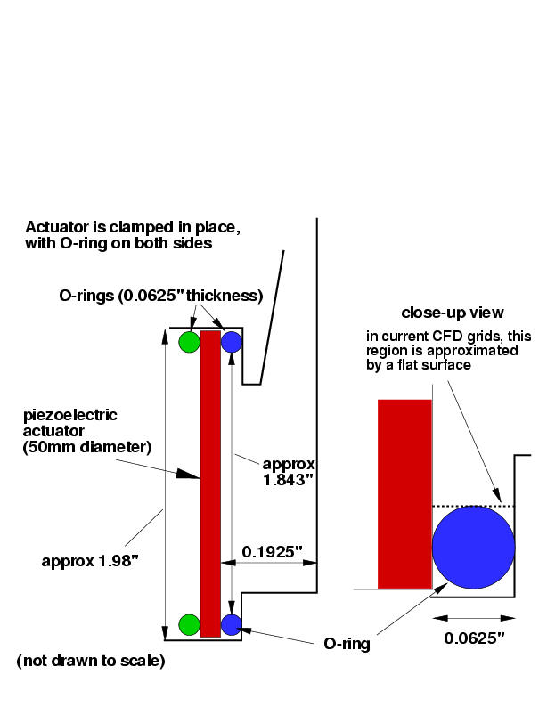
Cavity
Notes:
Schematic diagram showing cavity shape and layout

Slide 7
Methodologies
Structured & unstructured URANS (various turbulence models: SA, SST, k-e, nonlinear k-e, EASM, RSM)
Mostly 2nd order in space and time
Several Laminar, 1 RANS/LES, & 1 LES
1 reduced-order model (quasi-1-D inside slot) – 4th order in space and time
Mostly 2-D; a few 3-D (periodic)
Most modeled (an approximation of) the cavity, 2 applied BCs at slot exit
Wide variety of grid sizes and time steps
Notes:
Summary of CFD methods used by participants at CFDVAL workshop

Slide 8
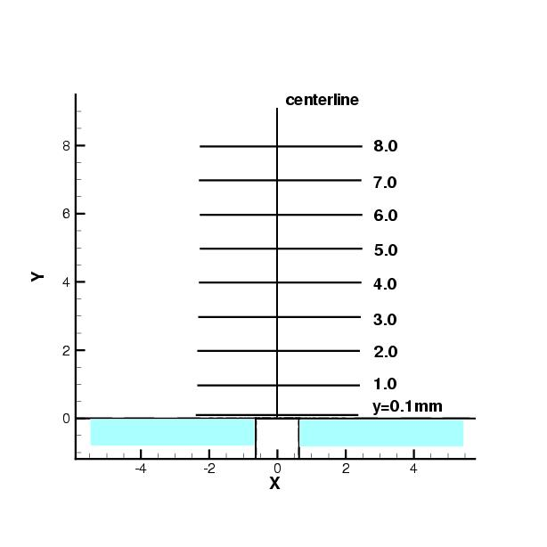
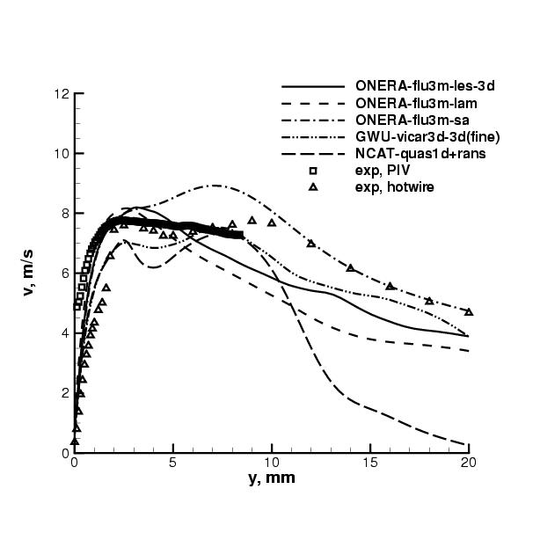
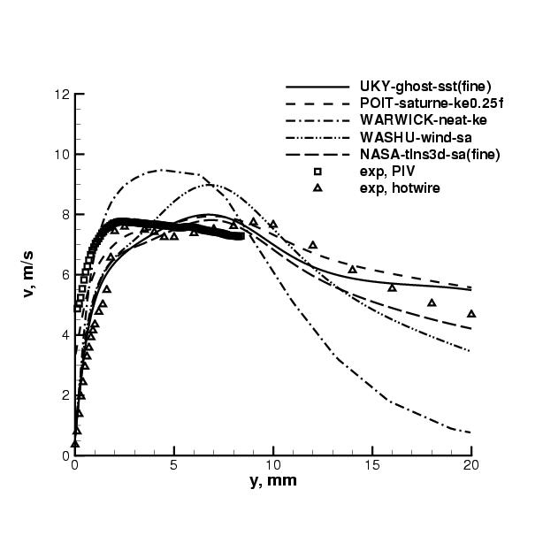
Average v-velocity at centerline (x=0)
(both plots of same thing, with different participants’ results)
Notes:
This shows long-time-average v-velocity results along centerline, from all participants. There is a lot of variation between CFD results. There is also significant difference between 2 measurement techniques (PIV & hotwire) near the slot. Individual uncertainty errors (approx 1-2% for PIV and 6% for hotwire near wall) are less than the measured differences seen in the wall region; this type of measurement discrepancy is an active area of experimental research for synthetic jet flows. It should also be noted that other experimental data were taken later using a different piezo-electric diaphragm (these devices are prone to occasional failure). This later data also included LDV measurements, but they were taken at slightly different conditions (higher max outflow velocity) than the data used for the workshop.

Slide 9
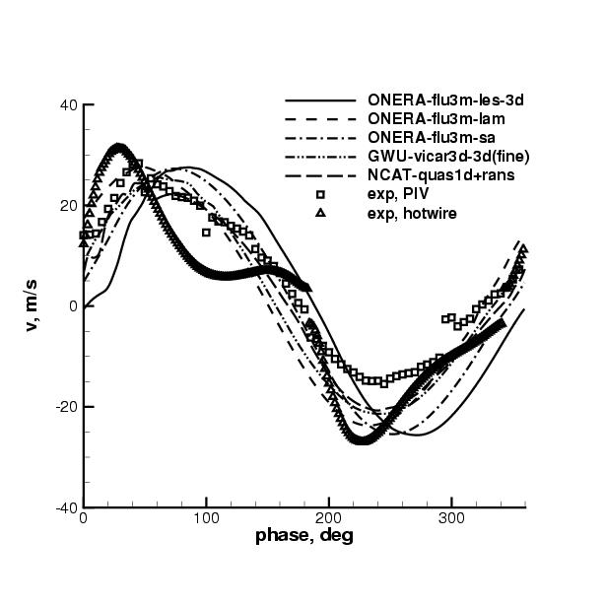
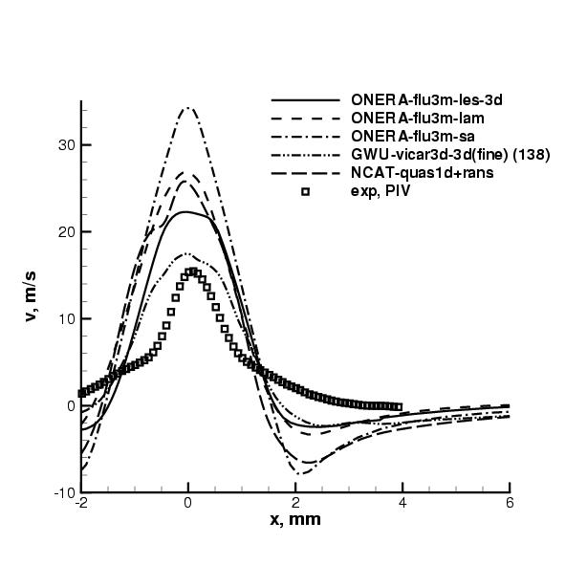
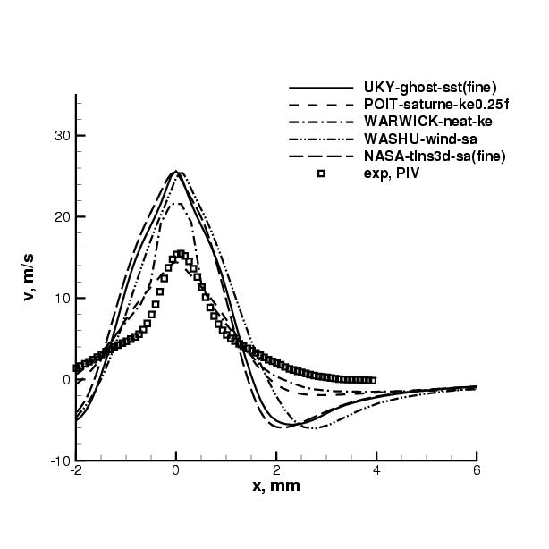
Phase-averaged v-velocity profiles at y=4 mm, phase=135 deg
(both plots of same thing, with different participants’ results)
Notes:
There is even wider variation among CFD results when looking at phase-average results. Results do not agree well with experiment.

Slide 10
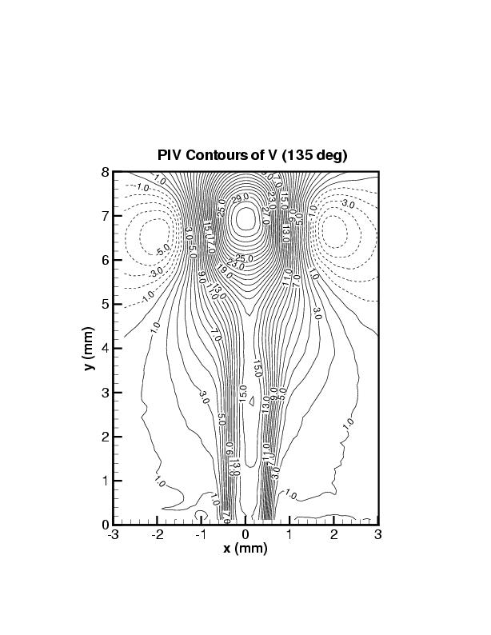
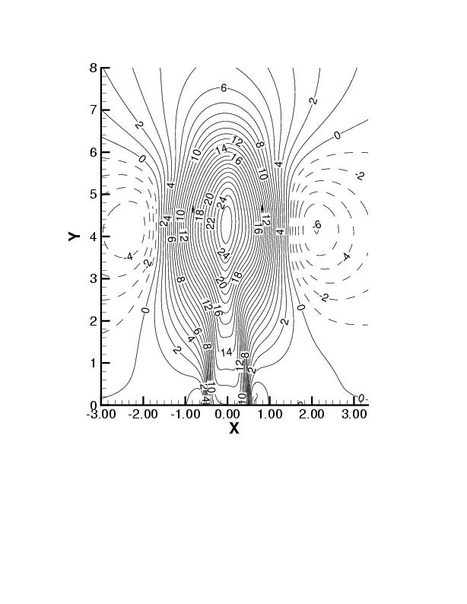
Example contours of phase-averaged v-velocity, phase=135 deg
experiment
NASA-tlns3d-sa(fine)
Notes:
The experimentally-measured velocity out of the slot was non-sinusoidal; the participants were generally unable to match these exit conditions well. As a result, results at particular phases tended to be off. An example of a typical disagreement in the phase-averaged flowfield is shown here: the CFD shows the peak jet velocity to be located lower than in the experiment. From subsequent experimental tests, it also appears very likely that 3-D effects due to ring vortices formed from the slot ends have an influence on the flow field, especially at distances far from the wall. None of the 3-D CFD computations accounted for the slot ends in their computations (all were periodic in the 3rd direction).

Slide 11
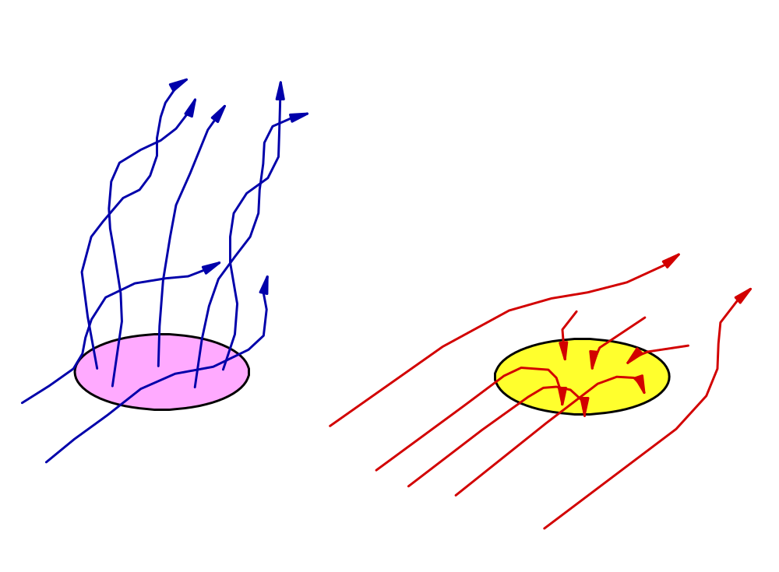
Case 2
Synthetic jet in crossflow
5 contributors
10 separate cases
Notes:
Case 2 overview slide

Slide 12
Case 2 Details
Synthetic jet flow in and out of circular orifice (6.35mm diameter)
Driven by bottom-mounted square-shaped piston (on elastic membrane) inside cavity
  Cavity is approx 1.7mm deep (tunnel on)
  150 Hz
  Max velocity out of slot approx 43 m/s (=1.3Uinf)
Flow issues into turbulent boundary layer (M=0.1, BL thickness approx 21mm)
Notes:
Case 2 details

Slide 13
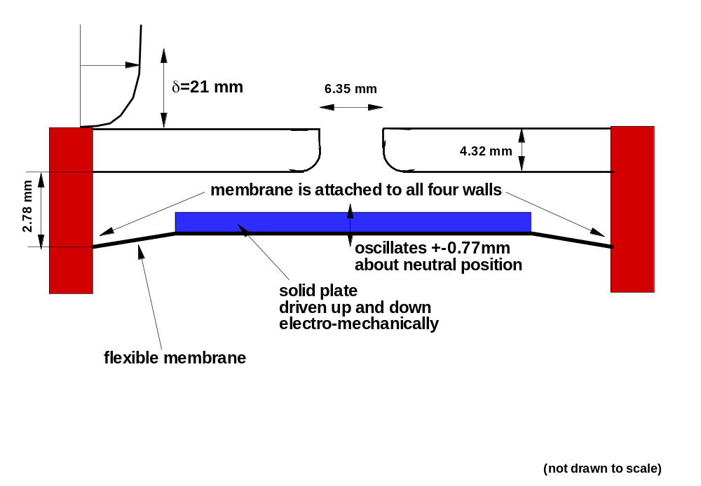
Cavity
Notes:
Schematic diagram of the Case 2 cavity

Slide 14
Methodologies
Structured & unstructured URANS (various turbulence models: SA, SST, k-e, EASM)
1 LES
All methods 2nd order in space and time
Both full-plane and half-plane modeled
4 modeled a cavity, 1 did not
Wide variety of grid sizes and time steps
Notes:
Summary of CFD methods used by participants at CFDVAL workshop

Slide 15
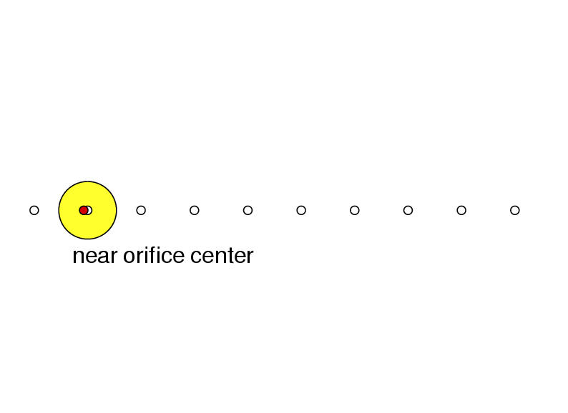
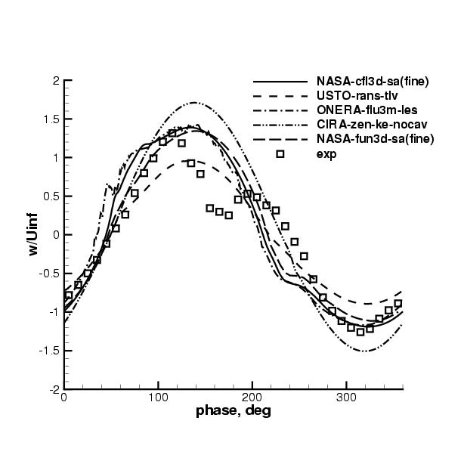
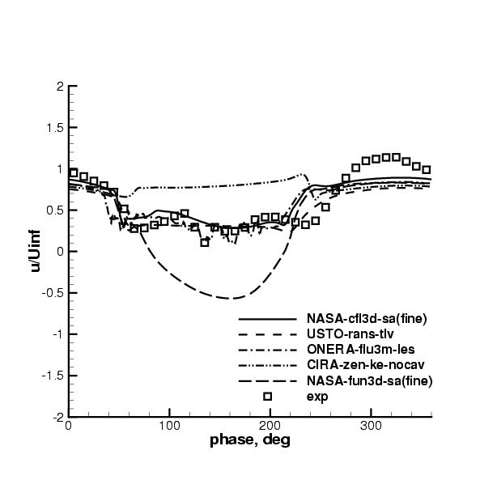
Time histories above orifice
x=50.63mm, y=0, z=0.4mm
u-velocity
w-velocity
Notes:
This shows the computed velocities above the orifice compared to experiment. Three of the participants did fairly well capturing the general shape, although there was a large dip in the w-velocity component not modeled by CFD. This dip in the experimental results may be related to an unusually large spanwise component of velocity measured at this location during the cycle. Due to symmetry, one would expect the v-component to be approximately zero. The reasons for this anomaly in the experiment have not yet been discovered. It should be noted that one of the methods here (NASA-fun3d) followed up later (AIAA 2005-5093) and improved their results by changing the BC used at the cavity floor, making their results consistent with the majority. This highlights the importance of using consistent BCs when comparing different CFD results, before drawing conclusions.

Slide 16
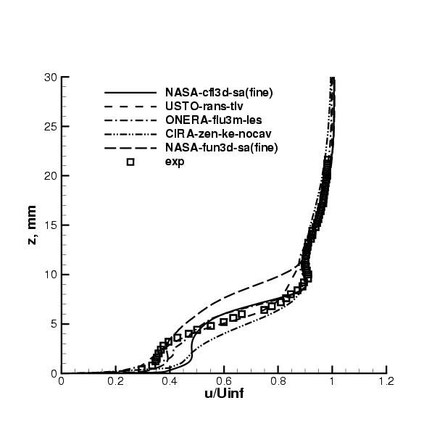
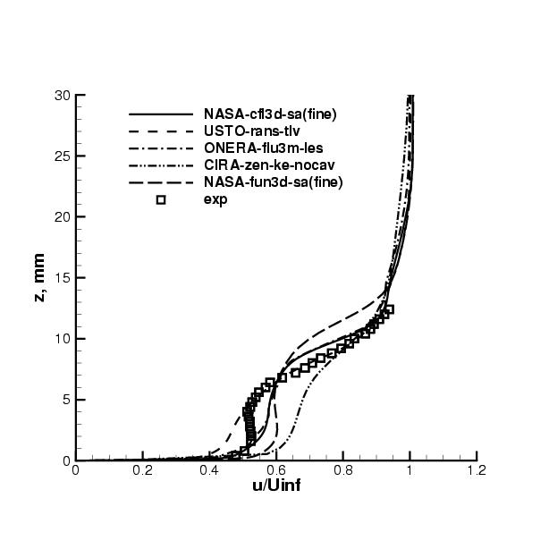
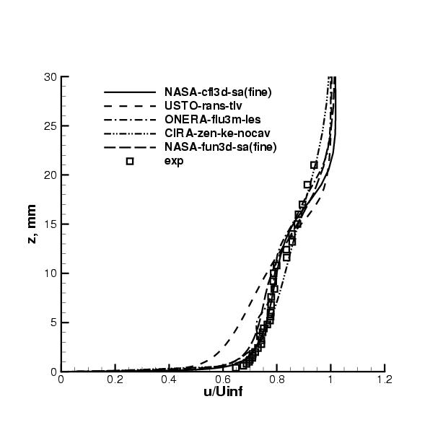
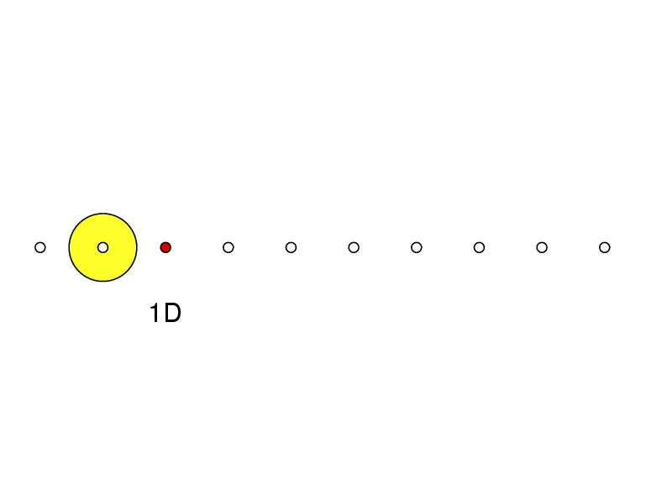
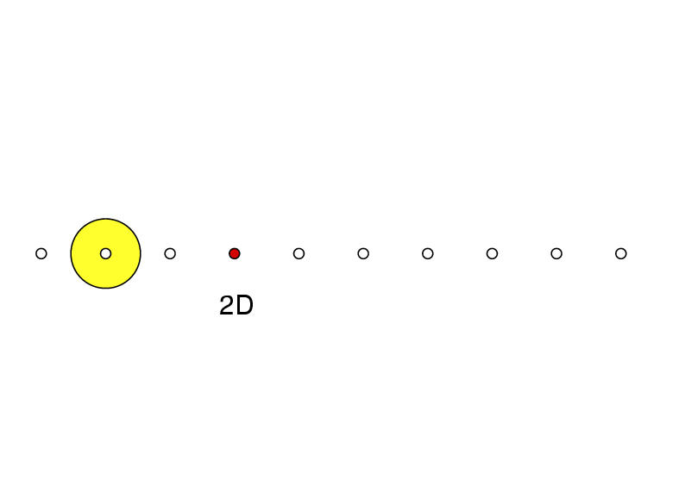
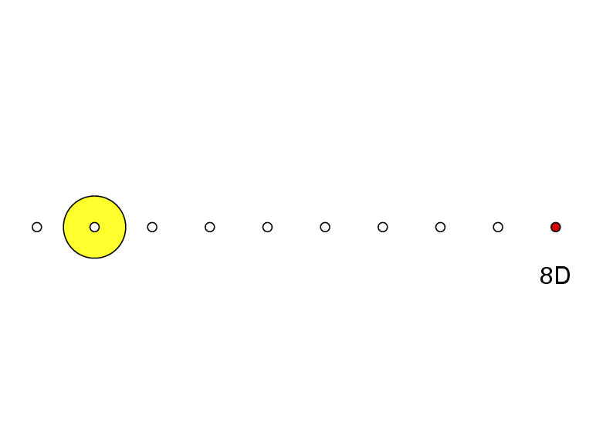
Average u-velocity on centerplane
1D downstream
2D downstream
8D downstream
Notes:
Long-time-average u-velocity results are shown here. CFD captures the general character in a global sense, although there are large variations between the individual results.

Slide 17
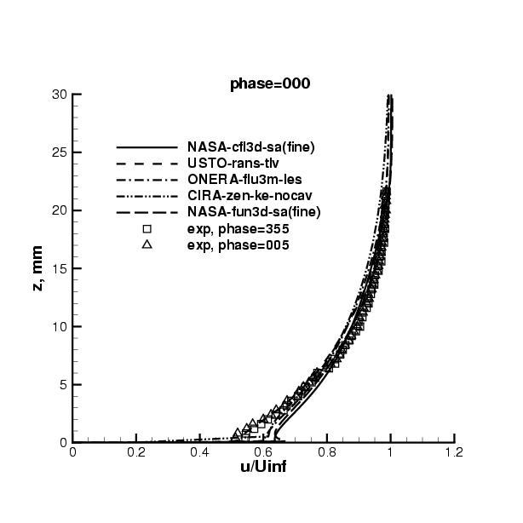
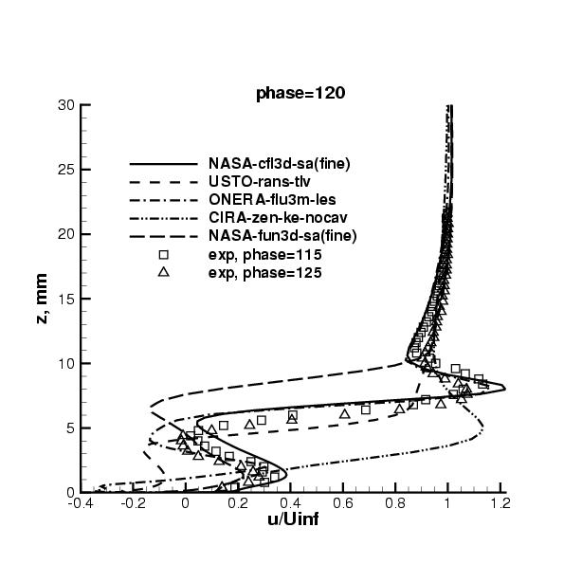
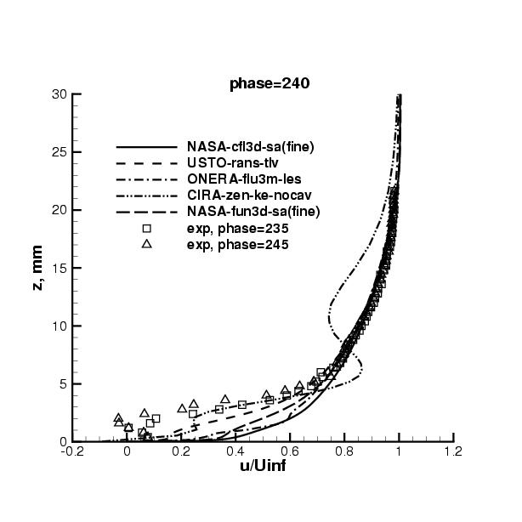
Phase-averaged u-velocity on centerplane 1D downstream
phase=0 deg
phase=120 deg
phase=240 deg
Notes:
At particular phases, CFD shows very wide variations. All 5 participants capture the general character of the flow, in the sense that the “event” when the ejected fluid passes over the location of interest causes a perturbation in the velocity field with a similar shape to experiment.

Slide 18
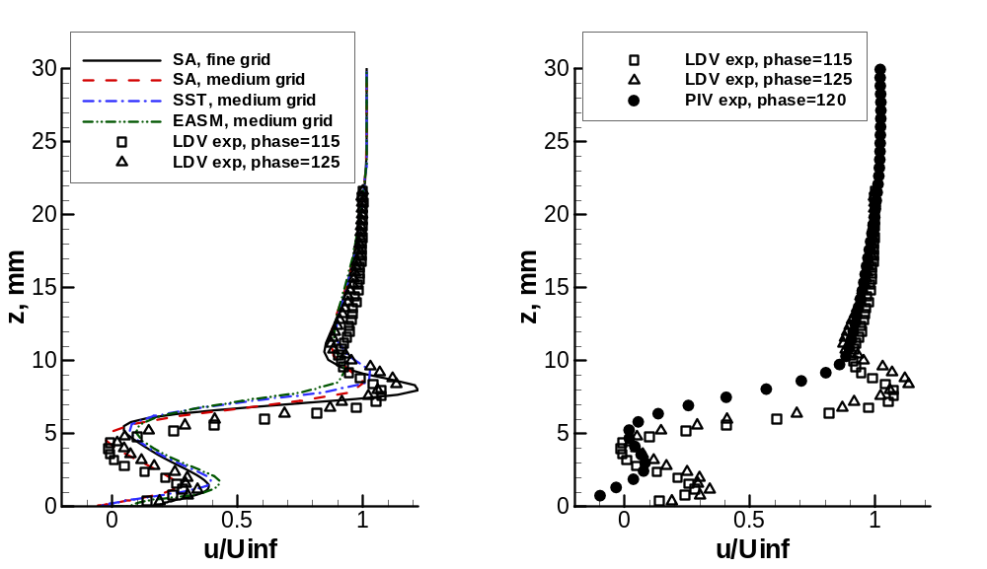
Phase-averaged u-velocity on centerplane 1D downstream
phase=120 deg
Notes:
This slide shows typical differences resulting from the use of different turbulence models, as well as medium vs. fine grids. Different turbulence models have some influence, but the difference is not very significant. The right hand plot shows typical differences seen using two different measurement techniques; the causes of this level of measurement discrepancy are unknown, and are an active area of experimental research for synthetic jet flows.

Slide 19
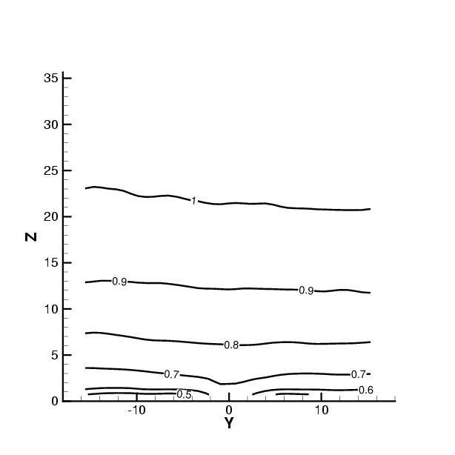
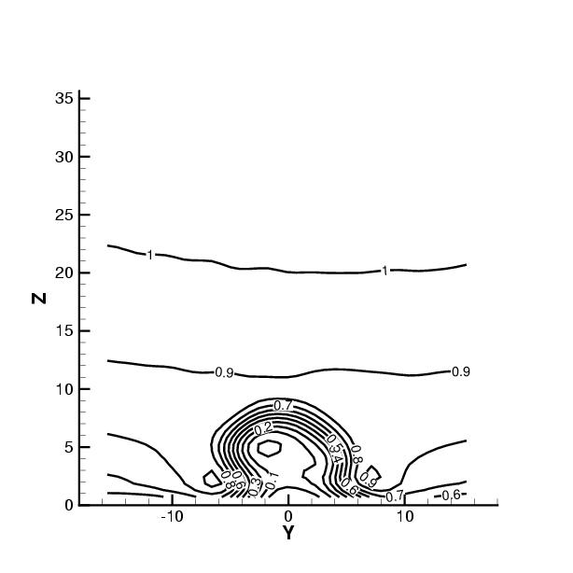
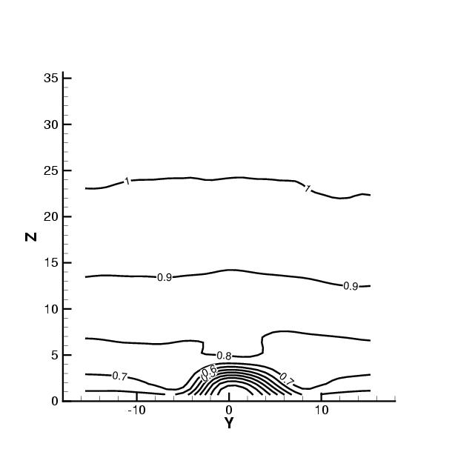
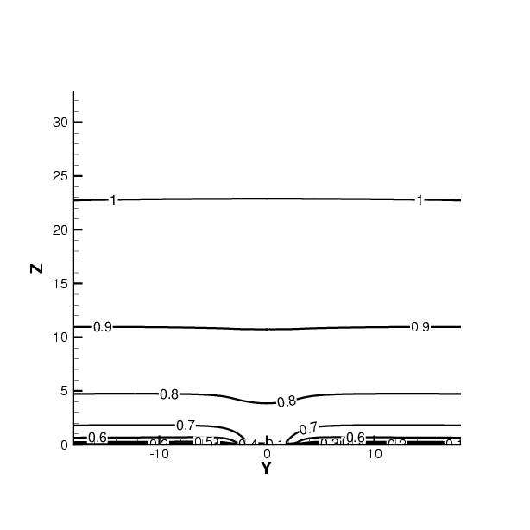
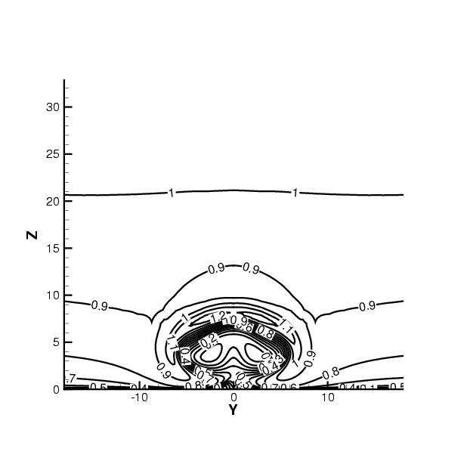
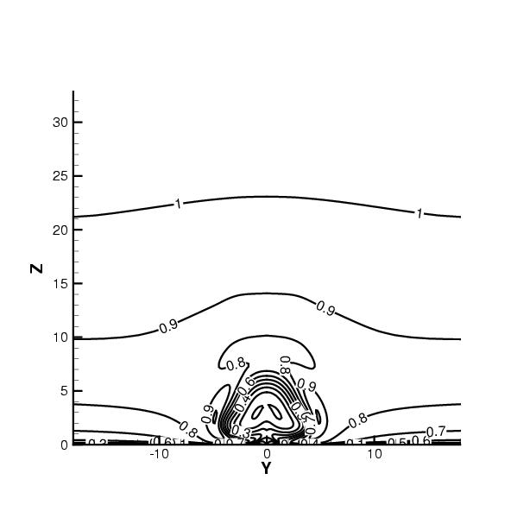
Example contours of phase-averaged u-velocity (1D downstream)
Exp:
Phase=0
Phase=120
Phase=200
NASA-cfl3d-sa(fine):
Notes:
Qualitatively, CFD did a reasonably good job capturing the general character of the time-dependent flowfield. Some phases agreed better than others.

Slide 20
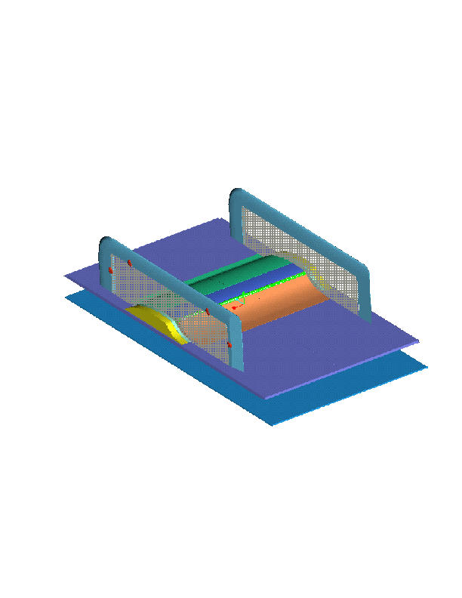
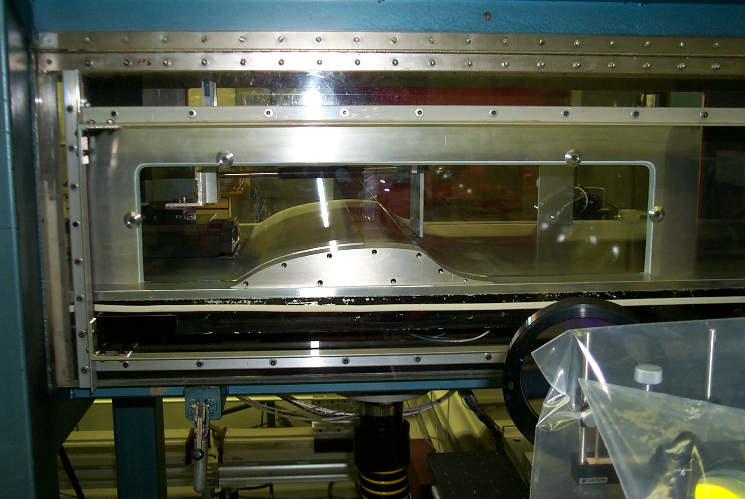
Case 3
Flow over a hump model
13 contributors
56 separate cases
Notes:
Case 3 overview slide

Slide 21
Case 3 Details
Flow over wall-mounted hump (chord = 420mm)
  Slot near 65%c (close to where separation occurs)
  Nominally 2-D flow – endplates at both sides
  M=0.1
Two mandatory test cases
  No flow control (no flow through slot)
  Steady suction (mdot = 0.01518 kg/s)
One optional test case
  Synthetic jet (138.5 Hz, peak velocity out of slot = 27m/s)
  Driven by bottom-mounted piston deep inside cavity
Notes:
Case 3 details

Slide 22
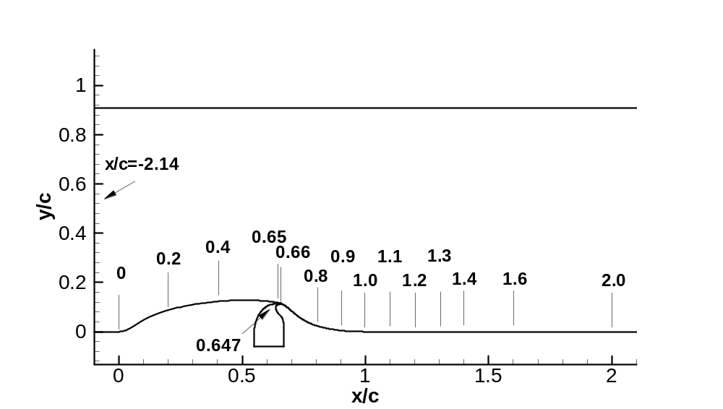
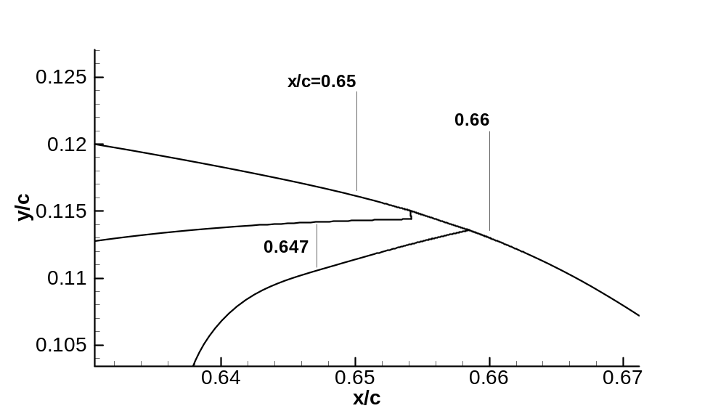
Sketch of case 3 comparison locations
Notes:
Diagram showing the hump, including upper tunnel wall and near-slot region.

Slide 23
Methodologies
Structured & unstructured RANS (various turbulence models: SA, SST, k-e, k-o, cubic k-e, EASM, v2f)
Mostly 2nd order in space (some 4th order)
A few blended RANS/LES (DES, LNS, FSM)
1 DNS (under-resolved near wall)
Mostly 2-D; some 3-D
Most modeled cavity, several did not
Many parametric variations performed; 2-D grids were generally very well-resolved
Notes:
Summary of CFD methods used by participants at CFDVAL workshop

Slide 24
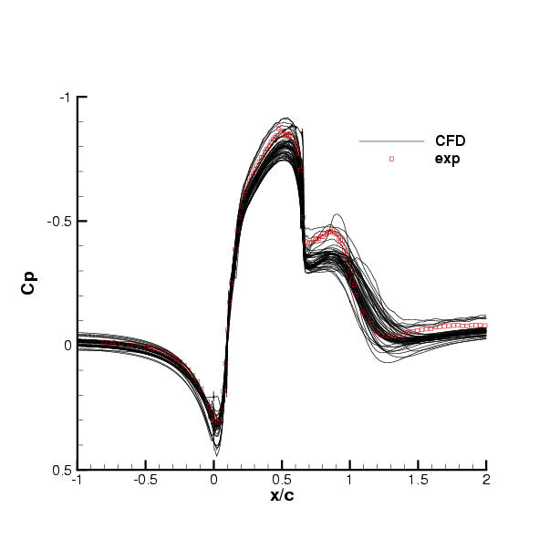
No-flow-control Cp’s
Notes:
No-flow-control case. Here we see ALL results on same plot. Shows CFD variation. Some of this variation is likely due to BC differences in back pressure used (which adjusts flow p gradient). Even so, most CFD tended to overpredict pressure over hump. The reason for this consistent overprediction is now believed to be due to blockage from the side plates, as shown in the next slide. (Note: uncertainty in measured CP was +-0.001.)

Slide 25
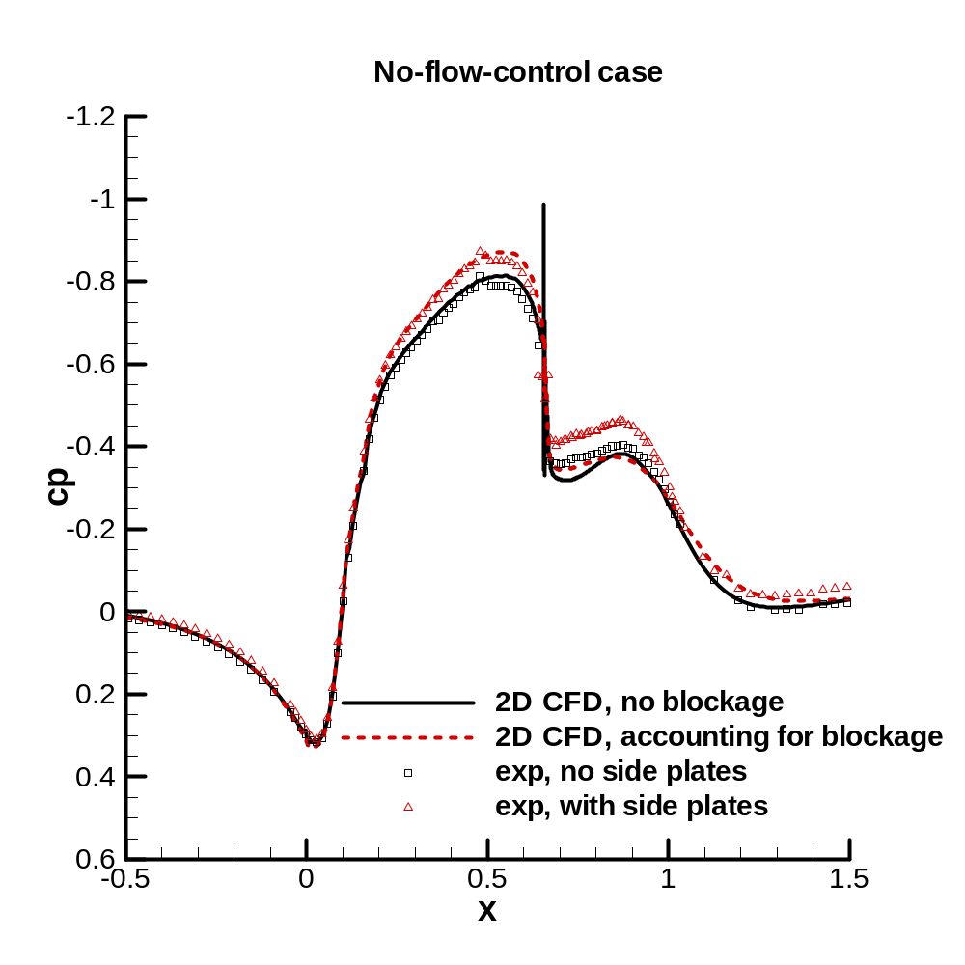
Blockage due to side plates
Notes:
It turns out that the side plates (used to improve/insure 2-D flow) caused noticeable blockage. One of the participants modeled the plates in a 3-D computation, and achieved good agreement with experiment. In a quick test (post-workshop), the no-flow-control case was also run with the plates removed; results verified that there is a noticeable influence. 2-D CFD can approximately emulate the blockage effect by constricting the upper wall shape near the hump to account for the decreased tunnel area.

Slide 26
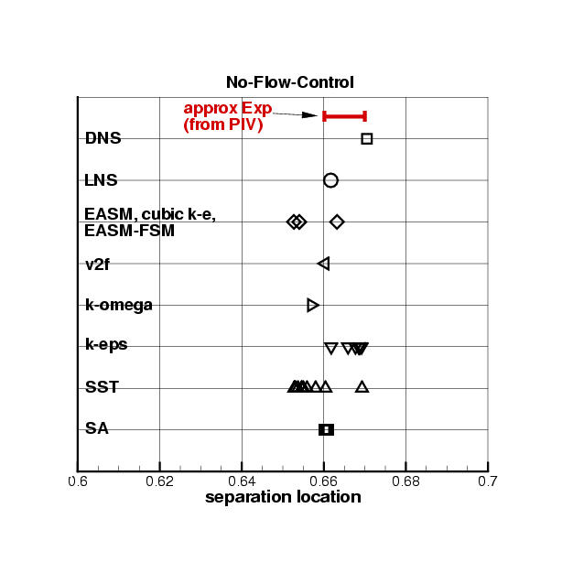
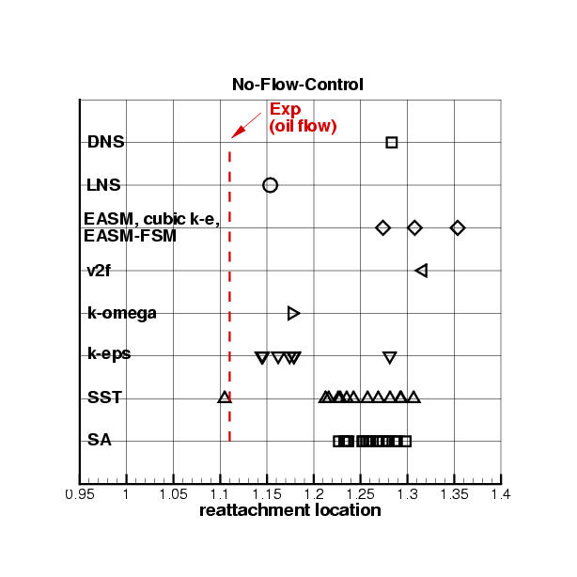
Separation and reattachment locations
no-flow-control case
Notes:
This case is not too challenging from point of view of predicting separation, but almost all methods predict reattachment too late. Except for a few exceptions, particular turbulence models tended to behave similarly. Even DNS did not get this right.

Slide 27
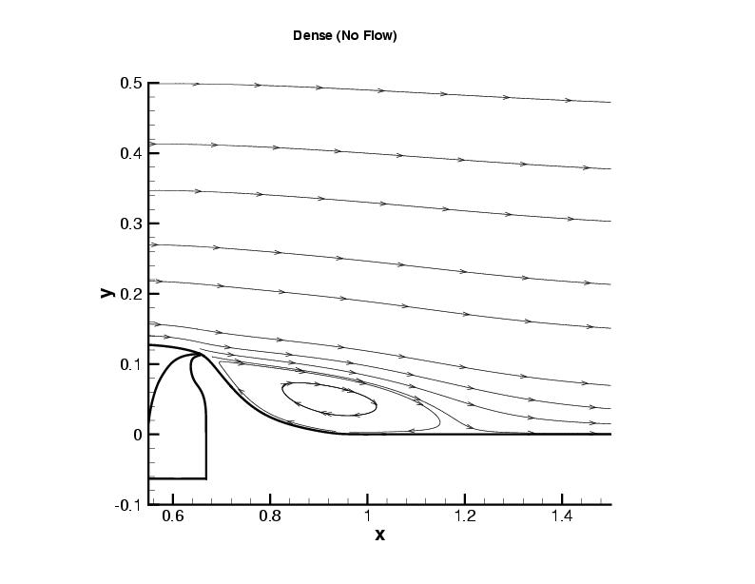
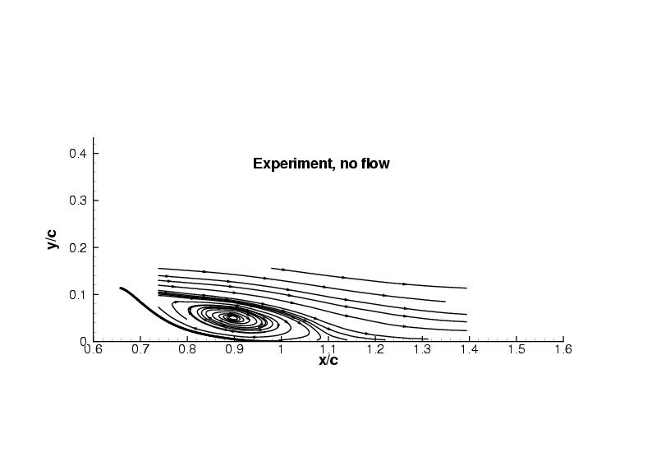
Example no-flow-control streamlines
Experiment
UK-ghost-sst-1
Notes:
Here are sample streamlines.

Slide 28
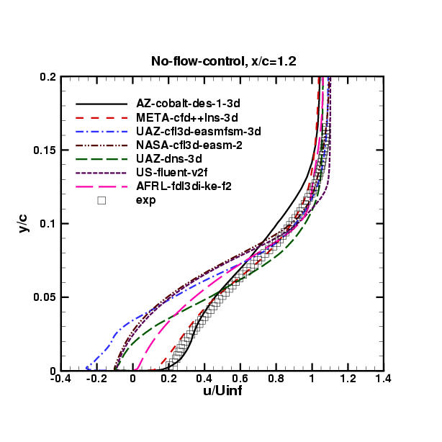
Sample u-velocity profiles at x/c=1.2
(downstream of experimental reattachment)
Notes:
Because it reattaches too late, most CFD profiles are off downstream. Here are samples. Note that for the no-flow case, however, 2 of the blended RANS-LES methods did a better job predicting flow recovery. But we’ll see later that for the suction case that these were bad again like everyone else. (Note: uncertainty in measured velocities was less than 3%.)

Slide 29
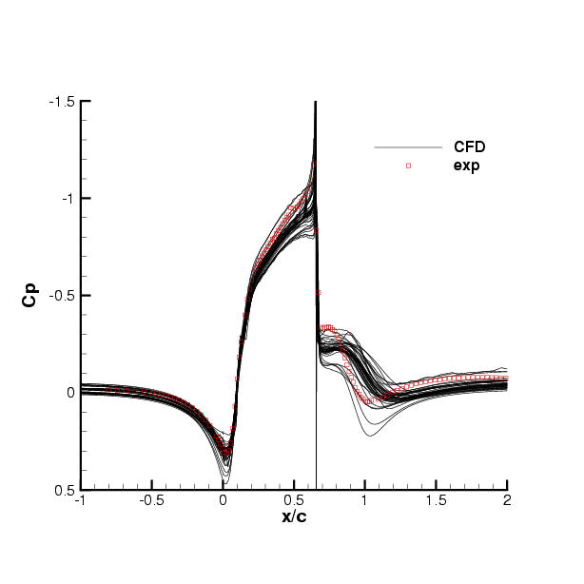
Suction Cp’s
Notes:
Suction case. CPs again high over front of hump (due to not accounting for side plate blockage). Not very good agreement in separated region. It should be noted that suction case was NOT full control, only partial (i.e., there is not enough suction to eliminate the separation bubble, only reduce it).

Slide 30
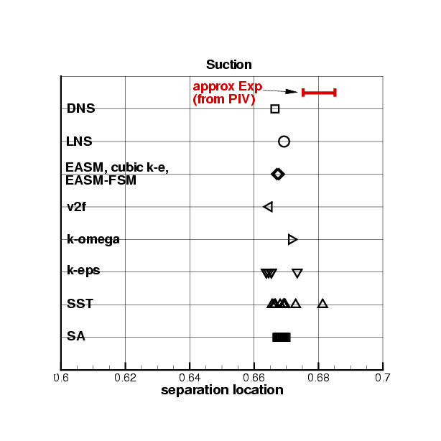
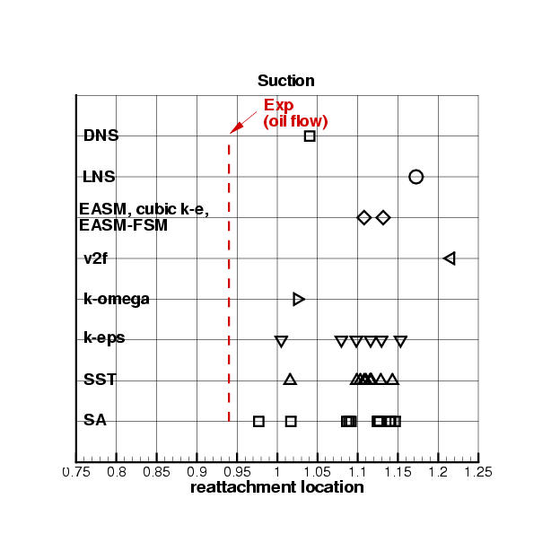
Separation and reattachment locations suction case
Notes:
Now, CFD tends to separate perhaps a little early, then like last case reattaches too late.

Slide 31
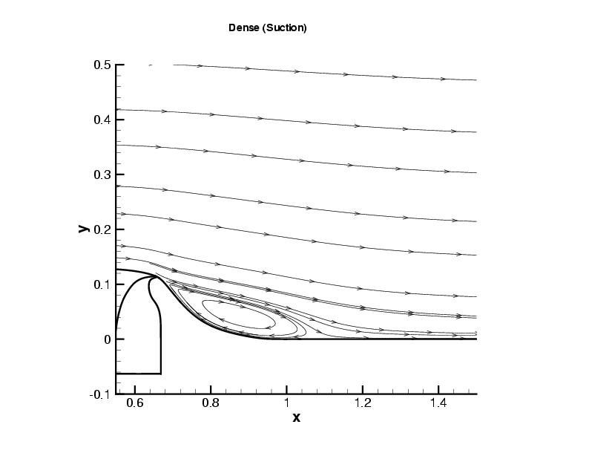
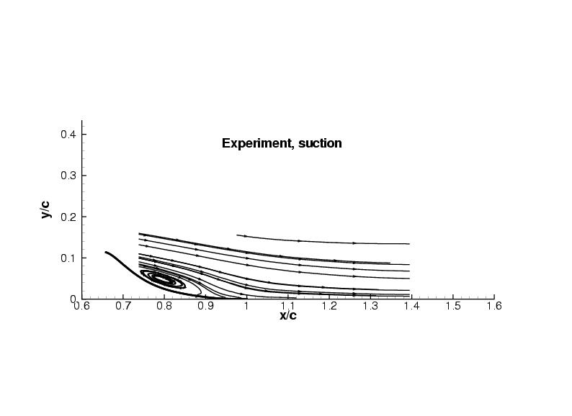
Example suction streamlines
Experiment
UK-ghost-sst-1
Notes:
Sample streamlines.

Slide 32
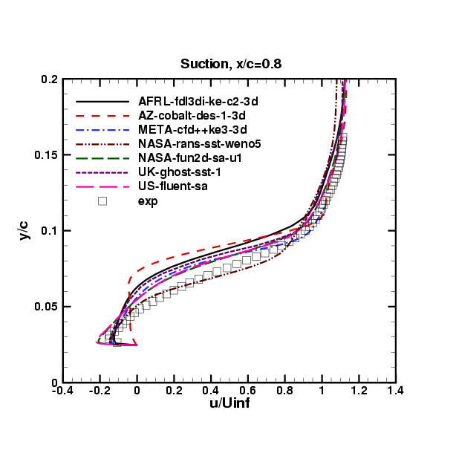
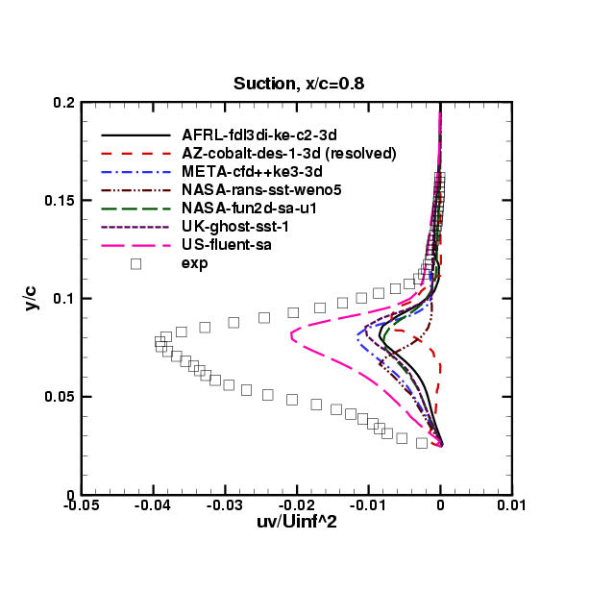
Velocity and turbulent shear stress at x/c=0.8
(inside separation bubble)
Notes:
For this case, we look first in the sep region. There is variation in velocity profiles, but qualitatively the RANS methods are not too bad compared with experiment. But in looking at u’v’ we see large underprediction of its magnitude. I.e., there’s not enough turbulence (mixing), needed to reattach the flow earlier. (Note: max uncertainty in measured u’v’ was approximately +-10%.)

Slide 33


Sample u-velocity profiles at x/c=1.0
(downstream of experimental reattachment)
Notes:
Then, downstream of exp reattachment, the CFD results are still separated / not recovered sufficiently. Note that here the blended RANS-LES methods are just as poor as the RANS results.

Slide 34

Mean oscillatory-case Cp’s
Notes:
Long-time-average CPs for the oscillatory case (all that was asked for from participants in CFDVAL2004). Blockage issue again – plus it appears that most results are probably again reattaching too late.

Slide 35
11th ERCOFTAC/IAHR Turbulence Modeling Workshop Results for Hump Model Case
April 2005
Notes:
The hump model case was one of the test cases for the subsequent workshop held in Sweden the following year.

Slide 36
Methodologies
RANS
  S-A
  k-epsilon
  hybrid k-epsilon+SSG
  RSM (elliptic blending model)
  RSM (SSG)
3-D DES
3-D LES (Smagorinsky)
(BLUE means new category of method, not used at CFDVAL2004)
Notes:
A list of the methodologies employed by participants in the Sweden workshop. At this workshop, a few participants also used RSM and LES.

Slide 37

Notes:
Unfortunately, the side plate blockage was only accounted for by one of the participants.

Slide 38

Noflow, C_{f}
Notes:
Skin friction shows very wide variation. Some of the results (e.g., LES) appear to be incorrect. There is more variation than one would expect in the region leading up to the hump.

Slide 39

Notes:
For no-flow-control case, velocity profiles in the separated region are consistent with each other, and agree well with experiment.

Slide 40

Notes:
Consistent with the CFDVAL workshop, u’v’ magnitude in the separated region is seriously underpredicted by RANS models (even full Reynolds stress models). But DES and LES do better.

Slide 41


Separation and reattachment locations
no-flow-control case
Notes:
Most turbulence models appear to be consistent with those run at the CFDVAL workshop. DES and LES here do a good job predicting reattachment location. (The RANS-type SSG model predicts reattachment well too, but its resulting profiles downstream look strange, as seen in the next slide.)

Slide 42

Sample u-velocity profiles at x/c=1.2
(downstream of experimental reattachment)
Notes:
DES and LES profiles look good downstream. Most RANS models indicate too much separation.

Slide 43

Notes:
For suction case, velocity profiles in the separated region are reasonably consistent with each other, and agree fairly well with experiment.

Slide 44

Notes:
Consistent with the CFDVAL workshop, u’v’ magnitude in the separated region is seriously underpredicted by RANS models (even full Reynolds stress models). DES is a little better but still too low. LES is quite good.

Slide 45


Separation and reattachment locations
suction case
Notes:
Only LES is able to predict the reattachment location for the suction case.

Slide 46

Sample u-velocity profiles at x/c=1.0
(downstream of experimental reattachment)
Notes:
Velocity profiles downstream show that only LES predicts reasonably good agreement with experiment.

Slide 47

Notes:
For this ERCOFTAC workshop, detailed experimental measurements for the oscillatory-control case were also available. Unfortunately, only one participant submitted results (RANS using Spalart-Allmaras). Phase-averaged CPs are shown here and on the following 3 slides. The convected locations of the shed vortices, as evidenced by the pressure oscillations, are well predicted, although the precise CP levels are somewhat off.

Slide 48

Notes:
Phase-averaged CPs, continued.

Slide 49

Notes:
Phase-averaged CPs, continued.

Slide 50

Notes:
Phase-averaged CPs, continued.

Slide 51

(long-time average)
Notes:
The long-time average CFD results do not agree well with experiment in the separated region downstream of the slot. The CFD is again predicting too long of an (average) separation bubble.

Slide 52

Notes:
Where does CFD start to go wrong? Here are u-velocity profiles just downstream of the slot. Agreement at various phases is excellent.

Slide 53

Notes:
Same location: v-velocities. Results are again excellent.

Slide 54

Notes:
Same location: u’v’. Computed peak results are reasonably close to experiment in magnitude (although somewhat low).

Slide 55

Notes:
Now we move slightly downstream. U-velocities again look good.

Slide 56

Notes:
Same location: v-velocities. Generally, results are fairly good, with phi=170 deg being furthest in error.

Slide 57

Notes:
Same location: u’v’. Now, these computed peak levels are way off! CFD is seriously underpredicting the u’v’ magnitude, even here near the very start of the separated region.

Slide 58

Notes:
Downstream, deeper into the separated region, the CFD continues to underpredict the magnitude of u’v’.

Slide 59

Hump reattachment point (CFL3D)
 | Exp. | CFD (fine) | CFD (med)
No-Flow | 1.11 | 1.24 | 1.23
Suction | 0.94 | 1.10 | 1.11
Osc. | 0.98 | 1.22 | n/a
Notes:
As expected, for the oscillatory case, the mean reattachment point is predicted too far downstream (similar to the no-flow-control and steady suction cases). The effect of grid density is also shown here for 2 of the cases.

Slide 60
Case 3 Summary
Overall, results from Sweden ERCOFTAC/IAHR workshop were consistent with results from CFDVAL2004 workshop:
  RANS models (including full RSM) generally overpredict separation length (underpredict magnitude of u’v’ in separated region)
  DES (blended LES-RANS) predicts correct separation length for no-flow-control, but overpredicts length for suction
  Differences in upstream and downstream BCs probably responsible for some of the variation among CFD results (e.g., Cf’s in front of hump)
  To get Cp’s, side-plate blockage generally must be accounted for
  Modeling the cavity itself does not appear to be crucial for steady cases
New LES results exhibited some odd behavior, but appear promising with regard to predicting separation correctly
For oscillatory case, RANS captures general unsteady character (vortex strength & convection) well, but again overpredicts separation length
Notes:
Summary of Case 3, from the Sweden ERCOFTAC workshop, relating its results to those from the CFDVAL workshop.

Slide 61
Conclusions
Notes:
Overall conclusions

Slide 62
Case 1 Conclusions
Wide CFD variation exhibited
Computing internal cavity problematic and did not appear to produce any significant benefit
Difficult experiment to simulate
  Case probably mostly laminar / transitional
  Piezo-electric driver and its effects (e.g., non-sinusoidal jet velocity at exit) difficult to model in CFD
  Ring vortices (3-D effect) formed from slot ends probably influence flowfield away from wall
Notes:
Case 1 conclusions

Slide 63
Case 2 Conclusions
Wide CFD variation exhibited
LES and URANS on similar-sized grids yielded similar results (in mean-flow quantities)
CFD missed some aspects of flow at cavity exit
  Experiment produced large cross-flow velocity component at orifice exit (not modeled by CFD)
  Need additional documentation of experimental orifice exit BCs
Different turbulence models had relatively small impact
Notes:
Case 2 conclusions

Slide 64
Case 3 Conclusions
CFD must account for blockage to match Cp’s
RANS CFD generally overpredicted separation length and underpredicted turbulent shear stress in separated region
  This is a turbulence modeling issue
    CAN RANS TURBULENCE MODELS BE FIXED?
  But even DNS, LES, and blended RANS-LES were not consistently better
    ONE GUESS: THIS MAY BE BECAUSE THESE METHODS ARE NOT EASY TO RUN CORRECTLY (grid resolution, spanwise extent, sufficient time, blending issues)
Notes:
Case 3 conclusions.

Slide 65
Next Steps / Future Directions
For synthetic jets, reduce CFD uncertainty by employing identical BCs.
For hump, turbulence models (for RANS) need to be improved to increase mixing in separated region to bring about earlier reattachment and recovery.
Possible further validation against hump model with oscillatory (synthetic jet) control at next (12th) ERCOFTAC turb. modeling workshop.
Note: the Hump case is now officially a part of the ERCOFTAC Database (Classic Collection). It is listed as Case C.83.
Notes:
Next steps. The ERCOFTAC database can be found at: http://cfd.me.umist.ac.uk/ercoftac/.

