Slide 1


医療とAI・ビッグデータ応用
MLP②
統合教育機構
須藤毅顕

Slide 2
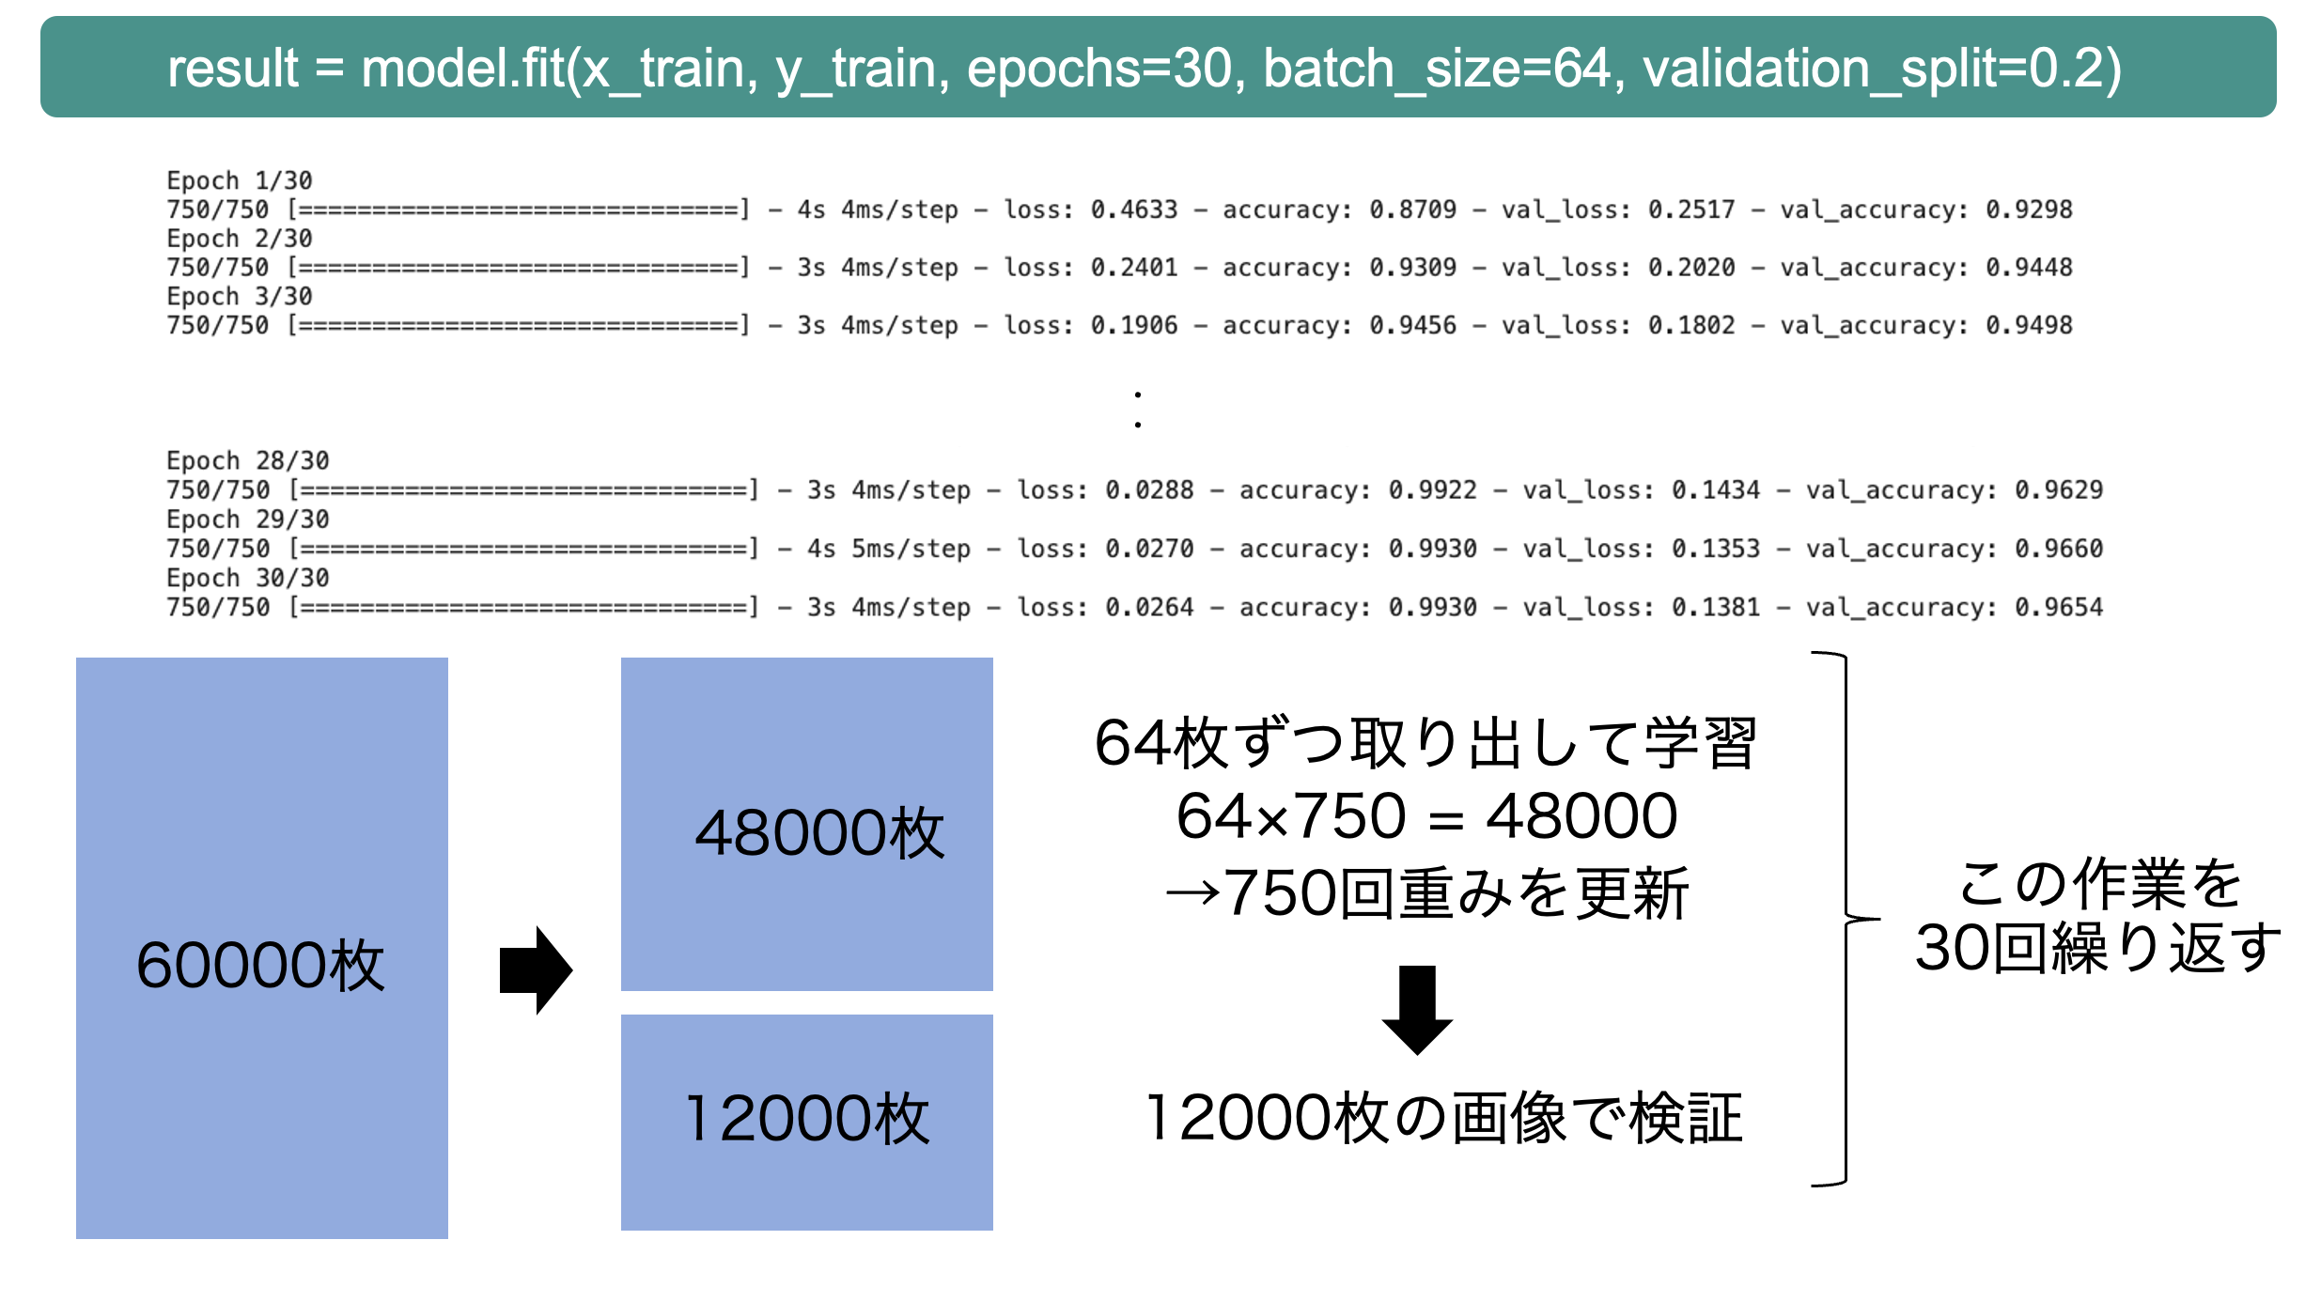
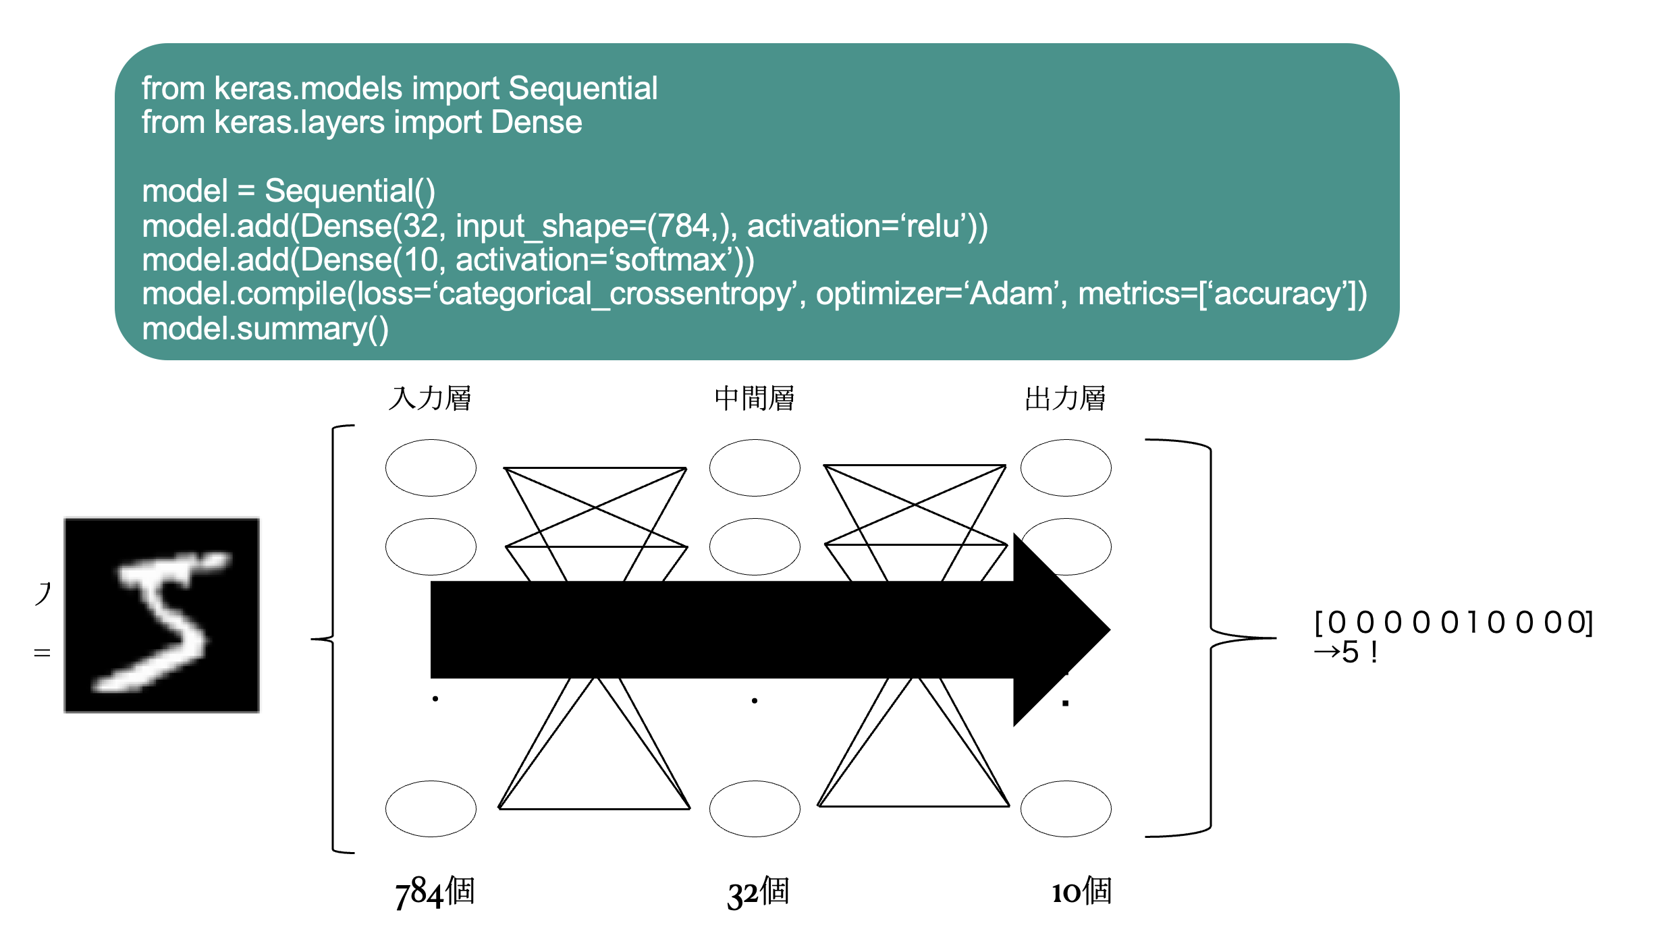
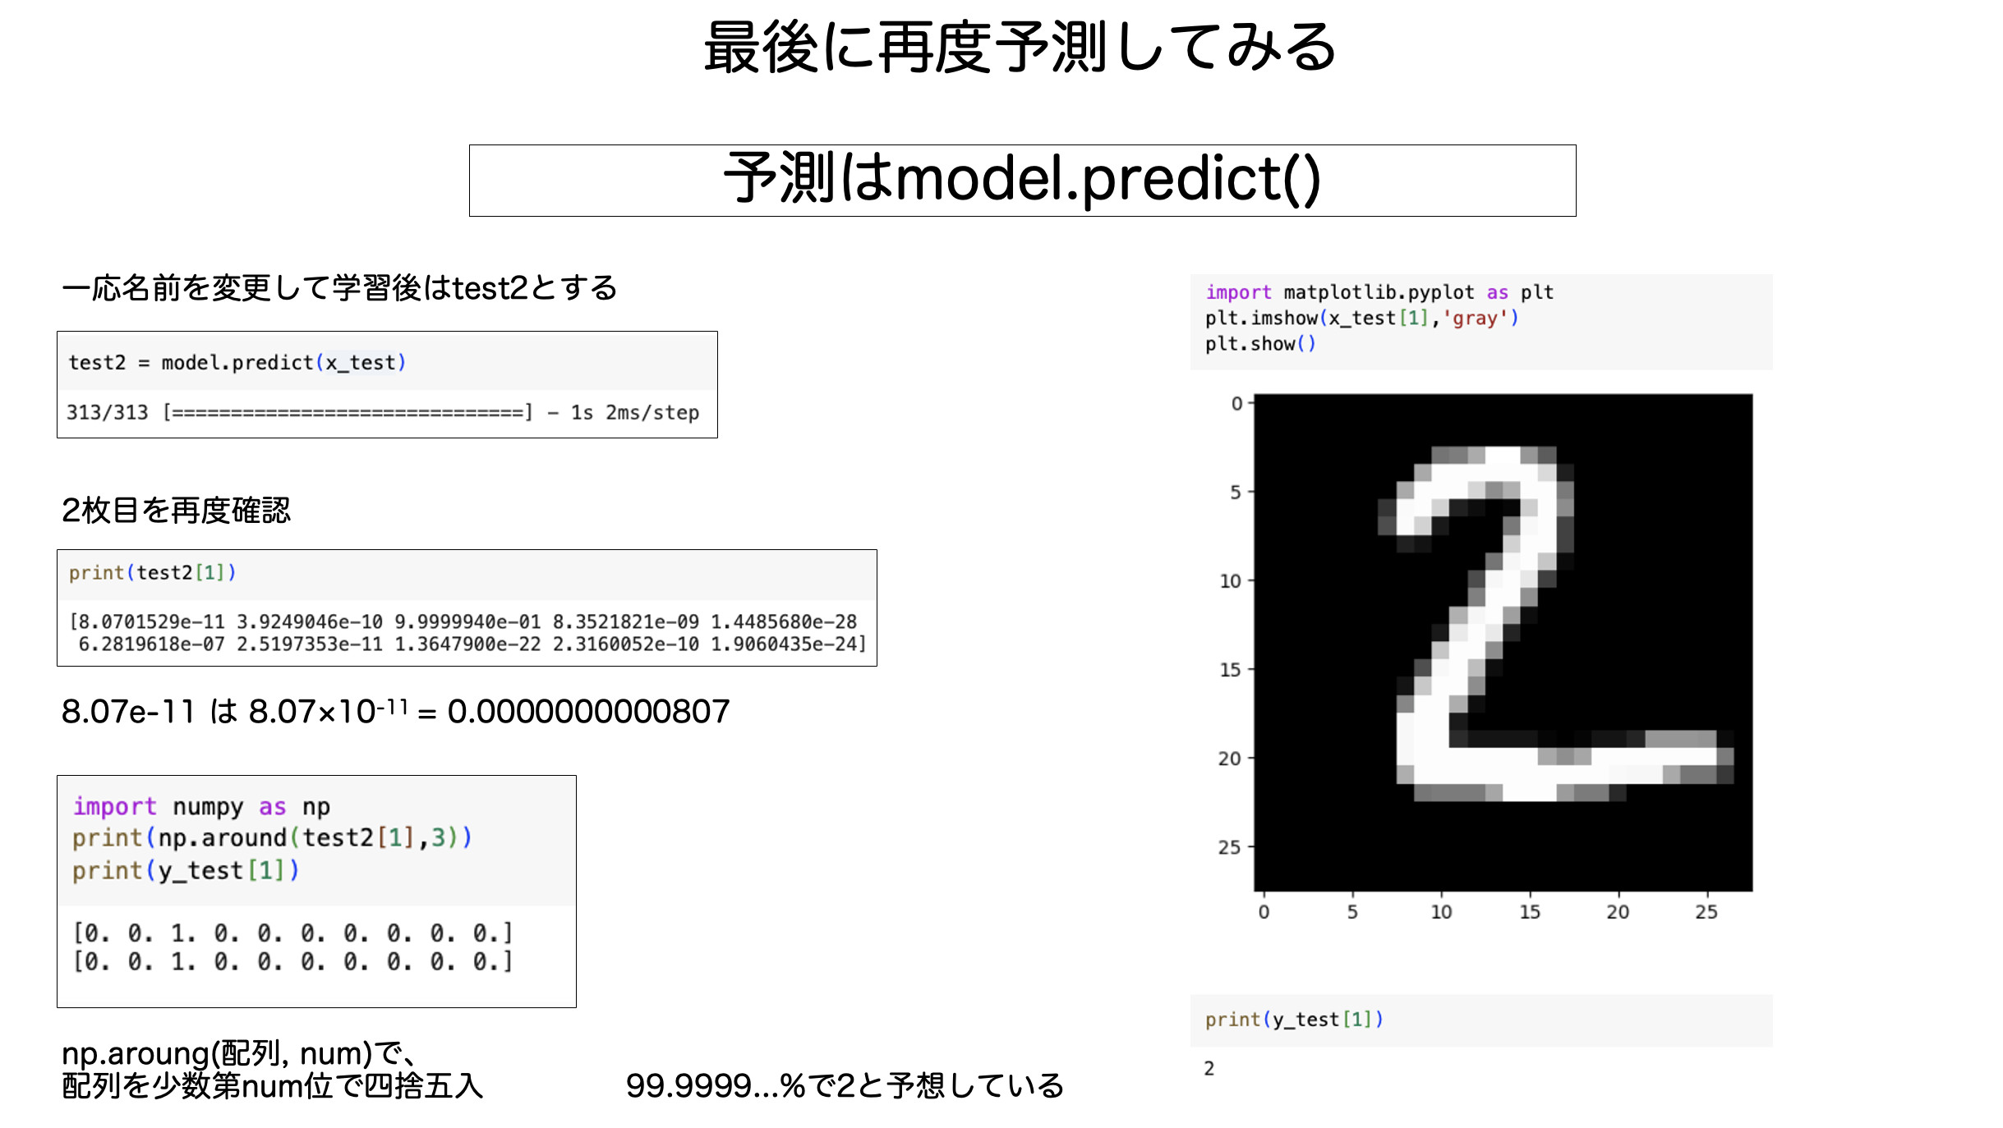
前回までの復習
学習
モデルの作成
予測
WebClassに「応用5_20231109_template.ipynb」
があるので開いて実行していきましょう
(GPUに変更してください)

Slide 3
epochs=50で実行し直しましょう
result = model.fit(x_train, y_train, epochs=50, batch_size=64, validation_split=0.2)
Epoch 1/50 750/750 [==============================] - 2s 2ms/step - loss: 0.6172 - accuracy: 0.7892 - val_loss: 0.4628 - val_accuracy: 0.8407
Epoch 2/50 750/750 [==============================] - 1s 2ms/step - loss: 0.4376 - accuracy: 0.8482 - val_loss: 0.4198 - val_accuracy: 0.8545
Epoch 3/50 750/750 [==============================] - 1s 2ms/step - loss: 0.4035 - accuracy: 0.8605 - val_loss: 0.4151 - val_accuracy: 0.8565
Epoch 4/50 750/750 [==============================] - 1s 2ms/step - loss: 0.3793 - accuracy: 0.8673 - val_loss: 0.3926 - val_accuracy: 0.8601
Epoch 5/50 750/750 [==============================] - 1s 2ms/step - loss: 0.3628 - accuracy: 0.8721 - val_loss: 0.3776 - val_accuracy: 0.8664
・
・
Epoch 47/50 750/750 [==============================] - 1s 2ms/step - loss: 0.1602 - accuracy: 0.9409 - val_loss: 0.4712 - val_accuracy: 0.8773
Epoch 48/50 750/750 [==============================] - 1s 2ms/step - loss: 0.1564 - accuracy: 0.9427 - val_loss: 0.4850 - val_accuracy: 0.8735
Epoch 49/50 750/750 [==============================] - 1s 2ms/step - loss: 0.1570 - accuracy: 0.9425 - val_loss: 0.4780 - val_accuracy: 0.8767
Epoch 50/50 750/750 [==============================] - 1s 2ms/step - loss: 0.1542 - accuracy: 0.9434 - val_loss: 0.5010 - val_accuracy: 0.8724
64枚ずつ取り出して学習
48000枚
64×750 = 48000
→750回重みを更新
この作業を
50回繰り返す
60000枚
12000枚
12000枚の画像で検証

Slide 4
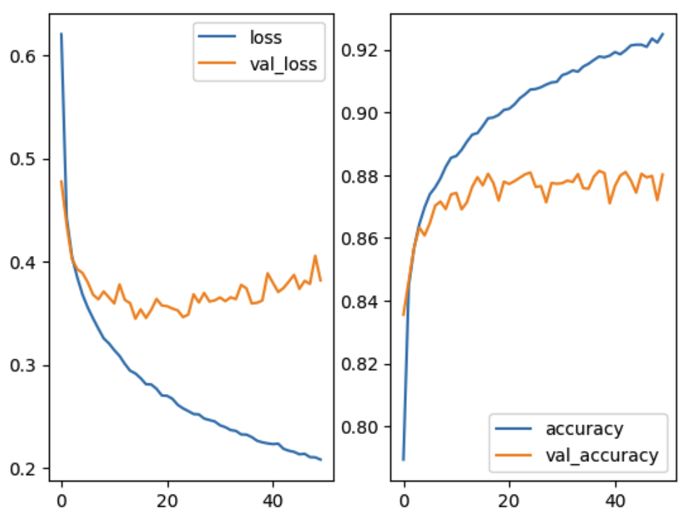
結果の作図
import matplotlib.pyplot as plt
plt.subplot(1,2,1)
plt.plot(result.history['loss'],label='loss')
plt.plot(result.history['val_loss'],label='val_loss')
plt.legend()
plt.subplot(1,2,2)
plt.plot(result.history['accuracy'],label='accuracy')
plt.plot(result.history['val_accuracy'],label='val_accuracy')
plt.legend()
plt.show()
縦1, 横2の1つ目
誤差(loss)の折れ線グラフ
縦1, 横2の2つ目
正解率(accuracy)の折れ線グラフ

Slide 5
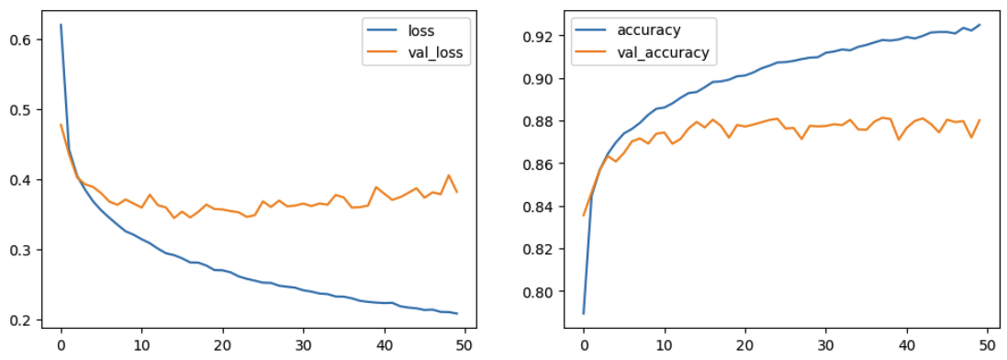
結果の作図
import matplotlib.pyplot as plt
plt.figure(figsize=(12,4))
plt.subplot(1,2,1)
plt.plot(result.history['loss'],label='loss')
plt.plot(result.history['val_loss'],label='val_loss')
plt.legend()
plt.subplot(1,2,2)
plt.plot(result.history['accuracy'],label='accuracy')
plt.plot(result.history['val_accuracy'],label='val_accuracy')
plt.legend()
plt.show()

Slide 6
result.historyの中身について
print(result.history)
{'loss': [0.6204796433448792, 0.4424095153808594, 0.4049777686595917, 0.38482892513275146, 0.3680422008037567, 0.3553660809993744, 0.34484514594078064, 0.3349671959877014, 0.32561713457107544, 0.3206530511379242, 0.3141988515853882, 0.30852627754211426, 0.3008130192756653, 0.29420095682144165, 0.29154443740844727, 0.28692877292633057, 0.28109729290008545, 0.28085023164749146, 0.27662160992622375, 0.2701963186264038, 0.26984351873397827, 0.26697129011154175, 0.26113253831863403, 0.25769904255867004, 0.2550542652606964, 0.2521992623806, 0.2518135905265808, 0.24781620502471924, 0.24636663496494293, 0.24498197436332703, 0.2412831038236618, 0.23945355415344238, 0.23669078946113586, 0.2358267456293106, 0.23242957890033722, 0.23221394419670105, 0.2298291176557541, 0.22631986439228058, 0.2247573286294937, 0.22372491657733917, 0.22302721440792084, 0.22342391312122345, 0.2184654176235199, 0.21663862466812134, 0.21550878882408142, 0.21314330399036407, 0.2136351317167282, 0.2104269564151764, 0.2101719230413437, 0.2080526500940323],
'accuracy': [0.789354145526886, 0.8447291851043701, 0.8566874861717224, 0.8643541932106018, 0.8697083592414856, 0.8739166855812073, 0.8761041760444641, 0.8789583444595337, 0.8826666474342346, 0.8855208158493042, 0.886104166507721, 0.8880624771118164, 0.8906458616256714, 0.8928750157356262, 0.8933958411216736, 0.8956249952316284, 0.898104190826416, 0.8983749747276306, 0.8991875052452087, 0.9007708430290222, 0.9011458158493042, 0.9025416374206543, 0.9044791460037231, 0.9057499766349792, 0.9072708487510681, 0.9074375033378601, 0.9079999923706055, 0.9088541865348816, 0.9095208048820496, 0.9097291827201843, 0.9118333458900452, 0.9124166369438171, 0.9133541584014893, 0.9129791855812073, 0.9146041870117188, 0.9154791831970215, 0.9166874885559082, 0.9177916646003723, 0.9175416827201843, 0.9180625081062317, 0.9192083477973938, 0.9185208082199097, 0.9197708368301392, 0.9213333129882812, 0.9215624928474426, 0.9215624928474426, 0.9208750128746033, 0.9235208630561829, 0.922249972820282, 0.9248958230018616],
'val_loss': [0.4776163697242737, 0.4357101321220398, 0.40258854627609253, 0.39271479845046997, 0.3889164924621582, 0.3798101842403412, 0.3678809702396393, 0.36349910497665405, 0.37104806303977966, 0.3652504086494446, 0.35947203636169434, 0.37782320380210876, 0.3629121482372284, 0.3596421778202057, 0.34462788701057434, 0.35367244482040405, 0.3453534245491028, 0.35335132479667664, 0.36383312940597534, 0.35738077759742737, 0.35678377747535706, 0.35446837544441223, 0.3527243733406067, 0.34618350863456726, 0.34865111112594604, 0.3683689832687378, 0.3603420555591583, 0.36953479051589966, 0.36129820346832275, 0.3623996675014496, 0.36520129442214966, 0.36162319779396057, 0.36536312103271484, 0.3636190593242645, 0.37748828530311584, 0.37399259209632874, 0.35947826504707336, 0.36005476117134094, 0.3623170256614685, 0.3886697292327881, 0.37945523858070374, 0.37049585580825806, 0.3743937611579895, 0.3805387318134308, 0.38715872168540955, 0.3735528290271759, 0.38132739067077637, 0.37841248512268066, 0.4056456685066223, 0.3818448781967163],
'val_accuracy': [0.8355000019073486, 0.8462499976158142, 0.8567500114440918, 0.8633333444595337, 0.8607500195503235, 0.8647500276565552, 0.8702499866485596, 0.8715833425521851, 0.8691666722297668, 0.8738333582878113, 0.8743333220481873, 0.8690833449363708, 0.8713333606719971, 0.8762500286102295, 0.8793333172798157, 0.8767499923706055, 0.8804166913032532, 0.8774999976158142, 0.871916651725769, 0.877916693687439, 0.8771666884422302, 0.878083348274231, 0.8791666626930237, 0.8802499771118164, 0.8808333277702332, 0.8762500286102295, 0.8765000104904175, 0.8713333606719971, 0.8774999976158142, 0.8772500157356262, 0.8774166703224182, 0.878250002861023, 0.8778333067893982, 0.8803333044052124, 0.8758333325386047, 0.8756666779518127, 0.8794999718666077, 0.8813333511352539, 0.8806666731834412, 0.8709999918937683, 0.8765833377838135, 0.8798333406448364, 0.8809999823570251, 0.878333330154419, 0.8744166493415833, 0.8804166913032532, 0.8792499899864197, 0.8797500133514404, 0.871999979019165, 0.8801666498184204]}

Slide 7
result.historyの中身について
print(result.history)
エポック50回分の誤差と正解率
{'loss': [0.6204796433448792, 0.4424095153808594, 0.4049777686595917, 0.38482892513275146, 0.3680422008037567, 0.3553660809993744, 0.34484514594078064, 0.3349671959877014, 0.32561713457107544, 0.3206530511379242, 0.3141988515853882, 0.30852627754211426, 0.3008130192756653, 0.29420095682144165, 0.29154443740844727, 0.28692877292633057, 0.28109729290008545, 0.28085023164749146, 0.27662160992622375, 0.2701963186264038, 0.26984351873397827, 0.26697129011154175, 0.26113253831863403, 0.25769904255867004, 0.2550542652606964, 0.2521992623806, 0.2518135905265808, 0.24781620502471924, 0.24636663496494293, 0.24498197436332703, 0.2412831038236618, 0.23945355415344238, 0.23669078946113586, 0.2358267456293106, 0.23242957890033722, 0.23221394419670105, 0.2298291176557541, 0.22631986439228058, 0.2247573286294937, 0.22372491657733917, 0.22302721440792084, 0.22342391312122345, 0.2184654176235199, 0.21663862466812134, 0.21550878882408142, 0.21314330399036407, 0.2136351317167282, 0.2104269564151764, 0.2101719230413437, 0.2080526500940323],
'accuracy': [0.789354145526886, 0.8447291851043701, 0.8566874861717224, 0.8643541932106018, 0.8697083592414856, 0.8739166855812073, 0.8761041760444641, 0.8789583444595337, 0.8826666474342346, 0.8855208158493042, 0.886104166507721, 0.8880624771118164, 0.8906458616256714, 0.8928750157356262, 0.8933958411216736, 0.8956249952316284, 0.898104190826416, 0.8983749747276306, 0.8991875052452087, 0.9007708430290222, 0.9011458158493042, 0.9025416374206543, 0.9044791460037231, 0.9057499766349792, 0.9072708487510681, 0.9074375033378601, 0.9079999923706055, 0.9088541865348816, 0.9095208048820496, 0.9097291827201843, 0.9118333458900452, 0.9124166369438171, 0.9133541584014893, 0.9129791855812073, 0.9146041870117188, 0.9154791831970215, 0.9166874885559082, 0.9177916646003723, 0.9175416827201843, 0.9180625081062317, 0.9192083477973938, 0.9185208082199097, 0.9197708368301392, 0.9213333129882812, 0.9215624928474426, 0.9215624928474426, 0.9208750128746033, 0.9235208630561829, 0.922249972820282, 0.9248958230018616],
'val_loss': [0.4776163697242737, 0.4357101321220398, 0.40258854627609253, 0.39271479845046997, 0.3889164924621582, 0.3798101842403412, 0.3678809702396393, 0.36349910497665405, 0.37104806303977966, 0.3652504086494446, 0.35947203636169434, 0.37782320380210876, 0.3629121482372284, 0.3596421778202057, 0.34462788701057434, 0.35367244482040405, 0.3453534245491028, 0.35335132479667664, 0.36383312940597534, 0.35738077759742737, 0.35678377747535706, 0.35446837544441223, 0.3527243733406067, 0.34618350863456726, 0.34865111112594604, 0.3683689832687378, 0.3603420555591583, 0.36953479051589966, 0.36129820346832275, 0.3623996675014496, 0.36520129442214966, 0.36162319779396057, 0.36536312103271484, 0.3636190593242645, 0.37748828530311584, 0.37399259209632874, 0.35947826504707336, 0.36005476117134094, 0.3623170256614685, 0.3886697292327881, 0.37945523858070374, 0.37049585580825806, 0.3743937611579895, 0.3805387318134308, 0.38715872168540955, 0.3735528290271759, 0.38132739067077637, 0.37841248512268066, 0.4056456685066223, 0.3818448781967163],
'val_accuracy': [0.8355000019073486, 0.8462499976158142, 0.8567500114440918, 0.8633333444595337, 0.8607500195503235, 0.8647500276565552, 0.8702499866485596, 0.8715833425521851, 0.8691666722297668, 0.8738333582878113, 0.8743333220481873, 0.8690833449363708, 0.8713333606719971, 0.8762500286102295, 0.8793333172798157, 0.8767499923706055, 0.8804166913032532, 0.8774999976158142, 0.871916651725769, 0.877916693687439, 0.8771666884422302, 0.878083348274231, 0.8791666626930237, 0.8802499771118164, 0.8808333277702332, 0.8762500286102295, 0.8765000104904175, 0.8713333606719971, 0.8774999976158142, 0.8772500157356262, 0.8774166703224182, 0.878250002861023, 0.8778333067893982, 0.8803333044052124, 0.8758333325386047, 0.8756666779518127, 0.8794999718666077, 0.8813333511352539, 0.8806666731834412, 0.8709999918937683, 0.8765833377838135, 0.8798333406448364, 0.8809999823570251, 0.878333330154419, 0.8744166493415833, 0.8804166913032532, 0.8792499899864197, 0.8797500133514404, 0.871999979019165, 0.8801666498184204]}
{‘loss’:[1回目の学習用データの損失,2回目の学習用データの損失,...,50回目の学習用データの損失],
‘accuracy’:[1回目の学習用データの正解率,2回目の学習用データの正解率,...,50回目の学習用データの正解率],
‘val_loss’:[1回目の検証用データの損失,2回目の検証用データの損失,...,50回目の検証用データの損失],
‘val_accuracy’:[1回目の検証用データの正解率,2回目の検証用データの正解率,...,50回目の検証用データの正解率]}

Slide 8
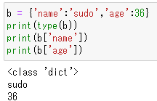
辞書型のデータの取得方法
print(result.history[‘loss’])
[0.6204796433448792, 0.4424095153808594, 0.4049777686595917, 0.38482892513275146, 0.3680422008037567, 0.3553660809993744, 0.34484514594078064, 0.3349671959877014, 0.32561713457107544, 0.3206530511379242, 0.3141988515853882, 0.30852627754211426, 0.3008130192756653, 0.29420095682144165, 0.29154443740844727, 0.28692877292633057, 0.28109729290008545, 0.28085023164749146, 0.27662160992622375, 0.2701963186264038, 0.26984351873397827, 0.26697129011154175, 0.26113253831863403, 0.25769904255867004, 0.2550542652606964, 0.2521992623806, 0.2518135905265808, 0.24781620502471924, 0.24636663496494293, 0.24498197436332703, 0.2412831038236618, 0.23945355415344238, 0.23669078946113586, 0.2358267456293106, 0.23242957890033722, 0.23221394419670105, 0.2298291176557541, 0.22631986439228058, 0.2247573286294937, 0.22372491657733917, 0.22302721440792084, 0.22342391312122345, 0.2184654176235199, 0.21663862466812134, 0.21550878882408142, 0.21314330399036407, 0.2136351317167282, 0.2104269564151764, 0.2101719230413437, 0.2080526500940323]
出力結果は各エポックの誤差がリストになっている
x = [要素,要素,...,要素]
x = {key:value,key:value,...,key:value}
a = [1,1,3,3,3]
これはリスト型
b = {‘name’:’sudo’,’age’:36}
これは辞書型
辞書型は変数名[key]で
valueを取り出せる!
result.history[‘loss’]で{‘loss’:[～～], ...}の[～～]を取り出している

Slide 9
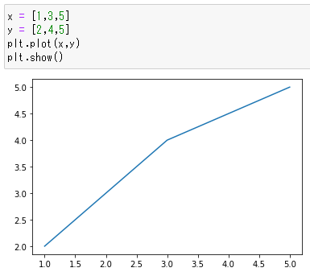
(x,y) = (1,2),(3,4),(5,5)の順に線で結ぶ

Slide 10
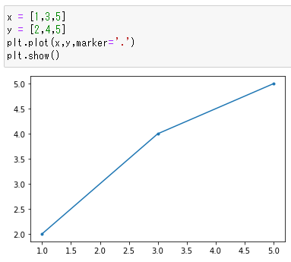
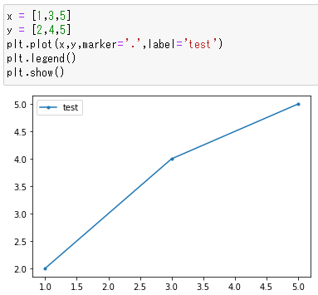
(x,y) = (1,2),(3,4),(5,5)の順に線で結ぶ
(x,y) = (1,2),(3,4),(5,5)の順に線で結んで点も打つ
引いた線に’test’という名前を付ける

Slide 11
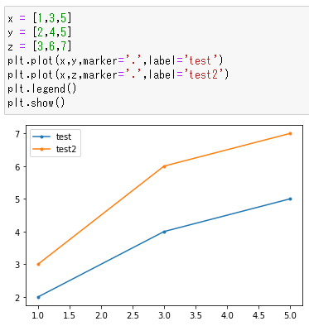
(x,y) = (1,2),(3,4),(5,5)の順に線で結ぶ
(x,y) = (1,2),(3,4),(5,5)の順に線で結んで点も打つ
引いた線に’test’という名前を付ける
（x,y)と(x,z)の線を
2本書く

Slide 12
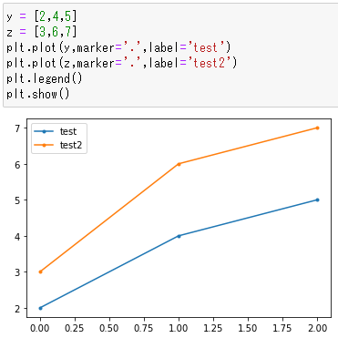
(x,y) = (1,2),(3,4),(5,5)の順に線で結ぶ
(x,y) = (1,2),(3,4),(5,5)の順に線で結んで点も打つ
引いた線に’test’という名前を付ける
x軸の変数が与えられない時はy軸の個数だけ順に0,1,2,3,..と与えられる。
（x,y)と(x,z)の線を
2本書く

Slide 13
plt.plot(result.history['loss'],label='loss')
plt.plot(result.history['val_loss'],label='val_loss')
'loss': [0.6204796433448792, 0.4424095153808594, 0.4049777686595917, 0.38482892513275146, 0.3680422008037567, 0.3553660809993744, 0.34484514594078064, 0.3349671959877014, 0.32561713457107544, 0.3206530511379242, 0.3141988515853882, 0.30852627754211426, 0.3008130192756653, 0.29420095682144165, 0.29154443740844727, 0.28692877292633057, 0.28109729290008545, 0.28085023164749146, 0.27662160992622375, 0.2701963186264038, 0.26984351873397827, 0.26697129011154175, 0.26113253831863403, 0.25769904255867004, 0.2550542652606964, 0.2521992623806, 0.2518135905265808, 0.24781620502471924, 0.24636663496494293, 0.24498197436332703, 0.2412831038236618, 0.23945355415344238, 0.23669078946113586, 0.2358267456293106, 0.23242957890033722, 0.23221394419670105, 0.2298291176557541, 0.22631986439228058, 0.2247573286294937, 0.22372491657733917, 0.22302721440792084, 0.22342391312122345, 0.2184654176235199, 0.21663862466812134, 0.21550878882408142, 0.21314330399036407, 0.2136351317167282, 0.2104269564151764, 0.2101719230413437, 0.2080526500940323],
'val_loss': [0.4776163697242737, 0.4357101321220398, 0.40258854627609253, 0.39271479845046997, 0.3889164924621582, 0.3798101842403412, 0.3678809702396393, 0.36349910497665405, 0.37104806303977966, 0.3652504086494446, 0.35947203636169434, 0.37782320380210876, 0.3629121482372284, 0.3596421778202057, 0.34462788701057434, 0.35367244482040405, 0.3453534245491028, 0.35335132479667664, 0.36383312940597534, 0.35738077759742737, 0.35678377747535706, 0.35446837544441223, 0.3527243733406067, 0.34618350863456726, 0.34865111112594604, 0.3683689832687378, 0.3603420555591583, 0.36953479051589966, 0.36129820346832275, 0.3623996675014496, 0.36520129442214966, 0.36162319779396057, 0.36536312103271484, 0.3636190593242645, 0.37748828530311584, 0.37399259209632874, 0.35947826504707336, 0.36005476117134094, 0.3623170256614685, 0.3886697292327881, 0.37945523858070374, 0.37049585580825806, 0.3743937611579895, 0.3805387318134308, 0.38715872168540955, 0.3735528290271759, 0.38132739067077637, 0.37841248512268066, 0.4056456685066223, 0.3818448781967163],
どちらも要素の数が50個のリスト
xは[0,1,2,...,49]が省略されている

Slide 14
score = model.evaluate(x_test, y_test)
print('Test loss:', score[0])
print('Test accuracy:', score[1])
model.evaluate()で評価
出来上がったモデルを別で用意している10000枚の画像で評価する
score = model.evaluate(特徴量,正解)
で、scoreにはmodelを用いた予測結果の
損失と正解率が代入される
score[0]で損失、score[1]で正解率が
得られる。
Test loss: 0.40565115213394165
Test accuracy: 0.8694000244140625
a = 5
print(a) 出力 5
print(‘aは’） 出力 aは
print(‘aは’,a) 出力 aは5

Slide 15
今回のモデルで学習した結果
Test loss: 0.40565115213394165
Test accuracy: 0.8694000244140625
もっと精度をあげたい

Slide 16
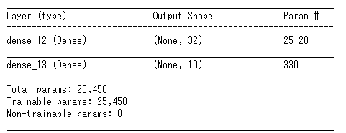
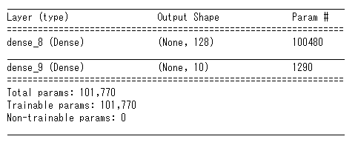
ニューロンの数を増やす
model = Sequential()
model.add(Dense(32,input_shape=(784,),activation='relu'))
model.add(Dense(10,activation='softmax'))
model.compile(loss='categorical_crossentropy’,
optimizer='Adam',metrics=['accuracy'])
model.summary()
model = Sequential()
model.add(Dense(128,input_shape=(784,),activation='relu'))
model.add(Dense(10,activation='softmax'))
model.compile(loss='categorical_crossentropy’,
optimizer='Adam',metrics=['accuracy'])
model.summary()

Slide 17
結果の分析
48000枚
60000枚
①trainを64枚ずつランダムに取り出して、学習、更新(750回/epoch)
val
train
train
x_train
12000枚
②1epoch終了後、trainとval両方でlossとaccuracyを算出(50epoch)
train
val
val
10000枚
③最後にtestで最終評価
(lossとaccuracy)
Test loss: 0.40565115213394165
Test accuracy: 0.8694000244140625
x_test

Slide 18
result.historyの中身について
print(result.history)
{'loss': [0.6204796433448792, 0.4424095153808594, 0.4049777686595917, 0.38482892513275146, 0.3680422008037567, 0.3553660809993744, 0.34484514594078064, 0.3349671959877014, 0.32561713457107544, 0.3206530511379242, 0.3141988515853882, 0.30852627754211426, 0.3008130192756653, 0.29420095682144165, 0.29154443740844727, 0.28692877292633057, 0.28109729290008545, 0.28085023164749146, 0.27662160992622375, 0.2701963186264038, 0.26984351873397827, 0.26697129011154175, 0.26113253831863403, 0.25769904255867004, 0.2550542652606964, 0.2521992623806, 0.2518135905265808, 0.24781620502471924, 0.24636663496494293, 0.24498197436332703, 0.2412831038236618, 0.23945355415344238, 0.23669078946113586, 0.2358267456293106, 0.23242957890033722, 0.23221394419670105, 0.2298291176557541, 0.22631986439228058, 0.2247573286294937, 0.22372491657733917, 0.22302721440792084, 0.22342391312122345, 0.2184654176235199, 0.21663862466812134, 0.21550878882408142, 0.21314330399036407, 0.2136351317167282, 0.2104269564151764, 0.2101719230413437, 0.2080526500940323],
'accuracy': [0.789354145526886, 0.8447291851043701, 0.8566874861717224, 0.8643541932106018, 0.8697083592414856, 0.8739166855812073, 0.8761041760444641, 0.8789583444595337, 0.8826666474342346, 0.8855208158493042, 0.886104166507721, 0.8880624771118164, 0.8906458616256714, 0.8928750157356262, 0.8933958411216736, 0.8956249952316284, 0.898104190826416, 0.8983749747276306, 0.8991875052452087, 0.9007708430290222, 0.9011458158493042, 0.9025416374206543, 0.9044791460037231, 0.9057499766349792, 0.9072708487510681, 0.9074375033378601, 0.9079999923706055, 0.9088541865348816, 0.9095208048820496, 0.9097291827201843, 0.9118333458900452, 0.9124166369438171, 0.9133541584014893, 0.9129791855812073, 0.9146041870117188, 0.9154791831970215, 0.9166874885559082, 0.9177916646003723, 0.9175416827201843, 0.9180625081062317, 0.9192083477973938, 0.9185208082199097, 0.9197708368301392, 0.9213333129882812, 0.9215624928474426, 0.9215624928474426, 0.9208750128746033, 0.9235208630561829, 0.922249972820282, 0.9248958230018616],
'val_loss': [0.4776163697242737, 0.4357101321220398, 0.40258854627609253, 0.39271479845046997, 0.3889164924621582, 0.3798101842403412, 0.3678809702396393, 0.36349910497665405, 0.37104806303977966, 0.3652504086494446, 0.35947203636169434, 0.37782320380210876, 0.3629121482372284, 0.3596421778202057, 0.34462788701057434, 0.35367244482040405, 0.3453534245491028, 0.35335132479667664, 0.36383312940597534, 0.35738077759742737, 0.35678377747535706, 0.35446837544441223, 0.3527243733406067, 0.34618350863456726, 0.34865111112594604, 0.3683689832687378, 0.3603420555591583, 0.36953479051589966, 0.36129820346832275, 0.3623996675014496, 0.36520129442214966, 0.36162319779396057, 0.36536312103271484, 0.3636190593242645, 0.37748828530311584, 0.37399259209632874, 0.35947826504707336, 0.36005476117134094, 0.3623170256614685, 0.3886697292327881, 0.37945523858070374, 0.37049585580825806, 0.3743937611579895, 0.3805387318134308, 0.38715872168540955, 0.3735528290271759, 0.38132739067077637, 0.37841248512268066, 0.4056456685066223, 0.3818448781967163],
'val_accuracy': [0.8355000019073486, 0.8462499976158142, 0.8567500114440918, 0.8633333444595337, 0.8607500195503235, 0.8647500276565552, 0.8702499866485596, 0.8715833425521851, 0.8691666722297668, 0.8738333582878113, 0.8743333220481873, 0.8690833449363708, 0.8713333606719971, 0.8762500286102295, 0.8793333172798157, 0.8767499923706055, 0.8804166913032532, 0.8774999976158142, 0.871916651725769, 0.877916693687439, 0.8771666884422302, 0.878083348274231, 0.8791666626930237, 0.8802499771118164, 0.8808333277702332, 0.8762500286102295, 0.8765000104904175, 0.8713333606719971, 0.8774999976158142, 0.8772500157356262, 0.8774166703224182, 0.878250002861023, 0.8778333067893982, 0.8803333044052124, 0.8758333325386047, 0.8756666779518127, 0.8794999718666077, 0.8813333511352539, 0.8806666731834412, 0.8709999918937683, 0.8765833377838135, 0.8798333406448364, 0.8809999823570251, 0.878333330154419, 0.8744166493415833, 0.8804166913032532, 0.8792499899864197, 0.8797500133514404, 0.871999979019165, 0.8801666498184204]}
'loss': 0.2080526500940323,
'accuracy': 0.9248958230018616,
'val_loss': 0.3818448781967163,
'val_accuracy': 0.8801666498184204

Slide 19
結果の分析
48000枚
60000枚
①trainを64枚ずつランダムに取り出して、学習、更新(750回/epoch)
val
train
'loss': 0.21
'accuracy': 0.92
train
x_train
12000枚
②1epoch終了後、trainとval両方でlossとaccuracyを算出(50epoch)
train
val
'val_loss': 0.38
'val_accuracy': 0.88
val
10000枚
Test loss: 0.41
Test accuracy: 0.87
③最後にtestで最終評価
(lossとaccuracy)
Test loss: 0.40565115213394165
Test accuracy: 0.8694000244140625
x_test

Slide 20
trainはlossも小さくaccuracyも高いのに、valは精度が悪い (testも悪い)
train_accuracy: 0.92
val_accuracy: 0.88
Test loss: 0.41
Test accuracy: 0.87
val_loss: 0.38
train_loss: 0.21
→ trainはうまく学習出来ているのに、valは出来ていない
→ trainのデータに合わせて学習し過ぎ
この状態を過学習と言う

Slide 21
学習のイメージ
学習はデータから当てはまりの良い関数(係数)を導く作業です
y
(正解)
x(入力データ)
一番シンプルな線形回帰 f₁(x) を想定します(xが増えるとyが一定の割合で増える)
y = f₁(x) = a₁ x + a₂ となり、このa₁とa₂を探します
深層学習のwがa₁、bがa₂に相当します

Slide 22
学習のイメージ
学習はデータから当てはまりの良い関数(係数)を導く作業です
y_{p}
y
(正解)
x_{p}
x(入力データ)
a1とa2が求まると、図のような直線が求まるので、
例えば x_{p}の時の予測結果y_{p}は、
y_{p} = f(x_{p}) = a₁ x_{p} + a₂ で予測することが出来ます

Slide 23
学習のイメージ
学習はデータから当てはまりの良い関数(係数)を導く作業です
y
(正解)
y
(正解)
x(入力データ)
x(入力データ)
y = a₁x + a₂では(どんなa₁、a₂を与えても)直線にしかならない
曲線や3次元空間、4次元以上で表現出来るデータも適切な関数を設定すれば学習出来る

Slide 24
過学習のイメージ
y
(正解)
x(入力データ)
仮に深層学習のデータをまとめて2次元で表したとする
(本当は高次元で作図が難しい)
学習用データ
検証用データ
テスト用データ

Slide 25
過学習のイメージ
trainはlossも小さくaccuracyも高いのに、valは精度が悪い (testも悪い)
y
(正解)
x(入力データ)
過学習はtrainのデータに合わせて学習し過ぎてしまった状態
この図だとtrainでは精度100%近いが、valやtestでは精度が落ちる
学習用データ
検証用データ
テスト用データ

Slide 26
完全に適合しているイメージ
実際はこのようにはなりません

Slide 27
過学習のイメージ
未知のデータでも精度が高くなるようなパラメータを探す作業
モデルの改変や学習用データに偏りがないかなど

Slide 28
ニューロンの数を増やす
model = Sequential()
model.add(Dense(32,input_shape=(784,),activation='relu'))
model.add(Dense(10,activation='softmax'))
model.compile(loss='categorical_crossentropy’,
optimizer='Adam',metrics=['accuracy'])
model.summary()
model = Sequential()
model.add(Dense(128,input_shape=(784,),activation='relu'))
model.add(Dense(10,activation='softmax'))
model.compile(loss='categorical_crossentropy’,
optimizer='Adam',metrics=['accuracy'])
model.summary()

Slide 29
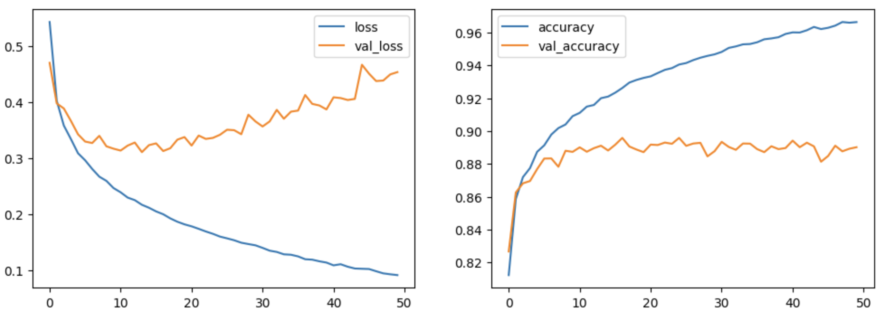
ニューロンの数を増やす
model = Sequential()
model.add(Dense(32,input_shape=(784,),activation='relu'))
model.add(Dense(10,activation='softmax'))
model.compile(loss='categorical_crossentropy’,
optimizer='Adam',metrics=['accuracy'])
model.summary()
model = Sequential()
model.add(Dense(128,input_shape=(784,),activation='relu'))
model.add(Dense(10,activation='softmax'))
model.compile(loss='categorical_crossentropy’,
optimizer='Adam',metrics=['accuracy'])
model.summary()
Test loss: 0.40565115213394165
Test accuracy: 0.8694000244140625
Test loss: 0.4939178228378296
Test accuracy: 0.885200023651123

Slide 30
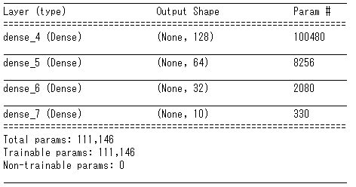
層を追加してみよう
model = Sequential()
model.add(Dense(128,input_shape=(784,),activation='relu’))
model.add(Dense(64,activation='relu’))
model.add(Dense(32,activation='relu'))
model.add(Dense(10,activation='softmax'))
model.compile(loss='categorical_crossentropy’,
optimizer='Adam',metrics=['accuracy'])
model.summary()
model = Sequential()
model.add(Dense(128,input_shape=(784,),activation='relu'))
model.add(Dense(10,activation='softmax'))
model.compile(loss='categorical_crossentropy’,
optimizer='Adam',metrics=['accuracy'])
model.summary()

Slide 31
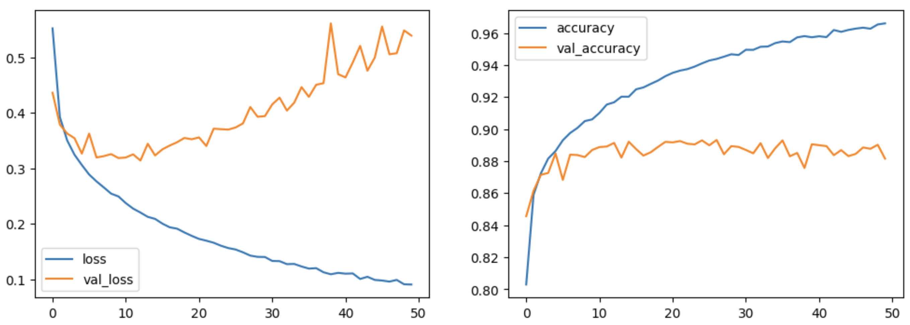
層を増やしても今回のデータでは精度あまり上がっていない
Test loss: 0.4939178228378296
Test accuracy: 0.885200023651123
Test loss: 0.5994181036949158
Test accuracy 0.8773999810218811

Slide 32
なぜ過学習が起きるのか
モデルの複雑さ： モデルが非常に複雑である場合（例えば、パラメータが多すぎる）、そのモデ
ルは訓練データのノイズまで学習してしまう。モデルがデータの真のパターン
よりも、データに含まれるランダムな誤差や無関係な特徴を学習してしまう。
データの不足： 訓練データが不十分である場合、モデルは利用可能なデータに過剰に適合してし
まう。十分なバリエーションのデータがなければ、モデルが一般化するための
「良い」パターンを学ぶことができない。
トレーニングの長さ： トレーニングを長く続けすぎると、モデルが訓練データセットの特異性を学
習し、新しいデータに対してうまく一般化できなくなる。
データの品質： データに偏りがあったり、誤った情報が含まれていたりすると、モデルが誤ったパ
ターンを学習する原因となる。

Slide 33
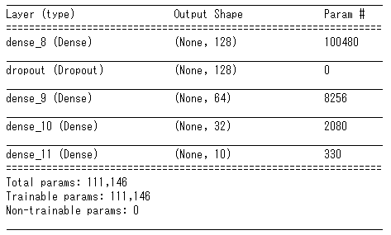
Dropoutを加えてみよう
from keras.layers import Dropout
model = Sequential()
model.add(Dense(128,input_shape=(784,),activation='relu’))
model.add(Dropout(0.5))
model.add(Dense(64,activation='relu’))
model.add(Dense(32,activation='relu'))
model.add(Dense(10,activation='softmax'))
model.compile(loss='categorical_crossentropy’,
optimizer='Adam',metrics=['accuracy'])
model.summary()
model = Sequential()
model.add(Dense(128,input_shape=(784,),activation='relu’))
model.add(Dense(64,activation='relu’))
model.add(Dense(32,activation='relu'))
model.add(Dense(10,activation='softmax'))
model.compile(loss='categorical_crossentropy’,
optimizer='Adam',metrics=['accuracy'])
model.summary()

Slide 34
Dropout
過学習を防ぐための対策の1つで、学習時に設定した確率で出力を０にする手法。
推論時には何も行わず、学習時にのみ行われる。これにより、特定のニューロン
の評価だけに依存し過ぎることを避けて、より頑健な(=データの本質的な構造を捉えた)
特徴を学習することを促す。
1
×
2
1
3
2
・
・
・
・
・
・
×
255
510
×
511
256
512

Slide 35
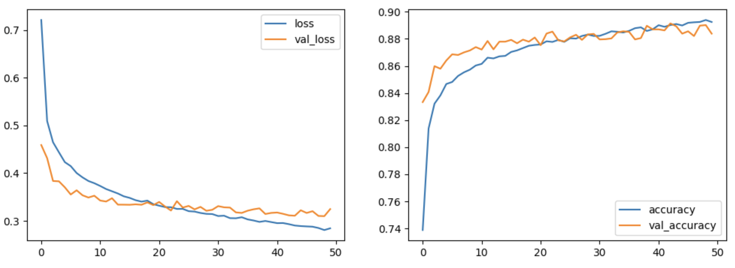
Dropoutを加えると過学習を抑制できる
Test loss: 0.5994181036949158
Test accuracy 0.8773999810218811
Test loss: 0.3330557644367218
Test accuracy: 0.8855000138282776
実際は過学習を抑えつつ精度をどれだけ上げられるかを検討する

Slide 36
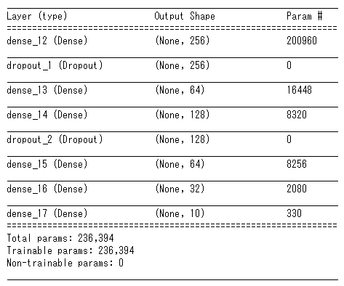
層はいくらでも増やすことが出来ます。
色々試してみましょう。
Test loss:
0.3416001796722412
Test accuracy:
0.8855000138282776
今回のデータの量、質だとMLPではパラメータを増やしても90%以上の精度は
なかなか出にくいようです。

Slide 37
課題
・WebClassにある”kadai5.ipynb”をやってみましょう
・実行したら”学籍番号_名前_5.ipynb”という名前で保存
して提出して下さい。
締め切りは2週間後の11/23の23:59です。
締め切りを過ぎた課題は受け取らないので注意して下さい

