Slide 1

404 Not Found

Slide 2
Problem Statement
The objective of this data research work is to create a predictive model to analyse patient traffic in hospitals in order to get prepared for the demand in medical equipment, drugs and staffs.
The results from the predictive analysis will provide insights that could be used by the health care trust, pharmaceutical companies, health care agencies for the strategic resource planning.

Slide 3

Data Mining
Emergency Wait Times
Date
Total Cases
Inpatient & Outpatient Data
Date
Total Cases
GP Prescriptions
Date
Drug Name
Trust Name
Speciality
Speciality Services
Practice Code
Drug Quantity
Trust Name
Critical Care Services

Slide 4
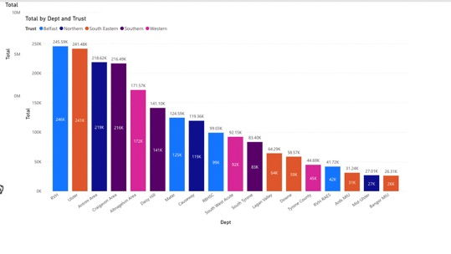
Insights

Slide 5
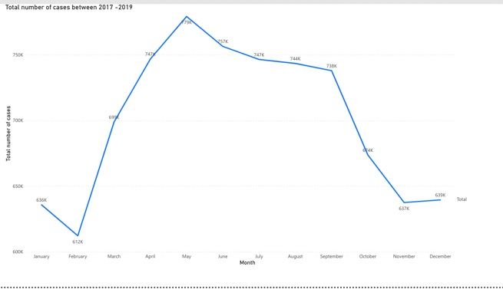
Insights

Slide 6
Questions?

