Slide 1

DISSERTATION ON INDIACOM WEBSITE (MCA – IV SEMESTER; BATCH 2022-24)
Internal Guide
Ms.Saumya Bansal (BVICAM, New Delhi)
Presentation by
Sanchit Talreja(352)
19-04-2024

Slide 2
Contents
Problem Description
Aim and Objectives
Methodology
Technology Used for Project Development
Project Modules and My Role
Screenshots
Design Documents (Use Case, Data Flow Diagram, Activity Diagram, etc.)
Testing of Project
Conclusion
Future Scope
Bibliography

Slide 3
Problem Description
The current system is not easily manageable, causing inconvenience for both faculty and students. There is no review system in place, making it difficult to address issues effectively. Problems are often detected by faculty upon login, indicating a lack of proper testing and debugging procedures.
Additionally, the database schemas are poorly designed, leading to inefficiencies and data management challenges. The administration system is not up to standard, further complicating tasks for users.
Moreover, the website's outdated design makes it appear as if it belongs to the 90s, detracting from the user experience.

Slide 4
Aim and Objectives
Aim:
The goal of this website is to improve its appearance and functionality, making it more user-friendly and accessible to individuals who may not have a background in coding. Additionally, it is important to establish a strong admin system to ensure smooth operation and easy maintenance. By achieving these objectives, we can create a website that is both visually appealing and easy to navigate, while also providing effective support for website administrators.
Objectives:
Providing a new review system so faculty don’t have to download papers to review them.
Make it visually appealing
Providing a simple database to understand
Providing an admin module by WordPress so it can be maintained and updated easily

Slide 5
Methodology
Methodology used for Project Development:
Prototyping Methodology:
Prototyping methodology in software development involves creating an initial version of the product, known as a prototype, based on gathered requirements. This prototype is then tested and refined iteratively based on feedback from stakeholders. The process continues until an acceptable prototype is achieved, which then serves as the blueprint for developing the final product. This methodology allows for early testing and feedback, reducing the risk of misunderstandings and ensuring the final product meets user needs effectively.

Slide 6
Technology used
Technology used for Project Development:
WordPress :Version 6.5.2
WP_Plugins: Elementor (basic,pro,essential addons,Ea-pro) , insert php code snippet, user registration,user role editor ,wp data access, wp frontend admin, disable gutenberg
Server: Apache (using mamp)
Languages: PHP 8.3.4, HTML, CSS
Database: My SQL 5.2.0

Slide 7
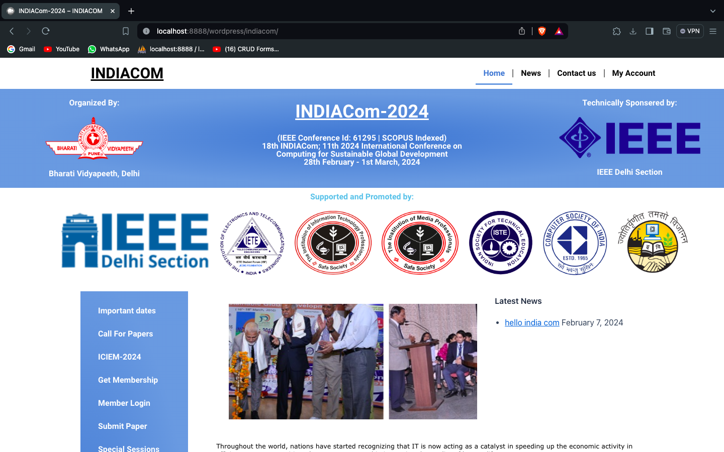
screenshot-1

Slide 8
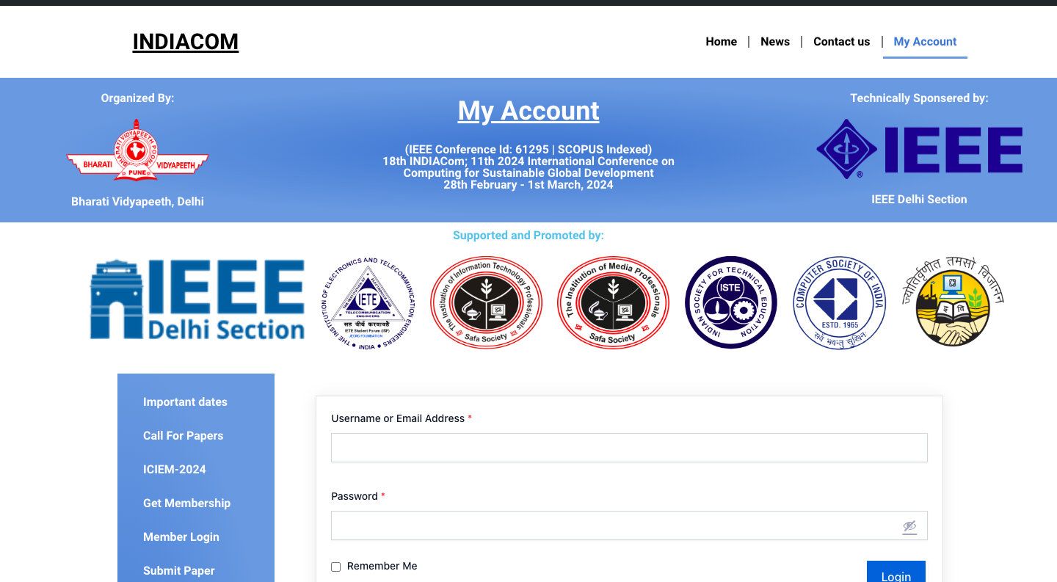
screenshot-2

Slide 9
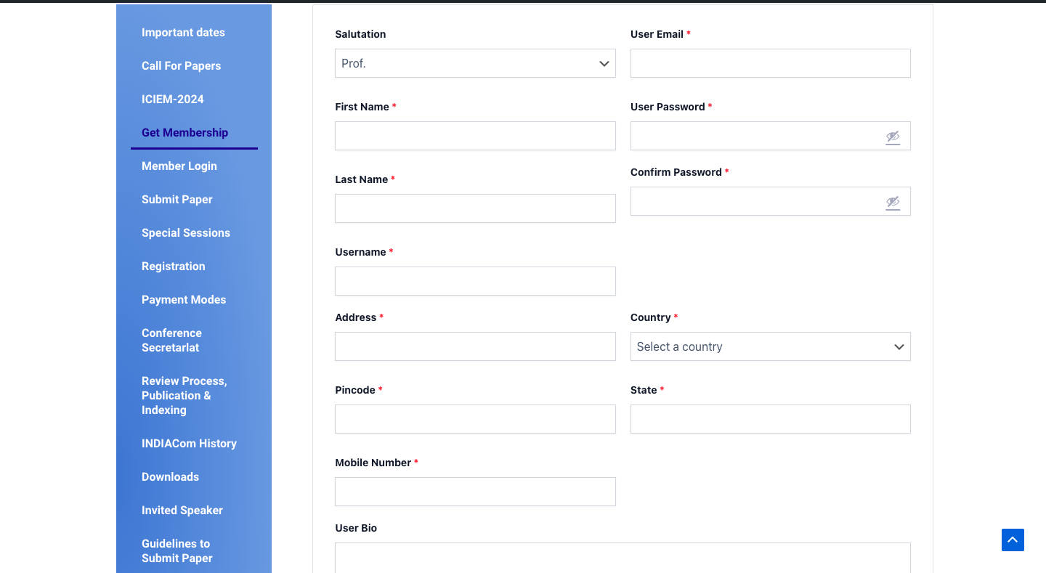
screenshot-3

Slide 10
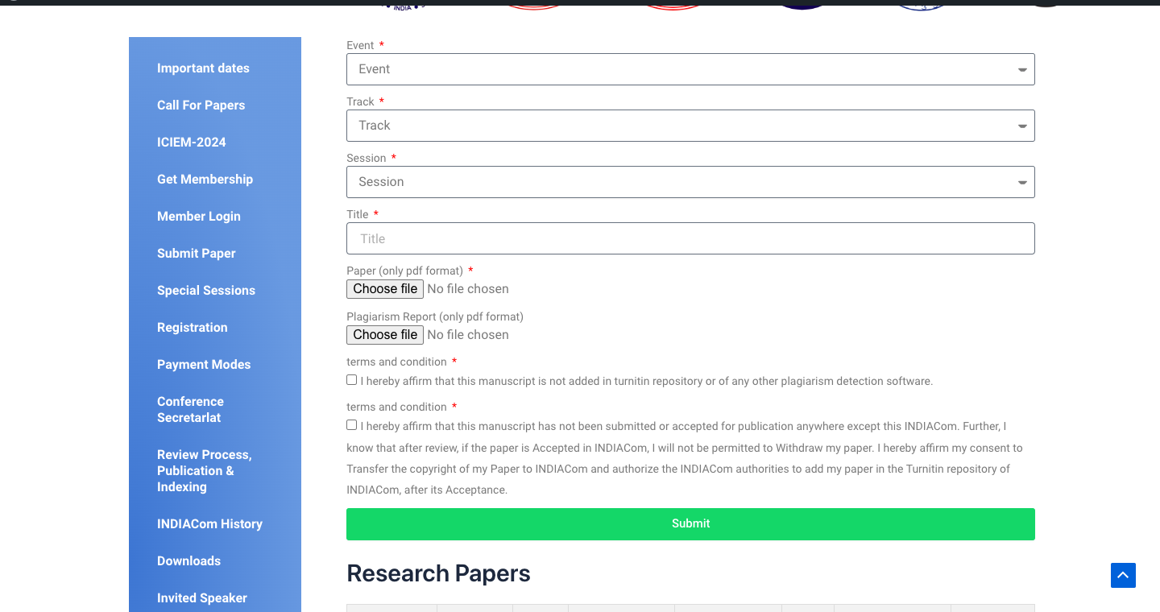
screenshot-4

Slide 11
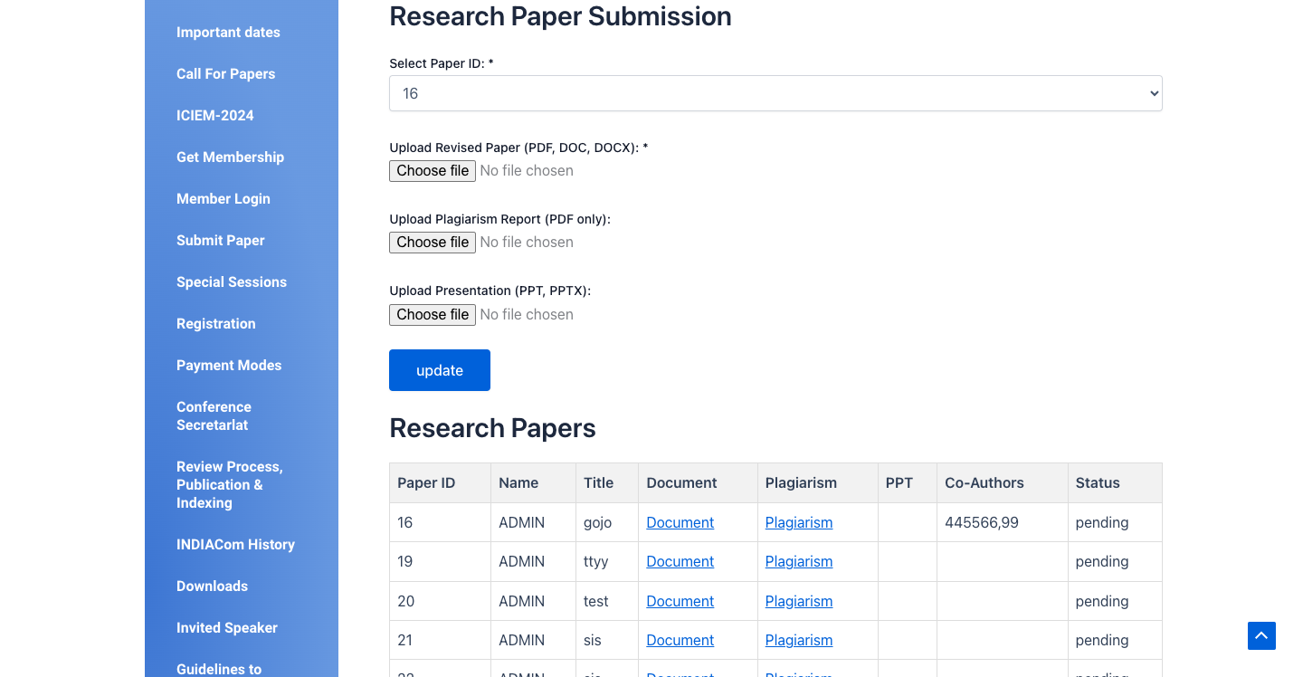
screenshot-5

Slide 12
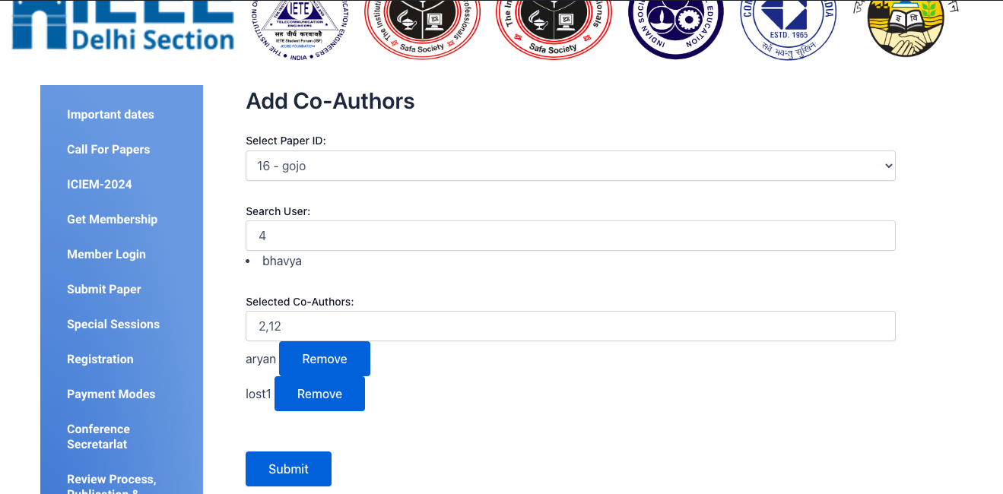
screenshot-6

Slide 13
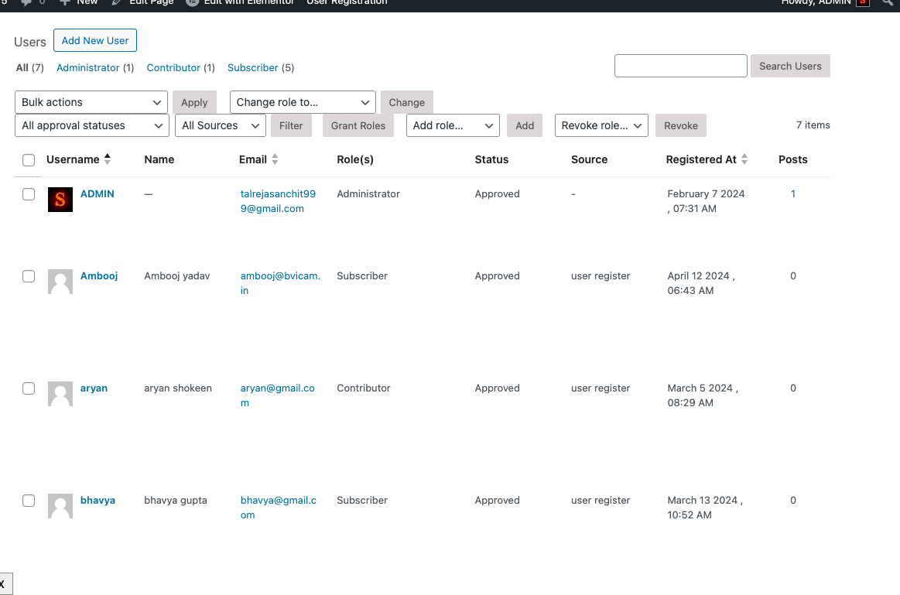
screenshot-7

Slide 14
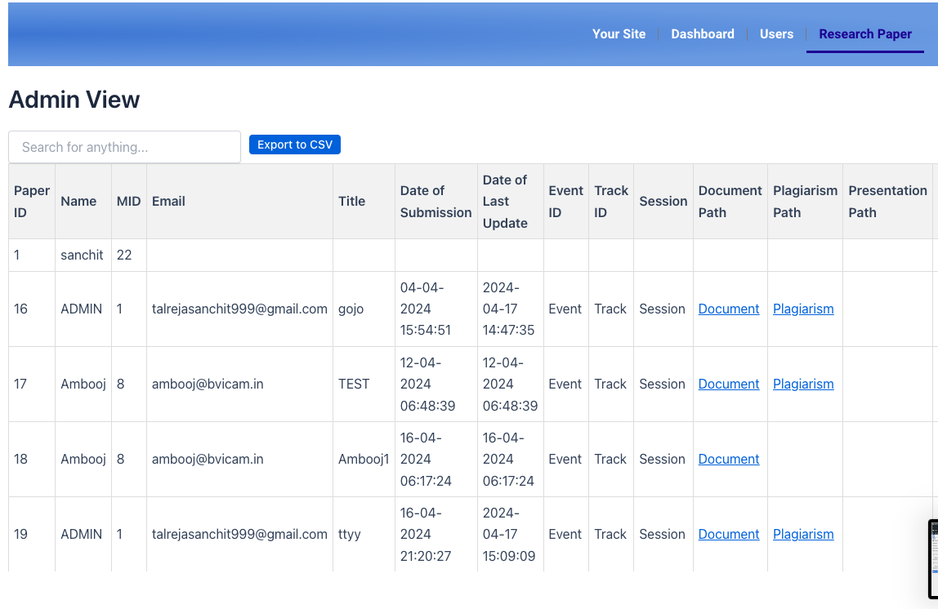
screenshot-8

Slide 15
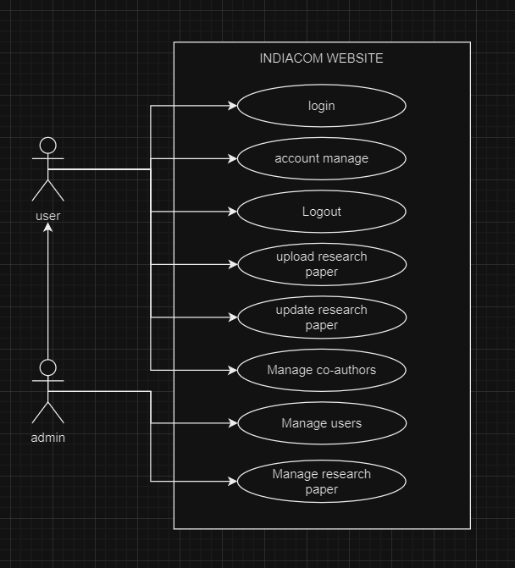
Use Case Diagram

Slide 16
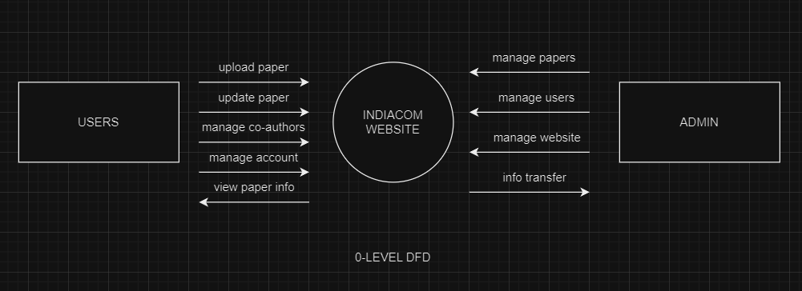
DFD LEVEL-0

Slide 17
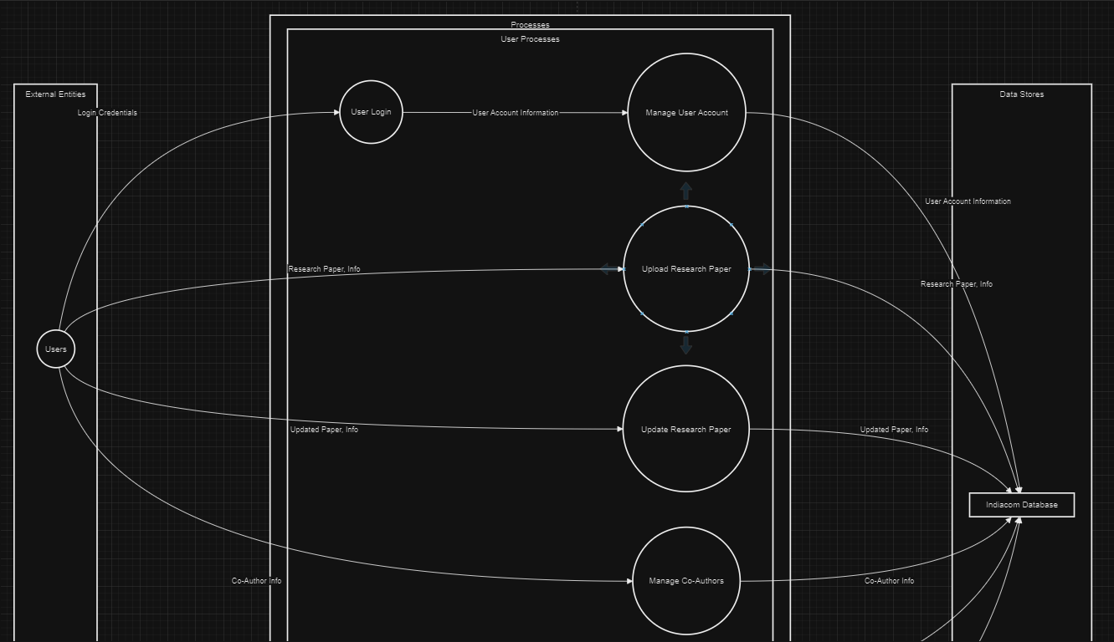
DFD LEVEL-1

Slide 18
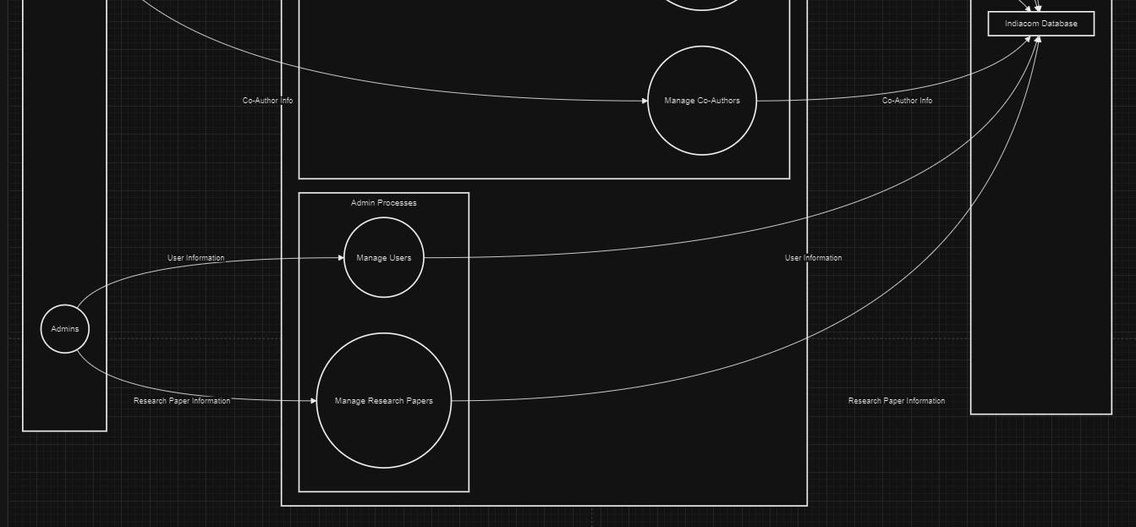
DFD LEVEL-1 (cont..)

Slide 19
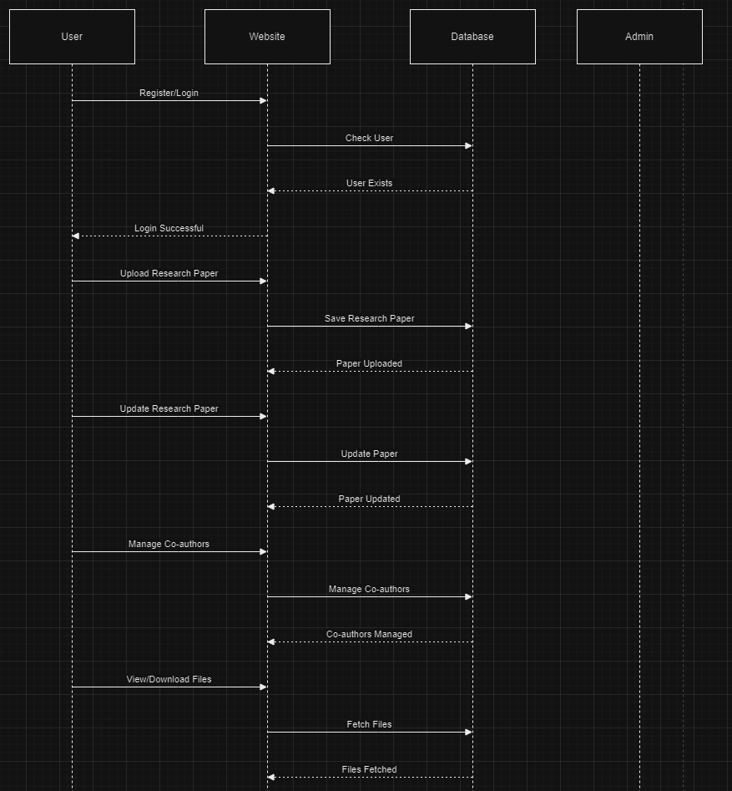
Sequence Diagram

Slide 20
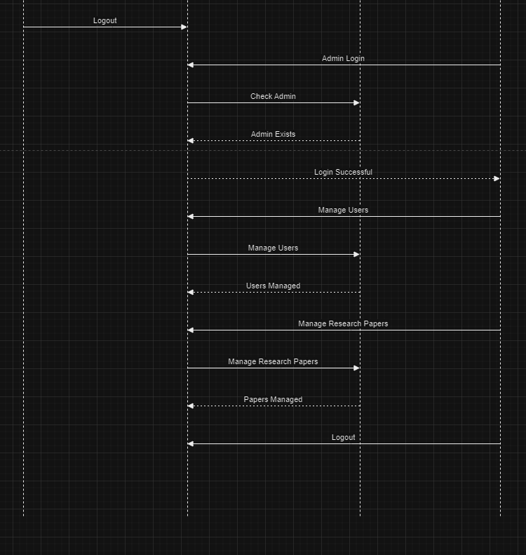
Sequence Diagram (cont..)

Slide 21
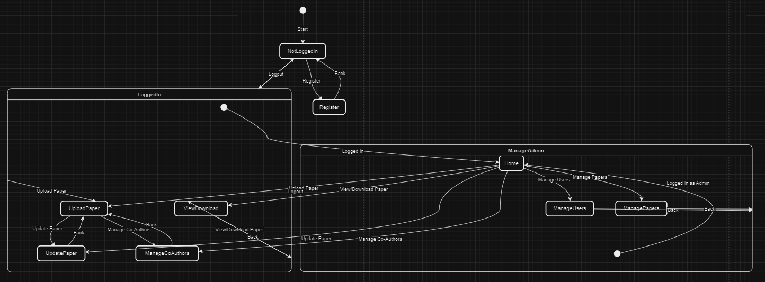
State Chart Diagram

Slide 22
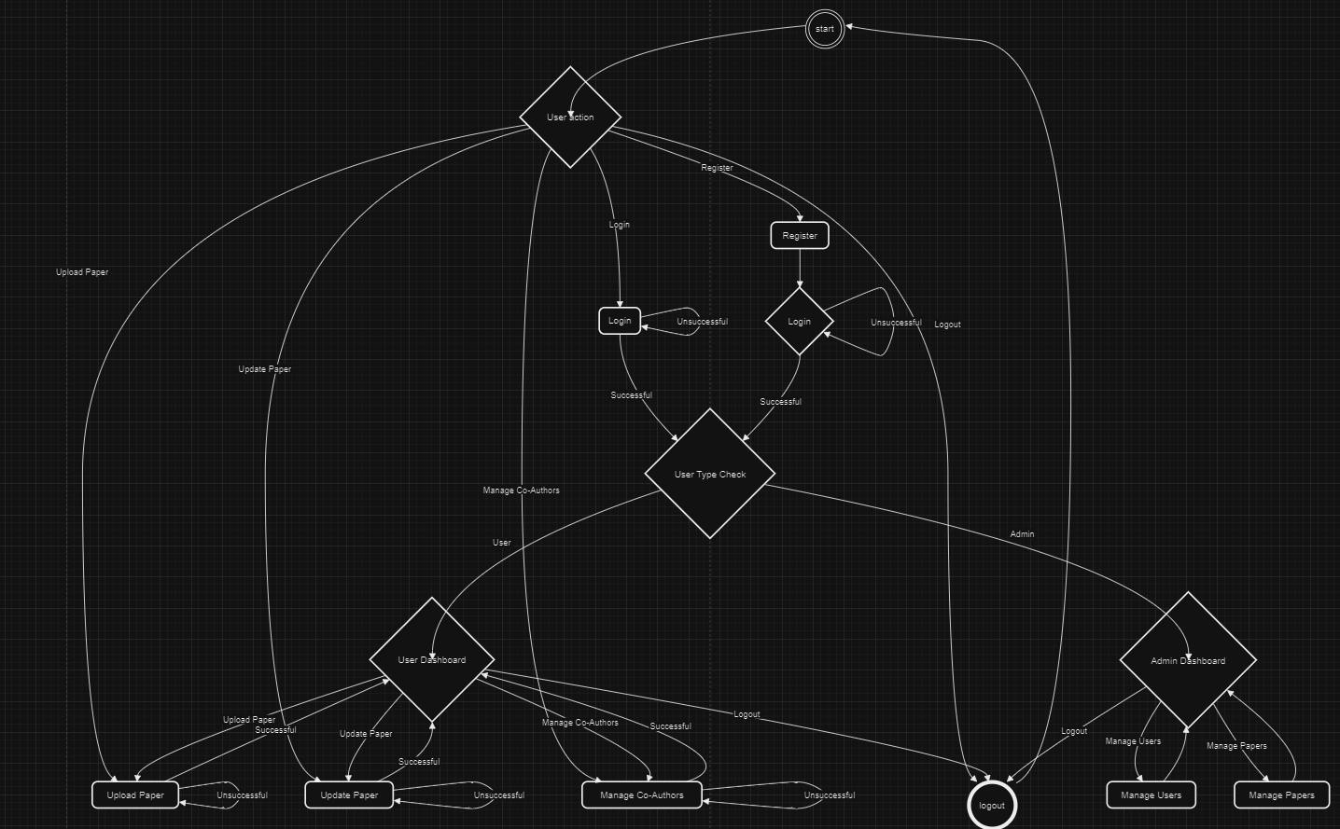
Activity Diagram

Slide 23
Entity Relationship Diagram

Slide 24
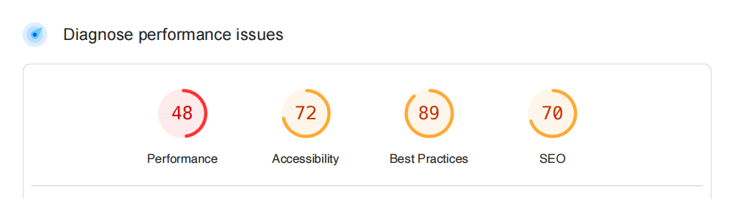
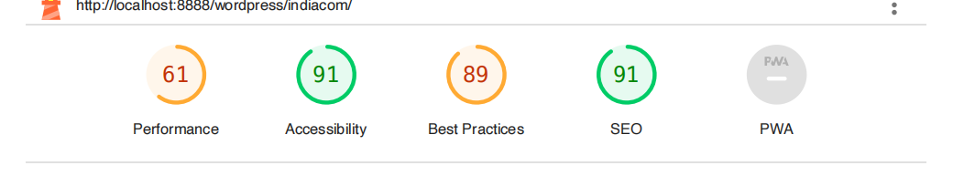
Generated Reports
old site report by pagespeed insights
new site report by lighthouse

Slide 25
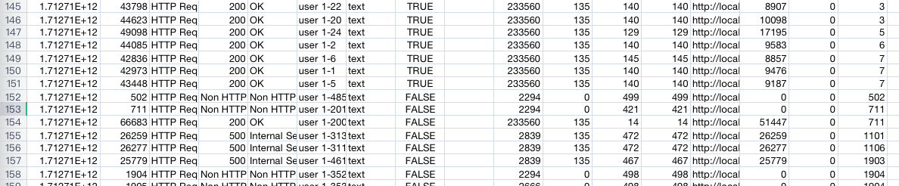
Load test
Test says 1 page can handle almost 150 members at a single time input given (total 500 threads , every second , increasing by one ) Test Done using jmeter

Slide 26
Testing of the Project
Id | Test Case Description | Test Case Input | Test Results |  | Status | Corrective Measure
 |  |  | Expected | Actual
1 | Billing person/Admin can successfully create the order | All the fields asked in the create order page are filled properly. | Order is created successfully | Order is created successfully | Pass | None
2 | All the orders that are successfully created should be displayed here. | No input | Successfully created orders are displayed. | Successfully created orders are displayed. | Pass | None
3 | Label with correct QR code and item no. is generated. | Warehouse ID, Item no. | Label is printed correctly. | Label is printed correctly | Pass | None

Slide 27
Testing of the Project (cont...)
Id | Test Case Description | Test Case Input | Test Results |  | Status | Corrective Measure
 |  |  | Expected | Actual
1 | Billing person/Admin can successfully create the order | All the fields asked in the create order page are filled properly. | Order is created successfully | Order is created successfully | Pass | None
2 | All the orders that are successfully created should be displayed here. | No input | Successfully created orders are displayed. | Successfully created orders are displayed. | Pass | None
3 | Label with correct QR code and item no. is generated. | Warehouse ID, Item no. | Label is printed correctly. | Label is printed correctly | Pass | None

Slide 28
Conclusion: A Brighter Learning Future
Our current platform hinders progress. We propose a user-friendly makeover, with a clear and accessible database and a streamlined review system. Integrating a WordPress admin module empowers administrators and simplifies maintenance.
This isn't just about convenience; a visually appealing platform fosters a positive user experience, boosting engagement. Investing in these improvements signifies our commitment to a modern learning ecosystem.
Imagine a dynamic hub for sharing knowledge, seamlessly integrating technology and style. Let's transform our system from a burden to a powerful tool. We create a platform that empowers students, professors , simplifies tasks for faculty, and ultimately builds a thriving research community.

Slide 29
Future Scope
Implement a second and third-level admin system for enhanced administrative control.
Introduce a real-time review system to facilitate immediate feedback.
Integrate AI technology for efficient plagiarism checks.
Develop a collaboration platform for qualified users to review papers.
Convert the entire system into a comprehensive mobile application for greater accessibility and convenience.

Slide 30
Bibliography
Books:
Get Coding!: Learn HTML, CSS & JavaScript & Build a Website, App & Game – by Young Rewired State
JavaScript: The Definitive Guide, by David Flanagan
Websites:
https://www.w3schools.com/
https://wordpress.com/learn/
https://www.coursera.org/
https://chat.openai.com/

