Slide 1

DISSERTATION ON INDIACOM CONFERENCE WEBSITE (MCA – IV SEMESTER; BATCH 2022-24)
Internal Guide
Dr.Saumya Bansal (BVICAM, New Delhi)
Presentation by
Sanchit Talreja(352)
03-06-2024
Notes:
1

Slide 2
Contents
Introduction
Problem Description
Aim and Objectives
Methodology
Technology Used for Project Development
Design Documents (Use Case, Data Flow Diagram, Activity Diagram, etc.)
Screenshots
Testing of Project
Conclusion
Future Scope
Bibliography

Slide 3
Introduction
The Indiacom Website is a web-based platform aimed at Streamlining the work on research paper submission and its review by PhD scholars.
We have a platform with a seamless user experience for both the academic authors and The people who review academic work.
Additionally, it is important to establish a strong admin system to ensure smooth operation and easy maintenance.

Slide 4
Problem Description
Problems are often detected by faculty upon login, indicating insufficient testing and debugging procedures.
Poorly designed database schemas lead to inefficiencies and data management challenges.
Problems faced when updating the website are very time-consuming and sometimes challenges in finding the right answers for code cause of less community for the previous language.
The Admin dashboard was not user-friendly.
The UI of the website was not visually appealing.

Slide 5
Aim and Objectives
Aim:
The goal of this website is to improve its appearance and functionality, making it more user-friendly and accessible to individuals who may not have a background in coding. Additionally, it is important to establish a strong admin system to ensure smooth operation and easy maintenance. By achieving these objectives, we can create a website that is both visually appealing and easy to navigate, while also providing effective support for website administrators.
Objectives:
Provide a new review system so faculty don’t have to download papers to review them.
Make it visually appealing
Providing a simple database to understand
Provide an admin module by WordPress so it can be maintained and updated easily

Slide 6
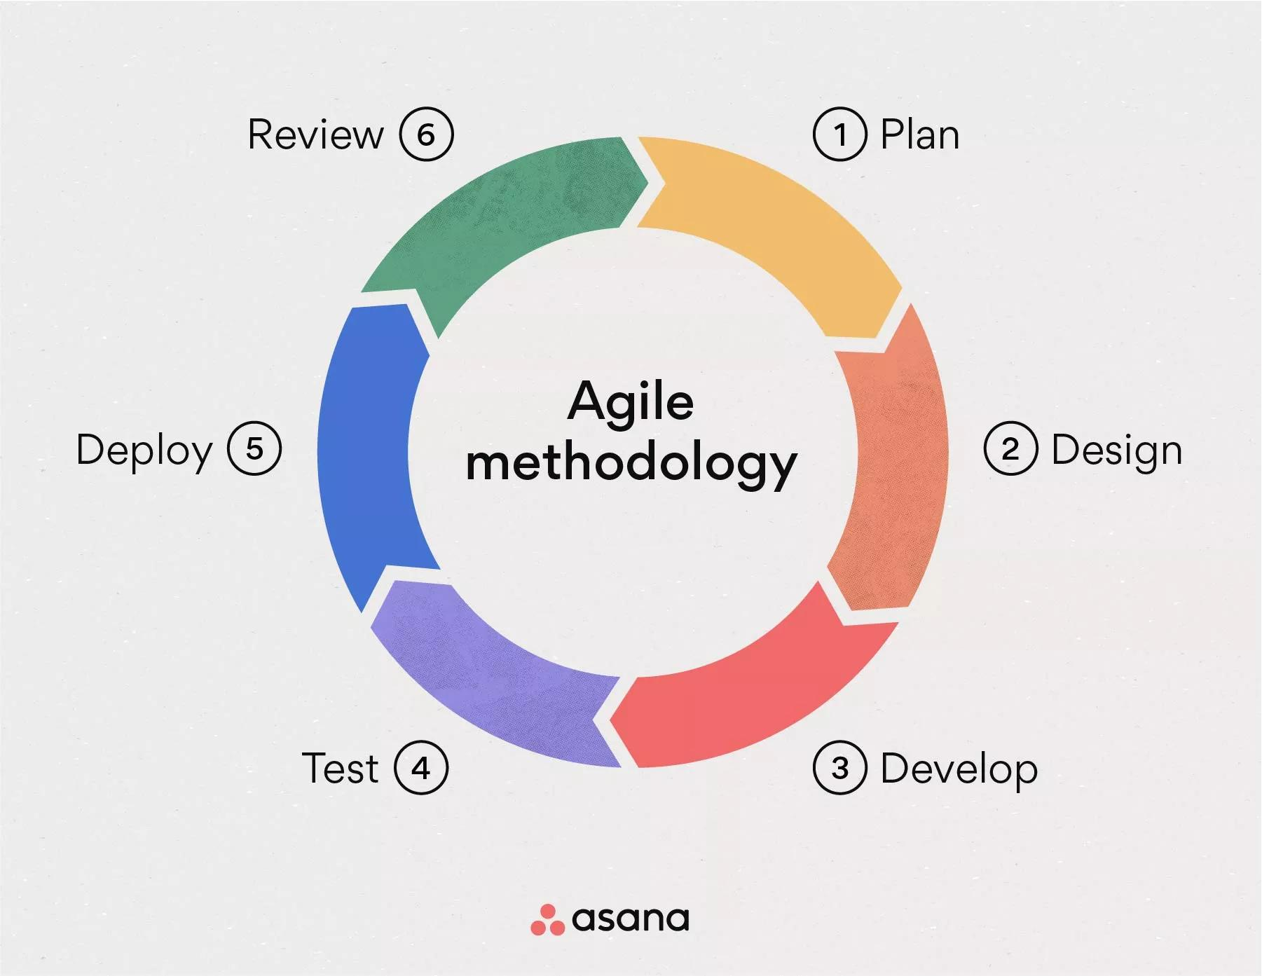
Methodology
Methodology used for Project Development:
Agile Methodology:
Agile web development is a model for the development of web applications. It is more efficient and powerful within a shorter timeline than other models incorporates face-to-face communication, and includes technical personnel as well as customers as part of the team.

Slide 7
Technology used
Technology used for Project Development:
WordPress :Version 6.5.2
WP_Plugins: Elementor (basic,pro,essential addons,Ea-pro) , insert php code snippet, user registration,user role editor ,wp data access, wp frontend admin, disable gutenberg
Server: Apache (using mamp)
Languages: PHP 8.3.4, HTML, CSS
Database: My SQL 5.2.0

Slide 8
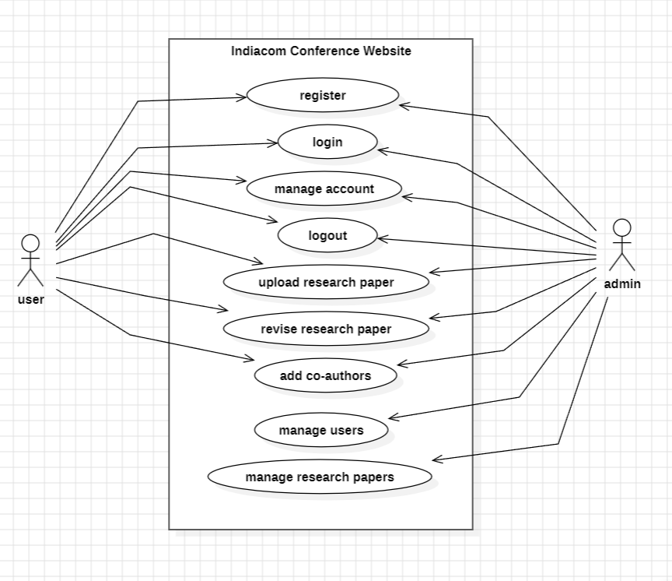
Use Case Diagram

Slide 9
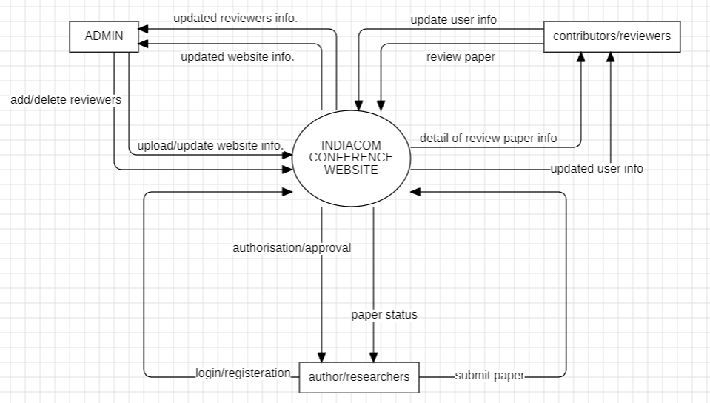
DFD LEVEL-0

Slide 10
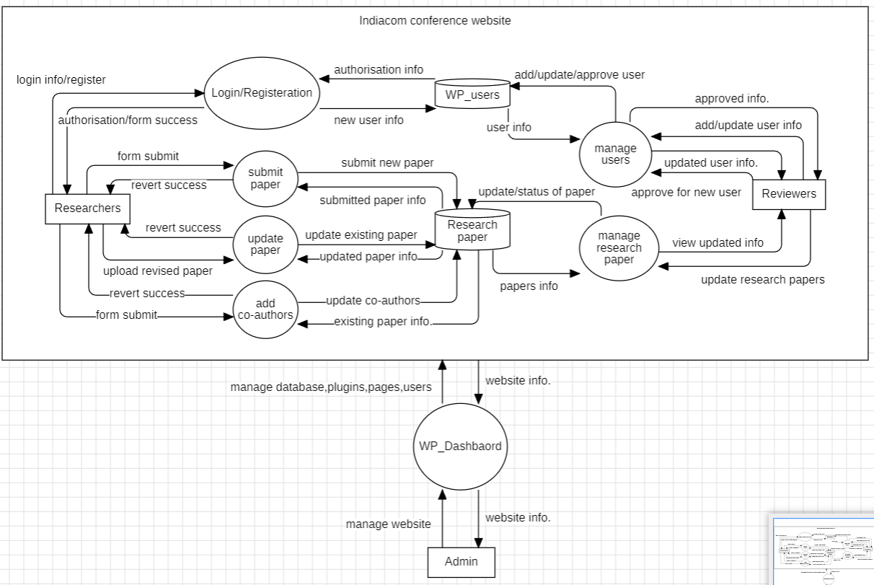
DFD LEVEL-1

Slide 11
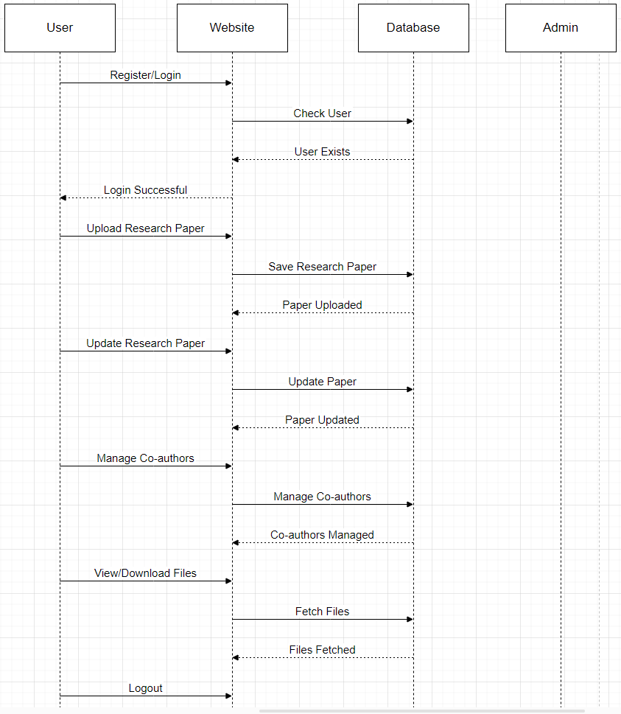
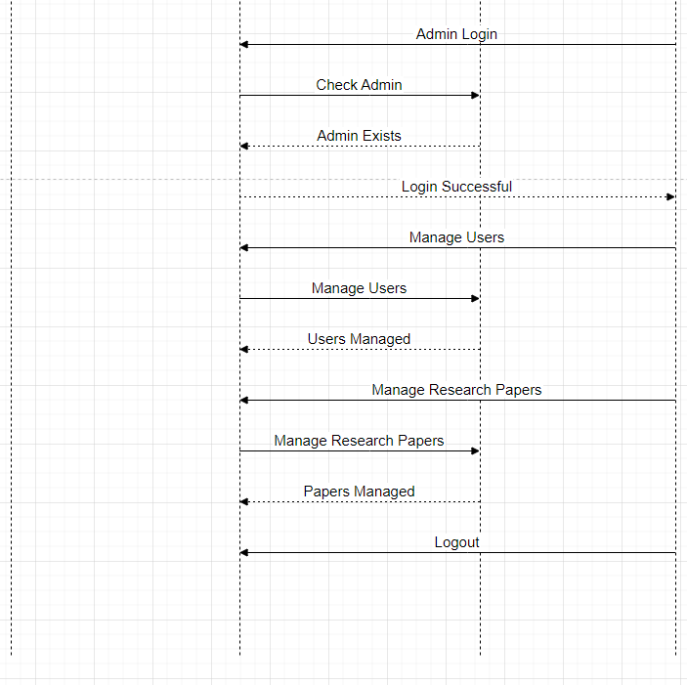
Sequence Diagram

Slide 12
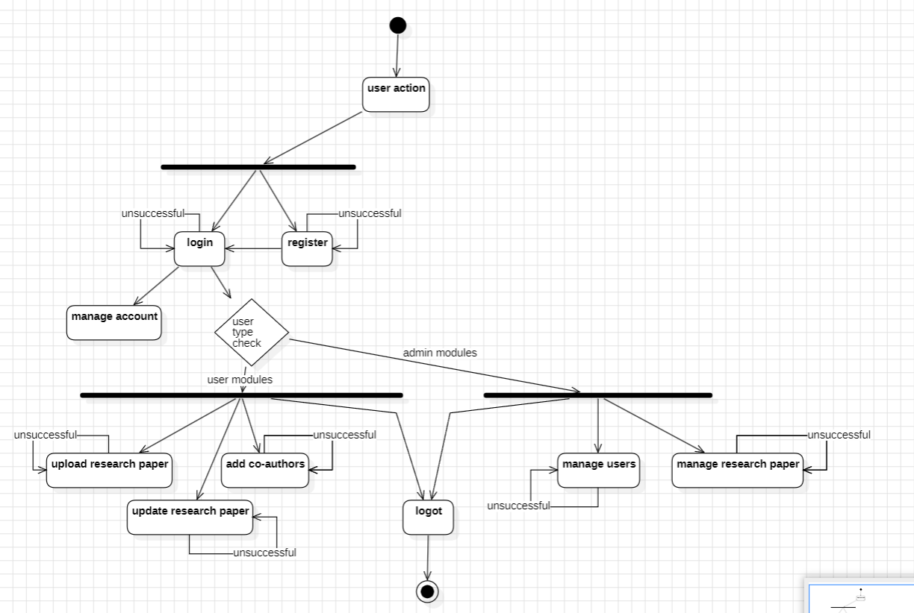
Activity Diagram

Slide 13
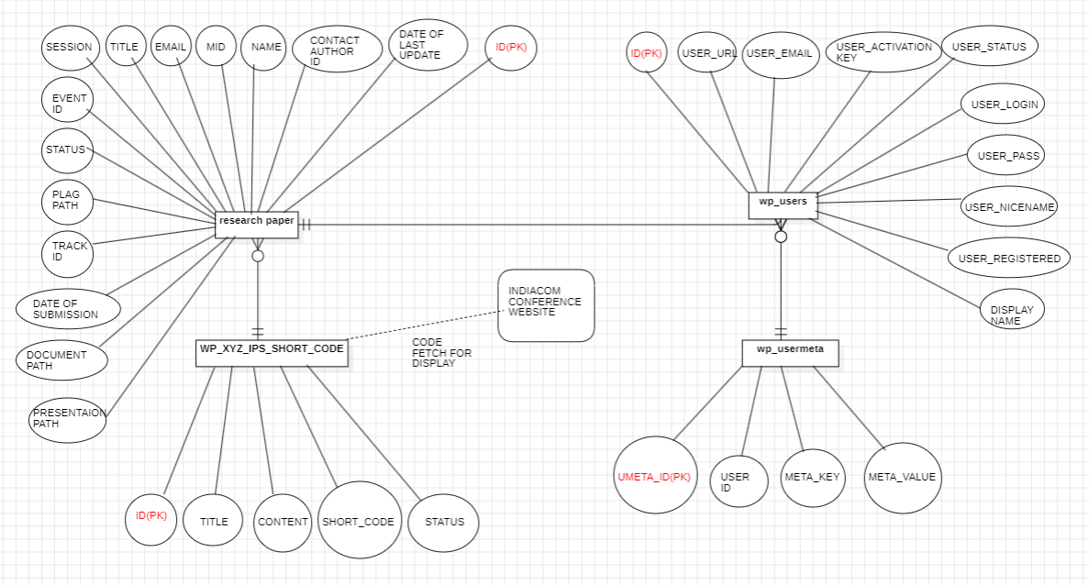
Entity Relationship Diagram

Slide 14
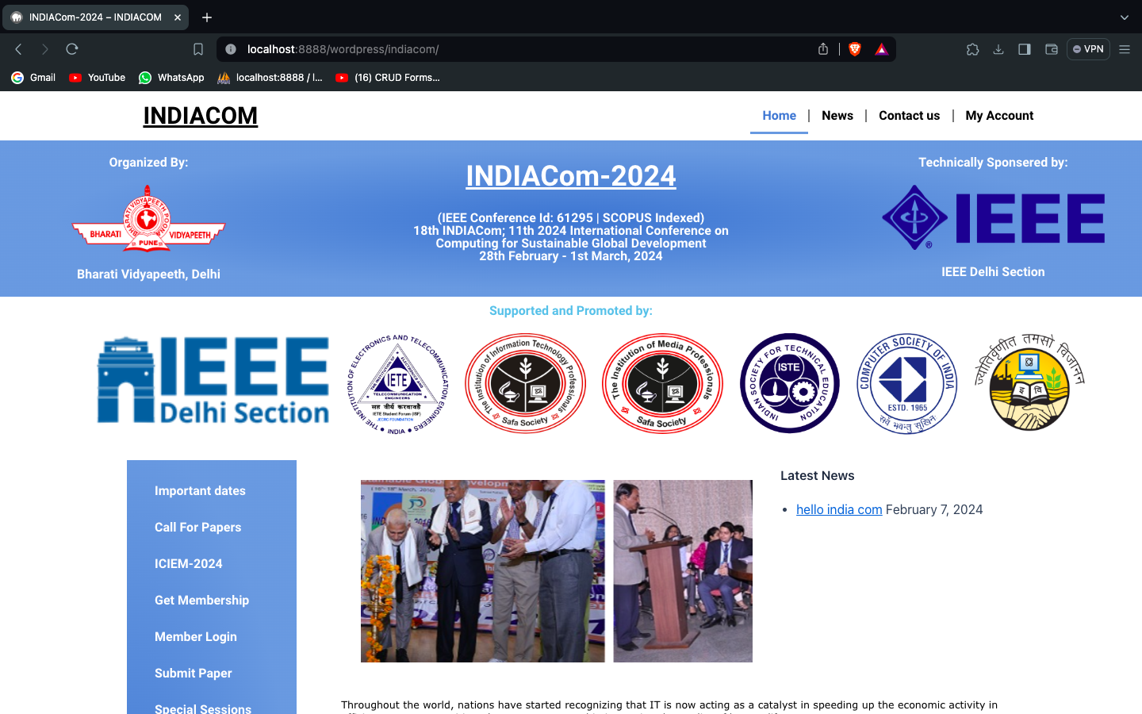
screenshot-1

Slide 15
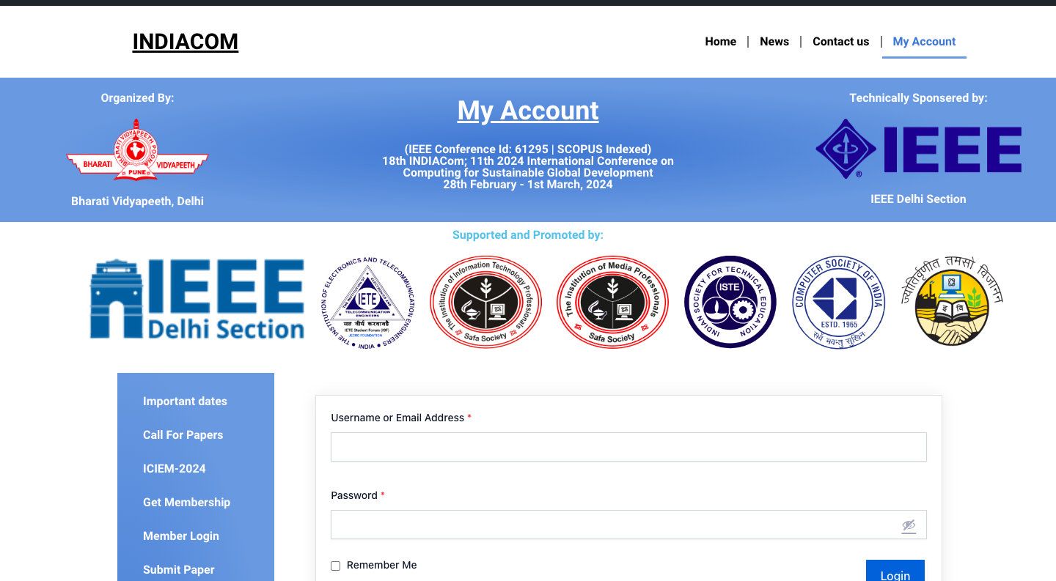
screenshot-2

Slide 16
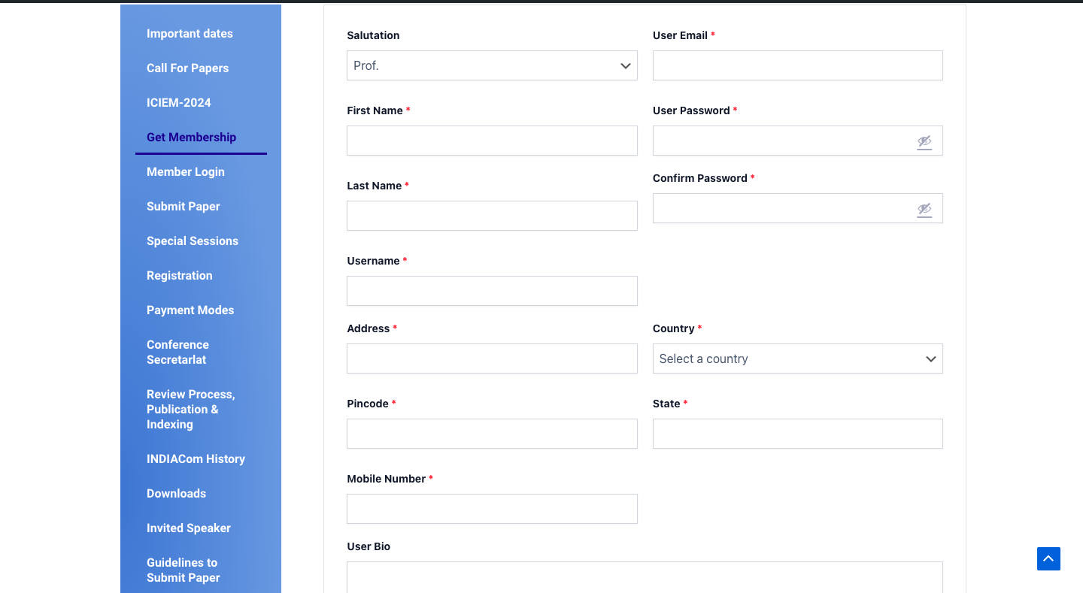
screenshot-3

Slide 17
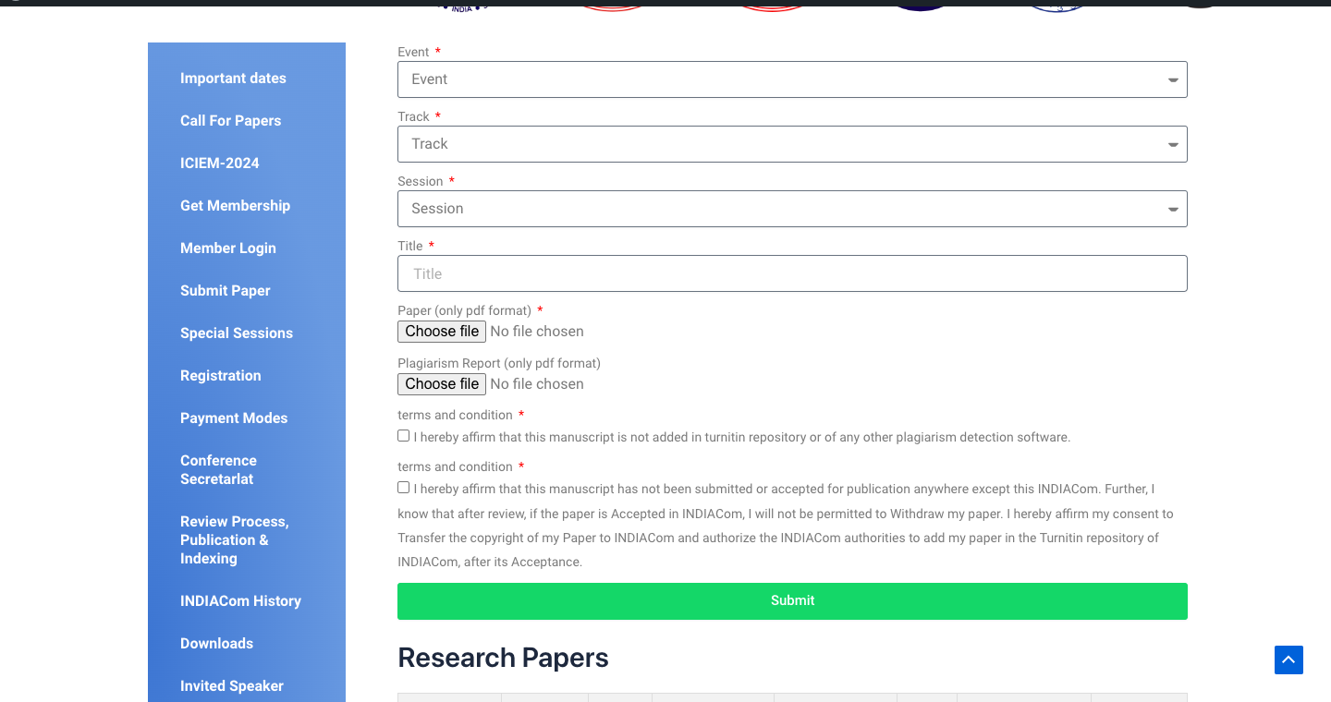
screenshot-4

Slide 18
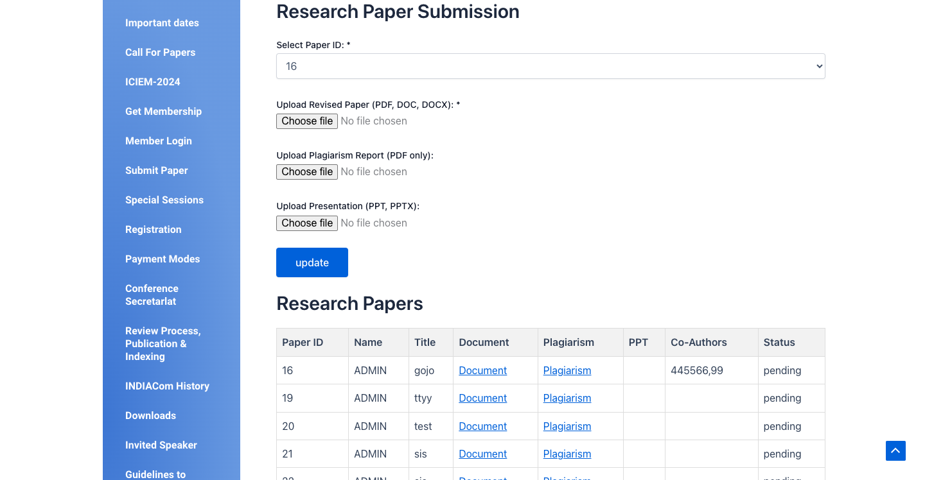
screenshot-5

Slide 19
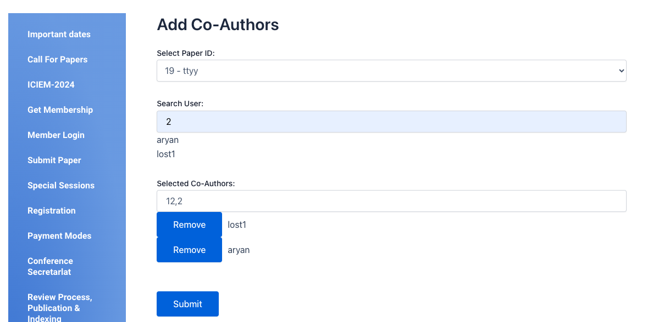
screenshot-6

Slide 20
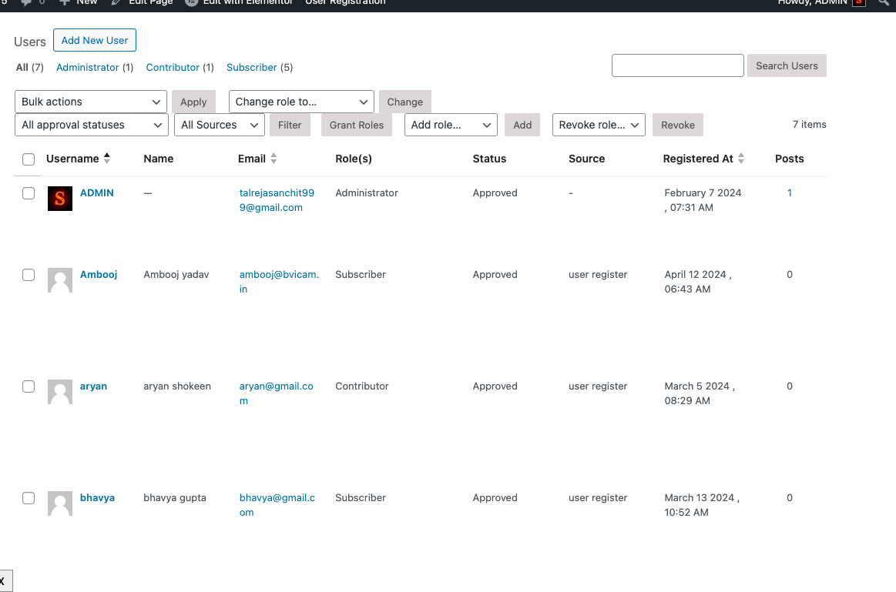
screenshot-7

Slide 21
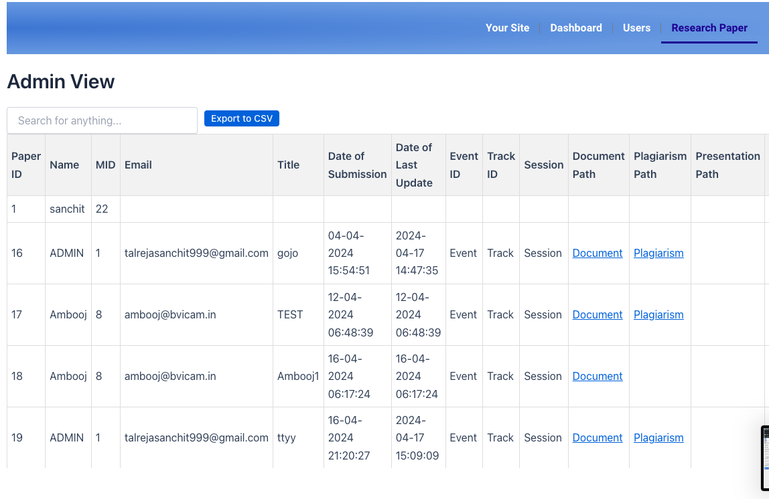
screenshot-8

Slide 22
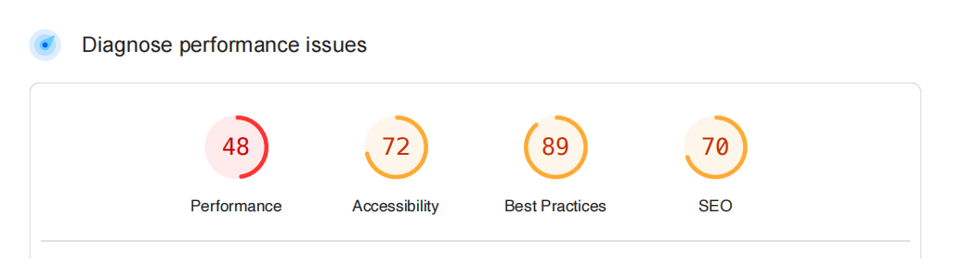
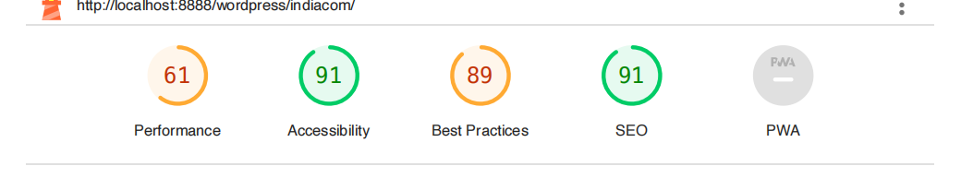
Generated Reports
old site report by pagespeed insights
new site report by lighthouse

Slide 23
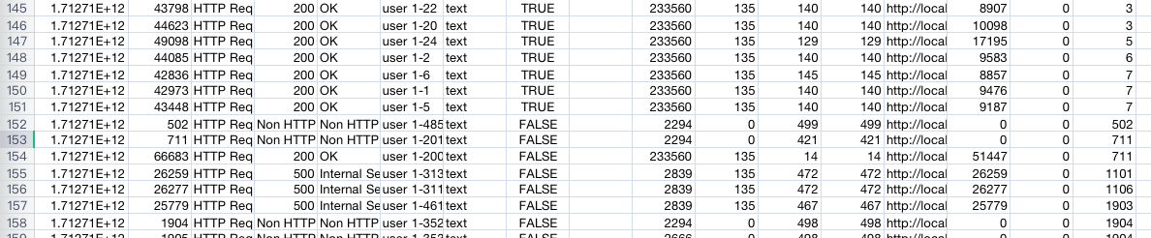
Load test
Test says 1 page can handle almost 150 members at a single time input given (total 500 threads , every second , increasing by one ) Test Done using jmeter.

Slide 24
Testing of the Project
Id | Test Case Description | Test Case Input | Test Results |  | Status | Corrective Measure
 |  |  | Expected | Actual
1 | registering as a user in the get membership page to create mid | All the fields asked in the create new user are filled properly. | user is created successfully | user is created successfully | Pass | None
2 | registering user with the already exsiting email id | All the fields asked in the create new user are filled properly. with alredy exsisting email id | user created succesfully | existing user is displayed in email field. | Fail | None
3 | generating a new paper in submitting new paper | All the fields asked in the create new paper are filled properly. | new paper is created successfully | new paper is created successfully | Pass | None
4 | updating the existing paper of the current user | All the fields asked in the update paper are filled properly. | paper is updated succesfully | paper is updated succesfully | pass | None
5 | adding all the co-authors of the paper of the current user | All the fields asked in the co-author are filled properly | co-authors added succesfully | co-authors added succesfully | pass | None

Slide 25
Testing of the Project (cont...)
Id | Test Case Description | Test Case Input | Test Results |  | Status | Corrective Measure
 |  |  | Expected | Actual
6 | admin can access the admin dashboard as well as wp admin page | login with admin and using admin dashboard | admins can use it | admins can use it | Pass | None
7 | contributers can access the admin dashboard but not the wp admin page | login with contributer and using admin dashbaord and using wp admin page | Succeed in both the panels | success use at admin dashboard but not wp admin | Fail | None
8 | no user can be made without the approval of admin | user approved by admin | user made successfully | user made successfully | Pass | None
9 | user can’t update or change the values of reserch paper of any other user. | form can’t be filled as select box is showing only that paper id which is created by that user. | can’t change others paper | can’t change others paper | Pass | None
10 | user display data is only for the display purpose for the users. (can be used to download their uploaded reserch paper,ppt,plagiarism) | no input needed | data displayed and ready to download | data displayed and ready to download | Pass | None

Slide 26
Conclusion
Our current platform is hindering progress, and we propose a user-friendly website.
This includes a clear and accessible database and a streamlined view system.
We integrated a WordPress admin module to empower administrators and simplify maintenance tasks.
A visually appealing platform fosters a positive user experience, which boosts engagement.
Imagine a dynamic hub for sharing knowledge, seamlessly integrating technology and style.
Our goal is to create a platform that empowers students and professors, simplifies tasks for faculty, and ultimately builds a thriving research community.

Slide 27
Future Scope
Implement a second and third-level admin system for enhanced administrative control.
2nd level: Again reviewing the papers more thoroughly with brief content. 3rd level: Last reviewing better with plagiarism checks and AI tools.
Introduce a paper view system to facilitate a better review mechanism.
Introducing Payment systems to get a more seamless user experience in one place
Using auto SEO plugins for monthly SEO to give this website a wider reach internationally.
Convert the entire system into a comprehensive mobile application for greater accessibility and convenience.

Slide 28
Bibliography
Books:
Get Coding!: Learn HTML, CSS & JavaScript & Build a Website, App & Game – by Young Rewired State
JavaScript: The Definitive Guide, by David Flanagan
Websites:
https://www.w3schools.com/
https://wordpress.com/learn/
https://www.coursera.org/
https://chat.openai.com/

