Slide 2
Exploring Algorithms in Python: Working with Polygons George Heineman
August 18 2017
Notes:
Still Draft!

Slide 3
Outline [Two Hour Presentation]
Polygons are useful geometric shapes
Investigate properties with application
Detect when two polygons intersect
Brute-force algorithm does not compute actual intersection
Intersection of convex polygons
Common subtype of polygons

Slide 4
Presentation Requirements
Python 3.4 installation
Github repository contains code
https://github.com/heineman/python-polygon-intersection
Assume you have reviewed following
app/app_skeleton.py
app/app_skeleton_animation.py

Slide 5
Polygon
A plane figure bounded by finite sequence of straight line segments called edges closing in a loop
Need at least three edges
Polygon with n edges has n points
Points are ordered {p₀, p₁, …, p_{n-1}, p₀}
Edges have direction (p_{i}, p_{i+1}) and (p_{n-1}, p₀)
How to represent a polygon in Python?
p₃
p₂
p₀
p₁

Slide 6
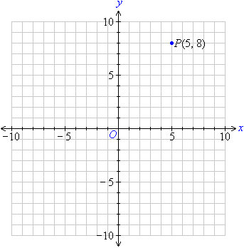
Polygon Representation
Desired criteria
Report number of points (and edges)
Iterate through points in order
Iterate through edges in order
Representation sub-tasks
Points in Cartesian space (x,y)
Edges defined by two points (x1,y1) → (x2,y2)

Slide 7
Class Definitions
Avoid using just native types (such as list, tuple)
You will need to define relevant functional behavior
Point class
Constructor and copy constructor
Methods to set and get (x,y) values
poly/point.py

Slide 8
Edge Class Definition
An Edge is defined by two points, head and tail
Constructor
Methods to get head and tail points.
Add concept of next edge
Next edge in sequence of edges in polygon
p₂
next
tail
head
next
p₁
p₀
next
poly/edge.py

Slide 9
Point and Edge Class Definitions
Point class
Edge class
def __init__(self, x, y):
self._x = x
self._y = y
def copy(self):
return Point(self._x, self._y)
def x(self):
return self._x
def y(self):
return self._y
def set(self, x, y):
self._x = x
self._y = y
def __init__(self, head, tail):
if head == tail:
raise ValueError("...")
self._head = head
self._tail = tail
self._next = None
def head(self):
return self._head
def tail(self):
return self._tail
def setNext(self, e):
self._next = e
def next(self):
return self._next

Slide 10
Polygon Class
Polygon
class Polygon:
def __init__(self, pts=[]):
self.points = []
for pt in pts:
self.points.append(pt.copy())
def add(self, x, y):
self.points.append(Point(x,y))
def get(self, n):
return self.points[n]
def remove(self, n):
del self.points[n]
def __iter__(self):
for pt in self.points:
yield pt
def valid(self):
return len(self.points) >= 3
A Polygon is defined by a list of Point objects
Store points in order
Initial point p₀ not repeated
What about edges?
p₃
p₂
p₀
p₁
poly/polygon0.py

Slide 11
Polygon Class
Polygon
class Polygon:
def edges(self):
order = []
for i in range(0, len(self.points)-1):
order.append(Edge(self.points[i], self.points[i+1]))
if self.valid():
n = len(self.points)
order.append(Edge(self.points[-1], self.points[0]))
# Link edges to next one in the chain.
for i in range(len(order)-1):
order[i].setNext(order[i+1])
order[-1].setNext(order[0])
return order
Generate Edges on demand
In order from p₀
Properly set next for each edge
p₃
p₂
p₀
p₁
poly/polygon0.py

Slide 12
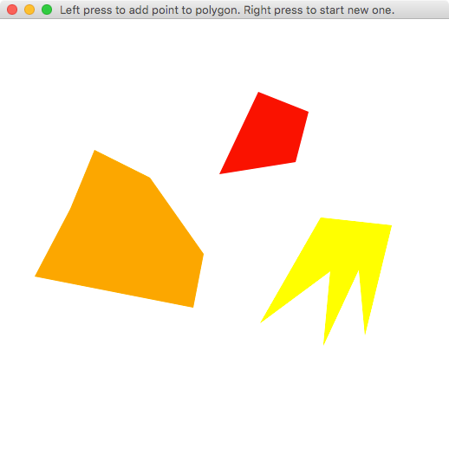
First Polygon Application
Draw a polygon by adding points one at a time
Right-click to switch to new polygon
Use Tkinter capabilities
self.canvas.create_polygon(…)
app/app_polygon.py

Slide 13
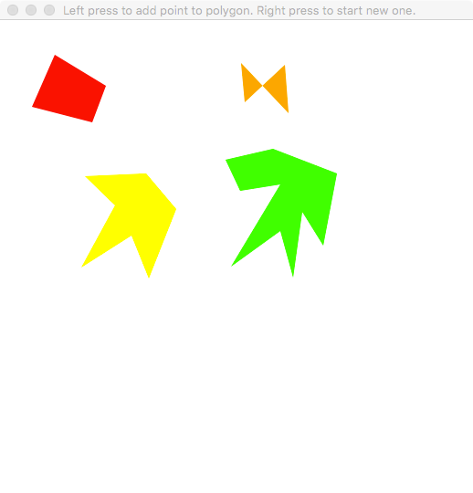
Experiment With Polygons
Different classes of polygons
Simple polygon – no overlapping edges
Convex polygon – all interior angles ≤ 180 degrees
Determine whether a polygon is simple or convex
app/app_polygon.py

Slide 14
Check Simple Property
Simple check
class Polygon:
def simple(self):
all = self.edges()
for i in range(0, len(all)-1):
e = all[i]
for j in range(i+1, len(all)):
if e.intersect(all[j]):
return False
return True
A polygon is simple if none of its edges intersect each other
Check each potential pair of edges ~ O(n²)
intersect method on edges
No intersection on end-points (head or tail)
Returns True or False
poly/polygon.py

Slide 15
Utility Methods
Intersection of two line segments
intersect(x1, y1, x2, y2, x3, y3, x4, y4)
Geometric interpretation (review code as needed)
Note: floating point arithmetic may introduce errors
intersecting
not intersecting
parallel
colinear
poly/util.py

Slide 16
Proper Orientation For Polygons
Define Standard Normal Form for Polygon
Ordered points and edges must appear in a counter-clockwise order
p₃
p₂
p₁
p₂
p₀
p₁
p₀
p₃
poly/polygon.py

Slide 17
Standard Form Yields Convex Detection
Given a polygon is in standard form
Review all sets of three consecutive points
If three points “make a left turn” then still convex
p₀, p₁, p₂ makes left turn, so OK, but…
p₂, p₃, p₀ makes right turn, so BAD
computeAngleSign method
p₂
p₃
p₀
p₁
poly/util.py

Slide 18
ComputeAngleSign method
ComputeAngleSign performs geometric computation of a number
Given three distinct points – p₀, p₁, p₂ – either
>0 : They form a left turn
<1 : They form a right turn
=0 : They form a straight line
Floating point computations may cause problem
poly/util.py

Slide 19
Floating Point Helper Method
Check zero
epsilon = 1E-9
def value(x):
if x >= 0 and x < epsilon:
return 0
if x < 0 and -x <= epsilon:
return 0
return x
Doesn’t always work, but standard way to try to deal with floating point errors
Useful to check if two numbers, a and b, are essentially the same
value(a–b) == 0
poly/util.py

Slide 20
Inside of Polygon in Standard Form
Given a polygon is in standard form
The “inside” of the polygon is on the left side of each edge
Edges are in counter-clockwise-order
These facts will prove necessary for the intersection algorithm
in

Slide 21
Detecting Polygon Intersection
How to detect whether two polygons intersect
Reuse edge intersection logic
M edges in polygon P and N edges in polygon Q
Check all M*N pairs for an intersection
Brute force algorithm takes O(M*N) time
P
Q

Slide 22
Intersection Detection
Simple check
class Polygon:
def intersect(self, p):
for e in self.edges():
for o in p.edges():
if e.intersect(o) is not None:
return True
return False
Check if any two edges from different polygons intersect
Returns True or False
However, does not compute actual intersection
Turns out this is an interesting problem!
app/app_intersect.py

Slide 23
Convex Polygon Intersection
Many common situations where concerned only with intersection between convex polygons
Graphics and gaming
Data analytics and clustering
Compute actual polygon formed by intersection
Requires O(M + N) time

Slide 24
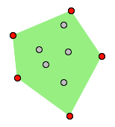
Aside: How To Create Convex Polygons
Don’t rely on user
Use algorithm to construct convex hull
The convex hull is the smallest convex polygon that fully encloses all points in a collection
code in hull/convex.py
Polygon computed is in standard normal form
app/app_hull.py

Slide 25
Ready For Convex Polygon Intersection
We can generate any number of convex polygons
See computeRandom(x, y, u, v)
We can now demonstrate an algorithm for computing the intersection of two convex polygons
Given polygons P and Q, compute a polygon R that results from the intersection of P and Q
Will be None if do not intersect
hull/convex.py

Slide 26
Review Convex Polygon Intersections
If two polygons P and Q intersect, there are three possibilities
P
P
Q
Q
P
Q
Q wholly contained in P
P wholly contained in Q
P partially intersects Q

Slide 27
Investigate Partial Intersection
Always even number of intersection points
And they come in pairs
These points must belong in computed polygon
P
P
Q
P
Q
Q
No intersection with endpoints of an edge

Slide 28
Structure of Intersecting Convex Polygons
Sickle shapes define the boundary of the intersection
Shaded region is intersection
Consider walking counter- clockwise around P
Sometimes edge is outside
Sometimes edge is inside and part of intersection
Q
P

Slide 29
Sketch Of A Solution
qe
Start with two arbitrary edges pe on P and qe on Q
Iteratively advance either pe or qe to try to find intersection points
But how?
Build up computed intersection edge by edge
Q
pe
P

Slide 30
Five Possible Situations For pe and qe
qe
Case 1:
Edge qe aims at pe, but pe doesn’t aim at qe
Observation
qe.next might yet intersect with pe
Result: advance qe
Q
pe
P

Slide 31
Five Possible Situations For pe and qe
Case 2:
Neither edge aims at each other
Observation
Advance the one “outside” which (for now) is determined by the orientation of pe and qe
Result: advance pe since it is outside relative to qe
Q
qe
pe
P

Slide 32
Five Possible Situations For pe and qe
Case 3:
Edge pe aims at qe, but qe doesn’t aim at pe
Observation
pe.next might yet intersect qe
Result: advance pe
Q
qe
P
pe

Slide 33
Five Possible Situations For pe and qe
Intersection:
Identify first point in intersection polygon
P is now “inside”
Neither pe or qe aims at each other
Result: advance qe since it is outside relative to pe
Intersection polygon has single point
Q
qe
P
pe

Slide 34
Five Possible Situations For pe and qe
qe
Case 3:
Edge pe aims at qe, but qe doesn’t aim at pe
Observation:
pe.next might yet intersect qe
Result: advance pe and add pe.tail to intersection as 2nd point since P is “inside”
Q
P
pe

Slide 35
Five Possible Situations For pe and qe
qe
Case 2:
Neither edge aims at each other
Observation:
qe is outside and qe.next might intersect pe
Result: advance qe
pe
Q
P

Slide 36
Five Possible Situations For pe and qe
qe
Intersection:
Add intersection as 3rd point in intersection polygon
Q is now “inside”
Observation:
pe is outside and pe.next might intersect qe
Result: advance pe
pe
Q
P

Slide 37
Five Possible Situations For pe and qe
qe
Case 1:
Edge qe aims at pe, but pe doesn’t aim at qe
Observation
qe.next might yet intersect with pe
Result: advance qe and add qe.tail to intersection as 4th point since Q is “inside”
Q
You might notice we are back where we started. Why aren’t we done?
pe
P

Slide 38
Aside: When Does Algorithm Terminate?
The intersection of two convex polygons is going to be a polygon
Which means it is a closed loop
We have to repeatedly iterate through P and Q until we compute the 1st intersection point again
This might require up to two passes around P and Q but no more. We thus iterate up to 2 * (M + N) times

Slide 39
Five Possible Situations For pe and qe
Case 2:
Neither edge aims at each other
Observation:
pe is outside and pe.next might intersect qe
Result: advance pe
Q
qe
pe
P

Slide 40
Five Possible Situations For pe and qe
Case 3:
Edge pe aims at qe, but qe doesn’t aim at pe
Observation
pe.next might yet intersect qe
Result: advance pe
Q
qe
P
pe

Slide 41
Termination Step Reached
Intersection:
Identify intersection that is same as first point
Terminate Algorithm
Result:
Intersection polygon of four points is computed
Q
qe
P
pe

Slide 42
Final Observations On Algorithm
There are FIVE situations to consider for pe & qe
Only one missed (in example) was where pe and qe are both aim towards each other
Handle in same fashion as case where neither aims at each other
qe
pe

Slide 43
Musn’t Forget Original Special Cases
What if one polygon wholly contains the other?
Then the 1st point in the intersection polygon is never found!
Must find a way to distinguish from two polygons that simply don’t intersect
P
P
Q
Q
P and Q don’t intersect
Q wholly contained in P

Slide 44
Check If Convex Polygon contains Point
If no intersections found then
Check if P contains any endpoint of Q
Check if Q contains any endpoint of P
Really nifty computation
Compute sum of interior angles θ₁ to θ_{n}
If sum = 360 then convex polygon contains point
P
θ₁
θ₂
θ₃
θ₅
θ₄
poly/convex_intersect.py

Slide 45
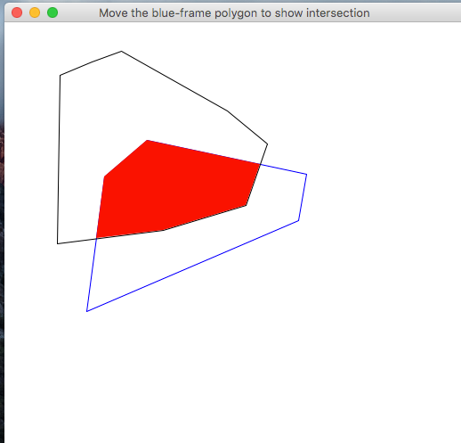
Evaluate Performance Of Algorithm
Execute and move the mouse to dynamically compute the intersection of the two polygons
If you observe unexpected behavior, then you have uncovered a “special case”
app/app_move_polygons.py

Slide 46
Potential Improvements
Performance: Polygon edges can be cached
Construct them on demand, but store them until polygon is modified
Robustness: Special Case Analysis
There are lots of hidden special cases that may prove challenging to resolve
Floating point errors always an issue

Slide 47
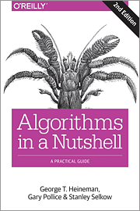
Some Final Thoughts
Intersections between arbitrary line segments is different problem
Find details in available book

