Slide 1
Operating Systems
Process & Processor Management

Slide 2
Topics Covered
The Process Concept
Lifecycle of a Process
Process Scheduling Policies
Deadlocks
Threads & Concurrency
Operating Systems

Slide 3
The ‘Process’ Concept
Operating Systems

Slide 4
Program & Process
A program is “a static entity with the potential for execution”
A program is NOT a process
A process is “a program in execution”
An active entity
Unit of work in a system
Also called a ‘task’ → single instance
A thread (or light weight process) “is a portion of a program that can be run independently of other portions but not meant to exist alone”
Operating Systems
Notes:
A system can be viewed as “a collection of processes”

Slide 5
Program and process
Program and process is same beast with different name or when this beast is sleeping (not executing) it is called program and when it is executing becomes process
The operating system manages many kinds of activities ranging from user programs to system programs like printer spooler, name servers, file server etc. Each of these activities is encapsulated in a process. A process includes the complete execution context (code, data, PC, registers, OS resources in use etc.).
It is important to note that a process is not a program. A process is only ONE instant of a program in execution. There are many processes can be running the same program.

Slide 6
Program and process
The five major activities of an operating system in regard to process management are
- Creation and deletion of user and system processes.
-Suspension and resumption of processes.
-A mechanism for process synchronization.
-A mechanism for process communication.
-A mechanism for deadlock handling.

Slide 7
Process Creation
In general-purpose systems, some way is needed to create processes as needed during operation. There are four principal events led to processes creation.
1. System initialization.
2. Execution of a process Creation System calls by a running process.
3. A user request to create a new process.
4. Initialization of a batch job.

Slide 8
Process creation
Following are some reasons for creation of a process
User logs on.
User starts a program.
Operating systems creates process to provide service, e.g., to manage printer.
Some program starts another process, e.g., Netscape calls xv to display a picture.

Slide 9
Process termination
A process terminates when it finishes executing its last statement. Its resources are returned to the system, it is purged from any system lists or tables, and its process control block (PCB) is erased i.e., the PCB's memory space is returned to a free memory pool. The new process terminates the existing process, usually due to following reasons:
Normal Exit Most processes terminates because they have done their job. This call is exit in UNIX.
Error Exist When process discovers a fatal error. For example, a user tries to compile a program that does not exist.

Slide 10
Process termination
Fatal Error An error caused by process due to a bug in program for example, executing an illegal instruction, referring non-existing memory or dividing by zero.
Killed by another Process A process executes a system call telling the Operating Systems to terminate some other process. In UNIX, this call is kill. In some systems when a process is killed, all processes it created are killed as well (UNIX does not work this way).

Slide 11
Process, The OS & CPU
The notion of a process enables an OS the ability to perform multiple actions at the same time
In parallel or concurrently
In the simplest case there is only one process to manage
The interesting case arises when there are many processes competing for system resources
On a system with multiple CPU's there can be more than one current process - but at most one per CPU
Processor, CPU, Core → all interchangeable
Operating Systems
Notes:
Processor ( CPU, central processing unit) –part of machine that performs calculations and executes programs.
Strictly speaking a processor can only do one job at a time – pesudo parallelism – the appearance of multi processes at once

Slide 12
Process Components
Address Space
The code for the executing program
The data for the executing program
A process stack (SP) encapsulating the state of procedure calls
The program counter (PC) indicating the next instruction
A set of operating system resources
(e.g. open files, network connections)
Process named using its Process ID (PID)
Operating Systems

Slide 13
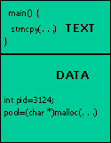
Process Address Space
A process is an entity, each has its own Process Address Space containing
Text Region → portion of address space where actual program instructions reside
Data Region → stores all data variables upon which the programs instructions operate
Process Stack → contains temporary data such as subroutine parameter, return address, and temporary variables.
Operating Systems
Fig 3.1 – Program view
Notes:
The central processing unit contains a number of memory locations which are individually addressable and reserved for specific purpose.
These memory locations are called registers.
Some of theses registers are accessible to the programmer while some others are for the exclusive use of CPU.

Slide 14
Multiprogramming
Conceptually each process has its own virtual CPU
In reality the processor switches back and forth from process to process
This is called multiprogramming
Strictly speaking a processor can only do one job at a time
Pseudo-parallelism → the appearance of multi processes at once
To manage the various processes, the OS maintains a set of data structures
Called Process Control Blocks (PCB)
Operating Systems
Notes:
One processor or CPU, shared by several jobs or processes is multi programming
Multiprogramming requires that the processor be “allocated” to each job or to each process for a period of time and “deallocated” at an appropriate moment.

Slide 15
Process Control Block
process in an operating system is represented by a data structure known as a process control block (PCB) or process descriptor.
The PCB is a certain store that allows the operating systems to locate key information about a process. Thus, the PCB is the data structure that defines a process to the operating systems

Slide 16
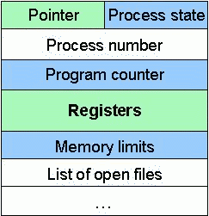
Process Control Block
How the OS represents a process
As a new process starts the OS starts a new data structure called a PCB
A record of all the information about a process
One PCB per process
Operating Systems
Fig 3.2 – Process Control Block
Notes:
values of the CPU registers (relevant only when the process is not running; when it is running, these values change constantly)

Slide 17
Process Control Block
The PCB contains the following:
Pointer → To parent or child process
Process State → Status (new, ready, running)
Process Number → PID, Unique identifier
Program Counter
Address of the next instruction to be executed
The processor it is running on
CPU Registers & CPU Scheduling Info
Accumulators, index registers, stack pointers
Process priority, scheduling queues
Memory Limits → Memory storage information
Operating Systems
Notes:
Accumulator: stores the result of the last processing step of the ALU.
Instruction register: holds the instruction while it is being executed.
Address register: holds the location of the next piece of data.
Storage register: holds the information on its way to and from the main memory.
Program counter: holds the address of the next instruction to e executed.
Input/output register: communicates with the input/output devices.xecution of instructions and the intermediate results.

Slide 18
PCB & Context Switches
The PCB also is where the OS keeps all of a processes hardware execution state when the process is not running
Program Counter (PC)
The Process Stack (SP)
Values of the CPU registers
This state is everything that is needed to restore the hardware to the same configuration it was in when the process was switched out of the hardware
Operating Systems
Notes:
At any one time, there are many processes in the system,
each in its own particular state
which typically contains temporary data such as subroutine parameter, return address, and temporary variables.

Slide 19
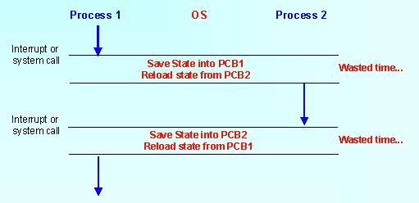
Context Switch
A Context Switch occurs when the OS “switchs the CPU to another process, saving the state of the old process and loading the saved state for the new process”
Operating Systems
Fig 3.3 – Context Switch
Notes:
Context switch time is pure overhead
A performance bottleneck, so threads are being used to avoid it
Threads
– One way of reducing context switch times
– Also known as lightweight processes
– Shorter context switch time than heavyweight processes

Slide 20
Life Cycle of a Process
Operating Systems

Slide 21
Process Manager & CPU
Process Manager performs job scheduling, process scheduling and interrupt management
In single-user systems, processor is busy only when user is executing a job, at all other times it is idle
Processor management is simple
In multiprogramming environment, processor must be allocated to each job in a fair and efficient manner
Requires scheduling policy and a scheduling algorithm – covered later on
Operating Systems

Slide 22
Job v Process Scheduling
Processor Manager is a composite of two sub-managers
Job Scheduler is a high level scheduler which selects jobs from a queue based on each jobs characteristics
Goal to put job in sequence to maximize resources
Process Scheduler is a low level scheduler that established the order in which processes from the Ready queue will be served by the CPU
Operating Systems
Notes:
Scheduling → determining which process should be current at any given time
Covered in detail later on

Slide 23
Scheduling
At a given time several processes could be competing for the use of the CPU
The OS decides the optimum sequence and timing of assigning processes to the CPU
High Level → decision to admit a ‘Job’ to the system, Long Term (HLS)
Medium Level → decision to temporarily remove or re-introduce a process (MLS)
Low Level → decision of which ready process should be assigned to the CPU for execution (LLS)
Operating Systems
Notes:
Scheduling → determining which process should be current at any given time
Covered in detail later on

Slide 24
Process States
OS must ensure that each process receives sufficient amount of CPU time
During a process lifecycle it moves through a series of discrete process states
The process state consist of everything necessary to resume the process execution if it is somehow put aside temporarily
Operating Systems
Notes:
A process is the OS abstraction for execution
Requires a set of resources
A thread (or light weight process) “is a portion of a program that can be run independently of other portions but not meant to exist alone”

Slide 25
Process States
As a process executes, it changes state
new: The process is being created.
running: Instructions are being executed.
waiting: The process is waiting for some event to occur.
ready: The process is waiting to be assigned to a processor.
terminated: The process has finished execution.

Slide 26
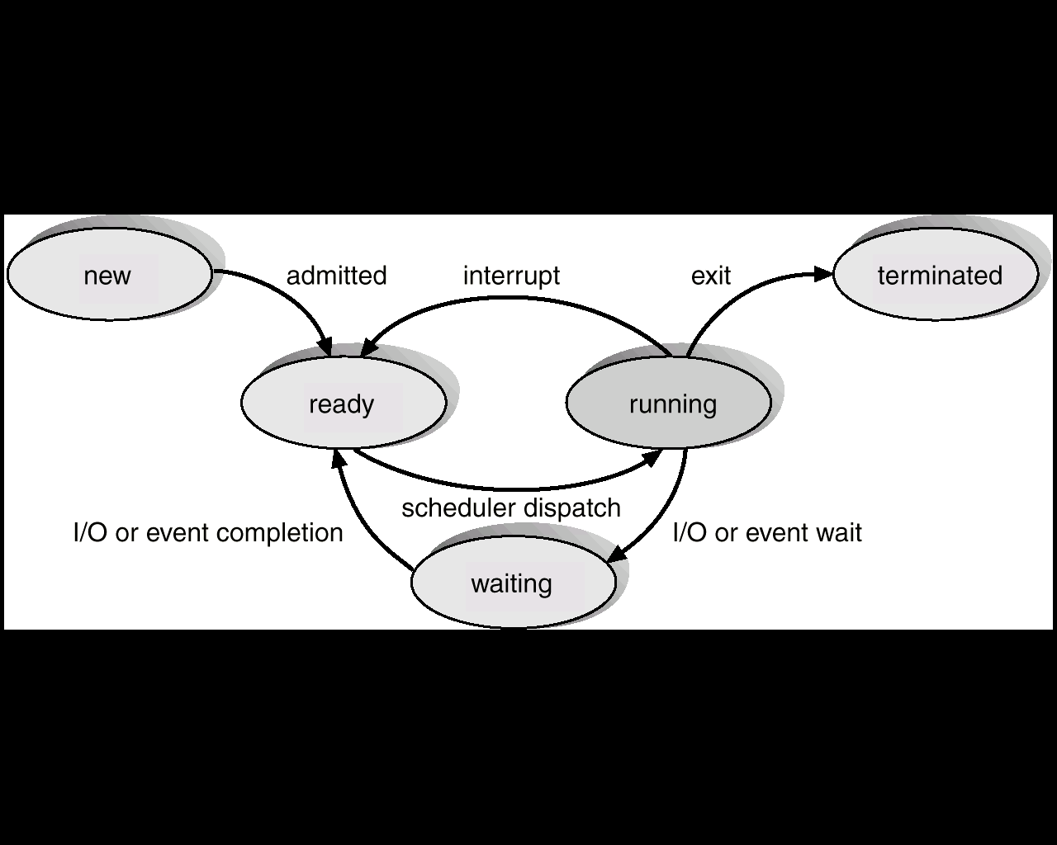
Process States

Slide 27
Process State Transitions
Transition 1 occurs when process discovers that it cannot continue. If running process initiates an I/O operation before its allotted time expires, the running process voluntarily relinquishes the CPU. This state transition is: Block (process-name): Running → Block./waiting
Transition 2 occurs when the scheduler decides that the running process has run long enough and it is time to let another process have CPU time. This state transition is: Time-Run-Out (process-name): Running → Ready.

Slide 28
Process Transition States
Transition 3 occurs when all other processes have had their share and it is time for the first process to run again This state transition is: Dispatch (process-name): Ready → Running.
Transition 4 occurs when the external event for which a process was waiting (such as arrival of input) happens. This state transition is: Wakeup (process-name): Blocked → Ready.
Transition 5 occurs when the process is created. This state transition is: Admitted (process-name): New → Ready.

Slide 29
Process Transition States
Transition 6 occurs when the process has finished execution. This state transition is: Exit (process-name): Running → Terminated.

Slide 30
PCB & State Queues
PCBs are data structures dynamically allocated in OS memory
When a process is created
The OS allocates a PCB for it
Initializes it &
Places it on the Ready queue
As the process computes, does I/O, etc., its PCB moves from one queue to another
When the process terminates, its PCB is de-allocated
Operating Systems

Slide 31
State Queues
The OS maintains a collection of queues that represent the state of all processes in the system
Typically, the OS has one queue for each state Ready, Blocked etc…
Each PCB is queued on a state queue according to its current state
As a process changes state, its PCB is unlinked from one queue and linked into another
Operating Systems
Notes:
Draw diagram state queues

Slide 32
Operating Systems
Note: Processes initially go to the Ready state Can only enter Running via the Ready state Can only leave from the Running state (normally)
Fig 3.6 – State Queues

Slide 33
CPU Scheduling
Basic Concepts
Scheduling Criteria
Scheduling Algorithms

Slide 34
Basic Concepts
Processor scheduling/CPU scheduling is the problem of determining when processors should be assigned and to which processes
When more than one process is runable, the operating system must decide which one first.
The part of the operating system concerned with this decision is called the scheduler, and algorithm it uses is called the scheduling algorithm.

Slide 35
CPU Scheduler
Selects from among the processes in memory that are ready to execute, and allocates the CPU to one of them.
CPU scheduling decisions may take place when a process:
1. Switches from running to waiting state.
2. Switches from running to ready state.
3. Switches from waiting to ready.
4. Terminates.
Scheduling under 1 and 4 is nonpreemptive – a new process must be selected for execution
Once the CPU has been allocated to a process, the process keeps the CPU until it releases the CPU either by terminating or switching to a waiting state
Used by Windows 3.1 and Apple Macintosh
All other scheduling is preemptive.
Requires mechanisms to coordinate access to shared data
Sections of kernel code must be guarded from simultaneous use

Slide 36
CPU Scheduling: General Goals
Fairness Fairness is important under all circumstances. A scheduler makes sure that each process gets its fair share of the CPU and no process can suffer indefinite postponement. Note that giving equivalent or equal time is not fair. Think of safety control and payroll at a nuclear plant.
Policy Enforcement The scheduler has to make sure that system's policy is enforced. For example, if the local policy is safety then the safety control processes must be able to run whenever they want to, even if it means delay in payroll processes

Slide 37
CPU Scheduling: General Goals
Efficiency Scheduler should keep the system (or in particular CPU) busy cent percent of the time when possible. If the CPU and all the Input/Output devices can be kept running all the time, more work gets done per second than if some components are idle.
Response Time A scheduler should minimize the response time for interactive user.
Turnaround A scheduler should minimize the time batch users must wait for an output.

Slide 38
CPU Scheduling: General Goals
Throughput A scheduler should maximize the number of jobs processed per unit time.
Waiting time – amount of time a process has been waiting in the ready queue
A little thought will show that some of these goals are contradictory. It can be shown that any scheduling algorithm that favors some class of jobs hurts another class of jobs

Slide 39
Criteria for Scheduling
Priority assigned to the Job
Class of job
Batch / online / real-time etc…
Resource requirements
Time, Memory etc…
I/O or CPU bound
Resources used to date
Amount of CPU time etc…
Operating Systems

Slide 40
Interrupts
There are instances when a job claims CPU for a very long time before issuing an I/O request
Builds up Ready queue & empties I/O queues
Creates an unacceptable imbalance in the system
Process Scheduler uses a timing mechanism to periodically interrupt running processes when a predetermined slice of time has expired
Suspends all activity on the currently running job and reschedules it into the Ready queue
Operating Systems

Slide 41
Policy Classification
Preemptive scheduling policy interrupts processing of a job and transfers the CPU to another job. In this case a process is runnable but is taken away from the CPU
Non-preemptive scheduling policy functions without external interrupts
Once a job captures CPU and begins execution, it remains in Running state uninterrupted Until it issues an I/O request (natural wait) or until it is finished (exception for infinite loops)
Operating Systems

Slide 42
Scheduling Policies
First Come First Served
Shortest Job First
Shortest Remaining Time First
Round Robin
Priority
Multi Level Feedback Queues
Operating Systems

Slide 43
First Come First Served
FCFS
Handles jobs according to their arrival time
The earlier they arrive, the sooner they are served
Simple algorithm to implement uses a FIFO queue
Favors long jobs, can lead to starvation
Non-preemptive
Operating Systems

Slide 44
Scheduling Algorithms First-Come, First-Served (FCFS)
Process Burst Time
P₁ 24
P₂ 3
P₃ 3
Suppose that the processes arrive in the order: P₁ , P₂ , P₃ The Gantt Chart for the schedule is:
Waiting time for P₁ = 0; P₂ = 24; P₃ = 27
Average waiting time: (0 + 24 + 27)/3 = 17
P₁
P₂
P₃
0
24
27
30

Slide 45
FCFS Scheduling (Cont.)
Suppose that the processes arrive in the order P₂ , P₃ , P₁
The Gantt chart for the schedule is:
Waiting time for P₁ = 6; P₂ = 0; P₃ = 3
Average waiting time: (6 + 0 + 3)/3 = 3
Much better than previous case.
Average waiting time is generally not minimal and may vary substantially if the process CPU-burst times vary greatly
P₂
P₃
P₁
0
3
6
30

Slide 46
Shortest Job First
SJF
Handles jobs based on length of their CPU cycle time
The estimated runtime is taken into account and jobs with the shorter runtimes are jumped in the queue ahead of longer jobs
Favors short jobs, can lead to starvation
Non-preemptive
Operating Systems
Notes:
Doesn’t work in interactive systems because users don’t estimate in advance CPU time required to run their jobs

Slide 47
Example of Non-Preemptive SJF
Process Arrival Time Burst Time
P₁ 0.0 7
P₂ 2.0 4
P₃ 4.0 1
P₄ 5.0 4
SJF (non-preemptive)
Average waiting time = (0 + 6 + 3 + 7)/4 = 4
P₁
P₃
P₂
P₄
0
3
7
8
12
16

Slide 48
Shortest Remaining Time First
SRT
Processor allocated to job closest to completion
When one job is currently running another job enters the system with a shorter estimated run time then the current job is preempted to allow the new job to proceed
Favors short jobs even more, can lead to starvation
Preemptive version of SJF
Operating Systems

Slide 49
Example of SRTF
Process Arrival Time Burst Time
P₁ 0.0 7
P₂ 2.0 4
P₃ 4.0 1
P₄ 5.0 4
SJF (preemptive)
Average waiting time = (9 + 1 + 0 +2)/4 = 3
P₁
P₂
P₃
P₂
P₄
P₁
0
2
4
5
7
11
16

Slide 50
Round Robin
Based on a pre-determined slice of time that is given to each job, called Time Quantum
Processes selected on a FCFS basis
If process runs beyond the Time Quantum it is interrupted and returned to the end of the Ready queue
Each job is given CPU time in rotation
Hardware timer generates interrupt at preset intervals
Preemptive
Operating Systems

Slide 51
Round Robin
Round Robin used where response time is essential
Incurs a significant overhead
Each quantum requires a context switch
Time Quantum should be set at a compromise
High Quantum → minimise context switch
Low Quantum → reduce users response time
Long enough to allow 80 % of CPU cycles to run to completion
At least 100 times longer than time required to perform one context switch.
Operating Systems
Notes:
If CPU cycle was interrupted by I/O request, then info about the job is saved in its PCB & it is linked at end of the appropriate I/O queue
Later, when I/O request has been satisfied, it is returned to end of READY queue to await allocation of CPU.

Slide 52
Example of RR with Time Quantum = 20
Process Burst Time
P₁ 53
P₂ 17
P₃ 68
P₄ 24
The Gantt chart is:
Typically, higher average turnaround than SJF, but better response.
P₁
P₂
P₃
P₄
P₁
P₃
P₄
P₁
P₃
P₃
0
20
37
57
77
97
117
121
134
154
162

Slide 53
Multilevel Feedback Queues
MFQ
Not a separate scheduling algorithm
Works in conjunction with several other schemes where jobs can be grouped according to a common characteristic
A number of queues of entry, each queue devised based upon varying factors
Past performance
Priority
CPU or I/O bound jobs
Operating Systems

Slide 54
Multilevel Feedback Queues
Within these queues the FIFO system is implemented
A Time Quantum can also be applied
Give special treatment to jobs that have been in system for a long time (aging)
Examples
Priority-based system with different queues for each priority level, High or Low
Put all CPU-bound jobs in one queue and all I/O-bound jobs in another, Alternately select jobs from each queue to keep the system balanced
Operating Systems

Slide 55
Priority Scheduling
A priority number (integer) is associated with each process
The CPU is allocated to the process with the highest priority (smallest integer ≡ highest priority).
Can be preemptive (compares priority of process that has arrived at the ready queue with priority of currently running process) or nonpreemptive (put at the head of the ready queue)
SJF is a priority scheduling where priority is the predicted next CPU burst time.
Problem ≡ Starvation – low priority processes may never execute.
Solution ≡ Aging – as time progresses increase the priority of the process.

Slide 56
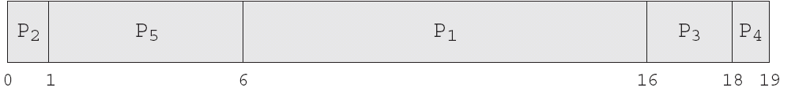
Priority Scheduling
Process | Burst Time | Priority
P1 | 10 | 3
P2 | 1 | 1
P3 | 2 | 4
P4 | 1 | 5
P5 | 5 | 2

Slide 57
Threads
Threads
Processes Vs Threads
Why Threads?
Advantages of Threads over Multiple Processes
Disadvantages of Threads over Multiprocesses

Slide 58
Threads
Despite of the fact that a thread must execute in process, the process and its associated threads are different concept.
Processes are used to group resources together and threads are the entities scheduled for execution on the CPU.
A thread is a single sequence stream within in a process. Because threads have some of the properties of processes, they are sometimes called lightweight processes.
In a process, threads allow multiple executions of streams. In many respect, threads are popular way to improve application through parallelism.

Slide 59
Threads
The CPU switches rapidly back and forth among the threads giving illusion that the threads are running in parallel. Like a traditional process i.e., process with one thread, a thread can be in any of several states (Running, Blocked, Ready or Terminated). Each thread has its own stack. Since thread will generally call different procedures and thus a different execution history. This is why thread needs its own stack. An operating system that has thread facility, the basic unit of CPU utilization is a thread. A thread has or consists of a program counter (PC), a register set, and a stack space.
Threads are not independent of one other like processes as a result threads shares with other threads their code section, data section, OS resources also known as task, such as open files and signals.

Slide 60
Overview
Many software packages are multi-threaded
Web browser: one thread display images, another thread retrieves data from the network
Word processor: threads for displaying graphics, reading keystrokes from the user, performing spelling and grammar checking in the background
Web server: instead of creating a process when a request is received, which is time consuming and resource intensive, server creates a thread to service the request
A thread is sometimes called a lightweight process
It is comprised over a thread ID, program counter, a register set and a stack
It shares with other threads belonging to the same process its code section, data section and other OS resources (e.g., open files)
A process that has multiples threads can do more than one task at a time

Slide 61
Processes Vs Threads
As we mentioned earlier that in many respect threads operate in the same way as that of processes. Some of the similarities and differences are:
Similarities
Like processes threads share CPU and only one thread active (running) at a time.
Like processes, threads within a processes, threads within a processes execute sequentially.
Like processes, thread can create children.
And like process, if one thread is blocked, another thread can run.

Slide 62
Processes Vs Threads
Differences
Unlike processes, threads are not independent of one another.
Unlike processes, all threads can access every address in the task .
Unlike processes, thread are design to assist one other. Note that processes might or might not assist one another because processes may originate from different users.

Slide 63
Why Threads?
Following are some reasons why we use threads in designing operating systems.
A process with multiple threads make a great server for example printer server.
Because threads can share common data, they do not need to use interposes communication.
Because of the very nature, threads can take advantage of multiprocessors.

Slide 64
Why threads
Threads are cheap in the sense that
They only need a stack and storage for registers therefore, threads are cheap to create.
Threads use very little resources of an operating system in which they are working. That is, threads do not need new address space, global data, program code or operating system resources.
Context switching are fast when working with threads. The reason is that we only have to save and/or restore PC, SP and registers.
But this cheapness does not come free - the biggest drawback is that there is no protection between threads.

Slide 65
Advantages of Threads over Multiple Processes
Context Switching Threads are very inexpensive to create and destroy, and they are inexpensive to represent. For example, they require space to store, the PC, the SP, and the general-purpose registers, but they do not require space to share memory information, Information about open files of I/O devices in use, etc. With so little context, it is much faster to switch between threads. In other words, it is relatively easier for a context switch using threads.
Sharing Treads allow the sharing of a lot resources that cannot be shared in process, for example, sharing code section, data section, Operating System resources like open file etc.

Slide 66
Disadvantages of Threads over Multiprocesses
Blocking The major disadvantage if that if the kernel is single threaded, a system call of one thread will block the whole process and CPU may be idle during the blocking period.
Security Since there is, an extensive sharing among threads there is a potential problem of security. It is quite possible that one thread over writes the stack of another thread (or damaged shared data) although it is very unlikely since threads are meant to cooperate on a single task.

Slide 67
Application that Benefits from Threads
A proxy server satisfying the requests for a number of computers on a LAN would be benefited by a multi-threaded process. I
n general, any program that has to do more than one task at a time could benefit from multitasking.
For example, a program that reads input, process it, and outputs could have three threads, one for each task.

Slide 68
Application that cannot Benefit from Threads
Any sequential process that cannot be divided into parallel task will not benefit from thread, as they would block until the previous one completes.
For example, a program that displays the time of the day would not benefit from multiple threads.

Slide 69
Context Switch
To give each process on a multiprogrammed machine a fair share of the CPU, a hardware clock generates interrupts periodically. This allows the operating system to schedule all processes in main memory (using scheduling algorithm) to run on the CPU at equal intervals.
Each time a clock interrupt occurs, the interrupt handler checks how much time the current running process has used. If it has used up its entire time slice, then the CPU scheduling algorithm (in kernel) picks a different process to run. Each switch of the CPU from one process to another is called a context switch.

Slide 70
Context Switch
Major Steps of Context Switching
The values of the CPU registers are saved in the process table of the process that was running just before the clock interrupt occurred.
The registers are loaded from the process picked by the CPU scheduler to run next.

Slide 71
Stack vs heap
The stack is a place in the computer memory where all the variables that are declared and initialized before runtime are stored.
The heap is the section of computer memory where all the variables created or initialized at runtime are stored.

