Slide 1
MLDP Project
Tran Minh Khoa| 2101432I | P02
Topic: Data Science Job salaries
Jobs in the field of Data Science vary widely in salary. This project aims to determine how various factors – such as job title, company size, and country of work – impact annual salary.

Slide 2
Dataset URL: https://www.kaggle.com/datasets/ruchi798/data-science-job-salaries
Column | Type | Description
company_location | Nominal | Country Code¹ of company’s contracting branch (50 unique values)
company_size | Ordinal | Number of people that worked for the company
employee_residence | Nominal | Country Code¹ of employee’s primary residence (57 unique values)
experience_level | Ordinal | Level of experience holding job_title
job_title | Nominal | Role of work (50 unique values)
remote_ratio | Ordinal | Percentage of work done remotely
salary_currency | Nominal | Currency of salary
salary | Interval | The salary paid
salary_in_usd | Interval | salary converted to USD
work_year | Interval | Year when salary was paid
¹ ISO 3166
² ISO 4217
Notes:
Insert a picture of one of the geographic features of your country.

Slide 3
Pre-processing
Cleaning
Transformation
Ignored duplicates
They probably refer to employees working for the same company, under the same title
Removed salary & salary_currency
Directly related to salary_in_usd
Removed employment_type
Low Variance
No Missing Values
Removed outliers in salary_in_usd
Ordinal Scaled³ company_size & experience_level
employee_residence
Booleanized as whether employee lived in the same country as company_location
Renamed as ricl (resides in company_location)
³ These columns are Ordinal: they can be ranked, and thus numericized.
Notes:
Insert a picture illustrating a season in your country.

Slide 4
More Transformation
company_location
Binned by continent
Ordinal Scaled from West to East
The Westmost continent, NA, is 1
The Eastmost, OC, is 6
job_title
Standardized using RegEx⁴
Popularity Encoded⁵
Renamed as job_popularity
Min-Max Normalized all columns except work_year
/.*Researcher/ ⇒ “Research Scientist”
/AI|Computer Vision|Machine Learning|NLP/ ⇒ “ML”
/.*(Data|ML).*(Analyst|Architect|Engineer|Researcher|Scientist).*/ ⇒ “$1 $2”
/(Director|Head).*|.*Manager/ ⇒ “Manager”
⁴ Pattern-based search & replace
⁵ Replace with frequency of value
Notes:
Insert a picture of an animal and or plant found in your country.

Slide 5
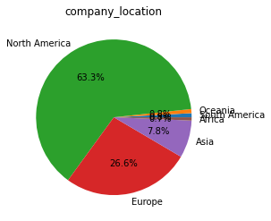
Exploration (Insights)
1: Most jobs Belong to North America
2: Salaries are really increasing year by year
Potential Correlation: the US consumes the most data in the world⁶
This could mean that NA has the most resources and opportunities available for Data Science jobs.
Or, that there is a bias in the data
 | Increase in mean salary | US Inflation Rate⁷
From 2020 to 2021 | 13% | 1.4%
From 2021 to 2022 | 34% | 7.0%
Salary Increase rates > Inflation rates
Jobs in the Data Science field are looking promising 💵💵💵
⁶ https://hbr.org/2019/01/which-countries-are-leading-the-data-economy
⁷ https://tradingeconomics.com/united-states/inflation-cpi

Slide 6
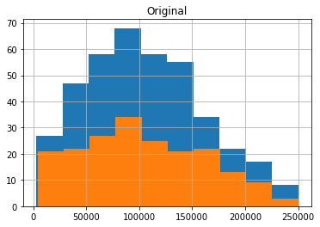
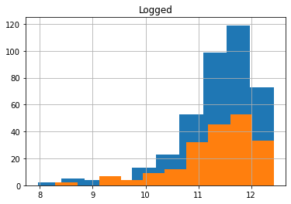
Pre-Modeling
Split Data
Target: salary_in_usd
Is right-skewed, but Logging makes it left-skewed
Models can be trained to target both original and logged values; the better result will be selected
Test Size: 1/3
Since Target is a continuous variable, only Regressors will be used (no Classifiers)
All models will be evaluated by Root Mean Squared Error (RMSE)
Notes:
Add key points in the history of your country to the timeline.

Slide 7
Optimization Algorithms
All optimizers use Cross-validation
Sequential Feature Selection (Backward Feature Elimination)
BFE removes a provided n number of “insignificant” (high p-value) features
For each model, different n’s will be compared; the best will be picked
n is clamped between all features and half of features
Using less than half of features was tested to be ineffective
Grid Search
GS tries different combinations of provided parameters and picks the best combination
Notes:
Insert a picture illustrating a custom or tradition here.

Slide 8
Models Explored & Shortlisted
Explored
Shortlisted for gs (After BFE)
Linear Regression (LR)
Best Fit Line
Ridge
L2 Regularization of LR
Lasso
L1 Regularization of LR
Regression Tree (RT)
Gradient Boosting Regressor (GBR)
Chained RTs
Support Vector Regression (SVR)
Best Fit Hyperplane
GBR (RMSE: 40117.74)
SVR (40292.60)
Logged Target
Removed work_year
LR (40608.50)
Logged Target
Notes:
Insert a picture of the head leader of your country.

Slide 9
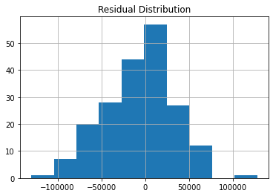
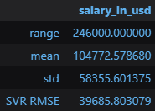
The Best Model (After GS)
SVR
Error
Parameters
C: 0.145
epsilon: 0.2
tol: 0.145
Trained with work_year removed and Target logged
RMSE: 39685.80
Distribution of Error is Normal
RMSE is satisfactory
Less than 20% (1/6) of the range of Target
Less than the standard deviation of Target
Notes:
Insert a picture that illustrates some part of your country’s economy.

Slide 10
Conclusion
Summary
Areas of Improvement
Data Science Job Salaries can be accurately calculated from
Company size & location
Whether one lives in the country of their company
Job popularity
One’s experience level
Percentage of work done remotely
SVR was found to predict salaries best
While the model can be considered satisfactory, a few areas have room for improvement:
Standardization of job_title
Assumes that standardized titles are similar
Perhaps Analysis of Variance or Natural Language Processing could be used to extract similarities
Min-Max Normalization
Limits domains
Notes:
Insert a picture of one of the points of interest for your country.

