Slide 1
CSC324 Individual Project
Interactive Greenhouse Gas Tracker
Tommy Liu

Slide 2
Data Visualization Purpose
Visualizes greenhouse gas emissions data
Include different countries/regions
From year 1851 to 2021
Provides insights into emissions trends and comparisons between countries
Map
Line charts
Bar charts

Slide 3
Questions
How have greenhouse gas emissions trends evolved over time?
How do different countries compare in terms of their emissions?
How do emissions metrics vary when normalized by population or GDP?

Slide 4
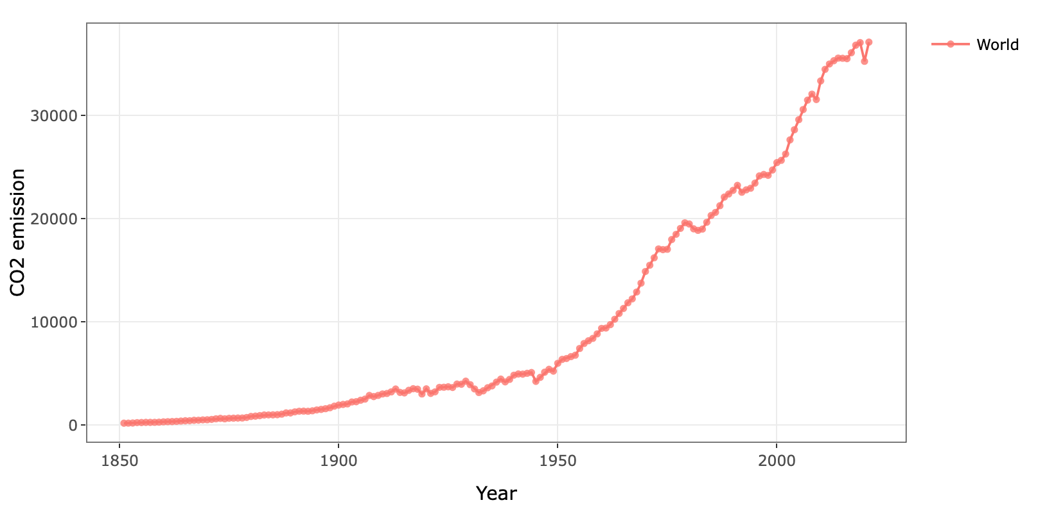
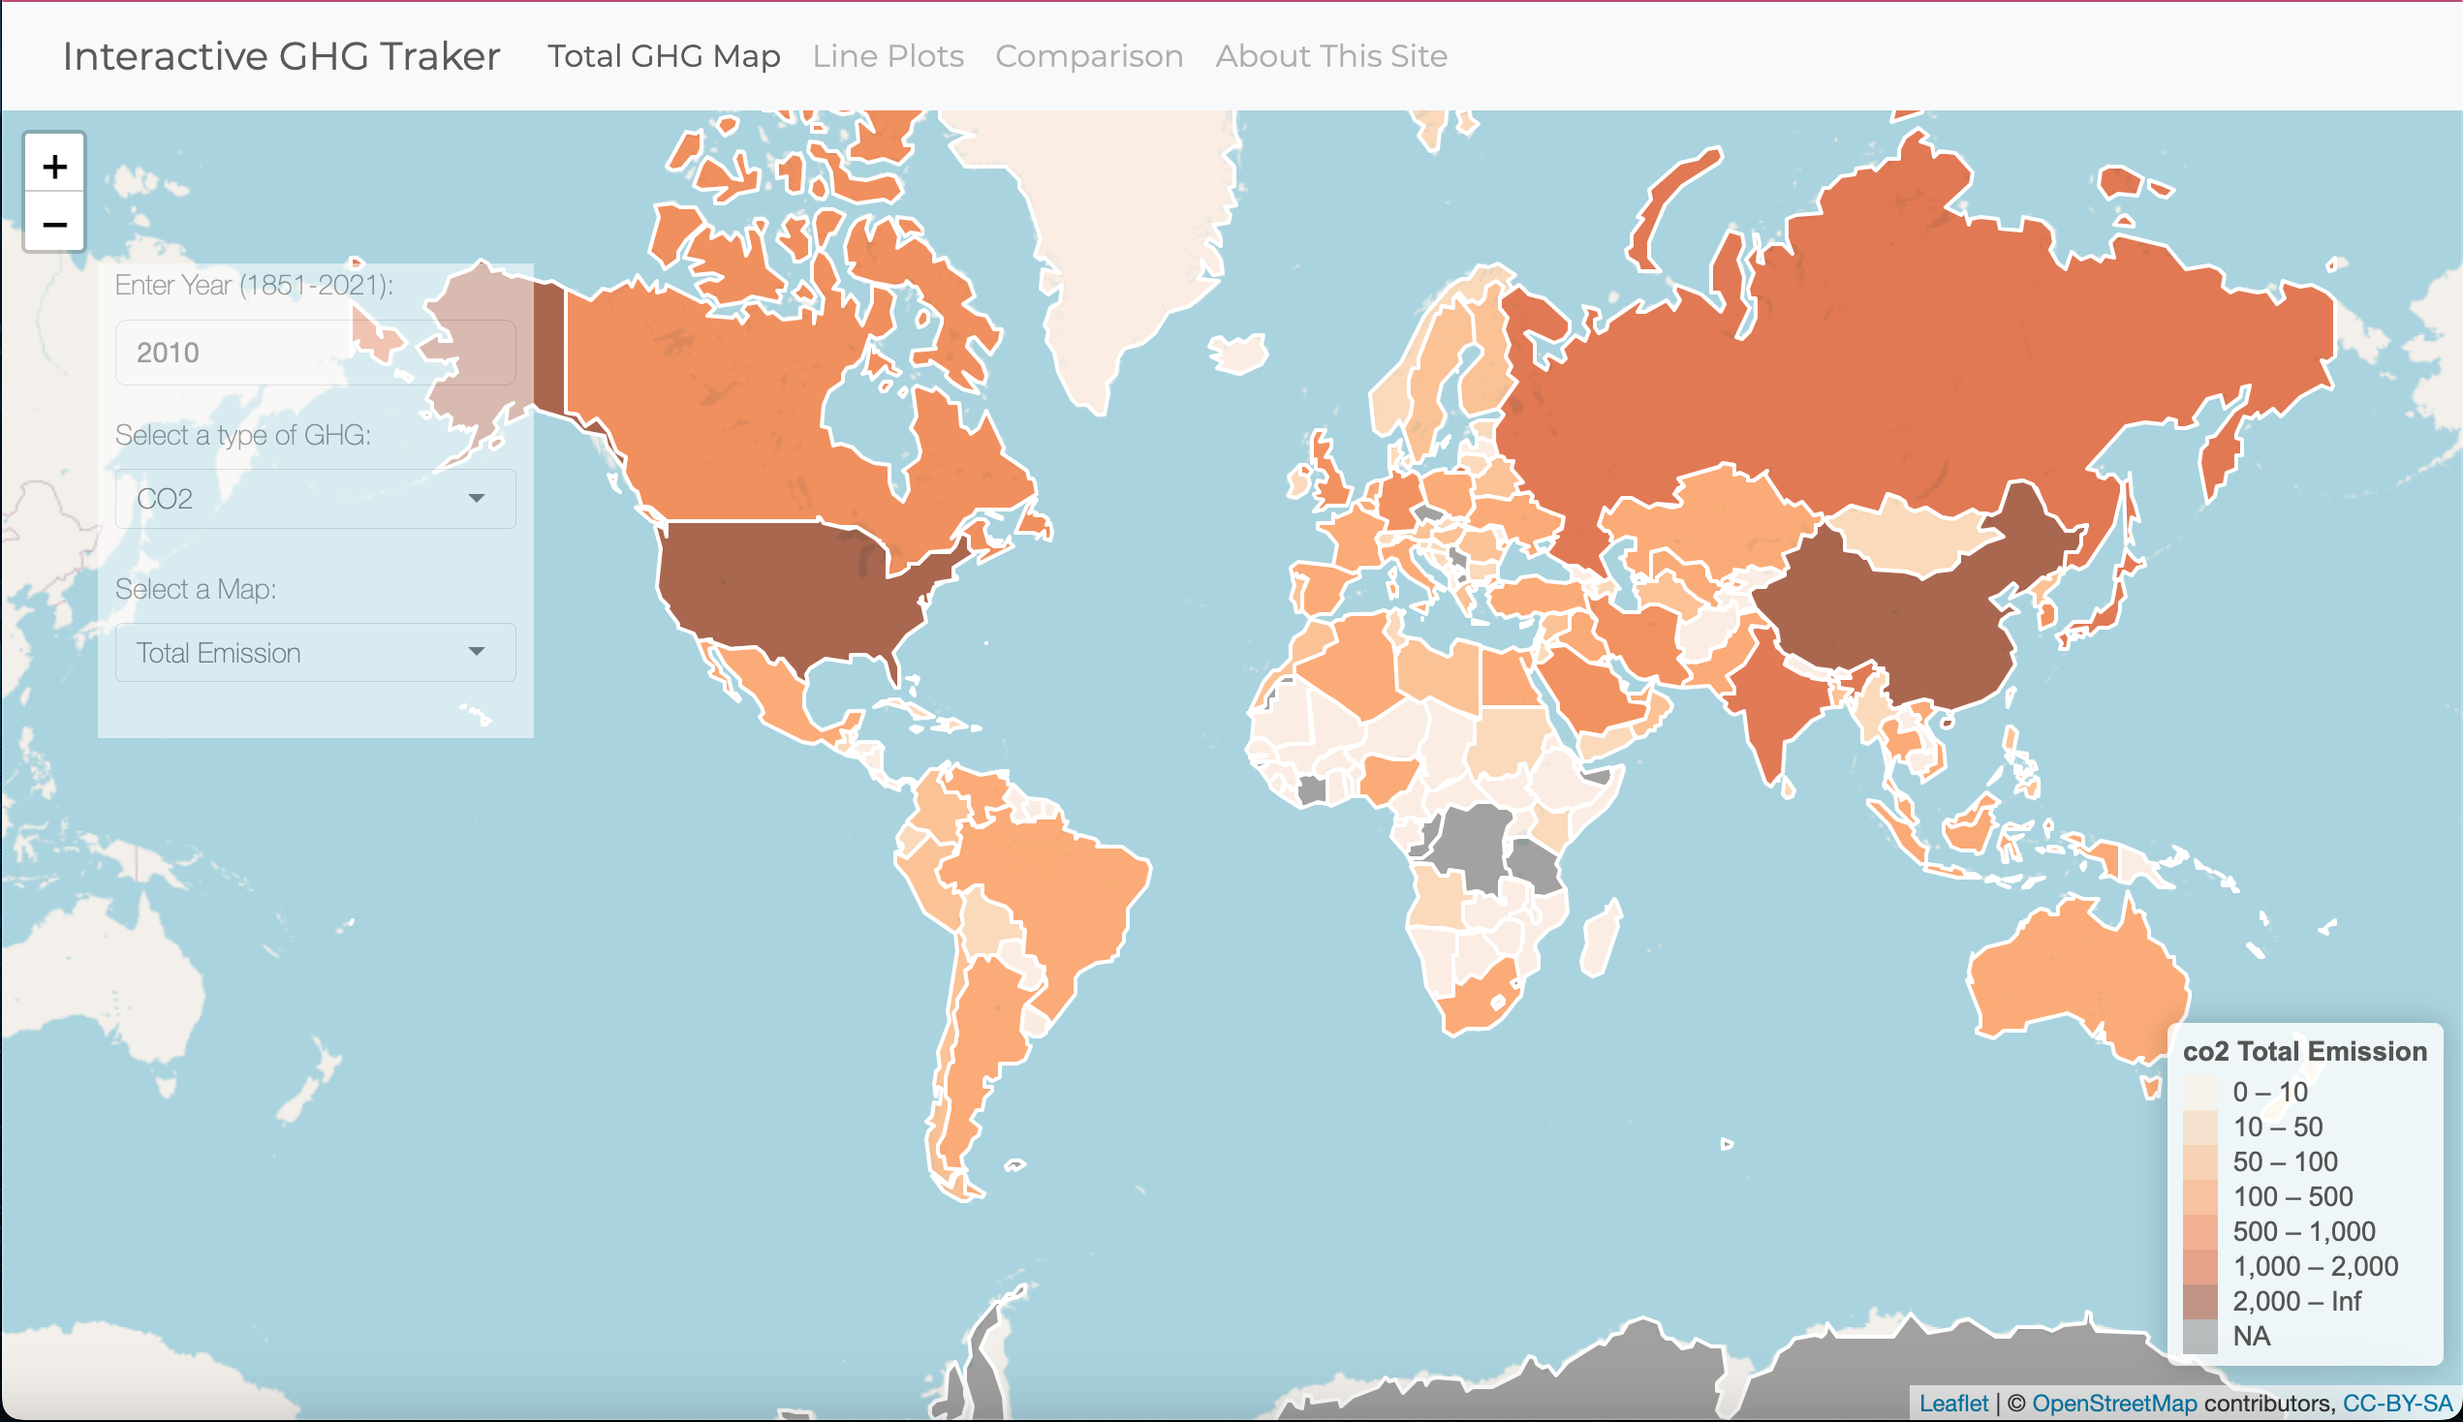
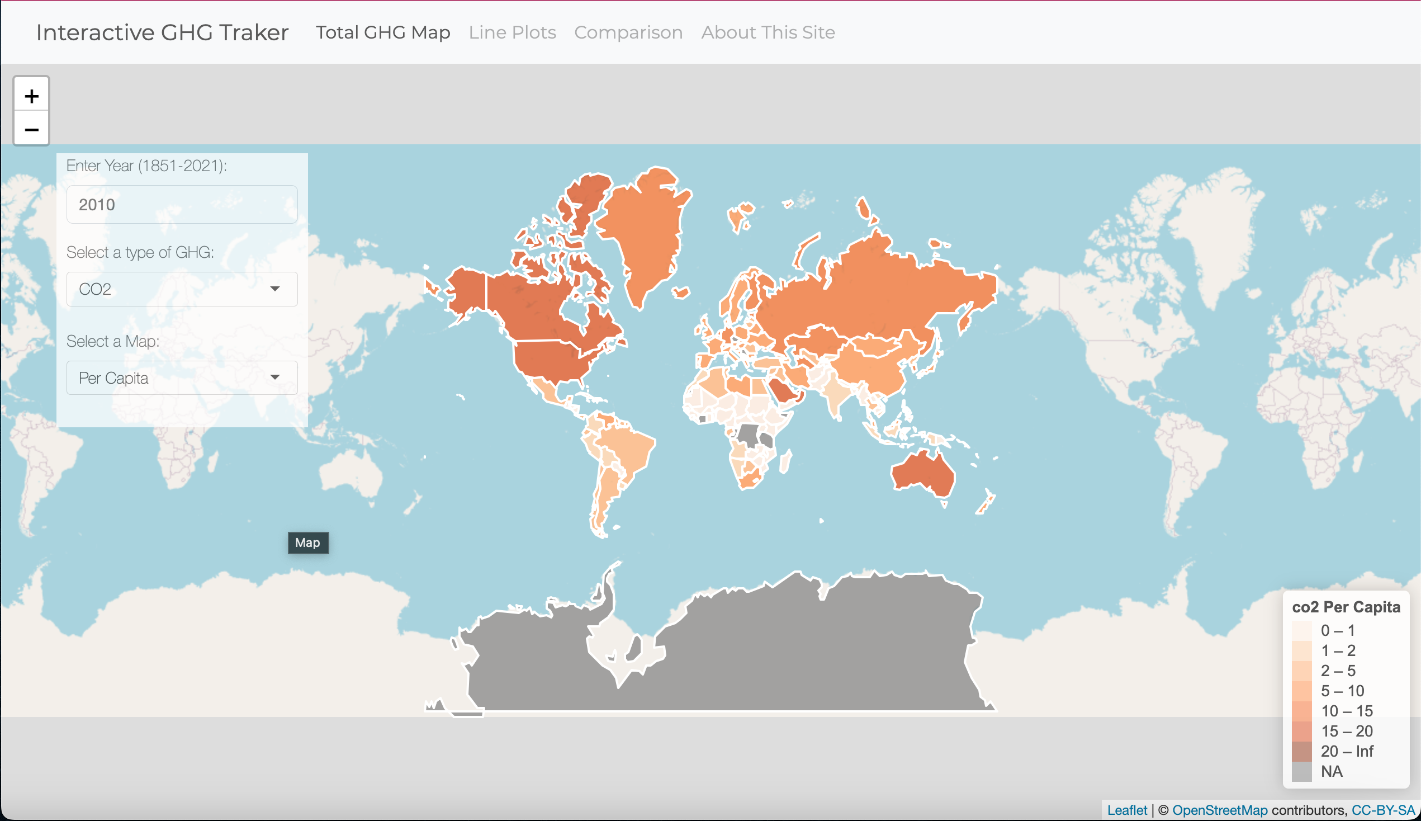
Insights
The total Greenhouse Gas emission is increasing. (Figure 1)
Increasing speed
Slight decrement during the covid and general economic recessions
The United States and China has the highest emission after the 21st century. (Figure 2)
The United States, Canada, and Australia has the heist emission both per capital and per GDP after the 21st century. (Figure 3)
Figure 1
Figure 2
Figure 3

