Slide 1
The Latent Structure of Dictionaries
Vincent-Lamarre et al. (2014)
情報経営システム工学 4年
ロペスチャパホセ
５月１２日２０２６年

Slide 2
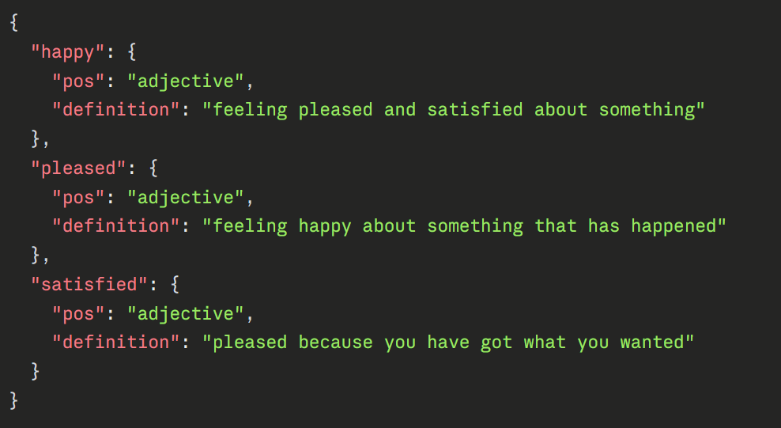
Step 0：Building the graph
What do we want to build？
How dictionary data actually looks like.
The Longman Dictionary of Contemporary English
We want a structure that captures, for every word in words it depends on to be defined, and which other words depend on it.
We want to be able to ask questions like:
Is this word used by anyone the dictionary, which other else?
How many words need this word in their definition?
Are there groups of words that define each other in circles?
Notes:
"Before we get into the problem, ill just explain briefly whar an AI coding agent actually is — because the rest of the proposal builds on this.
Claude Code is an agent that operates inside a terminal session. You describe a task in natural language — something like 'refactor this module' or 'fix the authentication bug' — and the agent takes over. It reads files, writes code, runs commands, debugs errors, and iterates. It acts autonomously over multiple steps, not just generating a single response.
Each session is structured as a back-and-forth conversation, and that conversation is saved as a JSONL file on disk. So there is a record — the data exists.
But here is the fundamental gap, and this is really the starting point of everything that follows: every new session starts completely fresh. The agent has no access to what happened last time. It doesn't know which decisions were made, which approaches failed, or which tools were already configured. The developer has to re-explain all of that context from scratch, every single time.
That's the problem we're trying to solve."

Slide 3
Step 0：Building the graph
Preprocessing
"A dog is a domesticated four-legged animal" → ["a", "dog", "is", "a", "domesticated", "four-legged", "animal"]
["a", "dog", "is", "a", "domesticated", "four-legged", "animal"] → ["domesticated", "four-legged", "animal"]
Before | After
runs | run
running | run
ran | run
Step 1 — Tokenization
Split the raw definition string into individual words. Lowercase everything. Punctuation and hyphens are treated as separators.
Step 2 — Stop word removal
Remove function words that carry no definitional meaning — articles, prepositions, conjunctions, pronouns, auxiliaries.
Step 3 — Lemmatization
Reduce every word to its base form so that different conjugations of the same word map to the same node. Why this matters: If "runs," "running," and "ran" are treated as separate nodes, the same concept splits into three disconnected points in the graph. Lemmatization collapses them into one.
Step 4 — Vocabulary filtering
Keep only words that have their own entry in the dictionary. If a definition uses a word with no entry — a proper noun, abbreviation, or rare term — that word is dropped. No node, no edge.
This keeps the graph self-contained: every node in the graph can itself be looked up and defined.
Step 5 — First sense only
Each word has only one definition processed — the first one listed. "Bank" means financial institution, not riverbank. This makes the graph tractable but loses polysemy. The paper acknowledges this as a limitation.
Notes:
"Before we get into the problem, ill just explain briefly whar an AI coding agent actually is — because the rest of the proposal builds on this.
Claude Code is an agent that operates inside a terminal session. You describe a task in natural language — something like 'refactor this module' or 'fix the authentication bug' — and the agent takes over. It reads files, writes code, runs commands, debugs errors, and iterates. It acts autonomously over multiple steps, not just generating a single response.
Each session is structured as a back-and-forth conversation, and that conversation is saved as a JSONL file on disk. So there is a record — the data exists.
But here is the fundamental gap, and this is really the starting point of everything that follows: every new session starts completely fresh. The agent has no access to what happened last time. It doesn't know which decisions were made, which approaches failed, or which tools were already configured. The developer has to re-explain all of that context from scratch, every single time.
That's the problem we're trying to solve."

Slide 4
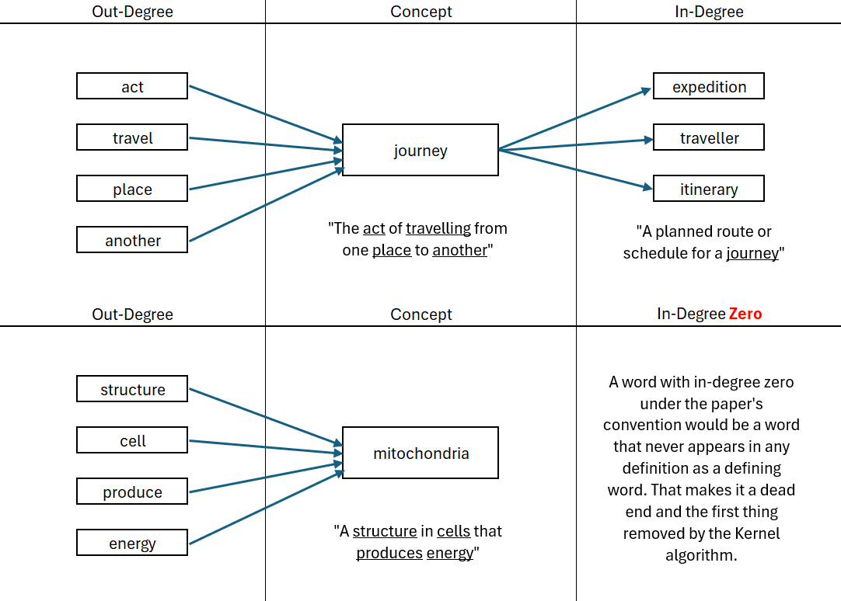
Step 0：Building the graph
Notes:
"Before we get into the problem, ill just explain briefly whar an AI coding agent actually is — because the rest of the proposal builds on this.
Claude Code is an agent that operates inside a terminal session. You describe a task in natural language — something like 'refactor this module' or 'fix the authentication bug' — and the agent takes over. It reads files, writes code, runs commands, debugs errors, and iterates. It acts autonomously over multiple steps, not just generating a single response.
Each session is structured as a back-and-forth conversation, and that conversation is saved as a JSONL file on disk. So there is a record — the data exists.
But here is the fundamental gap, and this is really the starting point of everything that follows: every new session starts completely fresh. The agent has no access to what happened last time. It doesn't know which decisions were made, which approaches failed, or which tools were already configured. The developer has to re-explain all of that context from scratch, every single time.
That's the problem we're trying to solve."

Slide 5
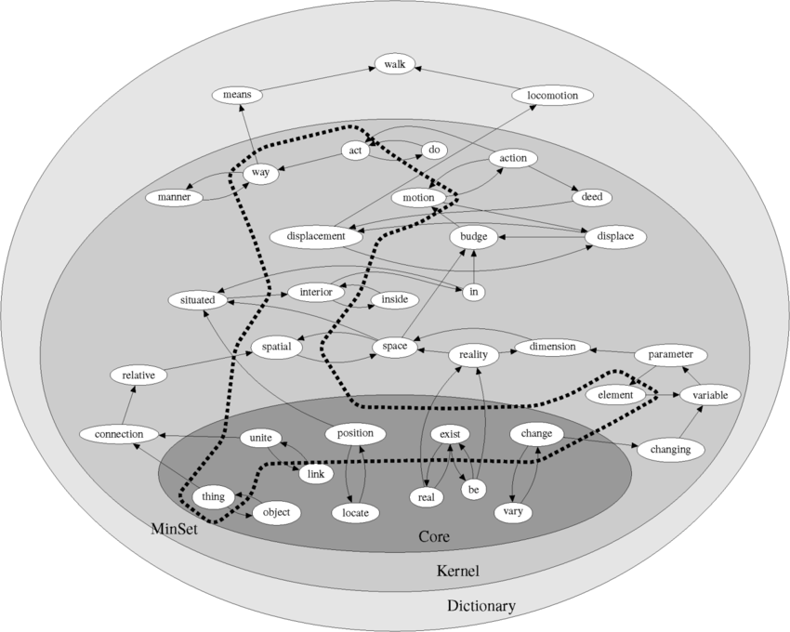
Step 0：Building the graph
Notes:
"Before we get into the problem, ill just explain briefly whar an AI coding agent actually is — because the rest of the proposal builds on this.
Claude Code is an agent that operates inside a terminal session. You describe a task in natural language — something like 'refactor this module' or 'fix the authentication bug' — and the agent takes over. It reads files, writes code, runs commands, debugs errors, and iterates. It acts autonomously over multiple steps, not just generating a single response.
Each session is structured as a back-and-forth conversation, and that conversation is saved as a JSONL file on disk. So there is a record — the data exists.
But here is the fundamental gap, and this is really the starting point of everything that follows: every new session starts completely fresh. The agent has no access to what happened last time. It doesn't know which decisions were made, which approaches failed, or which tools were already configured. The developer has to re-explain all of that context from scratch, every single time.
That's the problem we're trying to solve."

Slide 6
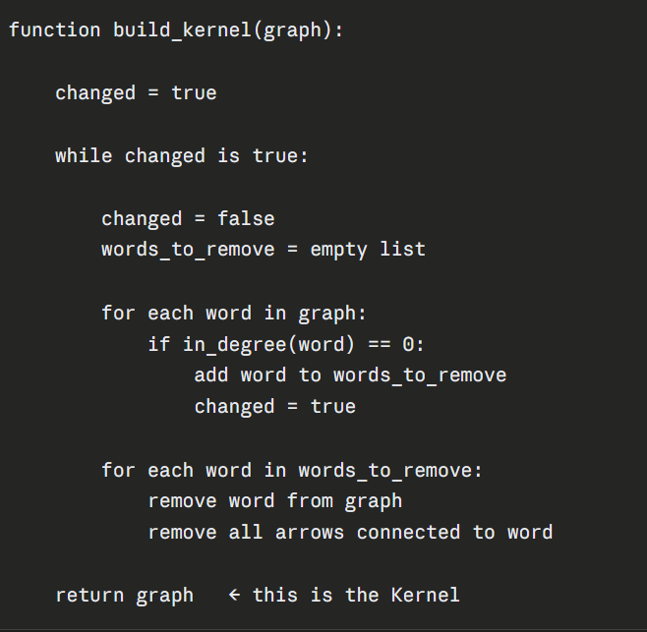
Step 1：Kernel
What is the kernel?
The Kernel is the minimum vocabulary through which the dictionary defines itself. It tells you which words are part of the dictionary's self-sustaining definitional core. The other 90% of words are peripheral — they enrich the vocabulary but the definitional machinery does not depend on them.
Intuition
Imagine you are trying to keep only the words that matter for the definitional system.
A word that never appears in any other word's definition is useless to the network, it consumes definitions but contributes nothing.
You can remove it without affecting anything else. Strip those words away, and some words that previously had arrows pointing into them from the removed words may now also be useless. Remove those too. Keep going until you cannot remove anything else. What remains is the Kernel.
Why the Kernel is unique
No matter what order you remove words, you always end up with the same Kernel.
Removing a word with in-degree zero cannot change whether any other word has in-degree zero except by potentially exposing new zeros. The final stable state is always identical regardless of removal order.
Every dictionary has exactly one Kernel. It’s about 10% of the dictionary
Notes:
"Before we get into the problem, ill just explain briefly whar an AI coding agent actually is — because the rest of the proposal builds on this.
Claude Code is an agent that operates inside a terminal session. You describe a task in natural language — something like 'refactor this module' or 'fix the authentication bug' — and the agent takes over. It reads files, writes code, runs commands, debugs errors, and iterates. It acts autonomously over multiple steps, not just generating a single response.
Each session is structured as a back-and-forth conversation, and that conversation is saved as a JSONL file on disk. So there is a record — the data exists.
But here is the fundamental gap, and this is really the starting point of everything that follows: every new session starts completely fresh. The agent has no access to what happened last time. It doesn't know which decisions were made, which approaches failed, or which tools were already configured. The developer has to re-explain all of that context from scratch, every single time.
That's the problem we're trying to solve."

Slide 7
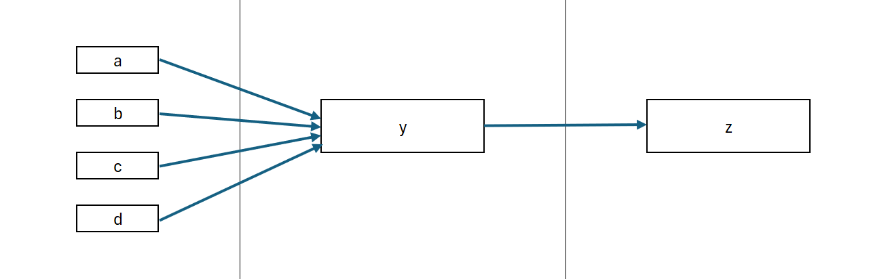
Step 1：Kernel
Notes:
"Before we get into the problem, ill just explain briefly whar an AI coding agent actually is — because the rest of the proposal builds on this.
Claude Code is an agent that operates inside a terminal session. You describe a task in natural language — something like 'refactor this module' or 'fix the authentication bug' — and the agent takes over. It reads files, writes code, runs commands, debugs errors, and iterates. It acts autonomously over multiple steps, not just generating a single response.
Each session is structured as a back-and-forth conversation, and that conversation is saved as a JSONL file on disk. So there is a record — the data exists.
But here is the fundamental gap, and this is really the starting point of everything that follows: every new session starts completely fresh. The agent has no access to what happened last time. It doesn't know which decisions were made, which approaches failed, or which tools were already configured. The developer has to re-explain all of that context from scratch, every single time.
That's the problem we're trying to solve."

Slide 8
Step 2：Core
What is the Core?
The Core is the giant Strongly Connected Component (SCC) at the center of the Kernel. An SCC is a set of nodes where every node is reachable from every other node by following directed edges. After all dead-end words have been stripped away, one group remains where every word can reach every other word by following definition arrows in any direction, from any starting point. That group is the Core. Around 75% of the Kernel and about 8% of the dictionary.
Why the Core is special
Self-contained. No word inside the Core needs anything from outside the Core to be defined.
Mutually reachable. You can navigate from any word to any other word inside it by following arrows.
Most abstract layer. Core words tend to be the most frequent, earliest-acquired, and most abstract words in the language — "make," "know," "go," "say," "good," "time," "place."
What does the Core tells you?
The words inside the core sit at the definitional center of everything and corresponds precisely to the words humans learn earliest and use most frequently.
Notes:
"Before we get into the problem, ill just explain briefly whar an AI coding agent actually is — because the rest of the proposal builds on this.
Claude Code is an agent that operates inside a terminal session. You describe a task in natural language — something like 'refactor this module' or 'fix the authentication bug' — and the agent takes over. It reads files, writes code, runs commands, debugs errors, and iterates. It acts autonomously over multiple steps, not just generating a single response.
Each session is structured as a back-and-forth conversation, and that conversation is saved as a JSONL file on disk. So there is a record — the data exists.
But here is the fundamental gap, and this is really the starting point of everything that follows: every new session starts completely fresh. The agent has no access to what happened last time. It doesn't know which decisions were made, which approaches failed, or which tools were already configured. The developer has to re-explain all of that context from scratch, every single time.
That's the problem we're trying to solve."

Slide 9
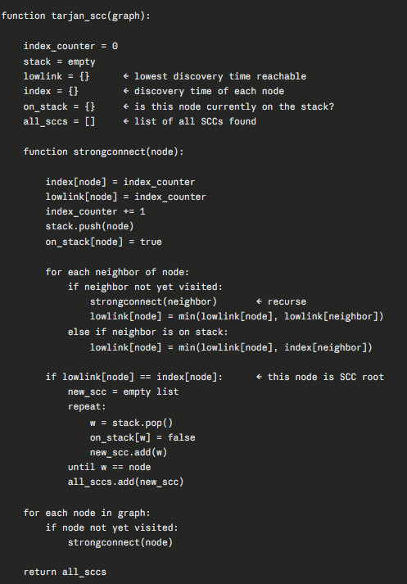
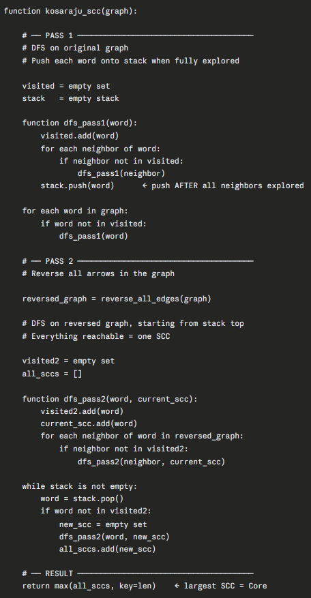
Step 2：Core
To construct the Core, there are two main approaches:
Tarjan's — one pass through the graph. Tracks two numbers per word: discovery time and lowlink. When a word's lowlink equals its own discovery time, an SCC boundary is detected and the group is popped off the stack immediately.
Kosaraju's — two passes. First pass records the order words finish being explored. Second pass reverses all arrows and walks the graph again using that finishing order. Everything reachable in the reversed graph from each starting point is one SCC.
The practical difference
Tarjan needs one traversal and a stack. Kosaraju needs two traversals and a reversed copy of the graph. Tarjan is generally preferred in NLP research because it avoids storing the reversed graph, which matters at dictionary scale with millions of edges.
Notes:
"Before we get into the problem, ill just explain briefly whar an AI coding agent actually is — because the rest of the proposal builds on this.
Claude Code is an agent that operates inside a terminal session. You describe a task in natural language — something like 'refactor this module' or 'fix the authentication bug' — and the agent takes over. It reads files, writes code, runs commands, debugs errors, and iterates. It acts autonomously over multiple steps, not just generating a single response.
Each session is structured as a back-and-forth conversation, and that conversation is saved as a JSONL file on disk. So there is a record — the data exists.
But here is the fundamental gap, and this is really the starting point of everything that follows: every new session starts completely fresh. The agent has no access to what happened last time. It doesn't know which decisions were made, which approaches failed, or which tools were already configured. The developer has to re-explain all of that context from scratch, every single time.
That's the problem we're trying to solve."

Slide 10
Step 3：MinSet
What is the MinSet?
The MinSet is the smallest possible set of words that must be learned from real-world experience — not from definitions — for every other word in the dictionary to become learnable by definition alone. Roughly 1% of the dictionary.
How it works mathematically
Every cycle needs at least one word removed to be broken. The MinSet is the smallest set of words that, if removed from the graph, eliminates every cycle simultaneously. Once those words are removed — meaning grounded in experience — every remaining word can be reached through definition chains that no longer loop. The entire vocabulary becomes learnable from those grounded foundations.
How are MinSets found?
Two approaches depending on dictionary size:
Exact — CPLEX (small dictionaries) A mathematical optimization solver. You give it the variables (one per word, 0 or 1), the objective (minimize total words selected), and the constraints (every cycle must lose at least one word). CPLEX searches the solution space using branch and bound — pruning combinations it can prove will never beat the current best — until it finds the provably optimal MinSet.
Approximate — greedy (large dictionaries) Repeatedly pick the word participating in the most remaining cycles and remove it. Not guaranteed to be the absolute minimum but close enough, and runs in a fraction of the time. Used for Webster (~248,000 words).
Why NP-hard?
The number of cycles grows exponentially with graph size. A dictionary Kernel has potentially millions of overlapping cycles. Finding the smallest set covering all of them simultaneously requires checking an exponential number of combinations in the worst case — no known algorithm guarantees the exact minimum in polynomial time. Even CPLEX, with all its pruning, took days of compute time for the larger dictionaries.
Notes:
"Before we get into the problem, ill just explain briefly whar an AI coding agent actually is — because the rest of the proposal builds on this.
Claude Code is an agent that operates inside a terminal session. You describe a task in natural language — something like 'refactor this module' or 'fix the authentication bug' — and the agent takes over. It reads files, writes code, runs commands, debugs errors, and iterates. It acts autonomously over multiple steps, not just generating a single response.
Each session is structured as a back-and-forth conversation, and that conversation is saved as a JSONL file on disk. So there is a record — the data exists.
But here is the fundamental gap, and this is really the starting point of everything that follows: every new session starts completely fresh. The agent has no access to what happened last time. It doesn't know which decisions were made, which approaches failed, or which tools were already configured. The developer has to re-explain all of that context from scratch, every single time.
That's the problem we're trying to solve."

Slide 11
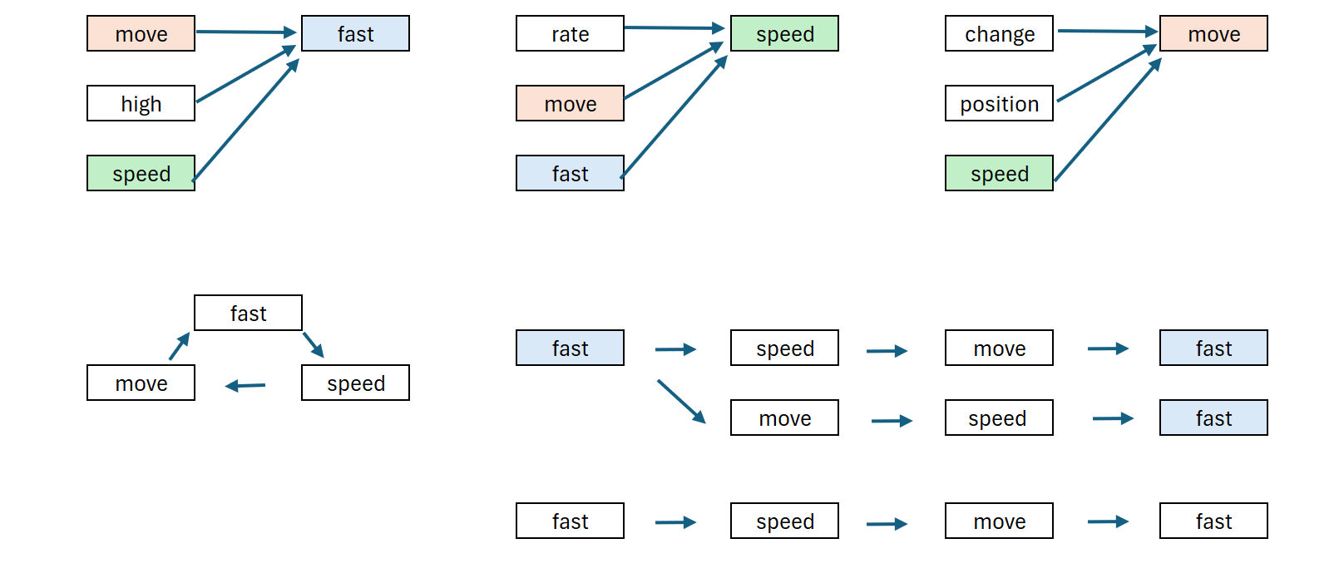
Step 3：MinSet
Fast: Moving at high speed
Speed: The rate at which something moves fast
Moving: Changing position at a speed
Removing "fast" from the graph means it enters the MinSet, it must be learned through direct experience, not definition. Once grounded, the loop breaks. "Speed" can now be learned from its definition using "fast“, which we already know, plus its other content words. "Moving" does the same. You pay the experiential cost once for one word, and the definitional system unlocks everything else that was trapped in the cycle with it.
Notes:
"Before we get into the problem, ill just explain briefly whar an AI coding agent actually is — because the rest of the proposal builds on this.
Claude Code is an agent that operates inside a terminal session. You describe a task in natural language — something like 'refactor this module' or 'fix the authentication bug' — and the agent takes over. It reads files, writes code, runs commands, debugs errors, and iterates. It acts autonomously over multiple steps, not just generating a single response.
Each session is structured as a back-and-forth conversation, and that conversation is saved as a JSONL file on disk. So there is a record — the data exists.
But here is the fundamental gap, and this is really the starting point of everything that follows: every new session starts completely fresh. The agent has no access to what happened last time. It doesn't know which decisions were made, which approaches failed, or which tools were already configured. The developer has to re-explain all of that context from scratch, every single time.
That's the problem we're trying to solve."

