Slide 1
Semantics: Primes and Universals
Wierzbicka (1996)
Semantic Primitives, fifty years later
Wierzbicka (2021)
情報経営システム工学 4年
ロペスチャパホセ
５月１９日２０２６年

Slide 2
Background
For communication across languages and cultures to be meaningful, there has to be some shared ground. When you translate a word from one language to another, you are assuming that the concept the word expresses exists in both languages — that the target language has a way to capture the same meaning. But this assumption breaks down constantly.
They reflect genuine differences in how languages organize meaning. Using English concepts to describe other languages smuggles cultural assumptions into analysis and presents them as universal when they are not.
The question is then: is there any conceptual common ground at all? Are there concepts that are not English, not European, not culturally specific — but human? Concepts that every language on earth already has a word for, not because of borrowing or cultural contact, but because they reflect something fundamental about human experience and cognition?
fair
= just + impartial + reasonable + morally acceptable
公平
= equal + balanced (impartial distribution)
≠ moral acceptability, reasonableness, or social fairness

Slide 3
NSM: Natural Semantic Metalanguage
In 1972, Anna Wierzbicka proposed the Natural Semantic Metalanguage (NSM) — the idea that all human languages share a minimal set of semantic primitives: concepts so fundamental they exist universally and cannot be defined using simpler terms.
To find them, she tested candidate concepts across 30+ languages from 16 language families. A concept qualified only if every language already had a dedicated word for it — not borrowed, not constructed, independently present. Starting from 14 candidates in 1972, the list was revised through decades of cross-linguistic testing until stabilizing at 65 primitives in 2014.
Category | Primes
Substantives | I, YOU, SOMEONE, SOMETHING, PEOPLE, BODY
Determiners / Quantifiers | THIS, THE SAME, OTHER, ONE, TWO, MANY, ALL, SOME, MORE
Mental Predicates | THINK, KNOW, WANT, FEEL, SEE, HEAR
Speech & Words | SAY, WORD, TRUE
Actions / Events / Life | DO, HAPPEN, MOVE, THERE IS, HAVE, LIVE, DIE
Evaluators & Descriptors | GOOD, BAD, BIG, SMALL
Time | TIME, BEFORE, AFTER, LONG TIME, SHORT TIME, NOW, FOR SOME TIME, MOMENT
Space | PLACE, BELOW, ABOVE, FAR, NEAR, SIDE, INSIDE, HERE, TOUCHING
Taxonomy / Similarity | PART OF, KIND OF, LIKE
Metapredicates & Linkers | NOT, CAN, VERY, IF, BECAUSE, MAYBE

Slide 4
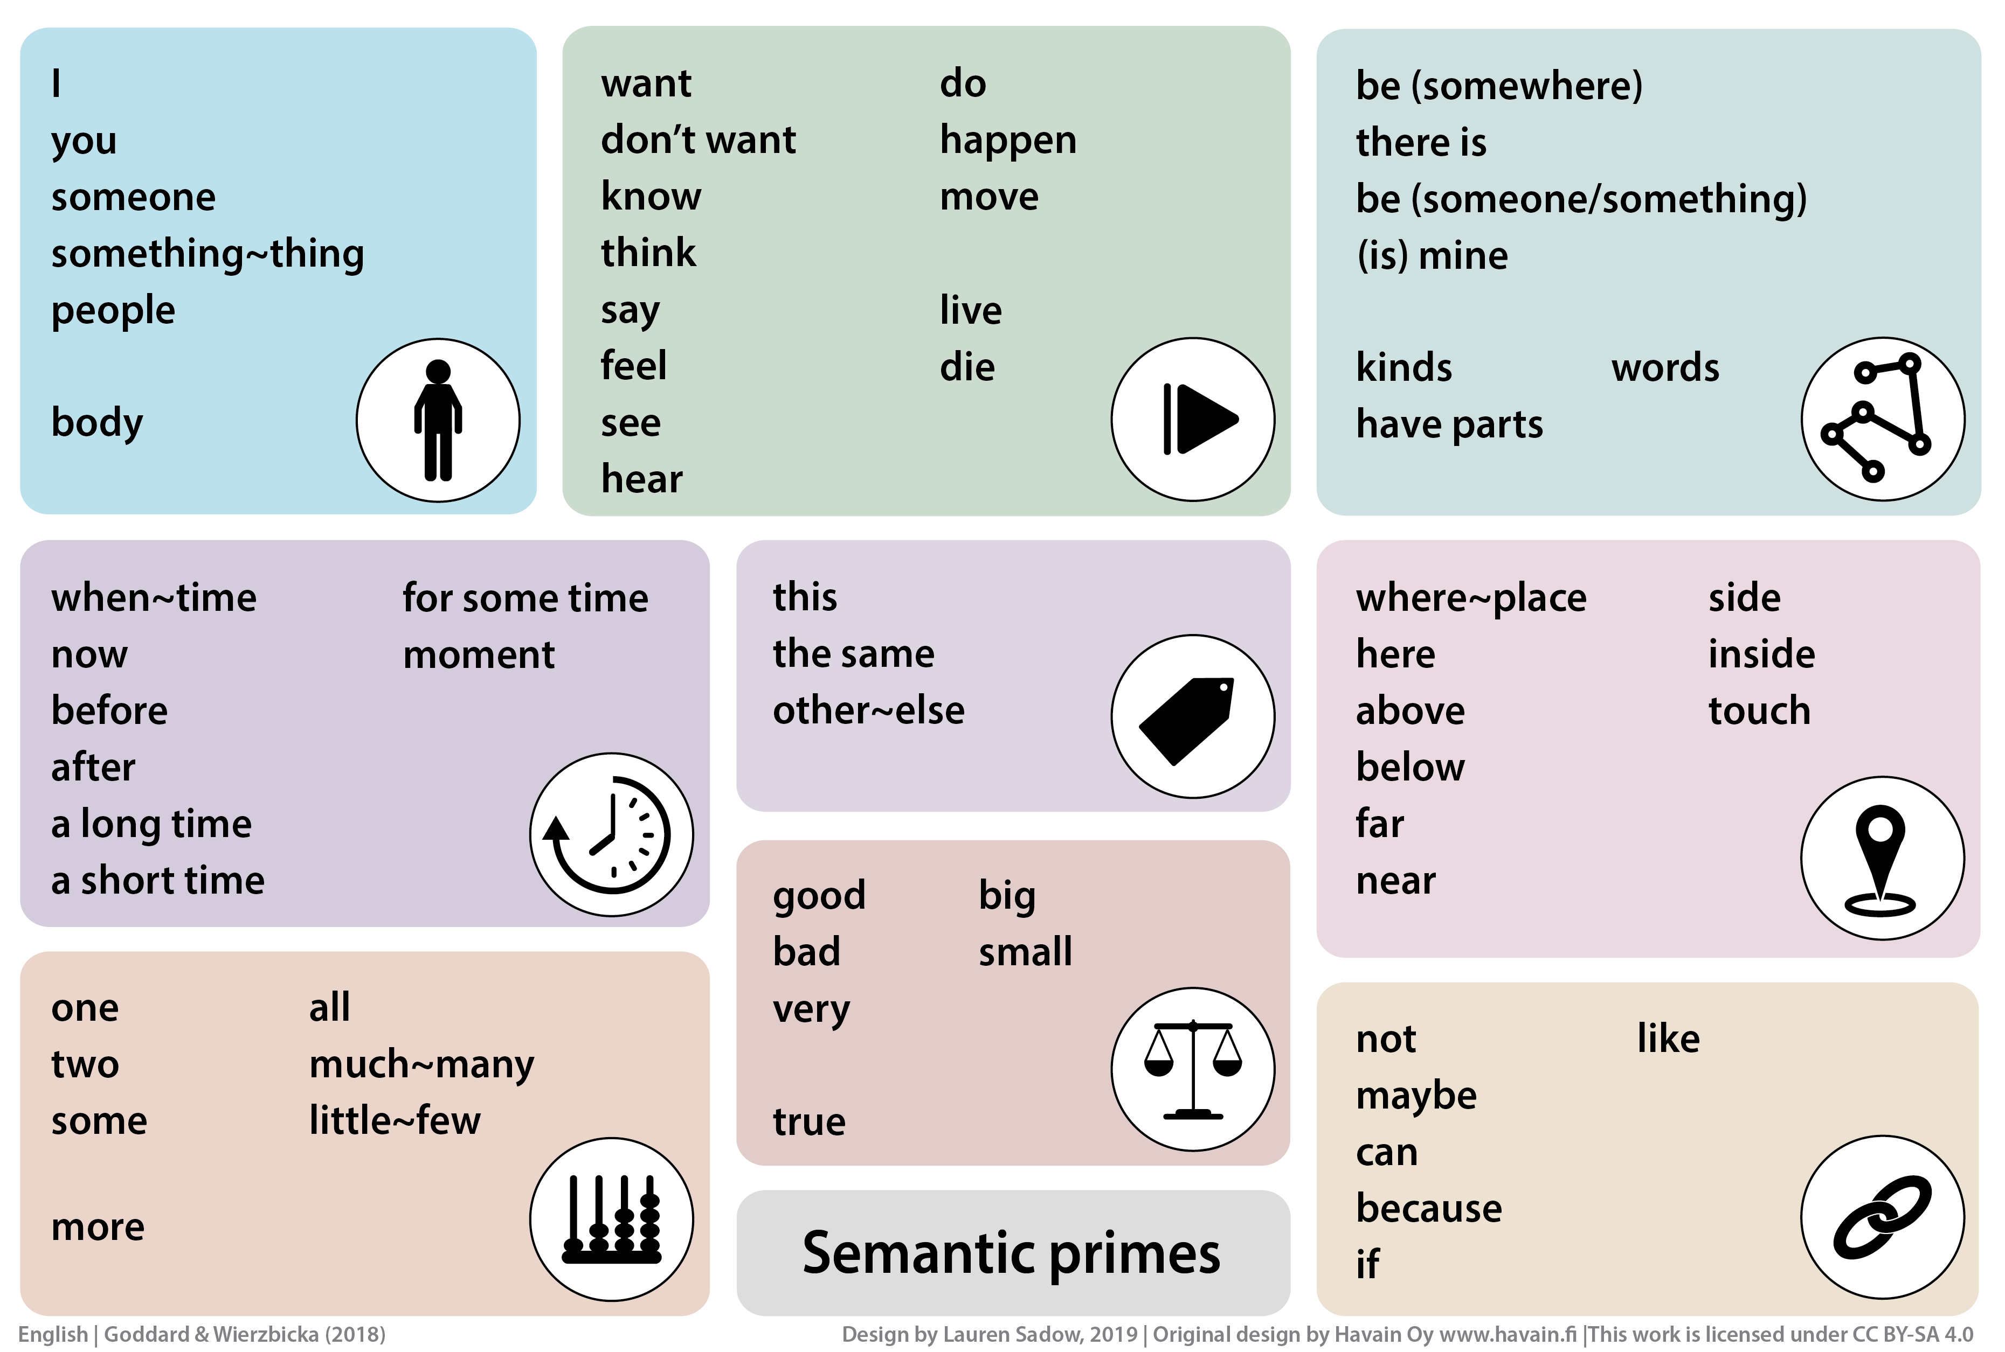
NSM: Natural Semantic Metalanguage

Slide 5
NSM Definitions
NSM definitions are written in something that reads like ordinary human language — not symbols, not formulas.
The Mini-Grammar / Valency Frames:
Allolexes:
Each prime has a specific set of grammatical combinations it can appear in. This is what makes NSM a language — not just a vocabulary. Without the mini-grammar, the primes cannot produce definitions.
Each prime can appear in different grammatical forms depending on context — these are called allolexes. They are not different primes. They are the same primitive concept expressed differently by the grammar of the language.
Prime | Grammatical combinations allowed
GOOD | something good / it is good that / good for someone
THINK | someone thinks something / someone thinks about something
MOVE | something moves / someone moves something / move to a place
WANT | someone wants something / someone wants to do something
BECAUSE | this happened because of something / X, because Y
Prime | Allolexes (surface forms)
MOVE | move / moving / moved / movement
THINK | think / thinking / thought / thinks
GOOD | good / better / best / well
SOMEONE | someone / somebody / one (person)
https://www.researchgate.net/publication/286033897_1_Natural_Semantic_Metalanguage_The_state_of_the_art
https://en.wikipedia.org/wiki/Natural_semantic_metalanguage

Slide 6
Semantic Primes – Semantic Molecules
Semantic Primitives
Semantic Molecules
Semantic primitives are concepts that are universal — they can be translated literally into any known language and retain their meaning — and primitive — they cannot be defined using simpler terms. They are the irreducible foundation of all meaning.
Semantic molecules are intermediary words used in definitions. While not primitives, they can be defined exclusively using primitives. They are words necessary to build upon in order to define other words.
Some molecules are universal or near-universal. Others are culture-specific.
Category | Primes
Substantives | I, YOU, SOMEONE, SOMETHING, PEOPLE, BODY
Determiners / Quantifiers | THIS, THE SAME, OTHER, ONE, TWO, MANY, ALL, SOME, MORE
Mental Predicates | THINK, KNOW, WANT, FEEL, SEE, HEAR
… | …
Category | Examples
Body parts | hands, mouth, eyes, head, ears, nose, face, teeth, fingers
Physical | long, round, flat, thin, hard, soft, sharp, heavy
Biosocial | children, men, women, mother, father, wife, husband
https://en.wikipedia.org/wiki/Natural_semantic_metalanguage

Slide 7
NSM+LDOCE: A Non-Circular Dictionary of English
Goddard (2011)
情報経営システム工学 4年
ロペスチャパホセ
５月１９日２０２６年

Slide 8
The Circular Definition Problem
In a typical dictionary, more than 25% of all definitions use words whose definitions ultimately refer back to the word being defined. This means that for at least one in four words you look up, following the chain of definitions will eventually loop back to the word you started with — leaving you no closer to understanding its meaning.
For a reader who already knows most words this is rarely a problem, since they can fill the gap from prior knowledge and existing vocabulary. But for a beginning learner with a small vocabulary, every unknown word in a definition must itself be looked up, and those definitions contain further unknown words that must also be looked up.
Those definitions circle back on themselves, trapping the reader inside a closed system. The dictionary ends up assuming the very knowledge it is supposed to provide, making it least useful precisely for the people who need it most.
illness = sickness of body or mind
sickness = the condition of being sick; illness; disease
sick = suffering from a physical illness; mentally ill
→ illness → sickness → sick → illness [LOOP]

Slide 9
How NSM could solve the Circular Definition Problem
The Longman Dictionary of Contemporary English (LDOCE) attempted to reduce circularity through a controlled defining vocabulary — a fixed set of around 2,000 high-frequency words used to write every definition across the entire dictionary.
If a reader knows those 2,000 words, the remaining 78,000 entries can be understood without hitting a circular loop.
The gap: The 2,000 core words themselves still need definitions — and those definitions loop back on each other. The core vocabulary is internally circular.
The solution: Instead of rearranging the 2,000 core words, Bullock replaces the bottom of the dictionary entirely. All 2,000 core words are redefined using only NSM primitives. Since primitives carry no definitions themselves, the chain stops there.
The result: 64 primitives → define 2,000 core words → define 78,000 entries
Note: Bullock (2011) uses 64 primitives (61 NSM + 3 tentative). The current official list, finalized in 2014, contains 65.
BEFORE — LDOCE
AFTER — NSM-LDOCE
colour → a shade, hue, tone
shade → a colour or tone
hue → a shade of colour
→ LOOP
colour → something people SEE
that makes one THING
look DIFFERENT from
another THING

Slide 10
Methodology: Building the NSM-LDOCE Dictionary
2,352 headwords were taken from the LDOCE core defining vocabulary. A definition was written for each one using two types of words:
NSM primitives (UPPERCASE) — the 61 bedrock concepts that carry no definition. They appear directly in definitions as irreducible building blocks.
Non-primitives (lowercase) — words from the LDOCE core that are not NSM primitives. They are used in definitions but each one has its own NSM-LDOCE entry where it is defined using primitives. They are the middle layer — complex enough to need a definition, stable enough to build on.
Every batch of 50 definitions was checked by script for circular references. When a loop was detected, the definition was reworded. If rewriting could not break the loop, the word was added as a tentative new primitive.
Example — "cup" (NSM-LDOCE vs. LDOCE):
The LDOCE defining vocabulary was developed from the General Service List — a list of high-frequency English words and their most common meanings compiled by West (1953).
Frequency — words that appear most commonly in everyday English use.
Sense restriction — only the most common, central senses of each word were permitted.
Non-idiomatic use only — fixed expressions and idioms were excluded.
LDOCE:
a small round container,
usu. with a handle, from
which liquids are drunk,
esp. hot liquids such as
tea or coffee
NSM-LDOCE:
SMALL THINGS PEOPLE make to contain hot liquid THAT PEOPLE drink; ONE PERSON CAN use ONE hand TO MOVE ONE OF THESE NEAR TO mouth and CAN drink ALL liquid THAT ONE OF THESE contain

Slide 11
Evaluation
To test whether NSM-LDOCE definitions conveyed meaning clearly enough to identify the word being defined, Bullock ran a headword identification experiment with 12 English-speaking students aged 14–18.
Three definition sources compared:
LNSM-LDOCE definitions
Standard LDOCE definitions
Full-length definitions from the NSM literature
Three tasks of increasing difficulty:
Task | Method
Fill in the blank | No help — definition alone must convey the meaning
Complete the word | First letter of the headword given as a hint
Multiple choice | Pick the headword from a list of 10 options

Slide 12
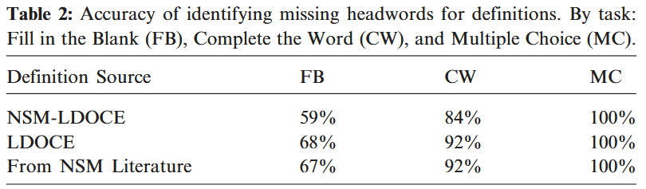
Results
Token composition across all 2,352 definitions:
48,900 total word tokens used across all definitions.
34,300 (~70%) were NSM primitives.
14,600 (~30%) were non-primitives, drawn from only 947 distinct headwords.
This means 70% of the entire dictionary is written in pure primitive language (64 words) — the non-primitive words are reused constantly across many definitions.
Circularity check:
Only 17 fewer than expected.
The study was originally launched anticipating many more loops that would expose NSM weaknesses. Most of the 17 were resolved simply by rewording.
Only 3 could not be resolved by rewording and required adding a tentative new primitive: colour, number, and shape.
Note: these 3 tentative primitives did not make the official 2014 list of 65 NSM primes.
The gap comes from two fixable limitations:
Fluency - rigid grammatical rules make some definitions sound awkward, interfering with comprehension.
Precision - the 100-word cap per definition sometimes leaves meanings too broad to pinpoint a single headword.
Neither is a fundamental weakness of NSM. Both are design constraints that future development could improve.

