Slide 1
Dictionary Graph Topology
Across Model Families
Facts about LLMs, or artifacts of two families?
A cross-family replication of kernel contraction, cycle irreducibility,
and the instruction-following regime
情報経営システム工学 4年
ロペスチャパホセ
２０２６年７月21日
Building on: Kumoi (2026), Dictionary Graph Topology as a Probe of LLM Conceptual Structure · Vincent-Lamarre et al. (2016)

Slide 2
The Central Question
What the prior study found
Within Qwen3.5 (0.8B–27B) and Gemma-4, definitional-graph metrics moved cleanly with scale — kernel ratio down, cycle irreducibility up — and a 92-word “universal kernel” appeared.
Why this needs testing
Five sizes of one architecture cannot tell us whether these are:
Laws — properties of LLMs in general, or
Family traits — quirks of the Qwen / Gemma training recipes
Goal: rerun the exact pipeline on many families and see which findings survive.

Slide 3
Background — the Dictionary Graph
From definitions to a directed graph
Each word → one LLM-generated definition. Edge u → v means “word u is used to define word v.”
Three metrics (Vincent-Lamarre 2016)
Behavioral covariate
• Kernel — minimal self-sufficient vocabulary
• Core — the mutually-defining center (source SCCs)
• MinSet / Kernel — fraction of the kernel that is irreducibly cyclic
• sr_rate — how often a model uses the word in its own definition, disobeying “do not use the word itself”
Metrics computed exactly — MFVS via ILP with a verified-acyclic convergence guarantee.
Vincent-Lamarre, Blondin Massé, Lord, Marcotte, Harnad (2016) — The latent structure of dictionaries. Topics in Cognitive Science.

Slide 4
Part 1 — Prior Findings
The four claims we set out to replicate

Slide 5
Prior Findings — the Four Claims
From Kumoi (2026),
# | Claim | Key statistic
1 | Kernel ratio decreases with model size | r = −0.862 (within Qwen3.5)
2 | MinSet/Kernel increases with model size | r = +0.982 (within Qwen3.5)
3 | A universal kernel of anchor words exists | 92 words, 15.4% NSM overlap
4 | sr_rate is a family-level trait, not scale | Qwen 76–92% vs Gemma <0.1%
Claims 1–2 were the headline “scaling-law” result. Claims 3–4 concern structure and behavior.

Slide 6
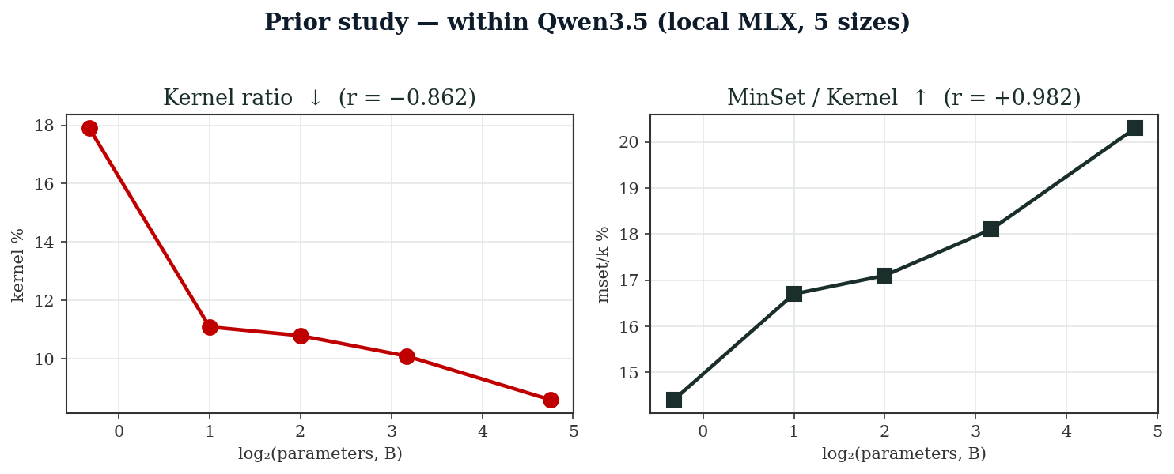
Prior Findings — the Scaling Result
The strong within-Qwen3.5 trends
Five sizes, near-perfect monotonicity — the evidence that motivated a “graph topology tracks scale” reading.
Prior values: kernel 17.9→8.6 %, mset/k 14.4→20.3 % across 0.8B→27B (single MLX stack, seed 42).

Slide 7
Part 2 — Replication Method
Same pipeline, many families

Slide 8
Method — the Pipeline (held constant)
Identical to the prior study
• 3,000 words (1,500 n / 900 v / 600 adj), WordNet + Brown ≥5, seed 42
• Same prompt · T=0.7, top_p=0.8, top_k=20, max_tokens 80, thinking disabled
• Same graph construction, same metric definitions
• WordNet baseline through the identical pipeline
Served via Together AI (serverless), 11 models
Each model was verified live before running (Phase 0 probe): catalog listings were partly wrong — several “serverless” models were dedicated-only or nonexistent.
Total cost of the full run ≈ $1.80. 10/11 models completed 3,000/3,000; gpt-oss-120b 2,999/3,000.

Slide 9
Method — Honest Deviations
What is not identical (kept in view throughout)
• Word list — regenerated deterministically, but not byte-identical to the original
• Inference stack — Together FP8/FP4 serving vs local MLX bf16
• MoE models — gpt-oss, cogito: scaling axis uses total params (active-param spans are narrower)
• gpt-oss thinking — reduced, not fully off (short reasoning trace remains)
Every within-run comparison is clean (shared word list). Every cross-run comparison (new vs prior tables) is ordinal at best.

Slide 10
The 11-Model Roster
Seven new families + two re-runs of prior models
New families (the actual test)
Cross-stack validation
• OpenAI gpt-oss 20B + 120B
• Meta Llama-3.3 70B
• Qwen2.5 7B · Qwen3.6-Plus
• DeepSeek-V4 · Kimi-K2.6
• cogito 671B · gemma-3n 4B
• Qwen3.5-9B (vs local MLX)
• gemma-4-31B (vs local MLX)
gpt-oss 20B→120B is the only new within-family size pair available on the catalog.

Slide 11
Part 3 — Results
What replicated, what didn't

Slide 12
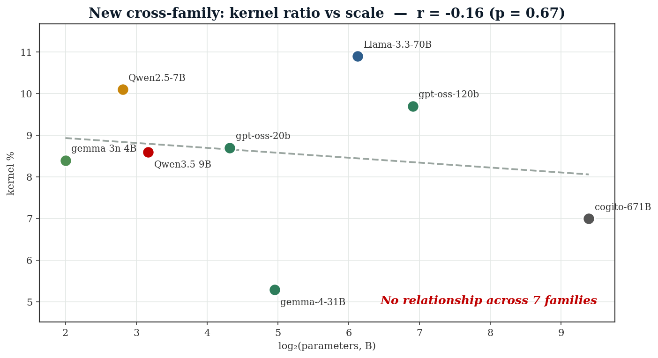
Result 1 — No Cross-Family Scaling
Kernel ratio vs parameter count, 7 families
The prior r = −0.862 (within Qwen3.5) becomes r = −0.16, p = 0.67 across families.

Slide 13
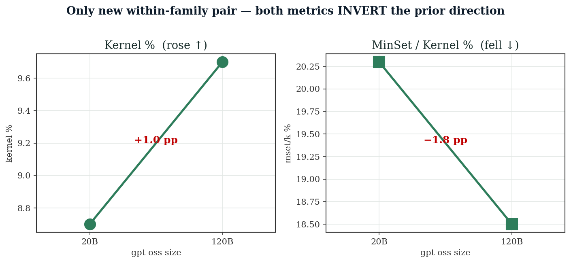
Result 1 — the Cleanest Refutation
gpt-oss 20B → 120B: the only new within-family pair
Both headline metrics move opposite to the prior Qwen3.5 direction. Prior Gemma-4 (4B→31B) had already contradicted it too.
Claims 1 & 2 do not generalize. They are real within Qwen3.5, not laws of scale.

Slide 14
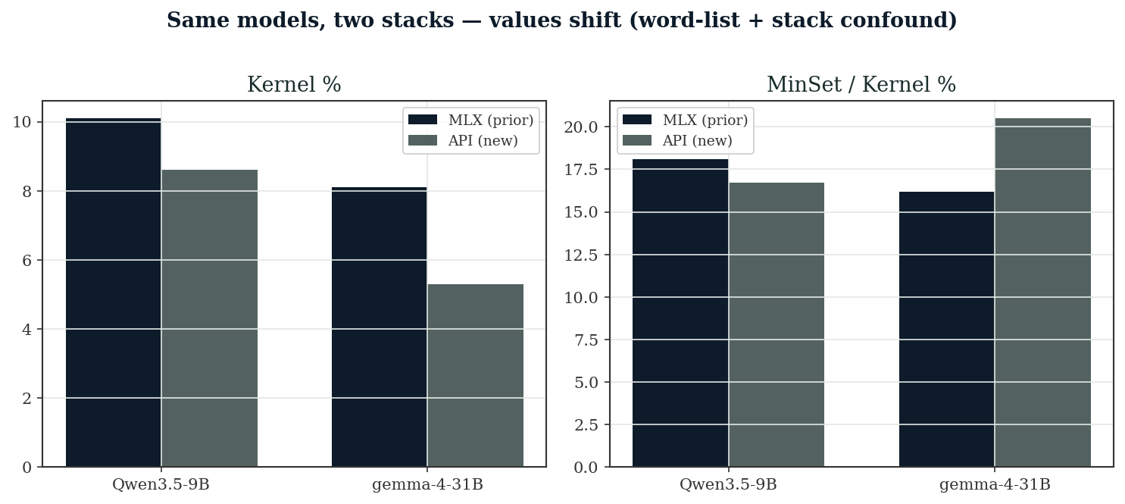
Same Models, Two Stacks
Qwen3.5-9B and gemma-4-31B: MLX vs API
Values shift noticeably — but stack effect and word-list effect cannot be separated here (both changed).
The word-list confound is quantified two slides on.

Slide 15
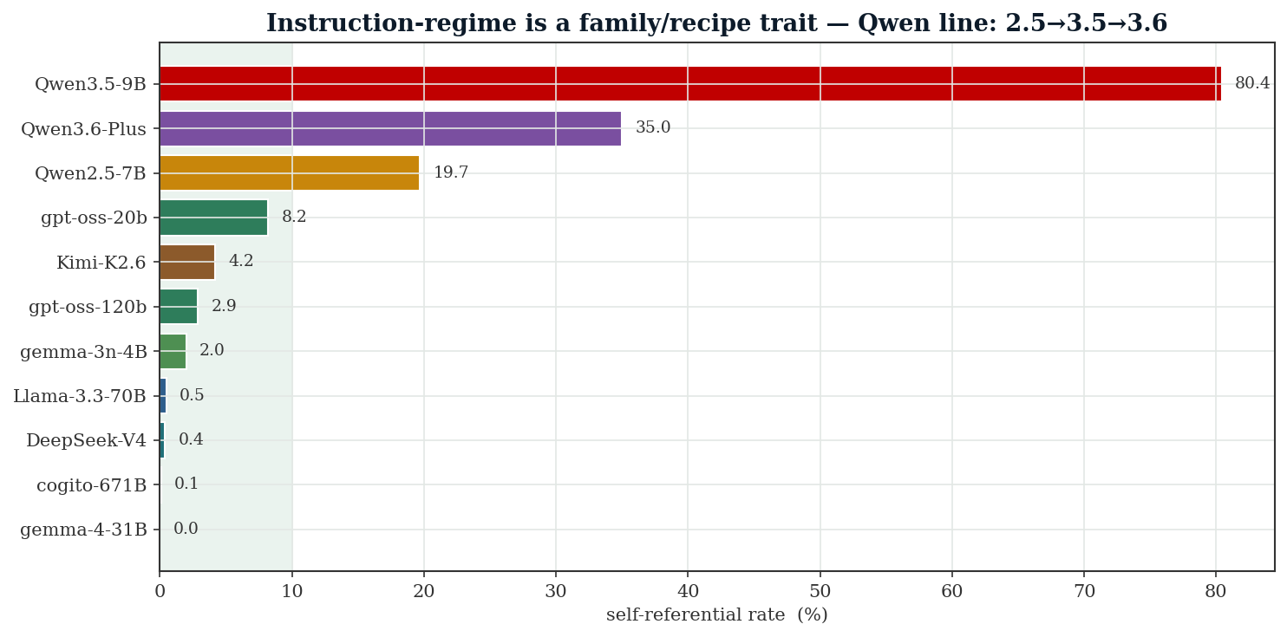
Result 2 — sr_rate Replicates Emphatically
Instruction regime is a family / recipe trait
Qwen3.5 ignores “don’t use the word itself” 80% of the time; every non-Qwen family ≤ 8%. Replicated across a different stack

Slide 16
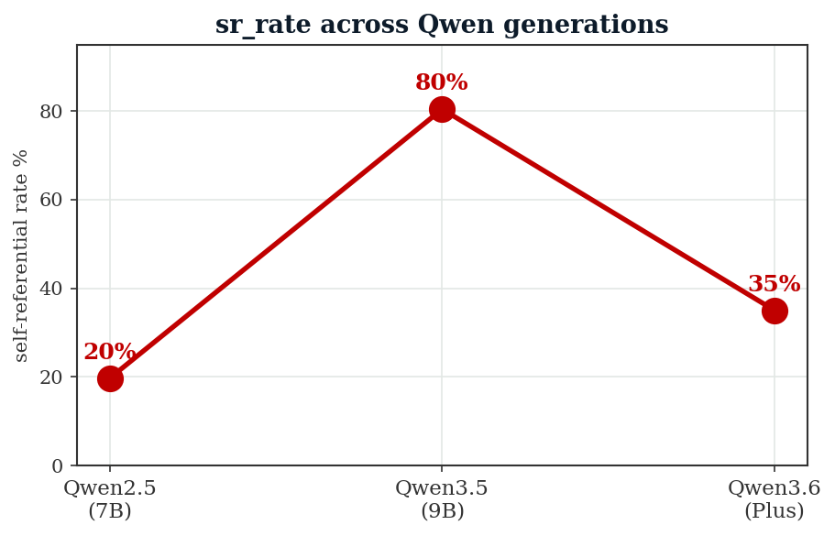
Result 2 — a New, Sharper Finding
The trait is generation-level, not lineage-level
Within the Qwen line the failure appears, peaks, then is partly corrected:
Qwen2.5 — 19.7%
Qwen3.5 — 80.4%
Qwen3.6 — 35.0%
It was introduced by the 3.5 post-training recipe.
sr_rate is a behavioral fingerprint of a training recipe — trackable across a vendor's releases.

Slide 17
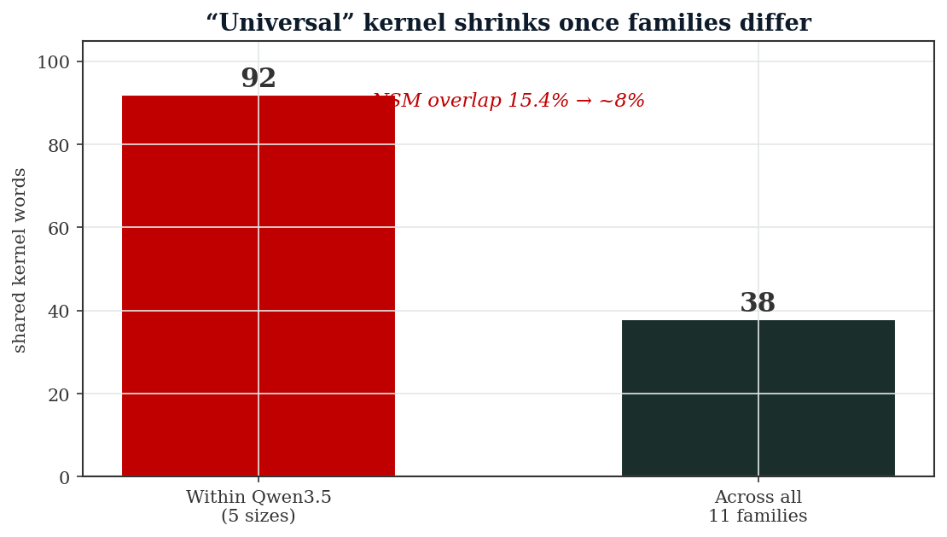
Result 3 — Universal Kernel Weakened
92 words within one family → 38 across many
• Within Qwen3.5 (5 sizes): 92 shared words
• Across all 11 families: 38 (union 672)
• NSM overlap 15.4% → ~8%
• Leave-one-out: not an outlier effect
Survivors skew concrete (hand, eye, object, hold), not cognitive primitives.
The “universal” kernel was largely a family kernel on a smaller genuine cross-family core.

Slide 18
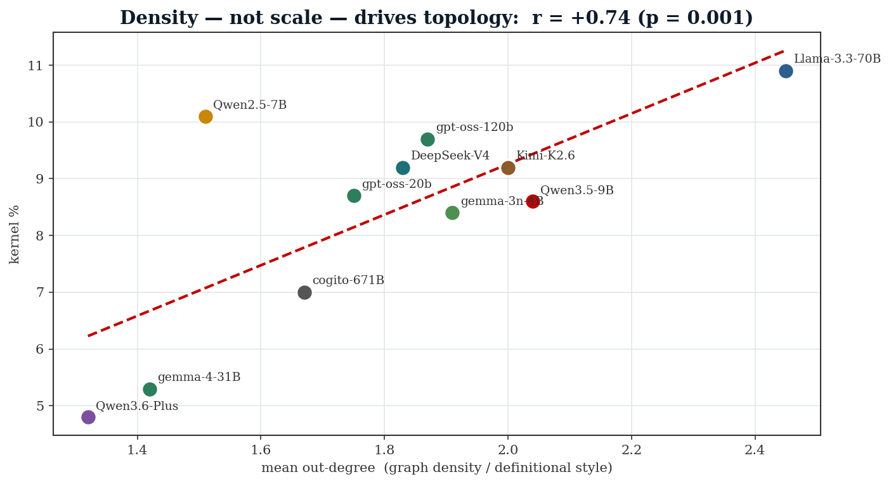
New Finding — Density Drives Topology
Out-degree, not scale, is the proximate cause
Mean out-degree predicts kernel ratio at r = +0.75 (p = 0.001) and circulation at r = +0.83 — far stronger than parameter count (r ≈ −0.16).

Slide 19
New Finding — a Mechanism to Test
Recipe → style → density → topology
Definitional style is a family trait: Llama writes verbose, common-word definitions (out-deg 2.45); Qwen3.6 is terse (1.32). Verbose definitions build denser graphs → larger, more cyclic kernels.
training recipe → definition style → graph density → topology metrics
(verbosity, word reuse, (out-degree) (kernel, mset/k, circ)
Prediction: a few-shot / length-controlled prompt should move kernel metrics without changing weights. The prior Qwen3.5 trend fits — out-deg fell 3.73→2.52 across its ladder, so scale was a proxy for style.

Slide 20
Part 4 — Conclusions

Slide 21
What Holds, What Was a Family Trait
Verdict on each prior claim
Prior claim | Verdict
Kernel ratio ↓ with scale | Family trait — Qwen3.5 only, no cross-family effect
MinSet/Kernel ↑ with scale | Family trait — inverts in gpt-oss & prior Gemma
Universal kernel (92 words) | Weakened — 38 across families, less NSM-like
sr_rate = family regime | Confirmed & upgraded — generation-level, stack-robust
Still standing as cross-family facts
✓ Smaller kernels are denser (mset/k anti-correlates with kernel size)
✓ All LLMs are more cyclically irreducible than WordNet (mset/k 15–23% vs 10%)

Slide 22
What This Investigation Adds
New contributions
• Density mediation — out-degree (definitional style) is the proximate driver of every topology metric (r ≈ +0.75), reframing scale as a proxy
• Generation-level sr_rate — Qwen 2.5→3.5→3.6 shows the instruction regime is a trackable recipe fingerprint
• Word-list sensitivity — absolute metrics swing ~8 pp with the sample; the single-list design cannot detect this
Recommended reframing: from “graph topology tracks scale” to “graph topology is a family fingerprint; within Qwen3.5 it also tracks scale, via definitional style.”

Slide 23
Limitations
Limitations
• Single seed, single generation/word
• Word list differs from prior → contaminates cross-run & cross-stack comparisons
• Only one new family had two sizes
• MoE param ambiguity; per-model quantization; gpt-oss residual reasoning

Slide 24
Bottom line
Dictionary-graph topology is a
training-recipe fingerprint — not a scaling law
The scaling claims are real within Qwen3.5 but do not generalize.
The instruction-regime finding is confirmed, stack-robust, and now generation-level.
Definitional style / density — not parameter count — drives the metrics.
情報経営システム工学 4年 ・ ロペスチャパホセ
Data & code: Investigation/replication/ · Full analysis: cross_family_replication_report.md · Cost ≈ $1.80

