Slide 1


GitHub:
Release the Open Source Kraken!
Created with Artificial Intelligence
Compiled by Thiago Michaelsen

Slide 2
GitHub
Release the Open Source Kraken!
This ebook will guide you through the essential aspects of GitHub, from basic commands to advanced project management strategies. We'll use real-world examples to illustrate each concept, ensuring you can confidently navigate the world of version control.

Slide 3
Disclaimer
This ebook was written with the assistance of artificial intelligence. It has not been reviewed or edited by a human author. While the AI has been trained on a vast dataset, it is still under development and may produce inaccurate, incomplete, or outdated information.
Please be aware that:
Some content may be incorrect or factually flawed.
The information provided may not be up-to-date.
This ebook should not be considered a definitive source of information.
We strongly encourage you to:
Verify any information presented in this ebook through reputable sources.
Consult with qualified professionals for advice or guidance on any specific topic discussed.
By using this ebook, you acknowledge and agree that:
The authors and publishers are not responsible for any errors, omissions, or inaccuracies in the content.
The information provided is for general informational purposes only and does not constitute professional advice.
We appreciate your understanding and hope this ebook provides you with useful information.

Slide 4
01
SETTING UP YOUR GITHUB ACCOUNT
Your Gateway to Collaboration: Setting Up Your GitHub Account

Slide 5
Setting Up Your GitHub Account
Before you dive into the technicalities, you need a GitHub account. This is where you'll store your code, track changes, and collaborate with others.
Head to https://github.com and create a free account.
Choose a username that reflects your identity or project preferences.
Set up a strong password for security.

Slide 6
02
GIT BASICS: THE COMMAND LINE INTERFACE
Speaking the Language of Git: Essential Commands

Slide 7
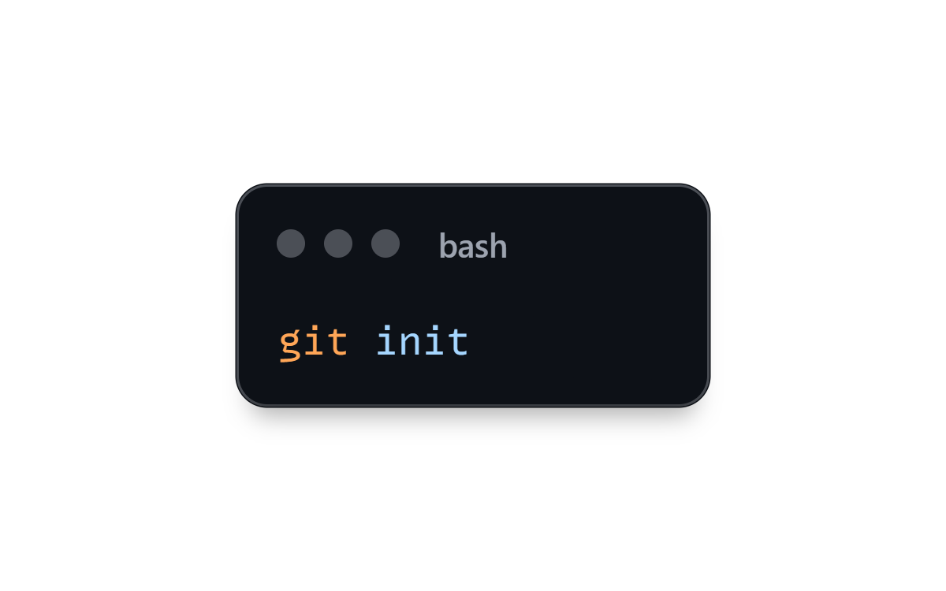
Git Basics: The Command Line Interface
Git is the version control system that powers GitHub. Familiarize yourself with these fundamental commands to manage your code:
1. git init : Initializes a Git repository in your project directory.

Slide 8

Git Basics: The Command Line Interface
Git is the version control system that powers GitHub. Familiarize yourself with these fundamental commands to manage your code:
2. git add . : Stages all changes in your working directory for commit.

Slide 9
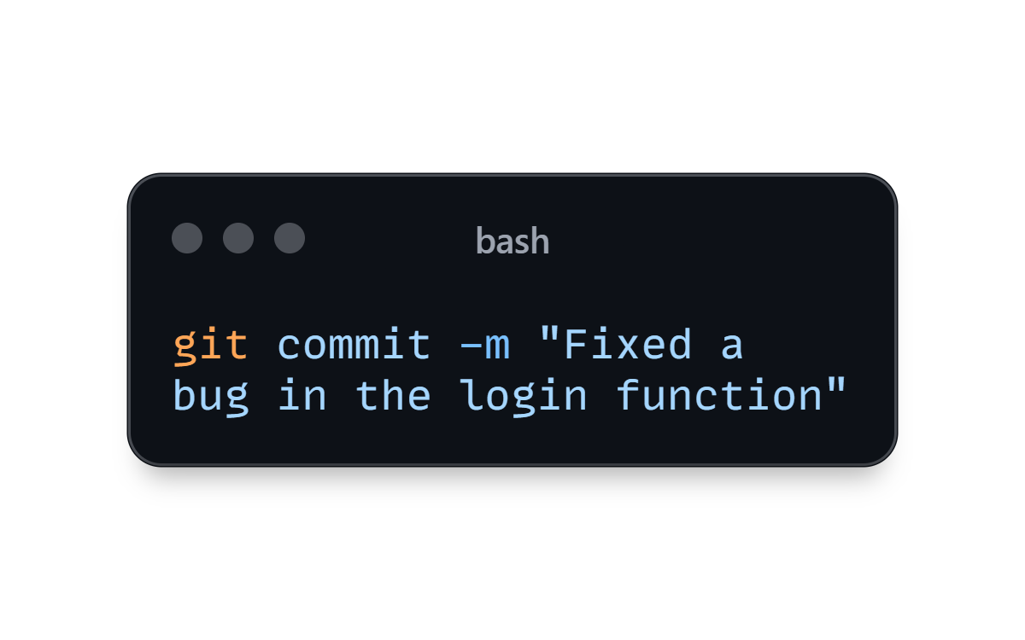
Git Basics: The Command Line Interface
Git is the version control system that powers GitHub. Familiarize yourself with these fundamental commands to manage your code:
3. git commit -m "Commit message": Records changes with a descriptive message.

Slide 10
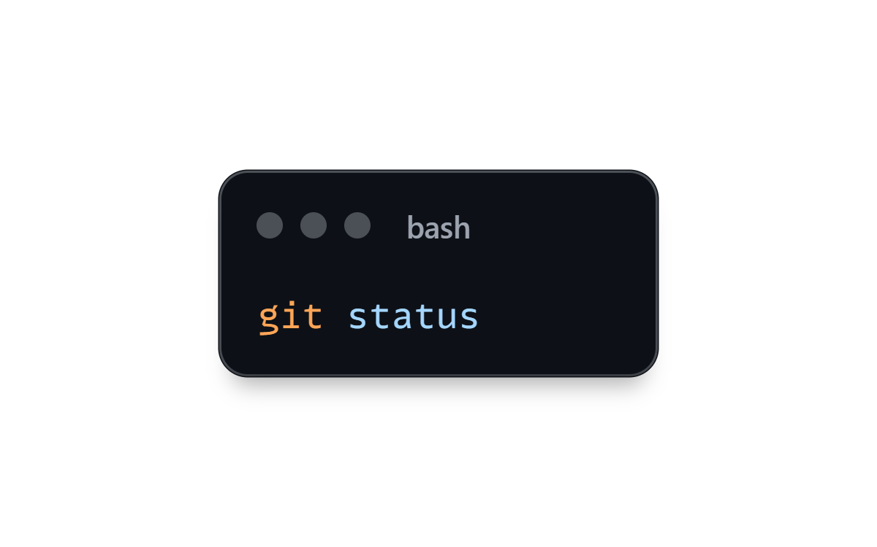
Git Basics: The Command Line Interface
Git is the version control system that powers GitHub. Familiarize yourself with these fundamental commands to manage your code:
4. git status: Checks the current status of your repository, showing modified or untracked files.

Slide 11
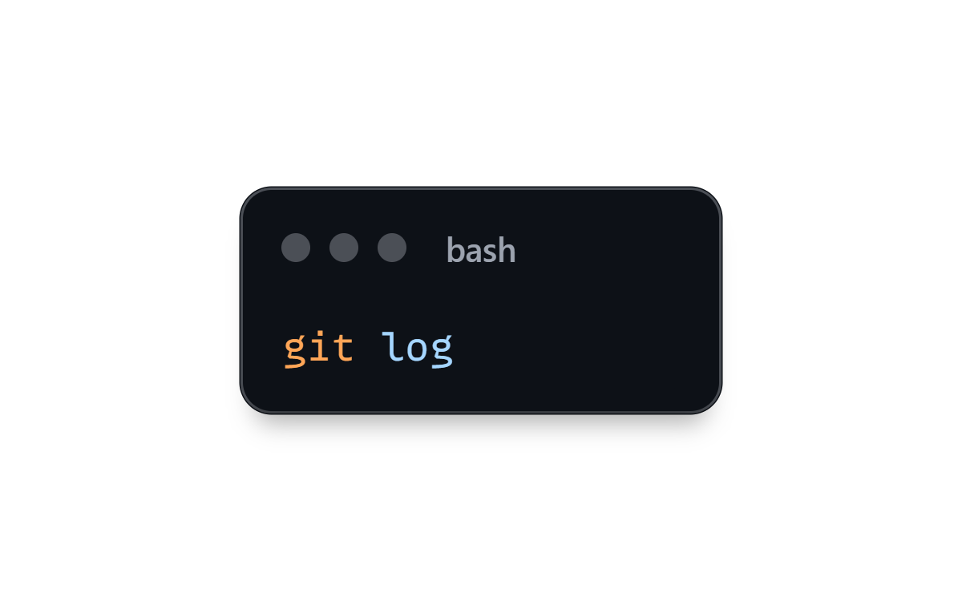
Git Basics: The Command Line Interface
Git is the version control system that powers GitHub. Familiarize yourself with these fundamental commands to manage your code:
5. git log: Displays a history of commits made to the repository.

Slide 12
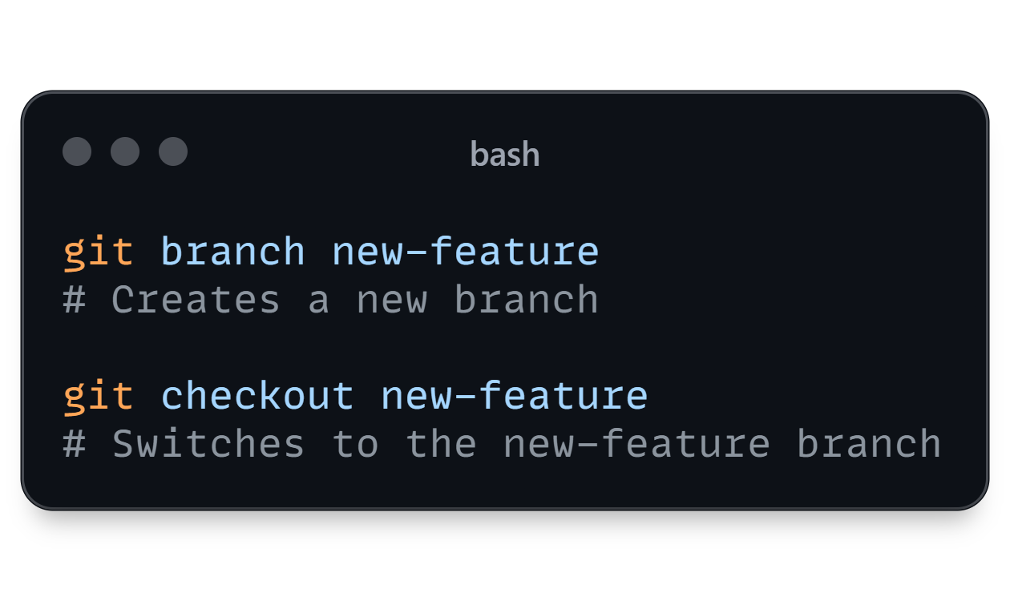
Git Basics: The Command Line Interface
Git is the version control system that powers GitHub. Familiarize yourself with these fundamental commands to manage your code:
6. git branch: Creates, lists, or switches between branches.

Slide 13
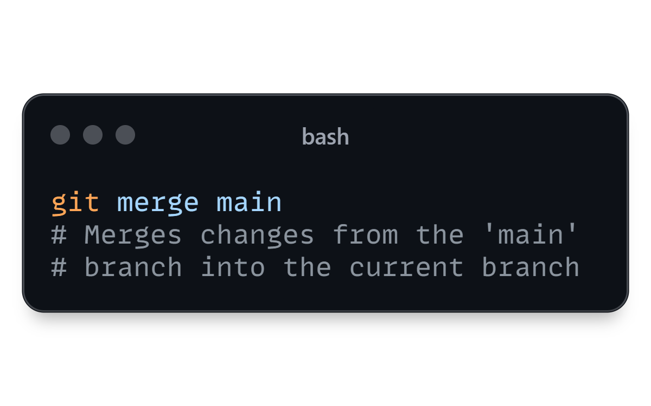
Git Basics: The Command Line Interface
Git is the version control system that powers GitHub. Familiarize yourself with these fundamental commands to manage your code:
7. git merge <branch-name>: Combines changes from another branch into your current branch.

Slide 14
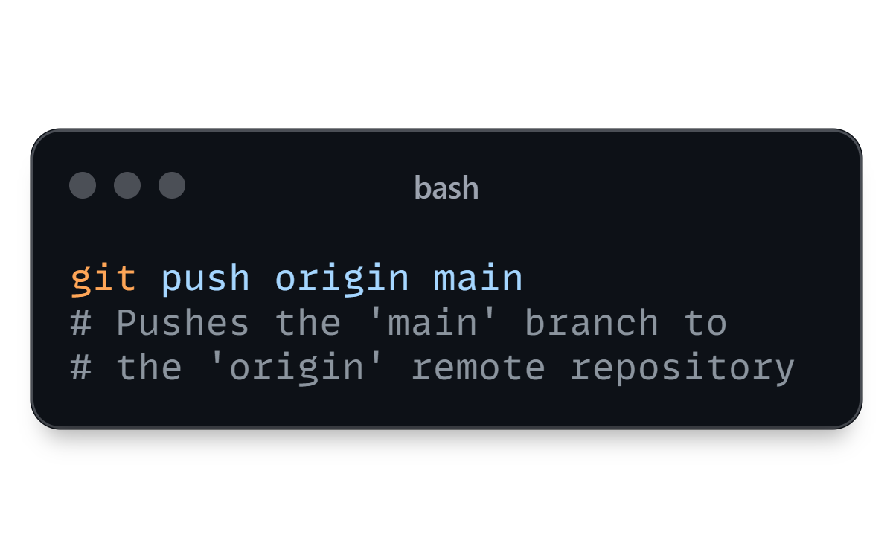
Git Basics: The Command Line Interface
Git is the version control system that powers GitHub. Familiarize yourself with these fundamental commands to manage your code:
8. git push origin <branch-name>: Uploads local changes to a remote repository on GitHub.

Slide 15
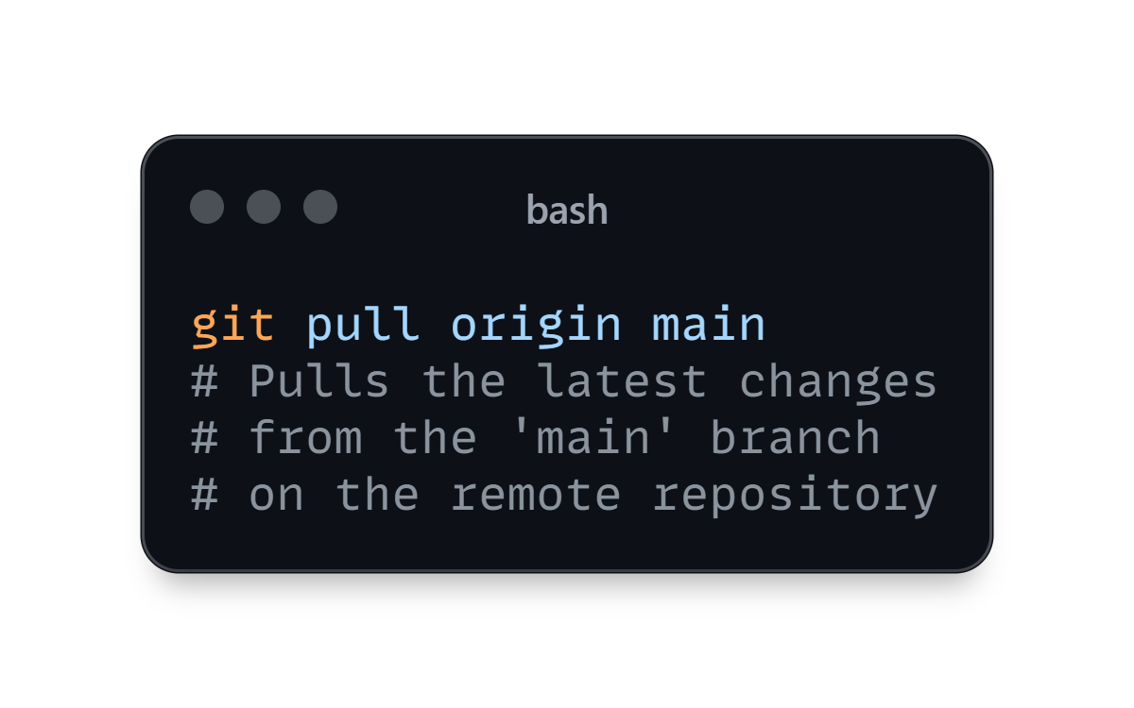
Git Basics: The Command Line Interface
Git is the version control system that powers GitHub. Familiarize yourself with these fundamental commands to manage your code:
9. git pull origin <branch-name>: Downloads changes from the remote repository and integrates them into your local branch.

Slide 16
03
WORKING WITH REMOTE REPOSITORIES
Beyond Your Local Space: Collaborating with Remote Repositories

Slide 17
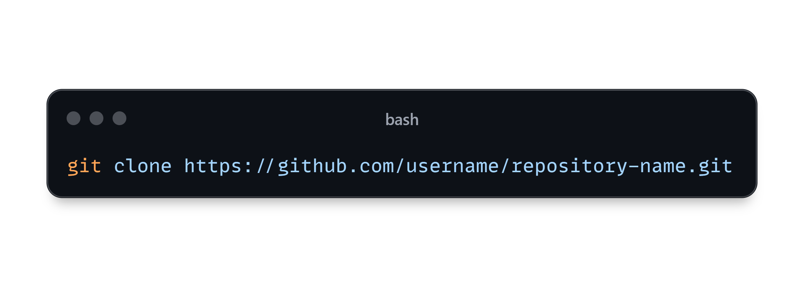
Working with Remote Repositories
Remote repositories on GitHub allow you to share your code, collaborate with others, and back up your work.
1. git clone <repository URL>: Creates a local copy of a remote repository.

Slide 18
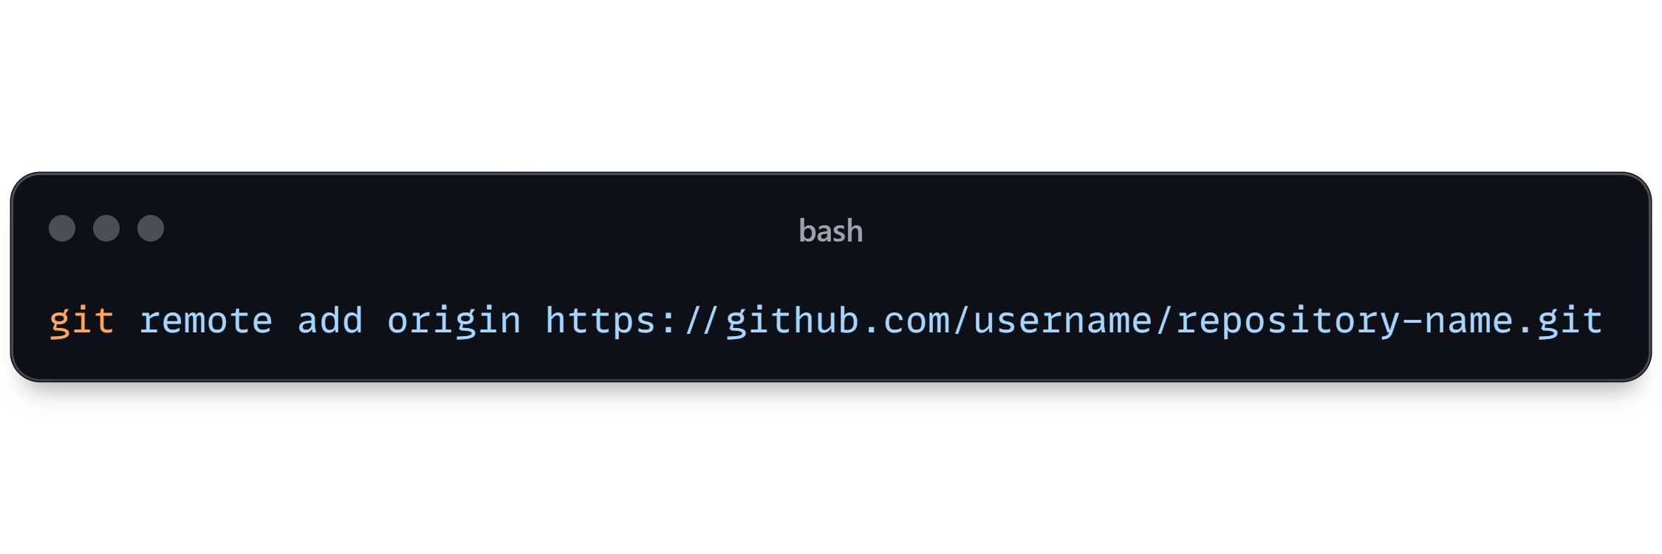
Working with Remote Repositories
Remote repositories on GitHub allow you to share your code, collaborate with others, and back up your work.
2. git remote add origin <repository URL>: Adds a remote repository to your local project.

Slide 19
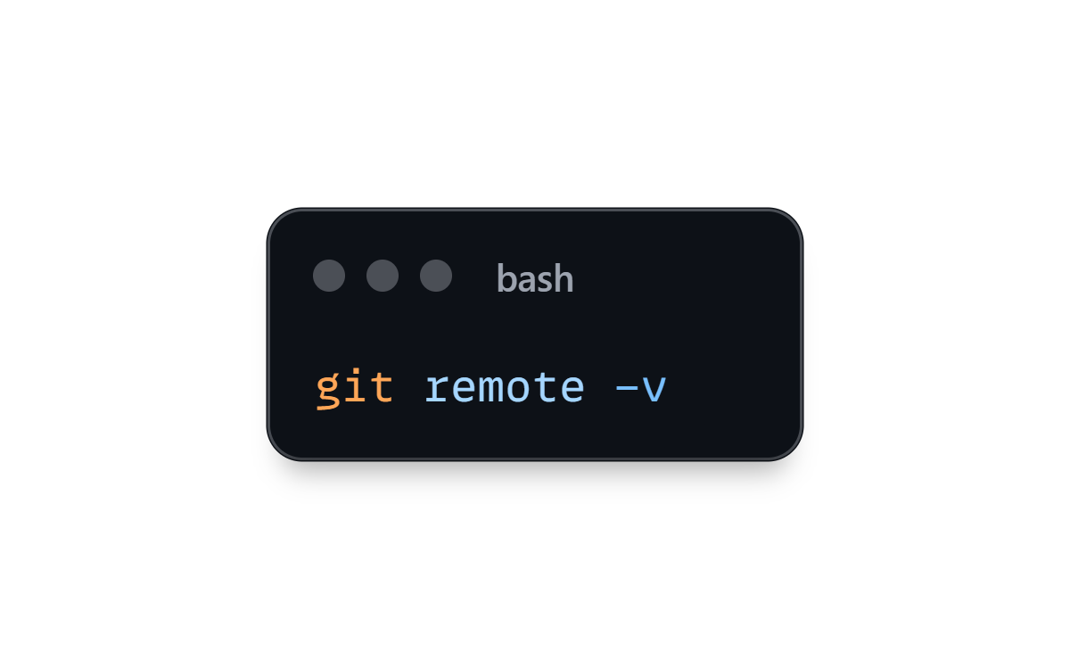
Working with Remote Repositories
Remote repositories on GitHub allow you to share your code, collaborate with others, and back up your work.
3. git remote -v: Lists all remote repositories connected to your local project.

Slide 20
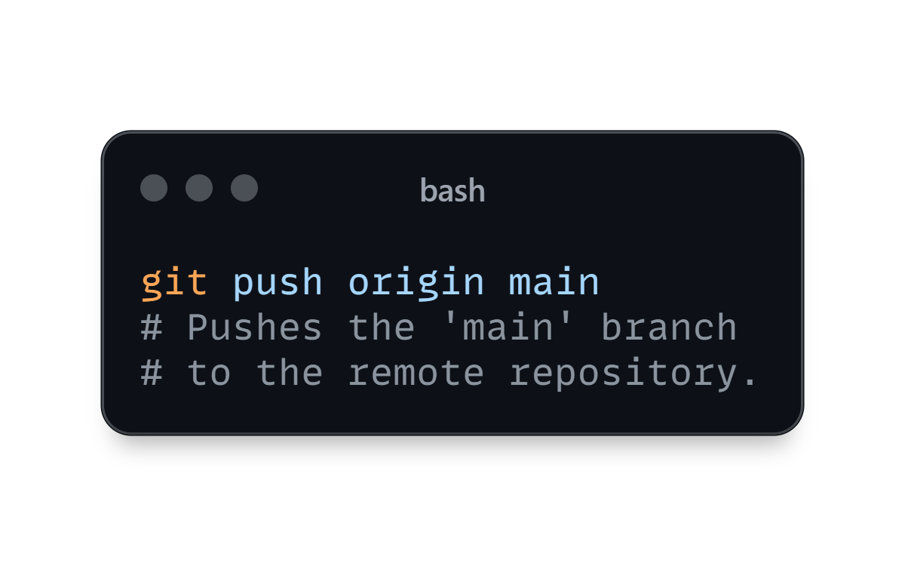
Working with Remote Repositories
Remote repositories on GitHub allow you to share your code, collaborate with others, and back up your work.
4. git push origin <branch-name>: Pushes your local changes to the remote repository.

Slide 21

Working with Remote Repositories
Remote repositories on GitHub allow you to share your code, collaborate with others, and back up your work.
5. git pull origin <branch-name>: Retrieves changes from the remote repository and integrates them into your local branch.

Slide 22
04
BRANCHING FOR FEATURE DEVELOPMENT
Isolating Your Code: The Power of Branching

Slide 23
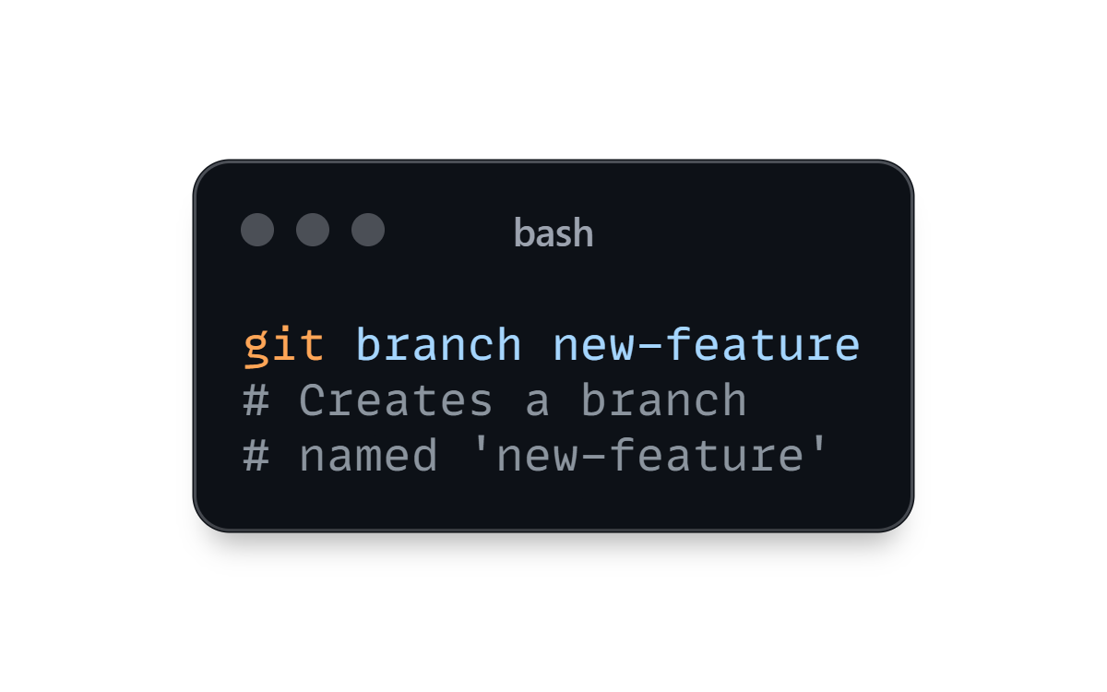
Branching for Feature Development
Branching allows you to develop features independently without affecting the main codebase.
1. git branch <branch-name>: Create a new branch for your feature development.

Slide 24
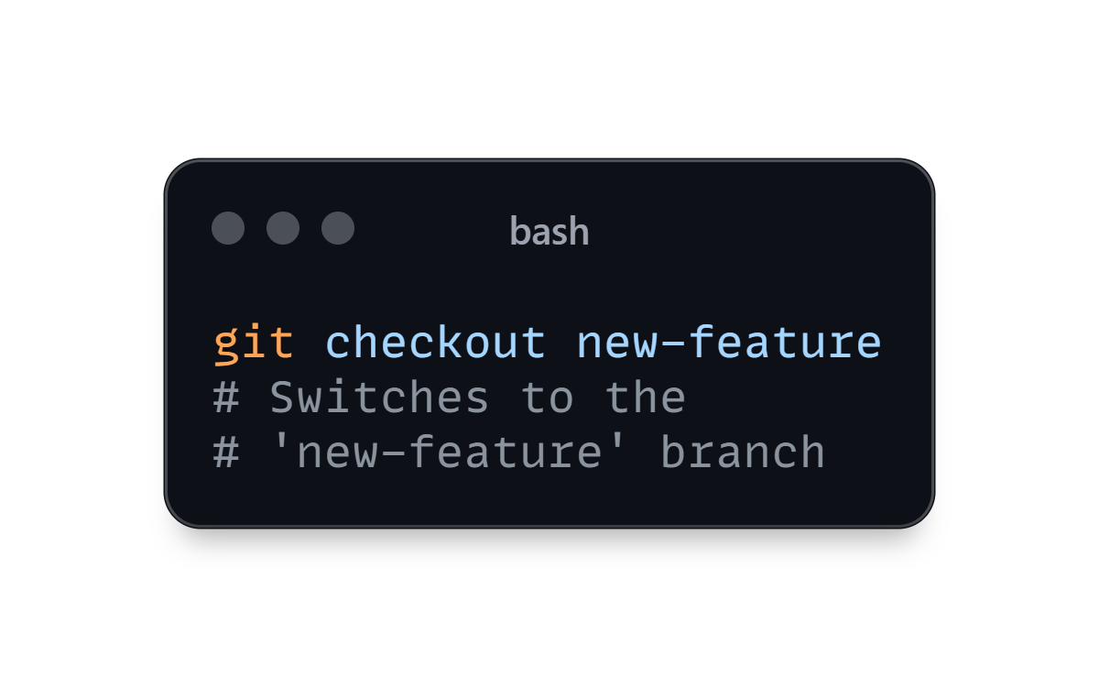
Branching for Feature Development
Branching allows you to develop features independently without affecting the main codebase.
2. git checkout <branch-name>: Switch to the new branch.

Slide 25
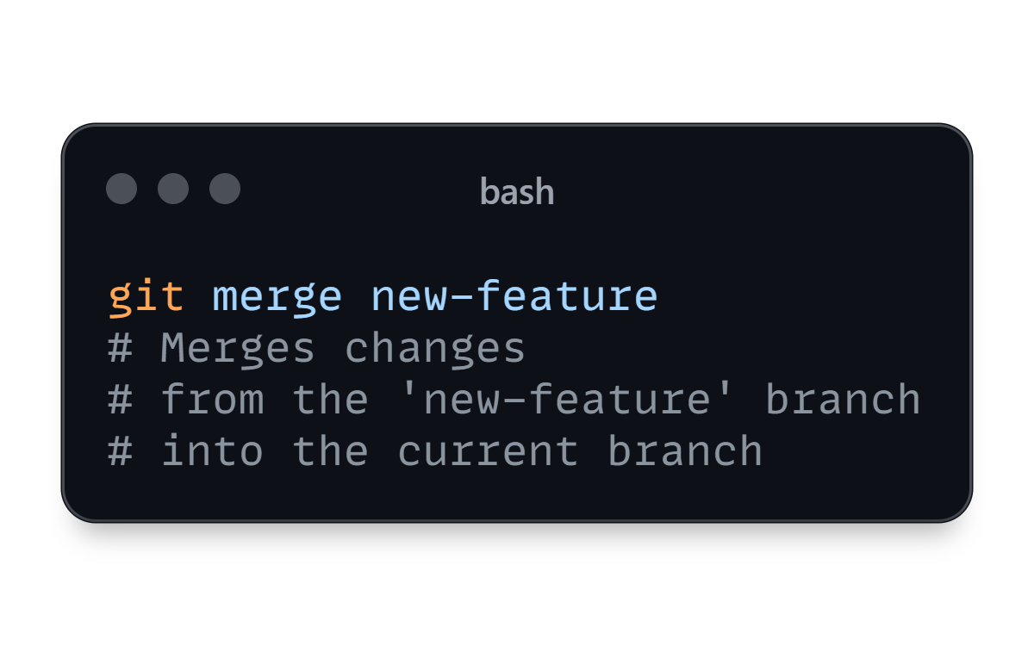
Branching for Feature Development
Branching allows you to develop features independently without affecting the main codebase.
3. git merge <branch-name>: Integrate changes from a branch into the current branch.

Slide 26
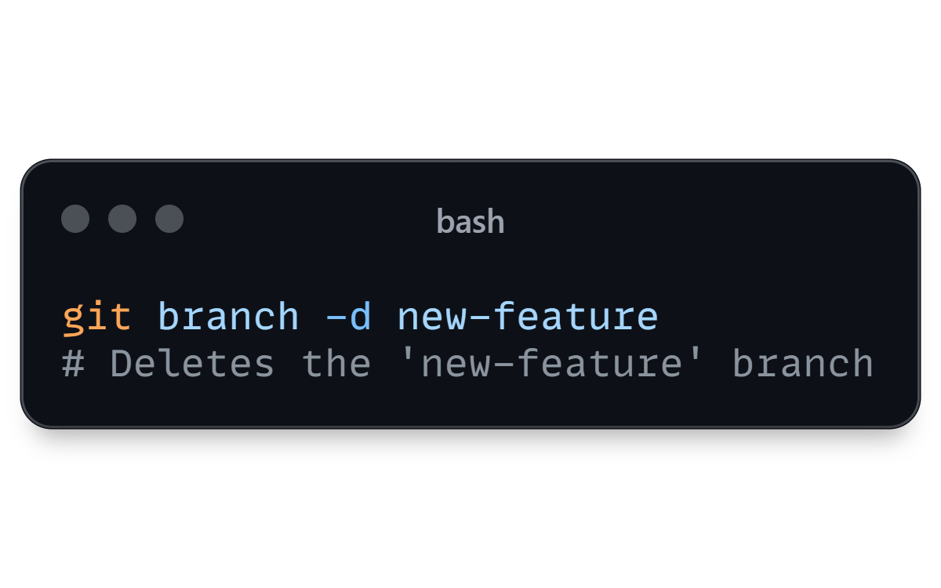
Branching for Feature Development
Branching allows you to develop features independently without affecting the main codebase.
4. git branch -d <branch-name>: Deletes a branch after it's been merged.

Slide 27
05
PULL REQUESTS: COLLABORATING SEAMLESSLY
Collaboration Made Easy: Working with Pull Requests

Slide 28
GitHub Pull Requests: Collaborating Seamlessly
Pull requests are the heart of collaboration on GitHub. They allow you to propose changes and review code before merging it into the main branch.
Create a Pull Request: Navigate to the "Pull requests" tab on your repository and click "New pull request." Select the branches you want to merge.
Write a Descriptive Title and Description: Clearly explain the purpose and changes in your pull request.
Review and Discuss: Collaborators can review your code, suggest changes, and discuss the implementation.
Merge the Pull Request: Once all reviews and comments are addressed, the pull request can be merged into the target branch.

Slide 29
06
PROJECT MANAGEMENT WITH GITHUB ISSUES
Keeping Track of Everything: Utilizing GitHub Issues

Slide 30
Project Management with GitHub Issues
GitHub Issues provide a powerful framework for managing tasks, bugs, and features within your project.
Create an Issue: Navigate to the "Issues" tab on your repository and click "New issue.“
Assign Labels: Use labels to categorize issues based on type (bug, feature, enhancement), priority, and area of the project.
Assign Milestones: Group issues into milestones to track progress on specific releases or projects.
Assign Users: Assign issues to specific users who are responsible for addressing them.
Add Comments and Updates: Leave comments to discuss issues, provide updates, and collaborate with team members.

Slide 31
07
GITHUB ACTIONS: AUTOMATING YOUR WORKFLOW
Streamline Your Process: Leveraging GitHub Actions

Slide 32
GitHub Actions: Automating Your Workflow
GitHub Actions automate repetitive tasks, such as testing, building, and deploying your code.
Create a Workflow File: Create a .yml file in the .github/workflows directory of your repository.
Define Triggers: Specify when your workflow should run (e.g., on push, pull request, schedule).
Configure Jobs: Break down your workflow into jobs, which represent independent tasks.
Define Steps: Each job consists of steps that run specific commands or actions.

Slide 33
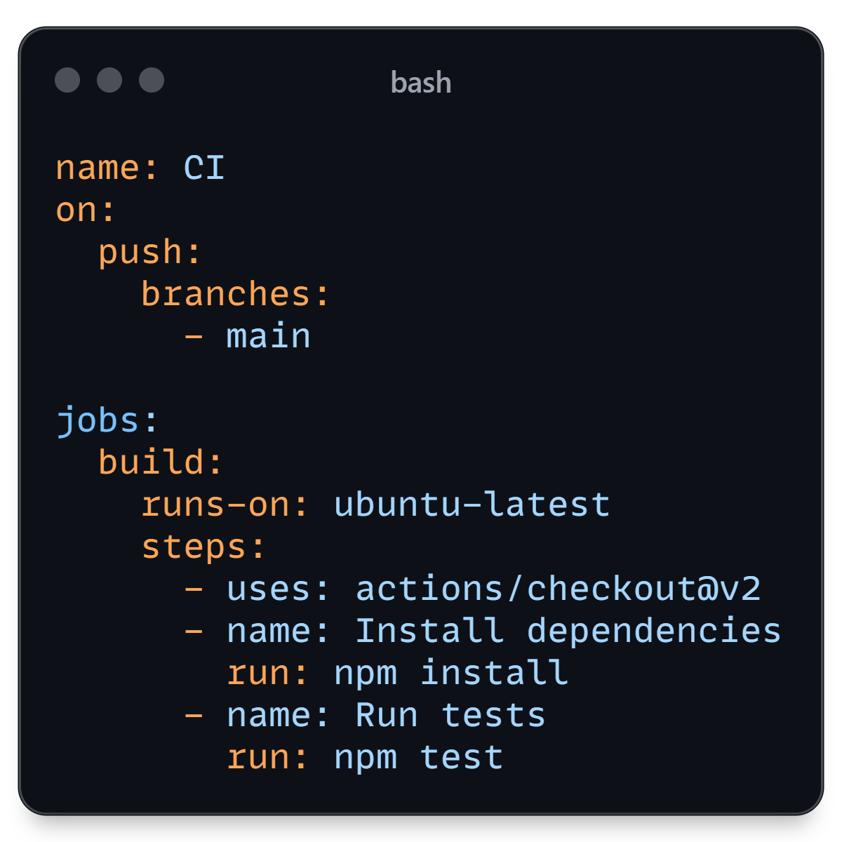
GitHub Actions: Automating Your Workflow
Example Workflow File:

Slide 34
CONCLUSION

Slide 35
Conclusion
This ebook provided a comprehensive overview of GitHub, equipping you with the knowledge and skills to navigate version control, collaborate effectively, and manage projects efficiently.
As you continue your GitHub journey, explore advanced features like forks, releases, and project boards to further enhance your workflow and productivity.

Slide 36
ACKNOWLEDGEMENTS

Slide 37
Acknowledgements
This content has been generated for didactic construction purposes, following DIO’s Santander 2024 - AI Fundamentals for Devs bootcamp. There has been no validation of the content to demonstrate the generative capacity of an AI.
The step-by-step instructions for this project can be found on my GitHub, as well as some other works. You can find me clicking on the following icon.
TMMichaelsen

