Slide 1
SCRUM TRAINING
For Managers.

Slide 2
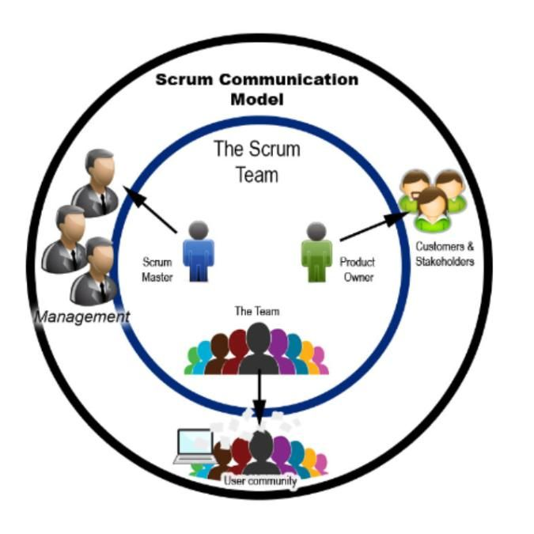
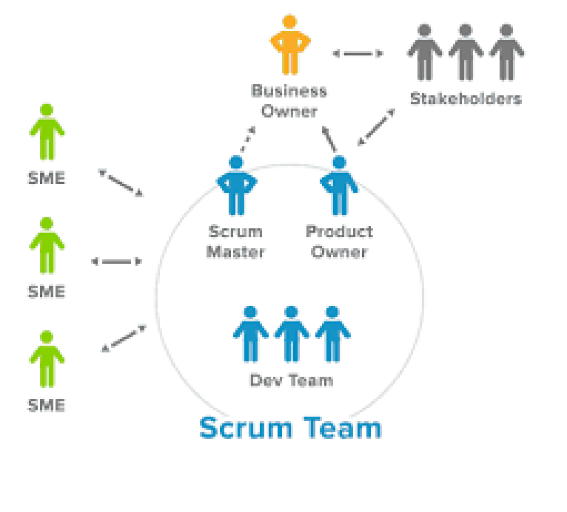

Slide 3
Managers Direct Team
False
Managers are Influencers.
HR Managers – Influence their people to improve and give career advice
Higher level people Influence by helping the Business Owners, Stakeholders, and Product Owners see the overarching vision and large roadmap.

Slide 4
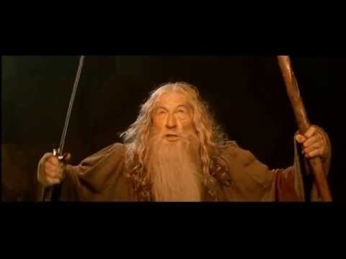
SCRUM Master

