Slide 1
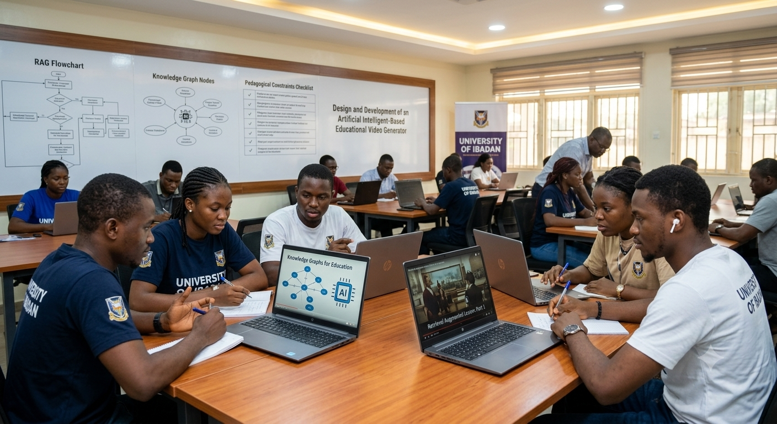
Design and Deveopment of an Artificial intelligent-Based Educational Video Generator Using Retrieval Augmented Generation, Knowledge Graphs and pedagogical constraints
Terdoo Simeon M
252405
Department of Industrial and Production Engineering
Faculty of Technology, University of Ibadan
July, 2026

Slide 2
Presentation Outline
01 Introduction
06 Literature Review
02 Statement of Problem
07 Methodology
03 Aim & Objectives of the Study
08 Expected Results
04 Justification of the Study
09 References
05 Limitation of the Study

Slide 3



Introduction
Education drives human and societal development; digital technologies—especially video—now play a central role in accessible, learner-centered instruction. Generative AI enables large-scale video production but often prioritizes information over pedagogy, producing inaccuracies, curriculum misalignment, and biased or shallow content.
1
2
Background
Opportunities
Digital learning and instructional videos improve engagement and retention (UNESCO, 2023).
Generative AI can automate text, images, audio, and video creation, expanding content availability (Kasneci et al., 2023).
3
Risks
AI hallucinations, curriculum misalignment, and lack of pedagogical structure threaten learning outcomes (Holmes et al., 2019).

Slide 4
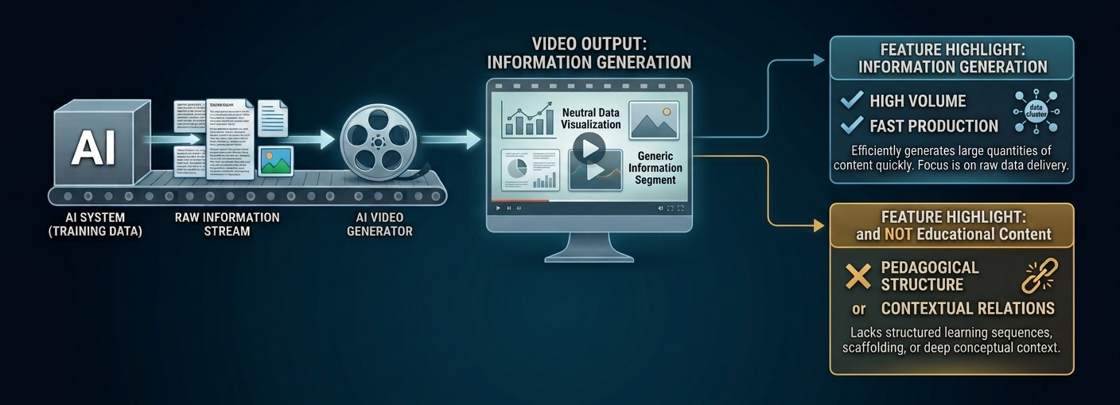
Statement of The Problem
Despite the increasing adoption of artificial intelligence for educational content generation, there have been significant challenges regarding the pedagogical quality of such content.

Slide 5
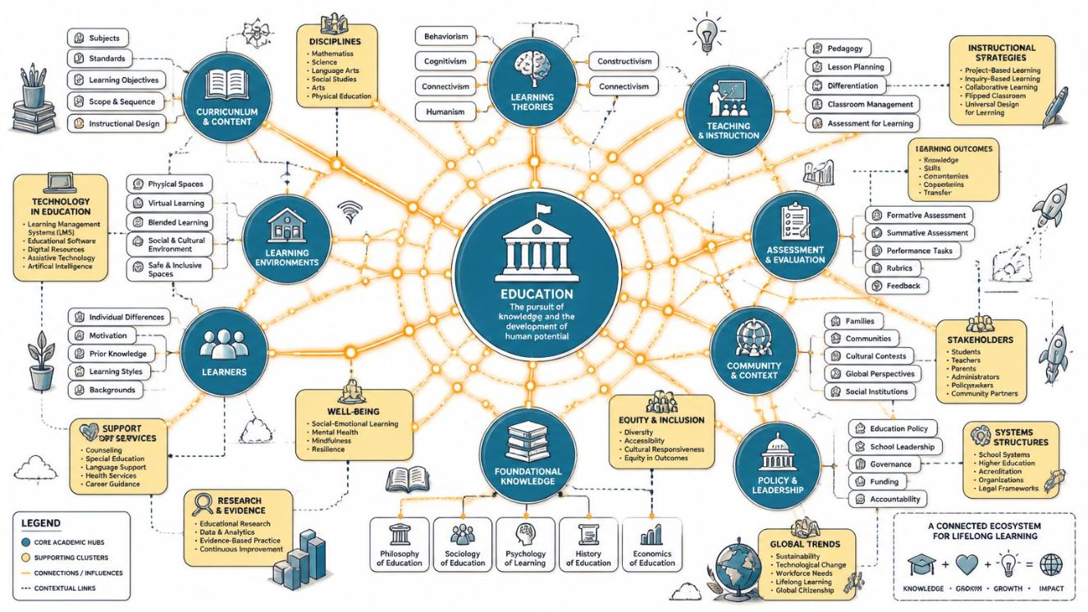



Aim, Objectives & Justification
Aim:
Enhance pedagogical quality of AI-generated instructional videos by building a structured pipeline that integrates Retrieval-Augmented Generation (RAG), knowledge graphs, and explicit pedagogical constraints.
Objectives
1. Develop a RAG component to retrieve relevant instructional materials for accuracy and context.
2. Combine knowledge graphs, RAG, and constraints into a unified AI pipeline and evaluate pedagogical effectiveness.
3. Design a knowledge-graph representation of domain concepts and prerequisites.
4. Integrate pedagogical constraints (scaffolding, cognitive load, sequencing) into video production.
Justification: Combining RAG, knowledge graphs, and pedagogical rules aims to produce accurate, curriculum-aligned, and pedagogically sound instructional videos—addressing scale, accessibility, and instructional quality concerns in AI-driven education.

Slide 6
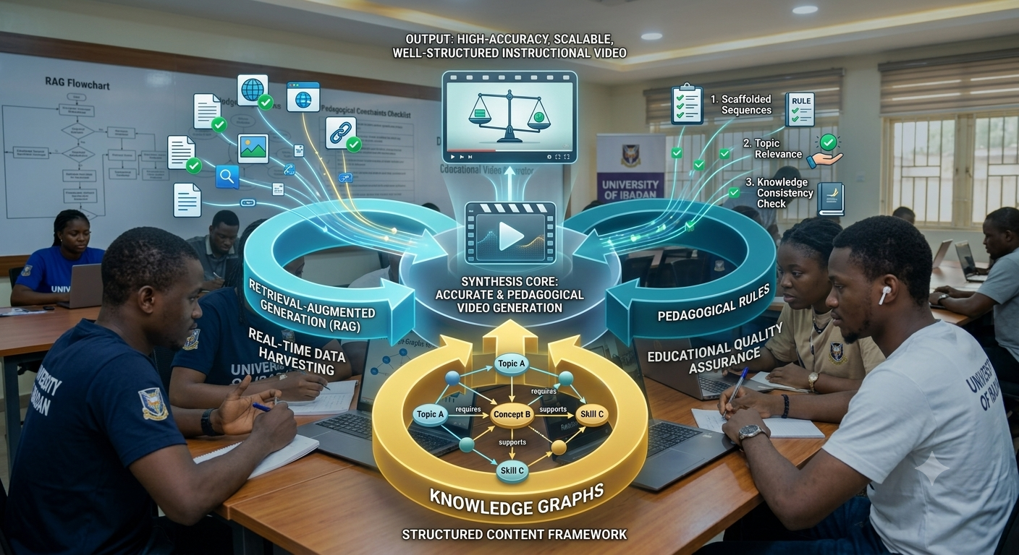
Justification of the Study
Artificial intelligence is increasingly being used to generate instructional videos and other educational content. however, most generative AI systems are designed to produce information rather than support effective learning, often resulting in content that lacks proper instructional structure

Slide 7
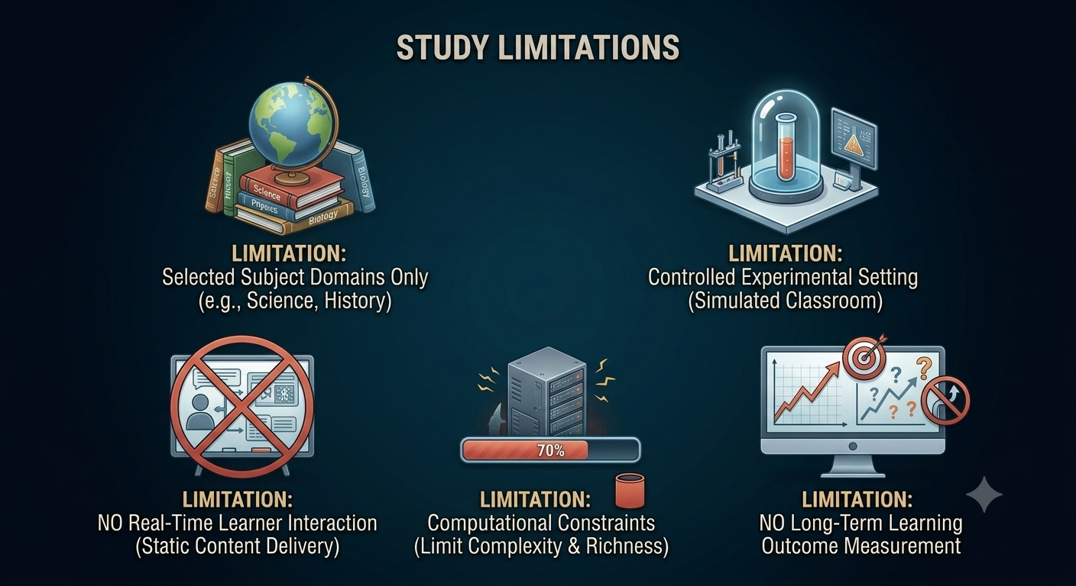

Slide 8

Literature Review
learning is a continuous process though with individuals acquire knwolege, skills, values and competencies. Illeris (2018) argues that while learners motivation, interest and interaction with others can significantly influence how well they understand and retain information. effective learning still depends on how well content is designed to align with how people process information, attention, encoding, retension and retrival

Slide 9

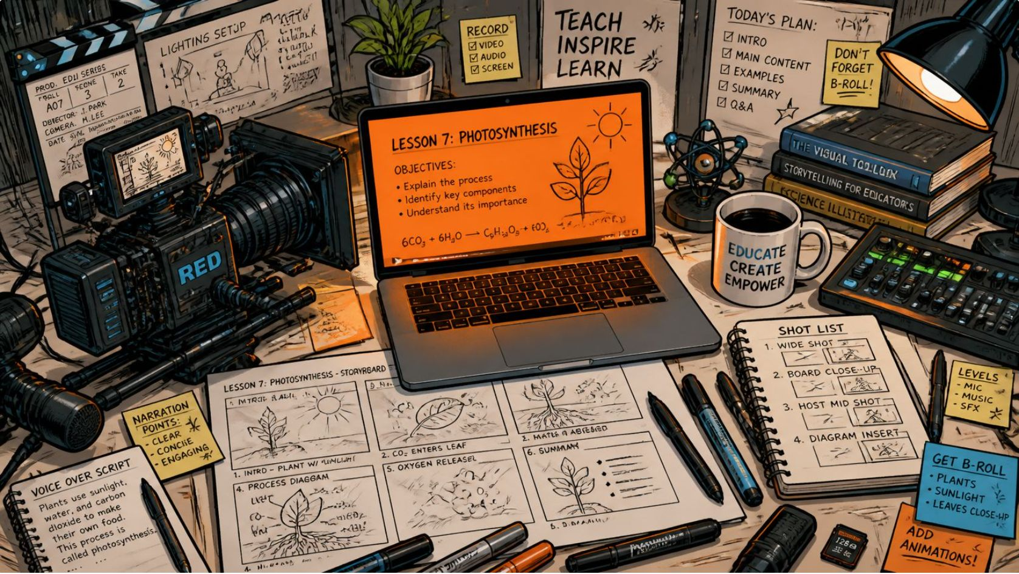
Foundations of Learning & Multimedia
Theories & cognitive processes
Behaviorism (reinforcement),
Cognitivism (assimilation/accommodation),
Constructivism (social construction, scaffolding). Attention, perception, memory, cognitive load, and prior knowledge guide design.
cognitive processes in learning:
attention, perception, retention and retrieval
Factors affecting learning effectiveness
Mayer insist that instructional design is a major factor that affects learning effectiveness, he concludes that the use of examples and multimedia elements can enhance comprehension which aligns with Illeris earlier submission
digital technologies for learning
while many leaning technologies have gained visibility in recent years (rani, 2020) flipped classroom model has uniquely been demonstrated to imporve student engagement and learning outcomes (Ullah 2023)

Slide 10
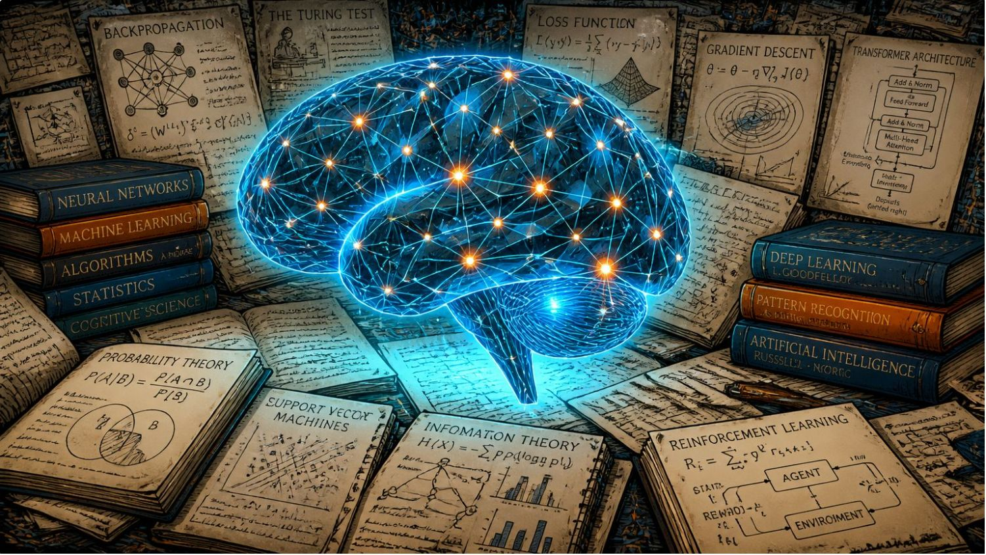

AI and NLP in education
ranging from intelligent tutoring systems, to dynamic content adjustments AI systems have improved in their resoucefullness for teaching and learning. with the advent of deep leaning models, AI systems can now produce human like text, summarize information and assiste in content createion (Brown et al, 2020)
AI, NLP, Generative Models & RAG
Challenges of AI in education
despite the contributions, AI also present several challenges of reliability, bias and fairness (Brown et al., 2020)
Retrieval-Augmented Generation (RAG)
following the challenges of AI for content generation, RAG emerged as a key approach for improving these systems as it integrates a retrieval mechanism with a generative model (lewis et al., 2020)

Slide 11
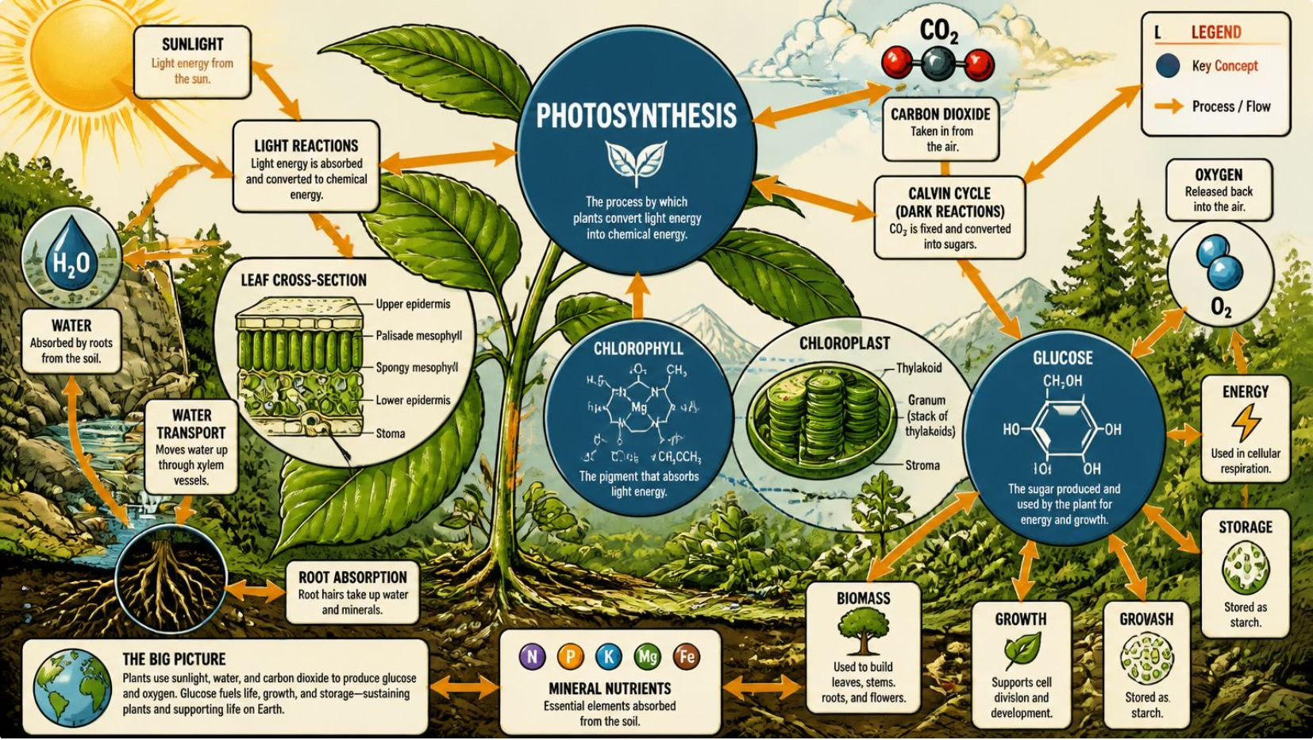
Knowledge Graphs, Hybrids & Research Gaps
Knowledge Graphs (KGs)
RAG has demonstrated usefulness in content grounding, however, Lewis in his work “Retrieval-augmented generation for knowledge-intensive NLP tasks 2020” argues that RAG results to increase system complexity and computational cost as it requires both retrieval and generation processes to operate simulaneously
RAG + KG integration
while RAG imporves factual grounding, it does not fully solve deeper reasoning challenges, especially in tasks that require multi- step logical inference or structured knowledge representation (Hogan et al 2021). Hogan believes that knowledge graphs solve this problem as they represent knowledge in a sturctured and semantically meaningful way

Slide 12
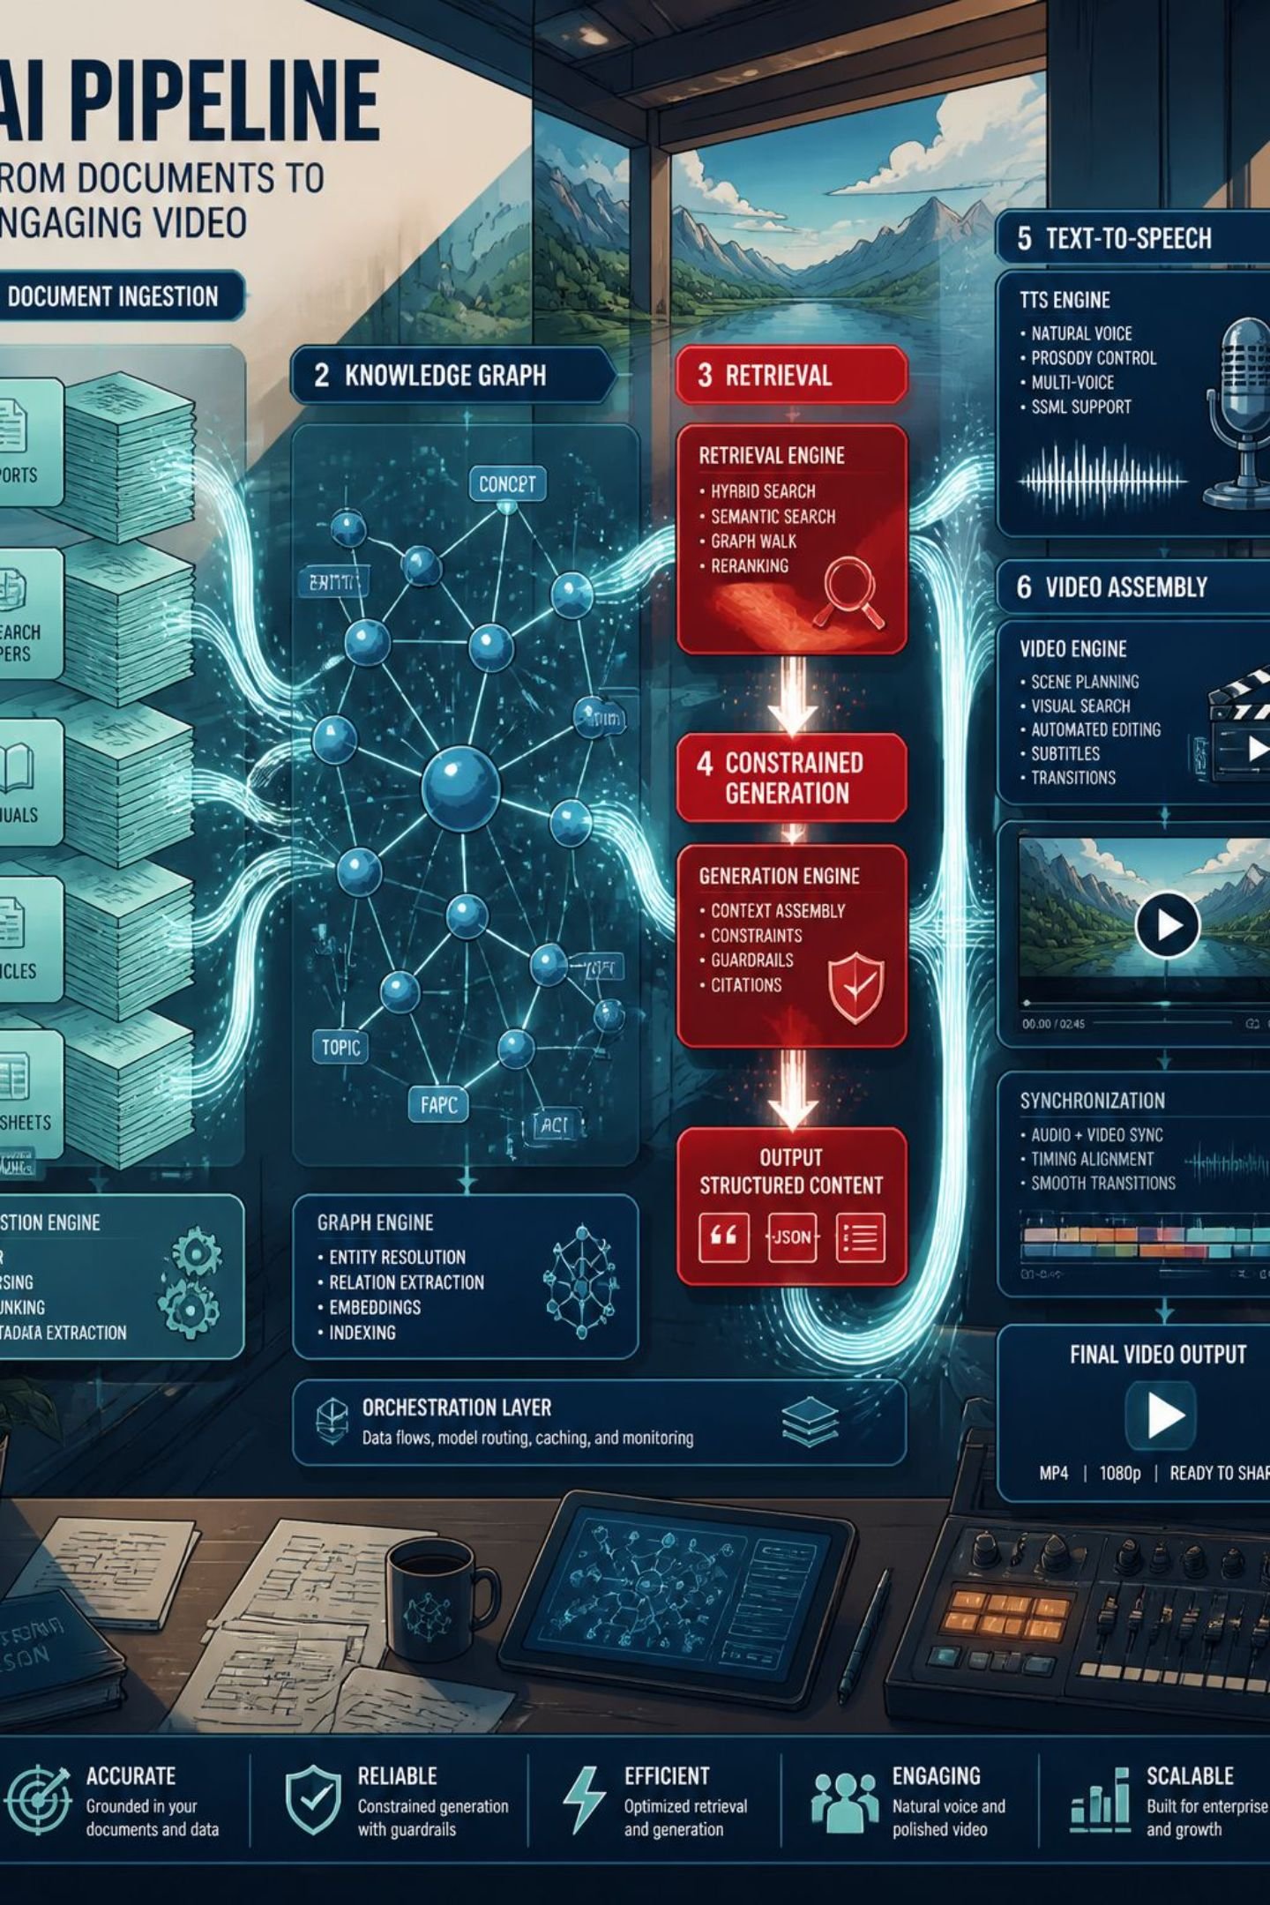
Methodology
The proposed method to generate video content in this work is an integrated pipeline which combines a knowledge graph, retrieval‑augmented generation (RAG), and a pedagogical constraint layer to produce scaffolded instructional video segments. Five pipeline states: (1) knowledge‑graph construction, (2) indexing & retrieval, (3) pedagogical constraint application, (4) narration (TTS), and (5) slide generation & video assembly.

Slide 13
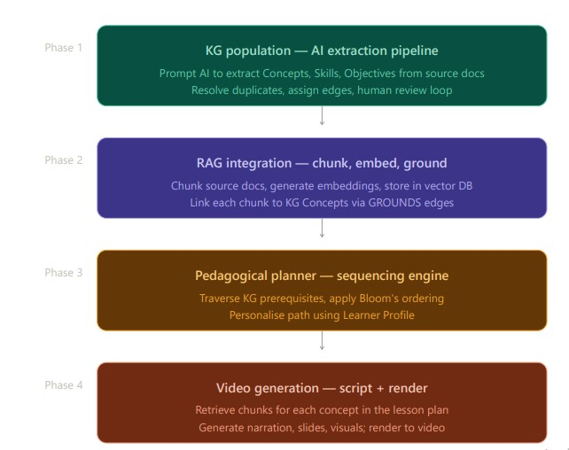
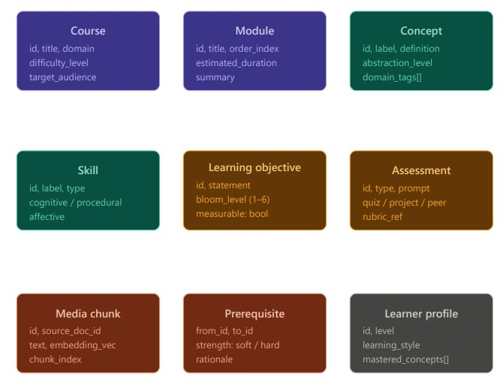
System Design & Implementation
Knowledge Graph Architecture
overall system

Slide 14
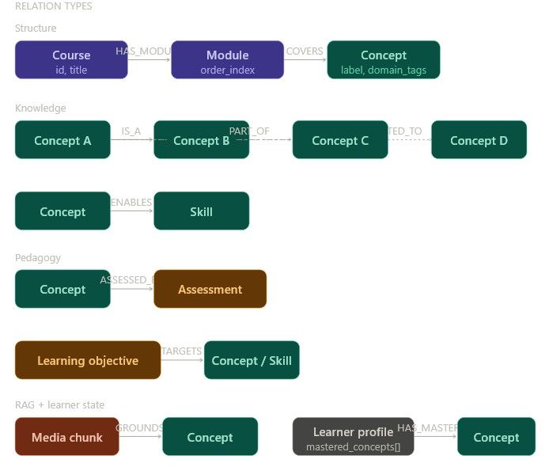
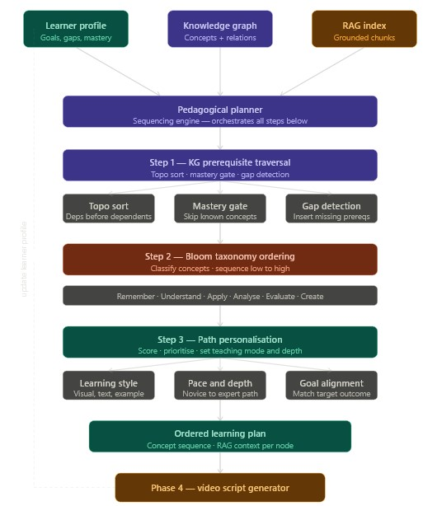
Overall system Workflow
KG relations

Slide 15
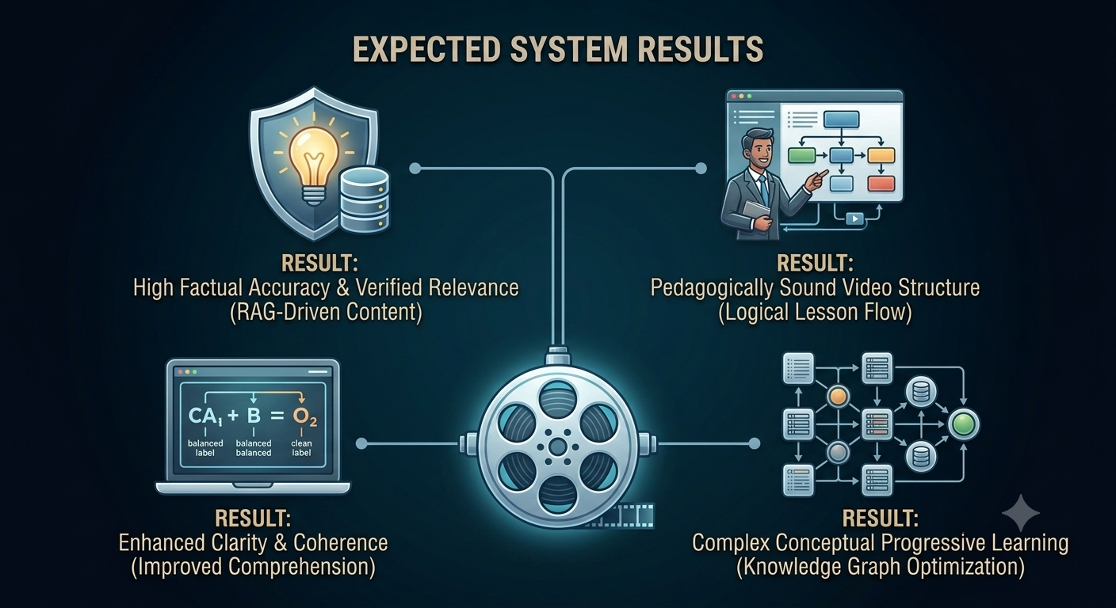

Slide 16
References
Kasneci, E. et al. 2023. ChatGPT for good? On opportunities and challenges of large language models for education. Learning and Individual Differences 103: 102274.
Illeris, K. 2018. Contemporary theories of learning: learning theorists ... in their own words. 2nd ed. Routledge.
Rani, D. 2020. Effectiveness of different teaching methods on knowledge, critical thinking, and skill development of undergraduate students: a systematic review. International Journal of Research and Analytical Reviews (IJRAR) 7.4.
Ullah, K. and Jinah, S. 2023. Effectiveness of flipped classrooms in promoting student learning at the tertiary level. ProScholar Insights 2.1: 28-39.
Brown, T. B. et al. 2020. Language models are few-shot learners. Advances in Neural Information Processing Systems 33: 1877-1901.
Lewis, P. et al. 2020. Retrieval-augmented generation for knowledge-intensive NLP tasks. NeurIPS 33: 9459-9474.
Hogan, A. et al. 2021. Knowledge graphs. ACM Computing Surveys 54.4: 1-37.

Slide 17
Thank You

