Slide 1
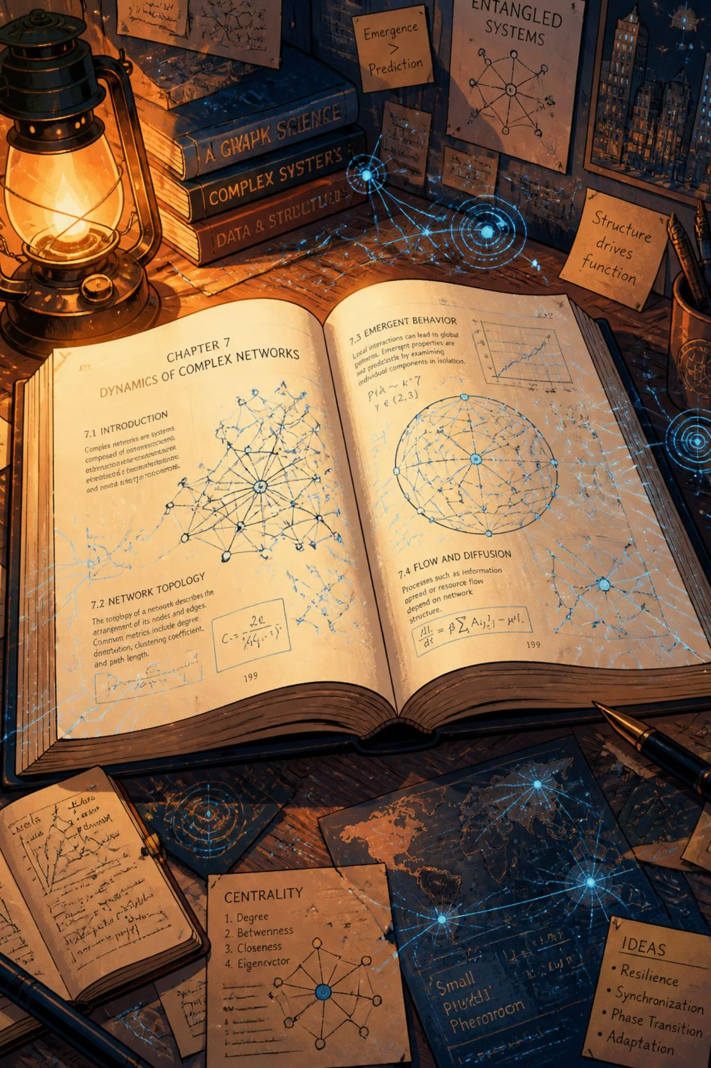
Chapter Two — Literature Review
Concise synthesis of foundations in learning, multimedia learning, instructional design, AI in education, NLP & LLMs, generative AI, RAG, knowledge graphs, hybrid architectures, and evaluation methods. Focus: how structured knowledge + retrieval improve accurate, pedagogically aligned educational video production.

Slide 2
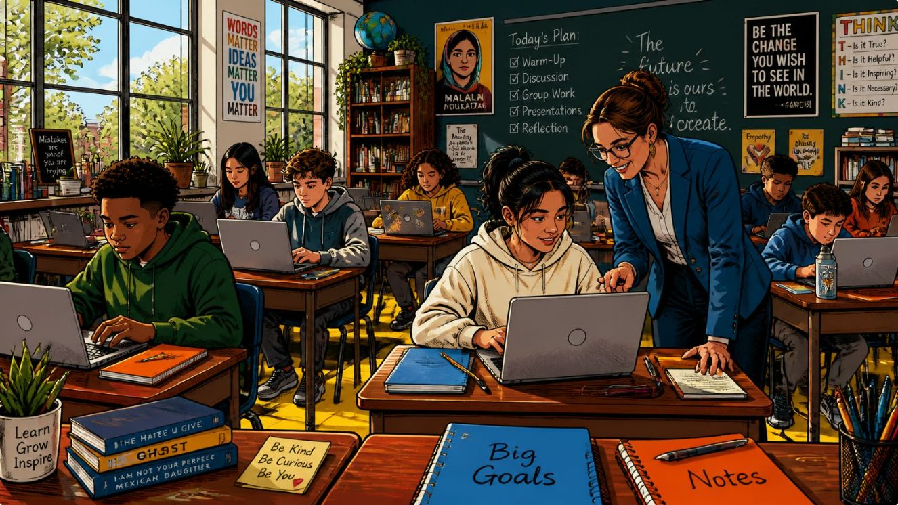
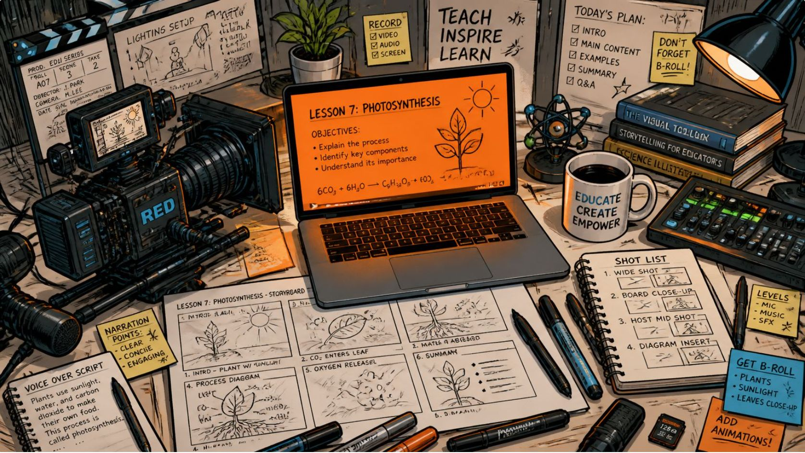
Foundations of Learning & Multimedia
Learning: definition & drivers
Learning = relatively permanent change in behavior/mental processes via experience. Cognitive, emotional, and social dimensions matter; motivation, prior knowledge, and environment shape outcomes (Illeris, Mayer).
Theories & cognitive processes
Behaviorism (reinforcement), Cognitivism (assimilation/accommodation), Constructivism (social construction, scaffolding). Attention, perception, memory, cognitive load, and prior knowledge guide design.
Multimedia & video learning
Multimedia combines text, visuals, audio to reduce cognitive load when designed per Mayer’s principles (coherence, signaling, segmentation). Videos increase engagement and support flipped classrooms but demand quality production.
Video types & trade-offs
Lecture, animated explainer, demonstration, simulation, interactive videos — each suits different objectives. Key limitations: production cost, potential cognitive overload, and limited interactivity if poorly designed.

Slide 3
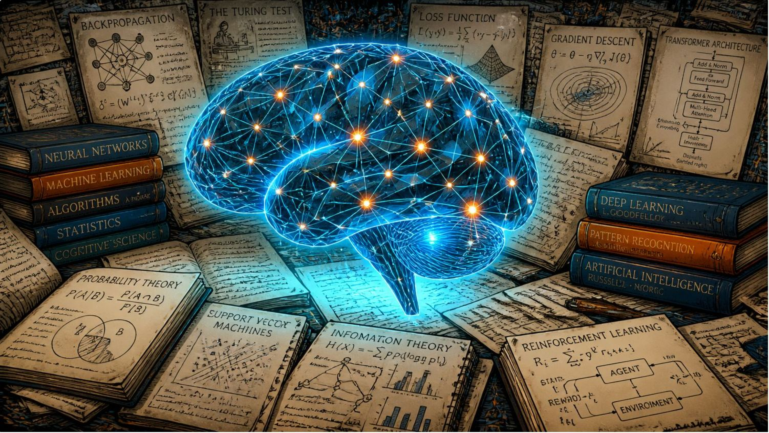

AI, NLP, Generative Models & RAG
AI and NLP in education
AI enables personalization, automation, ITS, adaptive systems, automated assessment, and chatbots. NLP powers grading, Q&A, and text generation; LLMs (transformers) improved fluency but have limits in reasoning and factual reliability.
Generative AI
GenAI (GANs, VAEs, diffusion, transformer-based LLMs) automates scripts, visuals, and narration—scalable but prone to hallucination, bias, and misalignment with pedagogical objectives.
Retrieval-Augmented Generation (RAG)
RAG couples document retrieval with generation to ground outputs in external sources. Components: retriever, knowledge base, generator (and optional reranker). Benefits: improved factual grounding, adaptability, traceability. Limits: retrieval quality, complexity, compute cost.

Slide 4
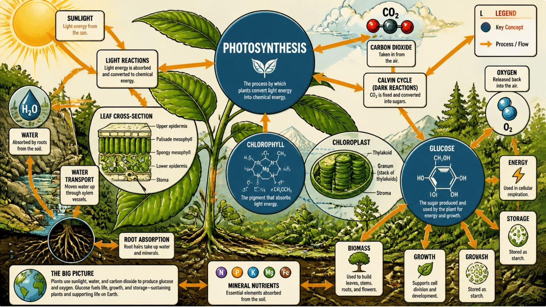



Knowledge Graphs, Hybrids & Research Gaps
Knowledge Graphs (KGs)
KGs model concepts (nodes) and relationships (edges) using ontologies for semantic structure, prerequisites, and curricular mapping. Advantages: structured representation, reasoning, interoperability, and explainability.
RAG + KG integration
Hybrid RAG–KG architectures combine dynamic retrieval with structured semantic context to reduce hallucination, improve sequencing and pedagogical alignment, and enable traceable, curriculum-aware video scripts.
Challenges
Opportunities
Validation
Hallucination, bias, privacy, copyright, explainability, and scalability remain unresolved in generative pipelines.
Hybrid systems combining RAG + KGs, plus graph-theoretic and embedding methods, offer a path to accurate, structured, and scalable educational video production.
Combine graph algorithms, embedding similarity (cosine), and rigorous statistical testing (t-tests, Cohen’s d) to evaluate learning outcomes and system effectiveness.
IMG:

