Slide 1
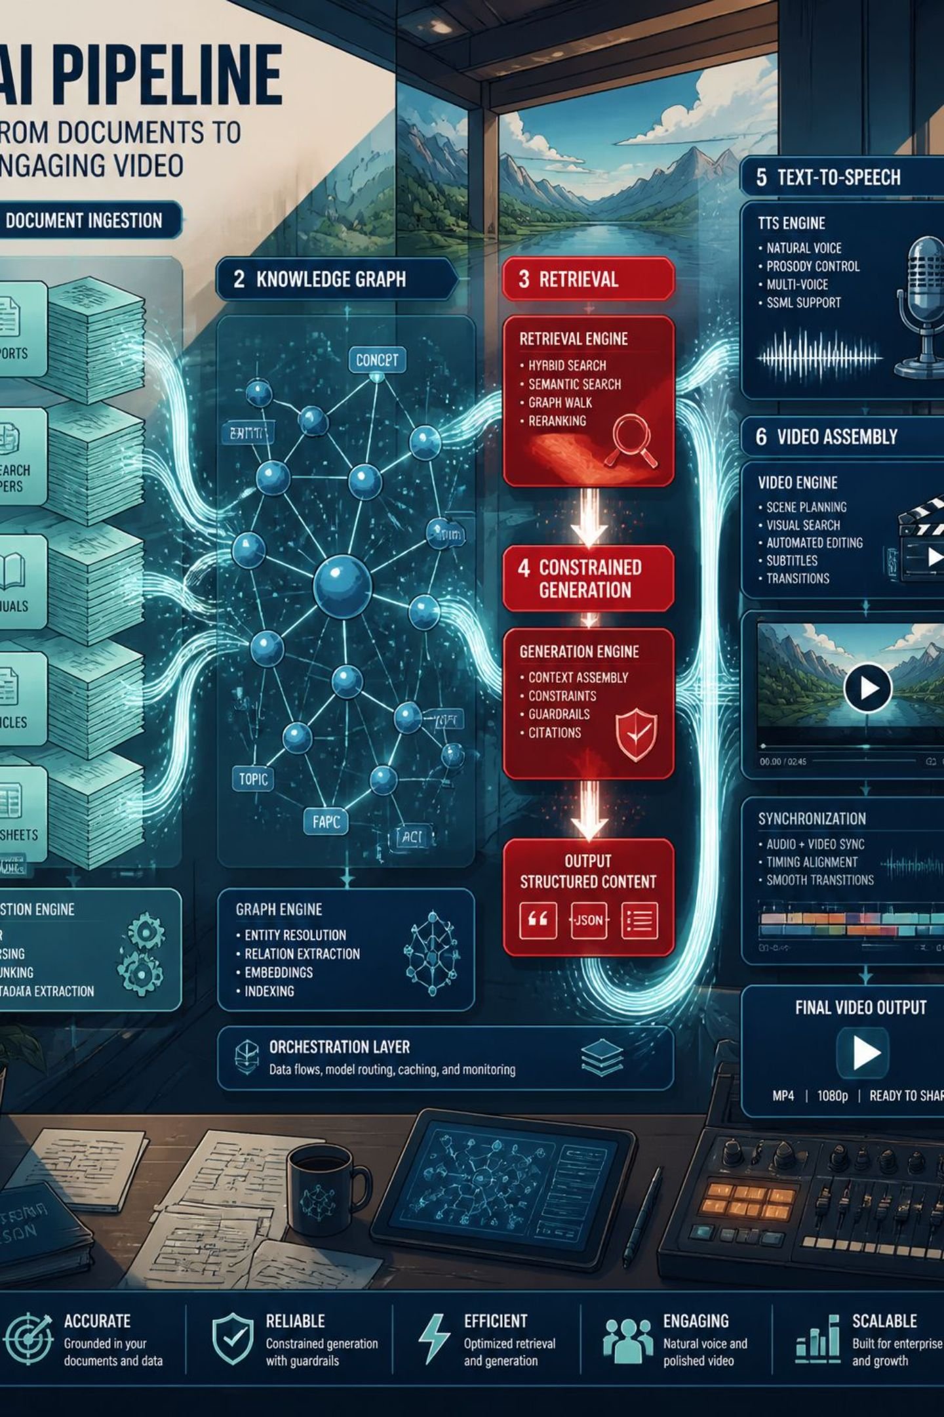
Methodology Overview — AI‑Generated Educational Videos
An integrated pipeline combines a knowledge graph, retrieval‑augmented generation (RAG), and a pedagogical constraint layer to produce scaffolded instructional video segments. Five pipeline states: (1) knowledge‑graph construction, (2) indexing & retrieval, (3) pedagogical constraint application, (4) narration (TTS), and (5) slide generation & video assembly.

Slide 2
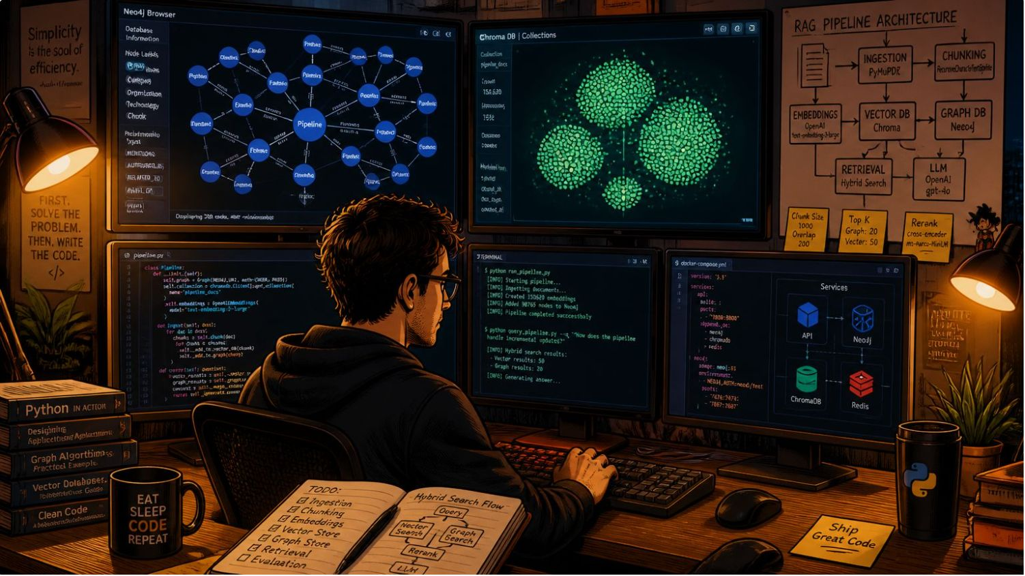
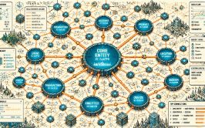
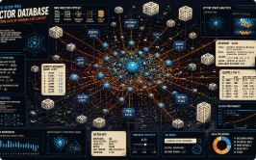

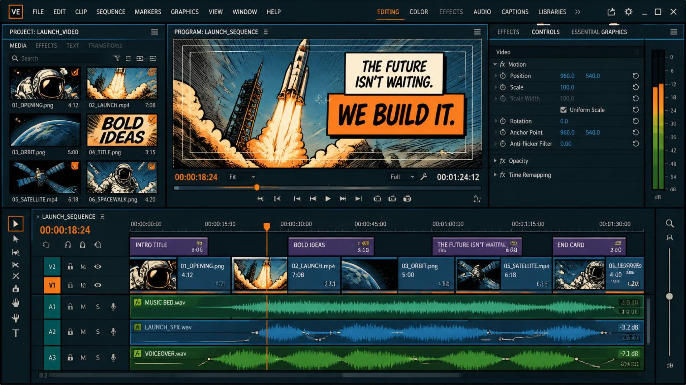
System Design & Implementation
Knowledge Graph
RAG (Chroma)
GPT extracts concept–relationship–concept triples; stored in Neo4j. Ordering follows a topological sort so prerequisites appear before dependent concepts.
Documents split into chunks, embedded, and stored in Chroma. Retrieval returns top_k=4 chunks by cosine similarity to ground generation and reduce hallucination.
Pedagogical Constraints
Each segment: recap → introduce one new concept → short worked example → one-line check question. Cognitive load limit: N_max = 1 new concept per segment.
Execution
Implementation in Python; modular functions for each pipeline stage.
Text-to-speech via GPT-based TTS for narration audio.
MoviePy stitches slides with audio and transitions into final video.

Slide 3


Evaluation, Case Study & Testing
Case Study
Functional Testing
Applied to Product Development (Industrial Engineering) to test scaffolding across interdependent concepts.
Each stage tested individually and end‑to‑end to ensure compatible inputs/outputs and automated video production.
Comparative Evaluation
Analysis
Two learner groups: AI‑video vs human‑made video. Immediate quiz administered to both groups for direct comparison.
Independent‑samples t‑test compares mean quiz scores (α=0.05); Cohen’s d reports effect size to assess instructional equivalence.
Tools & technologies: Python (pipeline), GPT (concept extraction & TTS), Neo4j (knowledge graph), Chroma (vector DB), MoviePy (assembly). Results and statistical findings reported in Chapter Four.
Modular, source‑grounded generation plus pedagogical constraints aim to reduce hallucination and ensure scaffolded learning.

