Slide 1

TMSMultiLab & TMS@40
Lots of people, et al...
https://github.com/TMSMultiLab/TMSMultiLab/wiki

Slide 2
Agenda
Introduction (~15 mins)
GitHub tour & discussion (~15 mins)
Project proposal & feedback (~15 mins)

Slide 3
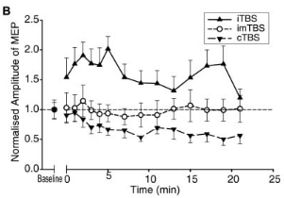
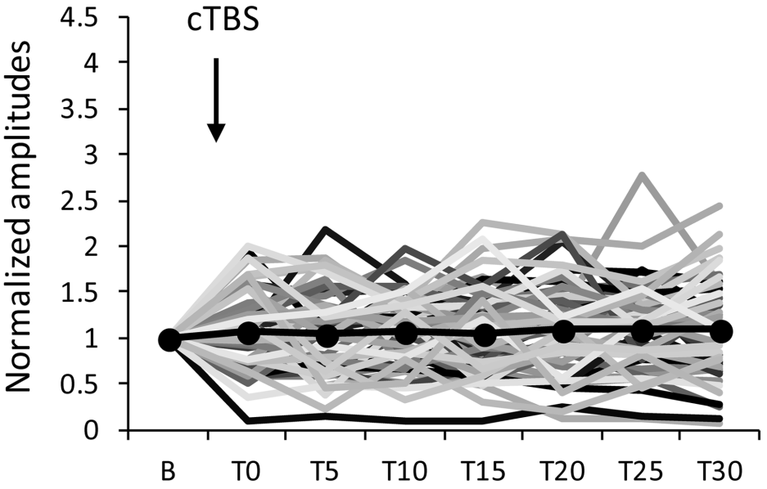
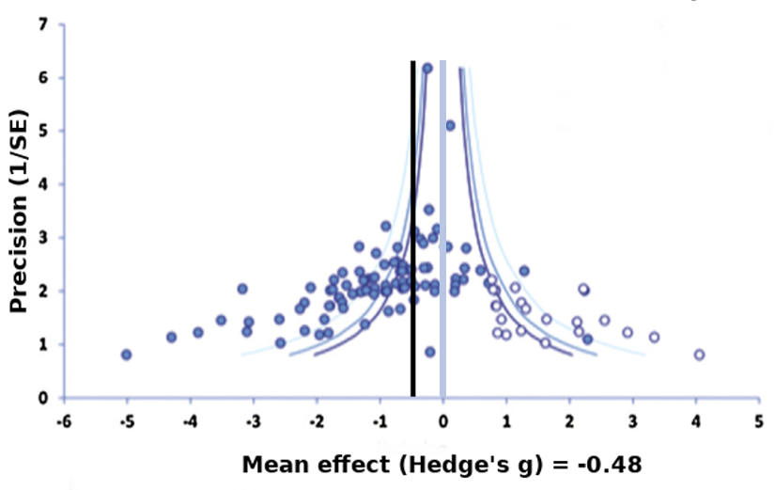
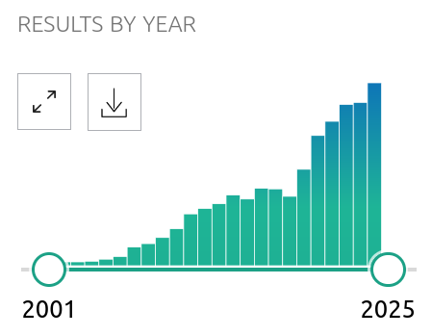
1. Motivation
Replication failures are (more) widely-acknowledged
But, (how) do we respond?
Example: Continuous theta-burst TMS
Huang et al. 2005 (N=9)
Hamada et al. 2013 (N=56)
Chung et al. 2016
PubMed search (late 2024)

Slide 4
2. Opportunity
TMS is 40 years old in 2025 (May 11th!)
The internet, data sharing & data publication
Electronic tools for collaboration & sharing:
GitHub
Open Science Framework
Big TMS Data Collaboration

Slide 5
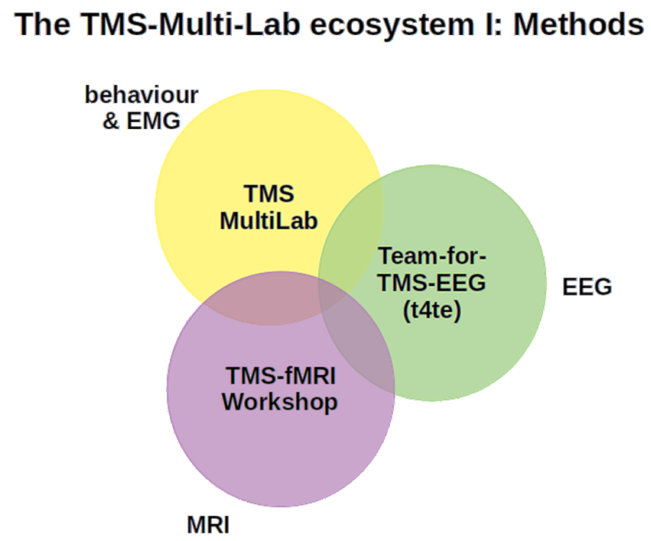
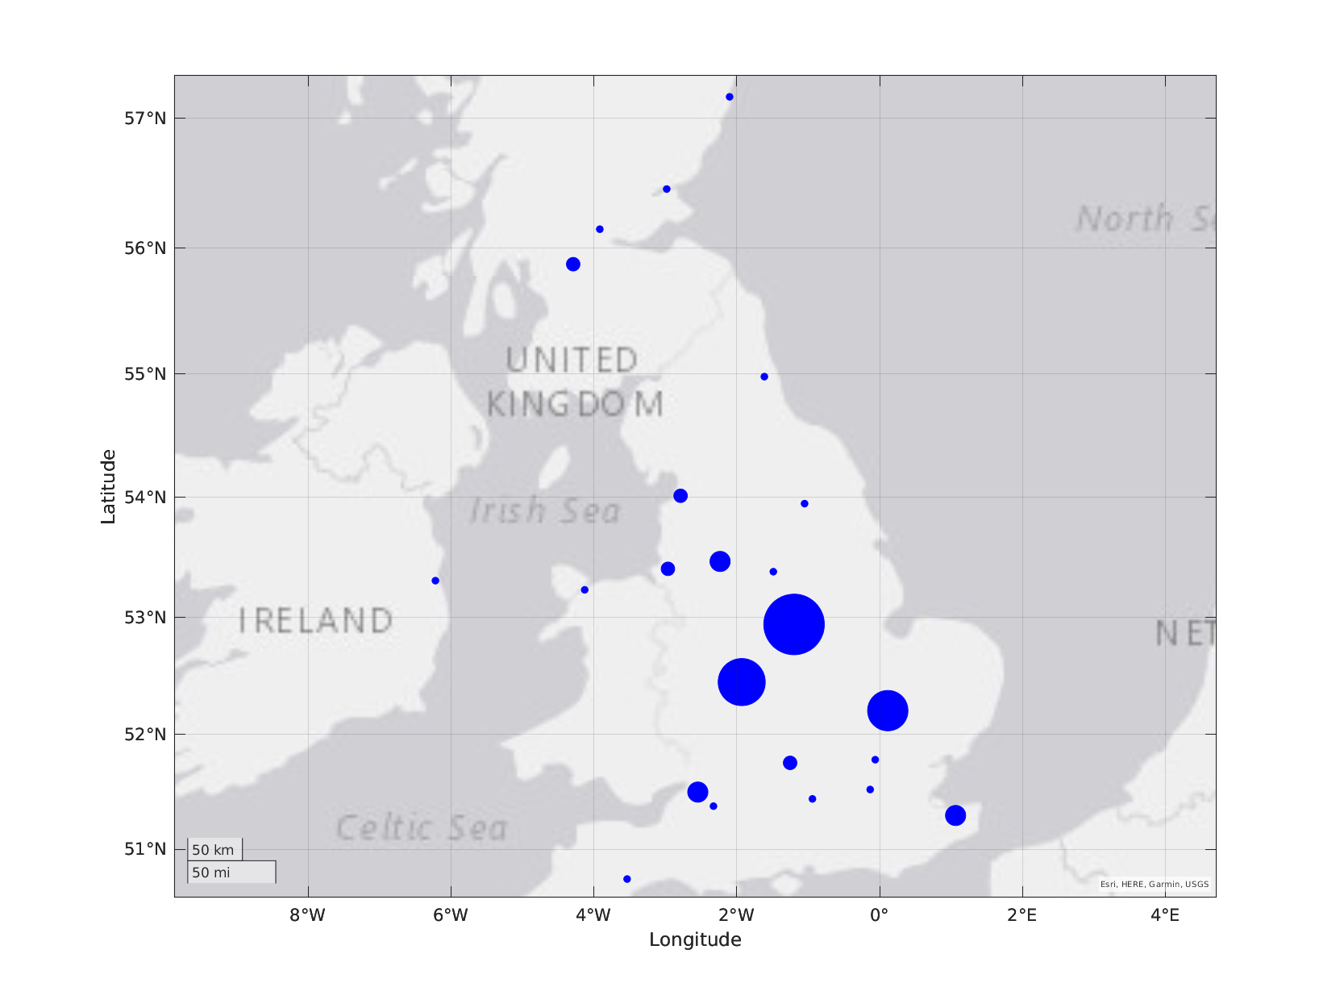
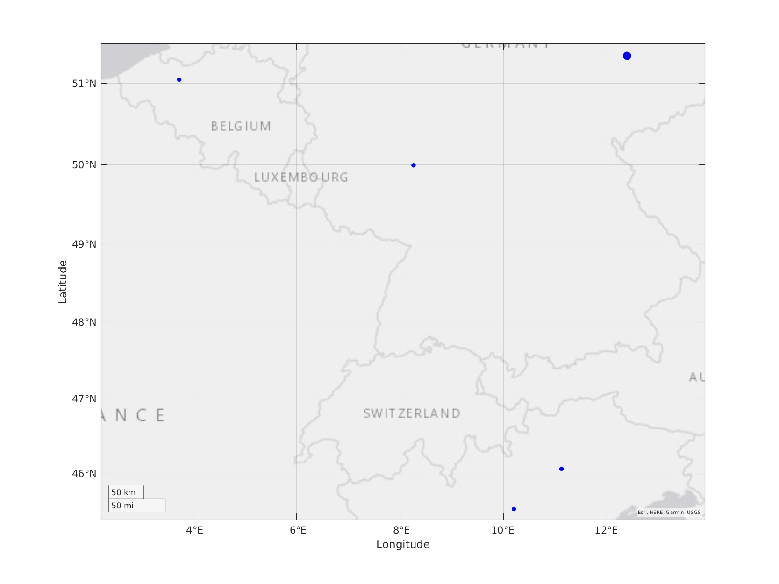
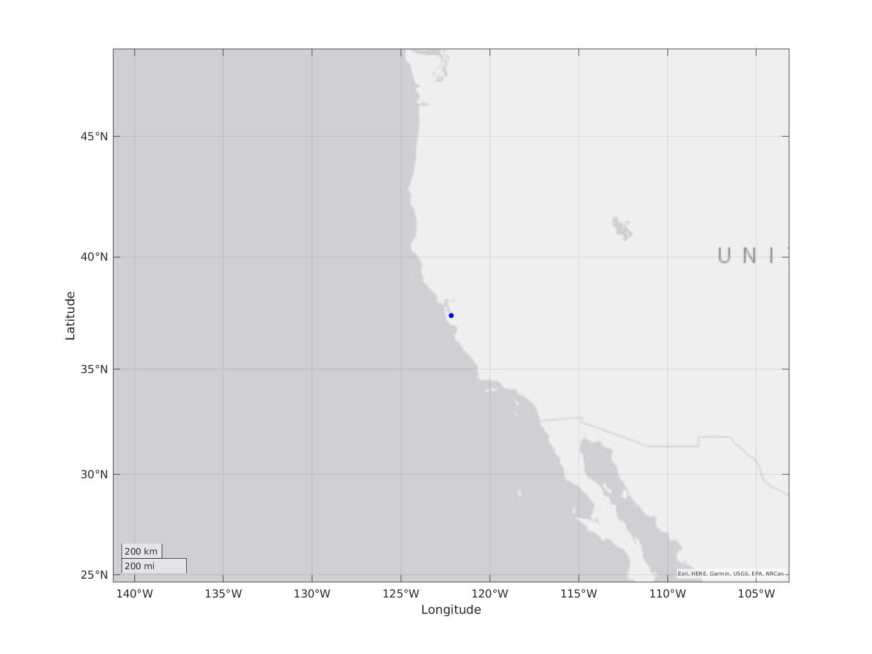
How it started: https://docs.google.com/document/d/1vh9ozpYi55-aiHsRsvMdjIyfta2f4Ee1W5ebpnBwlZI/edit?tab=t.0
3. Means
A collaborative TMS network
https://github.com/TMSMultiLab/TMSMultiLab/blob/main/Docs/TMSMultiLab_Ecosystem_I.png
https://github.com/TMSMultiLab/TMSMultiLab/blob/main/Docs/TMSMultiLab_Network.m

Slide 6
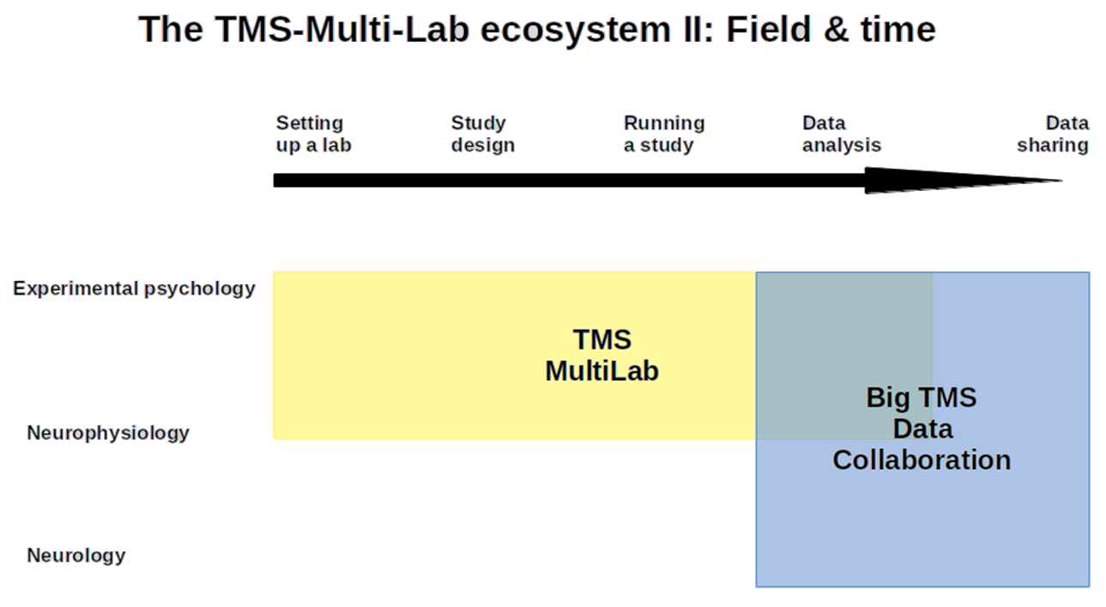
3. Means
https://github.com/TMSMultiLab/TMSMultiLab/blob/main/Docs/TMSMultiLab_Ecosystem_II.png

Slide 7








How to Science: The Old Way
Funding
Read
Design
Run
Analyse
Present
Read
Publish
YOU
guidance
biased
design
hope for
reviewers
who don’t
know these
studies...
ignore
Oops!
ignore
EVERYONE ELSE IN THE
EXPONENTIALLY-GROWING
SCIENTIFIC WORLD...

Slide 8


How to Science: A New Way?
Funding
Read
?
Studies
database
YOU
Design
Code
library
Publish
Run
Guidance
Read
Analyse
Present
EVERYONE ELSE IN THE
EXPONENTIALLY-GROWING
SCIENTIFIC WORLD...

Slide 9
TMSMultiLab Pipeline*
discussion, coding, consensus, writing
cloud
computers
OSF
Big TMS
GitHub
TMetaS
~Mb
~Mb
TMSMultiLab
repository
local
computers
MatLab
~GB
RAW
DATA
SUMMARY
DATA
META
DATA
manual
~GB
MySQL
~Kb
TMSMultiLab
repository
physical
laboratory
RUN
EXPERIMENT
DESIGN
EXPERIMENT
* one possible vision

Slide 10
3. Means
a) GitHub site is open, ready for your contributions
b) Monthly meetings from January 2025 (last Friday)
c) TMS@40 Workshop in April 2025 => paper
d) Three-site N=120 study of short-latency afferent inhibition
e) and..?

Slide 11
TMSMultiLab Project: help needed
TMS reporting & study quality (updating Chipchase et al. 2012)
Large meta-analysis of ~330 SAI TMS papers (near complete)
Each paper needs 2 people to rate study & reporting quality
15-30 mins per paper, so ~200 hours work needed
Will be used to develop & validate new reporting rating method
We need ~25 raters to rate ~25 papers each (~1 week’s work)
*** Co-authorship of ratings methods paper ***
Join the Quality_Rating team: https://github.com/orgs/TMSMultiLab/teams/quality_rating

