Slide 1

Feb. ‘25
TMSMultiLab & TMS@40
Lots of people, et al...
https://github.com/TMSMultiLab/TMSMultiLab/wiki

Slide 2
private
public
DATA
ACQUISITION
HARDWARE
DATA
ACQUISITION
SOFTWARE
RAW
DATA
(NIBS)-BIDS
(eg, via OSF)
+
FILTERED
DATA
FILTERED
DATA
CODE
SUMMARY DATA
NIBSds
(Big TMS)
SESSION/SUBJECT/CONDITION MEANS
+
SAMPLE MEANS
CODE
PUBLICATIONS
META-ANALYSIS

Slide 3
TMSMultiLab Pipeline*
discussion, coding, consensus, writing
cloud
computers
Journal
OSF
Big TMS
GitHub
TMetaS
TMSMultiLab
repository
local
computers
RAW
DATA
SUMMARY
DATA
META
DATA
TMSMultiLab
repository
physical
laboratory
RUN
EXPERIMENT
DESIGN
EXPERIMENT
* one possible vision

Slide 4
HandLab Pipeline
cloud
computers
LOCAL COPY
OF TMSMultiLab
REPOSITORY
GitHub
git
git
local
computers
Matlab
RAW
DATA
SUMMARY
DATA
META
DATA
daily or weekly cron
commands in linux
collected using MySQL
database, html, & php code
physical
laboratory
RUN
EXPERIMENT

Slide 5
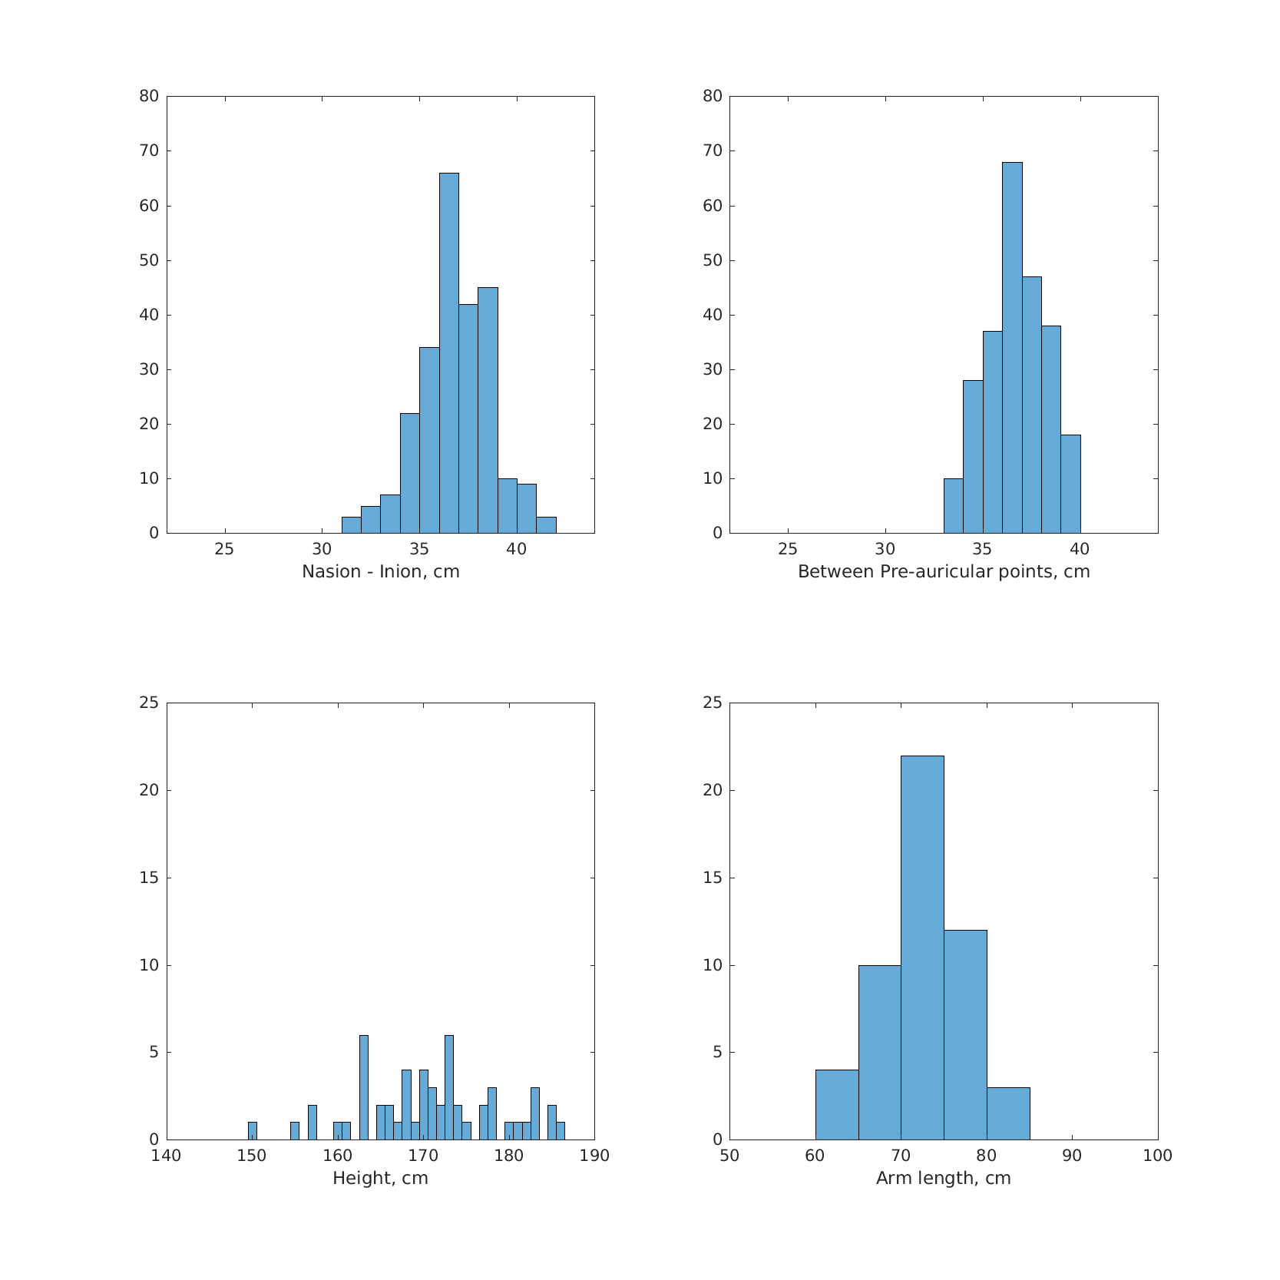
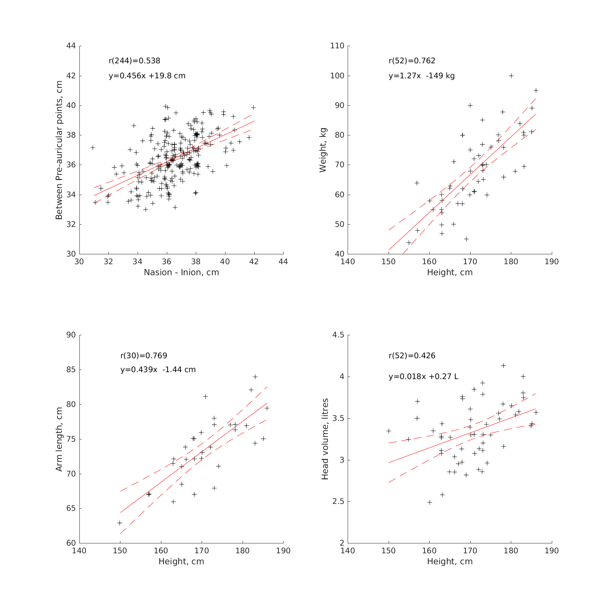
Example: Head measurements
cloud
computers
GitHub
page on wiki,
data in repo
git
local
computers
daily or weekly cron
commands in linux
run Matlab script
META
DATA
collected using MySQL
database, html, & php code
physical
laboratory
MEASURE
PEOPLE’S HEADS

