Slide 1

#1
Jan. ‘25
TMSMultiLab & TMS@40
the logo evokes: magnetic fields, geographical locations, communication, resonance??
Colour: #008fff
(nothing like Twitter: #1da1f2)
(or MagStim: #288eed)
Lots of people, et al...
https://github.com/TMSMultiLab/TMSMultiLab/wiki

Slide 2
Agenda
Introduction (~15 mins)
GitHub tour & discussion (~20 mins)
Project proposal / advert (~5-10 mins)

Slide 3
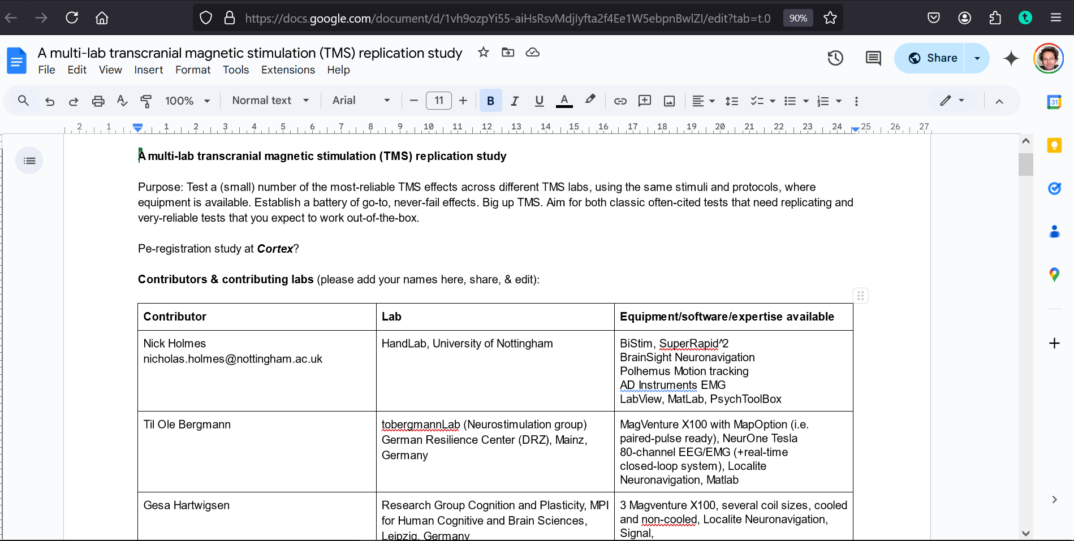
How it started…
2019… “Why don’t we run a prospective TMS replication study..?”
GoogleDoc asked for contributions and ideas from TMS researchers:
https://docs.google.com/document/d/1vh9ozpYi55-aiHsRsvMdjIyfta2f4Ee1W5ebpnBwlZI/edit?usp=sharing
then… something happened… can’t remember what, but we didn’t do the multi-lab TMS replication study…

Slide 4
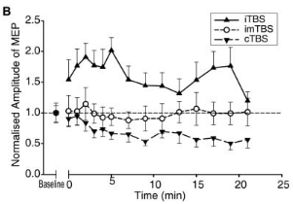
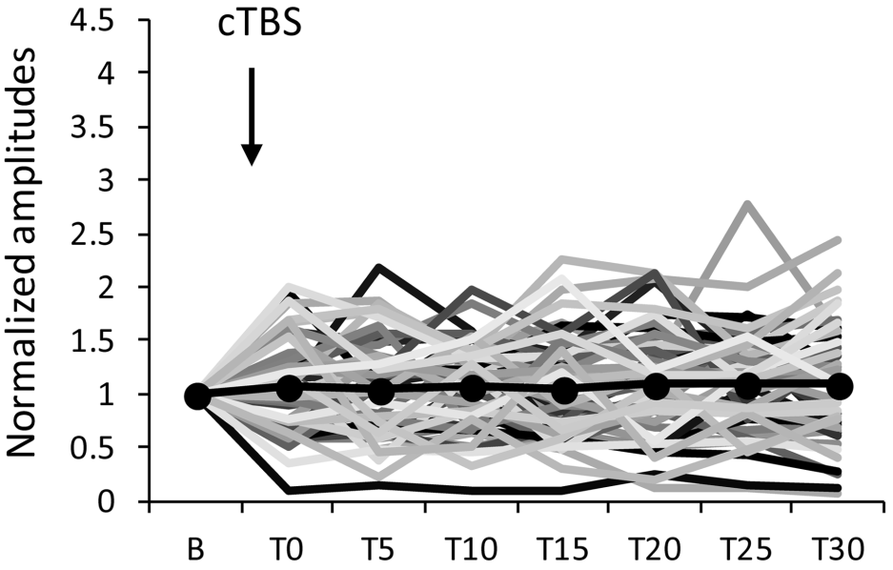
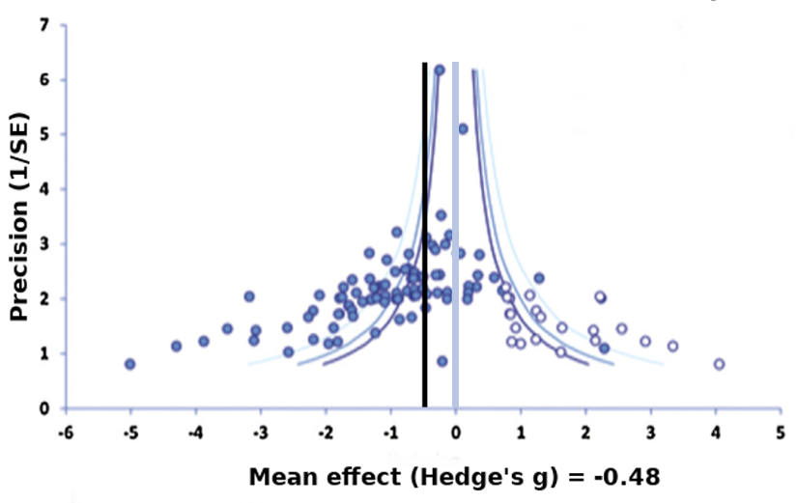
1. Motivation
Replication failures are (more) widely-acknowledged
But, (how) do we respond?
Example: Continuous theta-burst TMS
Huang et al. 2005 (N=9)
Hamada et al. 2013 (N=56)
Chung et al. 2016

Slide 5
2. Opportunity
TMS is 40 years old in 2025 (May 11th!)
The internet, data sharing & data publication
Electronic tools for collaboration & sharing:
GitHub
Open Science Framework
Big TMS Data Collaboration

Slide 6
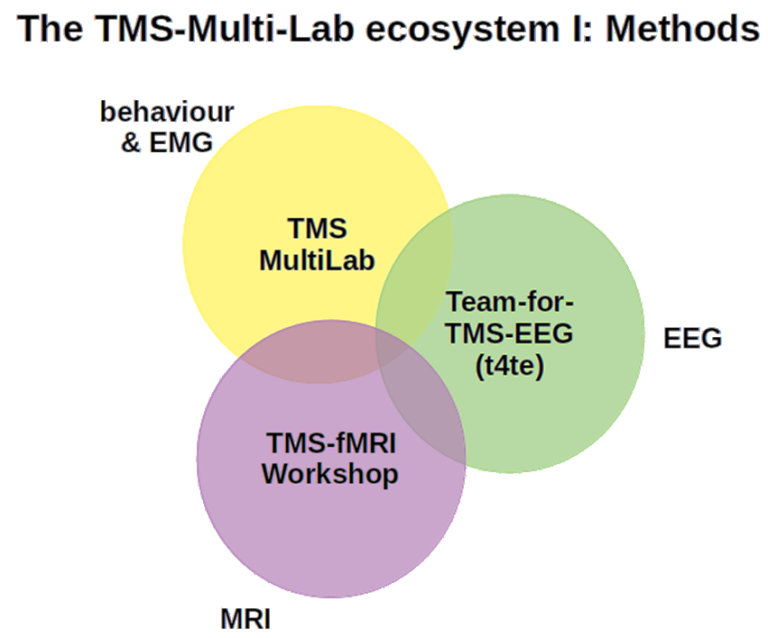
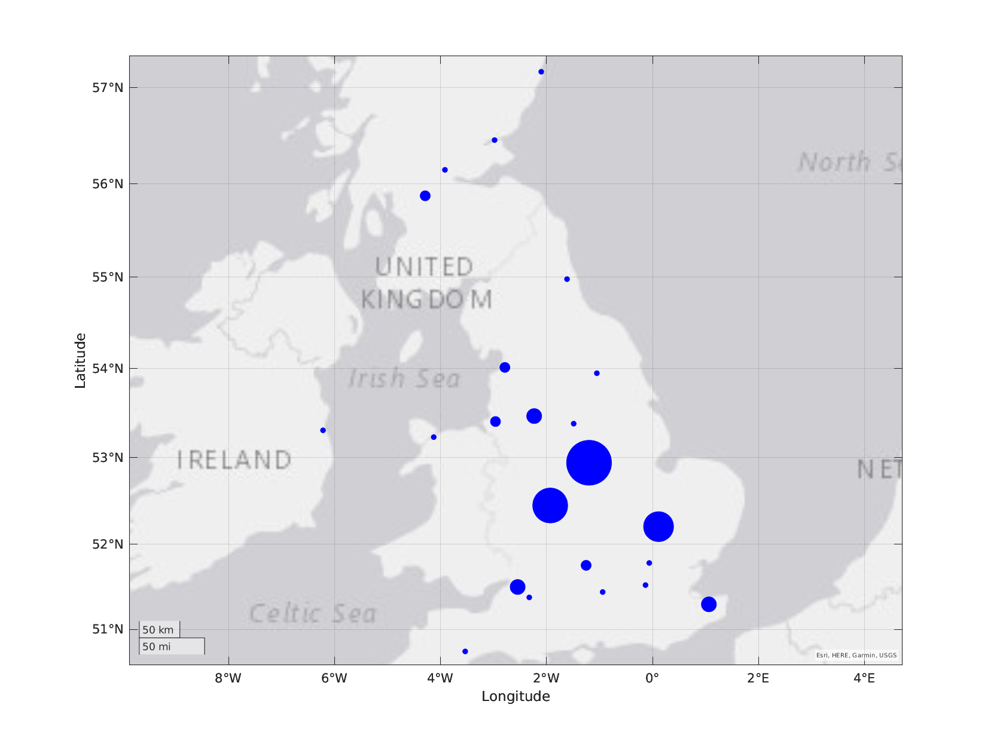
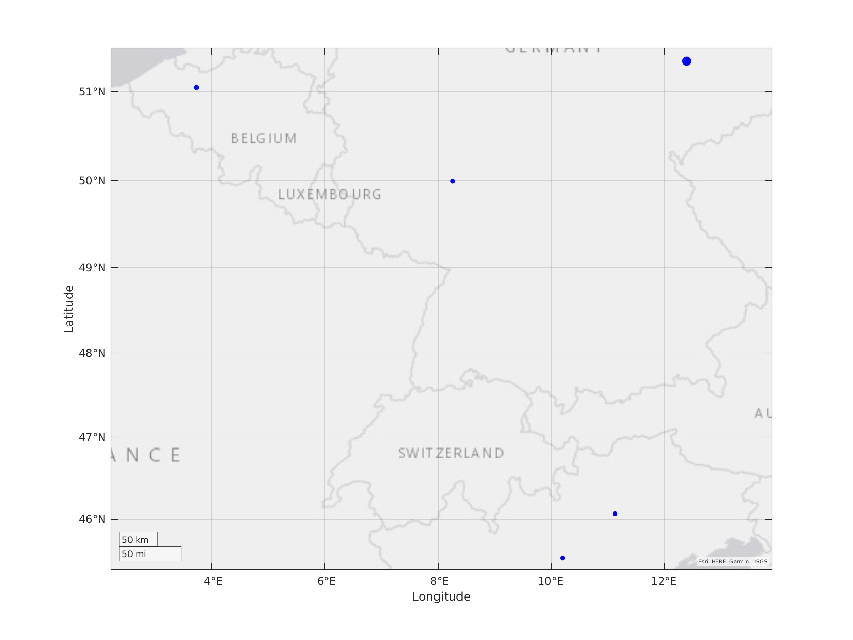
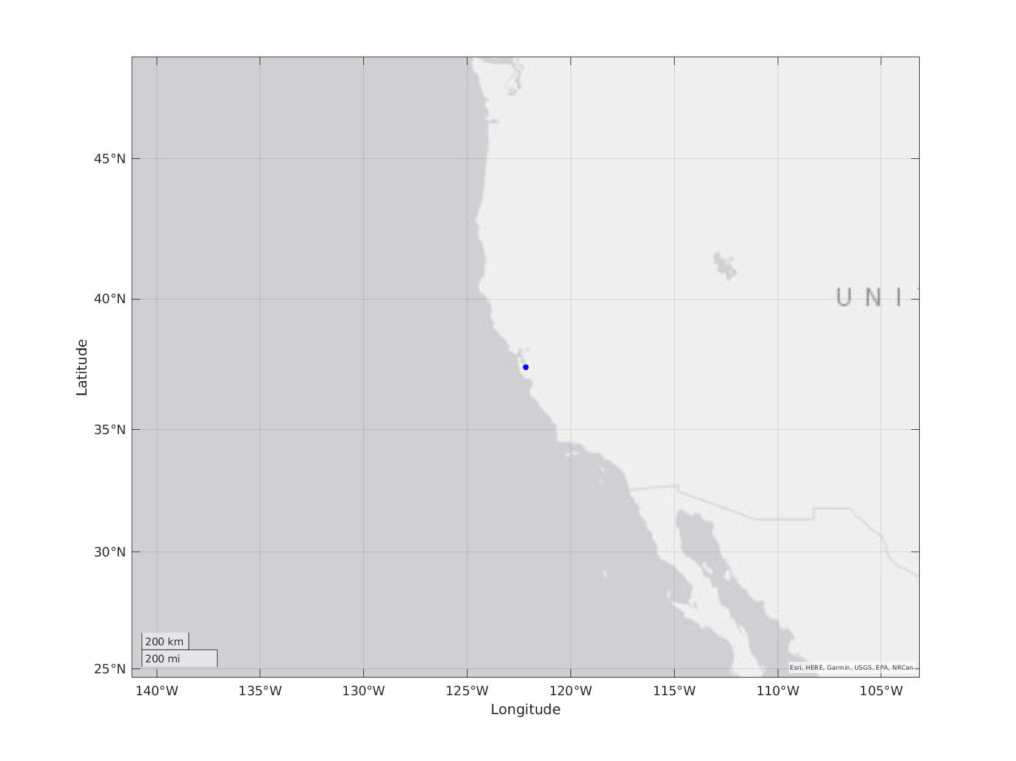
3. Means
A collaborative TMS network
UK
EUrope
US
not here?
UPDATE
MY CODE!
https://github.com/TMSMultiLab/TMSMultiLab/blob/main/Docs/TMSMultiLab_Ecosystem_I.png
https://github.com/TMSMultiLab/TMSMultiLab/blob/main/Docs/TMSMultiLab_Network.m

Slide 7
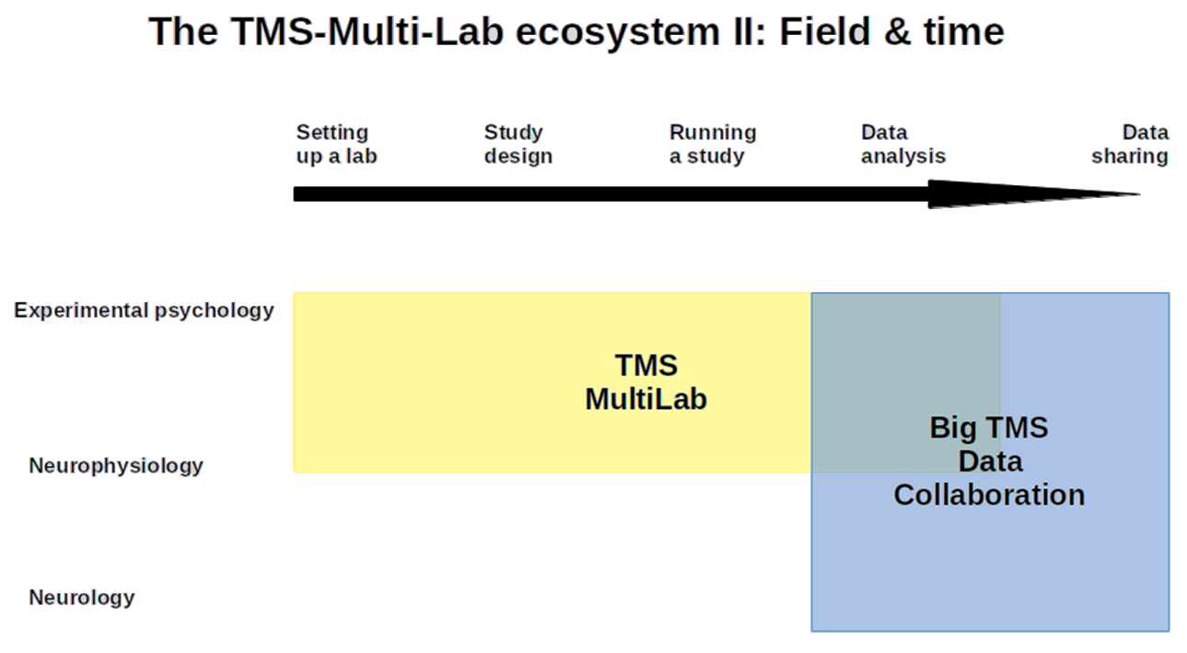
3. Means
https://github.com/TMSMultiLab/TMSMultiLab/blob/main/Docs/TMSMultiLab_Ecosystem_II.png

Slide 8








How to Science: The Old Way
Funding
Read
Design
Run
Analyse
Present
Read
Publish
YOU
guidance
biased
design
hope for
reviewers
who don’t
know these
studies...
ignore
Oops!
ignore
EVERYONE ELSE IN THE
EXPONENTIALLY-GROWING
SCIENTIFIC WORLD...

Slide 9


How to Science: A New Way?
Funding
Read
?
Studies
database
YOU
Design
Code
library
Publish
Run
Guidance
Read
Analyse
Present

Slide 10
TMSMultiLab Pipeline*
discussion, coding, consensus, writing
cloud
computers
Journal
OSF
Big TMS
GitHub
TMetaS
TMSMultiLab
repository
local
computers
RAW
DATA
SUMMARY
DATA
META
DATA
TMSMultiLab
repository
physical
laboratory
RUN
EXPERIMENT
DESIGN
EXPERIMENT
* one possible vision

Slide 11
3. Means
a) GitHub site is open, ready for your contributions
b) Monthly meetings from January 2025 (last Friday)
c) TMS@40 Workshop in April 2025 => paper
d) Multi-site study of short-latency afferent inhibition (N=120)
e) and..?

Slide 12
Discussion!
e) and..?

Slide 13
TMSMultiLab Project: help needed!
TMS reporting & study quality (updating Chipchase et al. 2012)
Large meta-analysis of ~330 SAI TMS papers (near complete)
Solya Szekely leading project; each paper needs 2 people to rate each study
~15-30 mins per paper, so ~200 hours work needed (eek!)
Develop & validate new TMS Reporting Assessment Tool (TMS-RAT 🐀)
Ideally: we will have ~26 raters rating ~26 papers each (~10-15 hours)
+ meetings, discussion, collaborative analysis & consensus-building…
*** Co-authorship of TMS-RAT 🐀 paper ***
Join the Quality_Rating team: https://github.com/orgs/TMSMultiLab/teams/quality_rating

