Slide 1



Apr. ‘25
TMS@40, an EPS Research Workshop
with additional support from NeuroMod+

Slide 2
THE END
of the beginning…

Slide 3
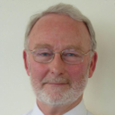

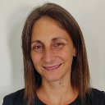
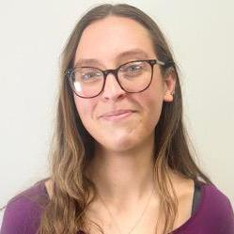
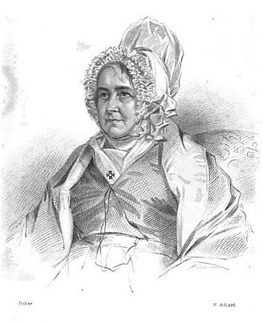
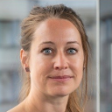
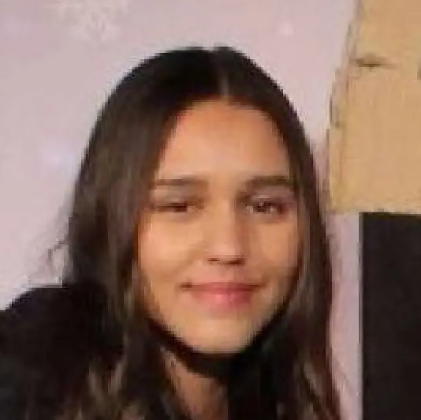
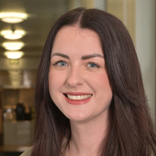

KeyNote Speakers & Responders
Tony Barker
Anna-Lisa Schuler
Marta Bortoletto
Isabel Farr
Gesa Hartwigsen
Louisa Gwynne
Charlotte Pennington
Roisin McMackin

Slide 4
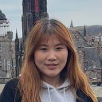

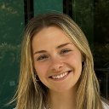


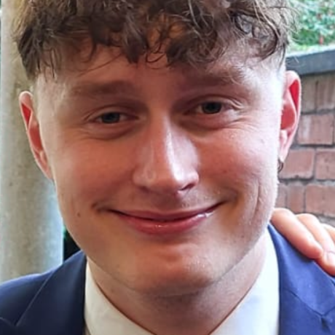
Who were we?
Xiaoxia Yuan
Shanelle Chan
Elsa Greed
Aliya Warden
Eddie Wiggins
George Arthur

Slide 5

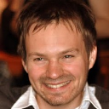


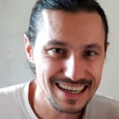

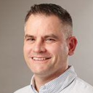
Who were we?
Nick Holmes
Ken Valyear
Kat Dyke
Helen Nuttall
Luigi Tamè
Mimma Veniero
Craig McAllister

Slide 6
Who were YOU?
PhD
student
Research assistant
Undergraduate
Post-
doctoral
researcher
Associate professor
Assistant
professor
N=50; 43 from UK, 4 from EU, 3 from Americas (remote); 29 institutions

Slide 7
Why were we here?
1. Celebrate 40 years of TMS
✓
2. Forge a new consensus on TMS methods
community
started to
3. Write a paper

Slide 8
A TMS timeline
first
‘cognitive’
paper
TMS
@40
TMS
invented
Big
NIBS
Data
theta-
burst
sim-
NIBS
IHI, SICI
SAI
safety
1985
1990
1995
2000
2005
2010
2015
2020
2025
Brain
Stimulation
Transcranial
Magnetic
Stimulation

Slide 9
Ongoing projects @TMSMultiLab
1. Experimental psychology of TMS consensus; Everyone!
→ June 2025…
2. TMS Reporting Assessment Tool (TMS-RAT 🐀); Székely et al
→ July 2025
3. Three-site, N=120 study of short-afferent inhibition; Dyke et al
→ October 2025
4. Meta-analysis of theta-burst TMS; Holmes et al
→ January 2026

Slide 10
Future projects @TMSMultiLab
1. [INSERT YOUR MULTI-LAB PROJECT HERE]
→ …

Slide 11
Monthly meetings
Last Friday of every month, 14:00 UK TIME
Zoom links sent via GitHub
Topics are on the Meetings page
All welcome! (especially if you lead the meeting)

Slide 12
Other meetings
Conferences page on the wiki

Slide 13
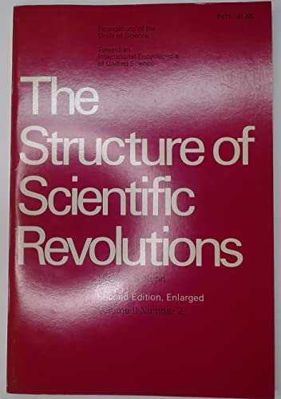
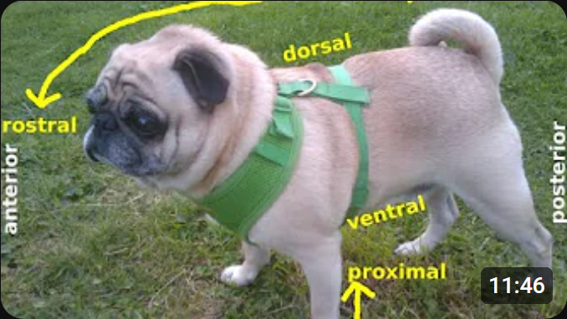
and finally…
Science is a social endeavour
Just publishing your amazing paper is not enough
Science develops fast when communities change course
← Thomas S Kuhn (1962)
‘periods of crisis’
Kuhn the pug →

Slide 14
THE END
of the beginning…

