Slide 1
Dose-response (input-output) curves: Ground truth for testing TMS methods?
Nick Holmes
citing work with / by
Kat Dyke, Luigi Tamè, Domenica Veniero, Xiaoxia Yuan, Shanelle Chan

Slide 2
How do you..?
1. Know if your TMS methods are working?
2. Test whether a manipulation has an effect?
3. Calibrate methods & results across labs?

Slide 3
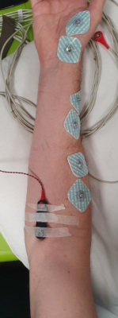
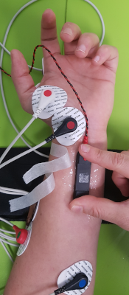
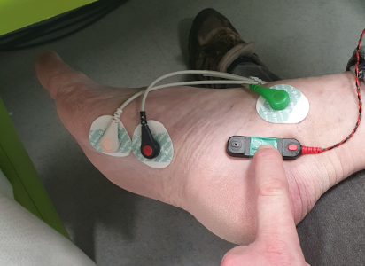
The (peripheral) motor system provides ground truth
Stimulate the peripheral motor nerve at increasing intensities
Very lawful increase in motor-unit recruitment, up to MMAX

Slide 4

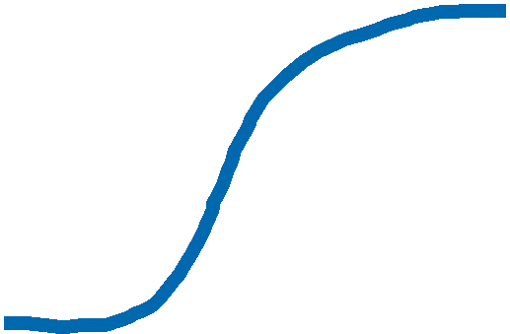
Model
Neuromuscular output is a sigmoid function of stimulus intensity
Parameters:
Baseline (y)
Threshold (x)
Growth rate (y/x)
Plateau (y)
response
dose

Slide 5


Theory predicts baseline (y) increase
response
dose

Slide 6
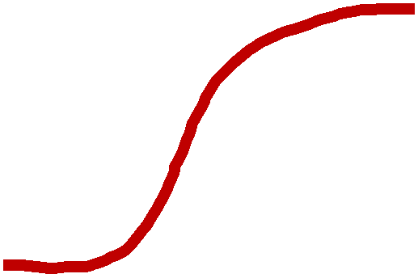
Theory predicts threshold (x) increase
response
dose

Slide 7
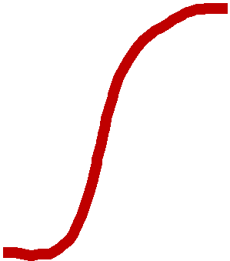
Theory predicts growth (y/x) increase
response
dose

Slide 8
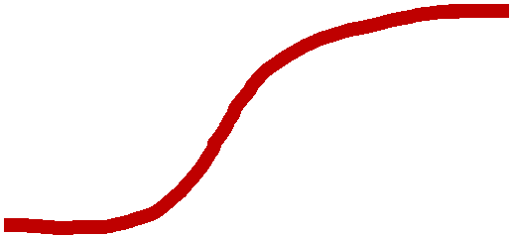
Theory predicts plateau (y) decrease
response
dose

Slide 9


Testing theories with (motor) TMS
Corticospinal output is a step, linear OR non-linear function of excitatory input
Feature | Step | Linear | Non-linear
Threshold | Yes | Yes | Yes
Velocity | Instant | Constant | Bell
Acceleration | Instant | Instant | Wave
Plateau | Yes | Yes | Yes
response
dose

Slide 10
Model
Working hypothesis: Corticospinal output is a sigmoid function of TMS intensity
Predictions:
Threshold ~50% MSO
Increase ~1mV / 5% MSO
Plateau ~80% MSO
~Sigmoid
~Continuous
response
dose

Slide 11
Model testing
Working hypothesis: Corticospinal output is a sigmoid function of TMS intensity
Minimal: 2 intensities
Can’t discriminate models
response
Intermediate: 3 intensities
Can’t discriminate linear/non
Full: ALL intensities
Can discriminate linear/non
dose

Slide 12
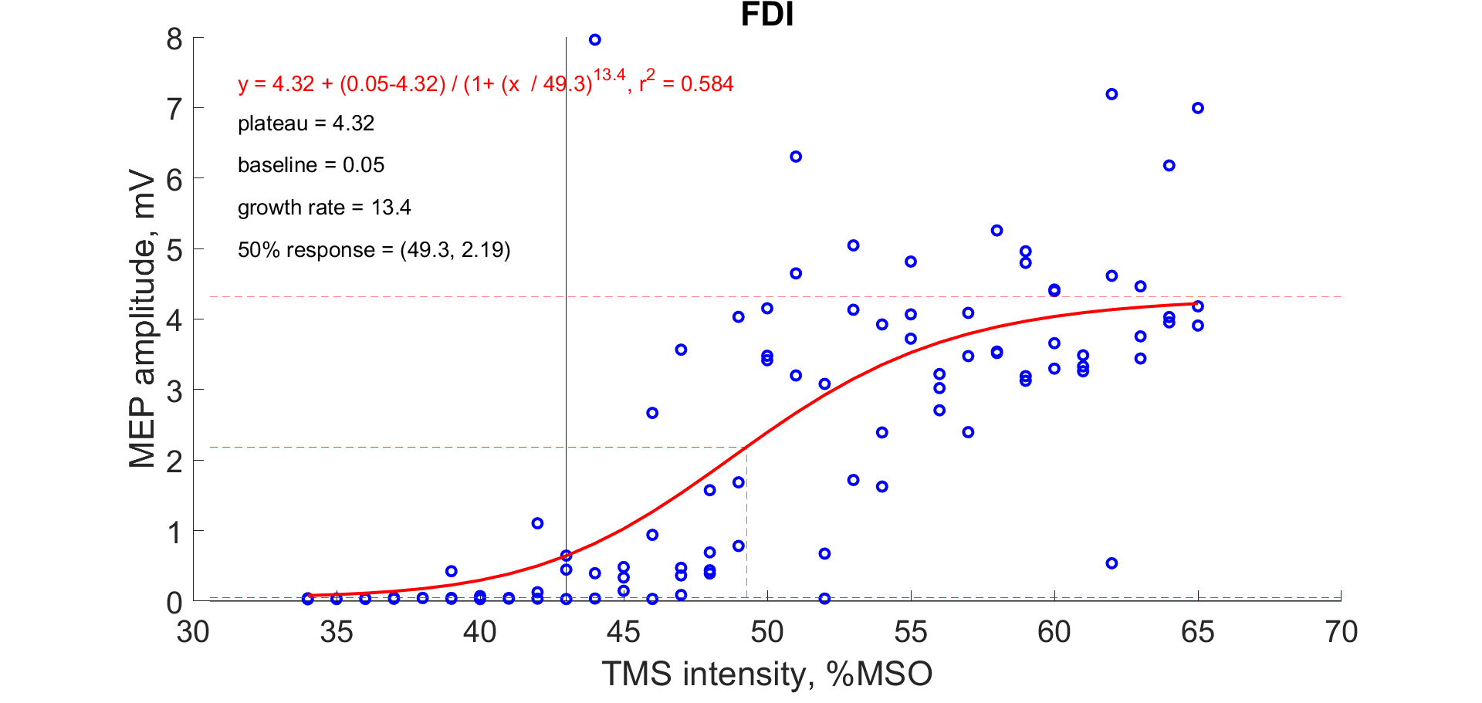
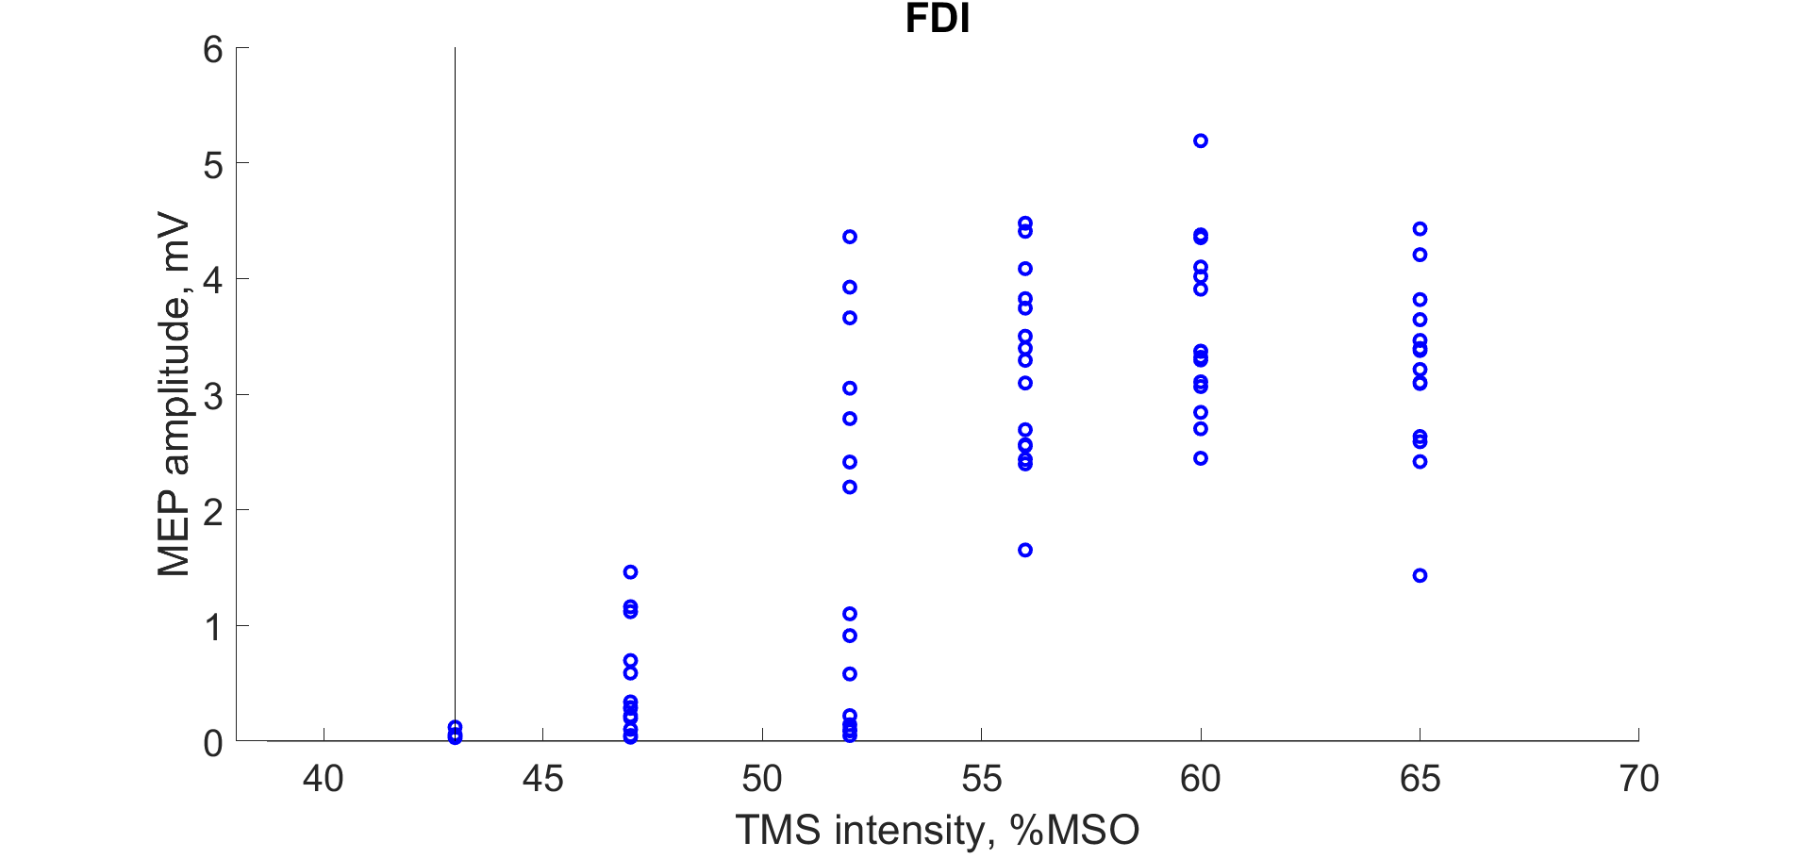
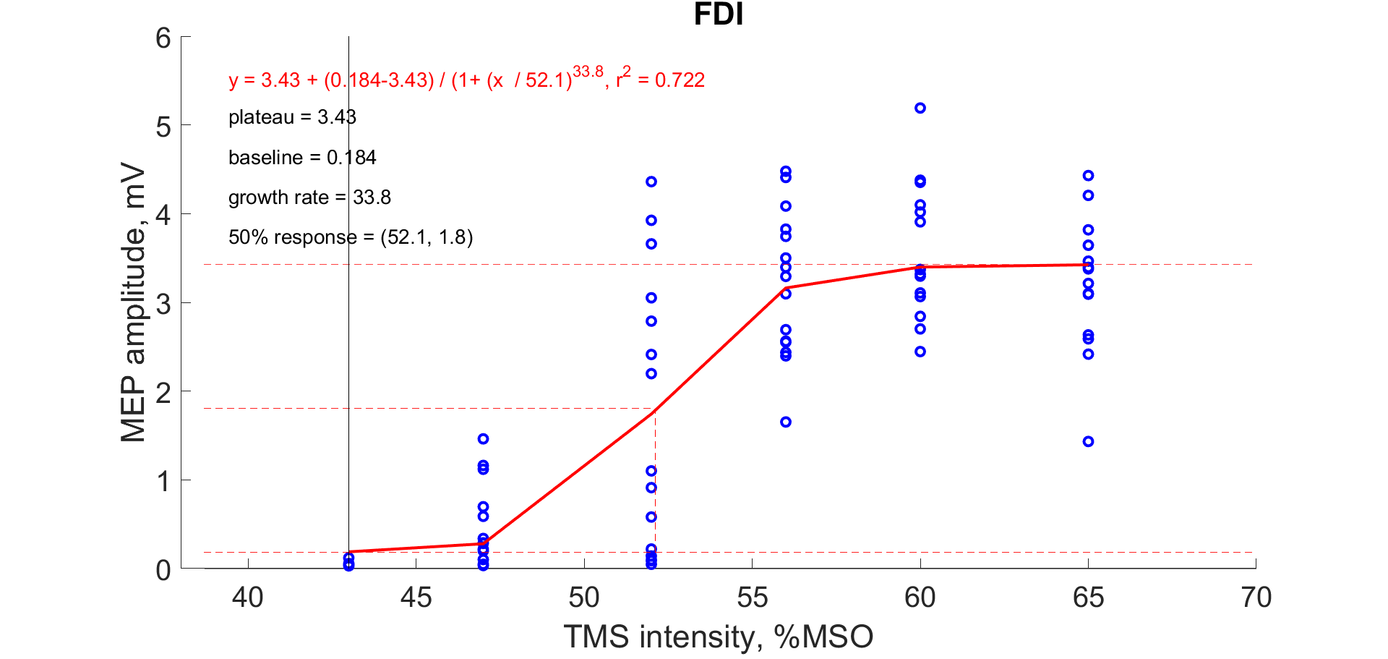
Data
Working hypothesis: Corticospinal output is a sigmoid function of TMS intensity
Design:
Discrete (6) vs. Continuous (30)
Baseline:
Ignored vs. Corrected
Transform
None vs. logarithmic
Measure:
P-2-P vs. A-U-C

Slide 13
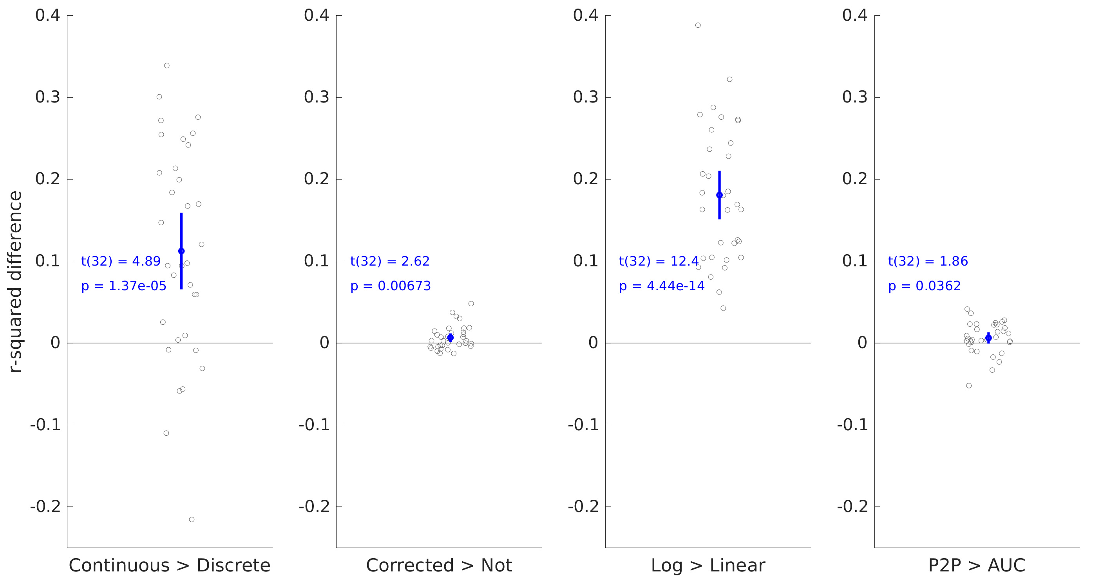
Data
Best fit = continuous design, baseline-corrected, log-transformed, peak-to-peak MEPs

Slide 14
So..?
Test TMS methods using D-R curve fits (R^2) as a DV
Background EMG activity
MEP measurements
Effects of motor preparation, conflict, imagery?
Cognitive effects on motor system
More widely? Then we need other dose-response curves

Slide 15
Discussion: Would this work for your study?
Dose-response code (MATLAB) is on the github

