Slide 1

#8
Aug. ‘25
TMSMultiLab & student projects

Slide 2
Why do TMS with students*?
Academics have to (!)
2. How else do researchers learn (to love) TMS?
3. Resources (participants, £, workload hours, etc)
* For this meeting, I refer only to pre-PhD students (UG, PG, Placement, Visiting, Summer, etc)

Slide 3
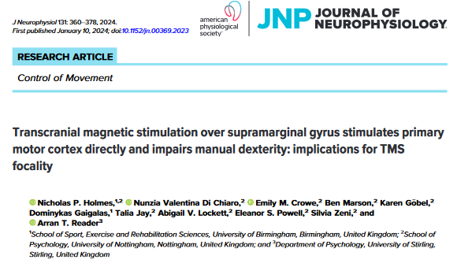
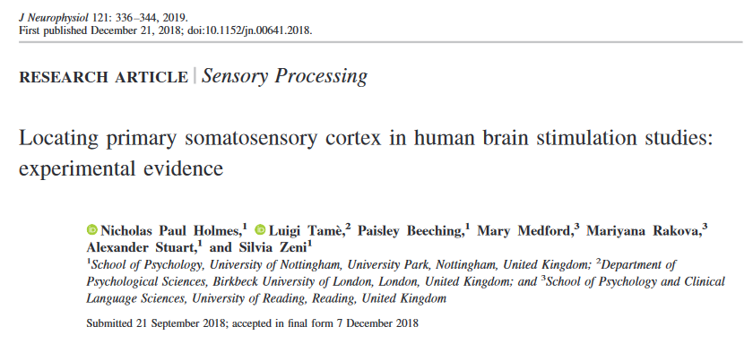
Can students do TMS?
YES.

Slide 4
PROS & CONS
Fulfils obligations
Brings resources
(@UoB - £150/student)
Increases my time doing TMS
Increases my time doing TMS!
Generates data for papers
Data sometimes lower quality
(usually: missing measures, no MEPs…)
Trains researchers (& me)
Training is intensive
>12 hours / group

Slide 5
What might TMSMultiLab do?
- Pilot-test screening, questionnaires, TMS Scripts / debriefs
- Compare basic methods (navigation, localisation, thresholding)
- Compile (anonymised) biometric / meta-data (height, sex, thresholds, etc)
AND/OR: develop joint projects (requires forethought!)

