Slide 1



Apr. ‘25
TMS@40, an EPS Research Workshop
with additional support from NeuroMod+

Slide 2
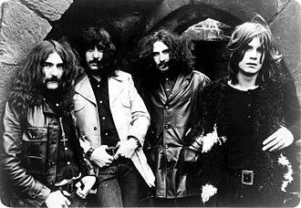


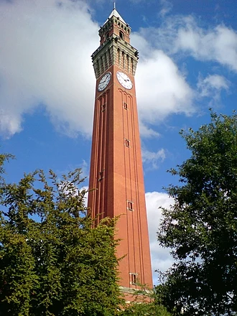


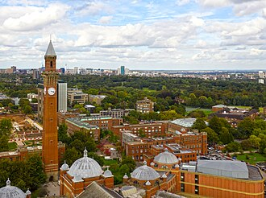
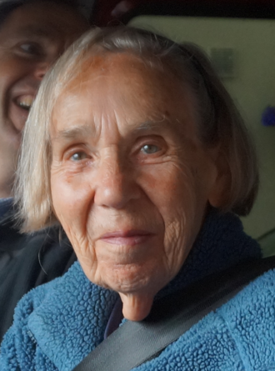
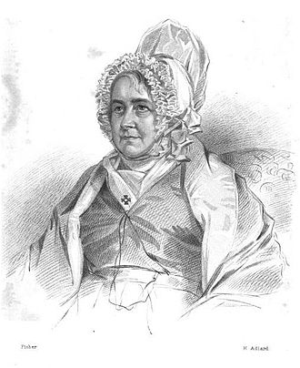

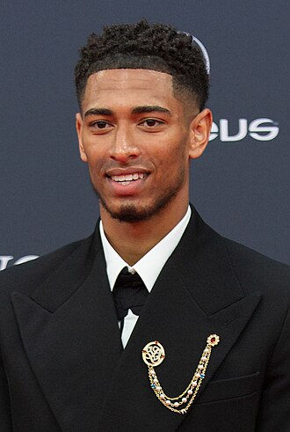


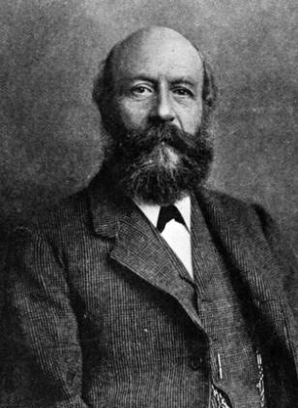
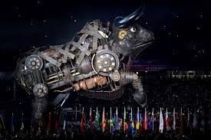

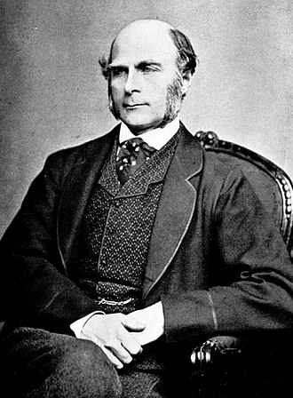

Welcome to Birmingham!

Slide 3

Public Service Announcement
If the fire alarm sounds:
Leave via the nearest exit
Assemble on the concourse in front of building
→
In case of emergency:
Call 0121 41 44444
Police: 101; Emergency: 999

Slide 4

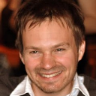





Who are we?
Nick Holmes
Ken Valyear
Kat Dyke
Helen Nuttall
Luigi Tamè
Mimma Veniero
Craig McAllister

Slide 5





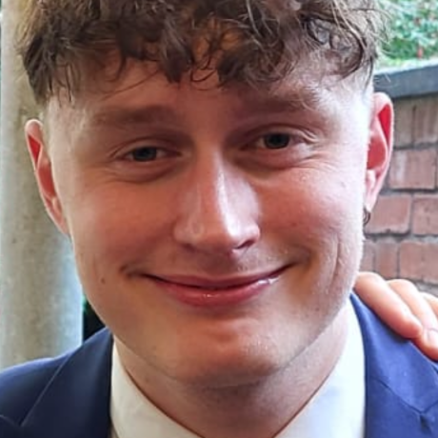
Who are we?
Xiaoxia Yuan
Shanelle Chan
Elsa Greed
Aliya Warden
Eddie Wiggins
George Arthur

Slide 6
Who are YOU?
PhD
student
Research assistant
Undergraduate
Post-
doctoral
researcher
Associate professor
Assistant
professor
N=50; 43 from UK, 4 from EU, 3 from Americas (remote); 29 institutions

Slide 7
Who are YOU?
to help everyone get to know you & your work:
Add your photo to your GitHub profile
Add links, co-authors, & abstract to your poster info

Slide 8




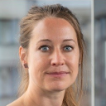

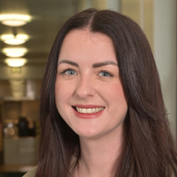

KeyNote Speakers & Responders
Tony Barker
Anna-Lisa Schuler
Marta Bortoletto
Isabel Farr
Gesa Hartwigsen
Louisa Gwynne
Charlotte Pennington
Roisin McMackin

Slide 9
Why are we here?
1. Celebrate 40 years of TMS
2. Forge a new consensus on TMS methods
3. Write a paper

Slide 10
Not all TMS methods work
But some work extremely well
2. Forge a new consensus on TMS methods
How – in principle – do we make more progress & faster progress?

Slide 11
Why Experimental Psychology?
(they are paying – thank you EPS!)
TMS involves awake, behaving humans
TMS is (just) a(nother) stimulus

Slide 12
I’ve attended a lot of workshops
most were workSHOPs
this is a WORKshop

Slide 13
What are we going to do?
4 Keynote speakers, responders & discussions
7 hackathon sessions (in which you will write)
2 poster sessions, 2 drinks receptions

Slide 14
14 papers were published on 11th May, 1985
7000
700
70
Citations
7
0.7
Orfeur
Leonard
Wain
Trees
Colley
Appleyard
Gillon
Long
Novacek
Murray
Phelps
Matsuzawa
Ray
Barker
First author

