Slide 1
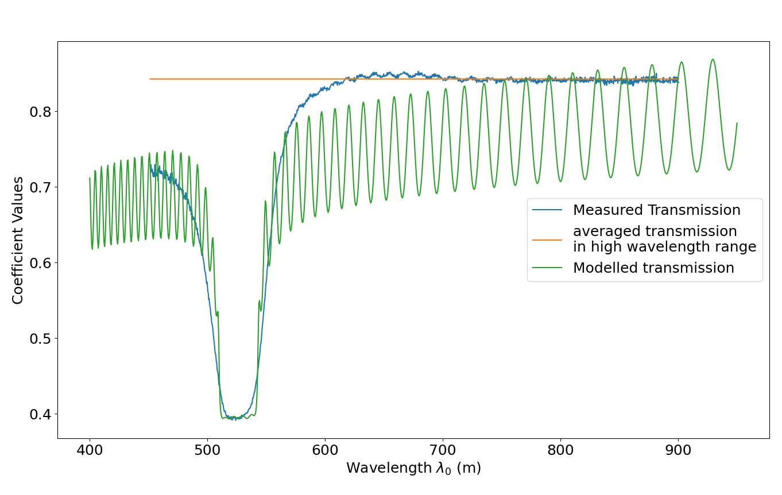
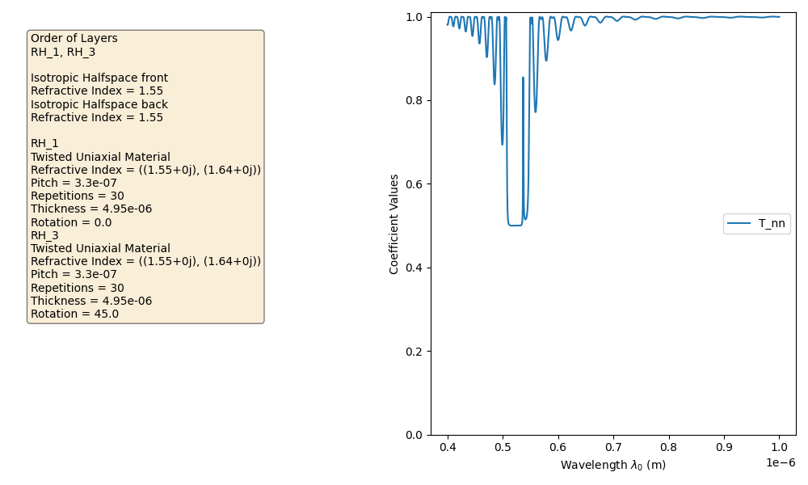
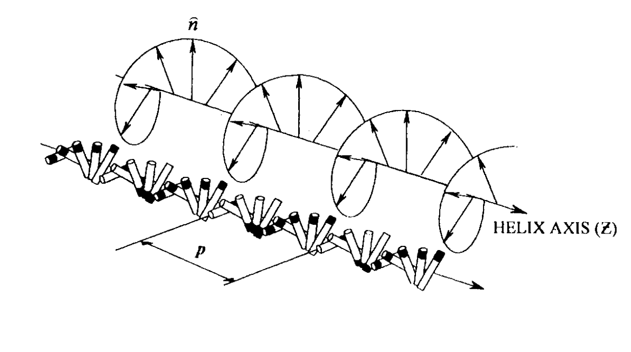
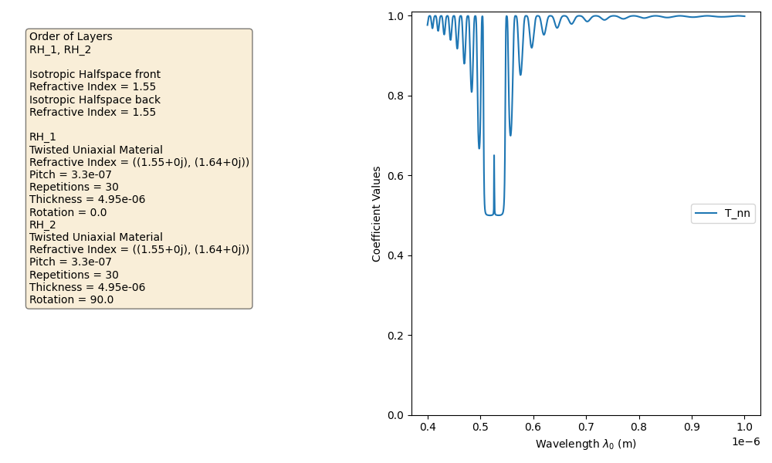
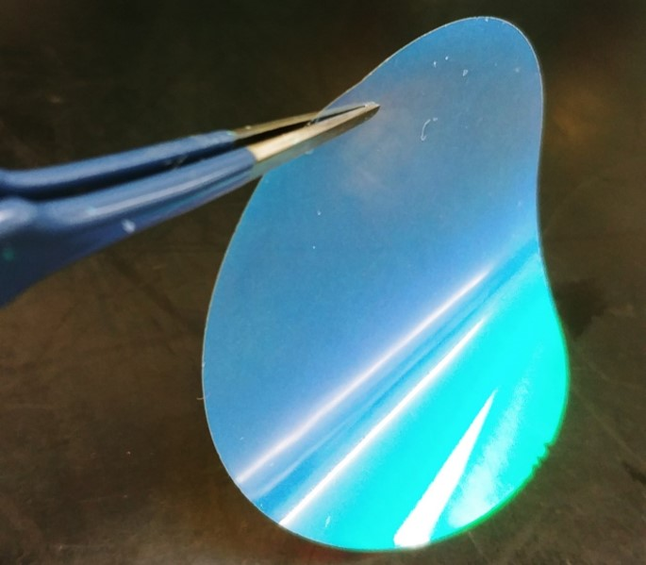
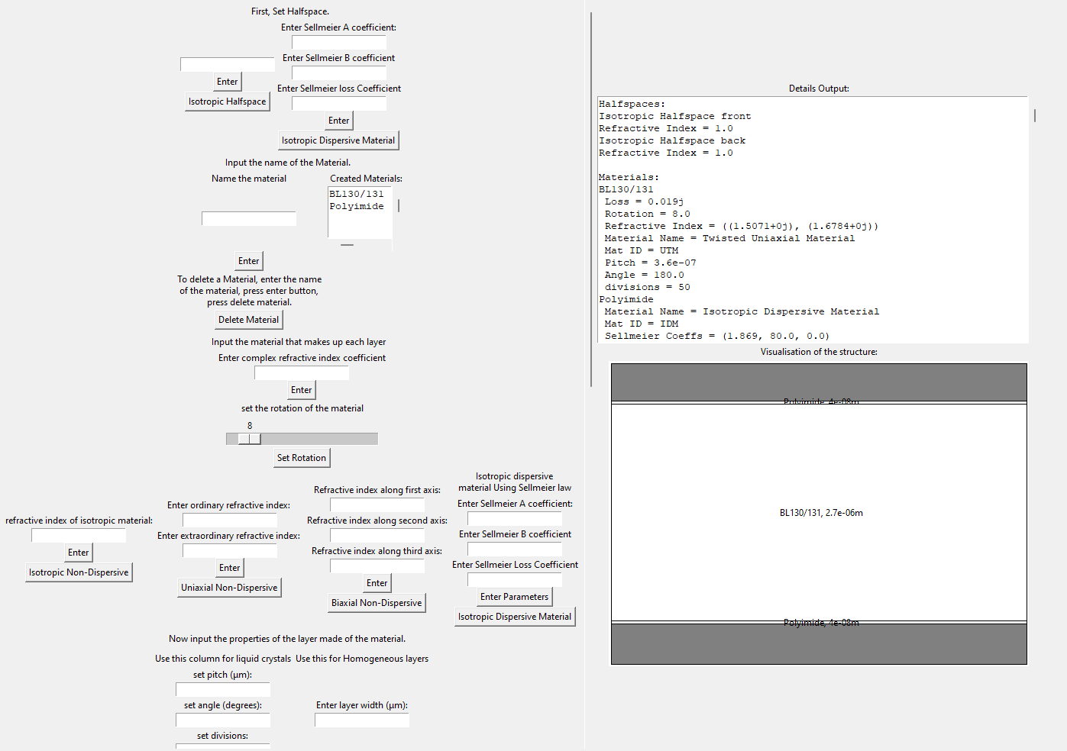
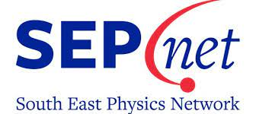


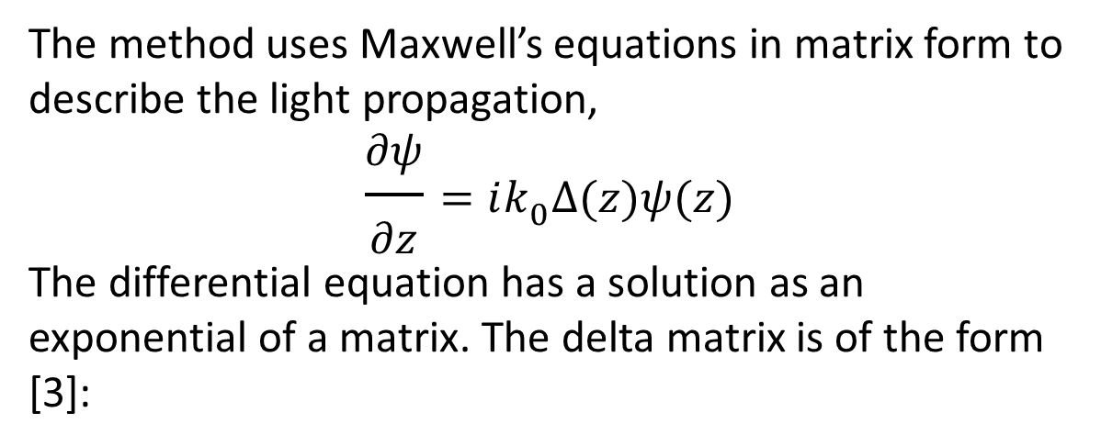
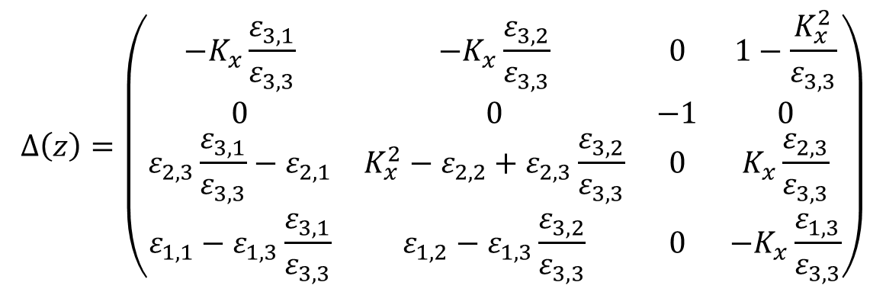
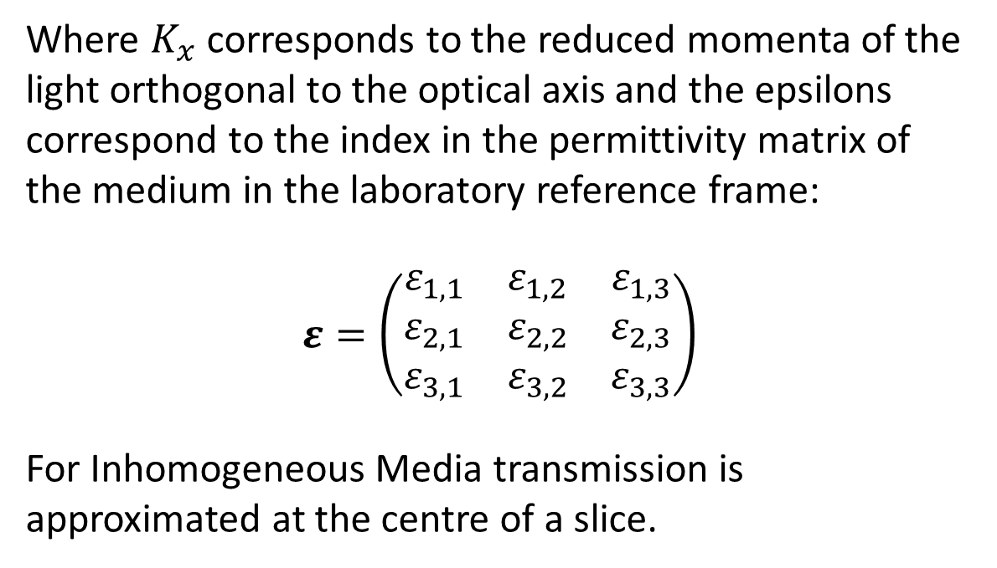
Modelling Optical Transmission and Reflection Through Chiral Nematic Liquid Crystals
Theodore Hirt Madden
2nd Year Mphys at University of Southampton, University Rd, Highfield, Southampton SO17 1BJ
Placement: Optomel Ltd, 1 Venture Road, University of Southampton Science Park Southampton, UK, SO16 7NP
Email: tdhm1g20@soton.ac.uk
Optomel email: info@optomel.com
Introduction
Example Modelling Data
Liquid crystals have a plethora of uses in the modern world. Used in all kinds of display devices, LCDs. The unique optical effects of liquid crystals make them versatile as optical filters.
The project aimed to create a working python model of the propagation of light through thin films consisting of liquid crystals and Homogeneous isotropic and anisotropic materials.
Where $K_{x}$ corresponds to the reduced momenta of the light orthogonal to the optical axis and the epsilons correspond to the index in the permittivity matrix of the medium in the laboratory reference frame:
$$ε=\left(\begin{matrix}ε_{1,1} & ε_{1,2} & ε_{1,3} \\ ε_{2,1} & ε_{2,2} & ε_{2,3} \\ ε_{3,1} & ε_{3,2} & ε_{3,3}\end{matrix}\right)$$
For Inhomogeneous Media transmission is approximated at the centre of a slice.
Chiral Nematic Liquid Crystals
Computation Flow Diagram
Liquid crystals are a phase of matter between solid and liquid where the molecules are slightly polarised and maintain some order comparatively to the liquid phase.
Chiral nematic liquid crystals have interesting optical properties due to high reflectance in a wavelength band. The molecules twist in each layer of the liquid crystals which contributes to their unique interaction with light.
Schematic of a chiral Nematic liquid crystal [1].
Conclusion
This flow diagram was implemented in python in an open source project [3]. The code was then optimised obtaining a 35x efficiency boost for non-dispersive systems and 8x for dispersive systems.
The created modelling program gives a tool to model the reflection and transmission of light through multilayer structures.
Future work on the model would look to add,
statistical nature of the director’s direction into the model
domain based modelling for 3D modelling of the liquid crystal
variation of the pitch through the liquid crystal.
The model acts as a fitting function for fitting parameters to experimental data.
A liquid crystal thin film created by Optomel [2].
Berreman 4x4
GUI
The method uses Maxwell’s equations in matrix form to describe the light propagation,
$$\frac{∂ψ}{∂z}=ik_{0}Δ(z)ψ(z)$$
The differential equation has a solution as an exponential of a matrix. The delta matrix is of the form [3]:
The GUI allows creation of optically active materials which can then be modelled across a chosen wavelength range and incident angle.
$$Δ\left(z\right)=\left(\begin{matrix}−K_{x}\frac{ε_{3,1}}{ε_{3,3}} & −K_{x}\frac{ε_{3,2}}{ε_{3,3}} & 0 & 1−\frac{K_{x}^{2}}{ε_{3,3}} \\ 0 & 0 & −1 & 0 \\ ε_{2,3}\frac{ε_{3,1}}{ε_{3,3}}−ε_{2,1} & K_{x}^{2}−ε_{2,2}+ε_{2,3}\frac{ε_{3,2}}{ε_{3,3}} & 0 & K_{x}\frac{ε_{2,3}}{ε_{3,3}} \\ ε_{1,1}−ε_{1,3}\frac{ε_{3,1}}{ε_{3,3}} & ε_{1,2}−ε_{1,3}\frac{ε_{3,2}}{ε_{3,3}} & 0 & −K_{x}\frac{ε_{1,3}}{ε_{3,3}}\end{matrix}\right)$$
References:
Demus, D., Goodby, J., Gray, G.W., Spiess, H.-W., Vill, V. and Coles, H. (1998). Chiral Nematic Liquid Crystals: Chiral Nematics: Physical Properties and Applications. In Handbook of Liquid Crystals (eds D. Demus, J. Goodby, G.W. Gray, H.-W. Spiess and V. Vill)
Optomel Ltd, https://www.optomel.com/technology
Berreman4x4, Olivier Castany, http://berreman4x4.github.io/Berreman4x4

