Slide 1
Mystique
Asfin Jannat Shamsi(RK:23)
Tanzeem Maliat(SN:51)

Slide 2
About
Mystique is an online clothing store to expand the business of local artisans.
This webapp is built using Python & Django framework.
A registered user can explore the product inventory as well as buy the desired products

Slide 3
Features
Register
Login
Change Password
Reset Password
Product Explore Page
Category Explore Page
Search For Products
Cart for registered user & guest user
Checkout page
Coupon Validation
PayPal Payment
Order Details
Contact Us
Logout

Slide 4
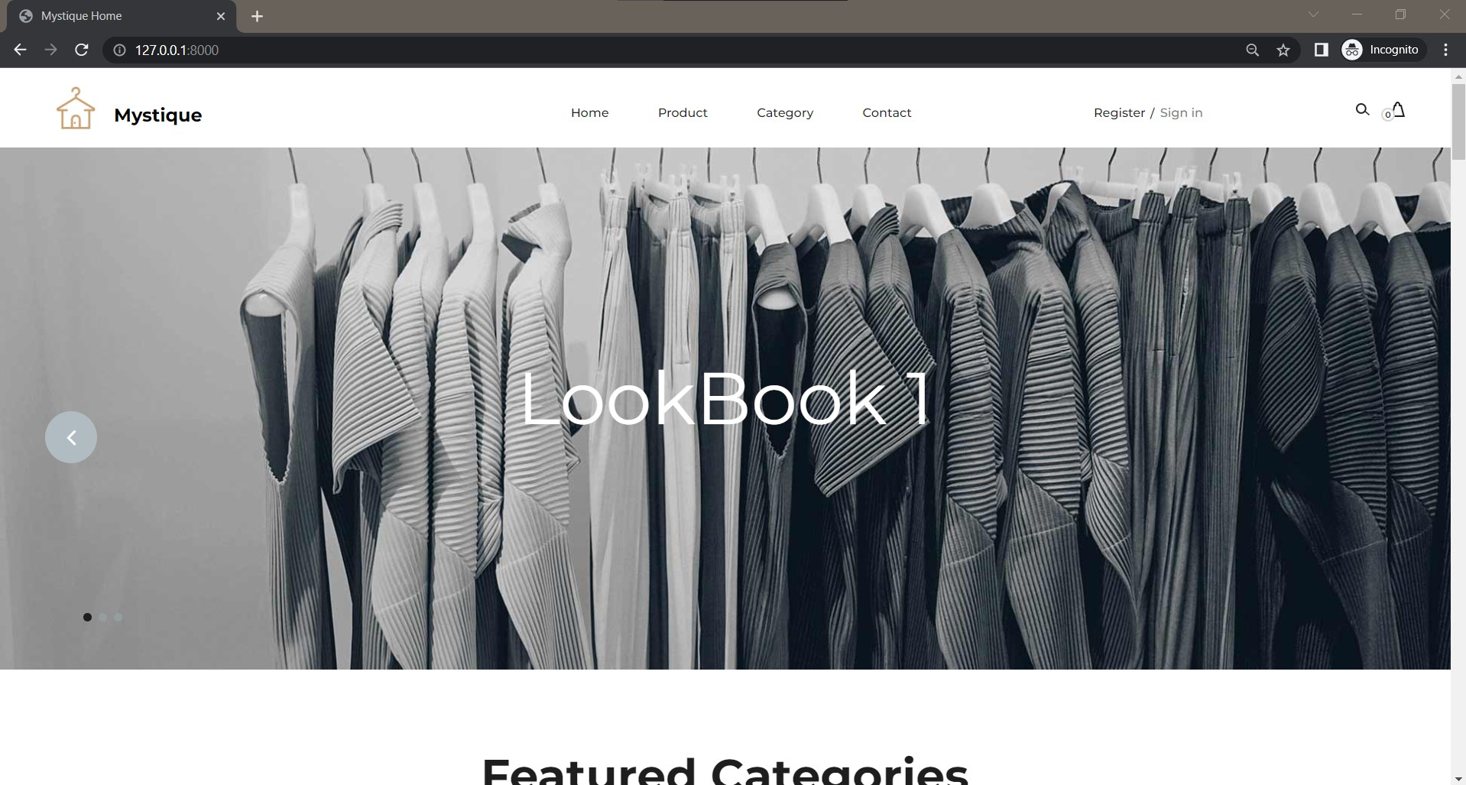
Home

Slide 5
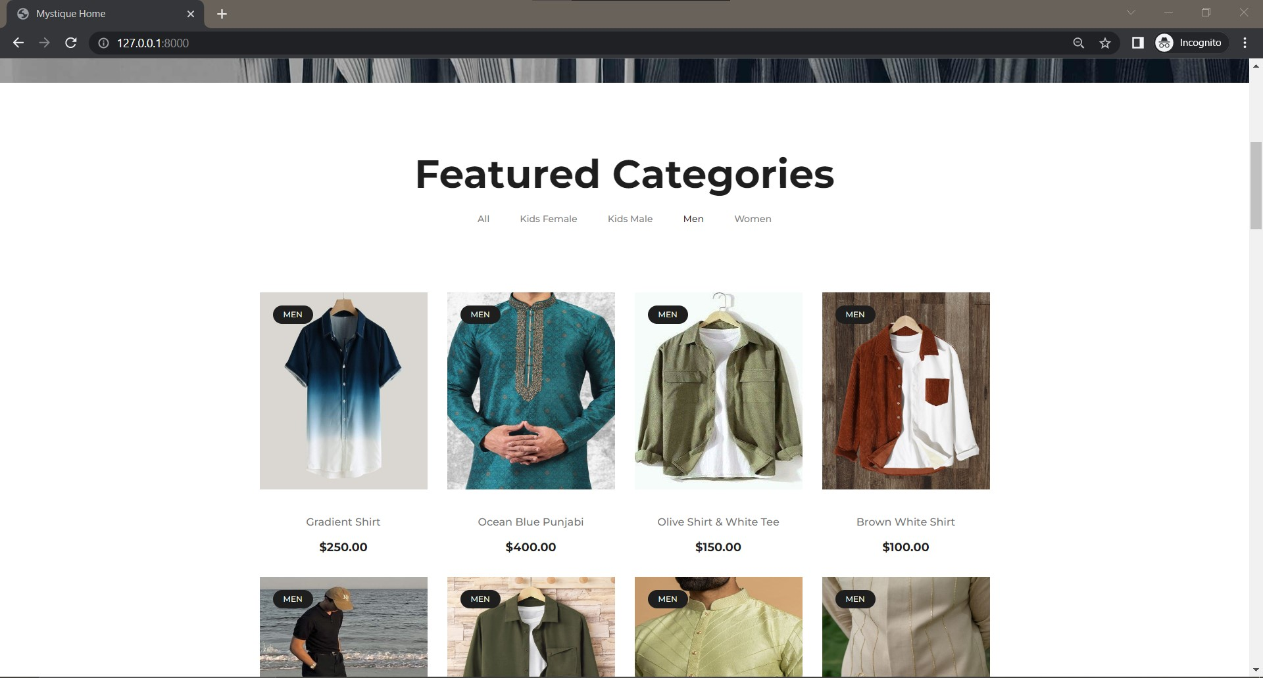
Home : Featured Category

Slide 6
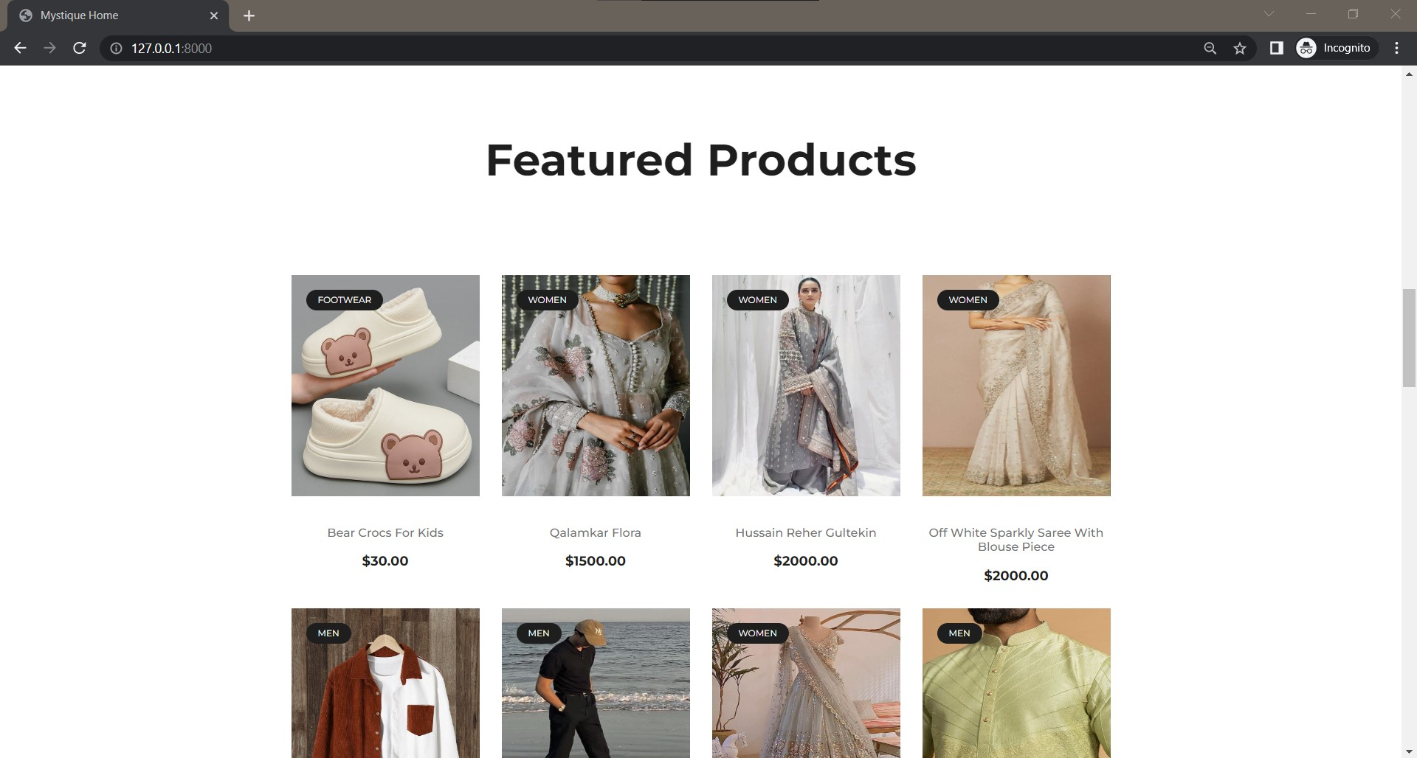
Home : Featured Products

Slide 7
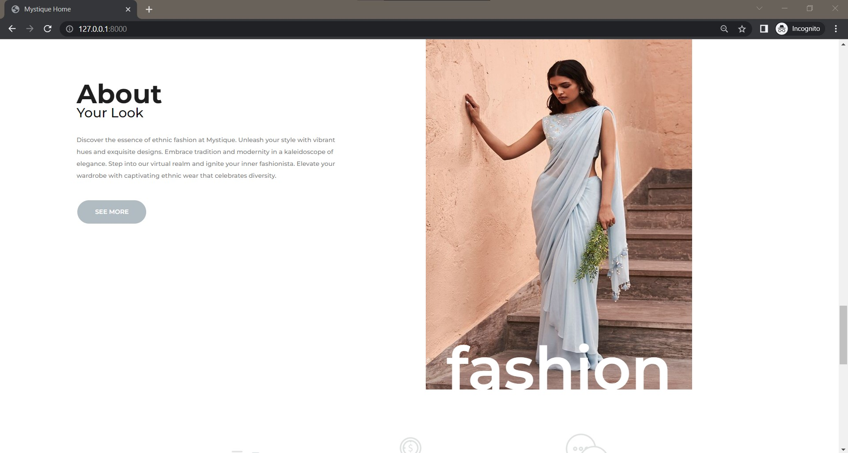
Home : About

Slide 8
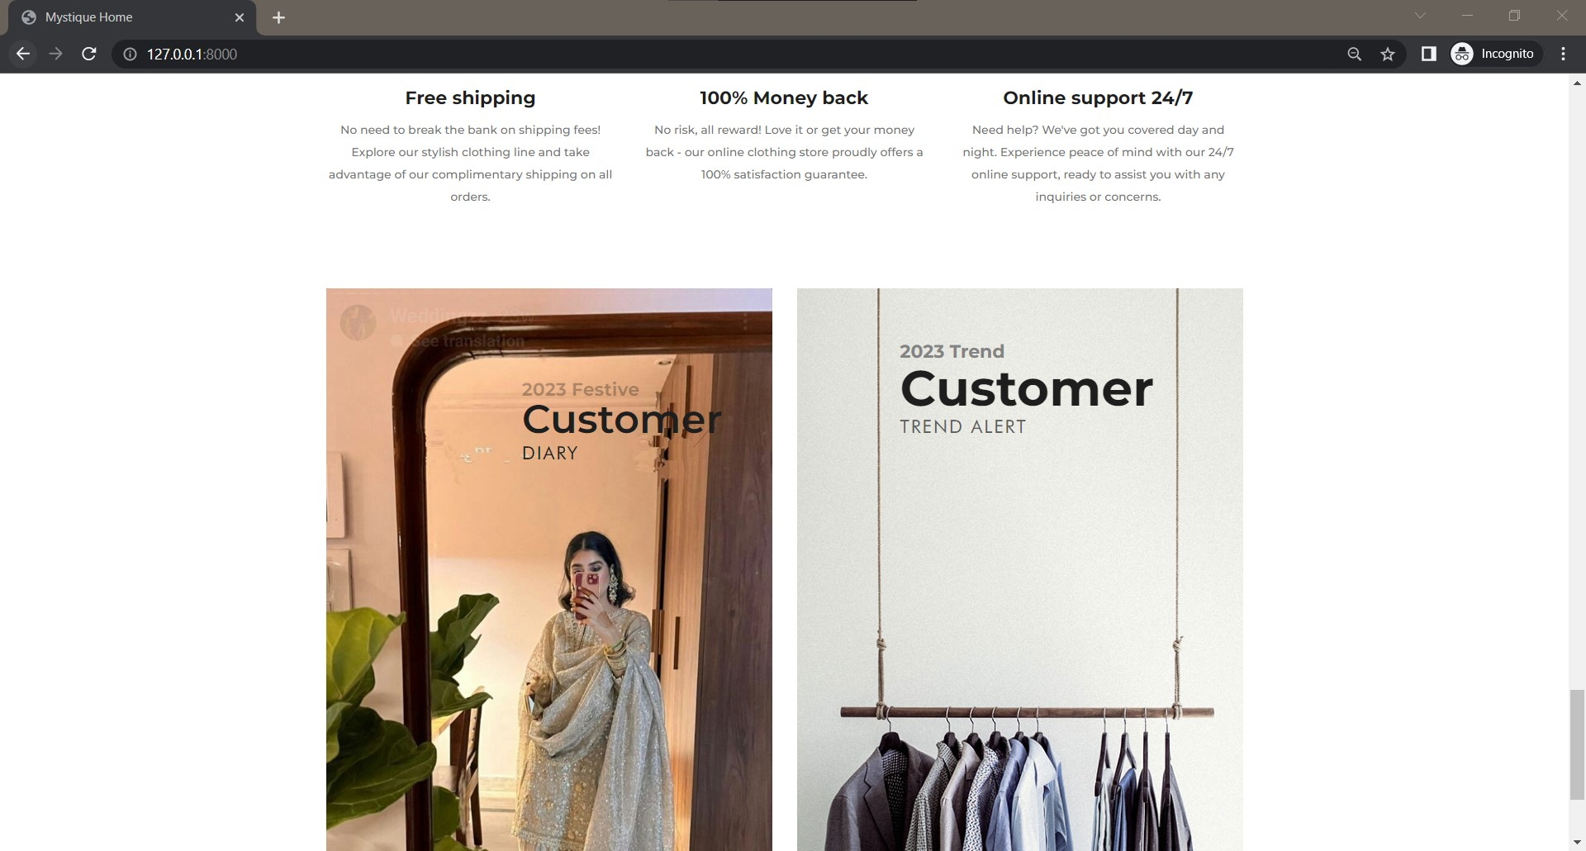
Home : Service & Customer Diary

Slide 9
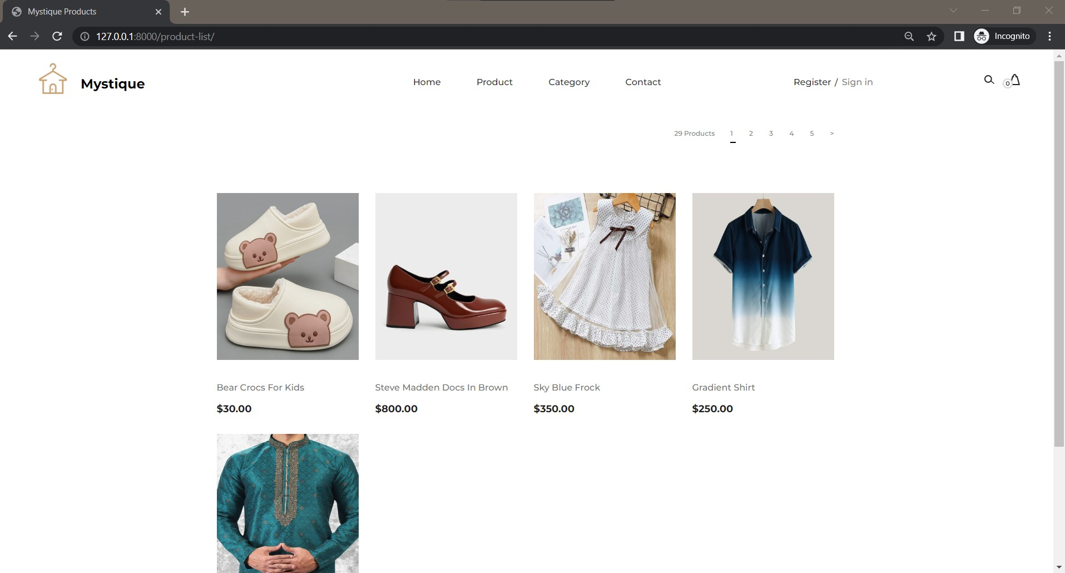
Product Explore Page

Slide 10
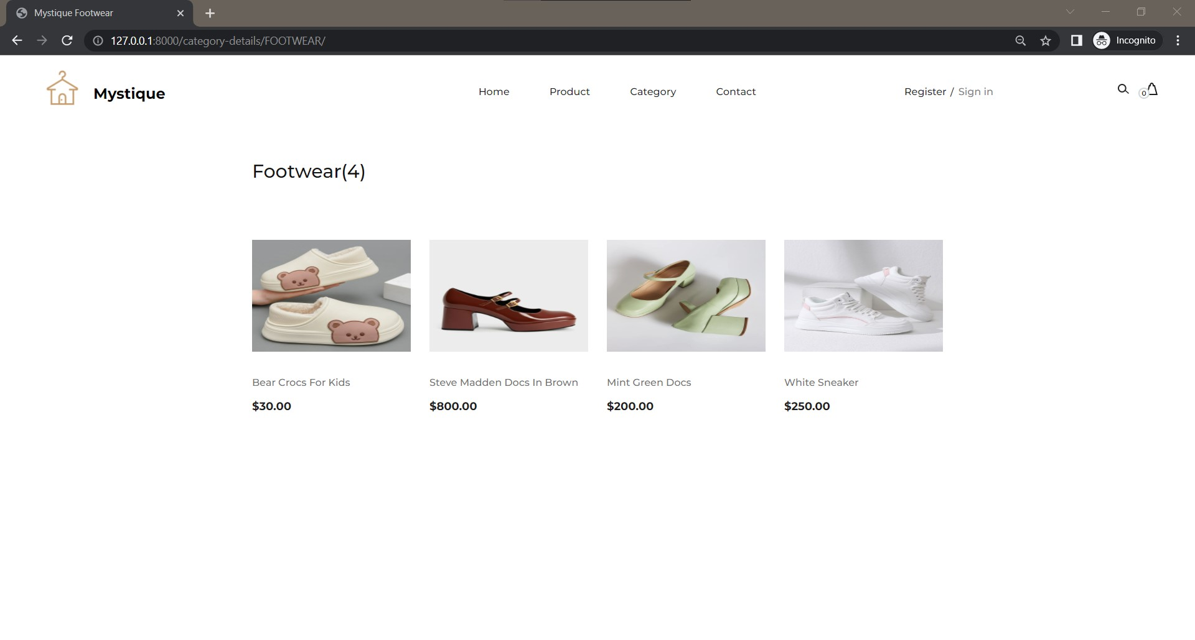
Category Explore Page

Slide 11
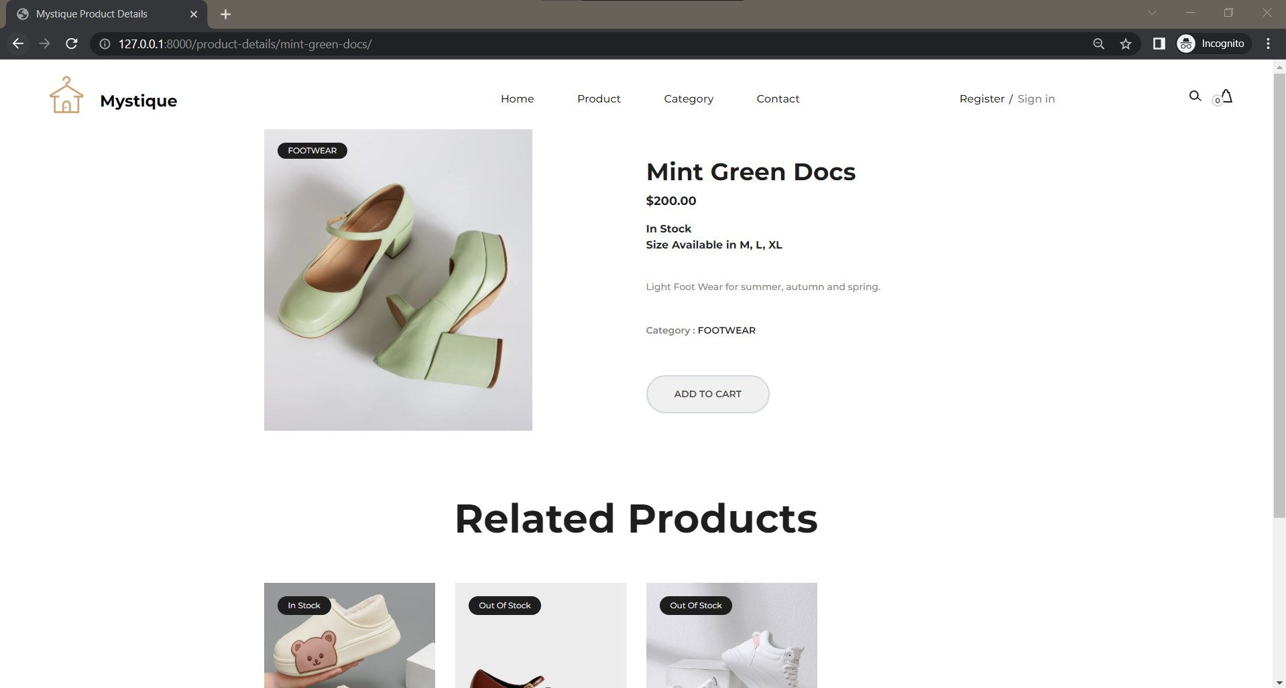
Product : In Stock & Add To Cart

Slide 12
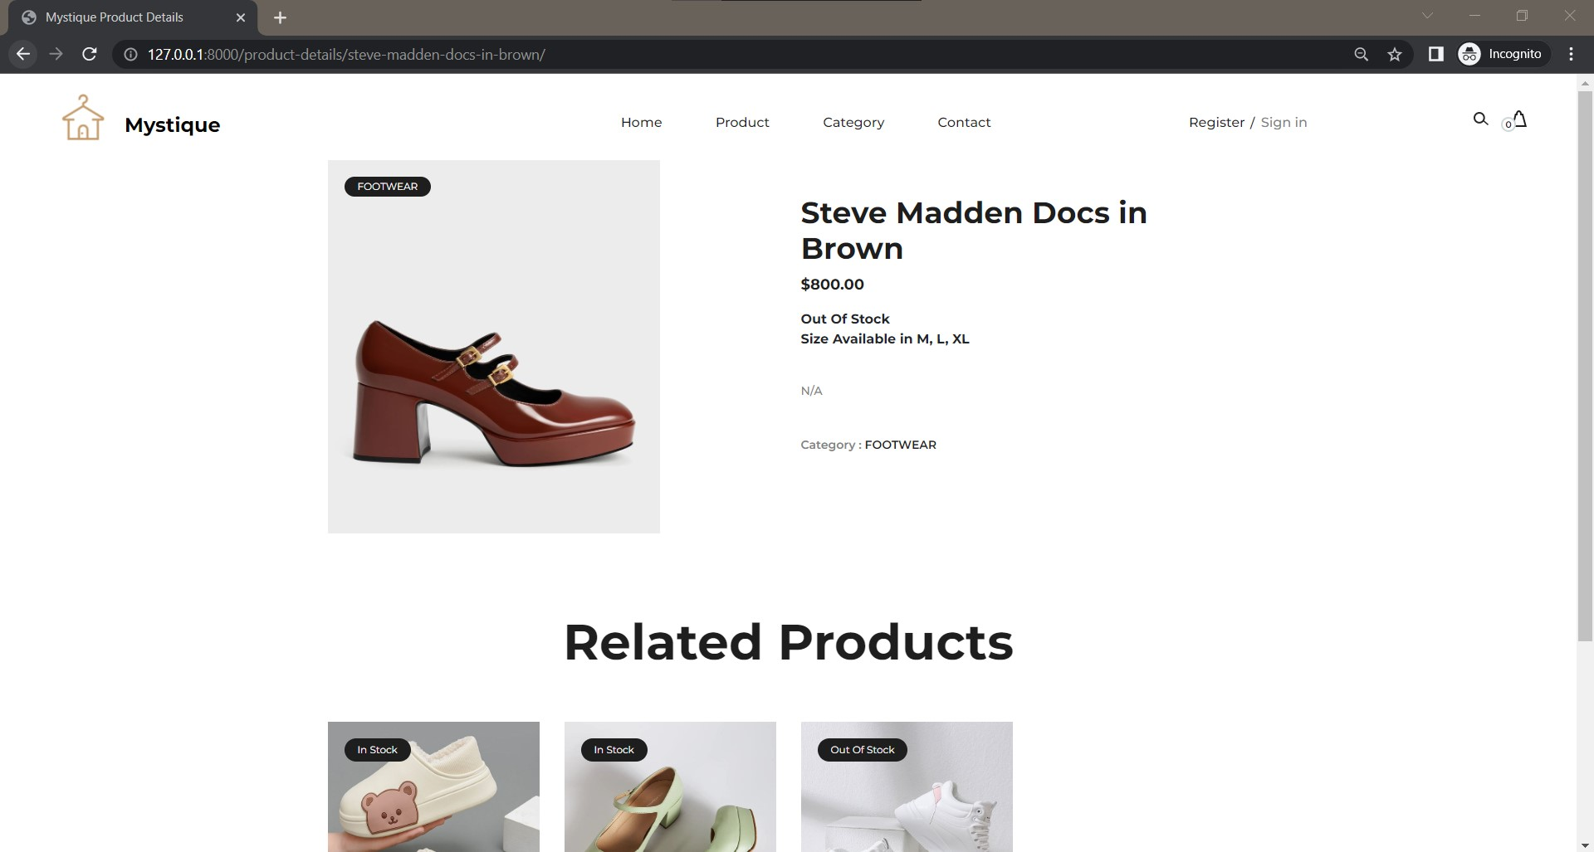
Product : Out Of Stock

Slide 13
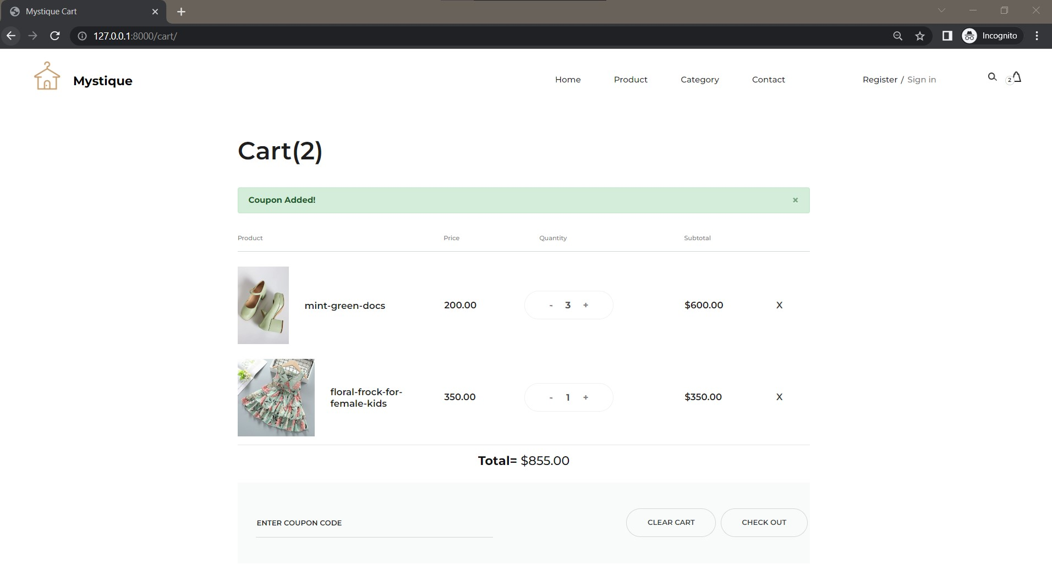
Cart For A Guest User

Slide 14
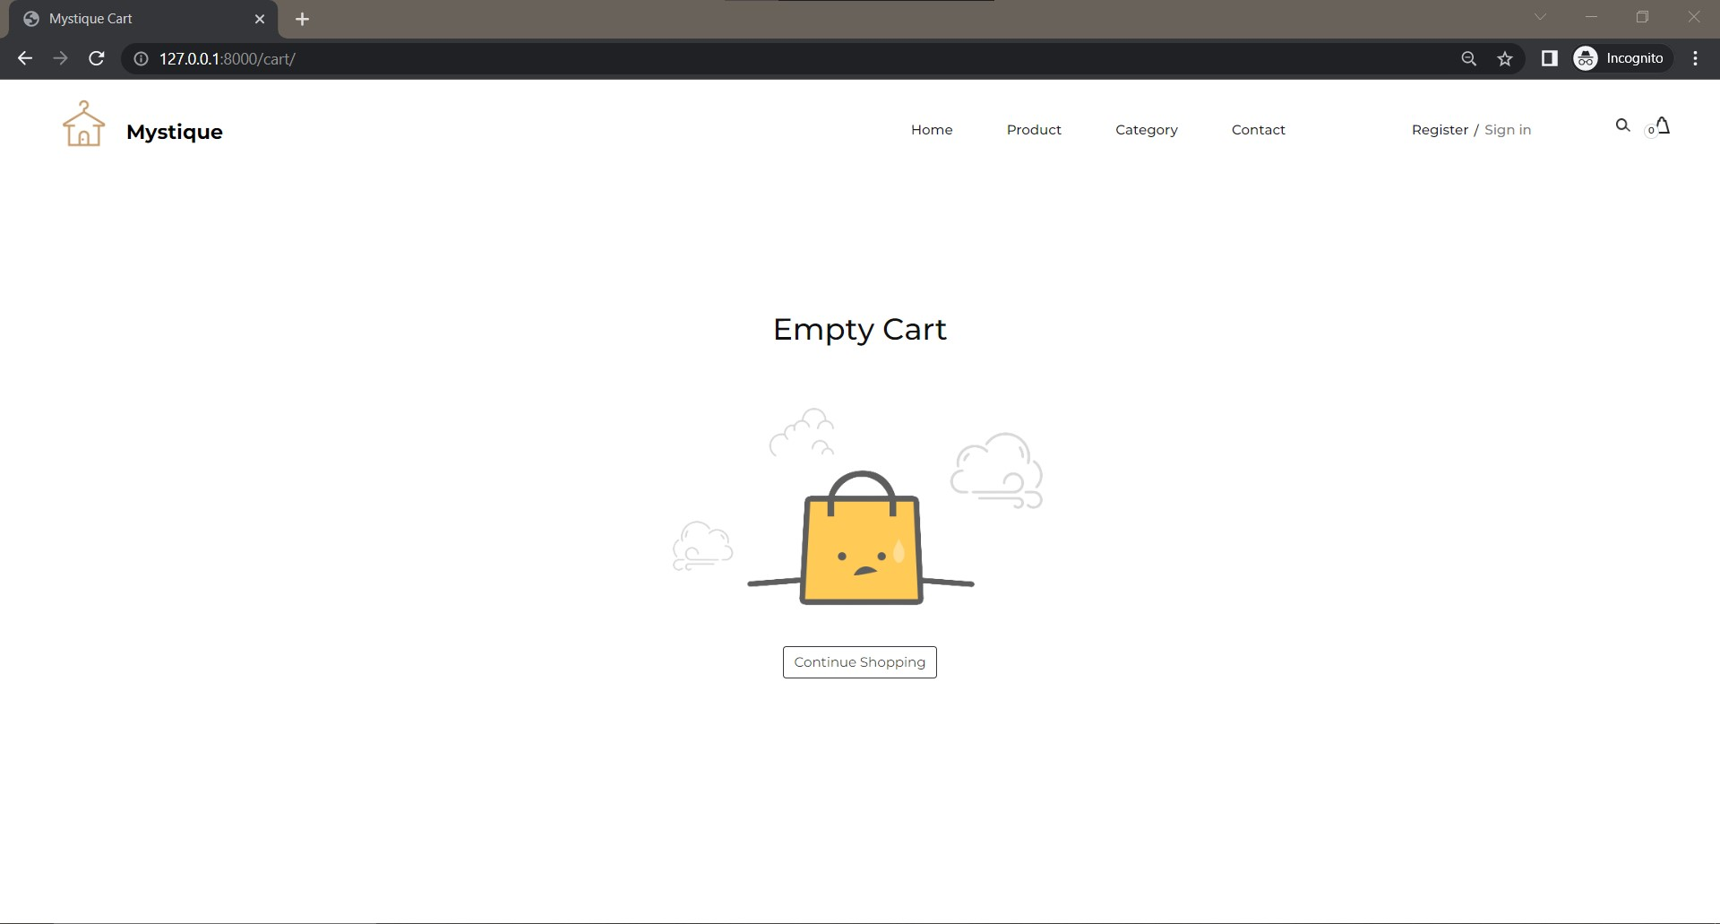
Empty Cart For A Guest

Slide 15
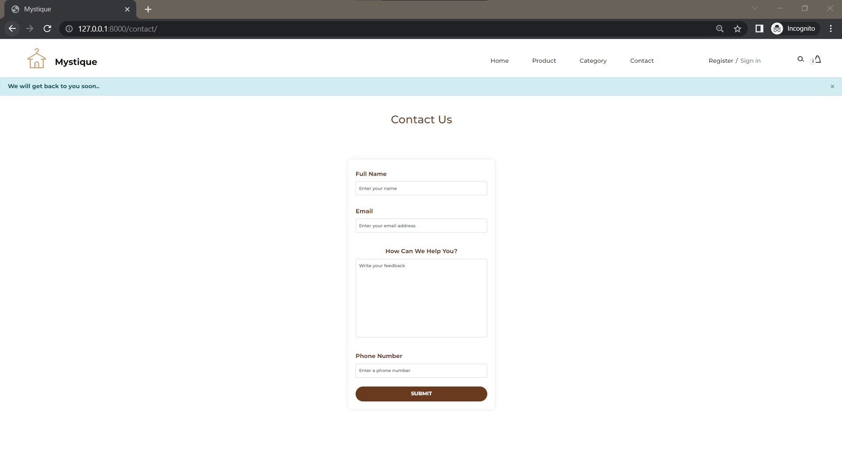
Contact Us

Slide 16
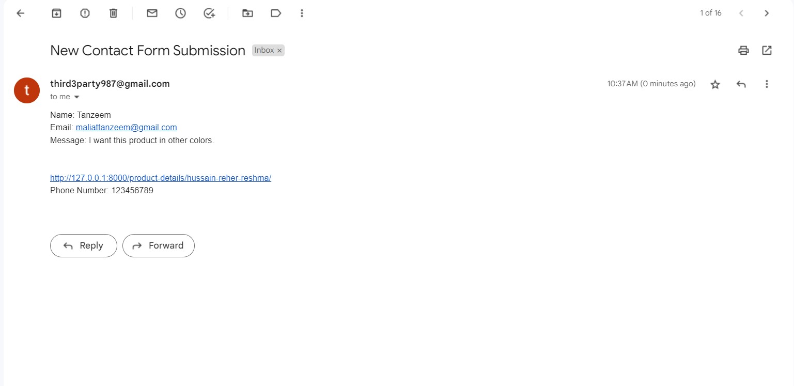
Mail Received At Admin Mail

Slide 17
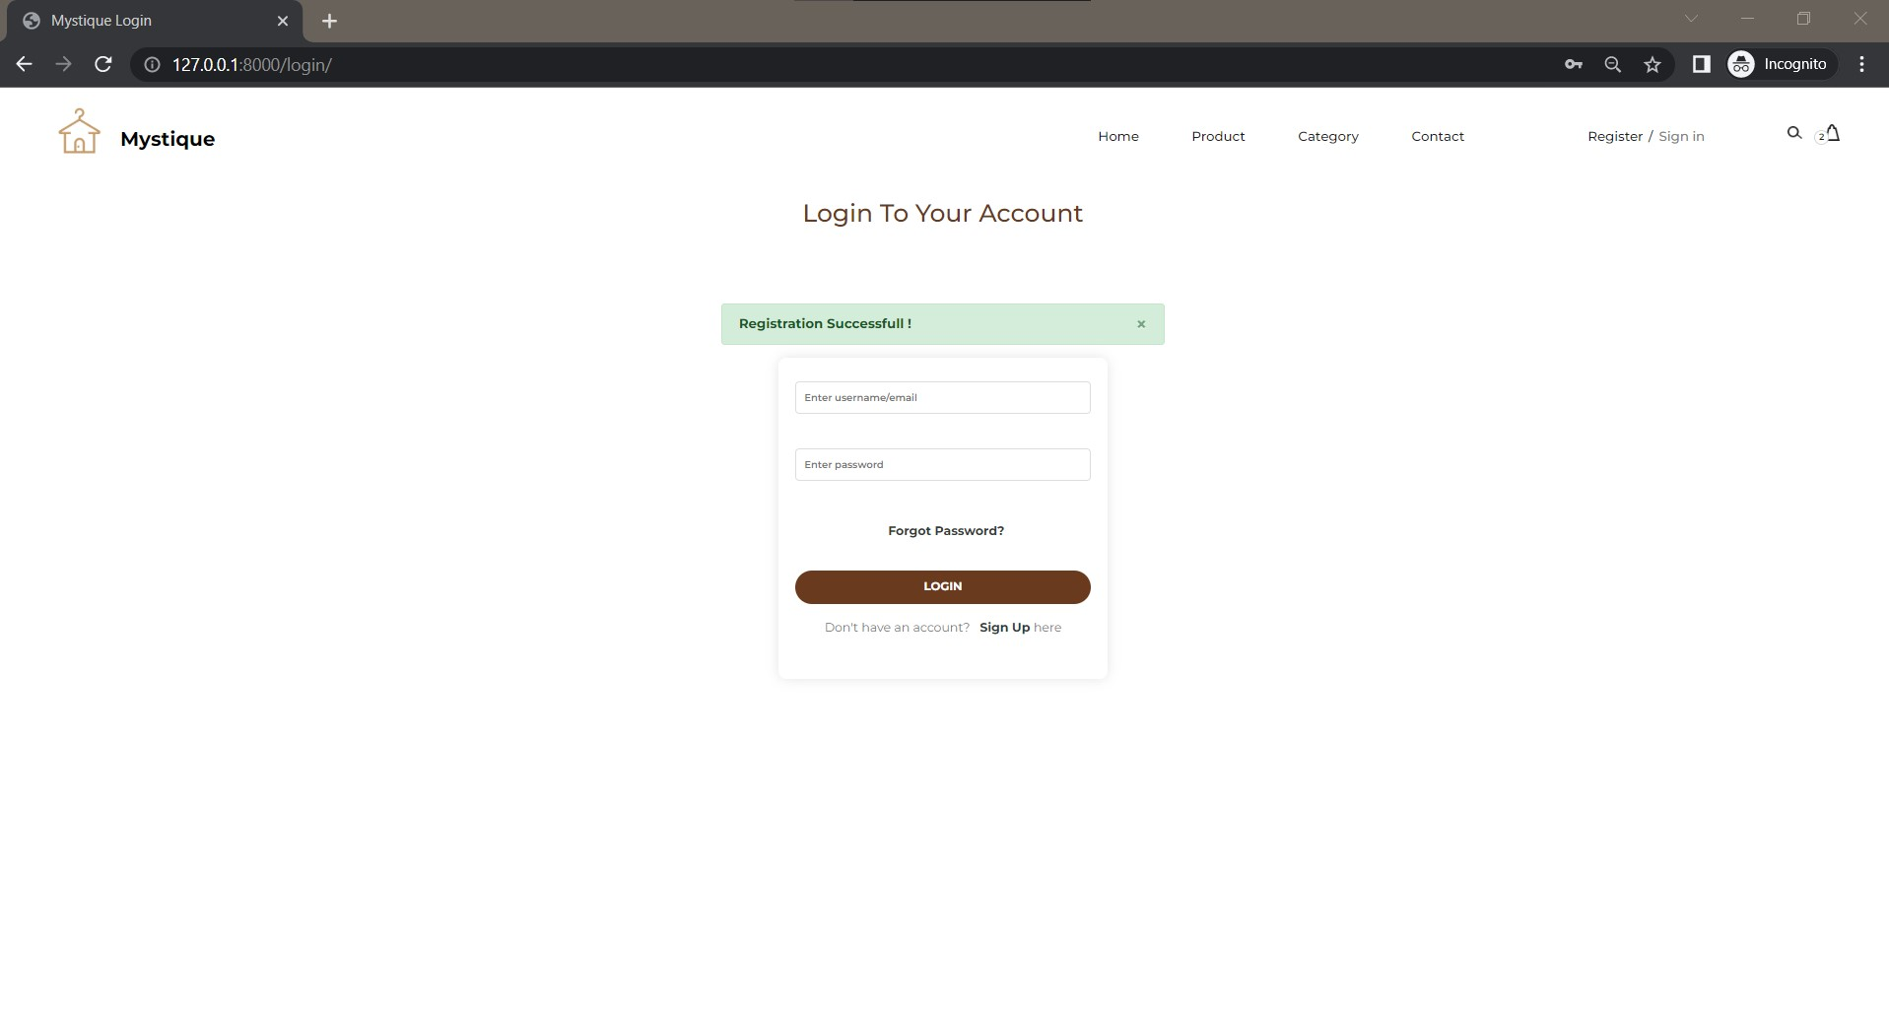
Registration Successfully Done

Slide 18
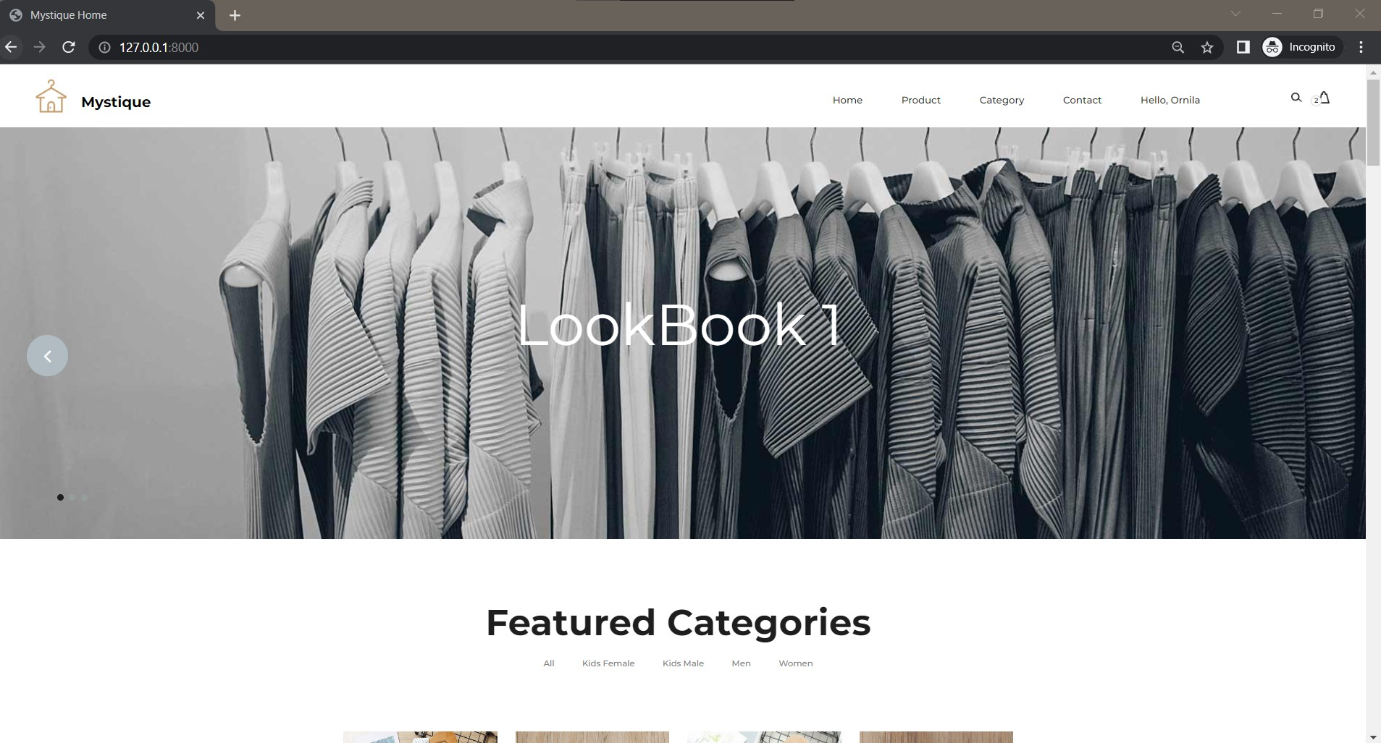
Home For A Registered User

Slide 19
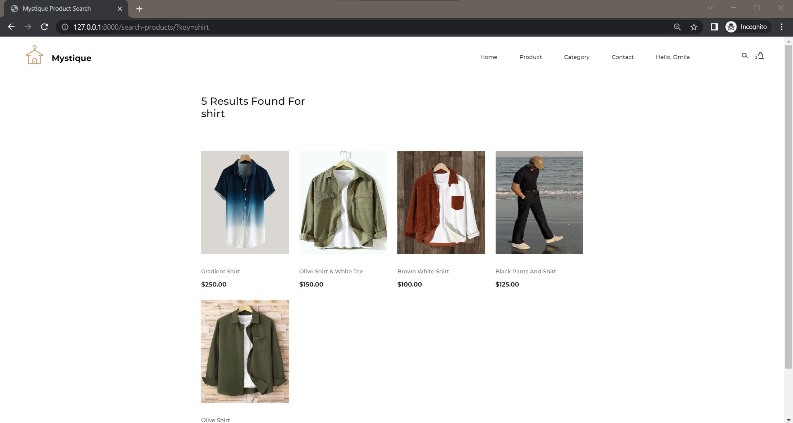
Search For Products/Categories : Found

Slide 20
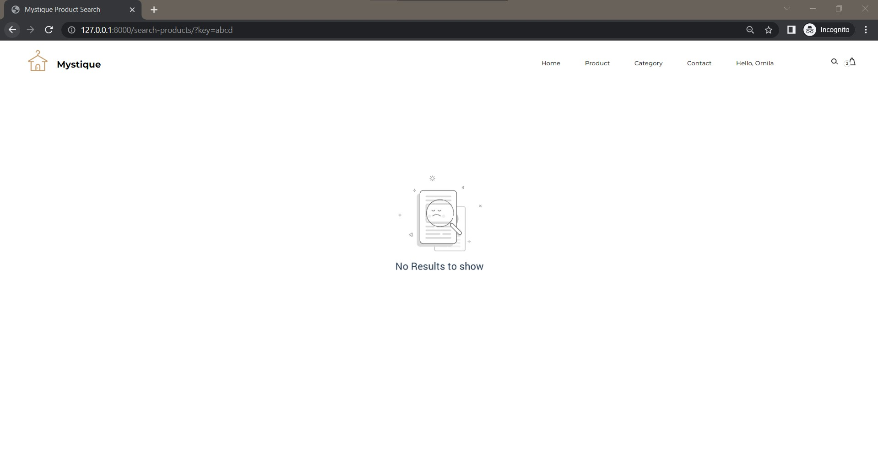
Search For Products/Categories : Not Found

Slide 21
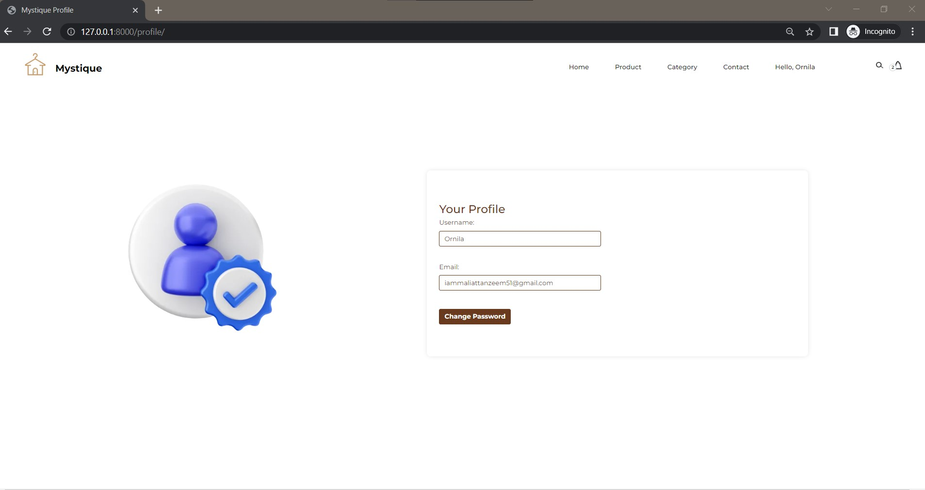
Profile For User : Name & Email Address

Slide 22
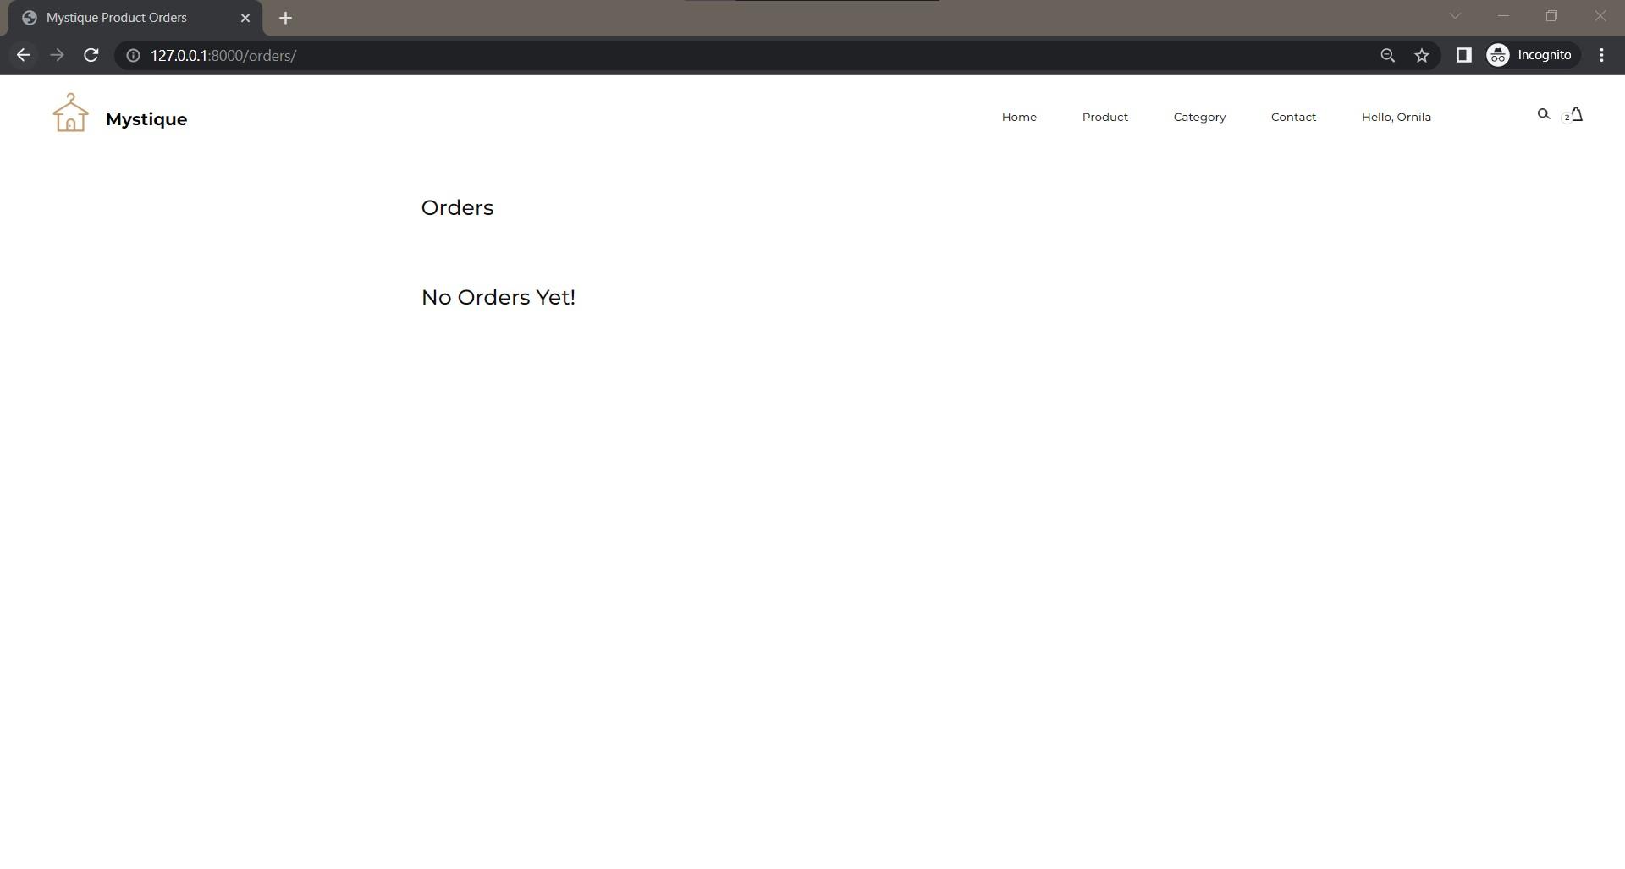
Order Page For New User

Slide 23

Login Page

Slide 24
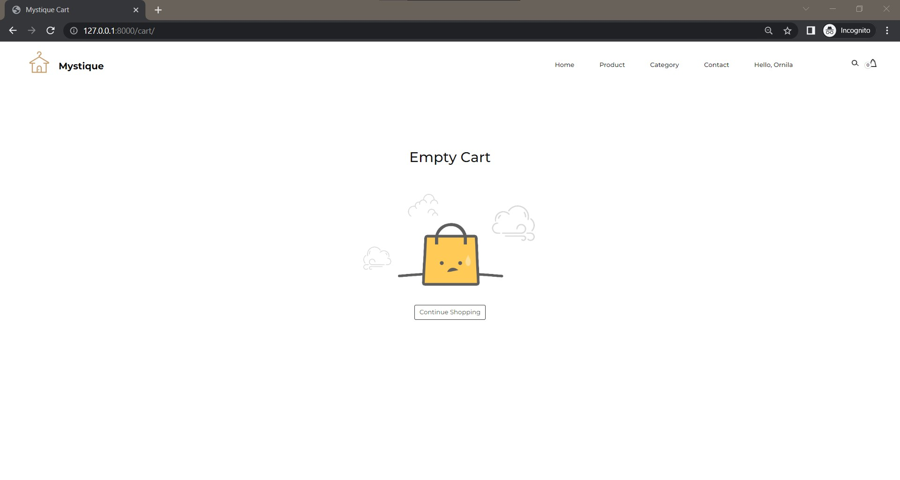
Empty Cart For User

Slide 25
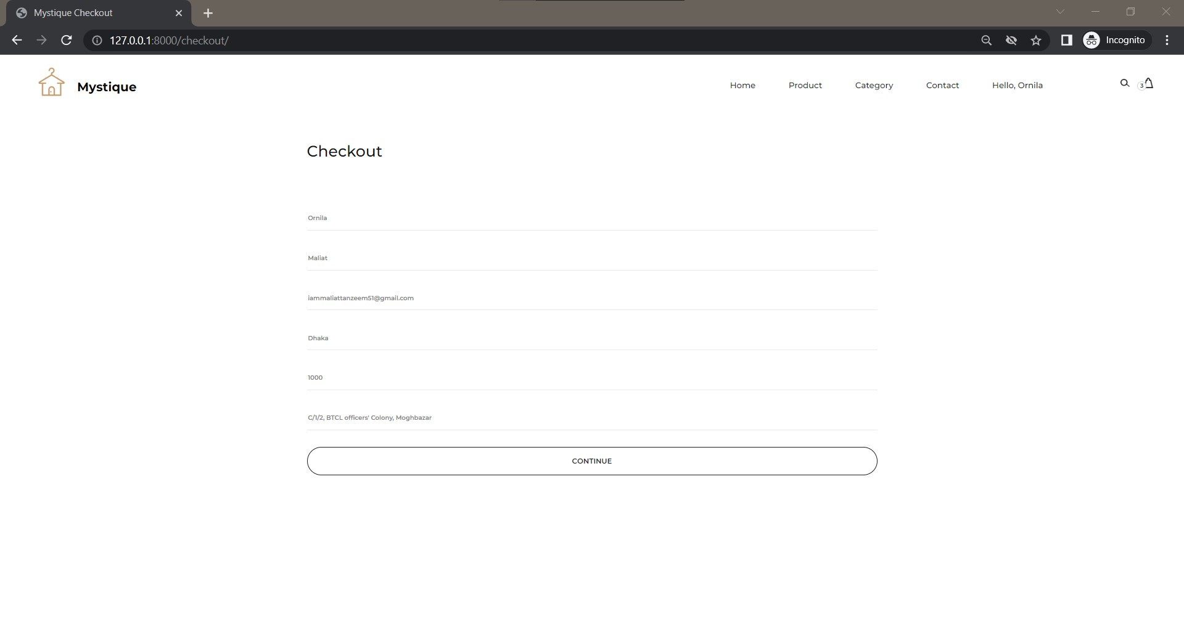
Checkout As A Registered User

Slide 26
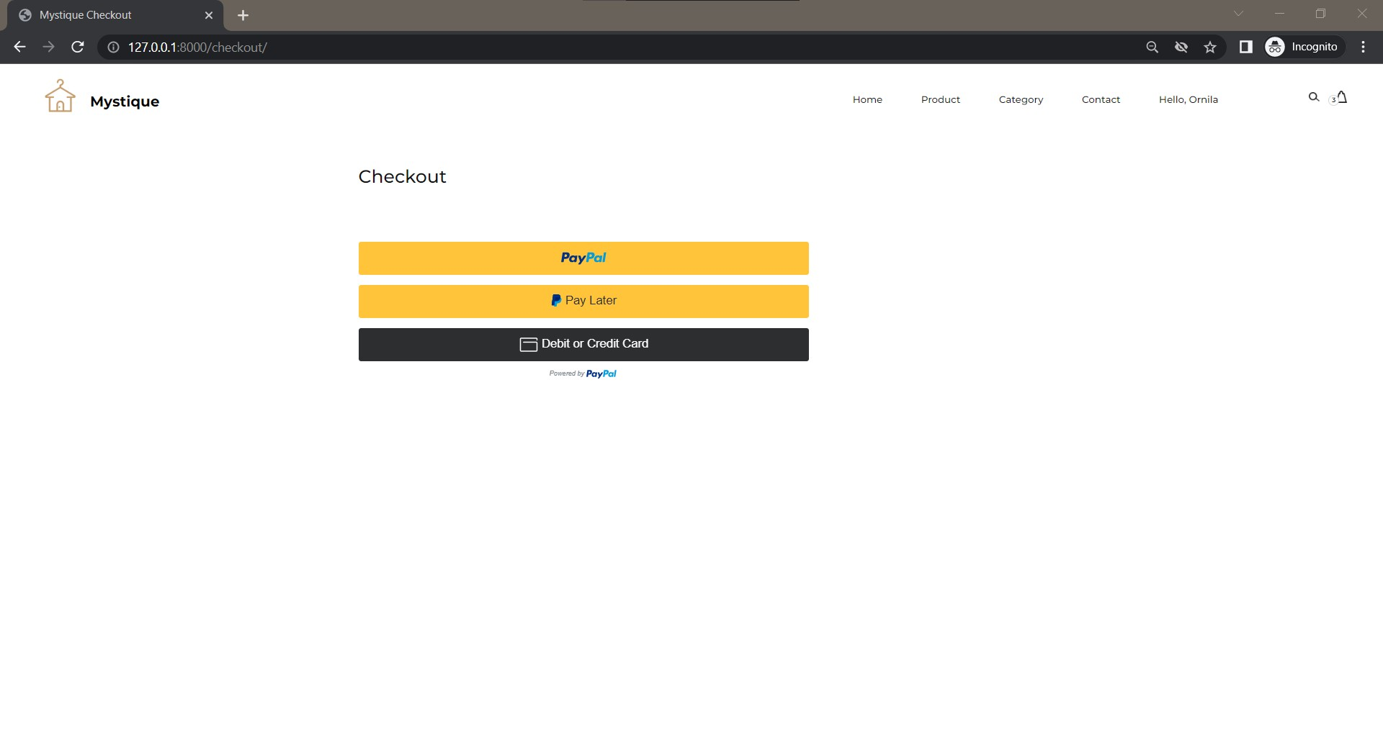
PayPal Payment For Registered User

Slide 27
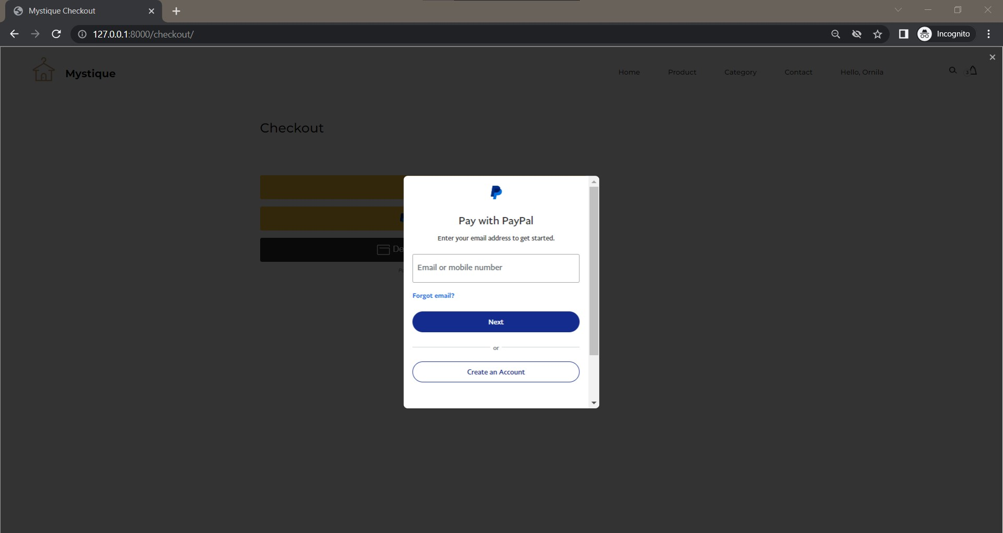
PayPal Payment Gateway

Slide 28
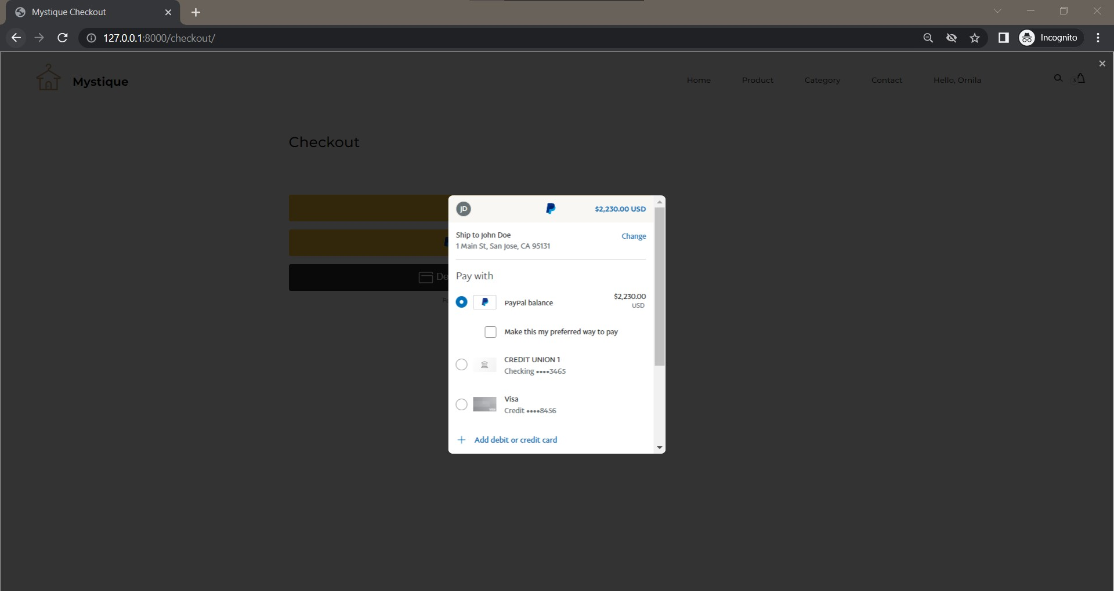
PayPal Payment With Final Total

Slide 29
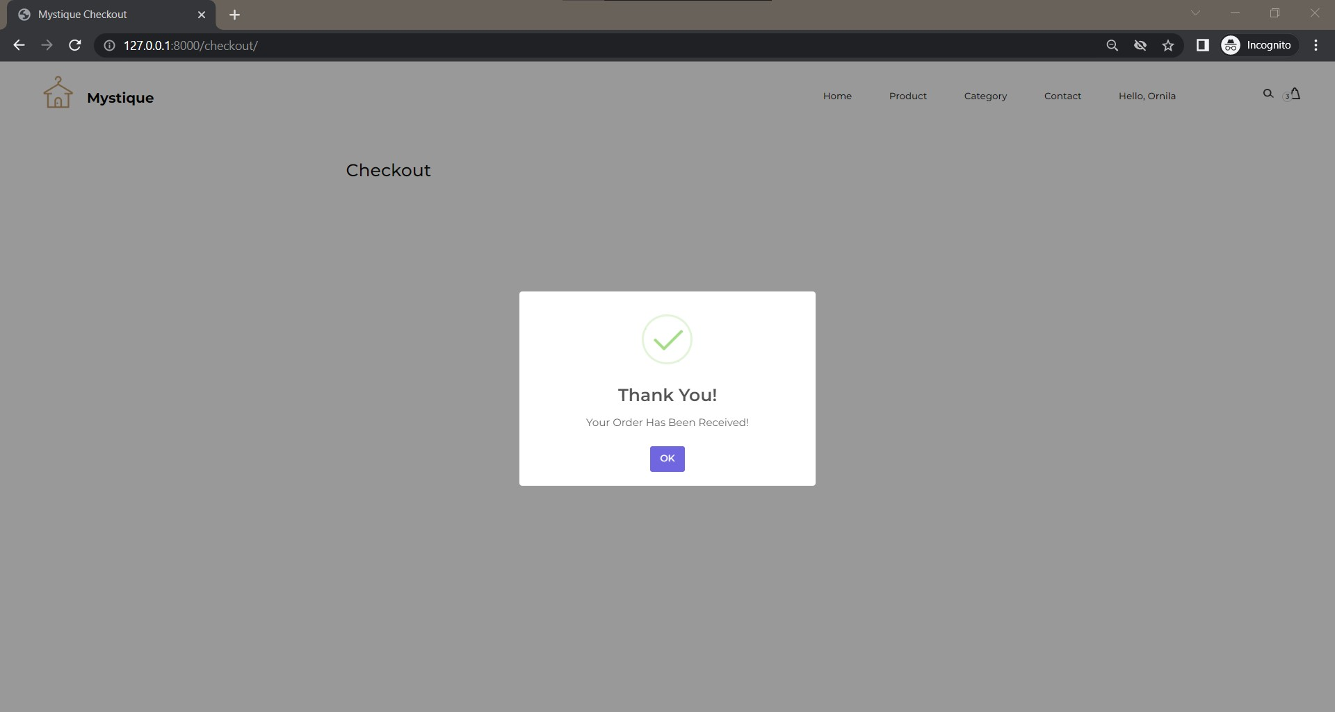
Payment Received At PayPal & Admin

Slide 30
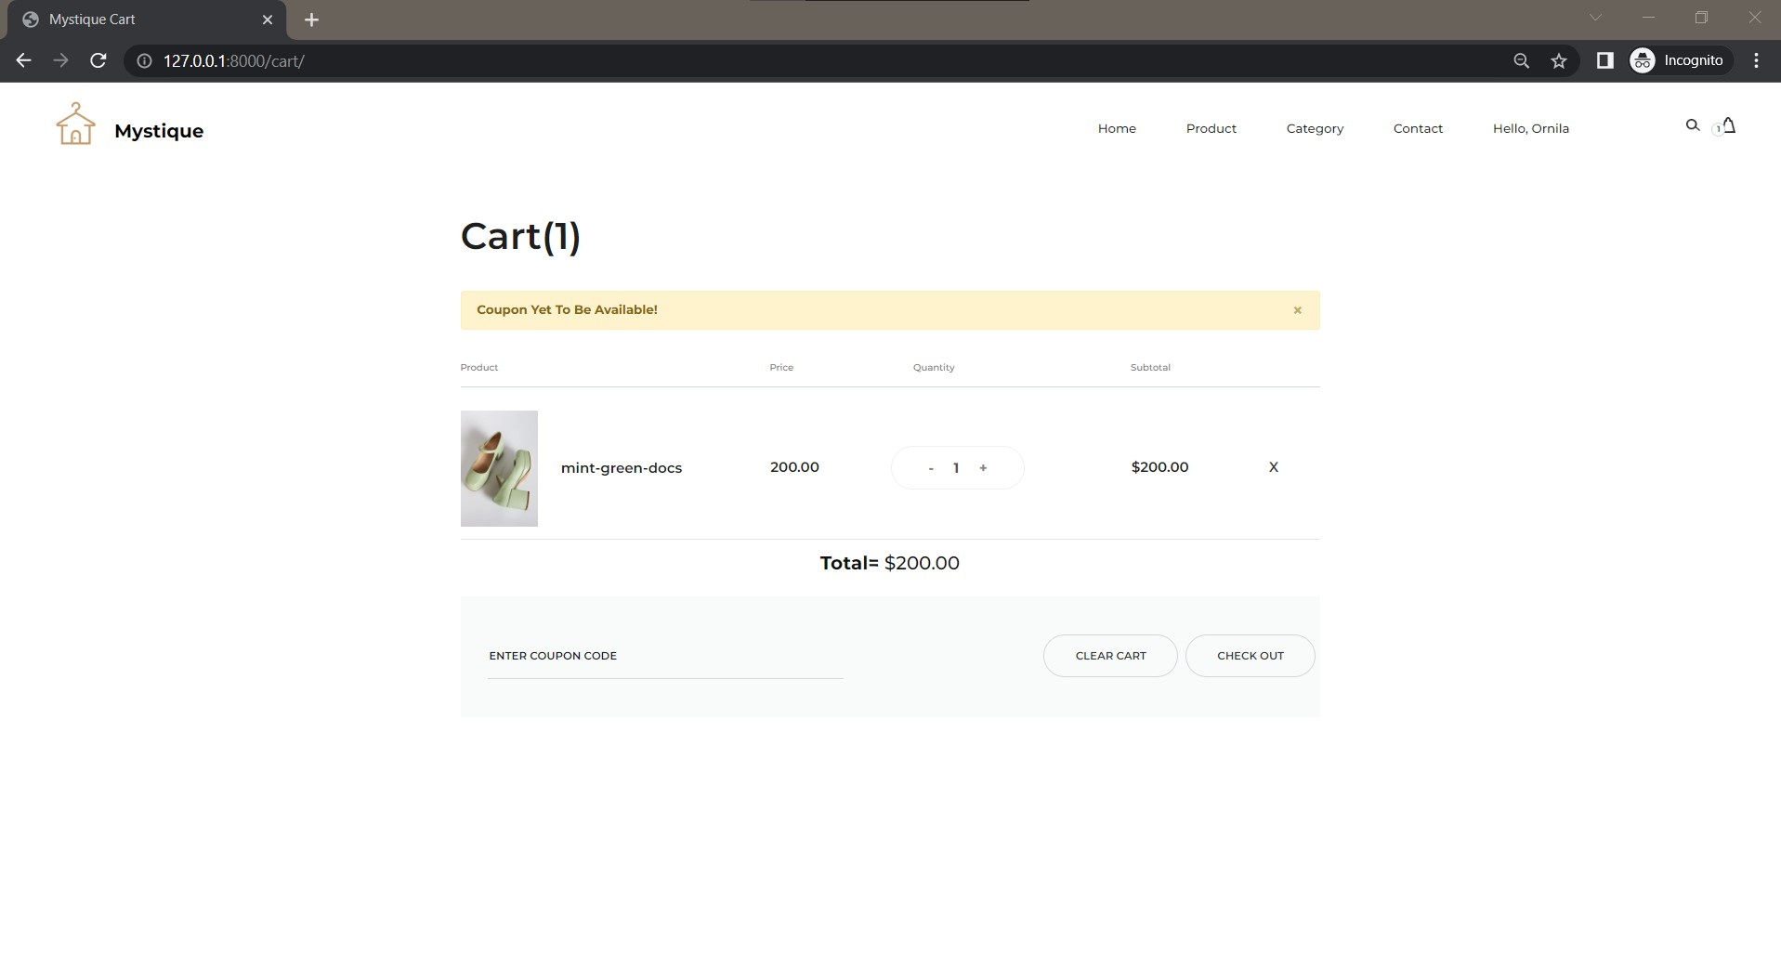
Coupon Validation At Cart

Slide 31
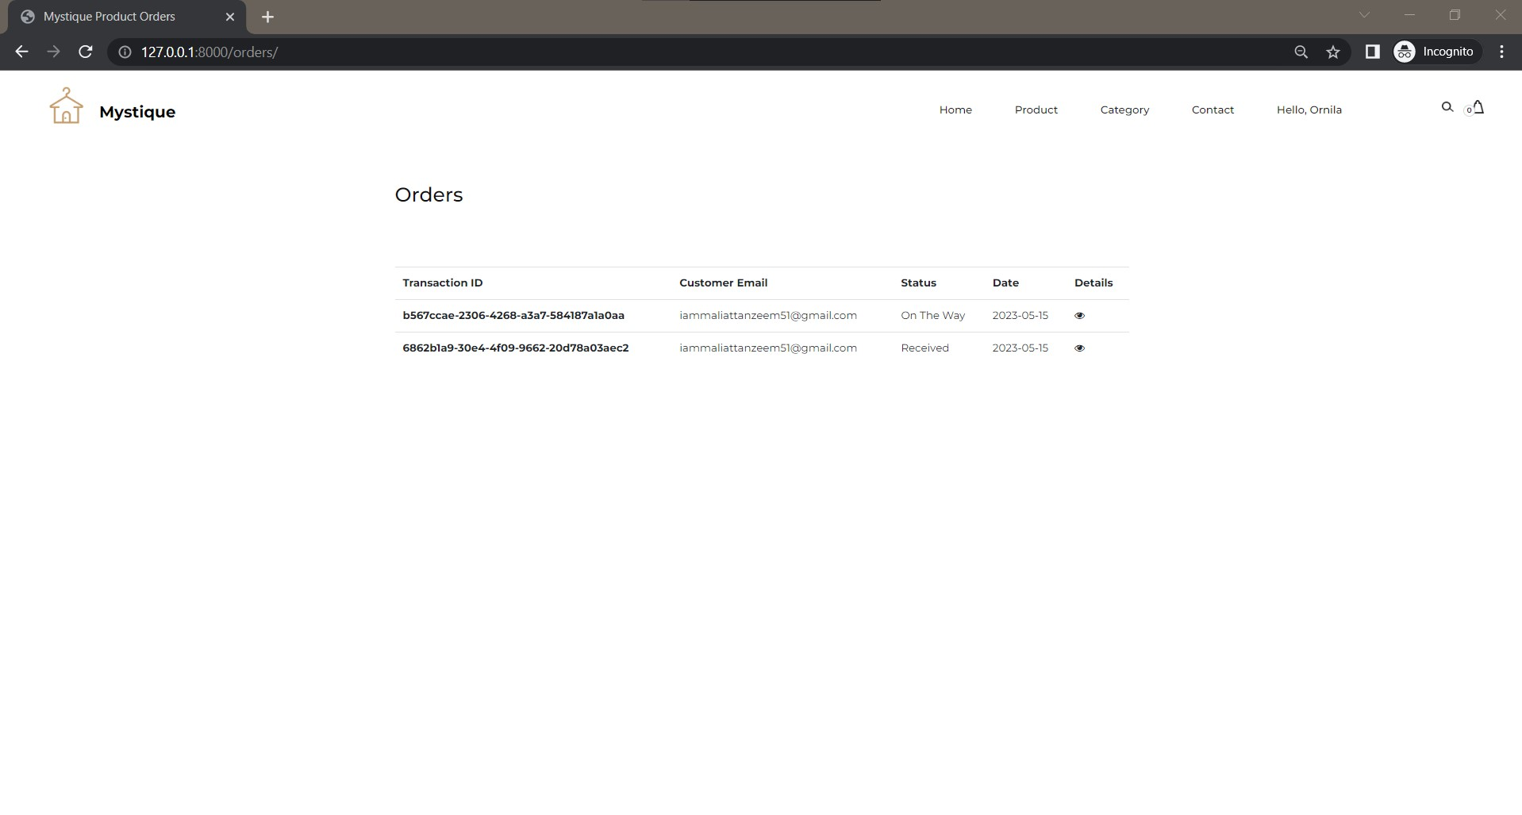
Order Details For Registered User

Slide 32
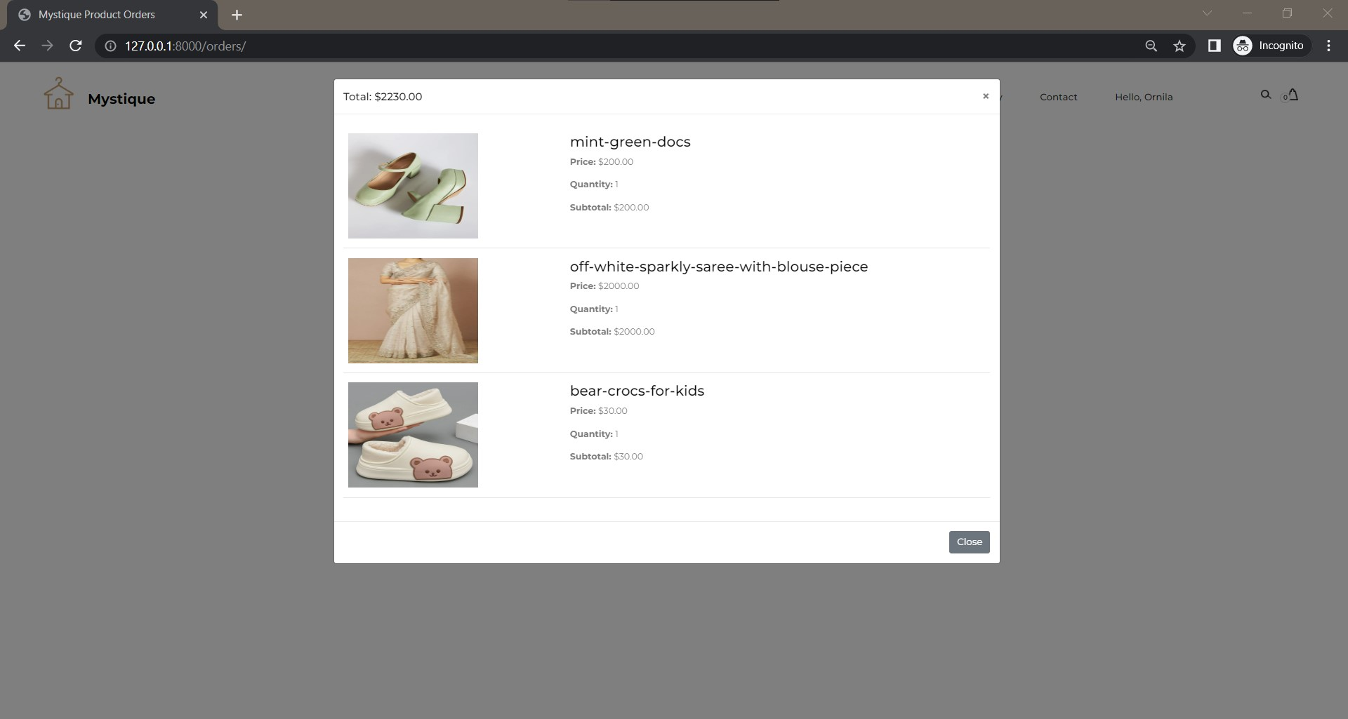
Order Details For Registered User

Slide 33
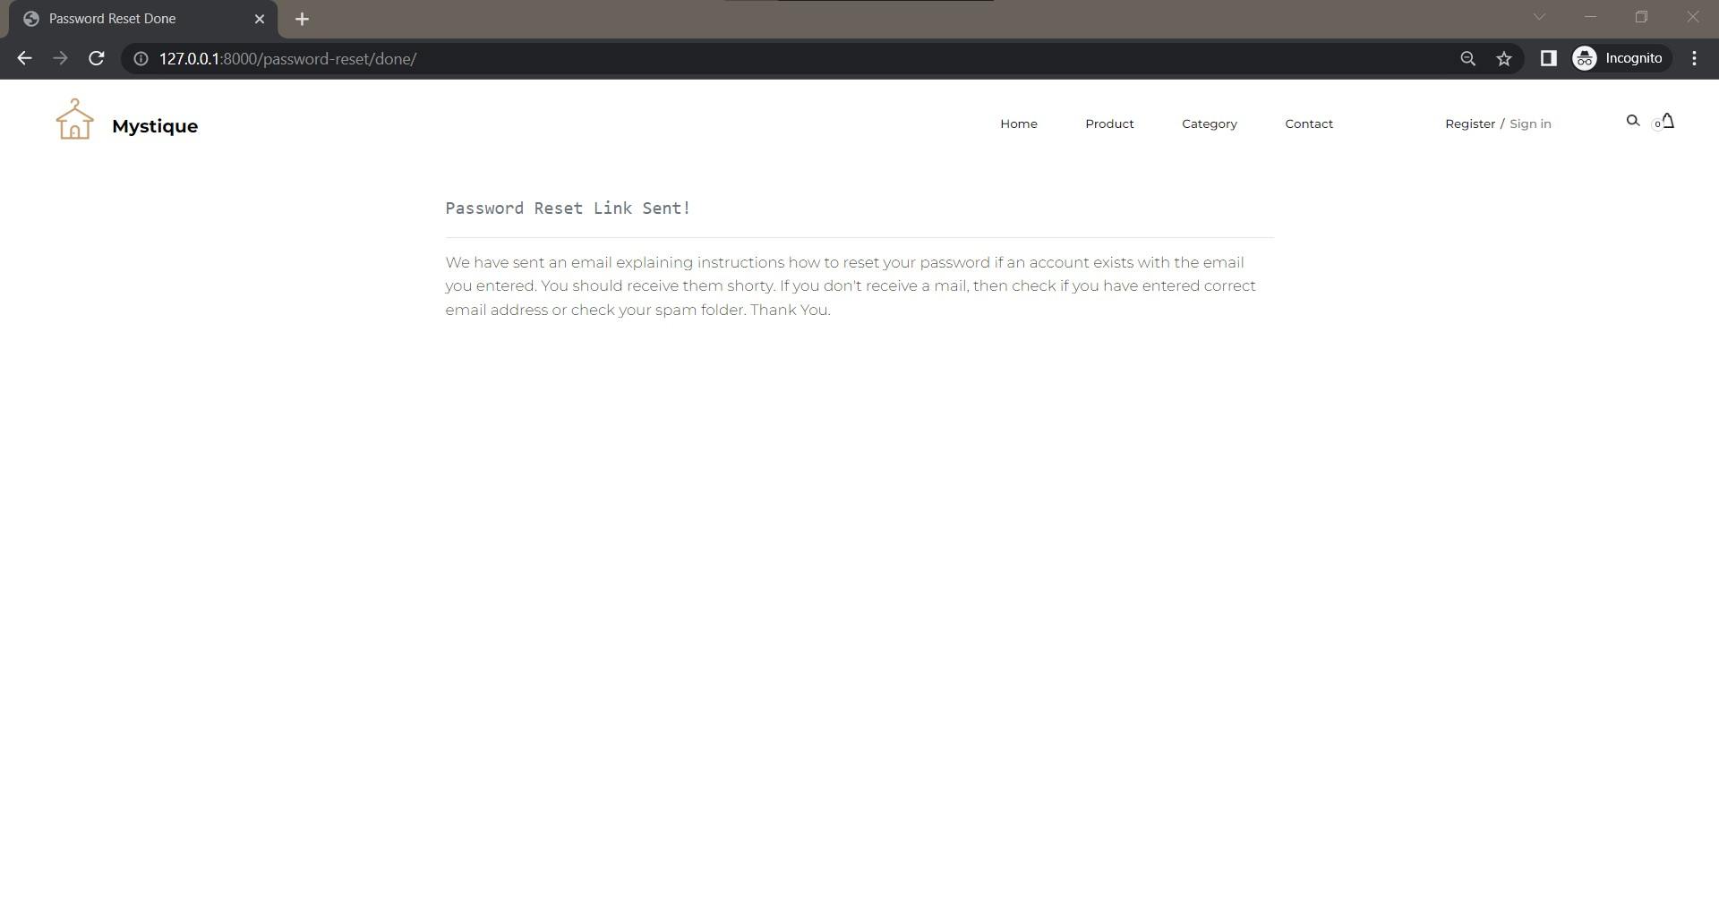
Reset Password Via EMail

Slide 34
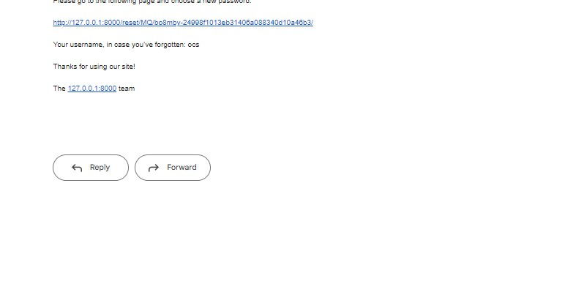
Password Reset Via EMail

Slide 35
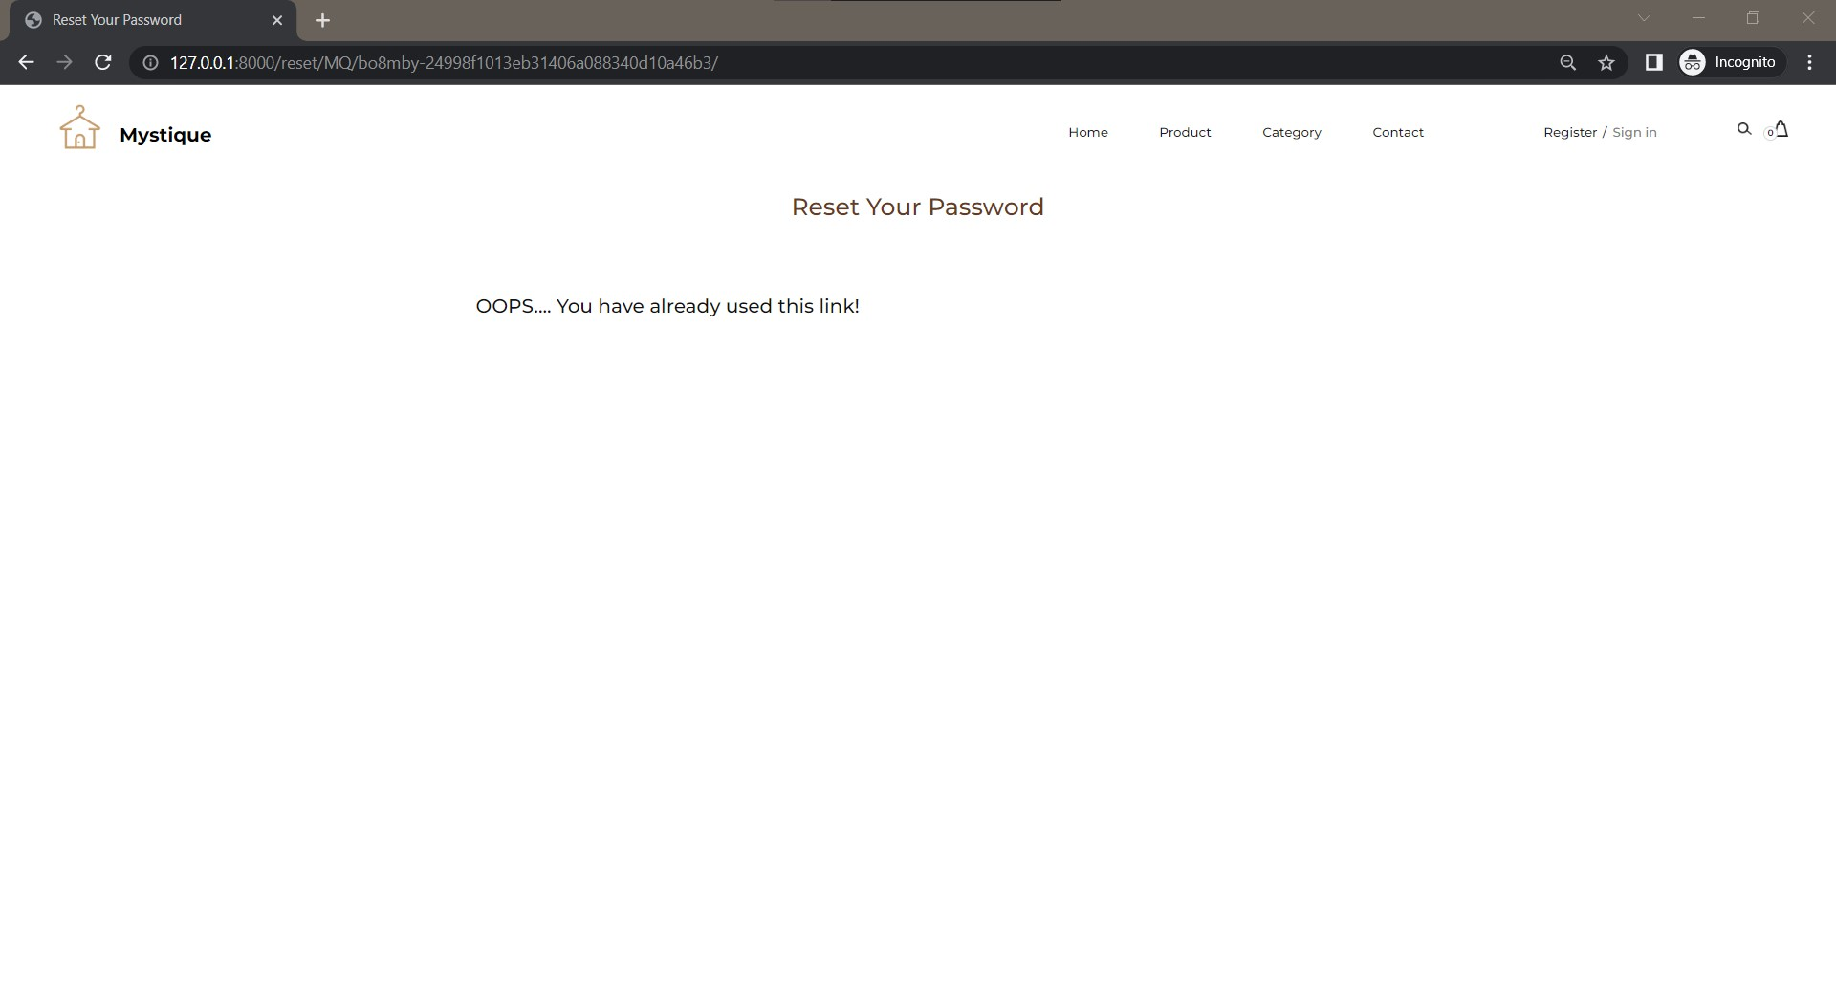
Password Reset Via EMail

Slide 36
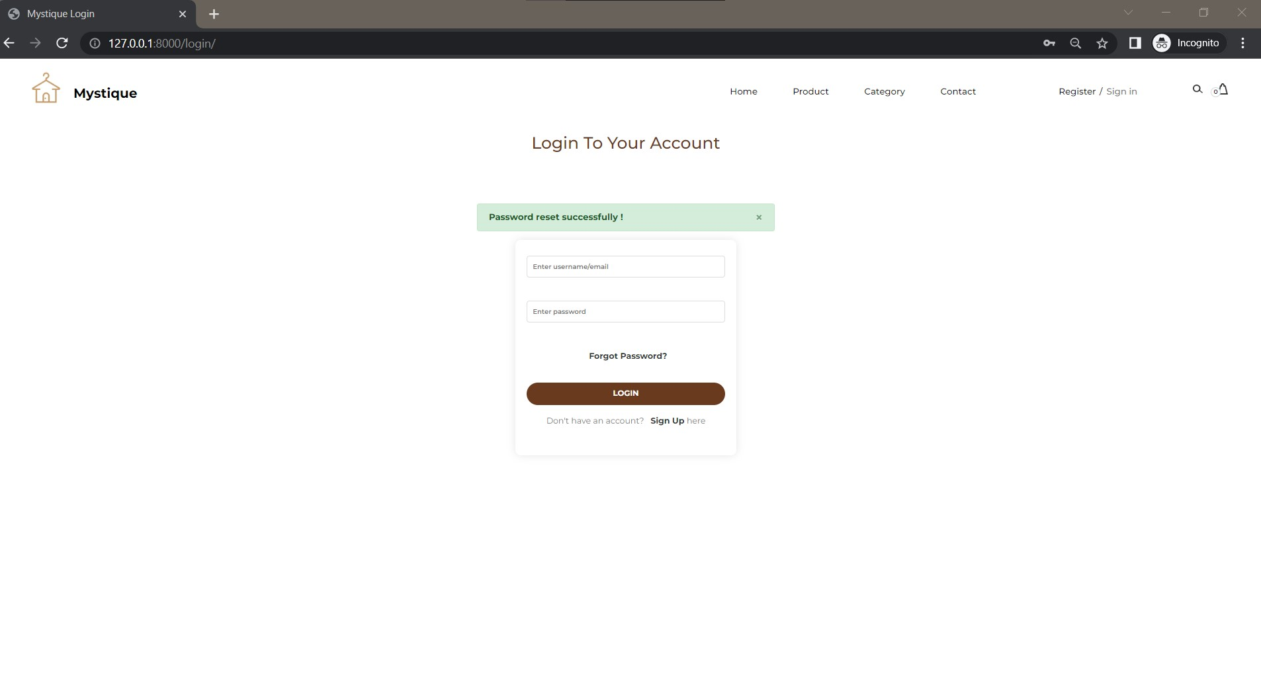
Logout

Slide 37
Any Query?

Slide 38
Thank You!

