Slide 1

Data Science-109 Natural Language Processing & Semantic Classification Part 1
Anthony Mele

Slide 2
Why do we want to work with language?
Outside of futuristic personal assistants and bots that will make interfacing with computers more natural, one point is that the volumes of data generated in social media are enormous.
Facebook generates 500TB of data /day.
Facebook users send 31.25 Million messages every minute.
At the moment less than 0.5% of all data is ever analyzed and used, just imagine the potential here.
More Stats

Slide 3
What is Natural Language Processing?
A subset of Artificial Intelligence, NLP is concerned with the communication of people and machines using natural spoken and written language in order to perform different tasks.
Natural Language Processing
Understanding input language
Natural Language Understanding (NLU)
Creation of output language
Natural Language Generation (NLG)
Meaning

Slide 4
NLP Components
Natural Language Understanding (NLU):
The process of taking free form inputs of text/speech and transforming them into machine language.
Natural Language Generation (NLG):
The production of meaningful text/speech from a machine that can be interpreted by people.

Slide 5
Challenges of Natural Language Understanding
Ubiquitous Ambiguity in free form input:
Lexical (word level) – They made a sharp point.
Referential – Amanda spoke with Tiffany and she said she was excited.
Syntactic – He saw the man with binoculars.
Scope – There are happy boys and girls.
Phonological - Knows and nose.
Punctuation - She went to the store the components on the shelf
etc …
Misspellings
Structure
Slangs
Multiple Languages (6909+ worldwide)
Punctuations

Slide 6
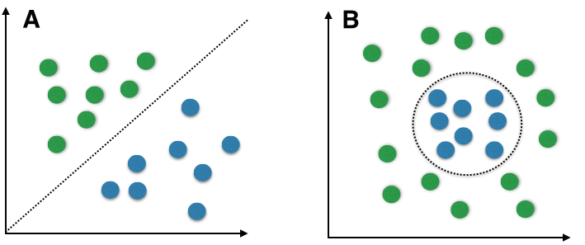
Semantic Classification
Semantic, meaning, the meaning of a text…
Classification is a Machine Learning process where we attempt to classify a new observation into a known or unknown set of categories, using an algorithm, given a dataset of previous meaningful observations.
Naïve Bayes
Linear
Support Vector Machines
Quadratic
Neural Networks

Slide 7
More on Classification & Data
Machine Learning, we recognize 3 distinct types of datasets.
Supervised Data, labeled data - Ex. Male/Female, High/Low, Good/Bad
Un-Supervised Data, unlabeled data
Semi Supervised Data, partially labeled data that requires additional prep
Generalizing, there are 2 types of data:
Qualitative
Ordinal/Nominal
Quantitative
Discrete Continuous

Slide 8
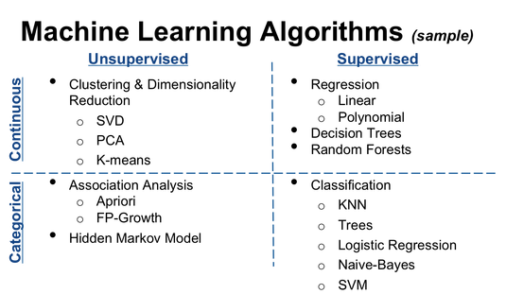
Additional online resources are provided in course docs to aid in model selection.

Slide 9
Class Example Problem
Given a dataset of labeled movie reviews, create a model to classify if a movie rating is good or bad.
Dataset - must be investigated
Labeled - this is a supervised dataset
Movie reviews - free text (dataset isn’t made from a STT system)
Model, classify good or bad, attempt a classification model
Good or bad, only 2 classifications which are categorical
After Exploratory Analysis we can see if these are correct assumptions

Slide 10
Exploratory Analysis
Data rarely presents itself in a form that can be intelligibly consumed by a Machine Learning algorithm. As a result, we need to investigate the form of every dataset to create a strategy for analysis and implementation. Many forms of investigation require the use of statistical methods to find truth in the data, and while this is an iterative process done over the course of developing the system, we need to find a balance between time spent analyzing and time spent building. That being said, spending more time here will save you time in the long run.
For our example problem, we might ask ourselves questions like:
Is there enough text in the reviews to warrant the model I have in mind?
Ill run a script to check the length of the strings and get a feel for how dense the information is..
Are misspellings few and far between or do I need to implement a spell checker?
Implement an off the shelf spell checking library, like whoosh, and see what percentage of a sample set needs correcting. Make a judgement call, learn from the outcome.
Are there special cases? Maybe your parsing regex needs to preserve “_” because you want to identify urls.
Btw… Exploratory Analysis should not be confused with Explanatory Analysis. Explanatory Analysis is performed after Exploratory, and it is the time when a Data Scientist will use their new knowledge of the dataset and other artifacts to tell a targeted story of only a few points.

Slide 11
Preprocessing
Often, free text will contain elements that need to be changed, eliminated, combined, and redesigned in order to normalize and prepare text as input to a Machine Learning Algorithm or model.
These techniques include:
Removing and preserving Special Characters
Lowercasing
Tokenization
Misspellings
Language Condensation
Stop words
Stemming
Numbers
Ngrams

Slide 12
Feature Extraction
For this example, we have essentially completed this in our preprocessing layer by generating tokens (features) of our data. However, in part 2 of this series, we will see different types of tokenization methods.
Ex.
“This is not good.”
-> unigram-> [“this”, “is”, “not”, “good”]
-> bigram -> [(“this”, “is”), (“is”, “not”), (“not”, “good”)]
If we define our features as bigrams, we can isolate the modifier “not” on the adjective “good”. Our unigram model will classify as positive when bigram will be negative.

Slide 13
Model Selection
The choice of our model is dependent upon the task at hand and the type of data we have. We have a supervised dataset of categorical free text.
Consider Naïve Bayes:
Quick build
Easy setup
Widely used, lots of support and examples
Accepts categorical Data
Works with supervised Data

Slide 14
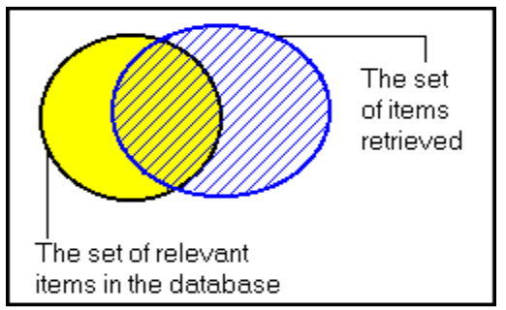
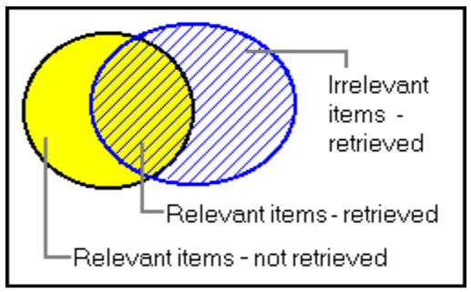
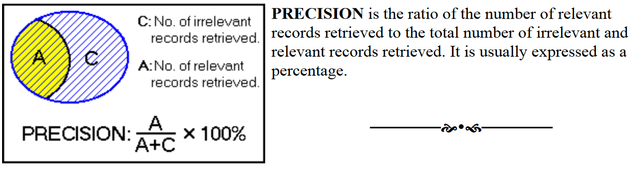
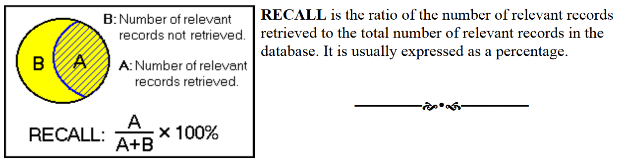
Interpreting Results
Accuracy: 0.73
Positive precision: 0.653
Positive recall: 0.984
Positive F-measure: 0.785, harmonic mean
Negative precision: 0.968
Negative recall: 0.476
Negative F-measure: 0.638 , harmonic mean

Slide 15
Exercise
Use the provided codes to build an email spam filter using the Enron email dataset.
The provided codes contain functions that will perform exploratory analysis, preprocessing, and modeling.
Decompose the functions such that you rewrite the majority of the codes so you can see the various techniques used and how well designed python is for working with strings. In fact, it was built for it..

Slide 16
Review
We learned about:
Structure and Components of NLP
Challenges in NLP
Semantics & Classification
Types of Datasets/Data
Brief look at Machine Learning Algorithms
Exploratory analysis
Investigating text
Preprocessing
Special Characters
Lowercasing
Tokenization
Stop words
Removing Numbers
Featurization
Randomization
Brief intro to model selection
Precision, Recall, and Cross Validation
Saving a classifier
Deploying a Classifier

Slide 17
Natural Language Processing & Semantic Classification Part 2
We will investigate:
Part of Speech (POS) Tagging
Noun and Verb phrases
Cross validation
Machine Translation
Context free grammars
Chunking
N-Grams
Stemming
Lemmatization
Sentences
Supervising unsupervised datasets, clustering, mapping
Web mining, text mining, process mining, and combinations
Additional Models
Clustering Algorithms
SVC/SVM, Support Vector Machine
Artificial Neural Networks
Logistic Regression
Pipelines

Slide 18
Appendix
Used this definition of Intermediate/Senior Software Engineer:
http://changelog.ca/log/2013/08/09/software_engineer_title_ladder#intermediate
Referenced various lectures and cases regarding NLP and my experiences

