Slide 1
Project 1
Working with Hive on Wikipedia Datasets
Querying Data from English Wikipedia with Hive

Slide 2
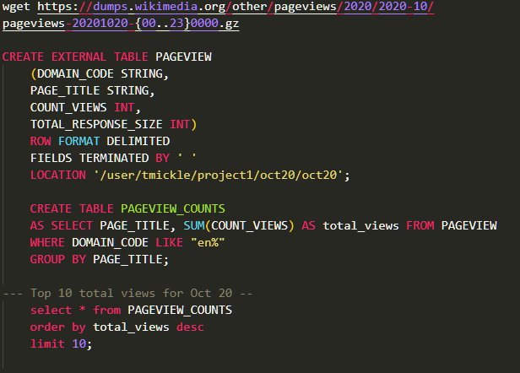
Q1:
Which English Wikipedia article got the most traffic on October 20?
Download the files using wget
Create a table for our page views.
Aggregate the Sum of the count_views of all the views from the 24 hours of October 20th. Limiting the domain code to English Wikipedia.

Slide 3
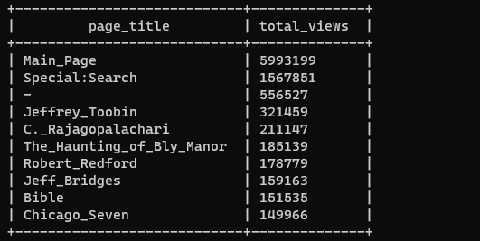
Q1:
Which English wikipedia article got the most traffic on October 20?
  Our Results:

Slide 4
Q2.
What English Wikipedia article has the largest fraction of its readers follow an internal link to another Wikipedia article?
Side notes on this solution:
-- We are answering only for September because of my limited HD space and computing power on a standalone machine. Ideally we would work on longer timescales.
– I'll present two solutions; one produces some outlier anomalies where a page is internally linked more than it is actually viewed.
– The other method ensures clean results in our ratios but isn't seemingly as accurate, if we trust the Pageview data more than the Clickstream data.

Slide 5
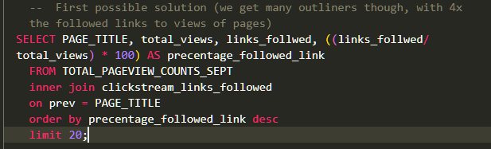
First approach to question 2:
In this solution we are joining a table of total page views for September with the click stream totals of internal link referrers on page titles. We are then checking out of the total views how many users followed a link out of the current page.

Slide 6
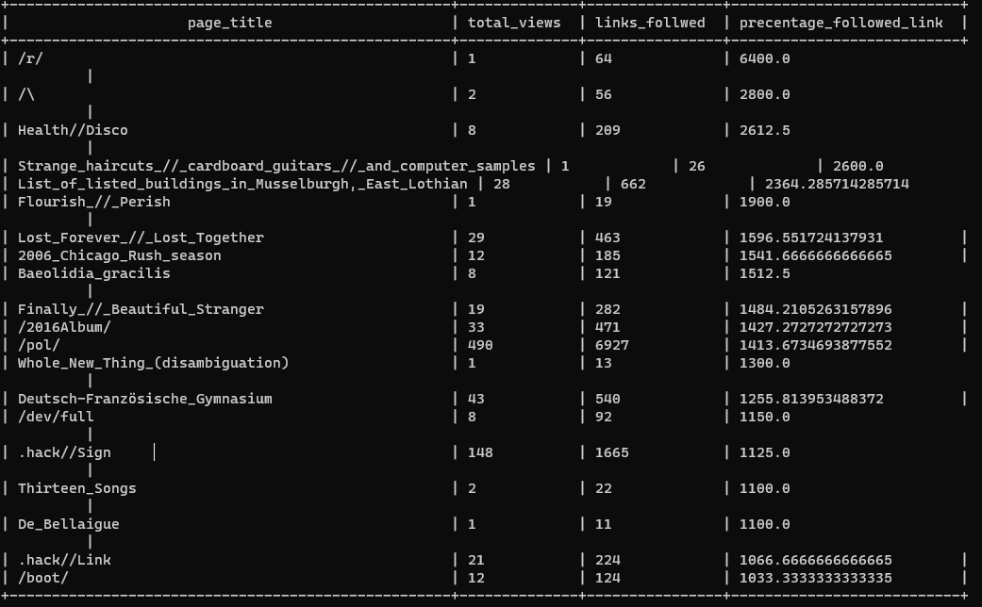

Slide 7
Q2: Take Two
Because of the issue with the Pageview aggregation, I stuck with using only the Clickstream data as our single source of truth for this question.
I created a new total for each page for the Month of September by using just the Clickstream data (I left out 'other' because they are either searches to another page / spoofed )
What we are leveraging is that every referring link is a guaranteed view + every page that's reached from an external link we know is a view.

Slide 8
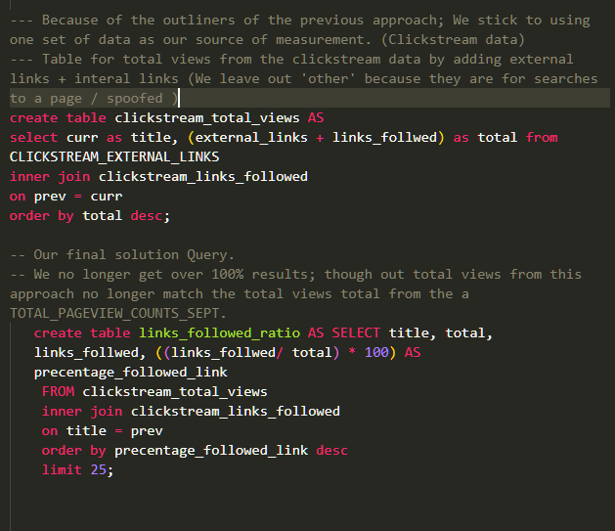
Q2: Results

Slide 9
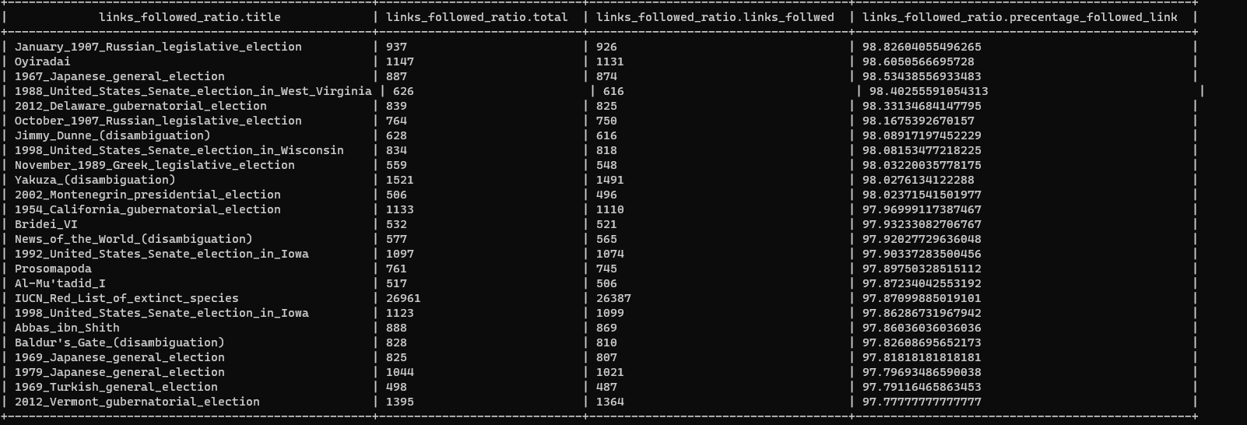

Slide 10
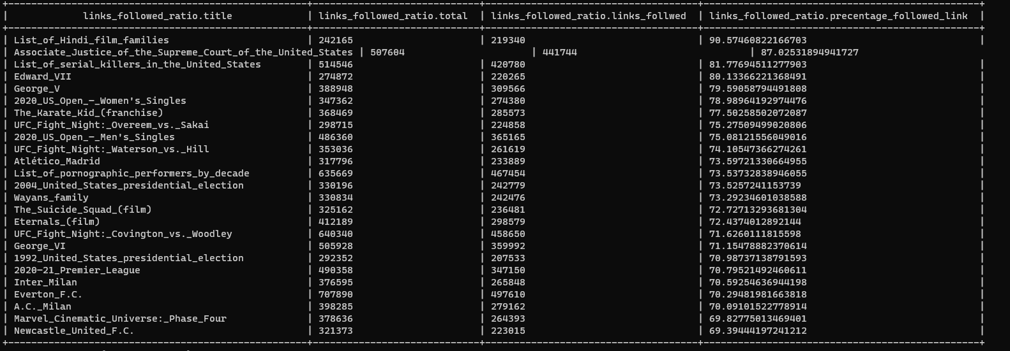
With Links Followed floor of 200,000

Slide 11
Q3:
What series of wikipedia articles, starting with [Hotel California] keeps the largest fraction of its readers clicking on internal links?
One way to approach this is by repeatably iterating queries on a Clickstream table, setting a conditional with WHERE prev = {the referring page} with the results of previous query, ordering by the most linked to page title.

Slide 12
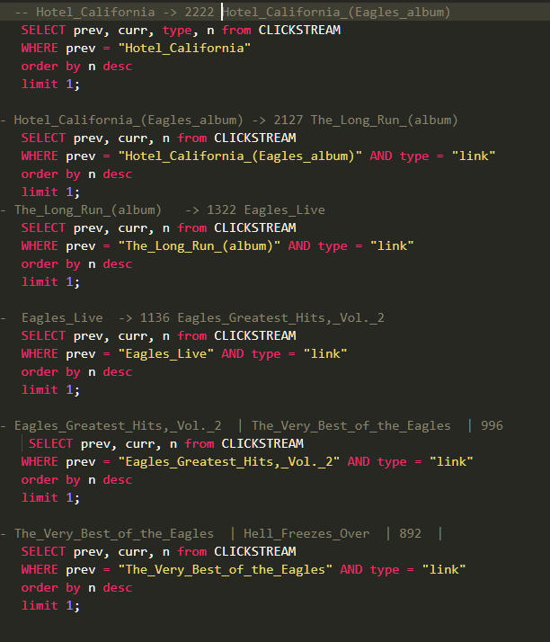

Slide 13
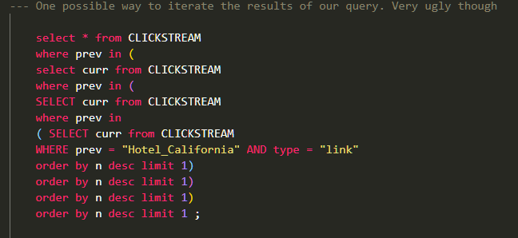
Another way is cramming it all into one query, like so:

Slide 14
Q4
Find an example of an English wikipedia article that is relatively more popular in the UK. Find the same for the US and Australia.
Answering this we will make use of the Wiki history dataset and make some assumptions about UK/US/AUS users of Wikipedia.
One of those assumptions is that people are most often to engage Wikipedia when its about the afternoon in their time zone. (The event_timestamp is set with UTC)
The other assumption is that more popular pages are more heavily edited as well for better or worse.
We start out then by creating tables for the top_revised articles for these times.

Slide 15
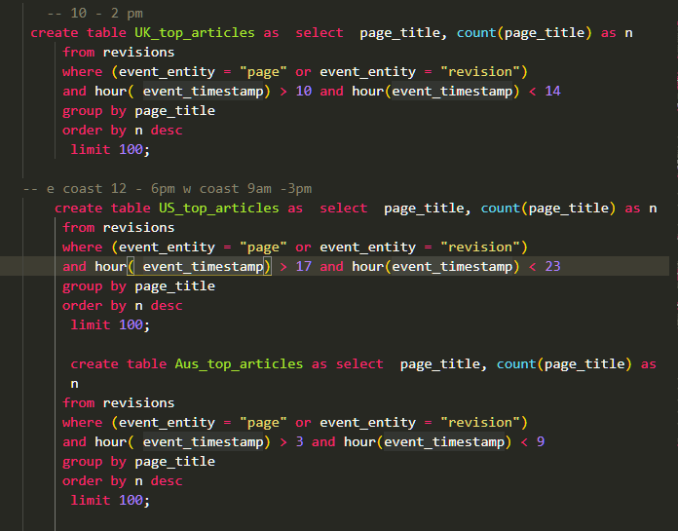
Q4:
Dividing by Timezone

Slide 16
Q4 cont-
We then are going to make some queries to get a rough deviation from an average of revisions on shared articles between the regions. We will be able to have a rough view of interest across time zones, but no guarantee of user's individual location. We need to keep in mind as well population sizes of the respective regions.
328.2 million US
66.65 million UK
24.99 million Aus
The reason for this is because of privacy concerns for Wikipedia's users.

Slide 17
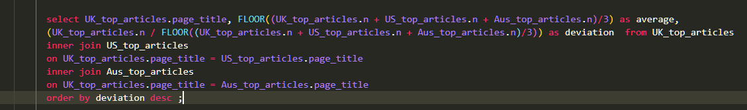
Here is very ugly query
Joining our Top_articles for each “region”
Page_title
Average – is the average revision to an article across regions
Deviation – is over-preforming or under-preforming of a region to the average

Slide 18
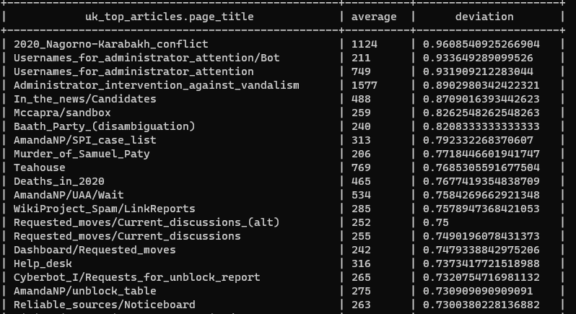
UK Deviations
Following slides are ordered by deviation from average revisions in October.

Slide 19
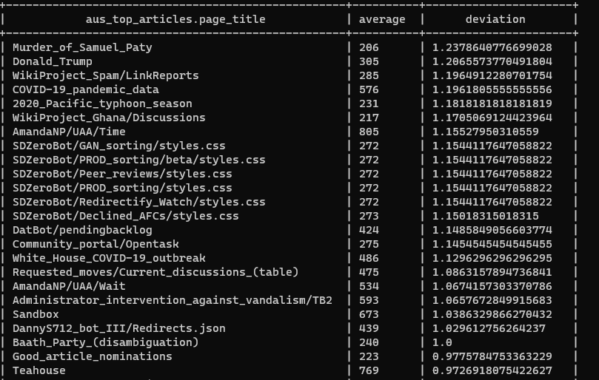
Australian timezone deviations

Slide 20
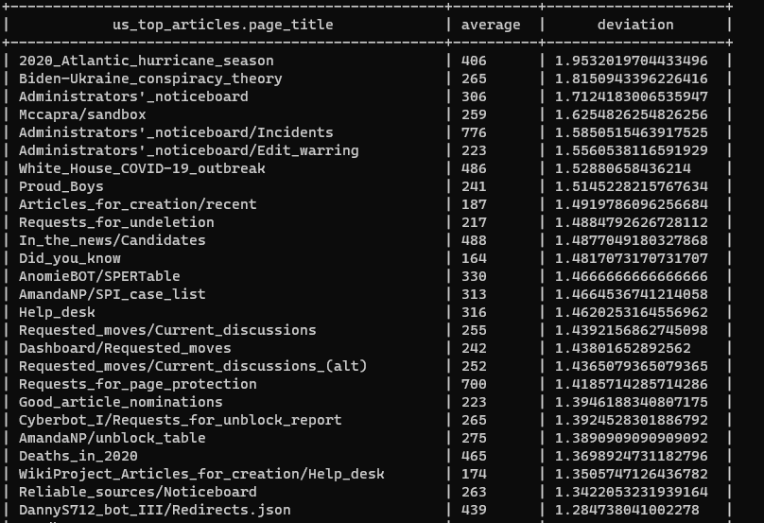
US Deviations

Slide 21
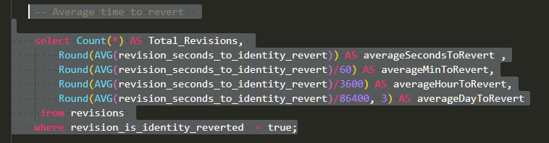
Q5. Analyze how many users will see the average vandalized Wikipedia page before the offending edit is reversed.
To answer this we query the wiki history, specifically the event_entity for revisions, which has a value for revisions which are reverted to their previous identity.
I am making an assumption that vandalized pages will receive close to this range, even though we are not explicitly checking for pages with vandalized information or targeted attacks. Vandalized reverts vs innocent reversions are indistinguishable.

Slide 22
The averages from the previous queries.

Slide 23
A bit additional thoughts:
I thought about taking the average views pages receive and then comparing the time that a vandalized page might stay up.
The problem with this approach from my perspective, is the average view for a page is about 12 views a day throughout the month of Sept.
While the Average revision times given are a good base to work from, the difference between high traffic pages vs low traffic pages evidently swing wide .

Slide 24
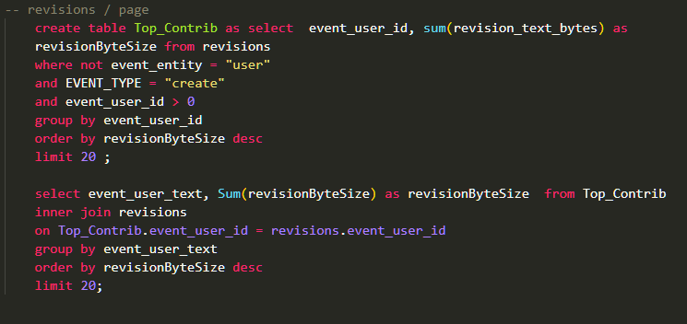
Q6:
Who is the user that has produced the most information by bytes for Wikipedia?

Slide 25
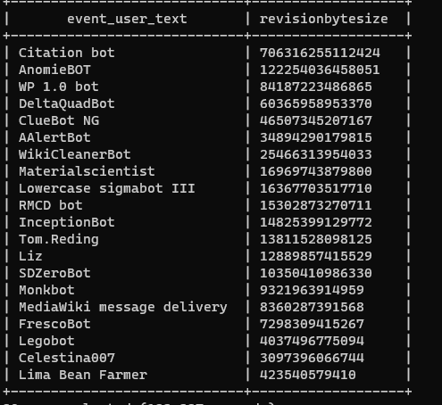
Very productive bots

